Slide 1
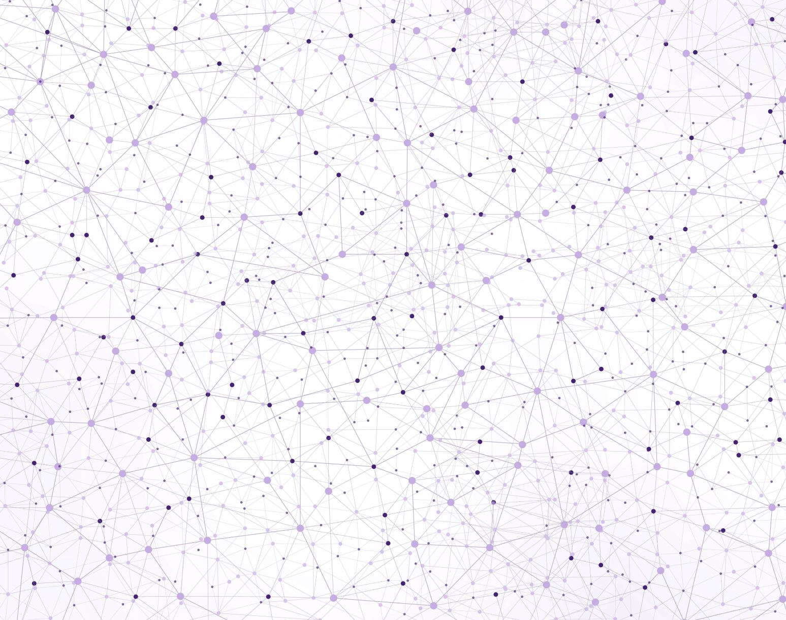
Self-Learning
Hyperparameter Tuning with Grid Search using Cross Validation & Bootstrapping

Slide 2
Hyperparameters
Each machine learning model needs a training, which is a process of tuning their hyperparameters and selecting their features (variables) for the best predictive performance.
For example, k in kNN, the number of hidden layers in Neural Networks, even the degree of of polynomials in a linear regression have to be tuned.
This tuning process is the core idea in self-learning algorithms.

Slide 3
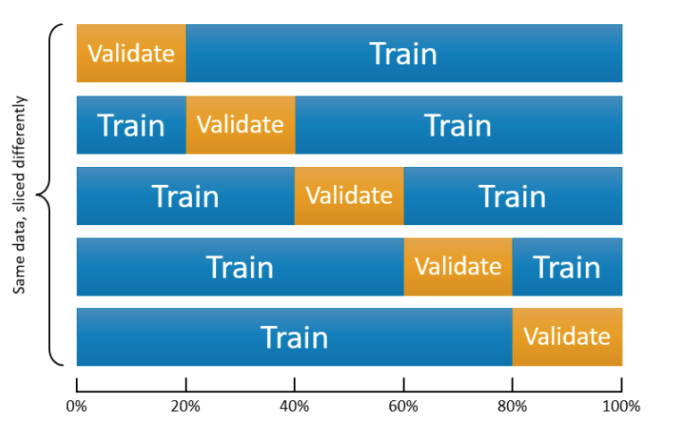
k-fold CV
Suppose Model1 requires to pick a value for λ, perhaps it is a degree of polynomials in the model.
We establish a grid, a set of sequential numbers, that is a set of possible values of λ.
We split the data into k random sections, let’s say 10 proportionally equal sections.
We leave one section out and use 9 sections. The combination of these 9 sections is our training set. The one that is left out is our validation set.
We fit the model using each value in the set of possible values of λ. For example, if we have 100 values of λ, we fit the model to the training set 100 times, once for each possible value of λ.
We evaluate each of 100 models by using their predictive accuracy on the validation set, the one that is left out. We pick a λ that gives the highest prediction accuracy.
We do this process 10 times (if it is 10-fold cross validation) with each time using a different section of the data as the validation set. So, note that each time our training and validation sets are going to be different. At the end, in total we will have 10 best λs.
We pick the average or modal value of λ as our optimal hyperparameter that tunes our predictive model for its best performance.

Slide 4
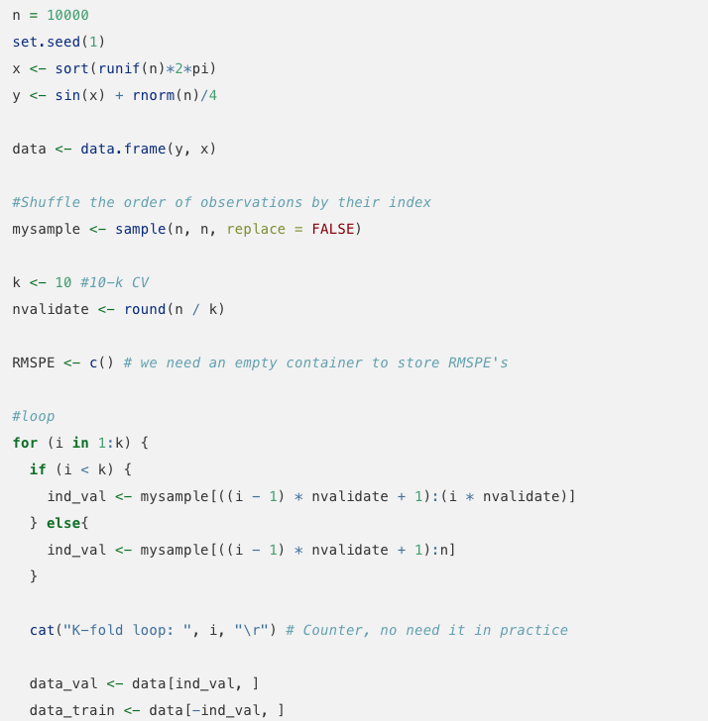
How to split the data in 10-fold CV

Slide 5
Grid search for LOESS
The traditional way of performing hyperparameter optimization has been a grid search, or a parameter sweep
It is simply an exhaustive search through a manually specified subset of the hyperparameter space of a learning algorithm.
There are two hyperparameters in LOESS: span and degree
Let’s do a grid search for LOESS

Slide 6
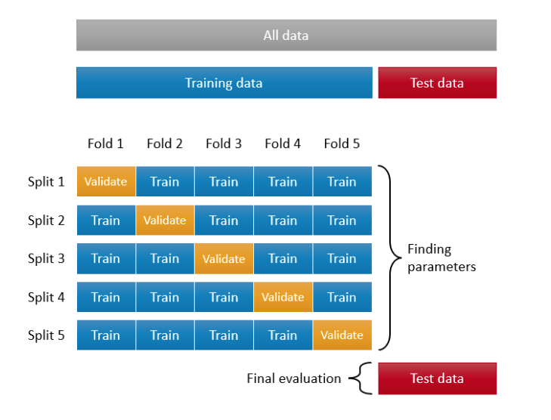
How are we going to do this?

Slide 7

Bootstrapping
Similar to cross-validation, the bootstrapping is another and a powerful resampling method
It randomly samples from the original data with replacement to create multiple new datasets (also known as “bootstrap samples”)
Due to the drawing with replacement, a bootstrap sample may contain multiple instances of the same original cases and may completely omit other original cases.
We can put these omitted original cases in a sample and form a hold-out set, which is also called as out-of-bag observations (OOB).
On average, the split between training and OOB samples is around 65%-35%. Here is a simple application to show the split:

Slide 8
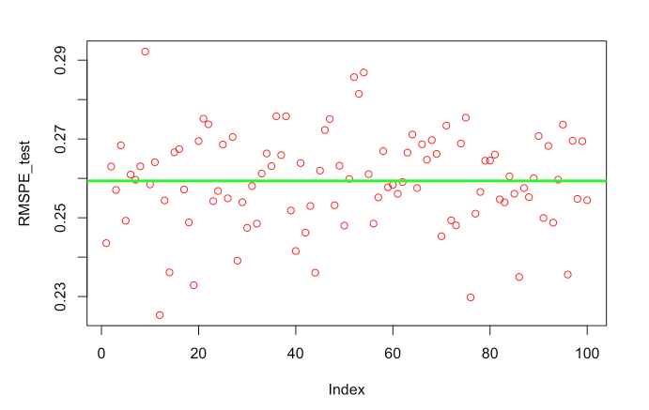
Reporting results

