Slide 1

Tree-Based Models – II
BAGGING - Bootstrap aggregating of Trees

Slide 2
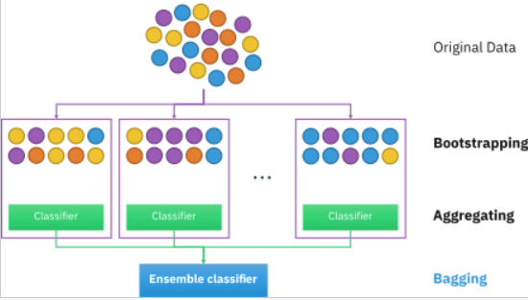
BAGGING “Wisdom of the Crowd”
The idea is simple: we train many models, each of which uses a separate bootstrapped sample
Then, we aggregate them to one final predictor for the final decision.

Slide 3
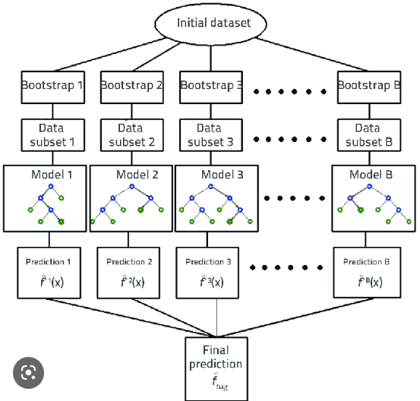
Leo Breiman (1994)
Take 500 repeated bootstrap samples from training set D
Fit a tree to each bootstrapped sample
Use fitted tree on the same test set
Get 500 sets of predictions
The average will be the final prediction

Slide 4
Implementation
Optimal performance is often found by bagging 50–500 trees.
Data sets that have a few strong predictors typically require less trees;
Whereas data sets with lots of noise or multiple strong predictors may need more.
Using too many trees will not lead to overfitting.
We use unpruned trees

Slide 5
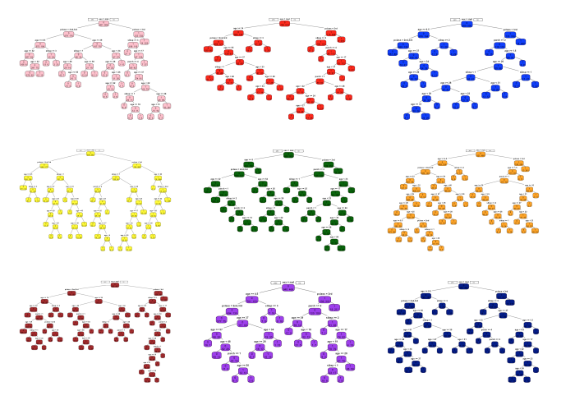
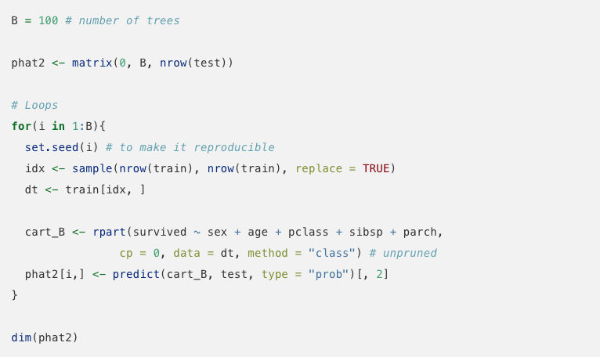
Simple Algorithm

Slide 6
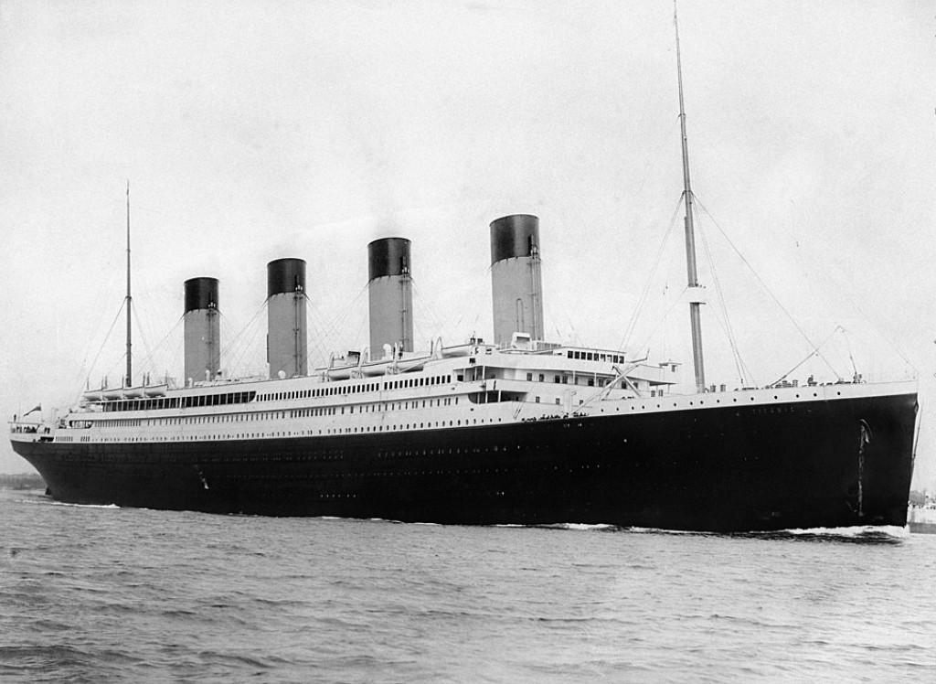
Bagging vs. Single Tree

