Slide 1
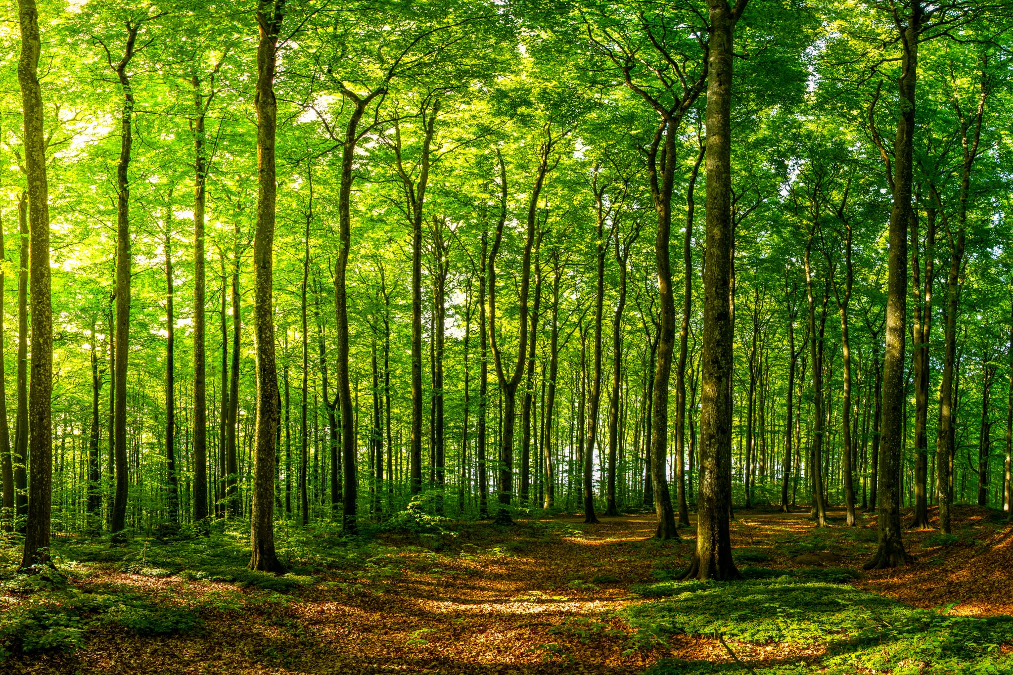
Random Forest

Slide 2
Overview
Random forest is a commonly-used machine learning algorithm trademarked by Leo Breiman and Adele Cutler
It’s an extension of BAGGING (1996, 2001): https://www.stat.berkeley.edu/~breiman/RandomForests/cc_home.htm
They have become a very popular “out-of-the-box” or “off-the-shelf” learning algorithm that enjoys good predictive performance with relatively little hyperparameter tuning. Its ease of use and flexibility have fueled its adoption, as it handles both classification and regression problems.
Random forests are a modification of bagged decision trees that build a large collection of de-correlated trees to further improve predictive performance.

Slide 3
Features of Radom Forests
It is unexcelled in accuracy among current algorithms.
It runs efficiently on large data bases.
It can handle thousands of input variables without variable deletion.
It gives estimates of what variables are important in the classification.
It generates an internal unbiased estimate of the generalization error as the forest building progresses.
It has an effective method for estimating missing data and maintains accuracy when a large proportion of the data are missing.
It has methods for balancing error in class population unbalanced data sets.
Generated forests can be saved for future use on other data.
Prototypes are computed that give information about the relation between the variables and the classification.
It computes proximities between pairs of cases that can be used in clustering, locating outliers, or (by scaling) give interesting views of the data.
The capabilities of the above can be extended to unlabeled data, leading to unsupervised clustering, data views and outlier detection.
It offers an experimental method for detecting variable interactions.

Slide 4
Use cases
Finance: It is a preferred algorithm over others as it reduces time spent on data management and pre-processing tasks. It can be used to evaluate customers with high credit risk, to detect fraud, and option pricing problems.
Healthcare: The random forest algorithm has applications within computational biology allowing doctors to tackle problems such as gene expression classification, biomarker discovery, and sequence annotation. As a result, doctors can make estimates around drug responses to specific medications.
E-commerce: It can be used for recommendation engines for cross-sell purposes.

Slide 5
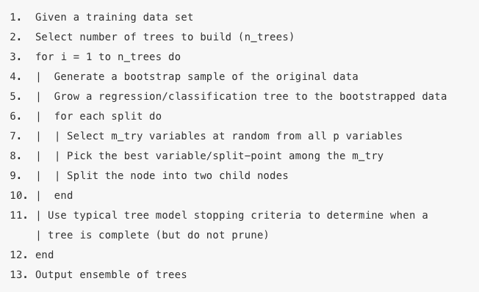
Algorithm
Each tree is grown as follows:
If the number of cases in the training set is N, sample N cases at random - but with replacement, from the original data. This sample will be the training set for growing the tree.
If there are M input variables, a number m<<M is specified such that at each node, m variables are selected at random out of the M and the best split on these m is used to split the node. The value of m is held constant during the forest growing.
Each tree is grown to the largest extent possible. There is no pruning.

Slide 6

Split-variable randomization
During the bagging process, random forests perform split-variable randomization where each time a split is to be performed, the search for the split variable is limited to a random subset of p features
p/3 is for regressions and sqrt(p) is for classification
When mtry = p, it becomes bagging
Since the algorithm randomly selects a bootstrap sample to train on and a random sample of features to use at each split, a more diverse set of trees is produced which tends to lessen tree correlation beyond bagged trees and often dramatically increase predictive power.

Slide 7
Tuning and Hyperparameters
Random forests have become popular because they tend to provide very good out-of-the-box performance. Although they have several hyperparameters that can be tuned, the default values tend to produce good results.
There is no need for cross-validation or a separate test set to obtain an unbiased estimate of the prediction error. It is estimated internally as each tree is constructed using a different bootstrap sample from the original data.
Although random forest models should not overfit when increasing the number of trees (ntree) in the forest, in practice maxnodes and mtry are used as hyperparameters in the field.

Slide 8
Two training methods – 1: Using OOB errors
About one-third of the cases (observations) are left out of the bootstrap sample and not used in the construction of the kth tree.
In this way, a test set classification is obtained for each case in about one-third of the trees.
In each run, the class is selected when it gets most of the votes among the OOB cases.
The proportion of times that the selected class for the observation is not equal to the true class over all observations in OOB set is called the OOB error estimate.
This has proven to be unbiased in many tests. Note that the forest’s variance decreases as the number of trees grows. Thus, more accurate predictions are likely to be obtained by choosing many trees.

Slide 9
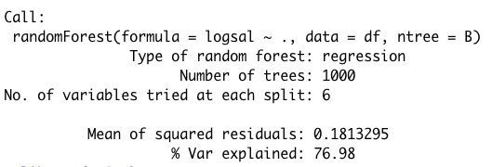
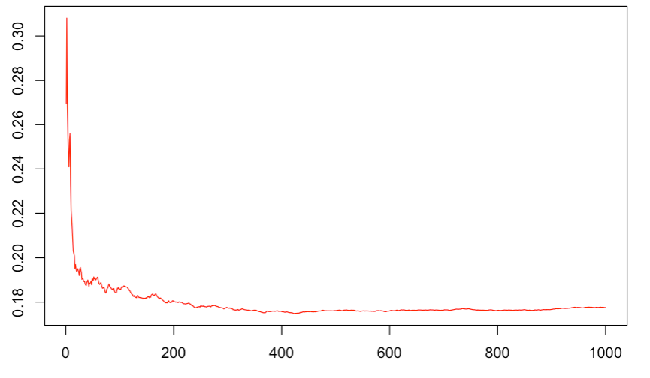
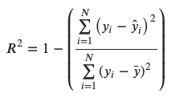
Using OOB errors - Regression

Slide 10
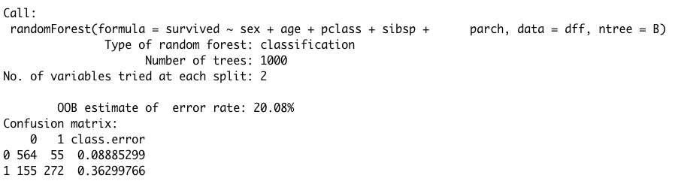
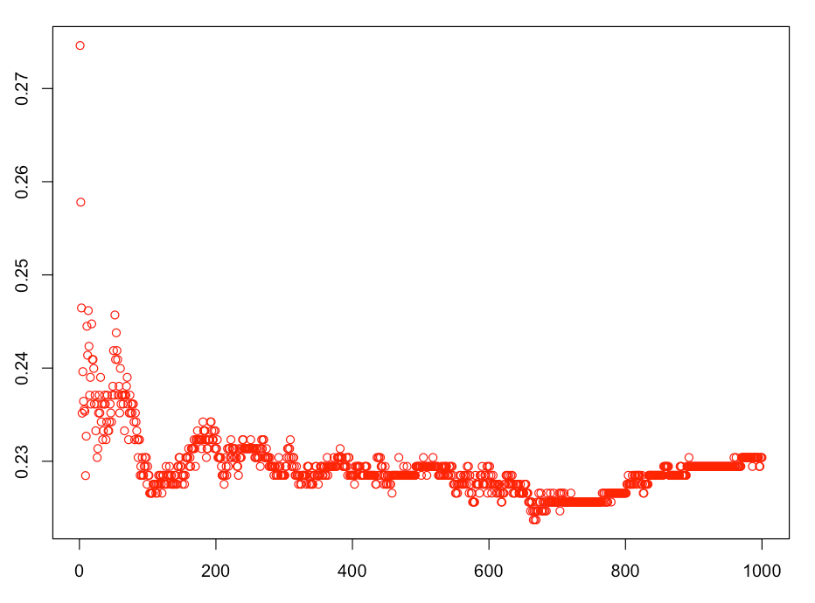
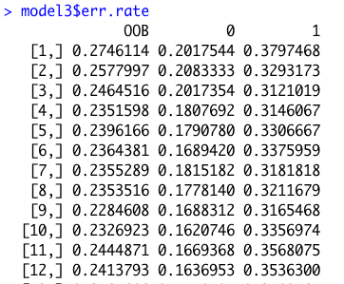
Using OOB errors - Classification

Slide 11
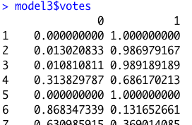


Using OOB errors – Classification (AUC)
votes (classification only) is a matrix with one row for each input data point and one column for each class, giving the fraction or number of (OOB) votes from the random forest.

Slide 12
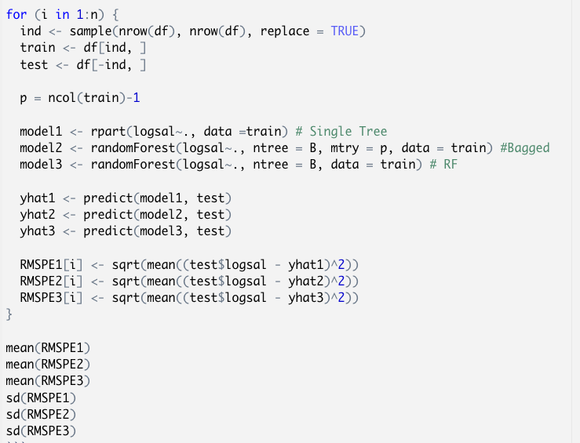
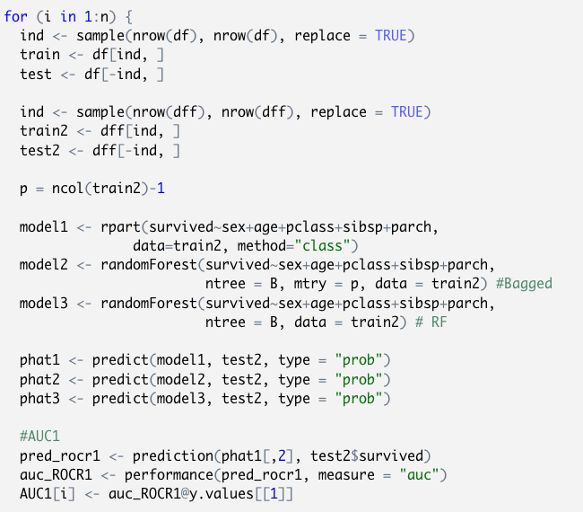
Two training methods – 2: Using test set

Slide 13
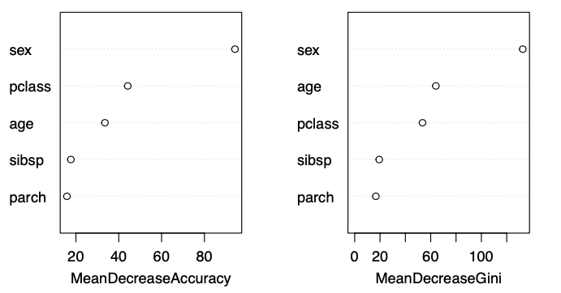
Interpretation: Mean Decrease in Impurity (MDI)
MDI measures the importance of a feature by calculating the weighted decrease in node impurity (e.g., Gini impurity for classification, variance for regression) when that feature is used to split data in the trees. The "weight" in this context refers to the proportion of samples that reach the node where the split occurs.
Pros: straightforward to calculate during the model training process and doesn't require additional computational resources post-training. It gives a good indication of how much a feature contributes to making the nodes purer, which directly impacts model accuracy.
Cons: can be biased towards features with more categories (in classification) or higher cardinality (in both classification and regression). It also doesn't account for the model's performance on unseen data, as it's based entirely on the training process.

Slide 14
Interpretation: Mean Decrease in Accuracy (MDA)
This is often referred to as "permutation importance."
MDA evaluates the importance of a feature by measuring the decrease in the model's prediction accuracy on a dataset (usually the validation set or out-of-bag samples for RandomForest) after permuting the values of that feature.
By disrupting the relationship between the feature and the target, you can assess how much the model's accuracy relies on that feature.
Computation: For each feature, its values are shuffled among the observations to break its true association with the response. The decrease in model accuracy due to this shuffling is calculated and attributed to the shuffled feature.
Pros: MDA is model-agnostic and it's less prone to bias from high cardinality features.
Cons: Computationally expensive, especially for large datasets or models with many features, as it requires multiple passes through the data. Additionally, it can be sensitive to data leakage or correlated features, where shuffling one feature also indirectly affects the information contained in another.

Slide 15
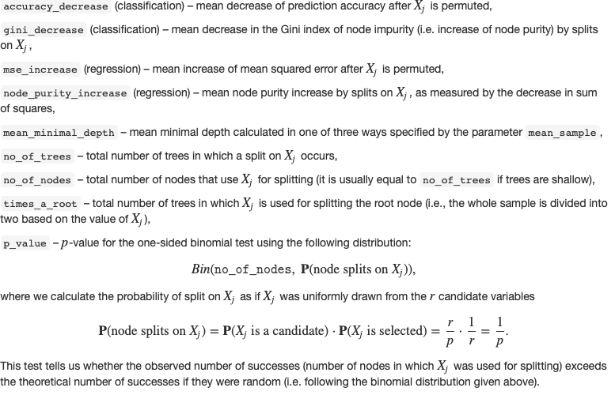
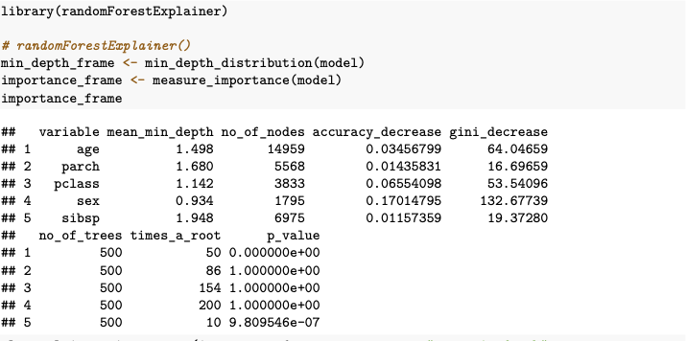
randomForestExplainer

Slide 16
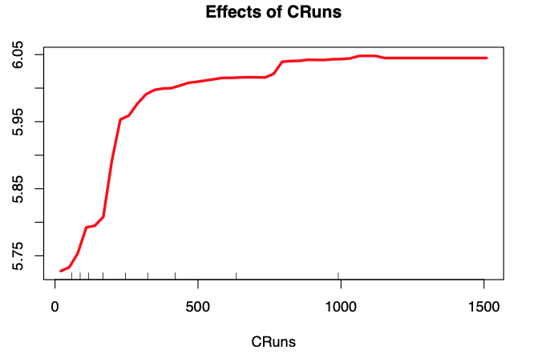
Partial dependence plots (PDPs)
Partial dependence plots (PDPs) are a graphical tool used to visualize the relationship between a single feature and the predicted outcome in a machine learning model, while averaging out the effects of all other features.
Fix the value and keeps all other feature values unchanged.
With the fixed feature value, obtain predictions for each instance.
Compute the average prediction across all instances for the fixed feature value.
This represents the partial dependence of the outcome on the chosen feature value.

Slide 17
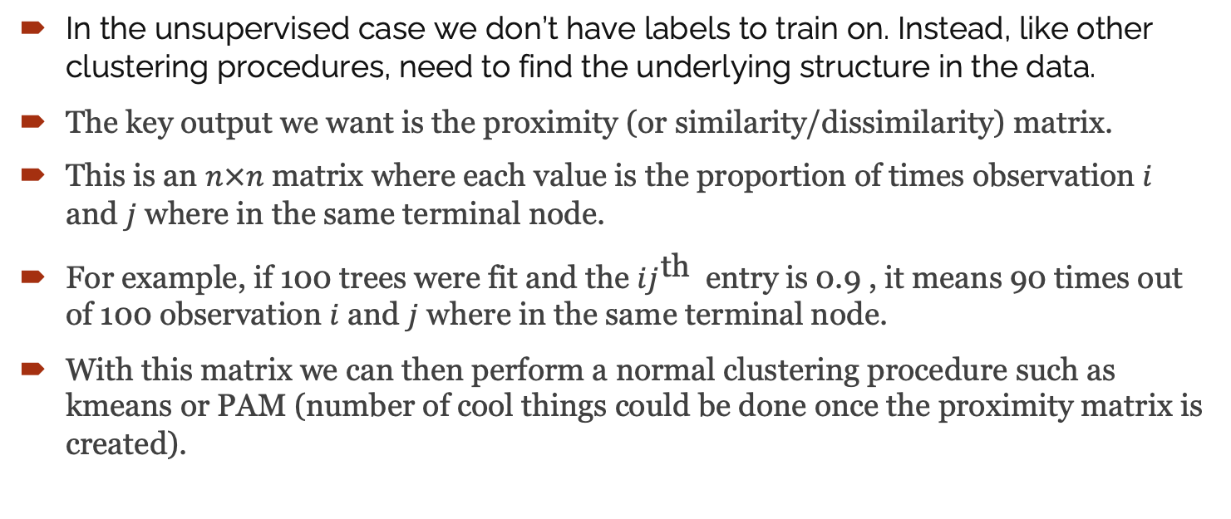
Unsupervised Random Forest (Appendix)
In the unsupervised case we don’t have labels to train on. Instead, like other clustering procedures, need to find the underlying structure in the data.
The key output we want is the proximity (or similarity/dissimilarity) matrix.
This is an $n×n$ matrix where each value is the proportion of times observation $i$ and $j$ where in the same terminal node.
For example, if 100 trees were fit and the $ij^{\text{th} }$ entry is 0.9 , it means 90 times out of 100 observation $i$ and $j$ where in the same terminal node.
With this matrix we can then perform a normal clustering procedure such as kmeans or PAM (number of cool things could be done once the proximity matrix is created).

