Slide 1

Boosting
Gradient Boosted Machines

Slide 2
The first original boosted application was offered in 1990 by Robert Schapire
Gradient boosted machines (GBMs) are an extremely popular machine learning algorithm that have proven successful across many domains and is one of the leading methods for winning Kaggle competitions.
Whereas random forests build an ensemble of deep independent trees, GBMs build an ensemble of shallow and weak successive trees with each tree learning and improving on the previous.
When combined, these many weak successive trees produce a powerful “committee” that are often hard to beat with other algorithms. This tutorial will cover the fundamentals of GBMs for regression problems.

Slide 3

A different approach!
Instead of creating a strong predictor to predict Y well, boosting starts with a weak learner and and tries to predict the error well
In regression trees, for example, each tree is fit to the residuals from the previous tree model so that each iteration is focused on improving previous errors.
This is called LEARNING FROM MISTAKES

Slide 4
ALGORITHM
Tree1
Start with an initial shallow tree (Tree 1)
yhat
Get the predictions (yhat). Store it (h * yhat)
Tree2
Fit Tree 2 on prediction errors obtained from Tree1. Use the same predictors (x)
ehat1
Get the predicted errors and store them (h * ehat1)
Tree 3
Fit Tree 3 on prediction errors obtained from Tree2. Use the same predictors (x)
ehat2
Get the predicted errors and store them (h * ehat2)
Repeat
Repeat this until Tree 100, and get 101 column matrix

Slide 5
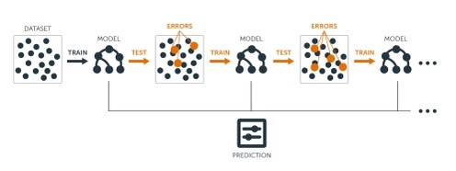

Slide 6
Tuning
Since there is no bootstrapping, this process is open to overfitting problem as it aims to minimize the in-sample prediction error.
Hence, we introduce a hyperparameter (learning rate, h) that we can tune the learning process with cross-validation to stop the overfitting and get the best predictive model.

Slide 7
Tuning GBM
There is no bootstrapping, trees are sequentially growing
The first tree is fit on the training set and get the yhat and the error
Then subsequent trees predict “the previous error”. The predicted error is called “improvement”
There are two sets of parameters to tune:
Boosting parameters
Tree parameters

Slide 8
Tuning Strategy
Choose a relatively high learning rate. Generally, the default value of 0.1 works but somewhere between 0.05–0.2 should work across a wide range of problems.
Determine the optimum number of trees for this learning rate.
Tune tree-specific parameters for decided learning rate.
Once tree-specific parameters have been found, lower the learning rate to assess for any improvements in accuracy.

Slide 9

Using gbm for tuning regression
gbm offers three methods to observed RMSE
OOB: bag.fraction = 0.5
test: train.fraction = NULL
Cross Validation: cv.fold = 0

Slide 10
My way
bag.fraction = 1, train.fraction = NULL, cv.fold = 0
Use boostraping with grid search

