Slide 1
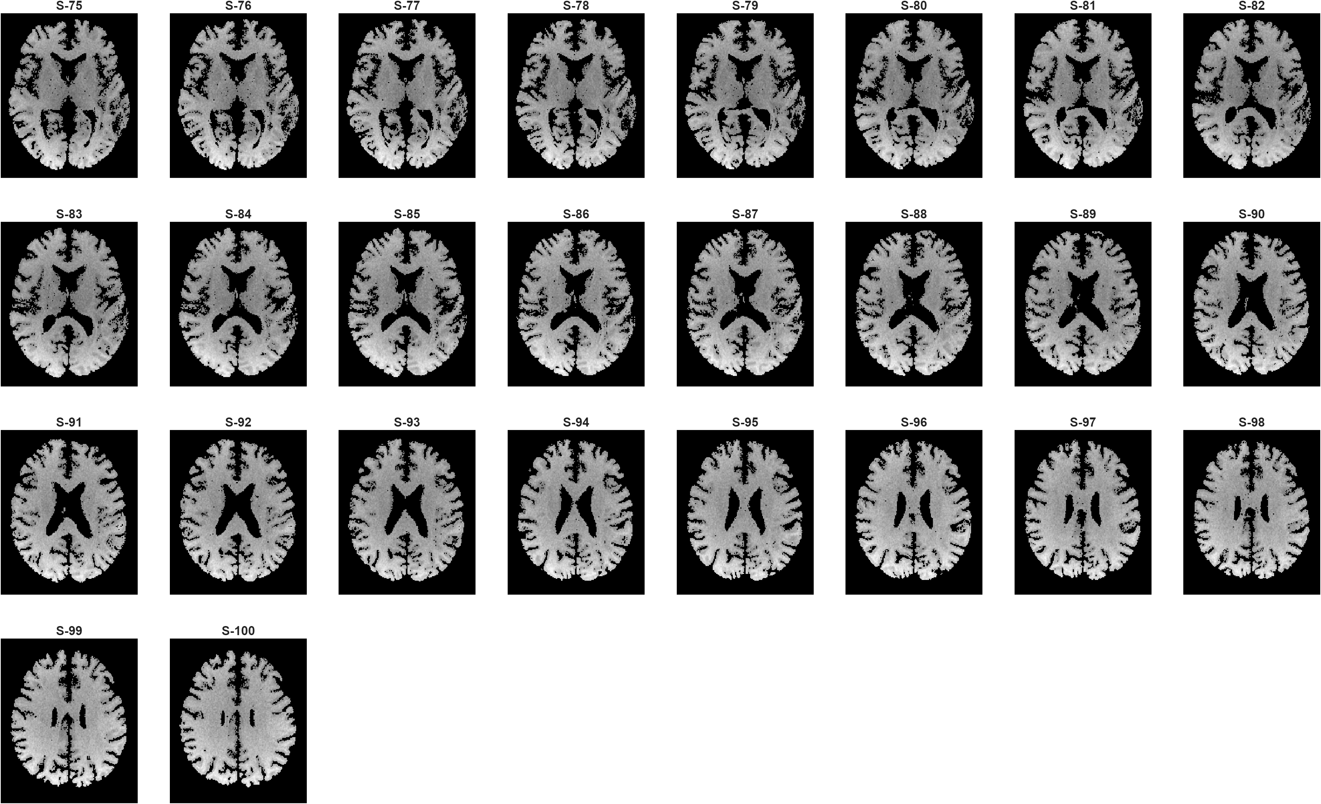
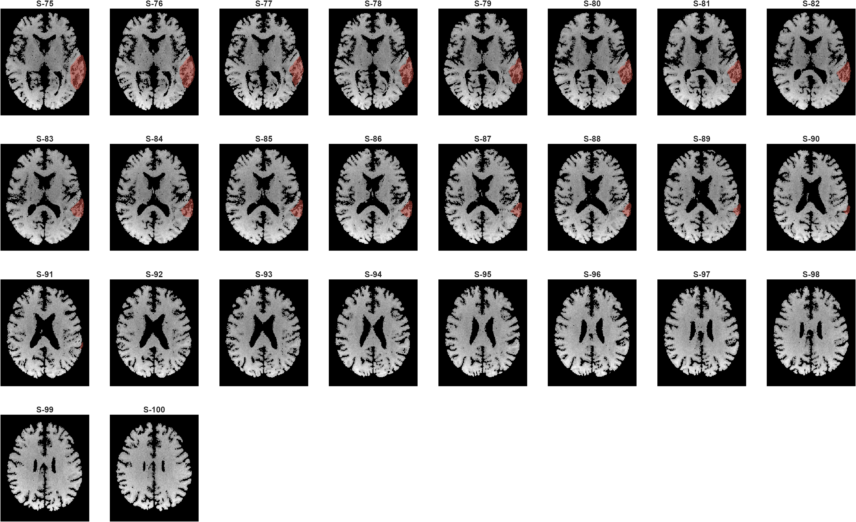
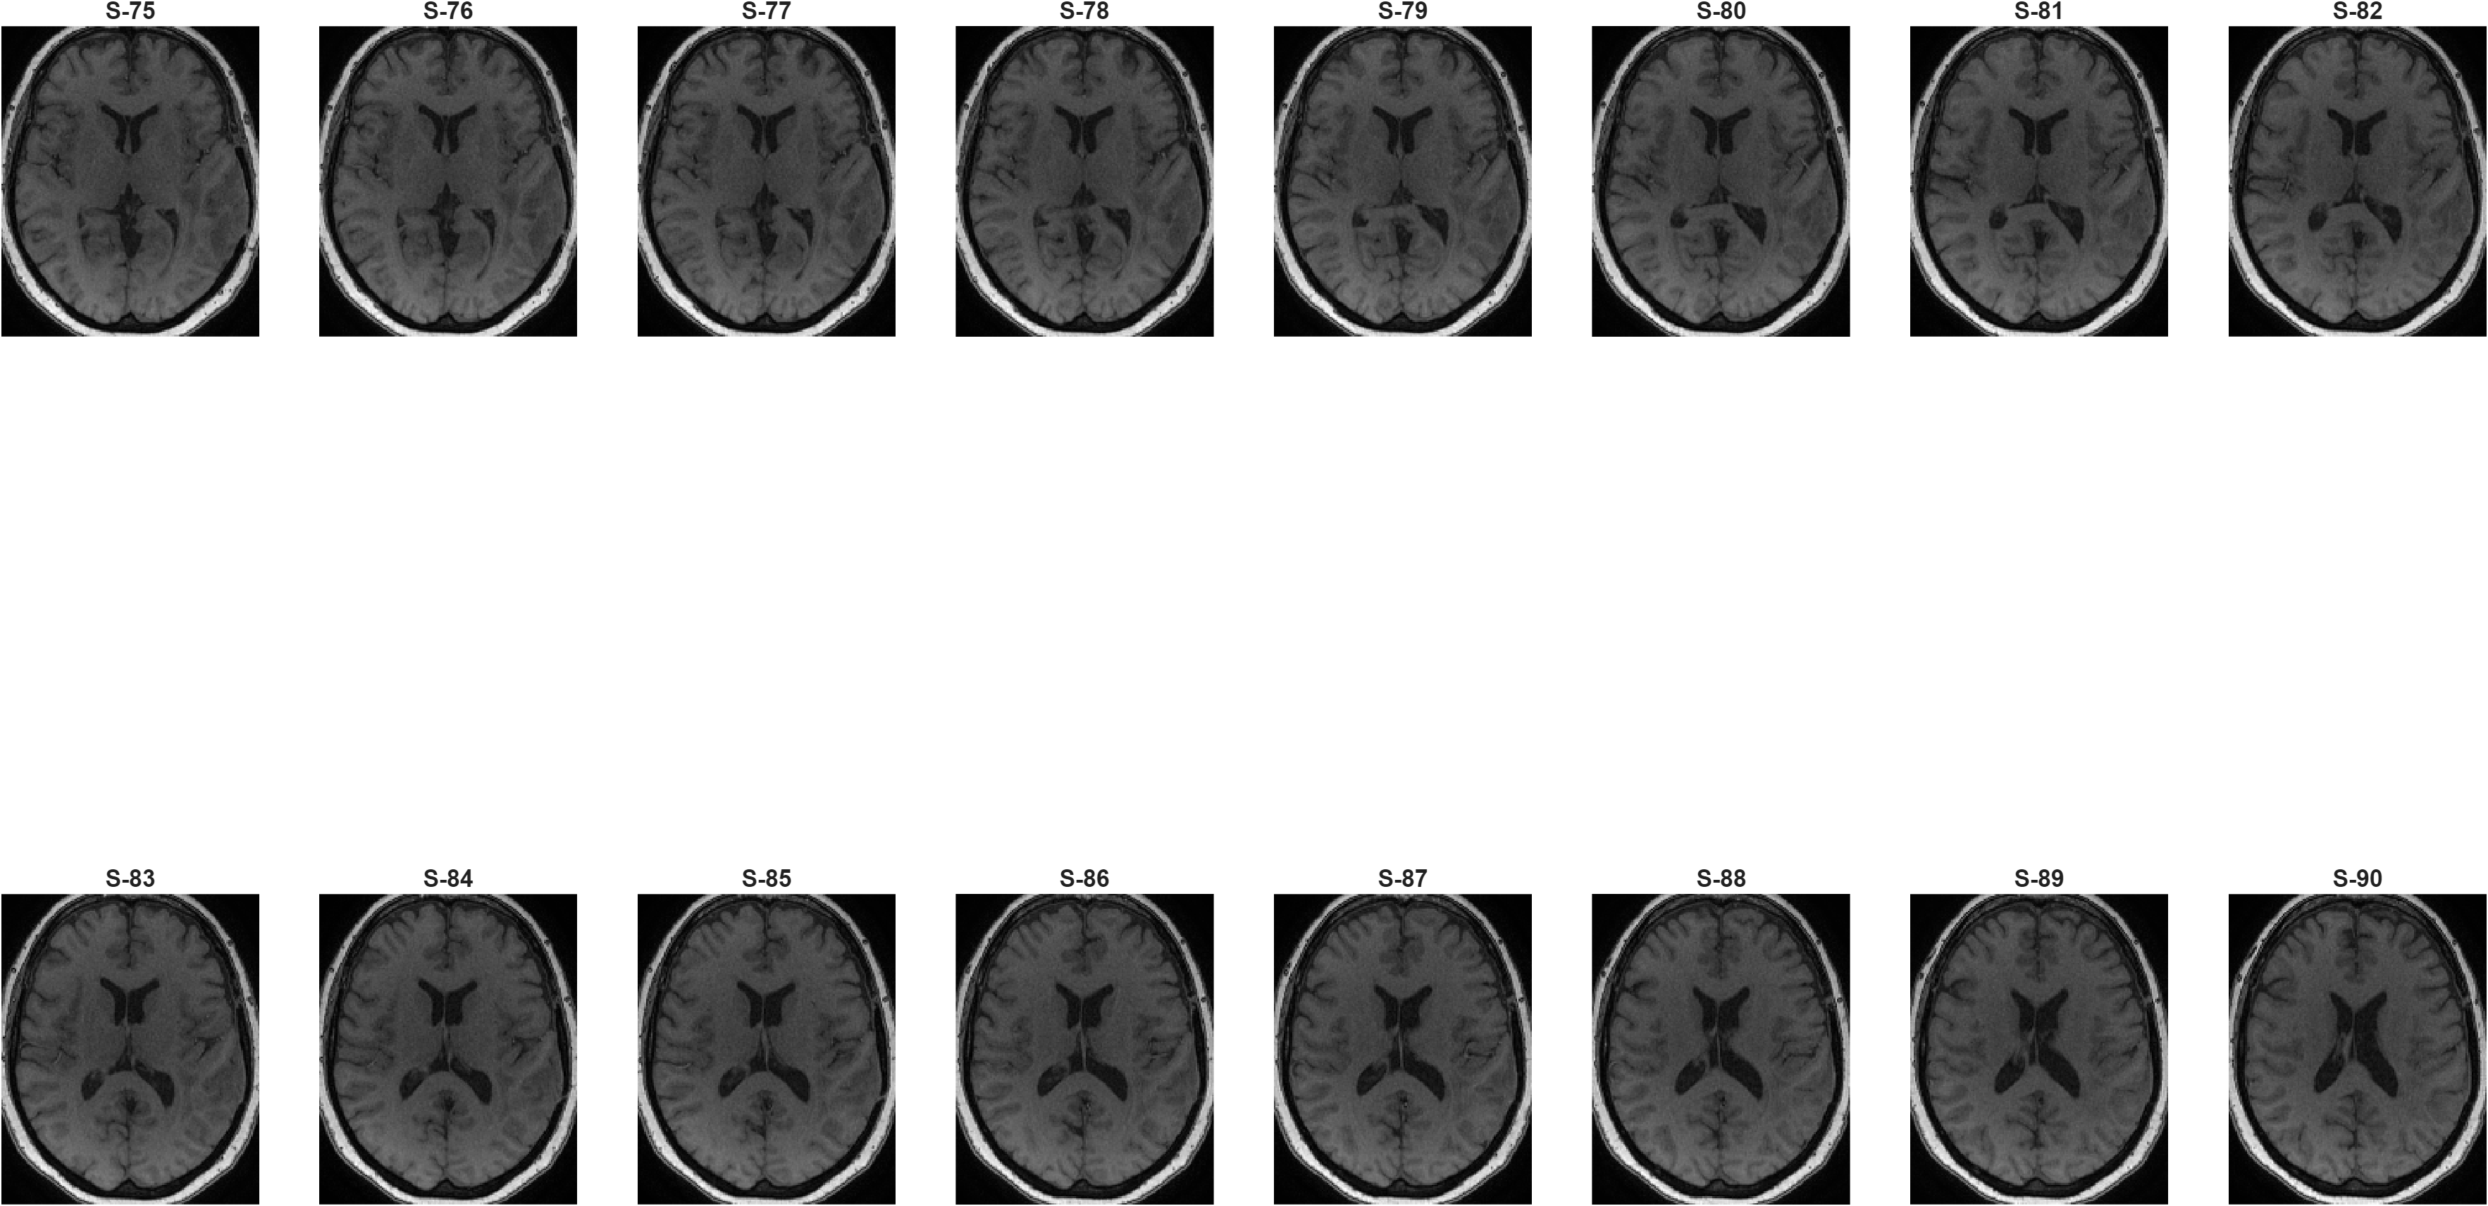
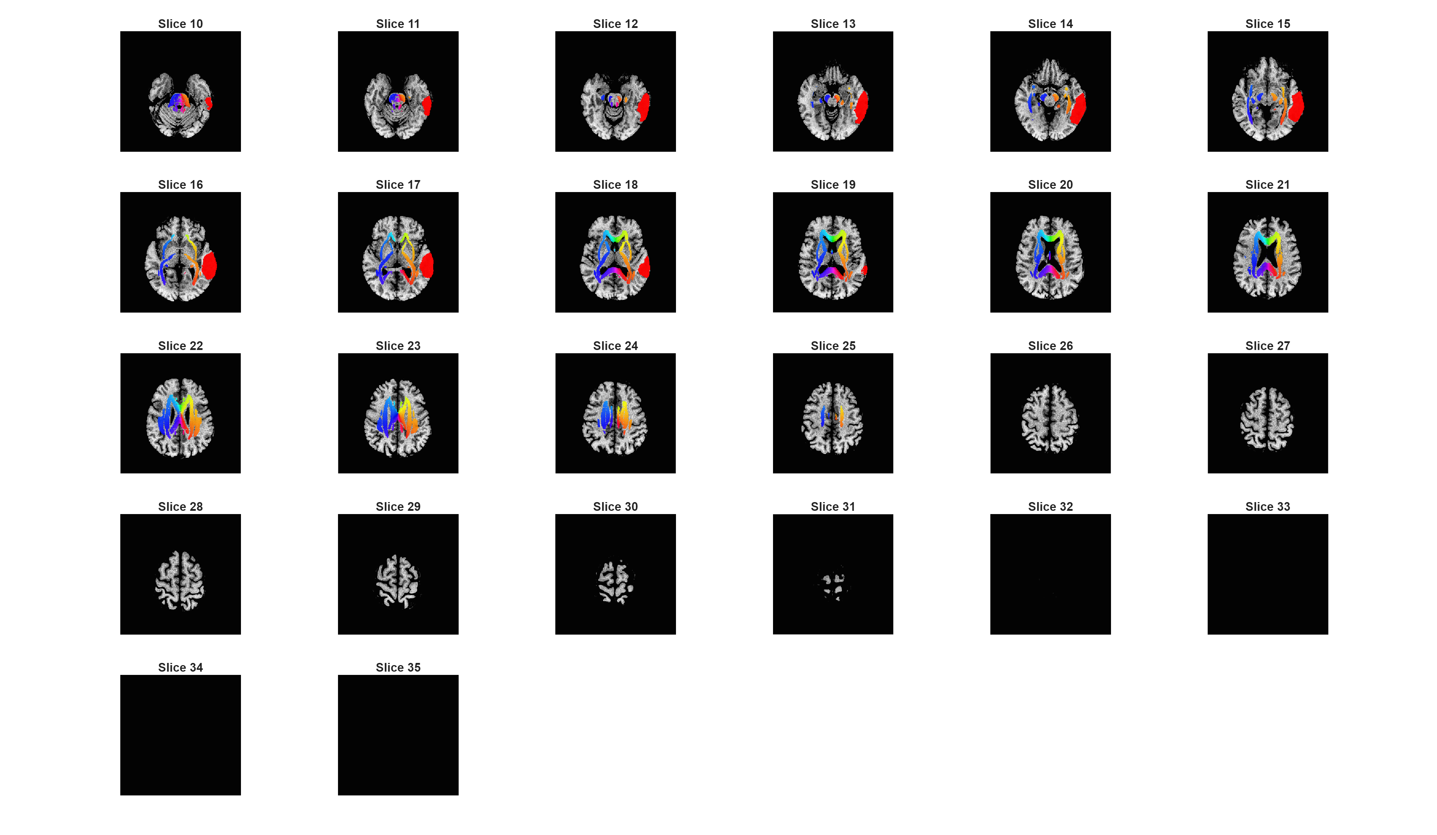
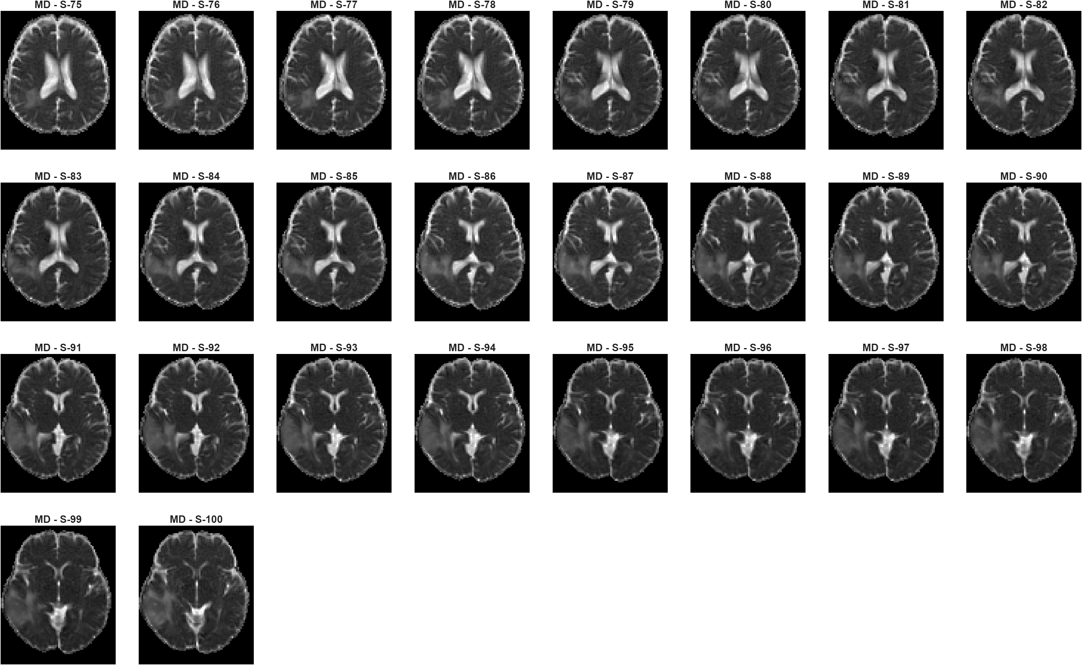
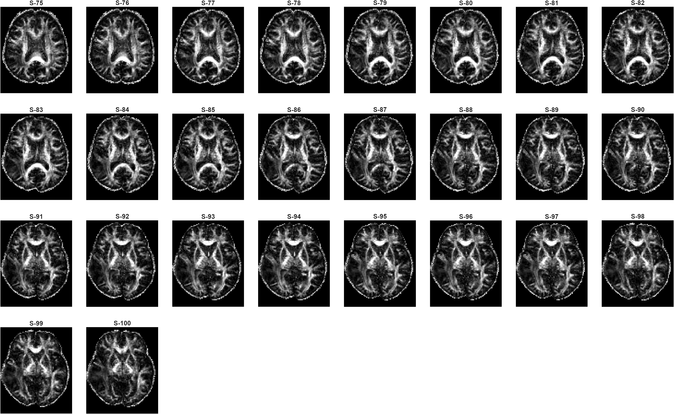
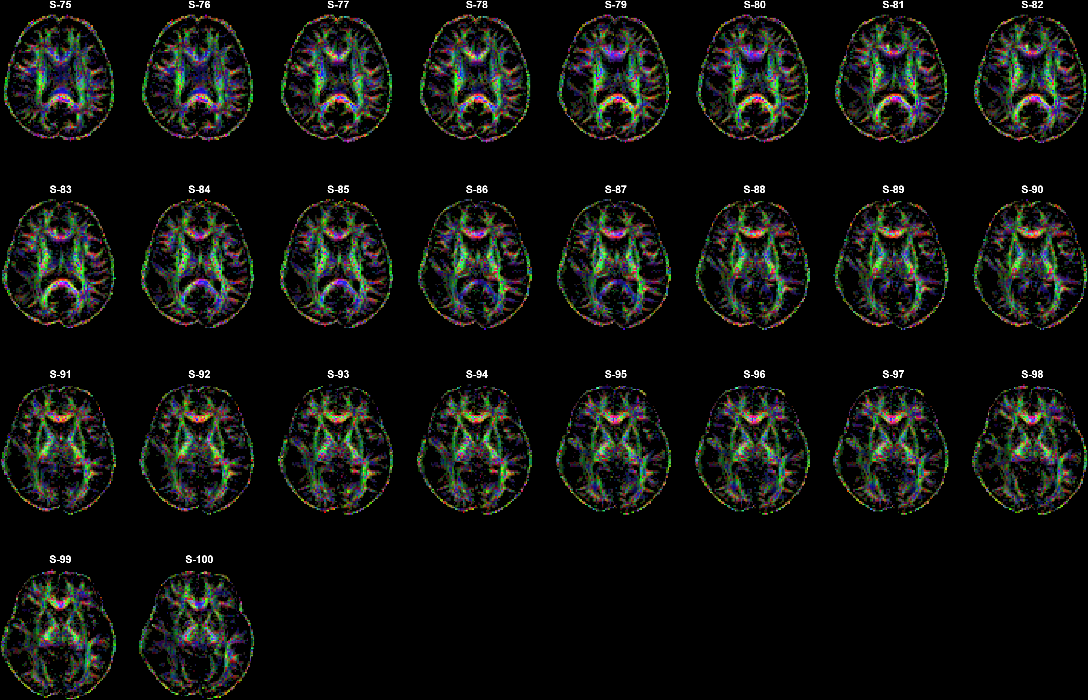
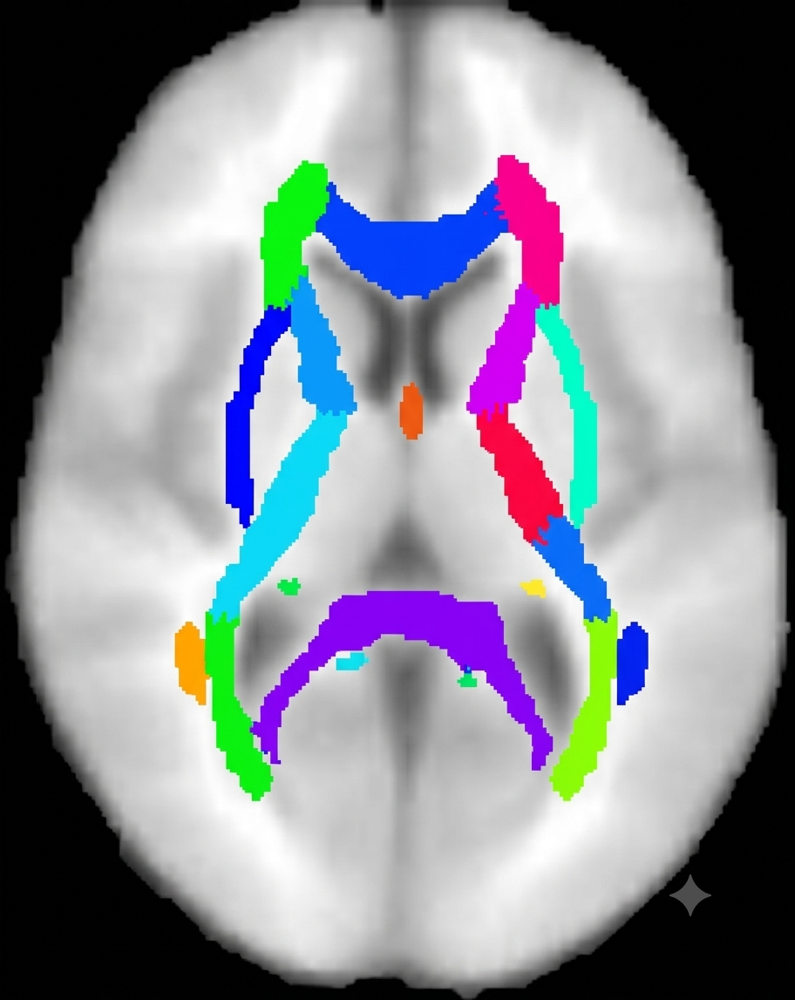
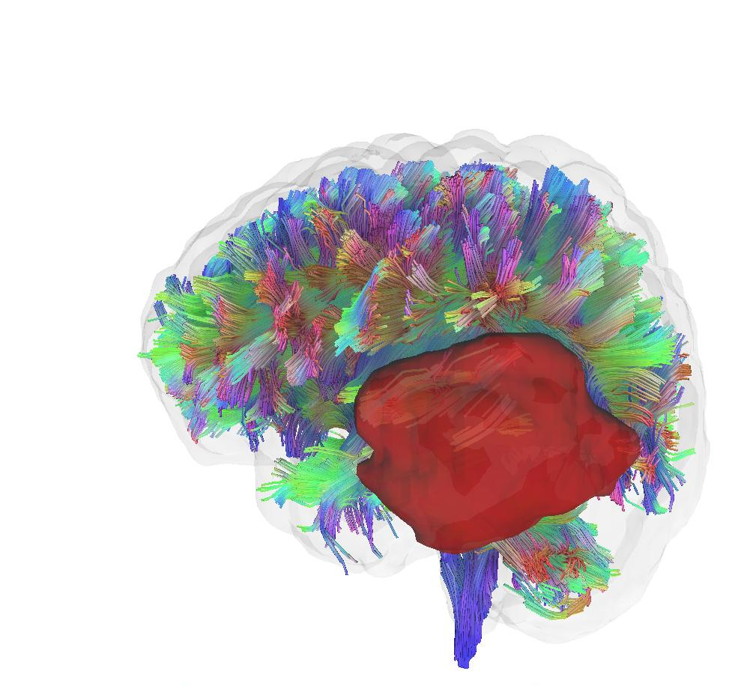
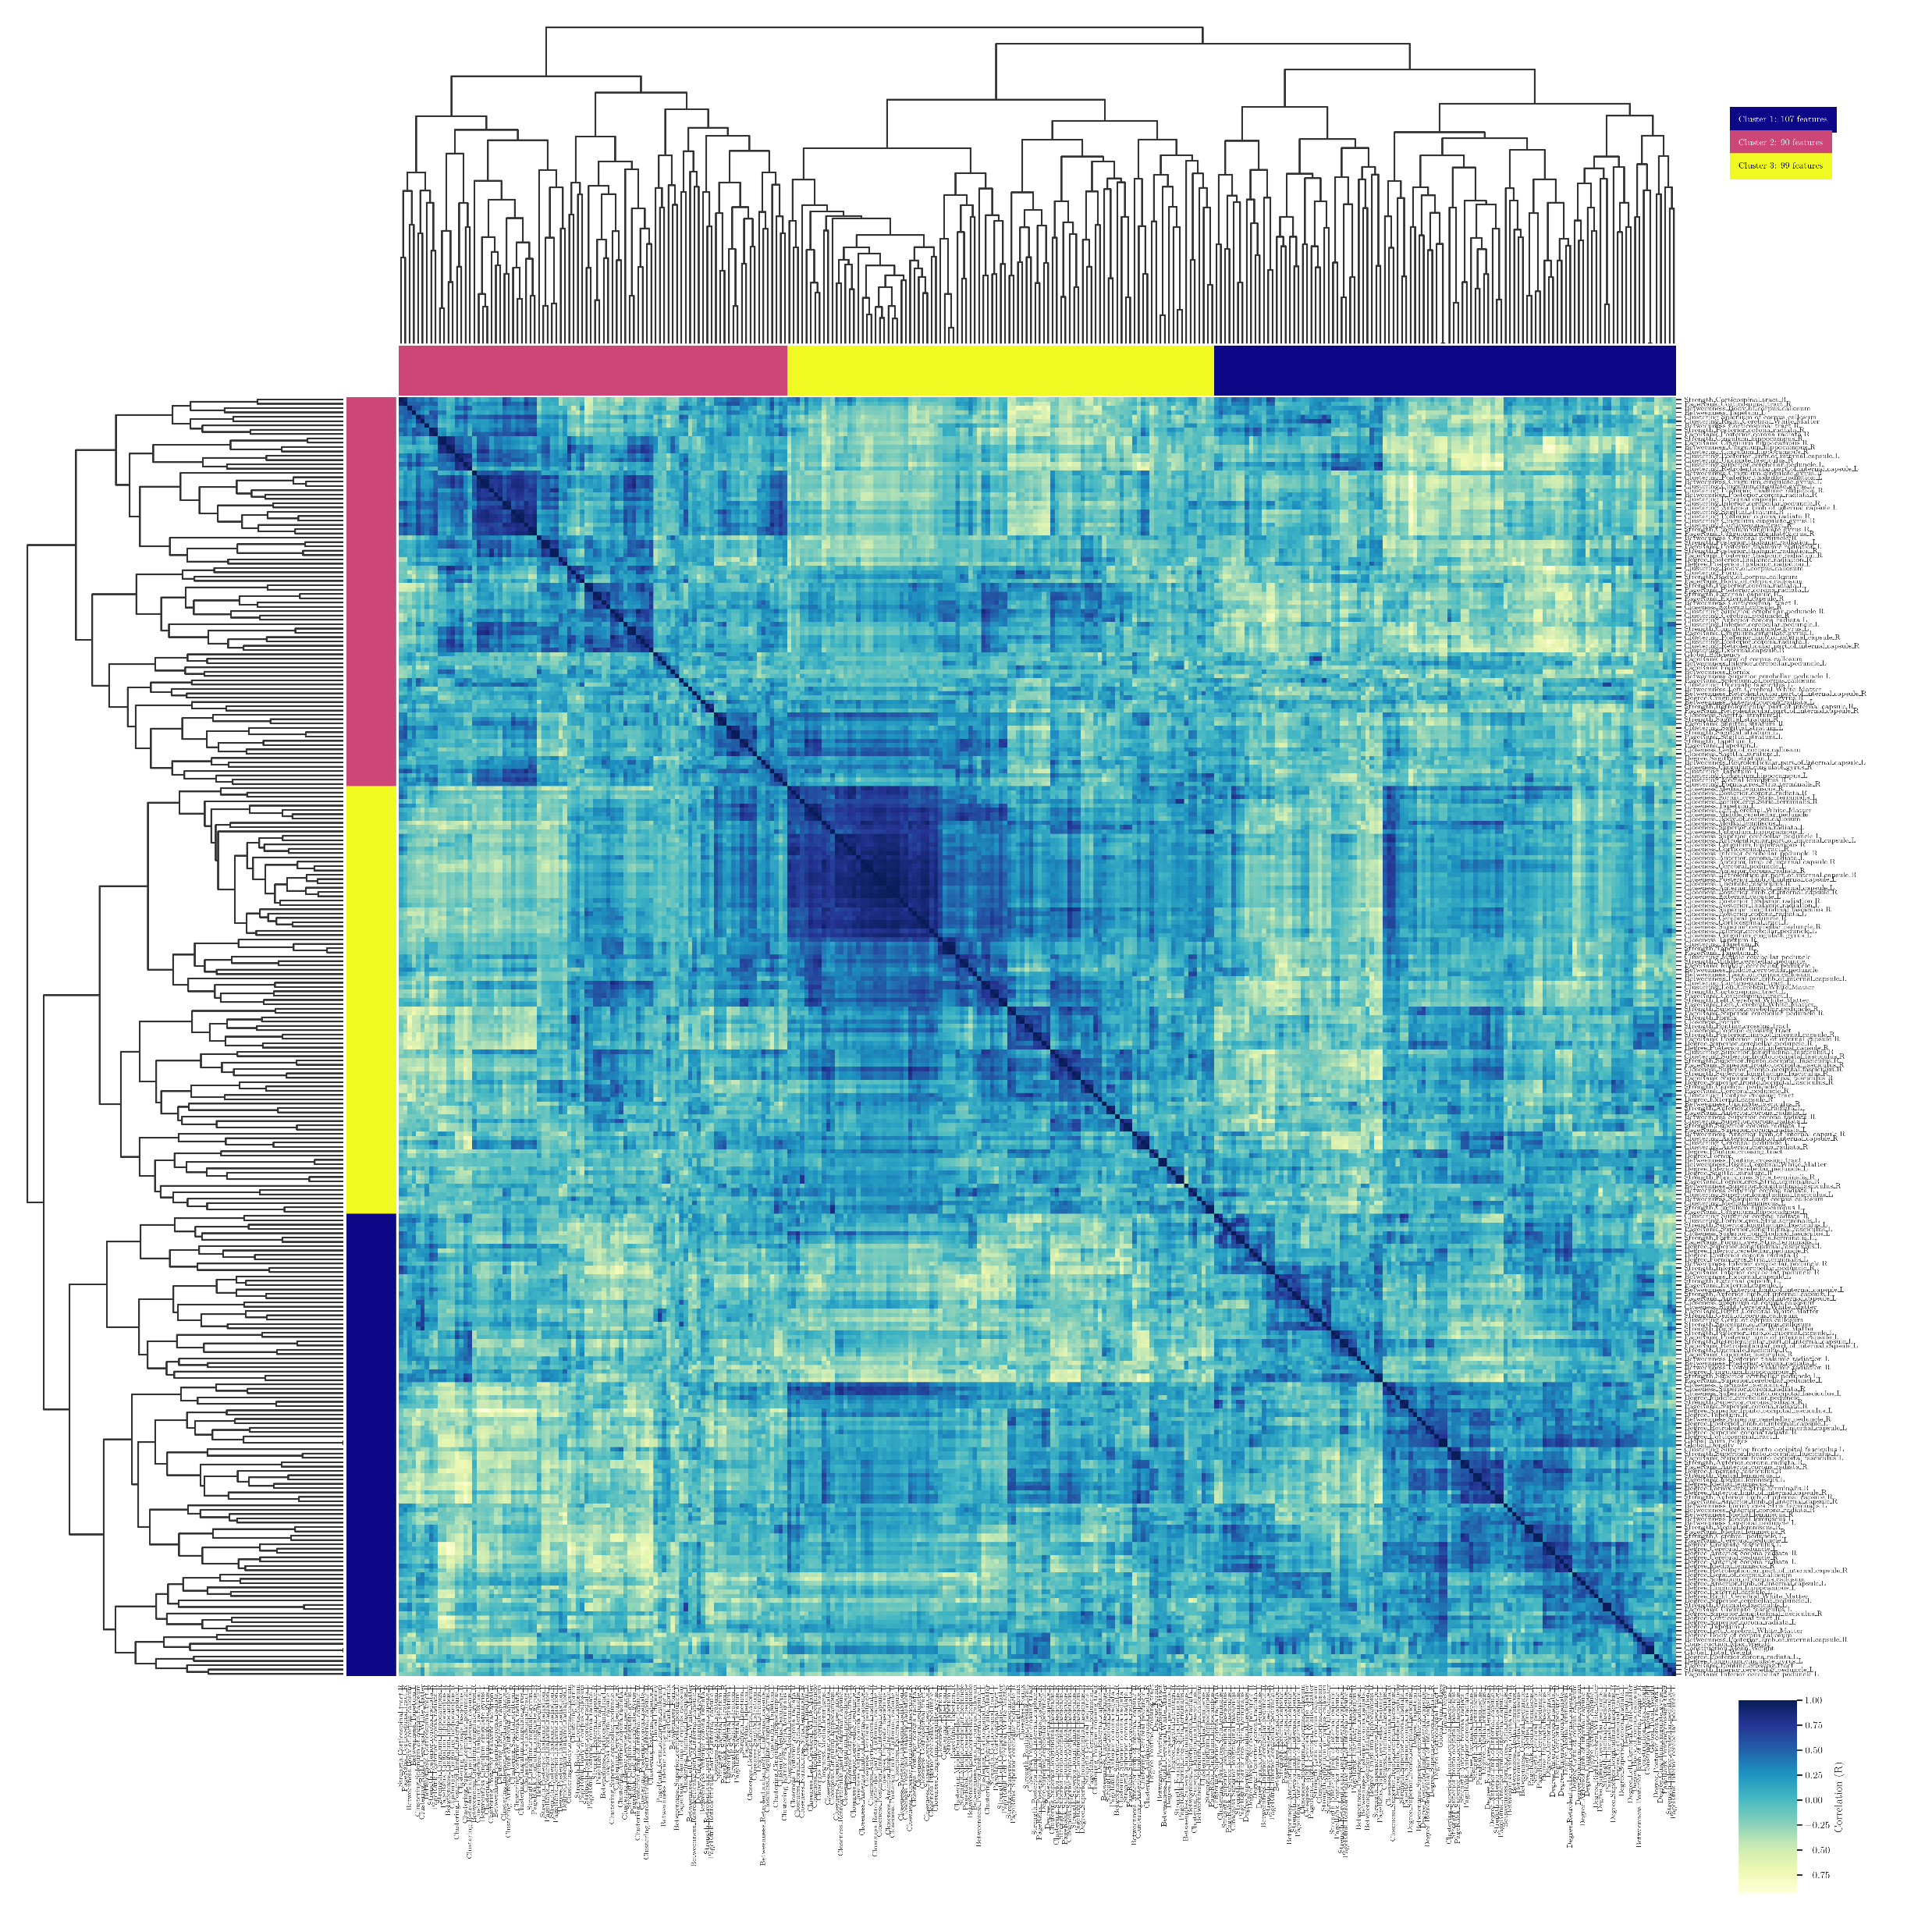
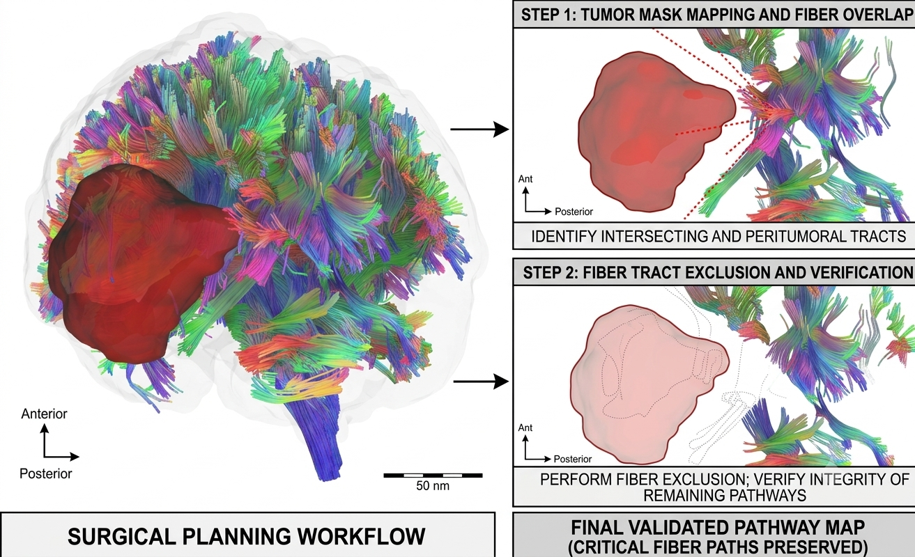
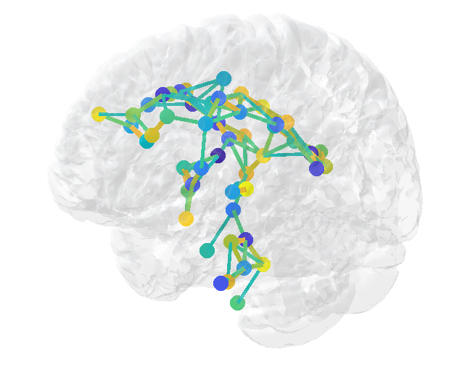
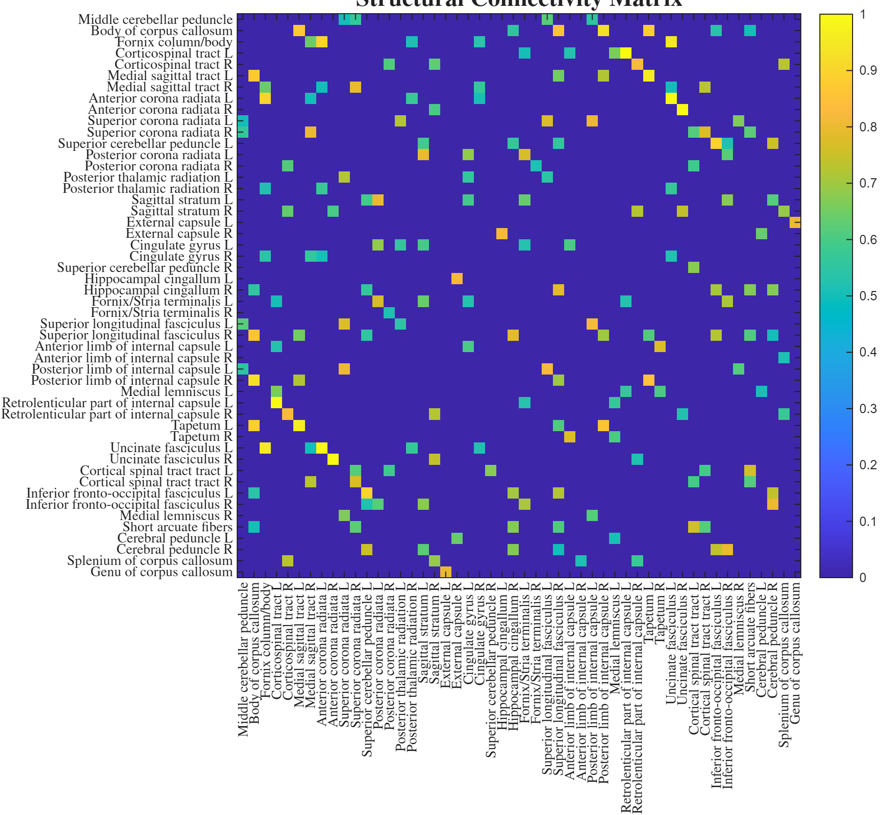


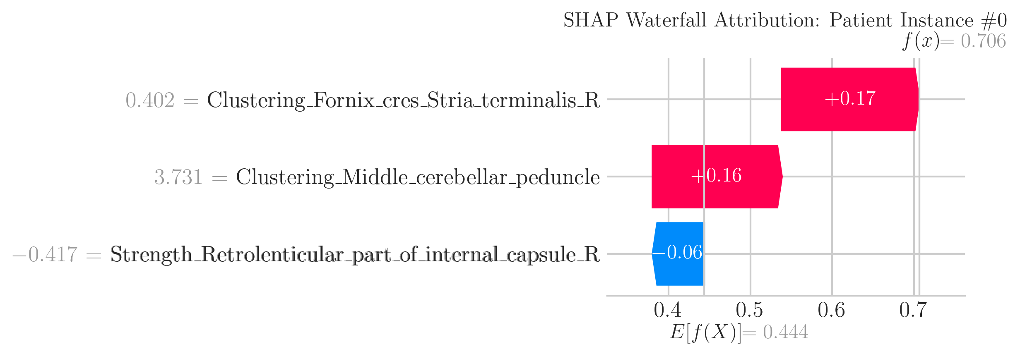
Stage 1: Input data and preprocessing
(a) T1-weighted MRI
Brain extraction
(c) Personalized Tumor Mask
Manually segmented
(e) Spatial Normalization to Atlas Space
(b) DWI Data
e.g., FA
Colormap
(d) JHU White Matter Atlas (MNI Space)
Subject-specific images were co-registered to a common anatomical atlas
Calculated DTI Maps
Stage 2: Tumor-masked Tractography
Tumor Mask Mapping and Exclusion
(b) Probabilistic Diffusion Modeling
(c) Structural Connectivity Matrix
(d) Multi-level Feature Extraction
m = 307 continous features
A.1. Tumor mask mapping and fiber overlap
A.2. Fiber tract exclusión and verification
Red = left-to-right orientation (X-axis)
Green = anterior-to-posterior orientation (Y-axis)
Blue = superior-to-inferior orientation (Z-axis)
3D Structural connectome
Stage 3: Explainable Machine Learning Strategy
Feature Selection
(b) Model Classification via Random Forest
(c) Model Interpretation
Diagnostic interpretability was quantified via tree SHAP values
m features
labels
p features
b.1. Random Forest Classifier
Ensemble of Decision Trees
Labels (diagnosis)
Tree 1
Tree 2
Tree n
LGG
SFS
HGG
…
N samples
N samples
Booststrap simples + Random feature selection
b.2. Prediction
(majority vote)
b.3. Performance Evaluation
Nested Cross-validation
(e.g., 5-fold)
Outer CV
Test Fold
Inner CV
SFS + RF
X
d
Predicted class: LGG
e.g., accuracy

