Slide 1
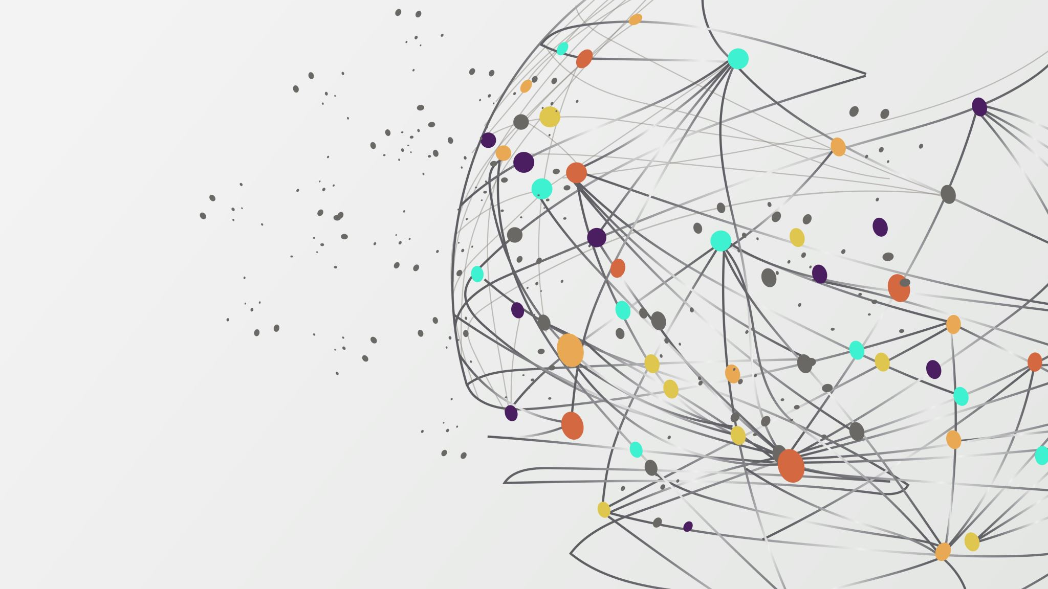
SafeSTEP

Slide 2
AGENT NAME
What’s the name of your NeuralSeek Agent?
SafeStep: this is an AI-powered digital assistant designed to help older adults and non-tech-savvy users safely use smartphones and computers. It provides simple, real-time guidance for everyday digital tasks while helping users avoid scams, unsafe websites, and confusing online processes.

Slide 3
AGENT PURPOSE
What is the agent’s primary purpose? What problem is it solving or what task is it automating/supporting?
SafeStep’s primary purpose is to support digital inclusion by helping users complete common digital tasks with confidence and safety. It solves the problem of digital confusion and vulnerability, especially for people who struggle with smartphones, laptops, websites, online payments, and unfamiliar apps.

Slide 4
TARGET AUDIENCE
Who will use this agent? What are their goals and pain points? What is their industry?
This agent is intended for older adults, non-tech-savvy users, and also family members or caregivers who want loved ones to use technology more safely and independently. Their goals are to complete everyday digital tasks, avoid scams, and feel more unsafe websites, and trouble following technical instructions. confident online and gain more independence in this area. Their pain points include confusing interfaces, fear of making mistakes or being phished/scammed, difficulty recognizing

Slide 5
CORE FUNCTIONS
gives step-by-step guidance for smartphone and laptop tasks
explains apps and websites in plain language
helps users make online payments more safely
checks for warning signs of suspicious or unsafe websites
helps users recognize scam messages, phishing emails, or fraud attempts
answers digital help questions in real time
adapts explanations to the user’s skill level
supports voice-based or text-based interaction
WOW Feature: receiving immediate and personalized assistance in simple terms

Slide 6
SOURCES
Source(s):
trusted cybersecurity guidance
website safety indicators and scam warning patterns
app help documentation and public support pages
curated digital literacy resources
user-provided screenshots, prompts, or task descriptions
Format(s):
text
FAQs
website metadata
screenshots
support articles
structured safety checklists
Update Frequency:
quarterly updated safety guidance
ongoing updates to scam patterns and common online risks
periodic refresh of app instructions and help resources
Ownership & Access Controls:
trusted public safety and digital literacy resources
organization-owned knowledge base if deployed by a company or service provider
user-specific data only when permission is given
minimal data retention and privacy-focused access controls

Slide 7
Tone & personality
The tone should be friendly, patient, calm, supportive, and nonjudgmental. It should avoid technical jargon and never make users feel embarrassed for asking basic questions. Its voice is friendly and easy to understand.

Slide 8
LIMITATIONS AND RISKS
What limitations should users know? What are the ethical, legal, or technical risks?
Users should know that the agent is a support tool, not a replacement for human judgment or professional cybersecurity services. It may help identify warning signs of unsafe websites or scams, but it cannot guarantee that a website is completely safe. It may also misunderstand screenshots, unfamiliar interfaces, or new scam tactics. Privacy is another important issue, especially if users are sharing sensitive information or financial tasks.
Key risks include:
false confidence about website safety
privacy concerns when handling personal or financial information
misinterpretation of screenshots or user questions
overreliance on the tool instead of independent caution
accessibility issues if the interface itself is not designed well

Slide 9
BENEFITS AND VALUE
Who benefits most from this agent? How will success be measured?
The people who benefit most are older adults, beginners with technology, caregivers, and communities affected by digital exclusion. Success could be measured by:
fewer user mistakes during digital tasks
greater confidence using devices
improved task completion rates
reduced exposure to scams or suspicious sites
increased independence in accessing online services
Frame ROI
Risk of not solving this: If this problem is not solved, many people remain digitally excluded, more vulnerable to scams, and dependent on others for basic online tasks like payments, communication, healthcare access, and account management.
Gain when solved: When solved, users gain confidence, independence, safety, and better access to digital services. Organizations also benefit because users can complete tasks more successfully and require less manual support.

