Slide 1
Text Generator Project

Slide 2
What we’re going to do today:
1
Welcome
2
Text generation
3
Coding a chain
4
Get started!
5
Next steps

Slide 3
Text generation

Slide 4
Ways to generate text
Nonsensical
Concatenate random words from a dictionary
Use a Markov chain to generate text based on the probabilities found in some source text
Train a neural network on large datasets of text from books, and ask the neural network to generate text based on prediction.
Store the parse trees for a large number of sentences and generate text based on possible sentence structures and possible words that can fill each grammatical role
Grammatical

Slide 5
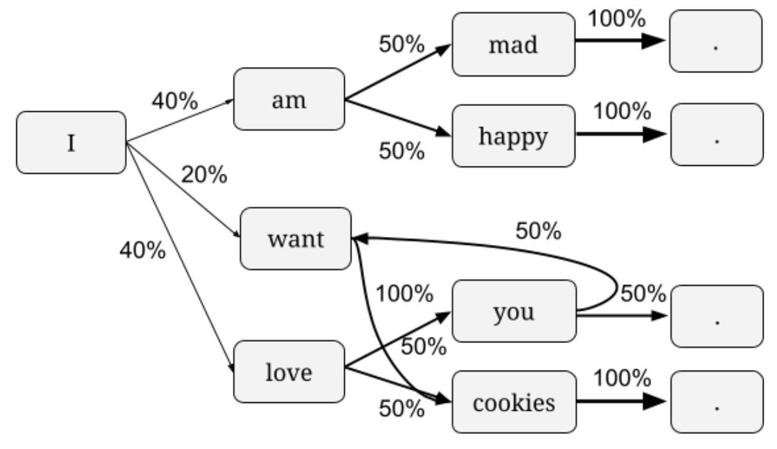
Markov chain
A way to model a sequence of events based on probabilities.
If the events are words, and the probabilities are the likelihood of one word following another word, then a Markov chain can model human language.
A toddler language:
I am mad.
I am happy.
I love you.
I want cookies.
I love cookies.
You want cookies.
Chain:
Possible output from chain:

Slide 6
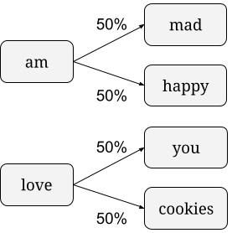
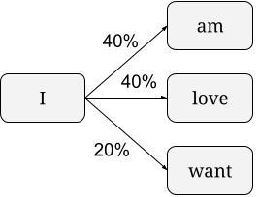
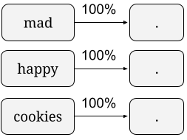

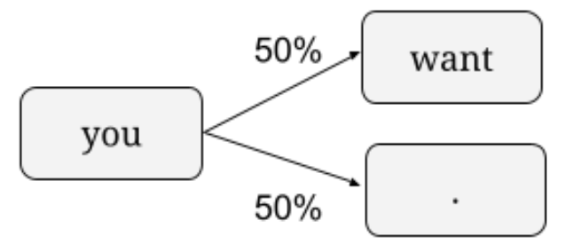
Building a Markov chain
A toddler language:
I am mad.
I am happy.
I love you.
I want cookies.
I love cookies.
you want cookies.
Words: I, am, mad, happy, love, you, want, cookies, .
Probabilities:

Slide 7
The full chain
A toddler language:
I am mad.
I am happy.
I love you.
I want cookies.
I love cookies.
you want cookies.

Slide 8
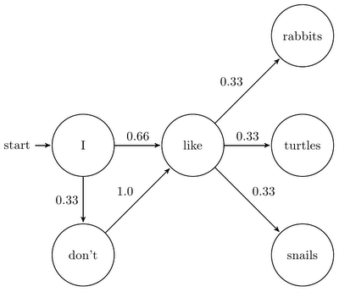
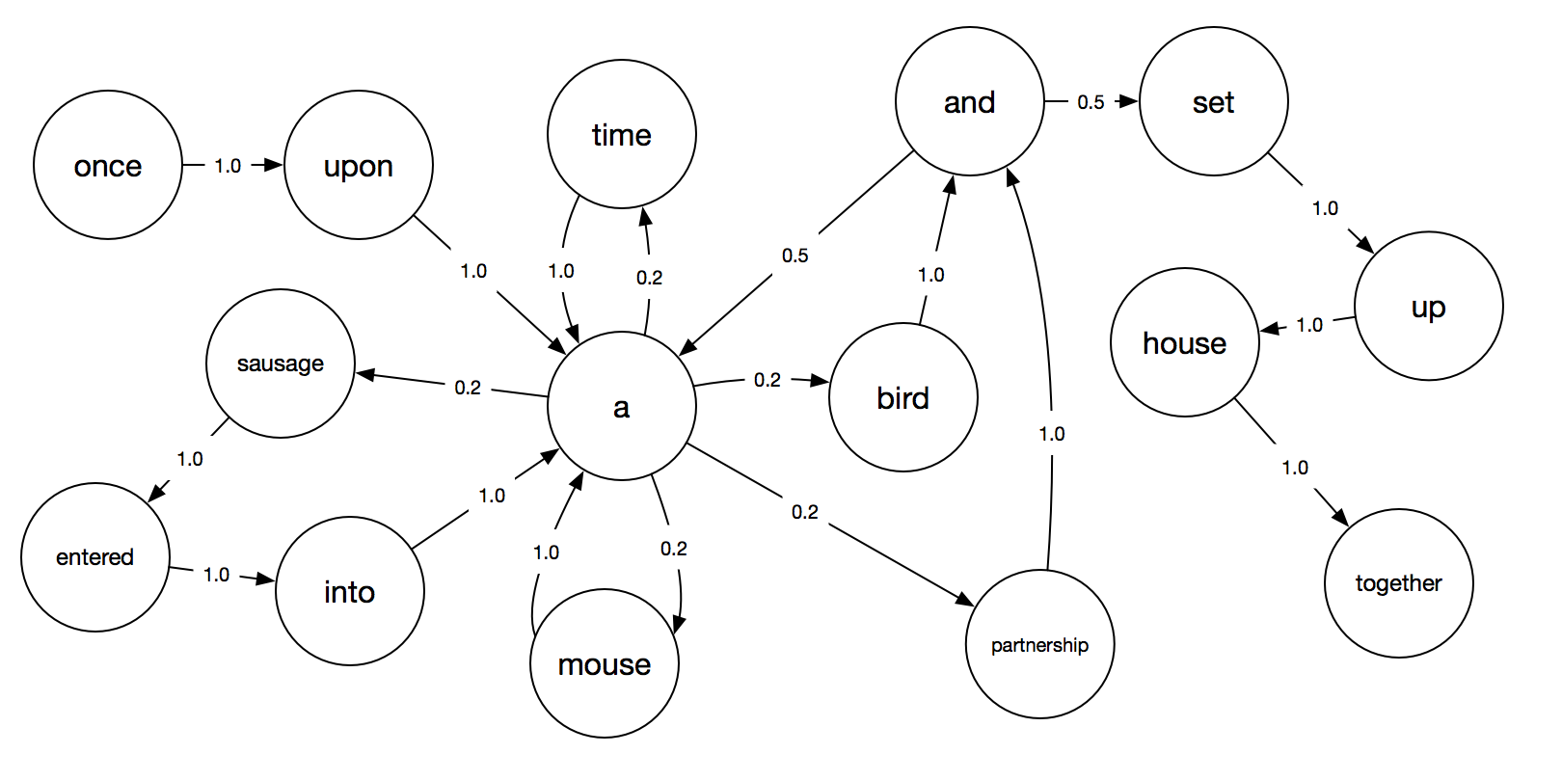
Other chains
https://thagomizer.com/blog/2017/11/07/markov-models.html
https://www.awalsh128.com/text-generation-using-markov-chains/

Slide 9
Coding a chain

Slide 10
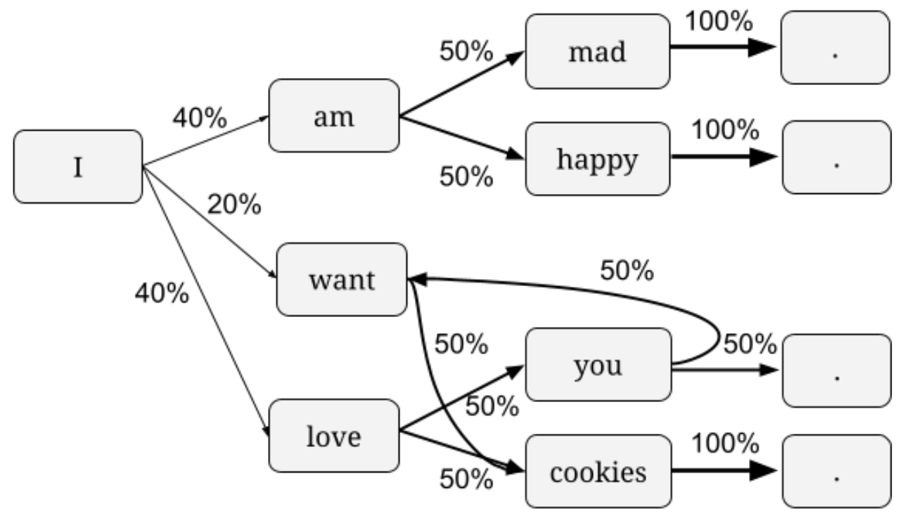
Generating text from a chain
Find input text and parse into sentences (or phrases)
Store sentences as lists of words
Based on the sentences, build a chain of words and the probabilities of the next word
Generate text by picking words probabilistically based on what words can show up after the current word
[“I”, “love”, “you”]

Slide 11
Representing a chain in code: Option # 1
{"START": {"I":0.8, “you”: 0.2},
"I": {"am": 0.4,
"want": 0.2,
"love": 0.4},
"am": {"mad": 0.5,
"happy": 0.5},
"want": {"cookies": 1.0},
"love": {"you": 0.5,
"cookies": 0.5},
"you": {"want": 0.5,
".": 0.5},
"mad": {".": 1.0},
"happy": {".": 1.0},
"cookies": {".": 1.0}
}

Slide 12
Representing a chain in code: Option # 2
Winner!
{"START": ["I", "I", "I", "I", "I", "you"],
"I": ["am", "am", "want",
"love", "love"],
"am": ["mad", "happy"],
"want": ["cookies"],
"love": ["you", "cookies"],
"you": ["want", "."],
"mad": ["."],
"happy": ["."],
"cookies": [".", "."]
}

Slide 13
Generating next word in a chain
The chain:
If current word is “I”, next word has historically been:
next_words = ["am", "am", "want", "love", "love"]
{"START": ["I"],
"I": ["am", "am", "want",
"love", "love"],
"am": ["mad", "happy"],
"want": ["cookies"],
"love": ["you", "cookies"],
"you": ["want", "."],
"mad": ["."],
"happy": ["."],
"cookies": [".", "."]
}
How could we select a next word in a way that reflects how often a next word has shown up historically?
random.choice(next_words)

Slide 14
Get Started!

Slide 15
Possible input sources
sayings.txt: ~2400 wise (or not so wise) sayings.
titles.txt: 6800 movie titles (which are on the shorter side, so your generated "sentences" will be quite short)
composingprograms.txt: 3800 sentences from composingprograms.com, a textbook about Python, Scheme, and SQL.
Project Gutenberg: An archive of public domain books. Find a book, then select “Plain Text UTF-8” link and copy the URL.

Slide 16
Breakout: Find text
Make a copy of the project notebook and change the sharing settings
Find an input source that you want to work with
Change the first code block to bring in that text source
Change the split() separator to work for your source text
Inspect the first few sentences to make sure they look as expected
If you have time, see if you can start on wordify_sentences
Ask any questions you run into!
Notes:
Maybe model one more example of questions.
Have people DM lists and comment on them.

Slide 17
Next Steps

Slide 18
👀 Next steps
Attend Office hours on Friday
Use Slack for support
Submit projects by end of day Sunday
Send peer review by end of day Monday

Slide 19
Any questions?

