Slide 1
SC1015
Mini Project
Mortality Prediction
Presented by: SC5 Group 2
Law Wei Zhen
Lee Ying Ying, Pamela
Lui Shi Ying

Slide 2
TABLE OF CONTENTS
01
Problem Motivation
02
Data Cleaning and Preparation
03
Exploratory Data Analysis
04
Machine Learning
05
Outcomes and Reflections

Slide 3
PROBLEM MOTIVATION
01

Slide 4


PROBLEM MOTIVATION
By 2030…
25% of Singapore’s population is estimated to be aged 65 and older

Slide 5
PROBLEM MOTIVATION
Predicting hospital mortality can help with patients’ risk stratification
Better level of care placement, closer follow-up and improved healthcare quality

Slide 6
DATASET
“In Hospital Mortality” Dataset from Kaggle
Variables:
Age
Gender
BMI
Heart Rate
Blood Pressure
Outcome
and so on…

Slide 7
How can hospitals predict the survival outcome of their in-hospital patients ?

Slide 8
DATA CLEANING & PREPARATION
02

Slide 9
DEALING WITH NULL VALUES
DROPPING IRRELEVANT COLUMNS
Numerical columns | df = df.fillna(df.mean())
‘Outcome’ (consists of ‘1’s and ‘0’s only): | df = df.dropna(subset=['outcome'])
Variables such as ‘group’ and ‘ID’ are not variables that would influence a patient's mortality outcome in any way

Slide 10
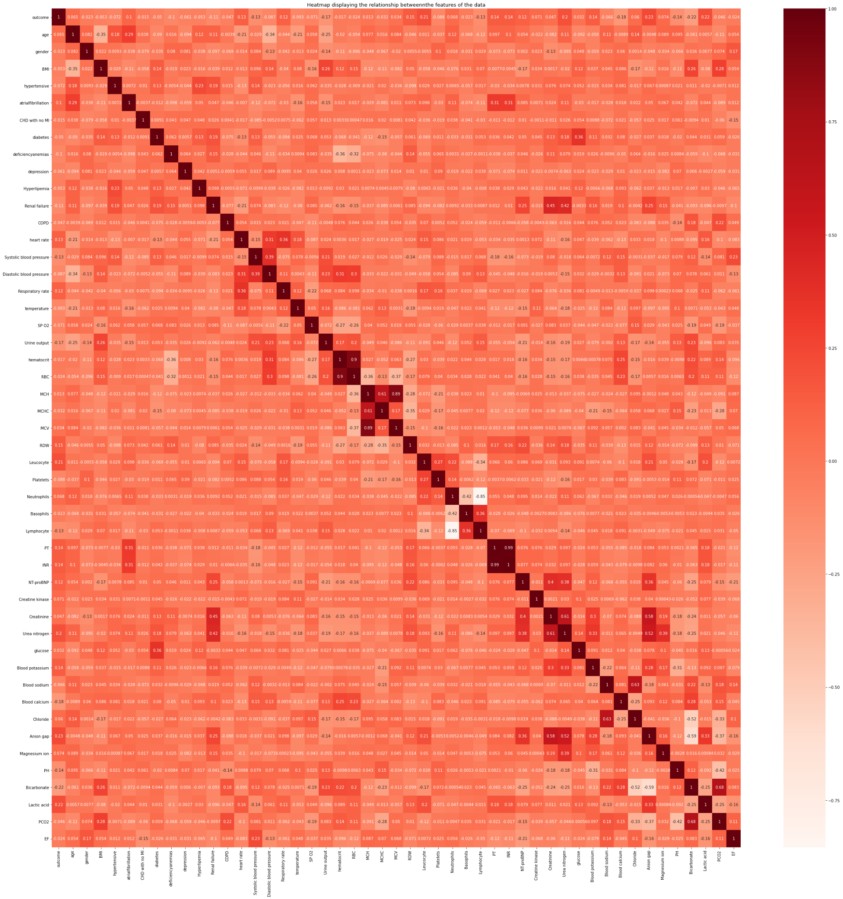
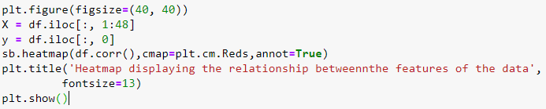
Feature Selection: Pairwise Correlation
Printed out heat map that involves all variables in our data frame
Identified pairs of variables that were most highly correlated
Discard variable with weaker correlation with target

Slide 11
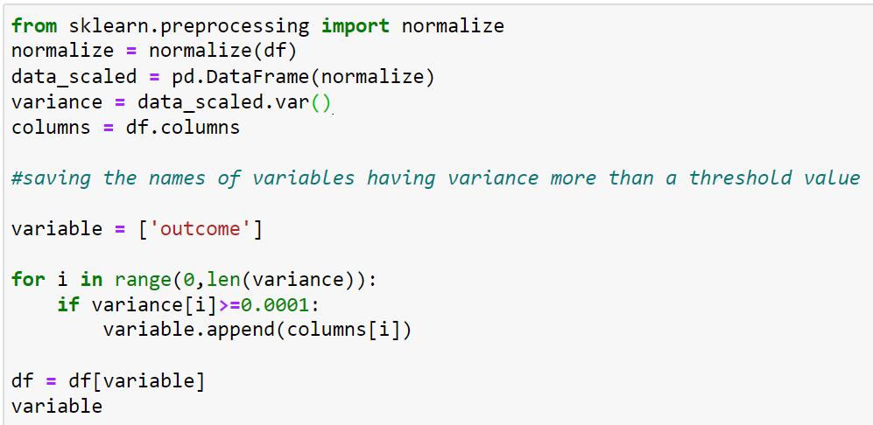
Feature Selection: Low Variance Filter
Removed all features that did not meet the Variance Threshold
Variables with extremely low variance values signify that the variable that roughly the same value in all its samples
Predictive capability is not strong enough to contribute sufficiently towards accurate prediction of our response variable

Slide 12
Final Variables
Age
Heart rate
Systolic blood pressure
Diastolic blood pressure
SP 02
Urine output
MCV
Platelets
Neutrophils
NT-proBNP
Creatine kinase
glucose
Blood sodium
Chloride
EF
Notes:
i.e. using the different variables to predict whether outcome is 1 or 0

Slide 13
EXPLORATORY
DATA ANALYSIS
03

Slide 14
EDA
Age
Heart rate
Systolic blood pressure
Diastolic blood pressure
SP 02
Urine output
MCV
Platelets
Neutrophils
NT-proBNP
Creatine kinase
glucose
Blood sodium
Chloride
EF
Notes:
i.e. using the different variables to predict whether outcome is 1 or 0

Slide 15
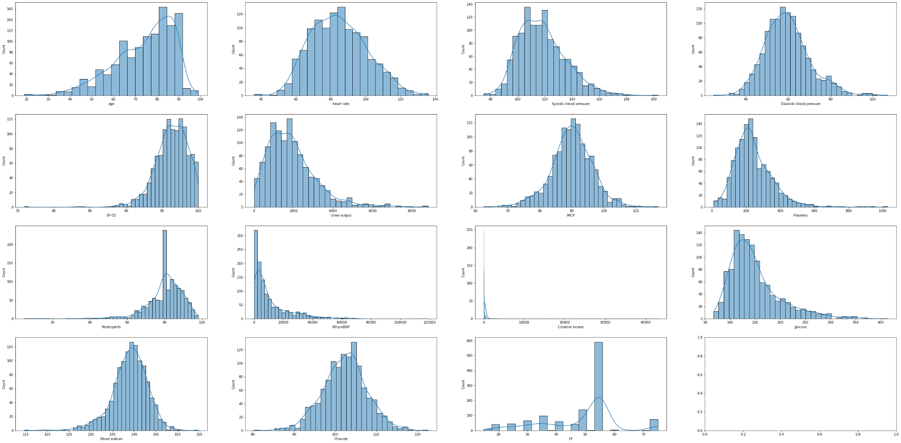
Univariate Visualisation
Univariate
Histogram + Density Plot

Slide 16
Univariate Findings
Variable | Range in which majority lies | Variable | Range in which majority lies
Age | 80-90 | Neutrophils | 80
Heart Rate | 70-90 | Creatine Kinase | 110
Systolic Blood Pressure | 110-120 | Glucose | 125
Diastolic Blood Pressure | 60 | Blood Sodium | 140
SP02 | 95-97 | Chloride | 102
Urine Output | 1000-2000 | EF | 55

Slide 17
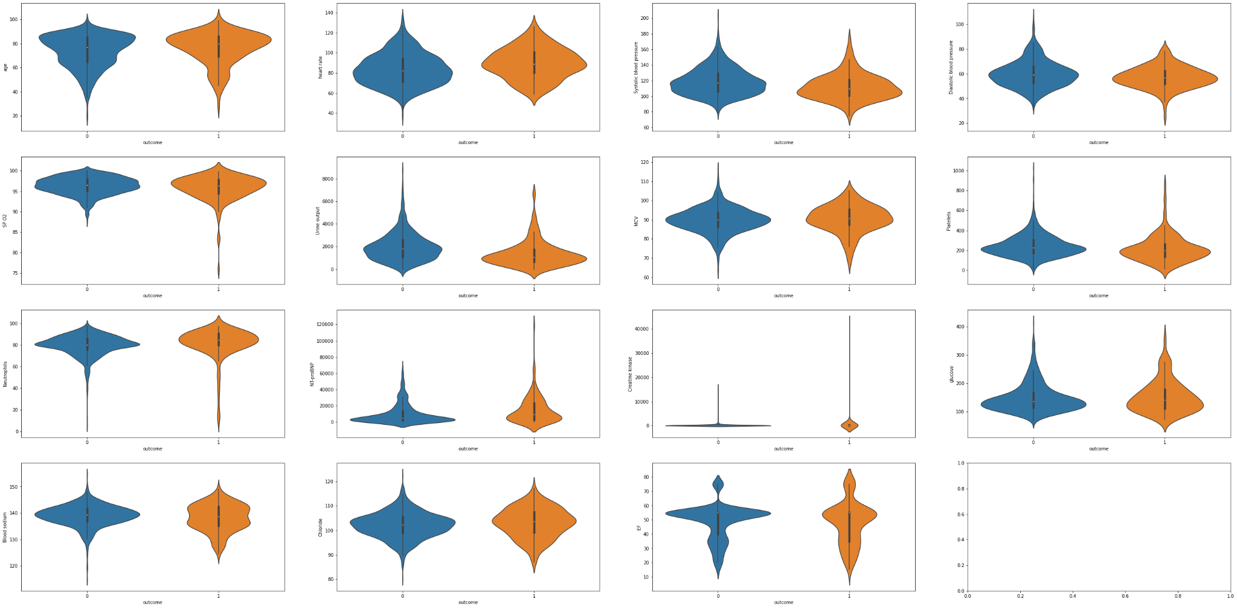
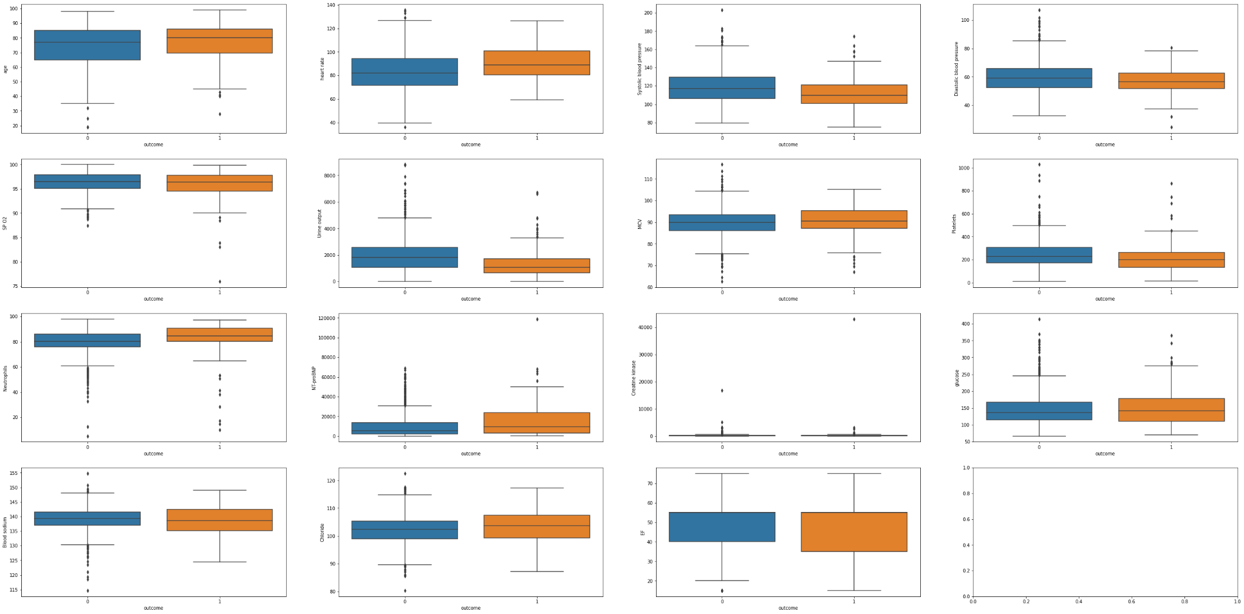
EDA Visualisation
Bivariate (against ‘outcome’)
Violin Plot & Box Plot

Slide 18
Insights from Bivariate Visualisation
Creatine kinase
Presence of extreme outliers
However: decided to keep as high levels of Creatine kinase is dangerous
Has impact on mortality rate
EF
Does not seem to have any impact on outcome
→ as seen from violin plot (and box plot)

Slide 19
MACHINE LEARNING
04

Slide 20
MACHINE LEARNING
K-NEAREST NEIGHBOURS
LOGISTIC
REGRESSION
RANDOM FOREST

Slide 21
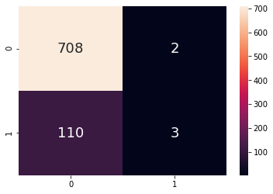
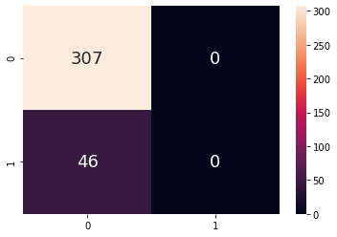
K-NEAREST NEIGHBOURS
K represents the number of nearest neighbours
Typically, the optimal K value is selected using square root of the total number of samples → 15
Train Dataset
Test Dataset
True Positive: 0.003645
True Negative: 0.8603
False Positive: 0.002430
False Negative: 0.1337
Accuracy: 0.8639
True Positive: 0.0
True Negative: 0.8697
False Positive: 0.0
False Negative: 0.1303
Accuracy: 0.8697

Slide 22
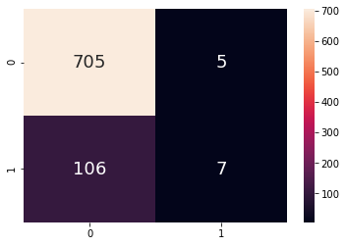
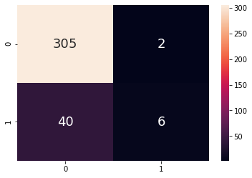
LOGISTIC REGRESSION
Goal: Predicting whether mortality ‘outcome’ will be ‘1’ or ‘0’
Hence, Logistic Regression is a suitable algorithm as it categorises data into discrete classes
Train Dataset
Test Dataset
True Positive: 0.008505
True Negative: 0.8556
False Positive: 0.006075
False Negative: 0.1288
Accuracy: 0.8651
True Positive: 0.01700
True Negative: 0.8640
False Positive: 0.005666
False Negative: 0.1133
Accuracy: 0.8810
Notes:
Accuracy score: Ratio of correct predictions to total number of predictions
F1 score:

Slide 23
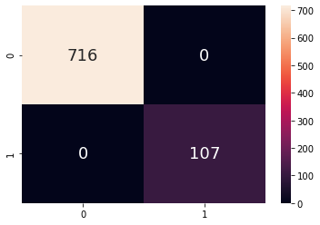
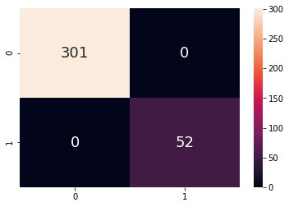
RANDOM FOREST
Constructs decision trees of multiple variables
Averages out their majority classification choice
Train Dataset
Test Dataset
True Positive: 0.1300
True Negative: 0.8700
False Positive: 0.0
False Negative: 0.0
Accuracy: 1.0
True Positive: 0.1473
True Negative: 0.8527
False Positive: 0.0
False Negative: 0.0
Accuracy: 1.0

Slide 24
EVALUATING MODELS
ML Model | K-Nearest Neighbours | Logistic Regression | Random Forest
Accuracy Score | 0.8697 | 0.8810 | 1.0
F1 Score | 0.0 | 0.2222 | 1.0
Random Forest is the best model for our prediction as it has the highest accuracy and F1 scores

Slide 25
05
OUTCOMES &
REFLECTIONS

Slide 26
DATA-DRIVEN INSIGHTS
Number of in-hospital patients increases with age
Older patients are hence at higher risk of mortality
Hospitals should pay closer attention to older patients who are admitted
Heart Rate, Systolic Blood Pressure, SPO2, Urine output etc. are notable determinants of mortality outcomes
Hospitals should install more medical devices to monitor changes in patient’s medical statistics in these areas

Slide 27
RECOMMENDATIONS TO HOSPITALS
Data Processing: Using the Random Forest machine learning algorithm
Action Plan: Hospitals can better allocate manpower and resources to monitor and care for patients whose data is signalling higher risk of mortality
Notes:
data collection variable choice (is as mentioned in leftover variables after EDA)

Slide 28
WHAT WE HAVE LEARNT
A
FEATURE SELECTION
B
LOGISTIC REGRESSION
C
K-NEAREST NEIGHBOURS
D
RANDOM FOREST

Slide 29
THANK YOU

Slide 30
REFERENCES
Krish Naik. (2020, April 28). How to visualize decision tree in random forest- Machine learning. [Video]. YouTube. https://www.youtube.com/watch?v=WQ0iJSbnnZA
Saini, A. (2021, October 19). An introduction to random forest algorithm for beginners. Analytics Vidhya. https://www.analyticsvidhya.com/blog/2021/10/an-introduction-to-random-forest-algorithm-for-beginners/
Sharma, P. (2021, April 25). Beginner’s guide to logistic regression using Python. Analytics Vidhya. https://www.analyticsvidhya.com/blog/2021/04/beginners-guide-to-logistic-regression-using-python/
Simplilearn. (2018, June 6). KNN algorithm in machine learning | KNN algorithm using Python | K nearest neighbor | Simplilearn. [Video]. YouTube. https://www.youtube.com/watch?v=4HKqjENq9OU

