Slide 1
#7 Data Journalism with R Slack + Book Club + R4DS-es
library(dplyr)
rladies_global %>%
filter(city == ’Munich')

Slide 2
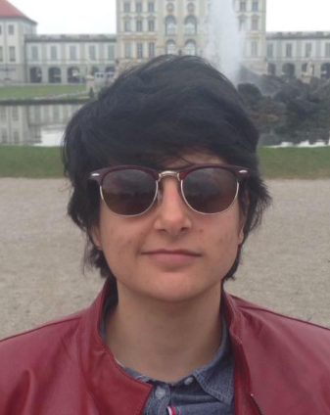
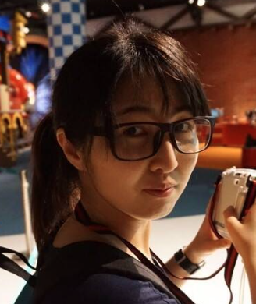
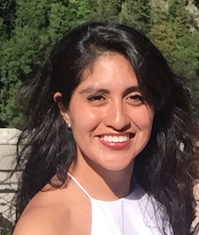
We’re Daloha, Dan, & Pam
And we’re so hyped about everyone in this room is making
RLadies Munich happen!
Join us in Meetup, Instagram, Twitter, Facebook and Slack

Slide 3

is back!

Slide 4
is back!
(now for real)

Slide 5

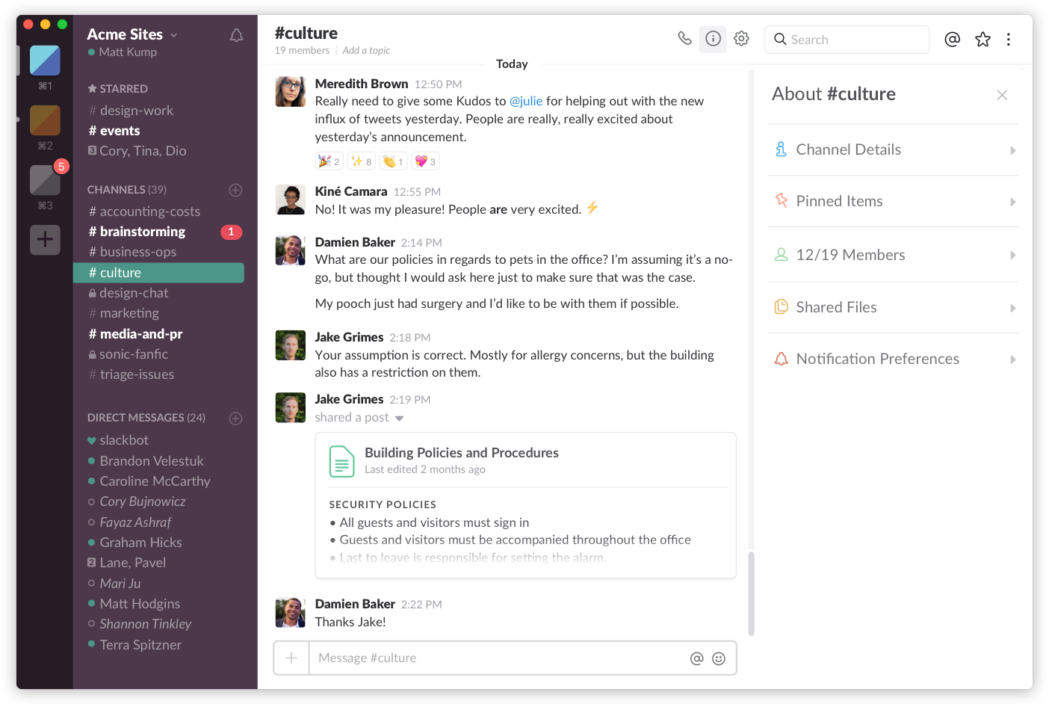
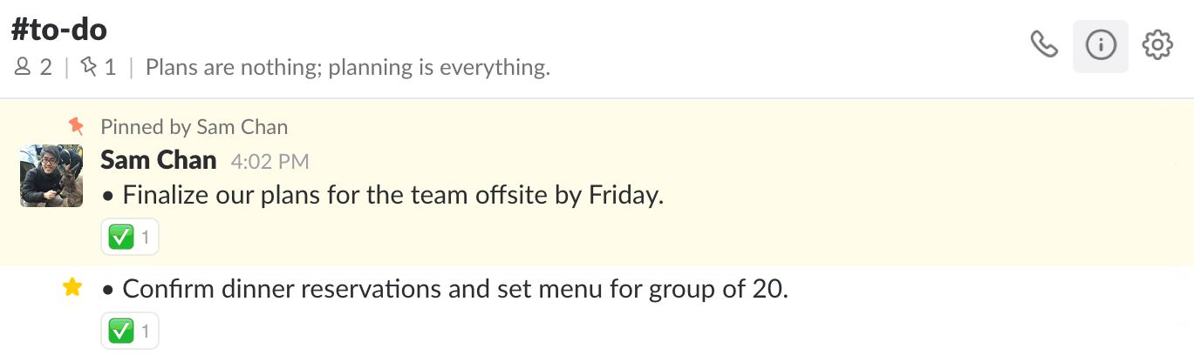
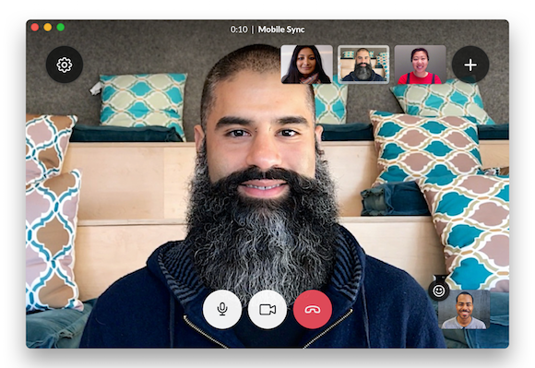
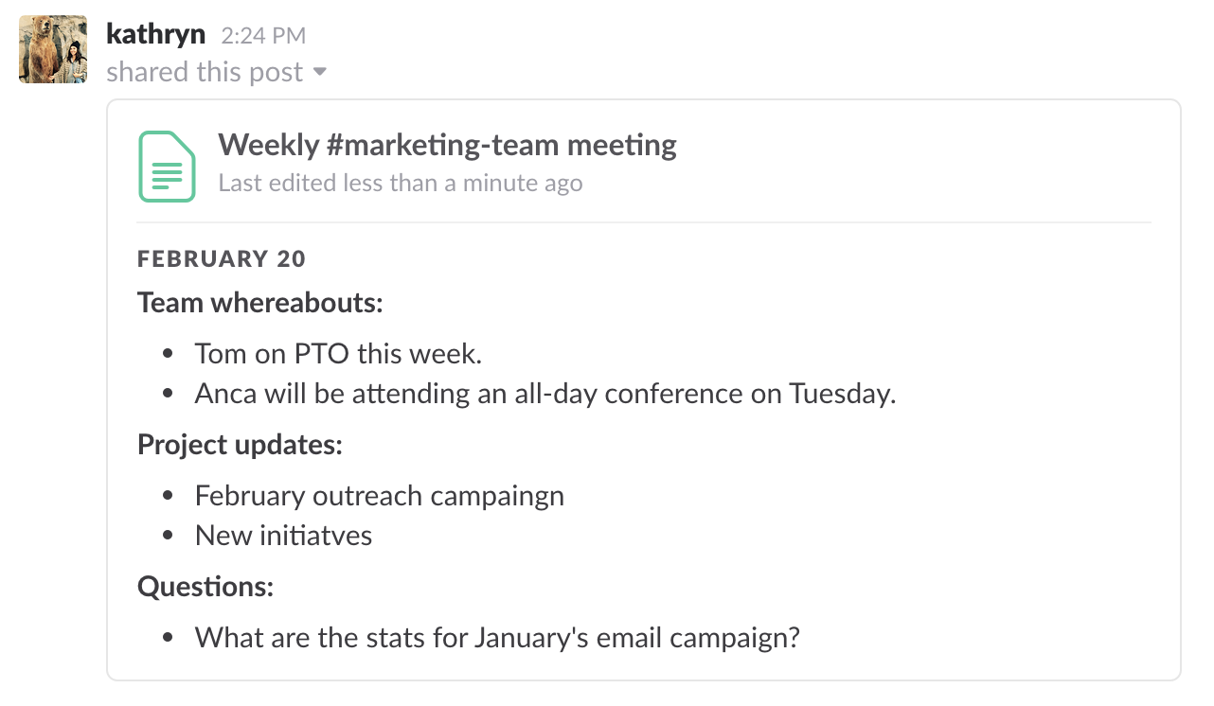
Our workspace
Communication + exchanging documents + sending GIFs == building our community

Slide 6
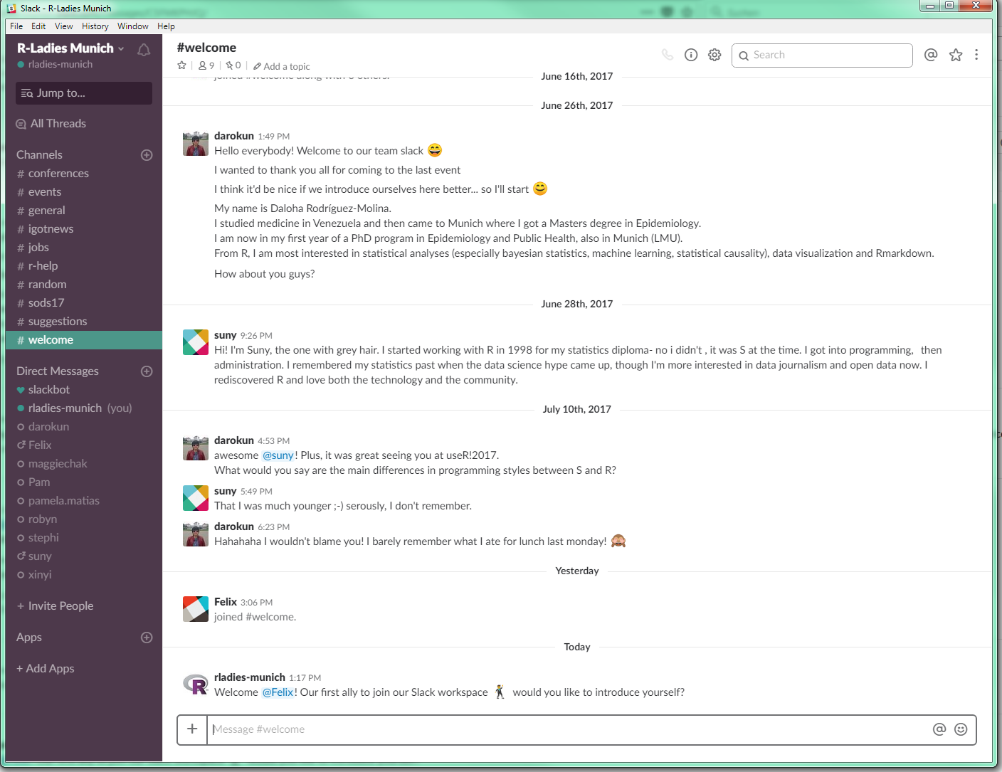
To join the R-Ladies Slack,
.slack.com
In case of doubts, drops us a line at
munich@rladies.org
and we’ll help you figure it out

Slide 7



Book Club
Starting up next fall
Suggestions for titles, workflow, etc

Slide 8
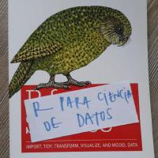
R4DS-es:
Translation of Hadley‘s classic into Spanish

Slide 9
Data Journalism with R: Experiences from data scientists at the Süddeutsche Zeitung

Slide 10
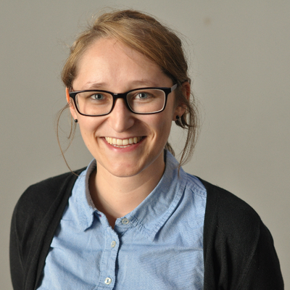

Katharina Brunner
info
Find her on

Slide 11
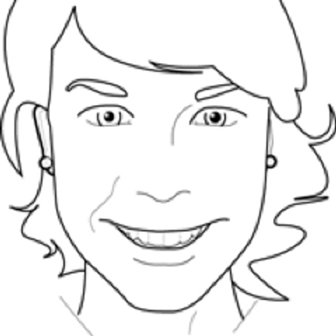
Martina Schories
dgdsb
You can also find her on

Slide 12
Bis zum nächsten Mal!

Slide 13
Bis zum nächsten Mal!
Next MeetUp
Date and topics to be announced, we will keep you updated

