Slide 1
#5 SpeakeRs Unite! Round 1 + Conferences + Slack
library(dplyr)
rladies_global %>%
filter(city == ’Munich')

Slide 2
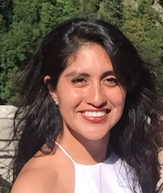



Welcome
I am Pam

Slide 3
Upcoming R
events & conferences

Slide 4
What’s been announced for 2018 (so far!)
January- March
April - June
July - September
October - December
> rstudio::conf, USA.
> SatRday, South Africa.
> New York R Conference, USA
> The European #rstats Users Meeting, Hungary
> R Day, Brazil.
> R/Finance 2018, USA.
> CascadiaRConf, USA.
> EARL, USA.
> WhyR? 2018, Poland. > 7eme rencontres R, France.
> useR! 2018, Australia.
> Noreast’R Conference. USA.
> LatinR 2018, Argentina.
> EARL London 2018, UK.
> Use of R in Official Statistics, The Netherlands.
> EARL, USA.

Slide 5
eRum 2018
May 14-16
Budapest, Hungary
Great alternative to useR! 2018
Speakers coming from economics, artificial intelligence, environmental science, software engineering… you name it!
Workshops on building packages, machine learning, spatial data and data structures
Check out their website or them

Slide 6
useR! 2018
July 10-13
Brisbane, Australia
Supported by the R Foundation
Speakers coming from environmental science, tax agencies, the World Bank and software development at RStudio
Scholarship options (+ two R Ladies Melbourne scholarships)
Why not submit an abstract? Deadline March 15th
Check out their website or them

Slide 7
EARL
September 11-13
London, UK
Speakers not yet announced: corporate and commercial use of R
Workshops from introductory to higher levels (R in 6h, Python crash course, deep learning, functional programming)
Why not submit an abstract? Deadline March 31st ;)
Check out their website or them

Slide 8
Why R?
July 2-5
Warsaw, Poland
Keynote speakers from Geoinformatics, Environmental Sciences, Language Research
Hackathon
Workshop and Presentation calls open starting today!
Why not give it a try? Deadlines are April 12th and May 25th
Check out their website

Slide 9

is back!

Slide 10

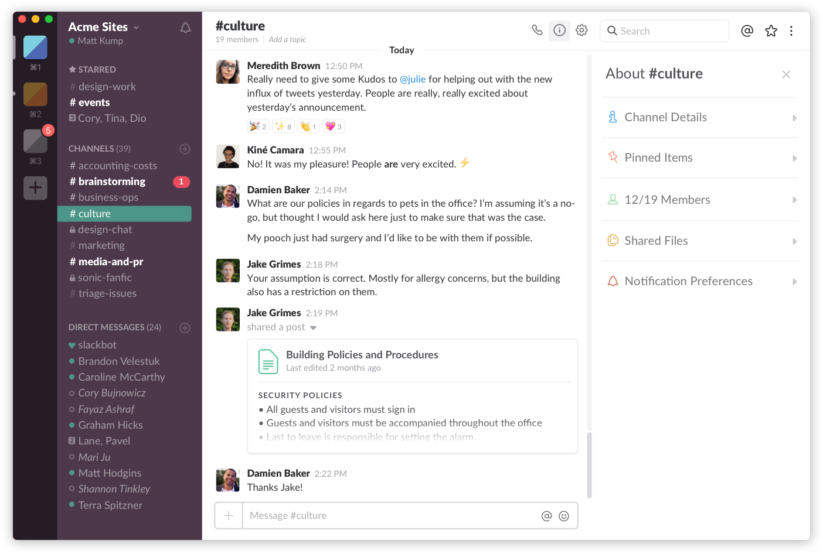
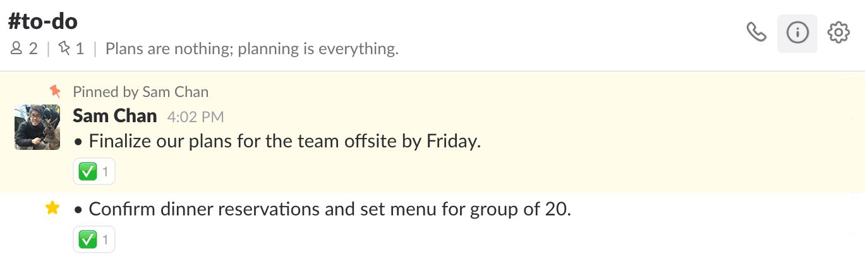
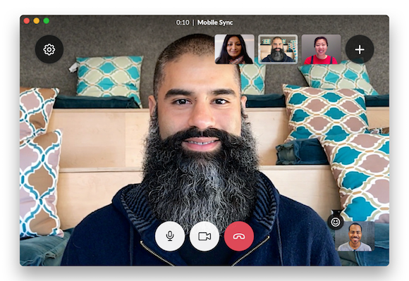
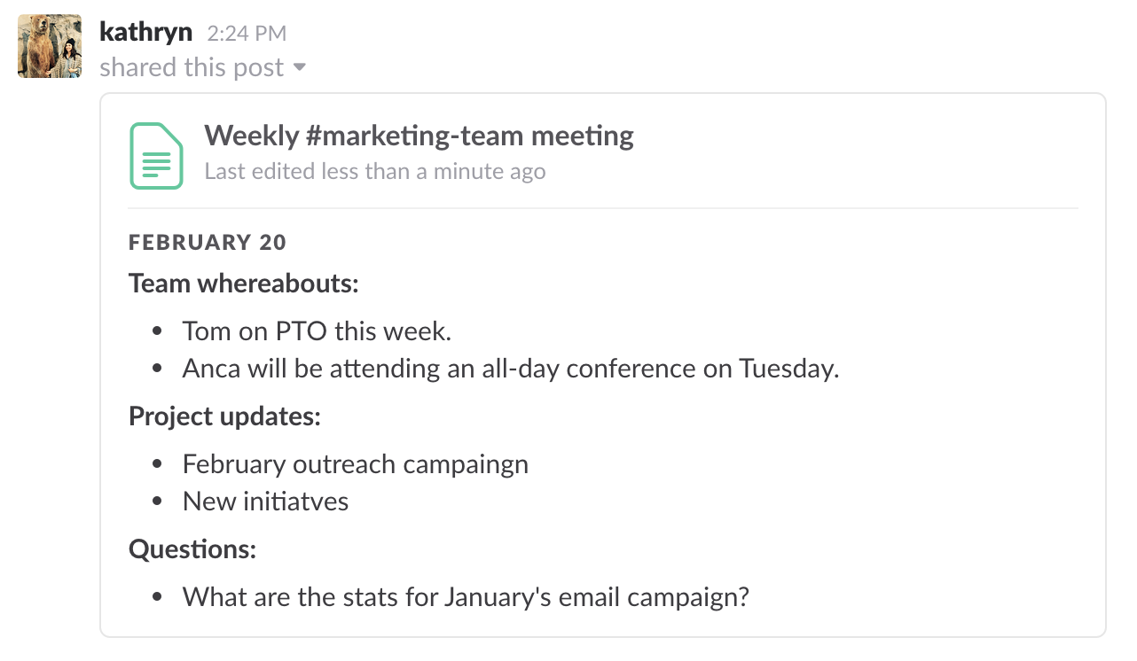
Our workspace
Communication + exchanging documents + sending GIFs == building our community

Slide 11
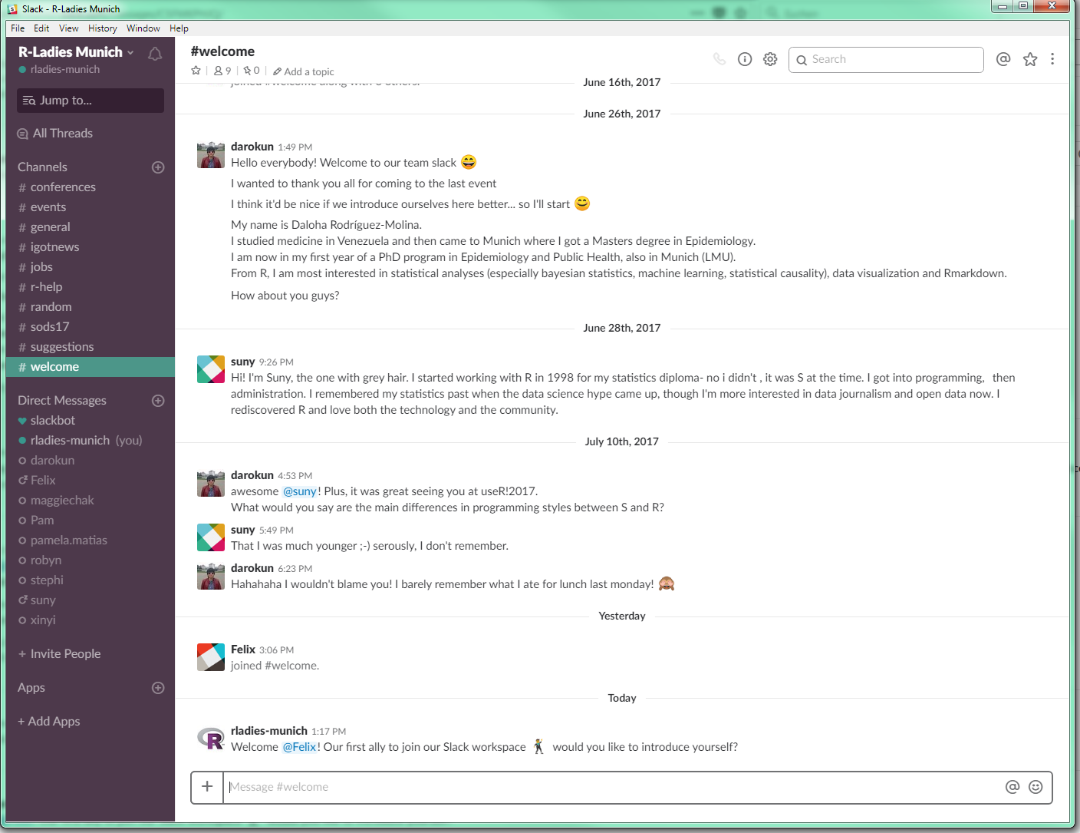
To join the R-Ladies Munich Slack,
rladies-munich.slack.com
please send us an email to
munich@rladies.org
and we’ll send you an invitation ☺

Slide 12

How to
What is Slack?
Getting started
1. Join the workspace
2. Set up your profile
3. Download the desktop/mobile app
Web browser also possible ;)
Working in Slack

Slide 13
SpeakeRs Unite!
Round 1

Slide 14
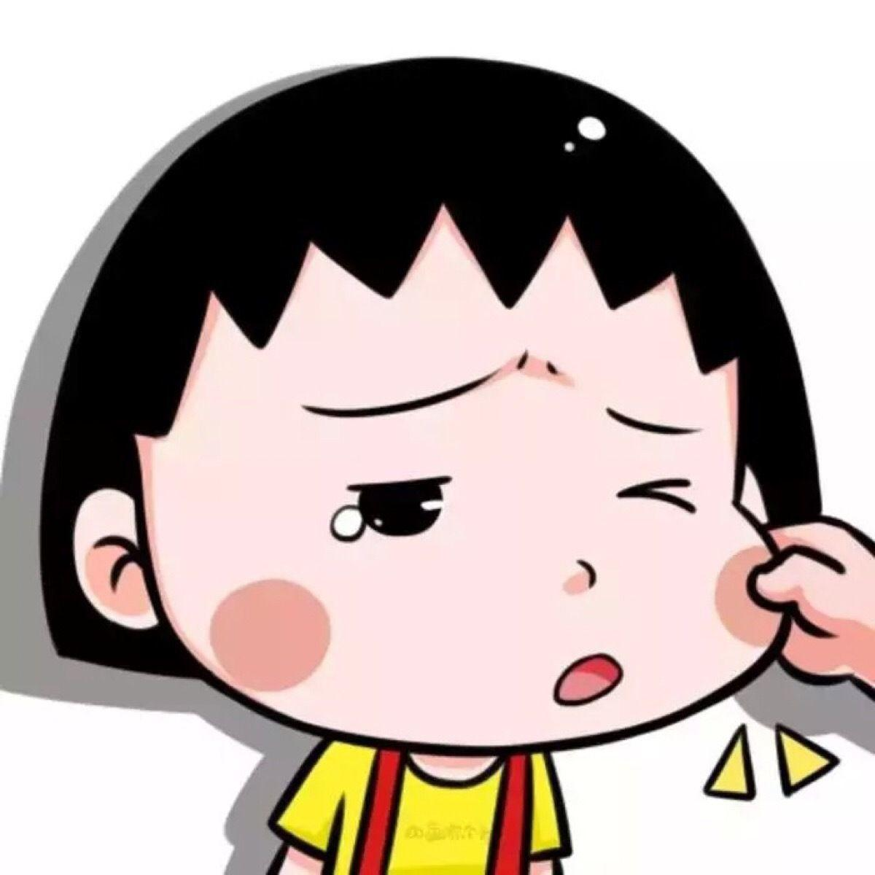
Beibei Jiang
PhD student at the Max Planck Institute of Psychiatry, Munich.
Developed a package called “SimPhe” to simulate phenotypes with epistatic interactions,
Selected for a lightning talk at useR!2017

Slide 15
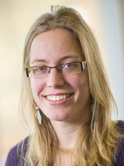
Sophie Molnos
PhD at the Helmholtz Center Munich
Developed a package called "pulver" to handle interaction terms from models based on big data.
Working in Genetic Epidemiology, analyzing mitochondrial DNA and its association with human traits.

Slide 16
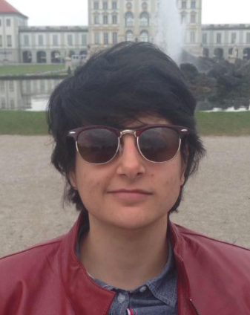
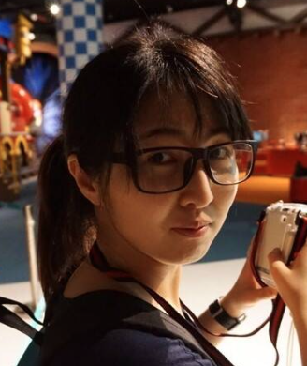
We’re Daloha, Dan, & Pam
And we’re so hyped about everyone in this room is making
RLadies Munich happen!
Join us in Meetup, Instagram, Twitter, Facebook and Slack

Slide 17
Bis zum nächsten Mal!

Slide 18
Bis zum nächsten Mal!
R-Ladies Stammtisch
* Friday, April 6th 2018
* Augustiner Bräustuben, Landsberger Straße 19, München
Important: RSVP necessary!

