Slide 1
CZ4042 Neural Networks and Deep Learning
Group Project E: Materials
By Teo Boon Shuan and Pamela Sin Hui

Slide 2
Introduction
Real-world materials have rich surface texture, geometry, lighting conditions, and clutter, which combine to make the problem difficult. The Materials in Context Database (MINC) was used, where 10 categories of fabric, foliage, glass, leather, metal, paper, plastic, stone, water, and wood were used, each category consisting of 2,500 images.
For this project, we performed a series of experiments to determine which preprocessing to use, the best pre-trained featuriser and best set of hyperparameters, further experimenting with fine-tuning through unfreezing final layers of the featuriser.

Slide 3
Agenda
Problem Statement
Dataset
Preprocessing
Basic - Horizontal Flip and Image Normalization
Advanced - CLAHE (Contrast-Limited Adaptive Histogram Equalization) and Otsu’s Thresholding
Modelling
MobileNet
InceptionV3
Results
Conclusion

Slide 4
Problem Statement
The goal of this project is to train a convolutional neural network to classify RGB images of the MINC dataset into one of 10 common material categories:
Fabric, Foliage, Glass, Leather, Metal, Paper, Plastic, Stone, Water, and Wood

Slide 5
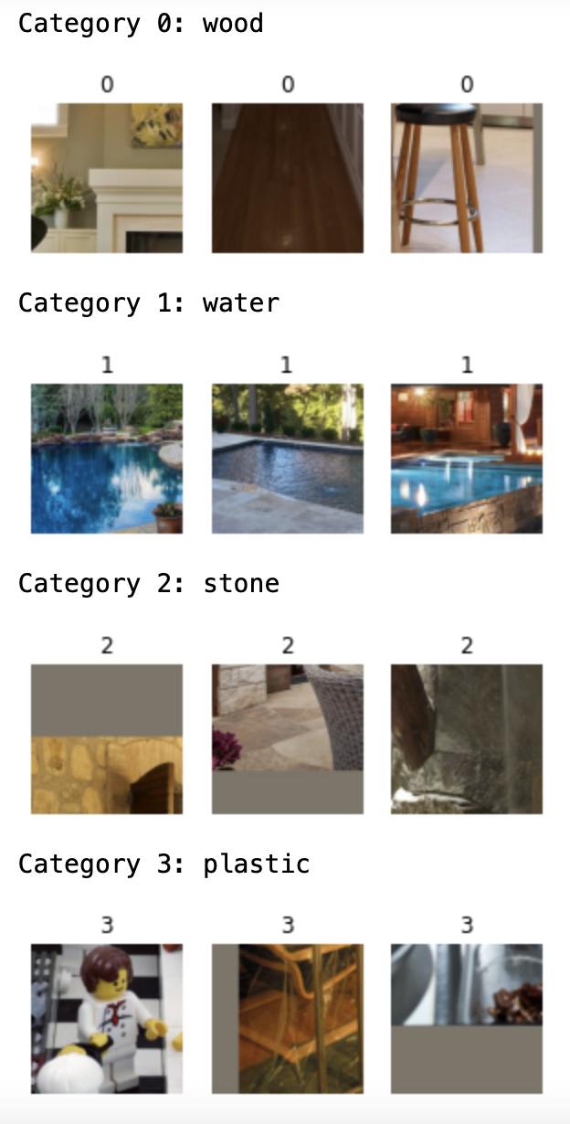
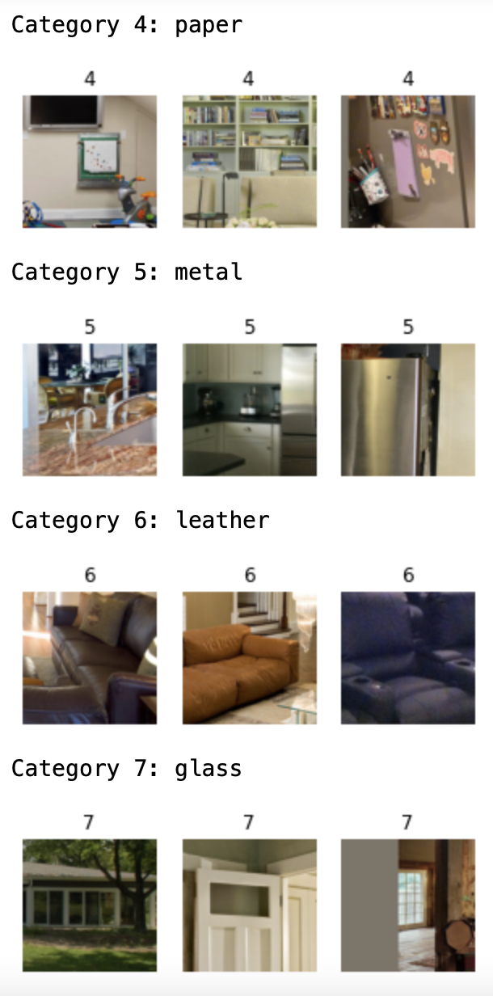
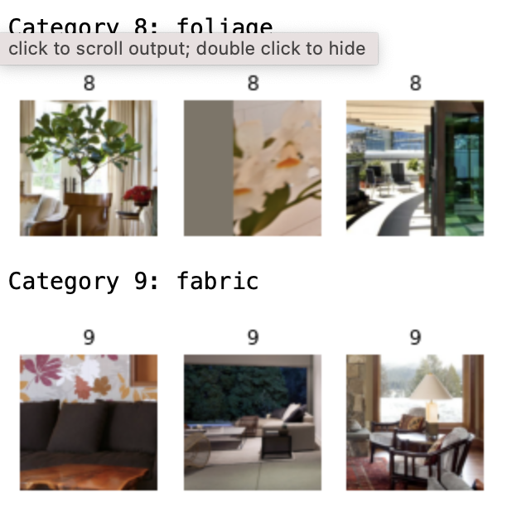
Dataset
10 Categories
2500 Images

Slide 6
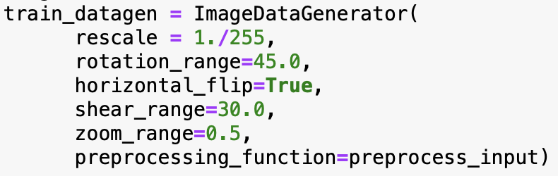
Preprocessing
Horizontal Flip: A horizontal flip is a data augmentation technique used to synthetically generate additional modified data.
Offline augmentation - OpenCV
Online augmentation - Keras

Slide 7
Preprocessing
Image Normalization: Image normalization is a process that changes the range of pixel intensity values in any given image.

Slide 8
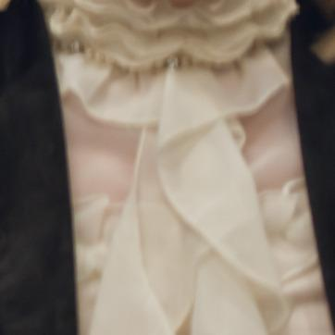
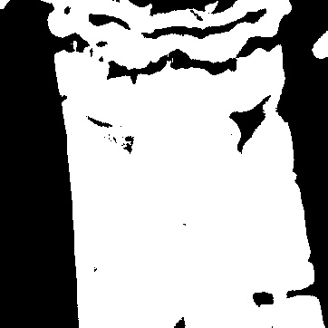
Preprocessing
CLAHE (Contrast-Limited Adaptive Histogram Equalization): 0.0974
This is achieved through the computation of several histograms, which each correspond to a certain section of an image. These computed histograms are then used to redistribute the brightness values of an image
Variant of the AHE
Used to improve contrast in images
Reduces undesired noise amplification

Slide 9
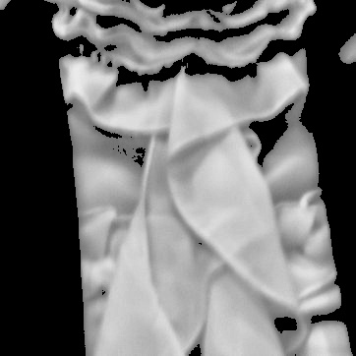
Preprocessing
Otsu’s Thresholding: 0.6982
Otsu's thresholding method proposes iterating through all the credible threshold values and enumerating a measure of spread for the pixel levels on each side of the threshold, i.e. the pixels that are in foreground or background.
Used to determine contours
Preserves information of image

Slide 10
Literature review: MobileNetV2
Depthwise Separable Convolutions
Depthwise convolution: Single convolutional filter per input channel (depth does not change)
1X1 convolution increases number of channels (features) through linear combinations of input channels

Slide 11
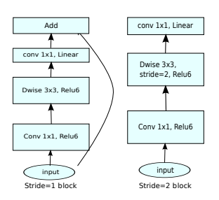
Literature review: MobileNetV2
2. Inverted residual and bottleneck layer
First layer: Takes low-dimensional tensor and performs 1X1 convolution to map to higher-dimensional space, then ReLU6
Second layer: Depthwise convolution using 3X3 kernels, then ReLU6
Third layer: Projects back to low-dimensional subspace using 1X1 convolution with linear activation (prevent further loss of information).
Residual connection between the two low-dimensional feature maps (first and third layer)

Slide 12
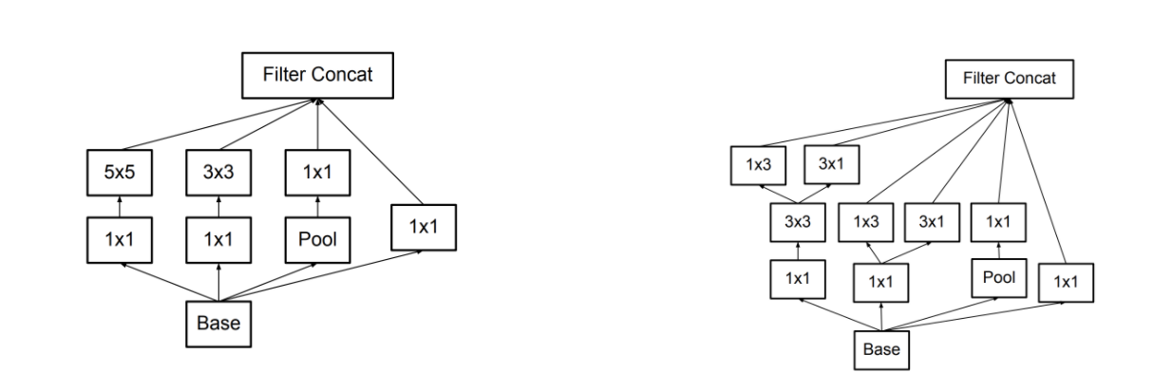
Literature review: InceptionV3
1. Factorized Convolutions: this helps to reduce the computational efficiency as it reduces the number of parameters involved in a network. It also keeps a check on the network efficiency.
2. Smaller convolutions: replacing bigger convolutions with smaller convolutions definitely leads to faster training.
3. Asymmetric convolutions:

Slide 13
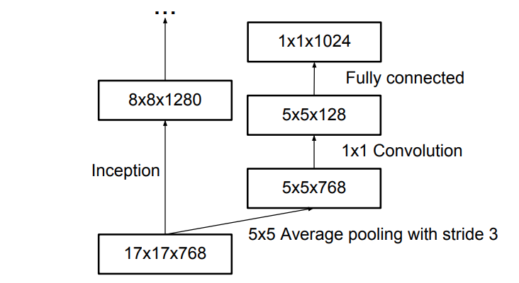
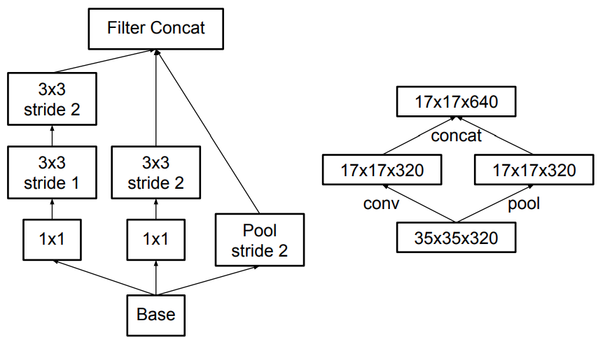
Literature review: InceptionV3
4. Auxiliary classifier: an auxiliary classifier is a small CNN inserted between layers during
training, and the loss incurred is added to the main network loss.
5. Grid size reduction:

Slide 14
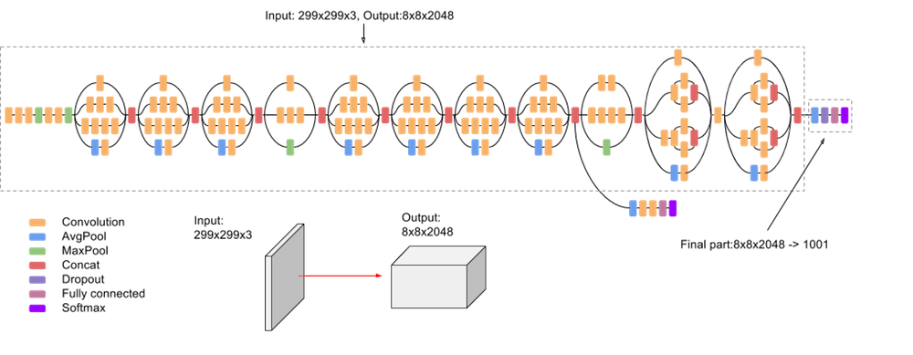
Literature review: InceptionV3
All the above concepts are consolidated into the final architecture.

Slide 15
Experiments - Featurisers and hyperparameter-tuning
32 experiments, 4 epochs each
Featuriser (transfer learning): MobileNetV2, InceptionV3
Number of neurons in hidden layer: 96, 128
Number of neurons in hidden layer with dropout: 64, 96
Dropout probability: 0.1, 0.3
Optimiser: Adam, SGD

Slide 16
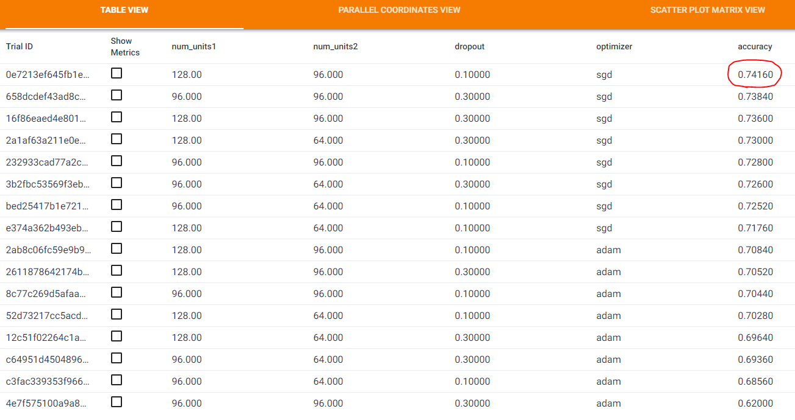
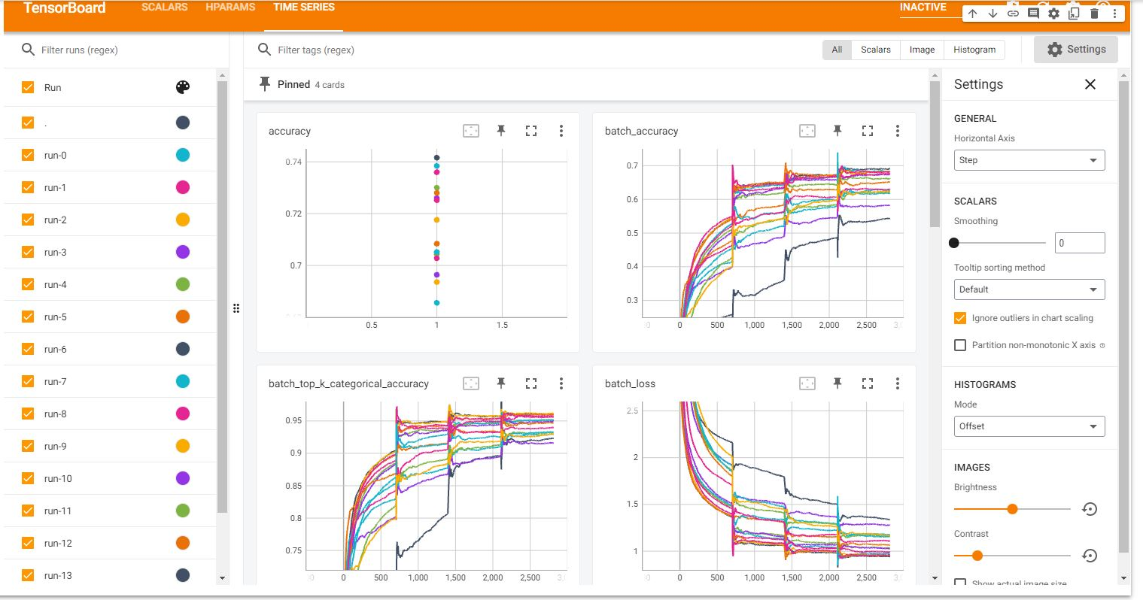
Experiment Results - MobileNetV2 featuriser

Slide 17
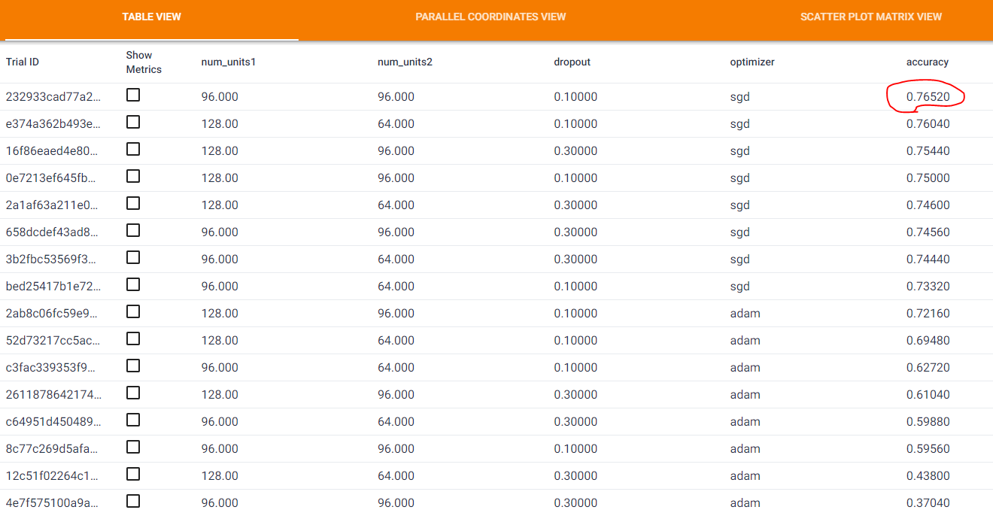
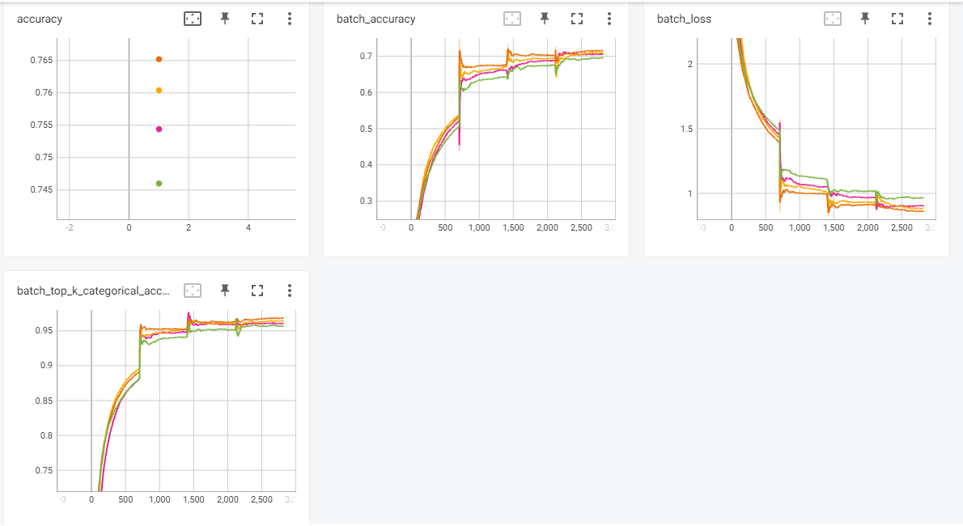
Experiment Results - InceptionV3 featuriser

Slide 18
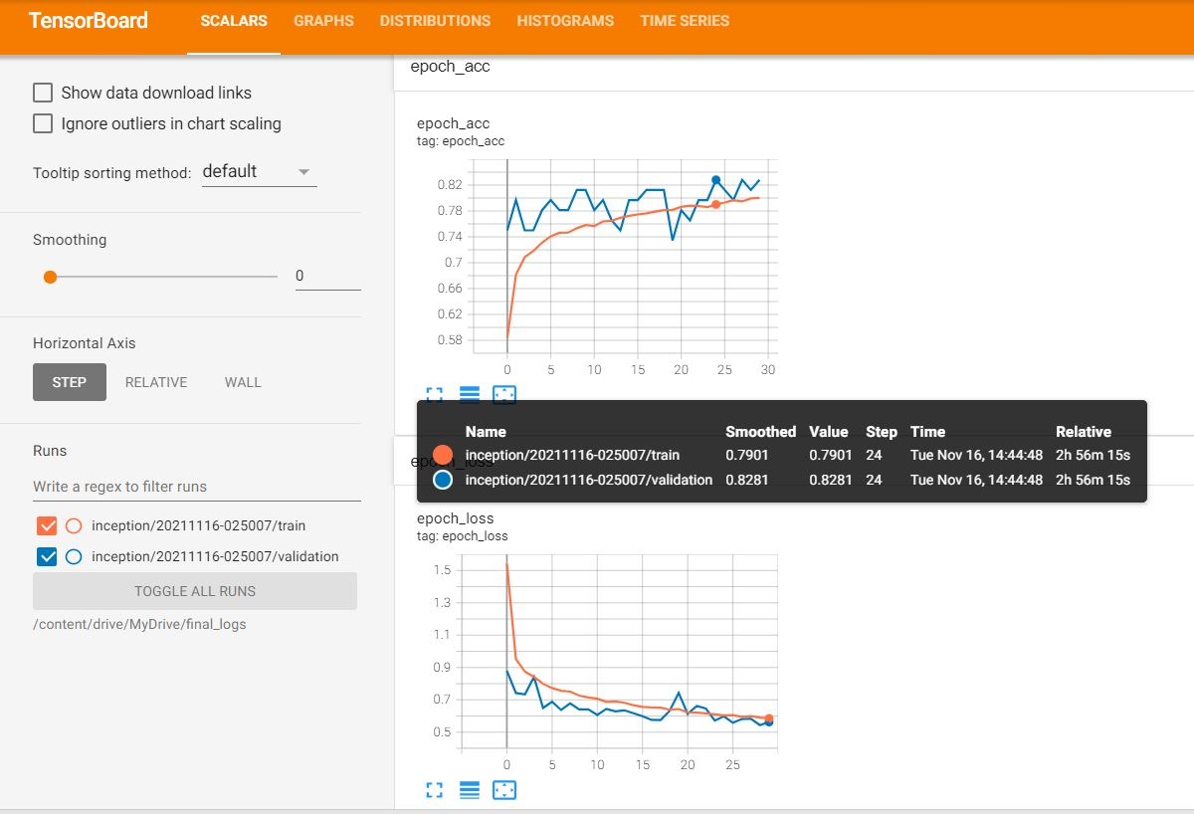
Using InceptionV3 + best hyperparameters
Based on the best set of hyperparameters obtained using the InceptionV3 featuriser, the model was run for 30 epochs based on a 90% train and 10% validation split.

Slide 19
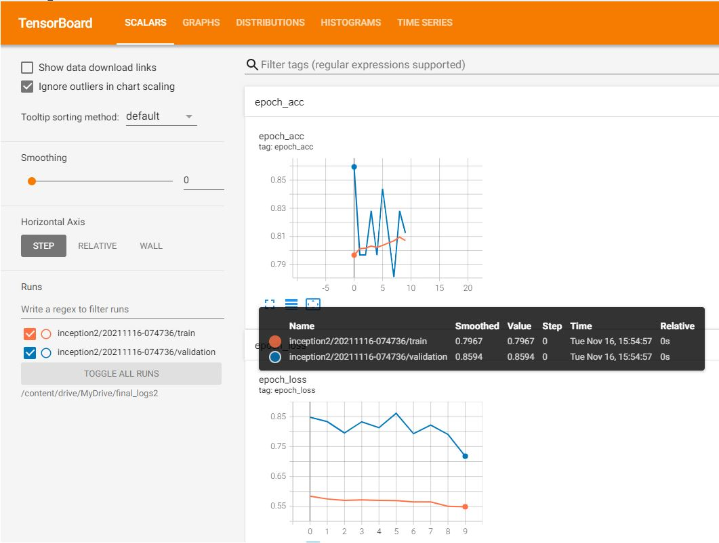
Further fine-tuning - Unfreeze featuriser layers
Fine-tuning was done where the final layers in the InceptionV3 featuriser was unfrozen, and the model was run for another 10 epochs.

Slide 20
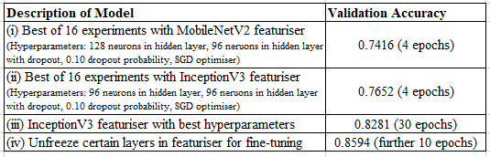
Summary of core results

Slide 21
Conclusion
In conclusion, we have tried experimenting with 2 different image preprocessing and augmentation methods: CLAHE and Otsu’s thresholding on top of the Horizontal Flip, to differentiate the object of interest in each image from its background, though both methods of augmentation have failed to improve the accuracy of the MobileNet model. We realise there were a few actions we could have taken:
Denoise the images before performing the methods
Find methods to preserve RGB information of images while performing the methods

Slide 22
Conclusion
InceptionV3 outperforms MobileNetV2 featuriser
Standard convolution (more parameters) versus depthwise separable convolution.
Possible extension to find a balance between two objectives of maximising accuracy and minimising computation time.
SGD outperforms Adam optimiser
Literature discussing empirical deep learning experiments where in certain settings, Adam generalize poorly compared to SGD.
Possible extension to test unfreezing different featuriser layers
More tests to determine the results of gradually unfreezing layers in fine-tuning and to what degree this improves accuracy.

Slide 23
The End

