Slide 1
Constructs

Slide 2
SCIM Constructs
Resource Creator (RC)
Resource Updater (RU)
Resource Manager (RM)
Resource Subscriber (RS)
Component of the system that create/updates the resources and their attributes
Component of the system that manage multiple Creators and Subscribers, maintaining the latest information on the resources
Component of the system that will consume the information from Resource Manager

Slide 3
SCIM Constructs
Resource Object(RO)
Resource Attribute (RA)
Set of attributes for a specific resource, that can contain attributes from multiple Schemas
Single Attribute for a Resources that is specify in one of the schemas of the Resource

Slide 4
Actions

Slide 5
Action: Action Push
RC / RU / RM
RS
Typically an IdM like Azure, OKTA, Google
HTTP GET /users
Typically an SaaS application like Webex, Zoom, Slack
Response 20X
HTTP POST /users
Response 20X
Server
/users
/groups
Client

Slide 6
Action: Action Pull
RS/RM
RC/RU
Typically Device or an SaaS application like Webex, Zoom, Slack
Typically Device Manager or an IdM like Azure, OKTA, Google
HTTP GET /device
Response 20X
Server
/device
/users
/groups
Client

Slide 7
Action: Active Dynamic Query
RS/RM
RC/RU
Typically Device or an SaaS application like Webex, Zoom, Slack
Typically Device Manager or an IdM like Azure, OKTA, Google
HTTP GET /user?
Response 20X
Server
/device
/users
/groups
Client

Slide 8
Triggers

Slide 9
Trigger : Time
A periodic interval trigger is a configured-in-advance agreement where a SCIM client performs an action at a specific time.

Slide 10
Time-based Active Push
The most common deployments today
SCIM
Server A
State B1
State B2
State B4
active
push
active
push
active
push
active
push
SCIM
Client B
DQ Token
State B1
State B2
State B3
State B4
Client-side
Change
TTS
(time to sync)
TTS
TTS
TTS
Client-side
Reconciliation
Deltas in
change Database

Slide 11
Time-based Active Pull
SCIM
Server A
State A1
State A2
State A3
active
pull
active
pull
active
pull
active
pull
SCIM
Client B
DQ Token
State A1
State A2
State A3
Client-side
Change
TTS
(time to sync)
TTS
TTS
TTS
Client-side
Reconciliation
Deltas in
change Database

Slide 12
Time-based Active Dynamic Query
SCIM
Server A
State A1
State A2
State A3
Initial
active
pull
Delta
active
pull
Delta
active
pull
Delta
active
pull
SCIM
Client B
DQ Token
State A1
State A2
State A3
Client-side
Change
TTS
(time to sync)
TTS
TTS
TTS
Client-side
Reconciliation
Deltas in
change Database

Slide 13
Trigger : Application
Application triggers occur when administrative or end-user interfaces are manipulated.

Slide 14
Triggered Active Push
The most common deployments today
SCIM
Server A
State B1
State B2
State B3
State B4
active
push
active
push
active
push
SCIM
Client B
DQ Token
State B1
State B2
State B3
State B4
Client-side
Change
TTS
TTS
TTS
Client-side
Reconciliation
Deltas in
change Database

Slide 15
Application Active Pull
SCIM
Server A
State A1
State A2
State A3
active
pull
some
trigger
active
pull
some
trigger
SCIM
Client B
DQ Token
State A1
State A2
State A3
Client-side
Change
TTS
(time to sync)
TTS
Client-side
Reconciliation
Deltas in
change Database

Slide 16
Triggered Active Dynamic Query
SCIM
Server A
State A1
State A2
State A3
initial
active
pull
Delta
active
pull
Delta
active
pull
some
trigger
some
trigger
SCIM
Client B
DQ Token
State A1
State A2
State A3
Client-side
Change
TTS
(time to sync)
TTS
(time to sync)
TTS
Client-side
Reconciliation
Deltas in
change Database

Slide 17
Trigger : Events

Slide 18
Event with Domain Replication Mode
SCIM
Server B
State E1
State E2
State E3
Event Operation
Event Operation
Event Operation
Domain Replication Mode
Domain Replication Mode
Domain Replication Mode
Event Operation
Domain Replication Mode
SCIM
Server A
State B1
State B2
State B4
SCIM Operation
SCIM
Client Z
DQ Token
State B1
State B2
State B3
State B4
Client-side
Change
TTS
(time to sync)
TTS
TTS
TTS
Client-side
Reconciliation
Deltas in
change Database

Slide 19
Event with Co-Ordinated Provision
SCIM
Server B
State E1
State E2
State E3
Event Operation
Event Operation
Event Operation
Co-Ordinated Provision
SCIM GET
Co-Ordinated Provision
SCIM GET
Co-Ordinated Provision
SCIM GET
Co-Ordinated Provision
SCIM GET
SCIM
Server A
State B1
State B2
State B4
SCIM Operation
SCIM Operation
SCIM Operation
SCIM Operation
SCIM
Client Z
DQ Token
State B1
State B2
State B3
State B4
Client-side
Change
TTS
(time to sync)
TTS
TTS
TTS
Client-side
Reconciliation
Deltas in
change Database

Slide 20
Trigger : SSO

Slide 21
Triggered Single Sign-On
Single User Flow
SCIM
Server A
State A1
State A2
State A3
SCIM
Push
User
additional
Details
SCIM
Push
User
additional
Details
SCIM
Push
User
additional
Details
First Time SSO with User creation
SSO
With user
details
SSO
With user
details
SCIM
Client B
DQ Token
State A1
State A2
State A3
Client-side
Change
TTS
(time to sync)
TTS
(time to sync)
TTS
(time to sync)
Client-side
Reconciliation
Deltas in
change Database

Slide 22
Use Cases

Slide 23
SCIM Use Case 1
IdM doing CRUD operations on SaaS applications
Resources are CUD (Created/Updated/Delete) in the service of RM, manual, bulk or through the use of proprietary APIs, at this point the Actor is a RC and RM
After CUD in RM System, it will be updated in the different RS, where RM will use push to do CUD in specific time intervals.
RS
.
.
.
RM\RC\RU
RS
SCIM

Slide 24
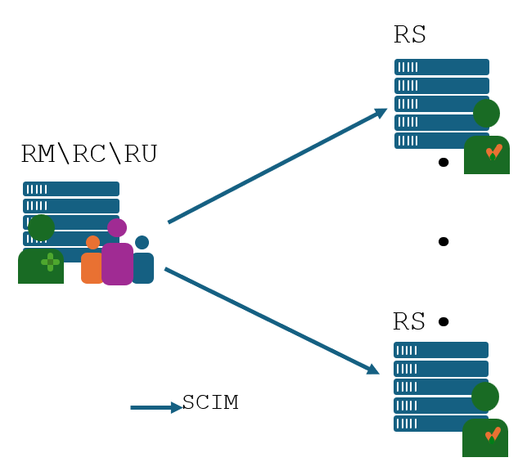


SCIM Use Case 1
IdM doing CRUD operations on SaaS applications
 | Use Case 1
Time-based Active Pull
Time-based Active Dynamic Query
Time-based Active Push
Application Active Pull
Application Active Dynamic Query
Application Active Push
Events with Domain Replication Mode
Events with Co-Ordinated Provision
Single Sign-On

Slide 25
SCIM Use Case 2
IdM doing CRUD operations on SaaS applications, and Objects coming from external non SCIM source
Resources are CUD (Created/Updated/Delete) from an external Identity Engine (typically LDAP source) and add to RM
After CUD in RM system, it will be updated in the different RS, where RM will use push CUD in specific intervals of time.
RC/RU
RS
.
.
.
RM/RC/RU
Other protocols like LDAP
RS
SCIM

Slide 26
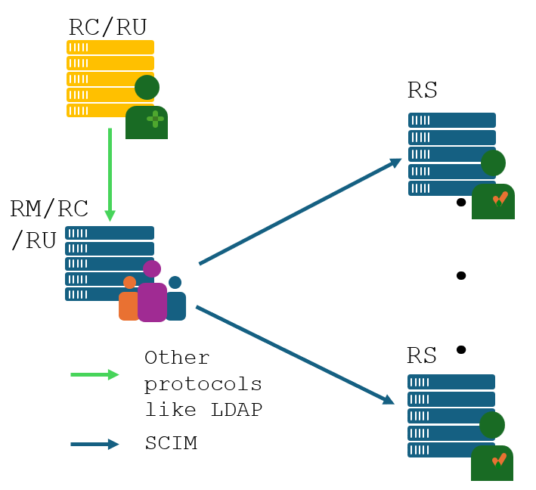
SCIM Use Case 2
IdM doing CRUD operations on SaaS applications, and Objects coming from external non SCIM source
 | Use Case 2
Time-based Active Pull
Time-based Active Dynamic Query
Time-based Active Push
Application Active Pull
Application Active Dynamic Query
Application Active Push
Events with Domain Replication Mode
Events with Co-Ordinated Provision
Single Sign-On

Slide 27
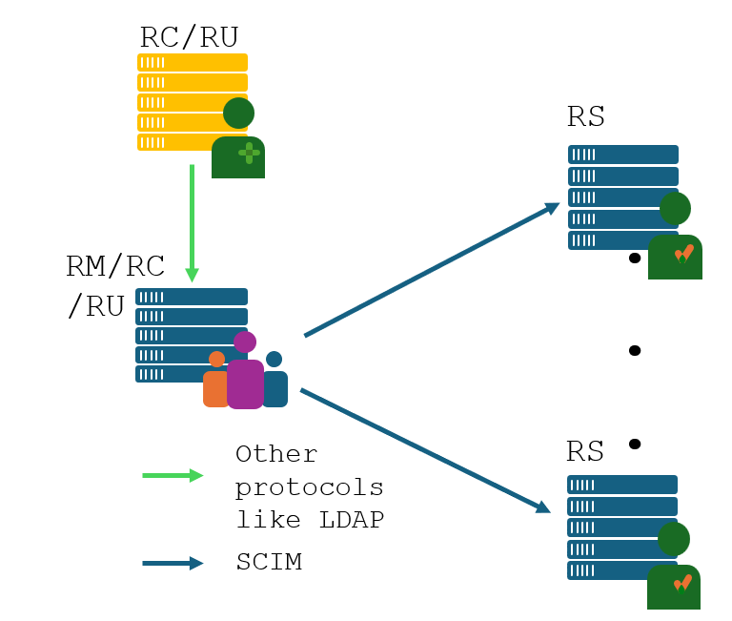
SCIM Use Case 2
IdM doing CRUD operations on SaaS applications, and Objects coming from external non SCIM source
SaaS App
SCIM Server
State B1
State B2
State B4
active
push
active
push
active
push
active
push
IDM
SCIM Client
State B1
State B2
State B3
State B4
DQ Token
Non SCIM
update
Non SCIM
update
Non SCIM
update
Client-side
Change
Legacy IdM
State T1
State T2
State T3
Client-side
Reconciliation
TTS
(time to sync)
TTS
TTS
TTS
Deltas in
change Database

Slide 28
SCIM Use Cases 3
IdM doing CRUD operations on SaaS applications, and Objects coming from external SCIM source
Resources are CUD (Created/Updated/Delete) from an RC (typically an HR applications) to the RM
After CUD in RM system, it will be updated in the different RS, where RM will use push to CUD in specific intervals of time.
RS
.
.
.
RC/RU
RM/RC/RU
RS
SCIM

Slide 29
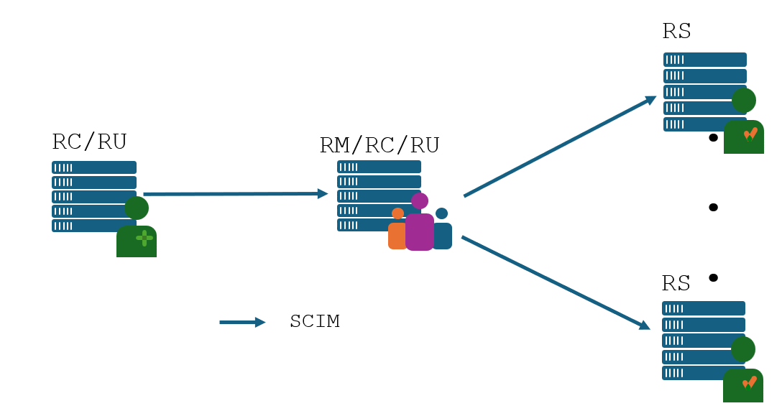
SCIM Use Cases 3
IdM doing CRUD operations on SaaS applications, and Objects coming from external SCIM source
 | Use Case 3.1 | Use Case 3.2
Time-based Active Pull
Time-based Active Dynamic Query
Time-based Active Push
Application Active Pull
Application Active Dynamic Query
Application Active Push
Events with Domain Replication Mode
Events with Co-Ordinated Provision
Single Sign-On

Slide 30
SCIM Use Cases 3.1
IdM doing CRUD operations on SaaS applications, and Objects coming from external SCIM source
SaaS App
SCIM Server
State B1
State B2
State B4
active
push
active
push
active
push
active
push
IDaaS
SCIM Client
SCIM Server
State B1
State B2
State B3
State B4
DQ Token
active
push
active
push
active
push
Client-side
Change
HR App
SCIM Client
State H1
State H2
State H3
Client-side
Reconciliation
TTS
(time to sync)
TTS
TTS
TTS
Deltas in
change Database

Slide 31
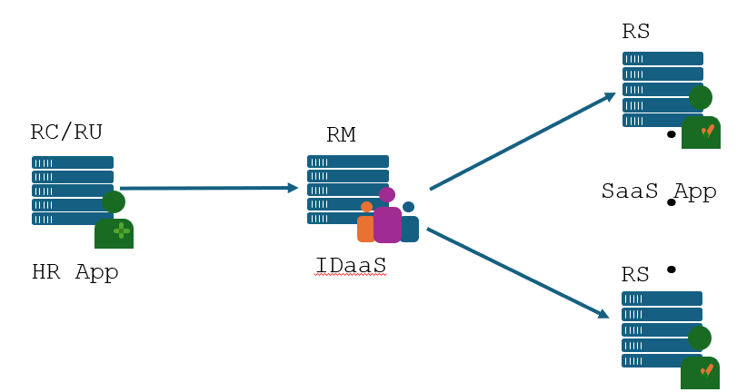
SCIM Use Cases 3.2
IdM doing CRUD operations on SaaS applications, and Objects coming from external SCIM source
SaaS App
SCIM Server
State B1
State B2
State B3
State B4
active
push
active
push
active
push
active
push
IDaaS
SCIM Client
State B1
State B2
State B3
State B4
DQ Token
Initial
active
pull
Client-side
Change
active
pull
active
pull
HR App
SCIM Server
State H1
State H2
State H3
Client-side
Reconciliation
TTS
(time to sync)
TTS
TTS
TTS
Deltas in
change Database

Slide 32
SCIM Use Cases 4
IdM doing CRUD operations on SaaS applications, and Objects coming from external SCIM and non SCIM sources including the IdM itself, where some object attributes come from SaaS application, and are updated in the SCIM object creator
Resources are CUD (Created/Updated/Delete)from an RC
or from external Identity engine but can also be done locally in the RM.
After CUD in RM system, it will be updated in the different RS, where RM will use push CUD in specific intervals of time.
Attributes that might not be originated in the RC, might need to be CUD in the RC (typically the HR application)
RC/RU/RS
RM/RC/RU/RS
.
.
.
RC/RU/RS
RC/RU/RS
Other protocols like LDAP
SCIM

Slide 33
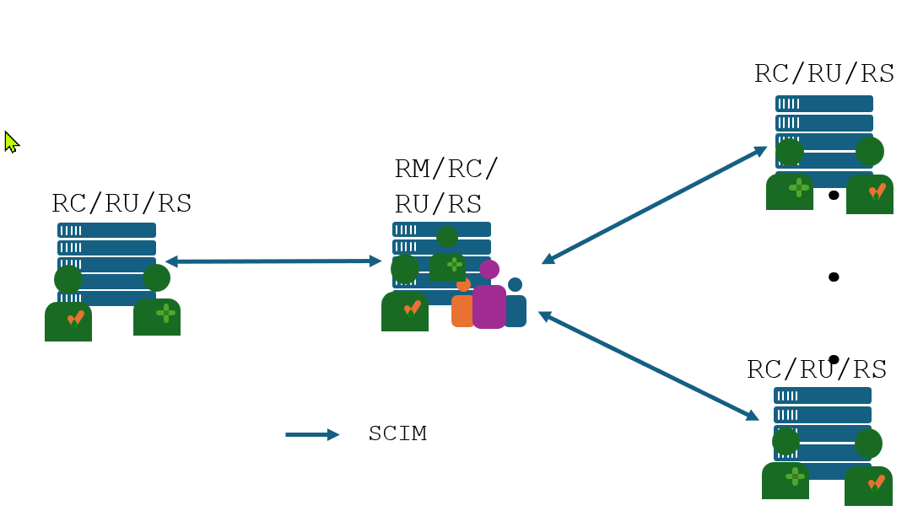
SCIM Use Cases 4
IdM doing CRUD operations on SaaS applications, and Objects coming from external SCIM and non SCIM sources including the IdM itself, where some object attributes come from SaaS application, and are updated in the SCIM object creator
 | Use Case 4.1 | Use Case 4.2
Time-based Active Pull
Time-based Active Dynamic Query
Time-based Active Push
Application Active Pull
Application Active Dynamic Query
Application Active Push
Events with Domain Replication Mode
Events with Co-Ordinated Provision
Single Sign-On

Slide 34
SCIM Use Cases 4.1
IdM doing CRUD operations on SaaS applications, and Objects coming from external SCIM and non SCIM sources including the IdM itself, where some object attributes come from SaaS application, and are updated in the SCIM object creator
{"schemas":["urn:ietf:params:scim:schemas:core:2.0:User", "urn:ietf:params:scim:schemas:extension:enterprise:2.0:User"],
"userName": "paucorre@xpto.com",
"name":{
"givenName":"Paulo Jorge",
"familyName":"Correia"
},
"displayName": "Paulo Jorge Correia“
"emails": [
{
"type": "work",
"value": "paucorre@identitylab10.ciscolabs.com"
}
],
"phoneNumbers":[
{
"value": "+351211234567",
"type": "work"
},
]
}
{"schemas":["urn:ietf:params:scim:schemas:core:2.0:User", "urn:ietf:params:scim:schemas:extension:enterprise:2.0:User"],
"userName": "paucorre@xpto.com",
"name":{
"givenName":"Paulo Jorge",
"familyName":"Correia"
},
"displayName": "Paulo Jorge Correia“
"emails": [
{
"type": "work",
"value": "paucorre@identitylab10.ciscolabs.com"
}
],
"phoneNumbers":[
{
"value": "+351211234567",
"type": "work"
},
]
}
RC/RU/RS
SCIM Client
(phoneNumber Attribute)
SCIM Server
SCIM Server
RM/RC/RU/RS
SCIM Active Push
{"schemas":["urn:ietf:params:scim:schemas:core:2.0:User", "urn:ietf:params:scim:schemas:extension:enterprise:2.0:User"],
"userName": "paucorre@xpto.com",
"name":{
"givenName":"Paulo Jorge",
"familyName":"Correia"
},
"displayName": "Paulo Jorge Correia“
"emails": [
{
"type": "work",
"value": "paucorre@identitylab10.ciscolabs.com"
}
],
"phoneNumbers":[
{
"value": "+351211234567",
"type": "work"
},
]
}
SCIM Client
SCIM Client
SCIM Server
RC/RU/RS
SCIM Active Push
SCIM Server
SCIM Client
(name and deisplayName Attribute)

Slide 35
SCIM Use Cases 4.2
IdM doing CRUD operations on SaaS applications, and Objects coming from external SCIM and non SCIM sources including the IdM itself, where some object attributes come from SaaS application, and are updated in the SCIM object creator
{"schemas":["urn:ietf:params:scim:schemas:core:2.0:User", "urn:ietf:params:scim:schemas:extension:enterprise:2.0:User"],
"userName": "paucorre@xpto.com",
"name":{
"givenName":"Paulo Jorge",
"familyName":"Correia"
},
"displayName": "Paulo Jorge Correia“
"emails": [
{
"type": "work",
"value": "paucorre@identitylab10.ciscolabs.com"
}
],
"phoneNumbers":[
{
"value": "+351211234567",
"type": "work"
},
]
}
{"schemas":["urn:ietf:params:scim:schemas:core:2.0:User", "urn:ietf:params:scim:schemas:extension:enterprise:2.0:User"],
"userName": "paucorre@xpto.com",
"name":{
"givenName":"Paulo Jorge",
"familyName":"Correia"
},
"displayName": "Paulo Jorge Correia“
"emails": [
{
"type": "work",
"value": "paucorre@identitylab10.ciscolabs.com"
}
],
"phoneNumbers":[
{
"value": "+351211234567",
"type": "work"
},
]
}
SCIM Server
RC/RU/RS
SCIM Active Dynamic Query
SCIM Client
RM/RC/RU/RS
SCIM Active Push
{"schemas":["urn:ietf:params:scim:schemas:core:2.0:User", "urn:ietf:params:scim:schemas:extension:enterprise:2.0:User"],
"userName": "paucorre@xpto.com",
"name":{
"givenName":"Paulo Jorge",
"familyName":"Correia"
},
"displayName": "Paulo Jorge Correia“
"emails": [
{
"type": "work",
"value": "paucorre@identitylab10.ciscolabs.com"
}
],
"phoneNumbers":[
{
"value": "+351211234567",
"type": "work"
},
]
}
SCIM Active Dynamic Query
SCIM Server
RC/RU/RS
SCIM Active Push

Slide 36
SCIM Use Cases 5
Multiple IdM doing CRUD operations on SaaS applications, and Objects coming from external SCIM and non SCIM sources including the IdM itself, where some object attributes come from SaaS application, and are updated in the SCIM object creator
Multiple Resource Managers, where the information from the RO/RA is consolidated across different domains/services.
RC/RU/RS
RC/RU/RS
RM/RC/RU/RS
.
.
.
RC/RS
RM/RC/RU/RS
RC/RU/RS
Other protocols like LDAP
SCIM

Slide 37
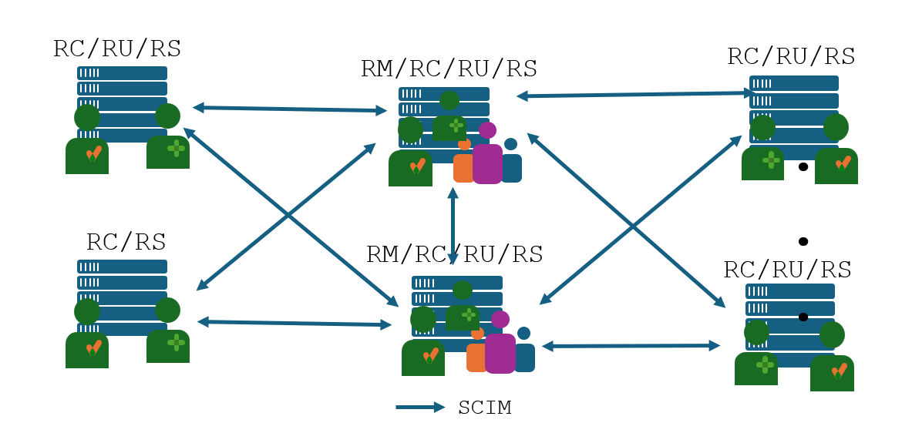
SCIM Use Cases 5
Multiple IdM doing CRUD operations on SaaS applications, and Objects coming from external SCIM and non SCIM sources including the IdM itself, where some object attributes come from SaaS application, and are updated in the SCIM object creator
 | Use Case 5
Time-based Active Pull
Time-based Active Dynamic Query
Time-based Active Push
Application Active Pull
Application Active Dynamic Query
Application Active Push
Events with Domain Replication Mode
Events with Co-Ordinated Provision
Single Sign-On

Slide 38
SCIM Use Cases 6
Get information of one or more objects
A management platform pull of one or more objects.
RS/RM
RC/RU
Typically a Device/Service
HTTP GET /device
Response 20X
Server
/device
Client
Typically a Management Platform
Typically client pull server details for RO Creation/Update

Slide 39
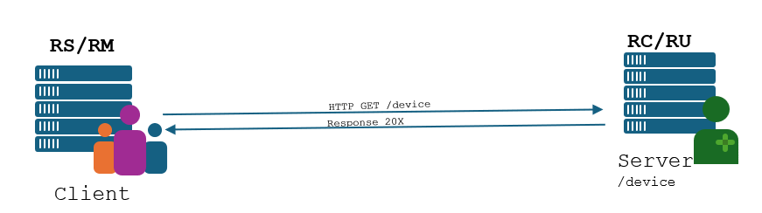
SCIM Use Cases 6
Get information of one or more objects
A management platform pull of one or more objects.
 | Use Case 6.1 | Use Case 6.2
Time-based Active Pull
Time-based Active Dynamic Query
Time-based Active Push
Application Active Pull
Application Active Dynamic Query
Application Active Push
Events with Domain Replication Mode
Events with Co-Ordinated Provision
Single Sign-On

Slide 40
SCIM Use Cases 6.1
Get information from a specific a device
A device management platform pull a single resource object from a Device.
RS/RM
RC/RU
Typically a Device
HTTP GET /device
Response 20X
Server
/device
Client
Typically a Device Manager
Typically client pull server details for RO Creation/Update

Slide 41
SCIM Use Cases 6.1 Device Draft Use Case
Get information from a specific a device
A device management platform pull a single resource object from a Device.
Device A
SCIM client for GE medical established at Mass Gen
GE posts to Mass Gen – creates device object
Identifier, schema is filled
Or
Administrator scans code on device B
Uses entitled app to push the Device data into the SCIM server
App is a SCIM Client and RC
RS
Control
Function
Device B
Server
/device
HTTP PUT /device
Admin – Mass General with Client Software
Response 20X
Mass General
RC
RS
HTTP GET /device
Device
Response 20X
Client
Server
/device
Device
Medical Supplier
(eg selling devices)
Typically client pull server details for RO Creation/Update

Slide 42
SCIM Use Cases 6.2
Get multiple records from a service
A Cloud Directory Service does synchronization of all the objects from multiple Contacts services, the reply is paginated.
RS/RM
RC/RU
Typically a Service
HTTP GET /contacts
Response 20X
Server
/Directory
Client
Typically a Cloud Directory Service
Typically client pull all records from a service

Slide 43
SCIM Use Cases 7
Reconciliation
For some reason, the RO and its RA’s that was push by the Client was change in the Server (by some mechanism that was outside the SCIM agreement), which means that until the RO or one of its RA’s changes in the Client, there will be no “fix” to the RO and its RA that are in the Server.
RM\RC\RU
RS

Slide 44
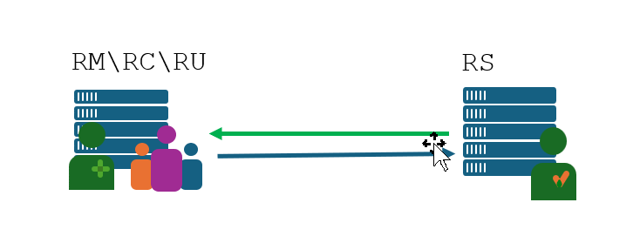
SCIM Use Cases 7
Reconciliation
 | Use Case 4.1 | Use Case 4.2
Time-based Active Pull
Time-based Active Dynamic Query
Time-based Active Push
Application Active Pull
Application Active Dynamic Query
Application Active Push
Events with Domain Replication Mode
Events with Co-Ordinated Provision
Single Sign-On

Slide 45
SCIM Use Cases 7.1
Reconciliation
Both services will have both roles of SCIM Client and Server and if something changes in their own changes local database, in the next trigger they will get in sync again.
RM\RC\RU
RS
SCIM Server
SCIM Client
IdM
SaaS Application
SCIM Client
SCIM Server

Slide 46
SCIM Use Cases 7.2
Reconciliation
Both services will have both roles of SCIM Client and Server and if something changes in their own changes local database, in the next trigger they will get in sync again.
RM\RC\RU
SCIM Active Dynamic Query
RS
IdM
SaaS Application
SCIM Active Push
SCIM Client
SCIM Server

Slide 47
SCIM Use Cases 8.1
SCIM Events
Both services will have both roles of SCIM Client and Server and if something changes in their own changes local database, in the next trigger they will get in sync again.
RM\RC\RU
RS
SCIM Server
SCIM Client
IdM
SaaS Application
SCIM Client
SCIM Server

Slide 48
Business Use Case
Lookup from Authoritative (Elliot)
Many RS
One RC
Active pull
Not a full pull

Slide 49
SCIM support: Multitenant Enterprise SaaS App Per-tenant infrastructure to consume user data from authoritative sources
Implementer
Business requirement:
Each tenant must rely on a separately credentialled remote corporate data store
Data must facilitate SSO
Users, groups, roles
Deployment Pattern
Resource Subscriber
SCIM Server
Per-tenant SCIM configuration
Common attribute mapping
Source A
SCIM Actions
Tenant A
Source B
SCIM Actions
Tenant B
Source C
SCIM Actions
Tenant C

Slide 50
Enterprise Last Mile App Integration Single integration fetching user data from a central authoritative source
Implementer
Business requirement:
Reliance: one source
Sophistication: low
Population: small
A central IAM pushes only needed users/groups
Could be a library or proxy
Recommended: Client Active Pull
Internal App A
SCIM Actions
Source A
SCIM Actions
Internal App B
SCIM Actions
Internal App C

Slide 51
Partner Device Registry Manufacturer details pushed to customers at time of device transfer
Spec: Device Flow
Business requirement:
Reliance: one source
Sophistication: low
Population: small
A central IAM pushes only needed users/groups
Manufacturer
Customer A
SCIM
Server A
Client Active Push
Customer B
SCIM Client
Client Active
Push
SCIM Server B
Client Active
Push
Customer C
SCIM Server C

Slide 52
Multi-tenant IAM Provisioning Platform
Platform
Data flowing to and from the platform using SCIM and non-scim integrations
Platform decides what combinations of push/pull is supported
HR System X
Graph API etc
SCIM Client
Saas App J
Homegrown
Non-SCIM
SCIM
Server
Client Active Push
HR System Y
SCIM Client
SCIM Client
SaaS App J
Client Active
Push
SCIM Server
SCIM Server
Client Active
Pull
HR System X
Customer B
SCIM Server
SCIM Client
Customer C
Client Active
Push
SCIM Server C
SCIM Client
Client Active
Push

Slide 53
SCIM Events
Provisioning Domain A
Provisioning Domain B
SCIM data can be aggregated, sorted, routed
Uses SSF pub/sub mechanism instead of REST
SCIM Server A
SCIM Entity X
SCIM Actions
SCIM Actions
Shared
Signals
Framework
Transmitter
Shared
Signals
Framework
Receiver
SCIM Server B
SCIM Entity Y
SCIM Actions
SCIM Actions
SCIM Server C
SCIM Entity Z

Slide 54
Inline Reconciliation & Remediation
Data in every fetch is checked for accuracy, errors
Remediation is… ?
SCIM Server
initial
fetch
delta
fetch
delta
fetch
SCIM Client
reconcile
reconcile
reconcile
time

Slide 55
Out-of-line Reconciliation Syncing/Reconciliation/Assessing Risk
SCIM Server
initial
fetch
delta
fetch
delta
fetch
initial
fetch
SCIM Client
reconcile
reconcile

