Slide 1
Kinase networks and pathways
Interpretation guide

Slide 2
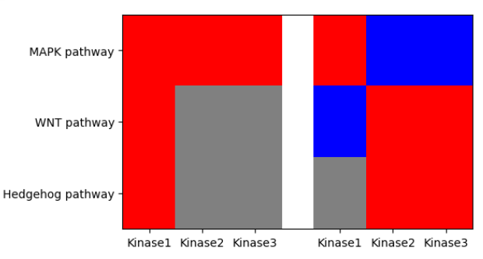
Quick start
How are networks generated?
In the network, each cluster of nodes is annotated with pathways by EnrichR, using the Reactome db.
Networks are generated from high scoring* kinases. Networks connect key kinases through high-confidence links and may include high confidence connector (hidden) nodes which are not in the data.
Sensitive – T vs C
Resistant – T vs C
Kinase node
Hidden node
Files:
Network.html: an interactive network figure which shows the Kinase Statistic (LogFC) and the pathways. Nodes and pathways are searchable. Networks help to understand kinases relationships.
Files:
Kinase_pathway_heatmaps folder: start exploring pathways with these figures to assess the change in the pathways across comparisons.
*Params.csv: shows how the data was pre-filtered. spec_cutoff is the threshold for specificity score. perc_cutoffs are the threshold(s) for percentile, which is usually 0.01 (shown at the end of the filename as _p01) so everything is used above the specificity cutoff.

Slide 3
Network generation enhances UKA results
INPUTS:
STRING as reference network;
selected nodes from UKA
RESULT:
“OPTIMAL” SUBNETWORK
7
6
6
Generating networks enhances robustness of UKA results:
pruning weakly connected or low-fold-change nodes (probably FP)
and recovering missing connections through hidden nodes (probably FN).
5
4
3
PCSF
algorithm
1
2
Based on (Arici & Tuncbag, 2021)
Key kinases & high-confidence links
Less FP (false positive – weakly connected)
Less FN (false negative, hidden nodes)
Nodes
Input nodes (size ~ LFC)
Hidden nodes
The Prize-Collecting Steiner Forest (PCSF) algorithm, given the reference network and input nodes, constructs a subnetwork through optimizing to:
include more input nodes with high prize (prize = absolute LFC)
Decrease edge costs (low cost ~ high evidence).
High evidence edge
Low evidence edge
Notes:
Networks are generated using the Prize-Collecting Steiner Forest (PCSF) algorithm with the STRING database as reference network. STRING contains weighted edges based on interaction evidence (weak evidence: higher cost of edge).
The algorithm, given the reference network and input nodes, constructs an optimal subnetwork. This is done by balancing node inclusion and edge costs. Node inclusion is decided using the absolute fold change (“prize”: higher abs fold change = more important node). The resulting network connects key kinases through high-confidence links and may add high confidence connector nodes which are not in the data (“Steiner” or „Hidden” nodes).
This approach enhances robustness by pruning weakly connected or low-fold-change nodes (probably false positives) and recovering missing connections through hidden nodes (probably false negatives).

Slide 4
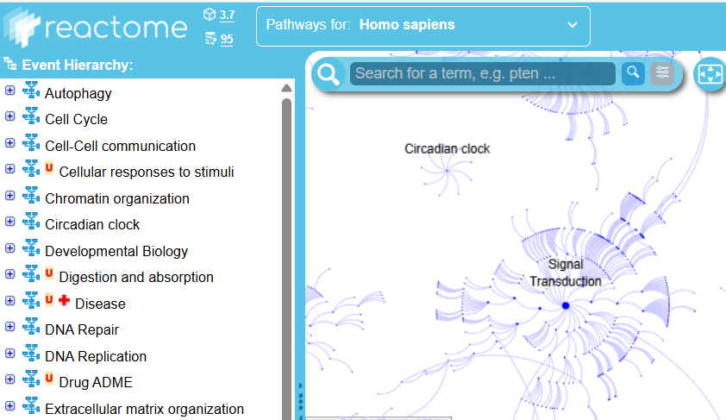
How to select most relevant pathways?
Use the Pathways_<T vs C>.csv:
Every pathway belongs to a Reactome pathway group (e.g. AKT signaling is under Signal Transduction).
These columns can help to identify relevant pathways:
N_hits, pathway_size, overlap columns show how many pathway members are in the data. (e.g. n_hits = 3, pathway_size = 10 means 3 kinases from the results are found in a pathway of 10 members).
Hierarchy_n column: shows the hierarchy level (e.g. Signal Transduction is level 1). Top levels are generic, bottom levels are specific. Middle levels might be the most interesting.
The Pathways_<T vs C>.csv file lists the selected pathways for each gene cluster (column Genes). However, additional pathways may also be annotated to the same gene cluster. In this file, the pathway chosen is the highest in the hierarchy (i.e., the most general). If a pathway is irrelevant, use Pathways_<T vs C>_all.csv to check whether there is another, more relevant pathway for the same gene cluster.

Slide 5
How to select most relevant pathways?
Which are the most relevant pathways?
There is no simple metric. Pathways usually share members, and a pathway that is relevant in one model may be irrelevant in another. In addition, statistical tests do not consider how specific members are to a pathway. As a result, a pathway may receive a strong p-value even if only non-specific members are detected.
Therefore, we recommend assessing pathway relevance using biological domain knowledge rather than relying on p-values or combined scores.

Slide 6
Other network files
Nodes.csv: list of all kinase and hidden nodes in the network
Nodes_clusters: Network clusters.
Missing nodes.csv: kinases that passed the thresholds but are not in the network because they are weakly connected / low fold change. Might be false positives.
Nodes with pathways.csv: nodes to pathways mapping
Folders with the files of the network html (don’t delete it)

Slide 7
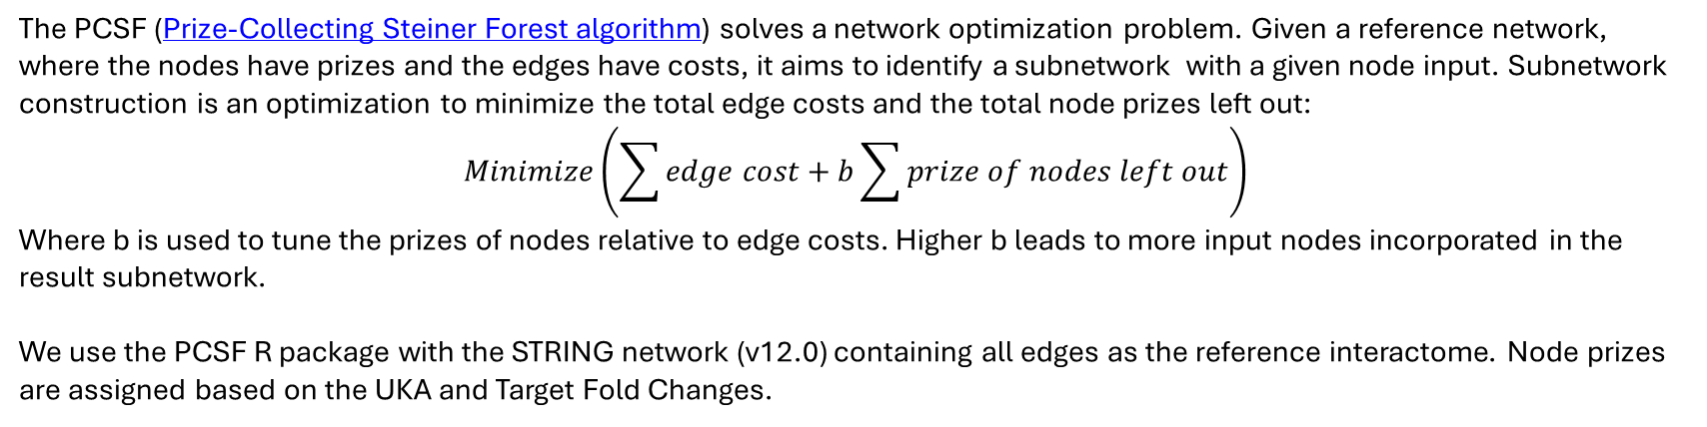
PCSF in details
The PCSF (Prize-Collecting Steiner Forest algorithm) solves a network optimization problem. Given a reference network, where the nodes have prizes and the edges have costs, it aims to identify a subnetwork with a given node input. Subnetwork construction is an optimization to minimize the total edge costs and the total node prizes left out:
$$Minimize\left(\sum{edge cost}+b\sum{prize of nodes left out}\right)$$
Where b is used to tune the prizes of nodes relative to edge costs. Higher b leads to more input nodes incorporated in the result subnetwork.
We use the PCSF R package with the STRING network (v12.0) containing all edges as the reference interactome. Node prizes are assigned based on the UKA and Target Fold Changes.

Slide 8
Evidence channels of STRING
Evidence Channel | Type | Reliability | Key Strength
Experimental | Direct | 🥇 Highest | Proof of direct physical or genetic interaction.
Curated Databases | Direct | 🥇 Very High | Expert-validated functional association in pathways/complexes.
Gene Fusion | Genomic | 🥈 High | Strong evolutionary evidence for functional interaction.
Gene Neighborhood | Genomic | 🥈 High (Prok) / Low (Euk) | Evidence for operons and co-regulation (mainly in bacteria).
Gene Co-occurrence | Genomic | 🥈 Medium-High | Evidence for participation in the same pathway/system.
Co-expression | Functional | 🥈 Medium | Strong evidence for co-regulation and functional association.
Text mining | Literature | 🥉 Lower | High-level associative

