Slide 1
Auto report file naming

Slide 2
QC
Tercen
Use CV_export_app to export the table
Filename structure:
QC_PTK.csv
File type. Should be QC.
Assay type. Options: PTK or STK

Slide 3
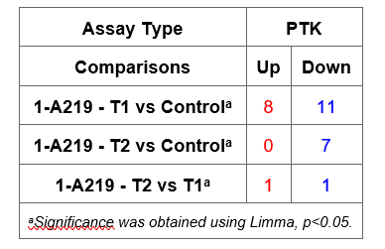
Phosphosite Analysis (Limma)
Tercen
Running a stats app in Tercen will automatically export the table needed for reporting. Rename this file.
PTK and STK files have to contain the exact same supergroup name!
Filename structure:
Output:
Limma_PTK_01_Supergroup.csv
Stats type: Limma
Assay type. Options: PTK or STK
Order, defines ordering in report.
Supergroup: the name of the supergroup factor.
NOT the name of the supergroup! This is NOT displayed in Table 1.
Must be unique. E.g. Supergroup or Test condition.
Both supergroup names and comparisons come from the file.

Slide 4
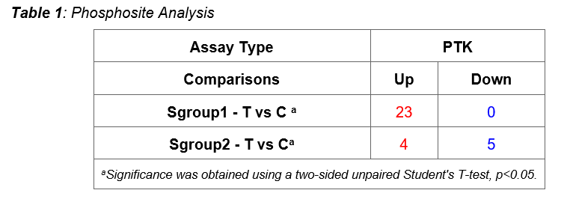
Phosphosite Analysis (T-Test supergroup)
Tercen
Running a stats app in Tercen will automatically export the table needed for reporting. Rename this file.
PTK and STK files have to contain the exact same supergroup name!
Filename structure:
TT_PTK_01_T vs C.csv
Output:
Stats type: TT
Assay type. Options: PTK or STK
Order, defines ordering in report.
Comparison, e.g. T vs C.
Comparison is displayed in Table 1.
Supergroups come from the file.

Slide 5
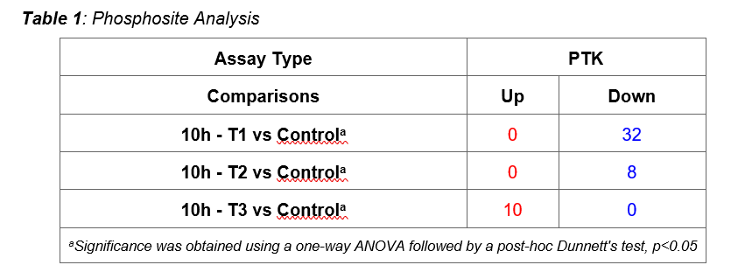
Phosphosite Analysis MTvC
Tercen
MTvC filenames need to be different if you want to include multiple MTvC files in one report
Running a stats app in Tercen will automatically export the table needed for reporting. Rename this file.
Filename structure:
MTvC_PTK_01_10h.csv
Output:
Stats type: MTvC
Assay type. Options: PTK or STK
Order, defines ordering in table.
Name of Supergroup. E.g., timepoint, cell line.
This is displayed in Table 1.
Comparisons come from the file.

Slide 6
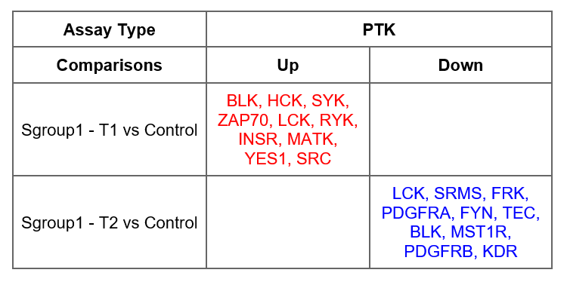
Kinase Analysis (UKA all vs all comparison)
Tercen
UKA_PTK_01_Supergroup.csv
Output:
Stats type: UKA
Assay type. Options: PTK or STK
Order, defines ordering in report.
Supergroup: the name of the supergroup factor.
This is NOT displayed in Table 2.
Must be unique. E.g. Supergroup or Test condition.
Both supergroup names and comparisons come from the file (from Sgroup_contrast column).

Slide 7
Kinase Analysis (UKA_MTvC, UKA_TGC app)
Tercen
UKA MTvC filename structure:
UKA TGC filename structure:
UKA_PTK_01_ukam-Sgroup1 vs C.csv
UKA_PTK_01_ukat-T vs C.csv
Autoreport generates „old” data format with these names:
UKA_PTK_01_Sgroup1 – T vs C.csv
UKA_PTK_02_Sgroup2 – T vs C.csv
UKA_PTK_01_Sgroup1 - T1 vs C.csv
UKA_PTK_02_Sgroup1 - T2 vs C.csv
File type: UKA
Assay type (PTK or STK)
UKA_PTK_01_ukat-Sgroup2 vs Sgroup1.csv
Order. Defines ordering in table.
Uka types (ukam or ukat)
UKA_PTK_01_Control - Sgroup2 vs Sgroup1.csv
UKA_PTK_02_Test - Sgroup2 vs Sgroup1.csv
Supergroup. If you don’t have supergroup, give it a neutral name, e.g. Test
Comparison. In format XvsY or X vs Y.
Comes from the file/Test Condition, not from the filename.

Slide 8
Kinase Analysis (UKA 2022 shiny app)
Tercen
Export report summary from UKA
Filename structure:
UKA_PTK_01_T1vsT2.csv
File type: UKA
Assay type. Options: PTK or STK
Order. Defines ordering in table.
Comparison. In format XvsY or X vs Y.

Slide 9
Phosphosite Analysis (single MTvC or TT) deprecated!
Tercen
Running a stats app in Tercen will automatically export the table needed for reporting. Rename this file.
Filename structure:
MTvC_PTK.csv
Stats type. Options: MTvC or TT
Assay type. Options: PTK or STK
Order, only for TT. Defines ordering in table.
Comparison, only for TT. In format XvsY or X vs Y.

Slide 10
QC
BioNavigator
Export flat file from BioNavigator after log2 transformation
Array factors: Barcode, Array, and Test condition
Spot factor: ID
Quantitation type: S100-logTransformed
Filename structure:
QC_PTK.txt
File type. Should be QC.
Assay type. Options: PTK or STK

Slide 11
Phosphosite Analysis (T-Test supergroup)
BioNavigator
Take tab-delimited text files from BioNavigator of LogFC and P values from the DataExports folder
PTK and STK files have to contain the exact same supergroup name!
Filename structure:
TT_PTK_01_Group_LogFC.txt
Stats type. Options: MTvC or TT
Assay type. Options: PTK or STK
Order, only for TT. Defines ordering in report.
Group, defines the name of the supergroup. Must be unique. Comparisons come from annotation.
File type. Options: LogFC.txt or p.txt

Slide 12
Phosphosite Analysis multiple MTvCs
BioNavigator
MTvC filenames need to be different if you want to include multiple MTvC files in one report
Take tab-delimited text files from BioNavigator of LogFC and P values from the DataExports folder
Filename structure:
MTvC_PTK_01_10h_LogFC.txt
Stats type. Options: MTvC
Assay type. Options: PTK or STK
Order, only for TT. Defines ordering in table.
Group name, indicates the type of MTvC. E.g., timepoint, cell line.
File type. Options: LogFC.txt or p.txt

Slide 13
Kinase Analysis
BioNavigator
Export report summary from UKA
Filename structure:
UKA_PTK_01_T1vsT2.txt
File type: UKA
Assay type. Options: PTK or STK
Order. Defines ordering in table.
Comparison. In format XvsY or X vs Y.

Slide 14
Phosphosite Analysis (single MTvC or TT) deprecated!
BioNavigator
Take tab-delimited text files from BioNavigator of LogFC and P values from the DataExports folder
Filename structure:
MTvC_PTK_LogFC.txt
Stats type. Options: MTvC or TT
Assay type. Options: PTK or STK
Order, only for TT. Defines ordering in table.
Comparison, only for TT. In format XvsY or X vs Y.
File type. Options: LogFC.txt or p.txt

