Slide 1


ETL Project
Homes, Living Expenses and Salary Across the Country

Slide 2
Frame
Why’s
Sources (CSV)
Tools
Relatable information
Conflict avoidance
Security
Measurement
WorldPopulationReview.com
DataUsa.io
Pandas
DBD
PostgreSQL
Notes:
Relatable information → could be used to set personal finance and career goals
Conflict avoidance → API vs CSV
Security → API key exposure while sharing work
Measurement → per state

Slide 3
Data Relationship
World Population Review
Median household income
DataUsa.io
Median home prices
Cost of living index
CSV

Slide 4
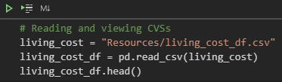


Extraction
Pandas

Slide 5
Extraction (cont.)
WorldPopulationReview | DataUsa
50 states | 52 states (PR, DC)
2021 | 2013-2018
Notes:
Conflicts between data extracted in 2 sources

Slide 6
Transforming
States (Pandas) | income_df = income_df.loc[(income_df['State'] != 'Puerto Rico') & (income_df['State'] != 'District of Columbia')]
Years (Pandas) | income_df = income_df.loc[(income_df['Year'] >= 2018) & (income_df['Race'] == 'Total')]
Columns (Pandas) | living_cost_df = living_cost_df.drop(columns = ['groceryCost','housingCost','utilitiesCost','transportationCost','miscCost’]) homes_df.set_index("state", inplace=True)
Labels (Pandas) | income_df = income_df.rename(columns={'State':'state', 'Household Income by Race':'income'})
Merging (PostgreSQL) | SELECT homes_df.*, living_cost_df.cost_index, income_df.income FROM homes_df INNER JOIN living_cost_df ON homes_df.state = living_cost_df.state INNER JOIN income_df ON income_df.state = living_cost_df.state;
Notes:
States → Using “locate” and “not equals to” to exclude
Years → doing the opposite of the above to only include 2018 (latest year) and “total” for race
Columns → dropped unnecessary and set the state as the index
Labels → renamed columns
Merging → **selected specific columns from each table to avoid repeting columns and joined** in PostgreSQL

Slide 7
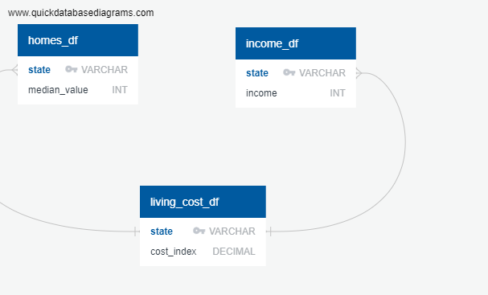
Loading
CREATE TABLE "homes_df" (
"state" VARCHAR NOT NULL,
"median_value" INT NOT NULL,
CONSTRAINT "pk_homes_df" PRIMARY KEY (
"state"
)
);
CREATE TABLE "income_df" (
"state" VARCHAR NOT NULL,
"income" INT NOT NULL,
CONSTRAINT "pk_income_df" PRIMARY KEY (
"state"
)
);
CREATE TABLE "living_cost_df" (
"state" VARCHAR NOT NULL,
"cost_index" DECIMAL NOT NULL,
CONSTRAINT "pk_living_cost_df" PRIMARY KEY (
"state"
)
);
ALTER TABLE "homes_df" ADD CONSTRAINT "fk_homes_df_state" FOREIGN KEY("state")
REFERENCES "living_cost_df" ("state");
ALTER TABLE "income_df" ADD CONSTRAINT "fk_income_df_state" FOREIGN KEY("state")
REFERENCES "living_cost_df" ("state");
DBD
Notes:
Creating schema through DBD

Slide 8
Loading (cont.)
Pandas
connection_string = “username:password@localhost:5432/project"
engine = create_engine(f'postgresql://{connection_string}')
engine.table_names()
living_cost_df.to_sql(name='living_cost_df', con=engine, if_exists=‘replace', index=True)
homes_df.to_sql(name='homes_df', con=engine, if_exists=‘replace', index=True)
income_df.to_sql(name='income_df', con=engine, if_exists=‘replace', index=True)
Notes:
Using engine to prep connection to PostgreSQL
Revising table names
Connecting Pandas tables into PosgreSQL **adding replace instead of append so it can be re-run if necessary/table that lends out foreign key is listed last to avoid error**

Slide 9
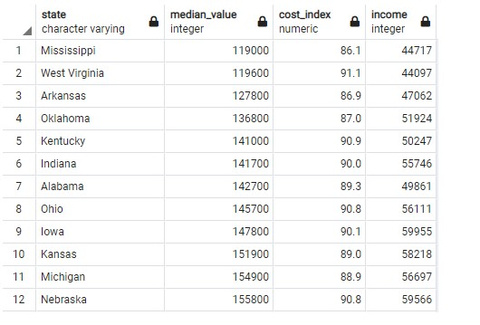
Final Product
PostgreSQL

Slide 10
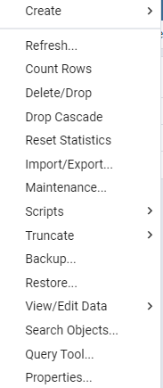


Extra Take-Aways
1. Re-do’s in Postgres:
Fix schema
“Table already exists”
2. Exposure avoidance:
GitiHub (creating new repo)
GitiBash
File names in this folder
“git add .” excludes

