Slide 1


ETL Project
Homes, Living Expenses and Salary Across the Country

Slide 2
Project Frame
Material Descriptions
Tools Used
Cost of Living per State - 2021
Latest Salaries per State
Latest Home Prices per State
Pandas
PGAdmin
QuickDBD

Slide 3
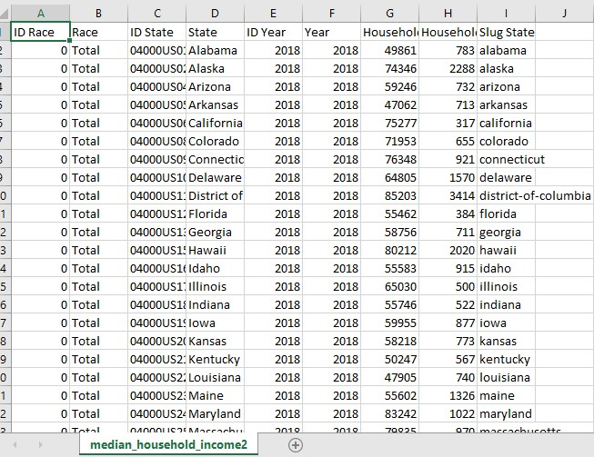
Extraction
CSV
CSV
Data we retrieved came from CVS files found on.
The data collected was for median income, cost of living, and median home prices.
Once the data was obtained. It was examined to then begin cleaning in Pandas.

Slide 4
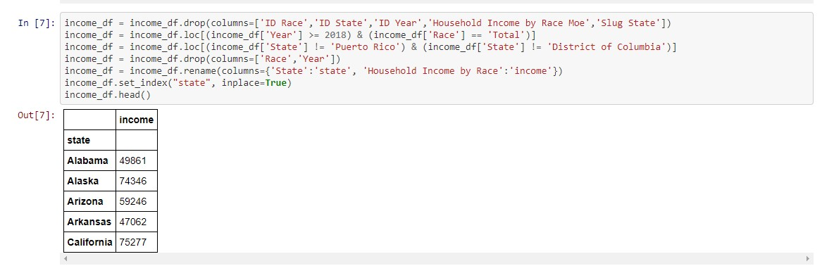
Transforming
Removed Territories
Some of the cleaning included removing columns
Renaming columns
Limiting data to year 2018

Slide 5
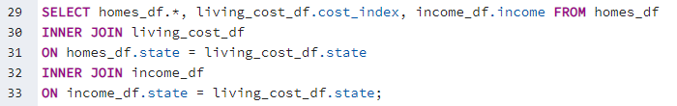
Transforming …
Postgres to join tables

Slide 6
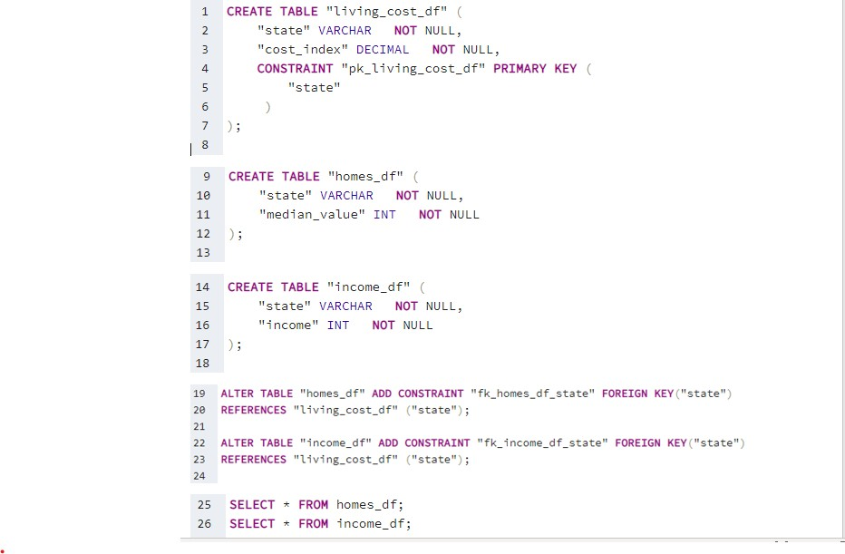
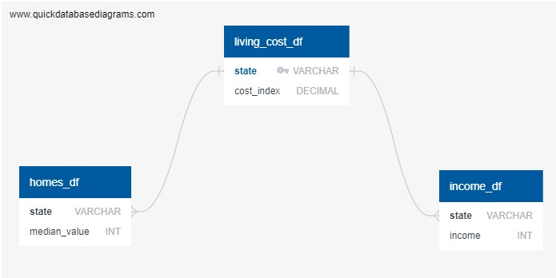
Load Preparing
Tables created; primary key identified
Queries

Slide 7
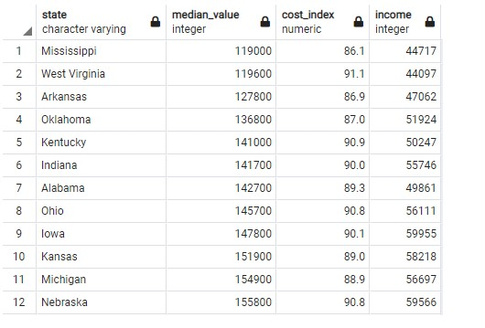
Loading
We loaded the cleaned versions of CVS into Postgres SQl and join tables to create one cleaned version of our data.

Slide 8
Why this was chosen?
Methods used were chosen because:
All of the datasets had States in common to join on
We used Quick DBD as a tool to create the tables and spot relationships of data
Pandas was used as primary tool for cleanup because of its efficiency to clean data.

Slide 9
Why was the topic chosen?
Topic was chosen because it was an interesting topic to analyze the cost living of living , median homes, and median nationwide. We wanted to see if there was a relationship between the datas. The information was chosen because it relatable to many people.

