Slide 1
Incarceration and Education

Slide 2
Hypothesis
Incarceration rates are linked to education (globally)
Education expenditure % of GDP
Graduation rates
Persons held in prison rates (per 100K population)

Slide 3
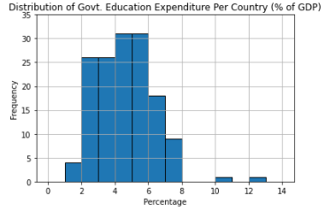
Notes:
Most countries in our sample spend between 2%-7% of their budget on education
Very few spend higher than average (gaps)

Slide 4
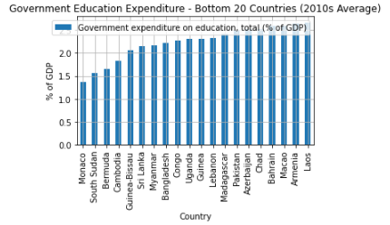
Notes:
Majority of bottom spending are developing countries
(Monaco → billionaires’ playground)

Slide 5
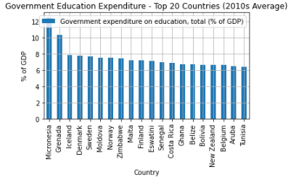
Notes:
Majority of top spending are developed countries

Slide 6
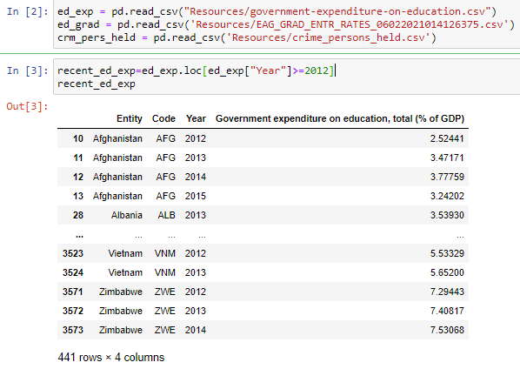
Expenditure Code
Notes:
2012 and beyond only

Slide 7


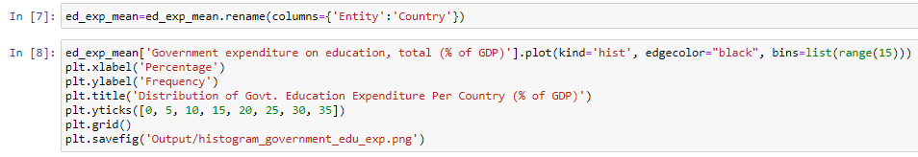
Cont.
Notes:
Columns that weren’t needed
Renamed
Average of all years
Reset index for histogram
Used bin of ranges*

Slide 8

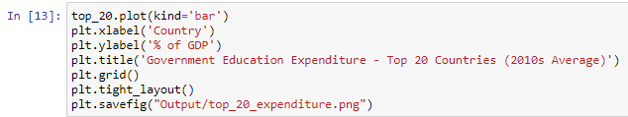
Cont.
Notes:
Set country back as index for bar graph
Reorganized data frame for biggest and lowest spenders
Extracted top 20 of each

Slide 9
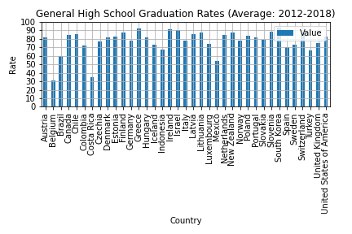
Notes:
Highest: South Korea, Greece and Ireland
Lowest: Costa Rica, Belgium(!!!), Mexico

Slide 10
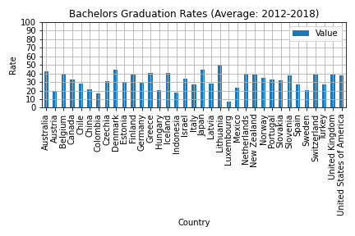
Notes:
Grad rates decreased by about half from high school
Highest: Denmark, Japan, Lithuania
Lowest: Luxembourg (!!!), Indonesia, Colombia

Slide 11
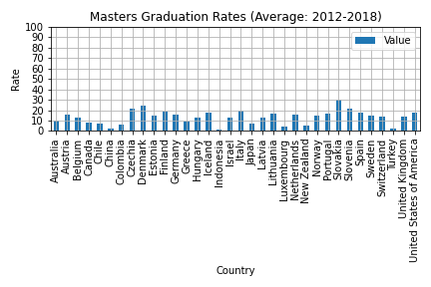
Notes:
Grad rates decreased by about half from bachelors
Highest: Slovakia, Denmark, Czechia, Slovenia
Lowest: Indonesia, Turkey, China (!!!)

Slide 12
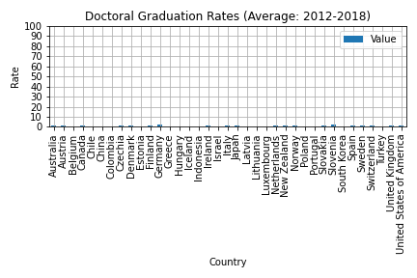
Notes:
Grad rates decreased by about more than half from bachelors
Highest: Germany and Slovakia
Lowest: about half of the countries’ rates have disappeared

Slide 13
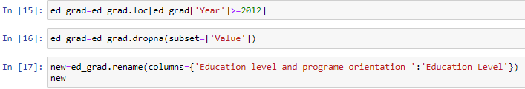

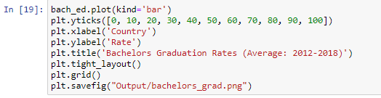
Graduation Rates Code
In [14]: ed_grad=ed_grad.drop(['COUNTRY', 'SEX','AGE', 'COUNTRY_ORIGIN', 'International students exclusion', 'ISC11_LEVEL_CAT', 'INDICATOR', 'Indicator', 'YEAR', 'Flag Codes','Flags'], axis=1)
Notes:
Columns that weren’t needed
NaN values
2012 and beyond only
Applicable type of education only (for each)
Average over the years
Set up the country as the index for graph

Slide 14
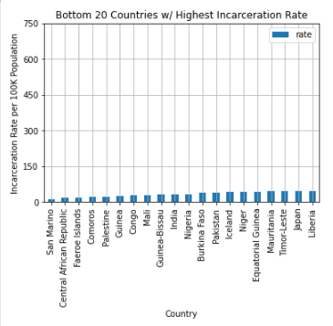
Notes:
Most common denominator: African and middle eastern countries
Only superpower country: Japan
Lowest: San Marino, Central African Republic

Slide 15
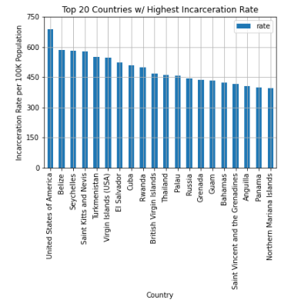
Notes:
Most common denominator: tropical climate countries
Only two superpower countries: USA, Russia
USA is highest

Slide 16
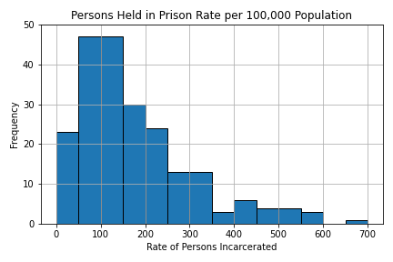
Notes:
Most countries keep their persons held in prisons rate minimal
Gap between USA and the rest of the world

Slide 17
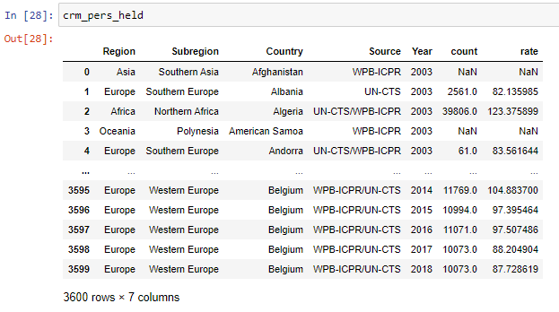
Incarceration Rates Code

Slide 18

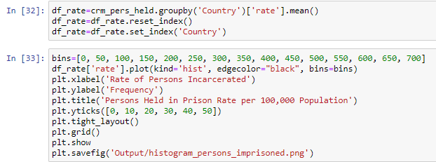
Cont.
Notes:
2012 and beyond only
Columns that weren’t needed
NaN values
Average over the years
Set up data frame for graphing
Played with bins and y ticks

Slide 19

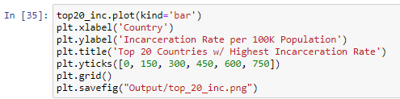
Cont.
Notes:
Reorganized for top countries
Cropped first 20

Slide 20
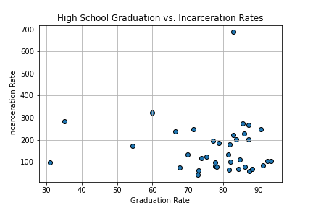
Notes:
Most countries’ incarceration rates are not affected by graduation rates

Slide 21
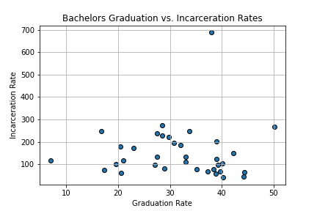
Notes:
Most countries’ incarceration rates are not affected by graduations at a bachelors level

Slide 22
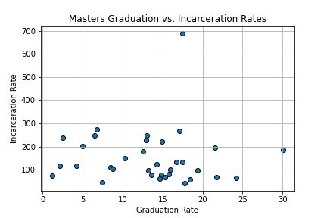
Notes:
Most countries’ incarceration rates are not affected by graduations at a masters level

Slide 23
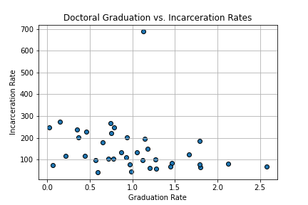
Notes:
Most countries’ incarceration rates are not affected by graduations at a doctoral level

Slide 24
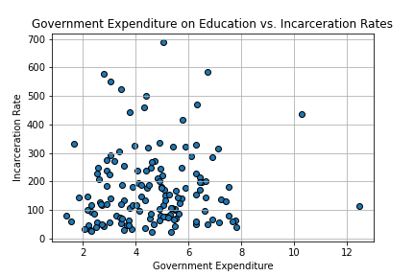
Notes:
Countries’ incarceration rates are mostly not correlated by education expenditure, unless they’re higher than average

Slide 25
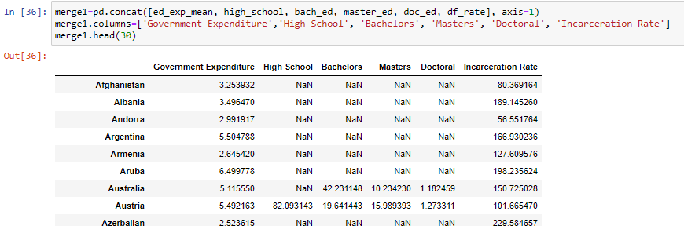
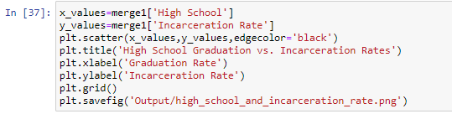
Merging Code
Notes:
Concatenated latest versions of each data frame
Tested data frame
Graphed each in comparison to incarceration rate

Slide 26
Issues…
Values missing from CSV
Years
NaN rates/counts
Misleading CSV
Faulty sources (education expenditure)
Tiny details (invisible spaces)
Merging data (countries names, Excel)

Slide 27
Conclusion:
Our hypothesis was wrong, but…
Further info needed for countries with higher-than-average incarceration rates

Slide 28
References
Graduation rates:
https://stats.oecd.org/Index.aspx?DataSetCode=EAG_GRAD_ENTR_RATES
Government expenditure on education (%of GDP):
https://ourworldindata.org/grapher/government-expenditure-on-education?time=2014
Persons held in prisons rates per 100K population:
https://dataunodc.un.org/data/prison/persons%20held%20total

