Slide 1
Crime and Education

Slide 2
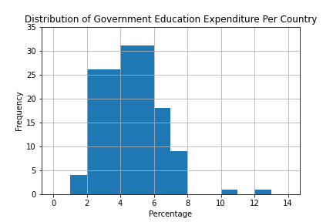
Notes:
Most countries in our sample spend between 2%-7% of their budget on education.

Slide 3
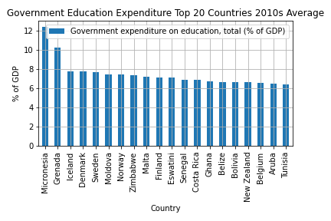
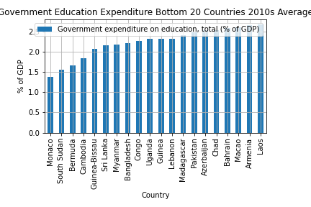
Notes:
Majority of top spending are developed countries, majority of bottom spending are developing countries

Slide 4
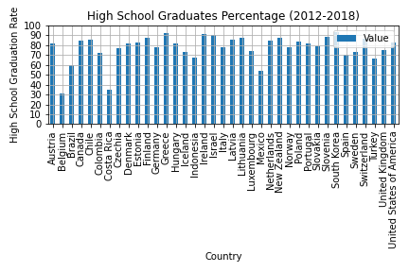

Slide 5
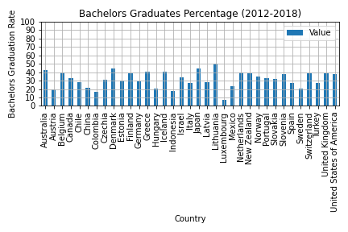

Slide 6
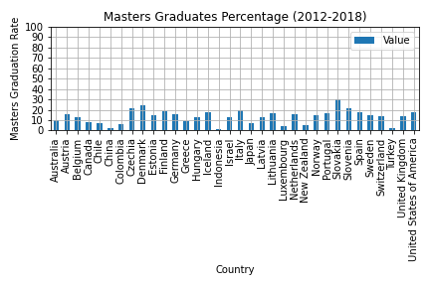

Slide 7
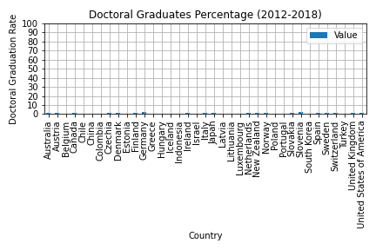

Slide 8
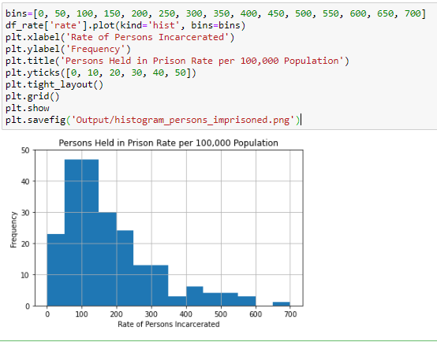

Slide 9
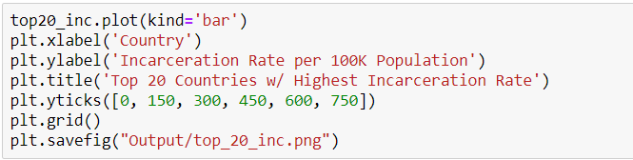
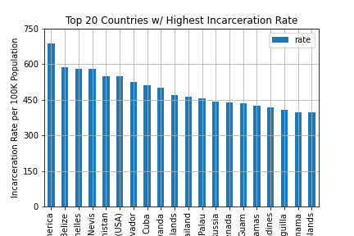

Slide 10
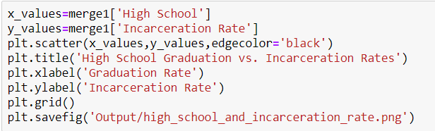
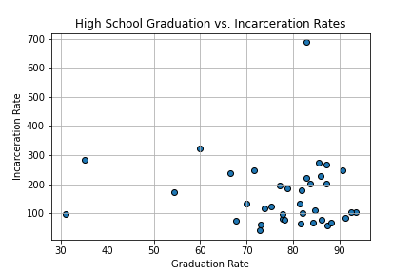

Slide 11
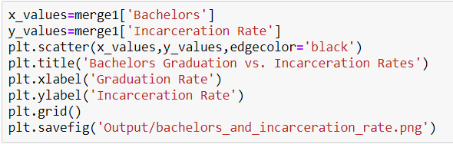
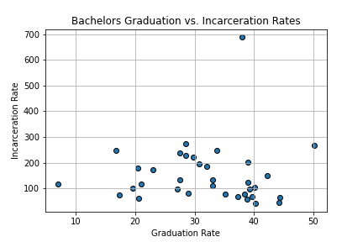

Slide 12
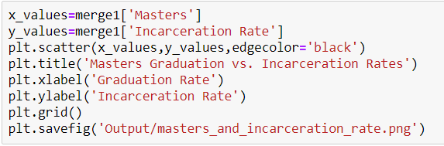
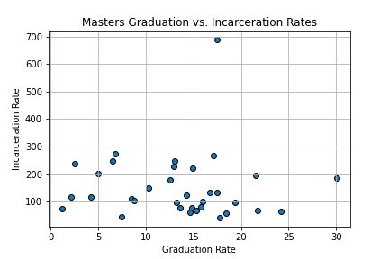

Slide 13

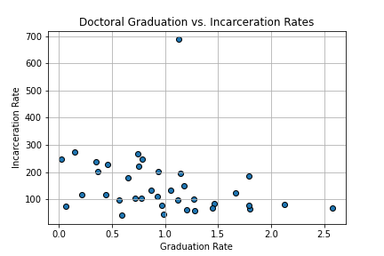

Slide 14
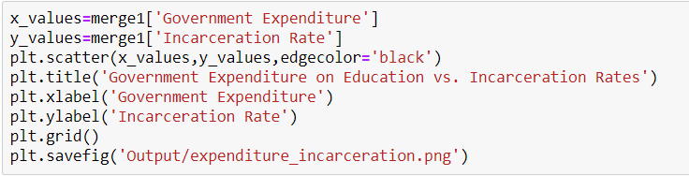
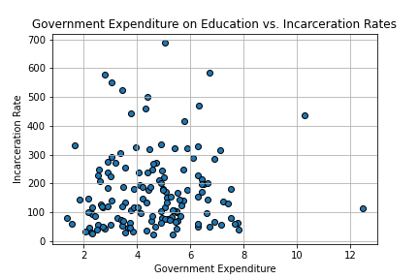

Slide 15
References
Graduation rates and entry rates:
https://stats.oecd.org/Index.aspx?DataSetCode=EAG_GRAD_ENTR_RATES
Government expenditure on education (%of GDP):
https://ourworldindata.org/grapher/government-expenditure-on-education?time=2014
Persons held in prisons:
https://dataunodc.un.org/data/prison/persons%20held%20total

