Slide 1
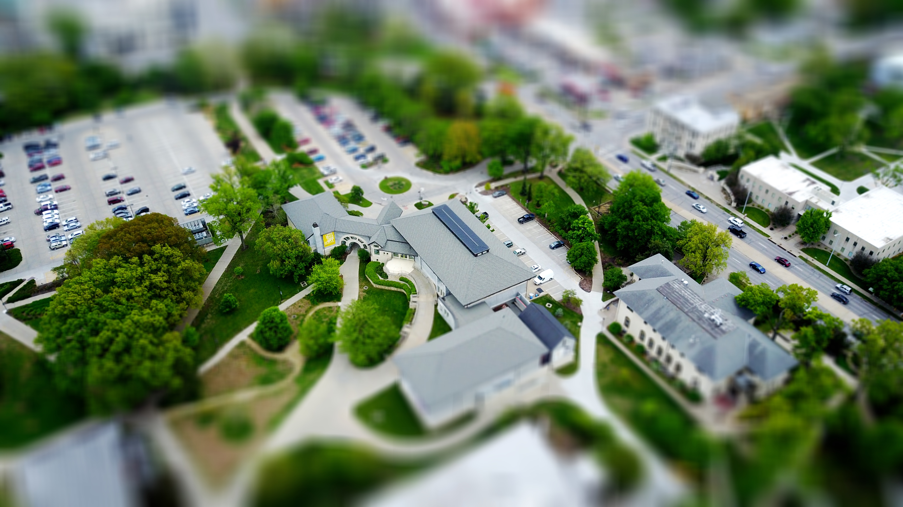
Final Project
Home Price Predictor

Slide 2
Intention
Price prediction based on: Home features
Make it user interactive
Provide graphs in the same place as where the user inserts information
Test with linear and random forest models:
ElasticNet, Ridge, Lasso, LinearRegression models
RandomForestRegressor

Slide 3
Tools Used
What | For
Python | ML model
Pandas | Data cleanup
Tableau | Visualizations
Flask | User interactivity
HTML | Display
CSS, Bootstrap | Styling

Slide 4
Process
Data cleanup
Test various scores
Flask
Best model selected
Search for top 10 variables
Keep top 3 and re-use best model

Slide 5
Scores

Slide 6
Process Highlights
Used: train = pd.get_dummies(train) for string columns
Used the process below to facilitate Tableau data loading
lasso_sorted.rename_axis(index='Id', inplace=True)
lasso_sorted.to_csv('Output/variables.csv', index = True)
Data cleanup: .fillna("None") vs. .fillna(0)
YearBuilt | YearRemodAdd | RoofStyle | RoofMatl
2003 | 2003 | Gable | CompShg
1976 | 1976 | Gable | CompShg
2001 | 2002 | Gable | CompShg
Lasso Score: 0.9029444299474153
Top 3 Lasso Score: 0.7584340996462217
Used: y_test_ravel = np.ravel(y_test) to change structure of actual values for data framing
Used:
pickle.dump(lasso2, open('model.pkl','wb'))
pickle.dump(x_scaler, open('x_scaler.pkl', 'wb'))
pickle.dump(y_scaler, open('y_scaler.pkl', 'wb’))
to save model and scalers into flask
Used: abs(var_df['coefficients’]) to determine true scores for variables

Slide 7
Additional Learning
Tableau in HTML
Flask for machine learning
Select project in Tableau Public
Select the share icon at the bottom right corner
Select Embedded Code
Paste in HTML
From Jupyter Notebook, “dump” model into your computer using pickle instead of json
In the flask app, use pickle again to load the model

Slide 8
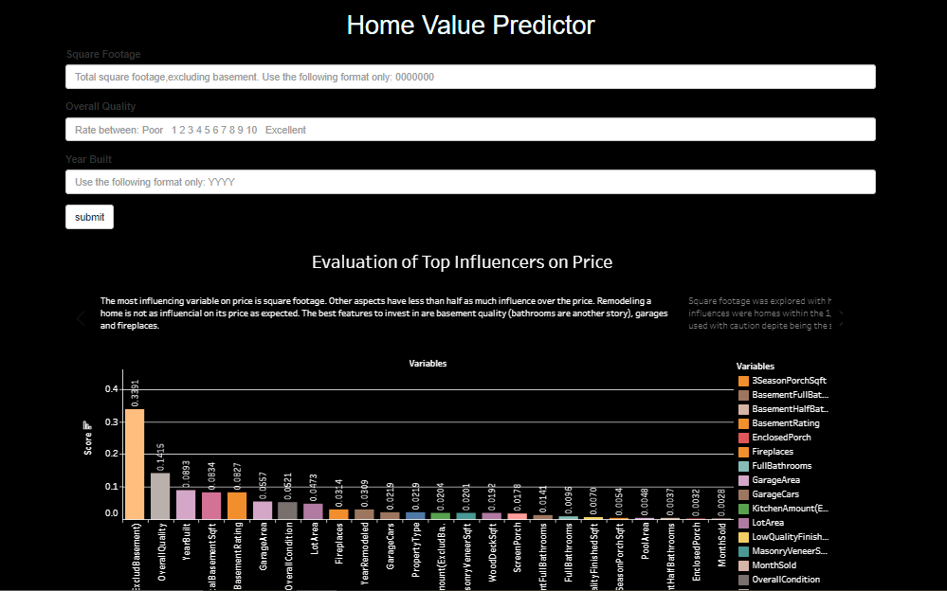
Demo

Slide 9
Unexecuted Ideas
Price prediction based on:
Home features
and
Dates (time series)
User can choose from landing page!
Interactive dashboard in landing page

Slide 10
Issues
Results mixed with options
variables | coefficients
GrLivArea | 0.339096
RoofMatl_ClyTile | 0.211141
OverallQual | 0.141465
Condition2_PosN | 0.10181
BsmtQual_Ex | 0.090708
YearBuilt | 0.089346
TotalBsmtSF | 0.083402
BsmtFinSF1 | 0.082735
KitchenQual_Ex | 0.079694
Neighborhood_NoRidge | 0.070848

Slide 11
Resources
Data
https://www.kaggle.com/c/house-prices-advanced-regression-techniques/data?select=data_description.txt
References
https://www.kaggle.com/erick5/predicting-house-prices-with-machine-learning
https://github.com/andersjh/extra_ml_stuff/tree/master/03_Flask_with_ML
https://towardsdatascience.com/deploy-a-machine-learning-model-using-flask-da580f84e60c

Slide 12
Feedback?

