Slide 1
Tesla Deaths
Nicolas Bello
Pamela Hinostroza
Marlyng Morales
Sasha Osipova

Slide 2

theme
What
Deaths involving Tesla vehicles
Worldwide
2013 - Q1 & Q2 2021
Click me
How
Scraping (Python JN)
JSON
Flask (Python)
Plotly, D3, Dropdown (JS & D3)
Dashboard

Slide 3
Coding approach
Python (data fetching) | fetch("http://127.0.0.1:5000/data/", { method: 'POST' }).then(response => response.json()).then((teslaDeaths) => { the rest of our data goes here};
Plotly (graphing) | var trace1 = { x: teslaDeaths.map(i => i.Year), y: teslaDeaths.map(i => i.PedestrianInvolvedCount),
D3 (adding options to dropdown) | d3.select("#selectButton") .selectAll('myOptions')
D3 (updating chart) | function update(selectedGroup) {
Python (connecting to database) | app.config["MONGO_URI"] = "mongodb://localhost:27017/project3" mongo = PyMongo(app)
Python (scraping) | def test_scrape (): # splinter url = 'https://www.tesladeaths.com/'
Python(JN)/MongoDB (data storing) | # Turning to JSON and connecting result = tesla_table.to_json(orient="records") parsed = json.loads(result) db = client.project3 tesla_deaths =db.tesla_deaths tesla_deaths.insert_many(parsed)

Slide 4
Data munging techniques
What | Fixing
Amount of records in data (Python JN) | Joining with manual CSV
 | Renaming columns
 | Dropping n/a’s
 | Dropping columns
 | Replacing data names
Plotly pulling JSON data from MongoDB | Ongoing

Slide 5
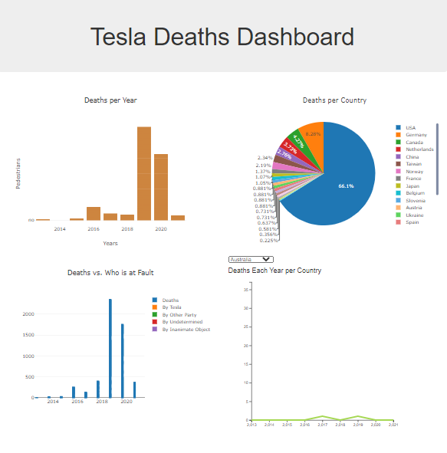
Final visualization
Click me

Slide 6
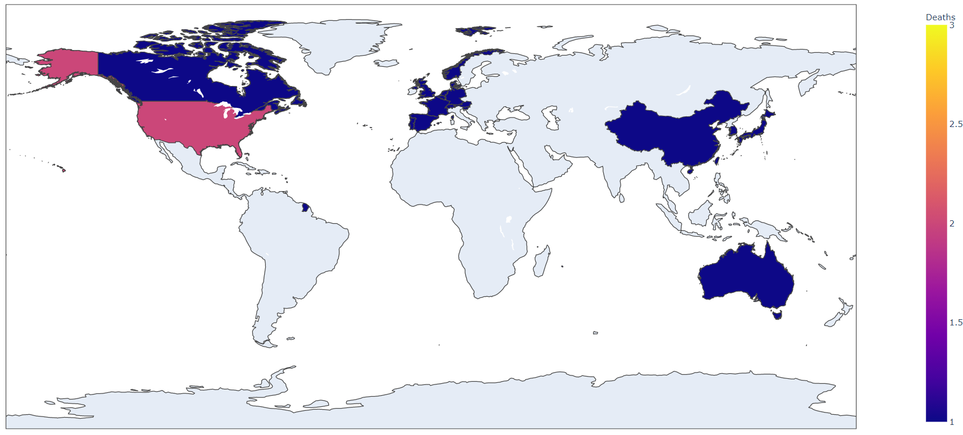
If we had more time…
Our actual map without using Flask
Leflet map added
Styling added
Dropdowns added for Plotly graphs
Linking one Plotly graph to another

