Slide 1
Starbucks
Team Cloud

Slide 2
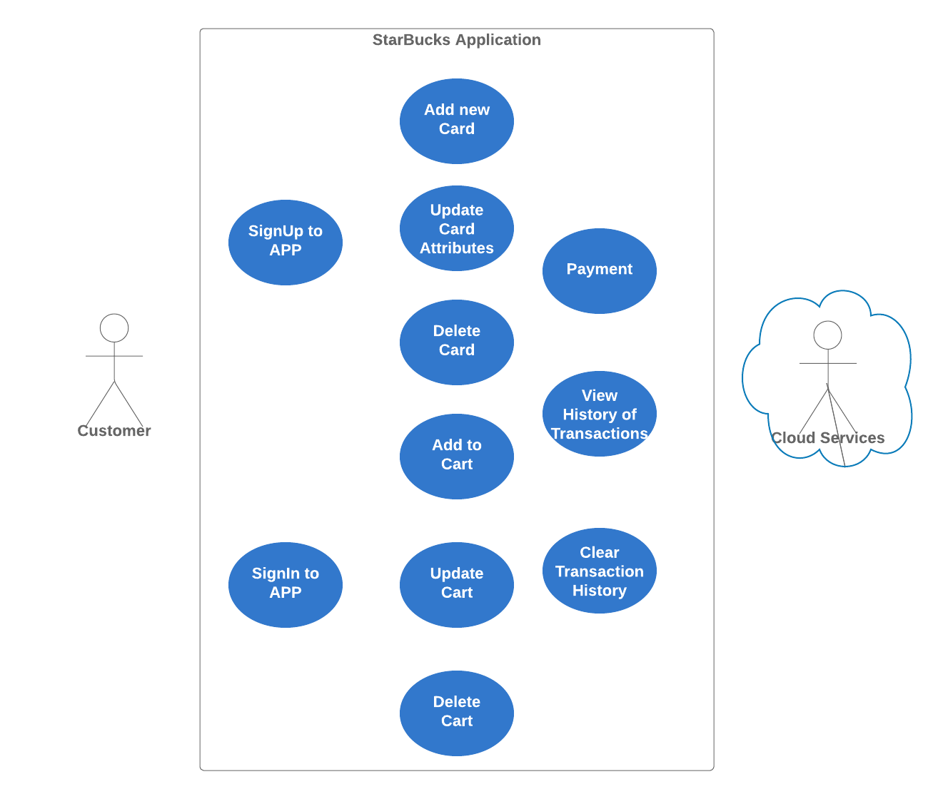
Requirements
Notes:
https://www.lucidchart.com/invitations/accept/4b7366fc-0426-454e-874d-2d30ee6dde26

Slide 3
Design Considerations
Microservices Architecture
Serverless Cloud Framework
NoSQL DB
FrontEnd: reactJS
Backend: nodeJS

Slide 4
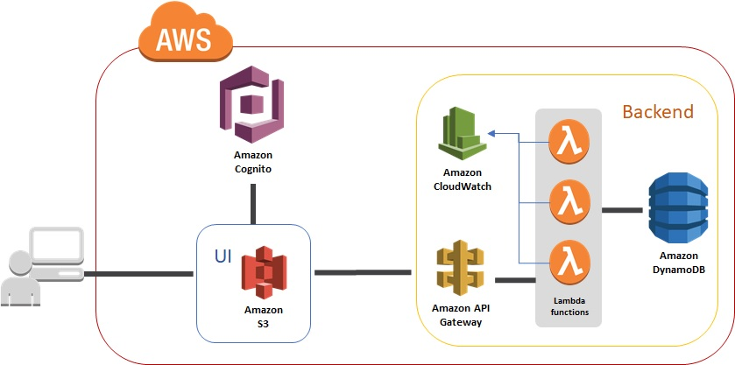
Cloud Architecture

Slide 5
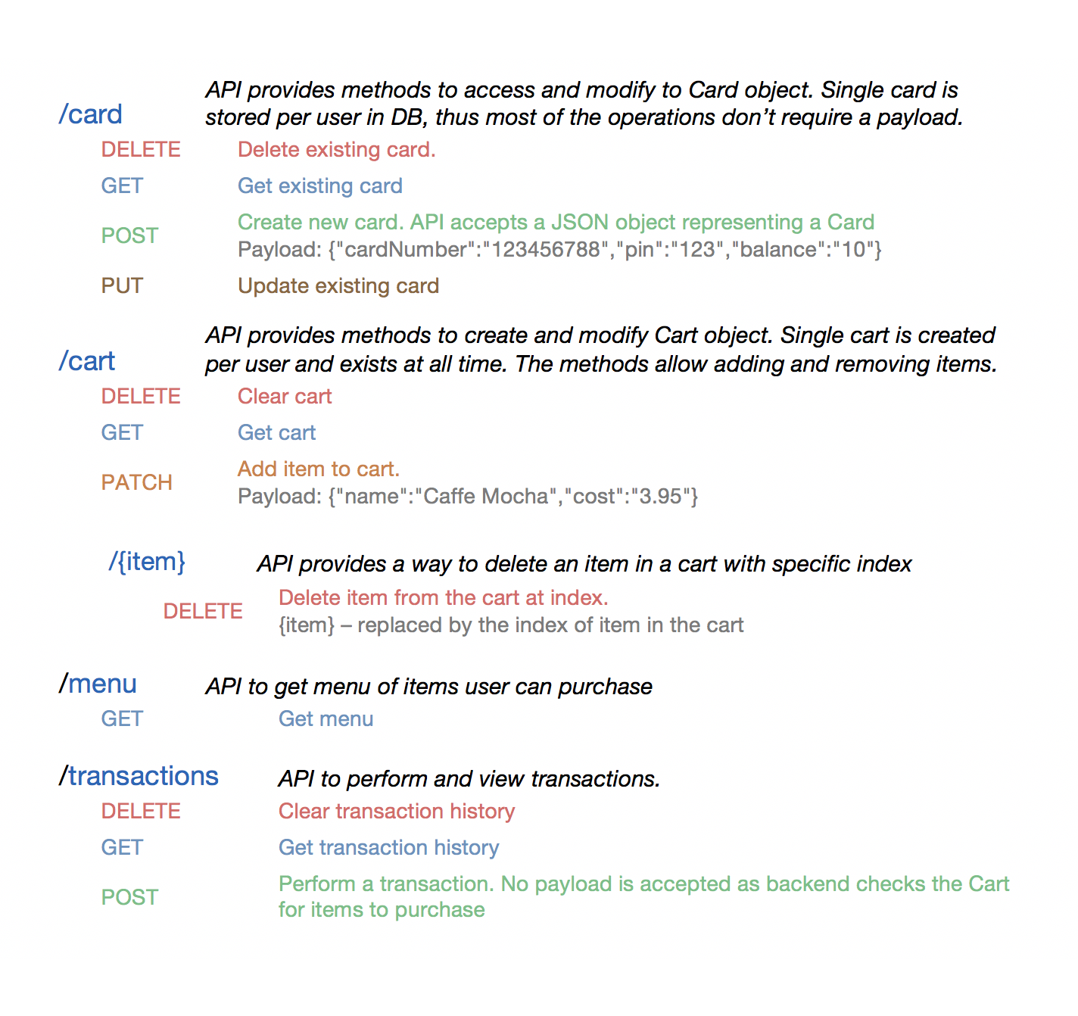
REST APIs

Slide 6
Project Dynamics
Name | Component Owned | API Developed
Parvizsho | Design and Unit Test Suit | Menu Item APIs
Navjot | Front end | Cart APIs
Dipti | Deployment | Transaction APIs
Meghana | Documentation | Card APIs

Slide 7
Team Culture
Communication
Nightly Zoom calls
Virtually Co-located team
Full Participation
Feedback
Design Review
PR review

Slide 8
Demo

Slide 9
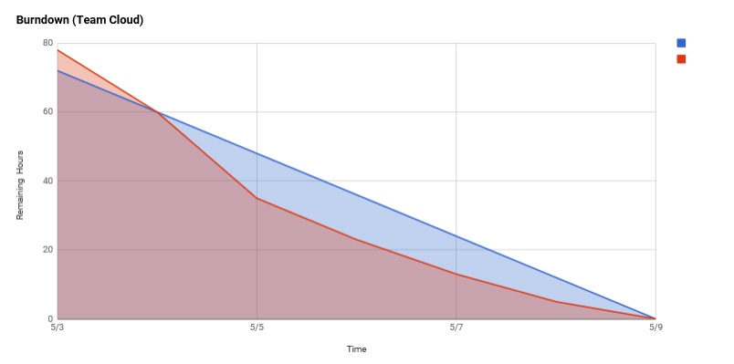
Scrum Practices
Sprint Task Sheet
Daily Standup Meeting Journal

Slide 10
Lessons Learned (Retrospective)
Good
Team communication is great.
Able to resolve issues quickly
Workflow was swift and easy (github, PR’s, etc)
Load management
Improvements
End to end testing should be done earlier

