Slide 1
Team 1 1)Sarah Dongyun Bi 2)Saurabh Parimal Doodhwala 3) Amirtha Ganesh Pugazhendhi
Assignment 4 – implementation1 &2 both are similar in structure but with few variations in function and output implementation.
1)Structure & function of the Program:
There were 5 files required for running this assignment program namely
"tictactoe.c“/"tictactoe1.c” – These are the c files for utility functions definition
Data Structure used: int, bool, char, 1-dimensional char array and 2-dimensional char array.
Functions definition: 1) checkEmpty() 2) twoConsecutiveRow () 3) twoConsecutiveCol () 4) oneEitherSideRow() 5) equalXAndO 6) count 7) printGrid 8) printGrid 9) puzzle_solve 10) rowDistinctionCheck() 11) colDistinctionCheck()12) twoConsecutiveCheck ()
"tictactoe.h“/"tictactoe1.h”– These are the h files for meant utility function declarations
Functions declared : The function from the tictactoe.c are declared in this h file for the modular implementation and data abstraction.
“main.c” /“main1.c” – These are the c files for program implementation or execution
Data Structure used:
Functions definition:
"makefile“- This file consist of “makefile” programming codes to produce object files and executable for
this assignment at once.
5. “myboolen.h”- This file consist of c programming codes for definition values of boolen variable true and false as “1” and “0” respectively. This h file is not needed all compilers.

Slide 2
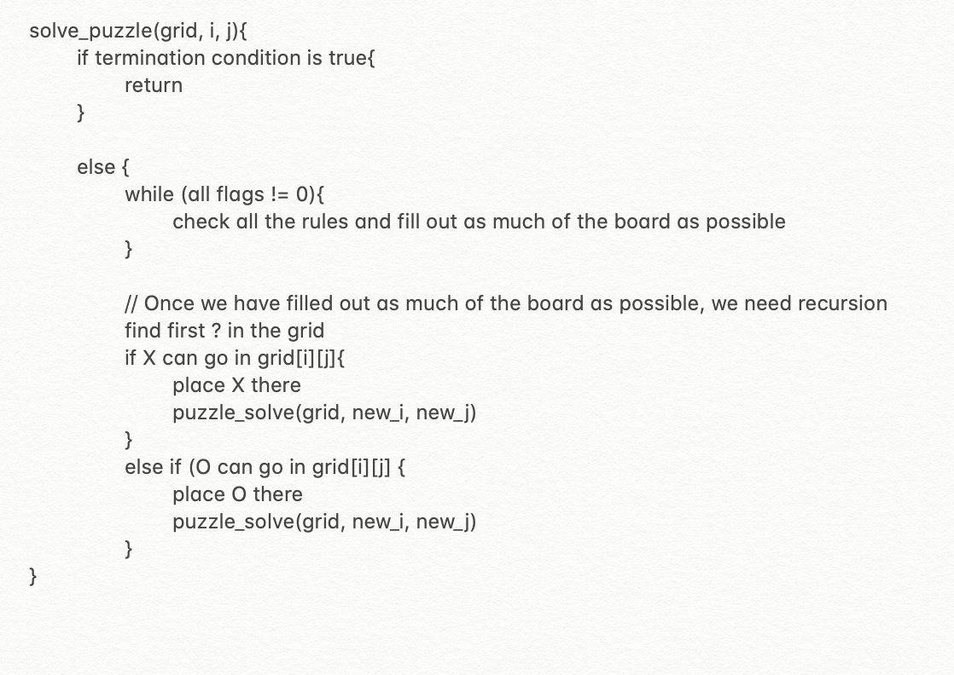
2) Description of the approach and future improvements.
1) Approach:
We used two-dimensional character array to store the initial puzzle grid characters. The utility functions defined in "tictactoe.c“ / "tictactoe1.c” are used to help the “solve_puzzle” function in solving the puzzle in recursive manner with backtracking. The terminating condition for the recursion is to check for grid whether it satisfies all the conditions/rules of the puzzle and check whether the grid is filled . Until the terminating is reached the, maximum possible assignments of ‘X’/’O’ is done using filling heuristics and then ‘X’/’O’ is placed in the possible unfilled location without violating the rules. Finally, the “solve_puzzle” function is recursively called using the latest updated grid. Backtracking is implemented to backtrack and try filling using the alternate character.
2) Future improvements:
when the recursive function is called , we should pass the grid, not a pointer to the grid. This is because when we just pass the variable, it will make a copy of it. we can make changes to this copy, but if we return from the recursive call, it will lose that copy. It is okay because when it return from the recursive call, we want what the grid looked like before we starting filling it out. This is what we believed would happen. However, that’s not happening exactly always. Though the results are optimal for 6x6, the program needs further fine-tunning to provide a robust implementation for all the grid dimensions.
Pseudo code for solve_puzzle function

Slide 3
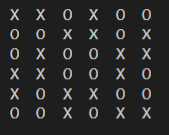
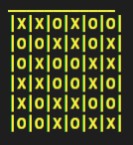
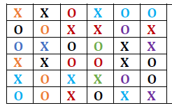
3) Evidence of correct operation
Implementation 1: Implementation 2: Solution from assignment file
Solution Grid 6x6
Solution Grid 6x6
Solution Grid 6x6
The Solution grid from the implementation 1 and 2 are same, as that of the solution provided in the assignment file . This proves that the both the implementations yield optimal results for 6 x 6 grid. However, the solution for high dimension matrix may or may not be optimal.

Slide 4
4)Division of labor
Activity/Role | Saurabh | Sarah | Amirtha Ganesh
Program Development Implementation 1 | 60% | 30% | 10%
Program Development Implementation 2 | 10% | 30% | 60%
Program Debugging and integration | 20% | 50% | 20%
Documentation and Slide preparation | 40% | 20% | 40%
Approximate man-hours | 20 | 20 | 20

