Slide 1
1) Amirtha Ganesh Pugazhendhi
Assignment 5 – Generate Maze
1)Structure & function of the Program:
There were 4 files required for running this assignment program namely
“generate.c” – These are the c files for utility functions definition
Data Structure used: int, char, 2-dimensional char array , file, Graph and Stack.
Functions definition:
1) Stack utility functions - 6 functions
2) Graph utility functions - 3 functions
3) Random DFS utility functions - 15 functions
"generate.h”– These are the h files for meant utility function declarations
Functions declared : The function from the “generate.c “are declared in this h file for the modular implementation and data abstraction and program linking.
“main_ generate.c”– These are the c files for program implementation or execution
Data Structure used: No new definition
Functions definition: No new definition
"makefile“- This file consist of “makefile” programming codes to produce object files and executable for this assignment at once.
2) Athulya Ram Sreedharan Nair
Assignment 5 – Solve Maze
1)Structure & function of the Program:
There are 5 files required for running this part of the assignment:
1. solve.c - This is the c file where utility functions are defined.
Three structures defined: LLNode, LLQueue, and LLGraph.
Functions defined:
1. Queue utility functions – 7 functions
2. Array manipulations – 3 functions
3. BFS implementation – 1 function
2. solve.h - h file for function declarations
Functions from solve.c are declared here.
3. main_solve.c - c file for program execution.
Reads in filename.txt (output of maze generation
program), creates a graph based on the information in
the file, and displays the path between start and finish
that is found using BFS function.
4. makefile - Consists of programming codes to produce
object files and executable for this assignment at once.
5. filename.txt - The output file from maze generation
program in the structure detailed in Assignment
instructions.

Slide 2
2 a) Maze generation.
At first nodes equal to size of the maze( row x col) created by instantiated the Graph
Then, Stack will be instantiated to store the visited nodes and the top of stack will currently chosen node
Then an Array will be created with boundaries to stop the node from traversing beyond the boundary. The visited node and boundaries will be marked with “1” and unvisited node will be marked in “0”.
Then the first node will be randomly selected and will be inserted into the array. At the same it will be push into the stack.
Then it checks for whether exist a unvisited node (i.e) any “0” adjacent to the current node. If yes, then it randomly select the nearest available node. Then selected node will be pushed into stack
Else if there no free node available adjacent to the selected, then it pops-out the top element of the stack and updates it as current selected node. This process of going back to previous selected node in search of free node is called as backtracking
This will go on till the all the unvisited array is filled.
Once all the unvisited array is filled. The dimension of grid , start and endpoint , and finally adjacency list of all nodes will be printed to text file in same directory

Slide 3
2 b) Maze Solving
First, three structures are defined: LLNode, LLQueue, and LLGraph.
Then I have functions to manipulate a queue, similar to Assignment 2.
I define two more functions to manipulate arrays.
int is_present(int a[], int value, int size) - function tells me if the element 'value' is present in array 'a' of size 'size'.
int FindIndex(const int a[], int size, int value ) - function returns the index of the element 'value' in array 'a' of size 'size'.
Now that I have all the utility functions, I define the function void bfs(struct LLGraph* graph, int startVertex, int endVertex, int size) that implements BFS algorithm on a linked-list graph, to display the path from startVertex to endVertex.
First, the function creates a queue to hold elements in BFS algorithm.
I initialize two arrays – visited[] and predecessor[]. visited[] stores the index of vertices in the order they are visited in the BFS algorithm. predecessor[] stores the predecessors of each vertex found through BFS. Predecessor of vertex i is stored at predecessor[i]. Predecessor of the startVertex is defined as –1.
To start the BFS algorithm, startVertex is marked as visited. Then startVertex is added to the queue.
Now we run a while loop until the queue is empty.
We pop the first element of the queue and store it as currentVertex. This is also stored into the array vertex[]. Its neighbours are accessed. Running another while loop to go through every neighbour, each neighbour is added to the queue, predecessor of each of these neighbours are noted as currentVertex in the array predecessor[].
Once the loops are complete, I construct a path starting from endVertex to startVertex, tracing through the predecessors. As the maze was generated through randomized DFS, we know that the maze has a solution. So tracking the predecessors give us the path from endVertex to startVertex. This path is constructed using a while loop until we get to the startVertex.
This gives us a path of length 'size' which takes us from endVertex to startVertex. The function print_loop(path, startVertex, size) prints the path from startVertex to endVertex, disregarding the extra elements.
The main function reads in the text file. It stores the first two lines as dimensions and start and end vertices.
Size of the graph is defined as ncol*nrow – the product of dimensions of the graph.
Using a for loop until 'size' to loop through all the lines, I get each character in each line and adds an edge between the 'line' number (that specifies the vertex number) and the characters in the line (which specifies the vertices that are connected to it).
This graph is input to my BFS implementation function to display a path between startVertex and endVertex.

Slide 4


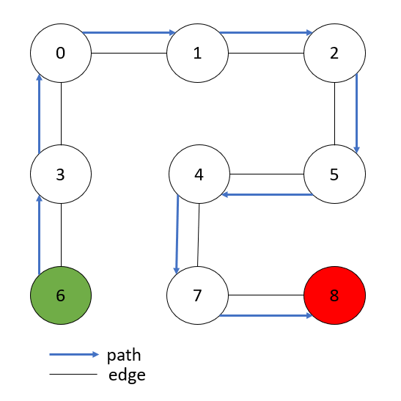
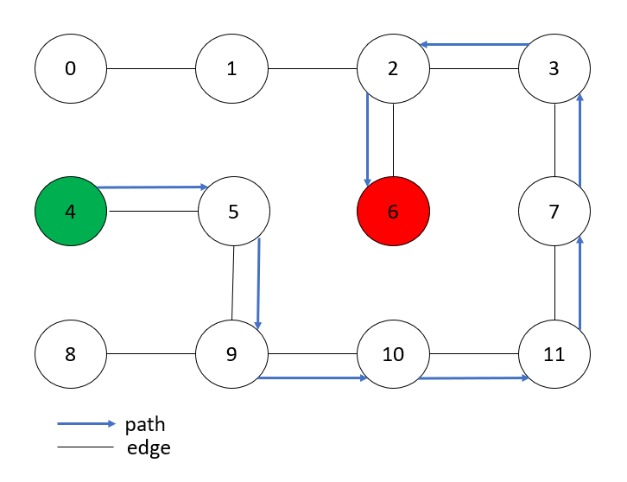
3) Evidence of correct operation
Case 1) Symmetrical maze
Case 2) Asymmetrical maze
MAZE Grid 3x4
MAZE Grid 3x3
Solution Path
Solution Path
For both the cases the we were able to generate a random maze and solve it.
The programs were checked for mazes of size up to 100x100. Simple cases are shown here due to ease of demonstration.

Slide 5
4)Division of labor
Activity/Role | Amirtha Ganesh Pugazhendhi | Athulya Ram Sreedharan Nair
Maze Generation (Program development and debugging) | 100% | NA
Maze Solving (Program development and debugging) | NA | 100%
Documentation and Slide preparation | 50% | 50%
Approximate man-hours | 24 | 24

