Slide 1
EKS Terraform POC on AWS
Proof of Concept demonstrating AWS EKS infrastructure creation using Terraform and Kubernetes deployment validation.

Slide 2
Project Overview
This POC includes:
AWS VPC creation using Terraform
Public and Private Subnets
Internet Gateway and NAT Gateway
EKS Cluster and Node Group creation
IAM Users, Roles and Policies
Helm Provider integration
Metrics Server deployment
Kubernetes Deployment, Service and HPA
kubectl validation and monitoring

Slide 3
Terraform Folder Structure
Terraform files used in the project:
1-providers.tf
2-vpc.tf
3-igw.tf
4-subnet.tf
5-nat.tf
6-routes.tf
7-eks.tf
8-nodes.tf
9-add-developer-user.tf
10-add-manager-role.tf
11-helm-provider.tf
12-metric-server.tf

Slide 4
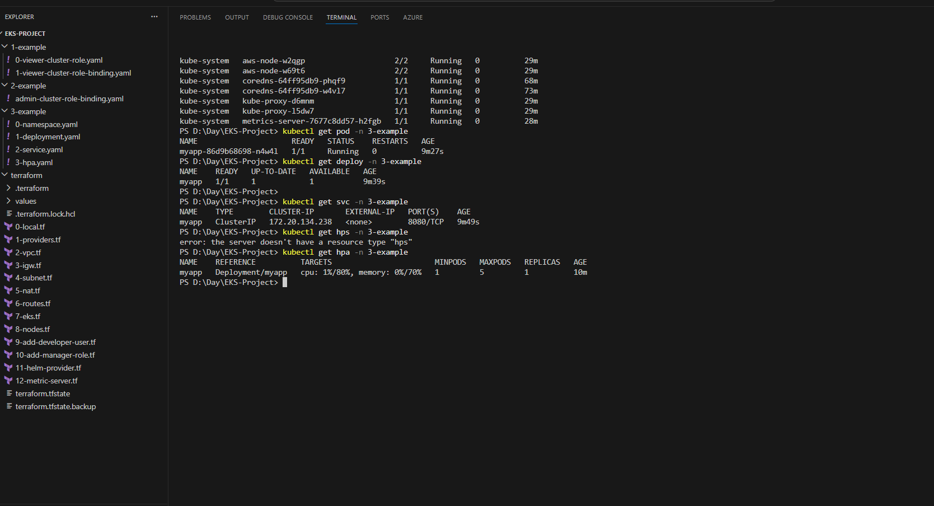
Terraform and Kubernetes Validation Output

Slide 5
Validation Commands Used
Kubernetes and Terraform verification commands:
terraform init
terraform validate
terraform plan
terraform apply
kubectl get nodes
kubectl get pods -A
kubectl get deployment -n 3-example
kubectl get svc -n 3-example
kubectl get hpa -n 3-example

Slide 6
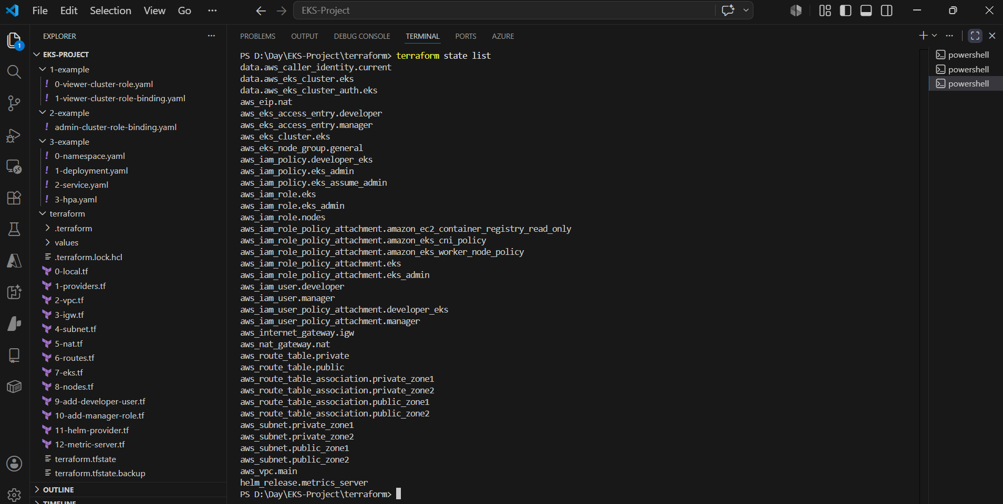
Infrastructure provisioned

Slide 7
POC Outcome
The Terraform-based EKS setup was successfully completed.
AWS infrastructure created using Infrastructure as Code
EKS cluster and worker nodes deployed successfully
Metrics Server installed using Helm
Application deployment and service validated
Horizontal Pod Autoscaler (HPA) configured and verified
Cluster monitored using kubectl commands

Slide 8
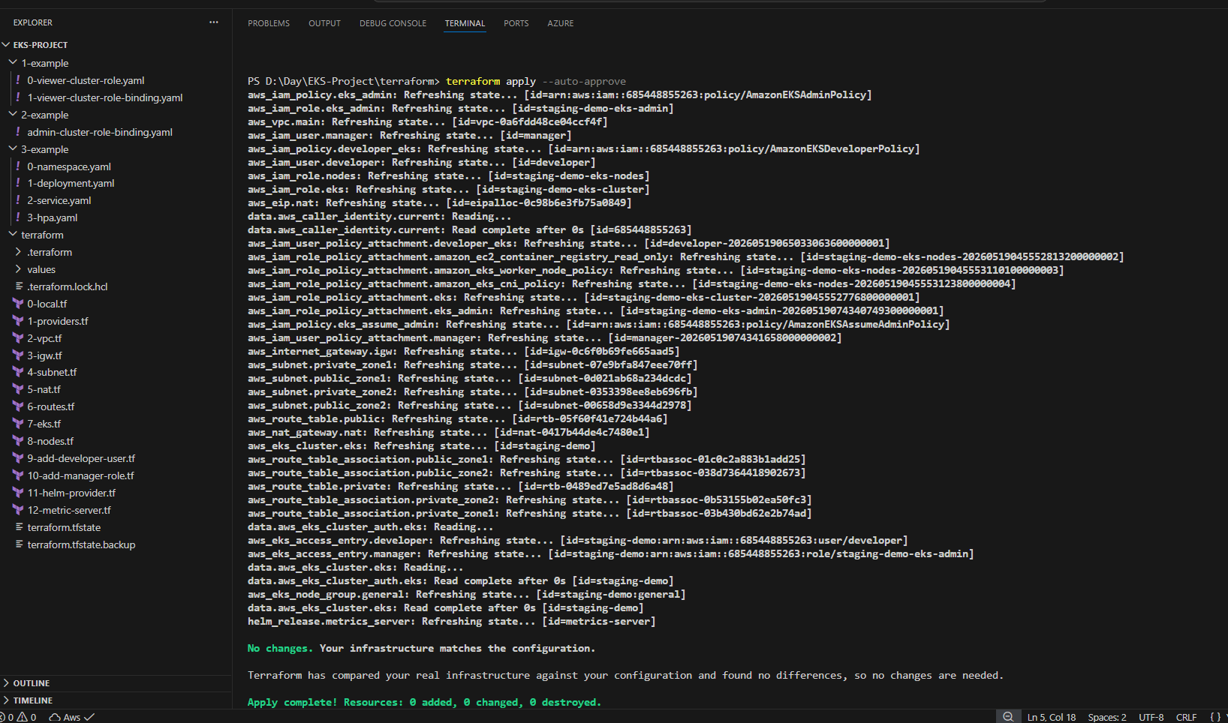
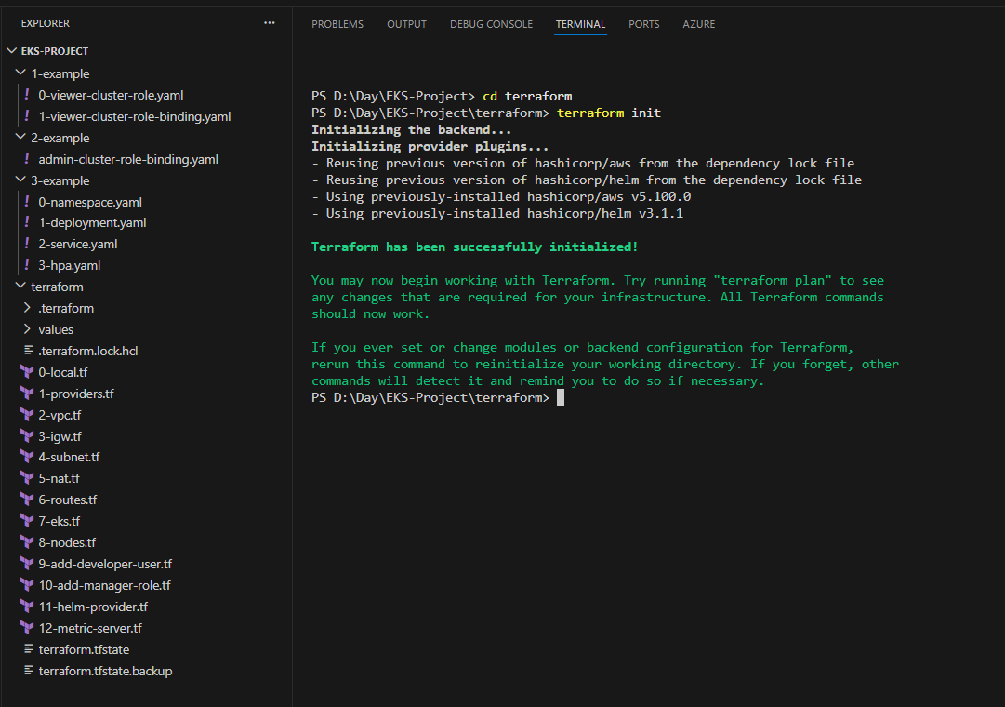
Infrastructure provisioning
Terraform init && Terraform apply

Slide 9
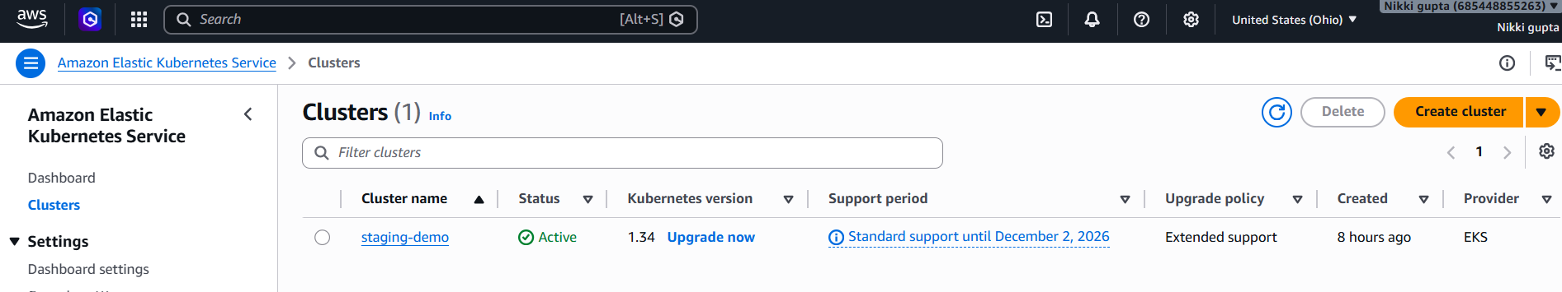
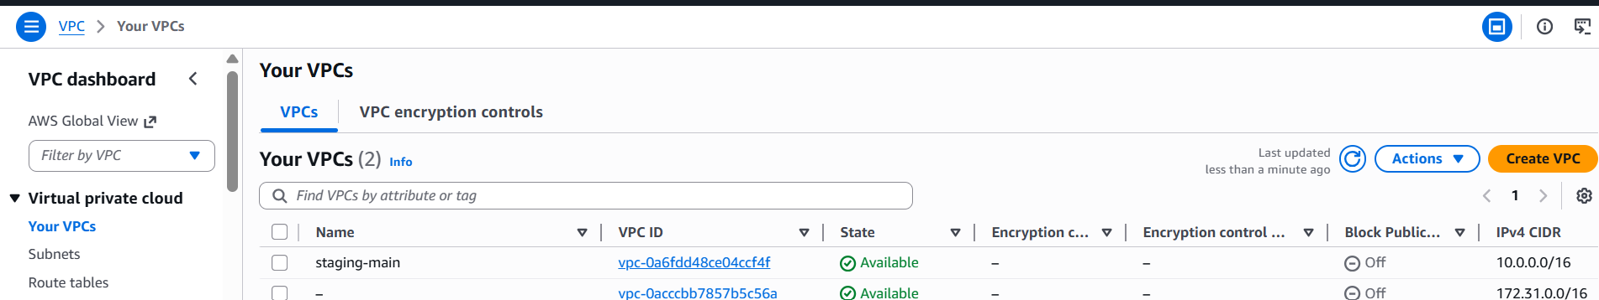
Aws provision
EKS : VPC

Slide 10
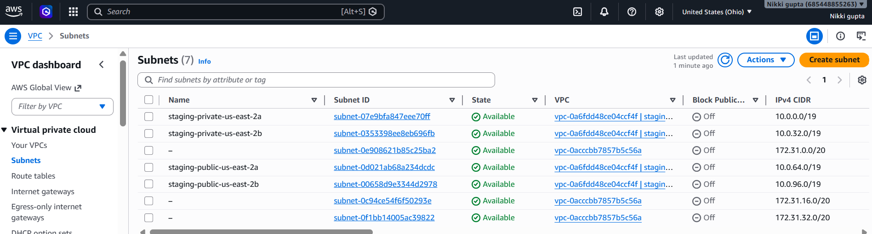
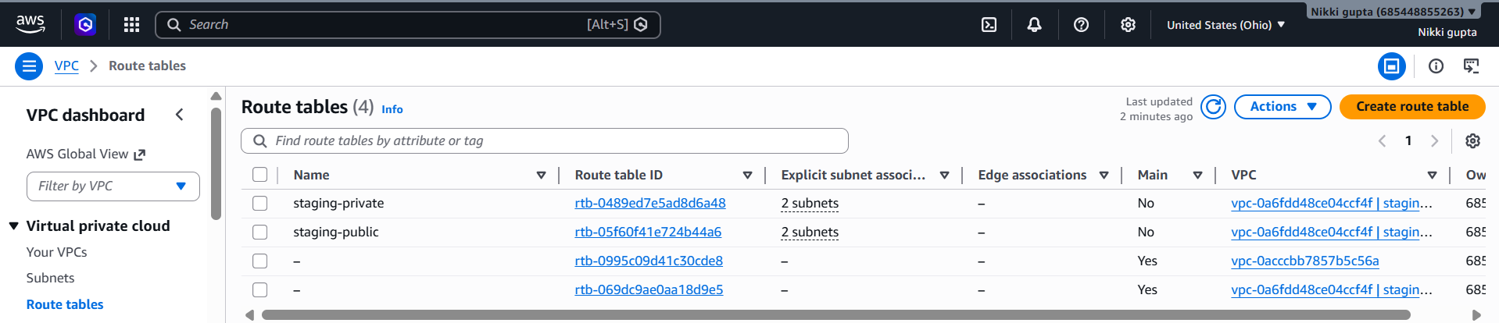
Subnet:Routetable

Slide 11
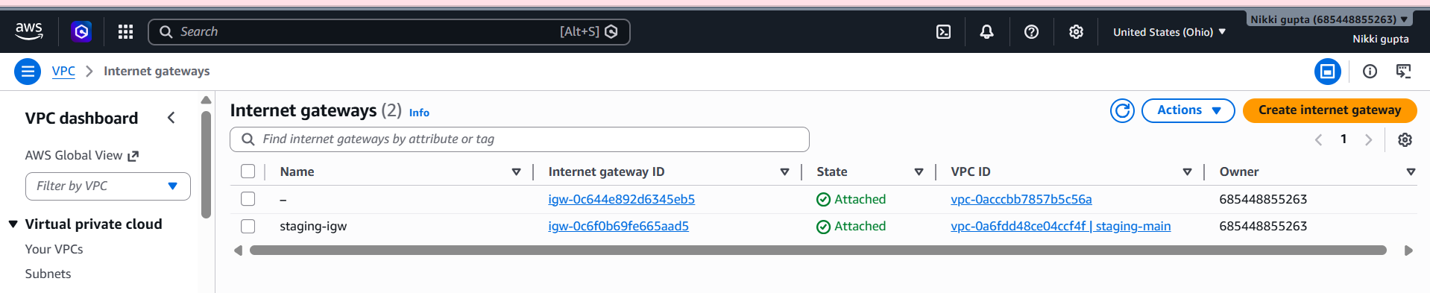
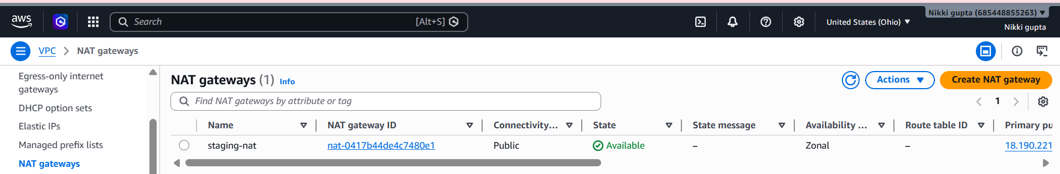
IG:NAT

Slide 12
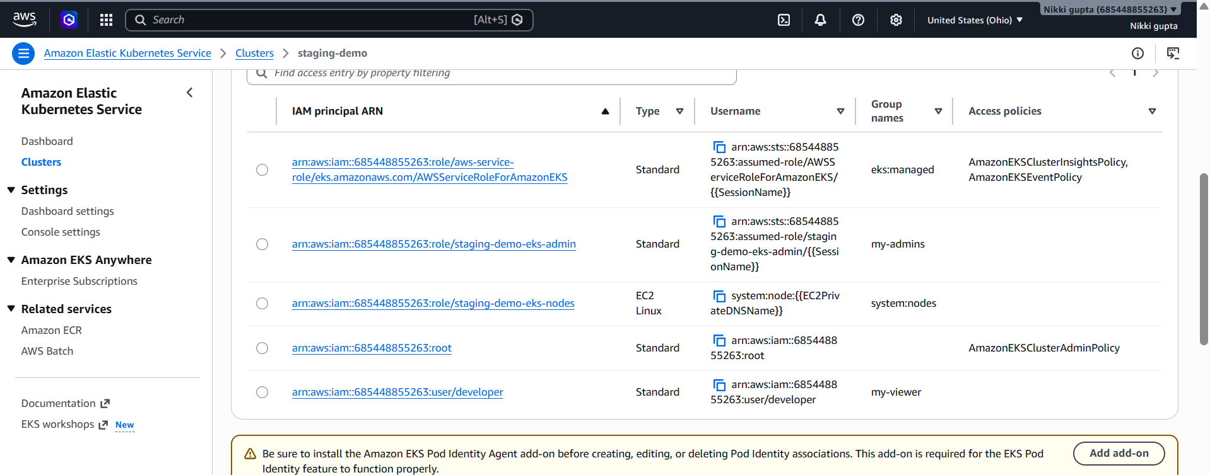
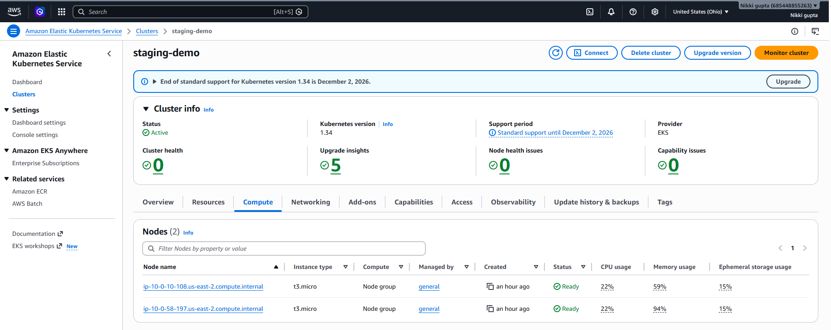
Iam Access Enteries: Worker Nodes

Slide 13
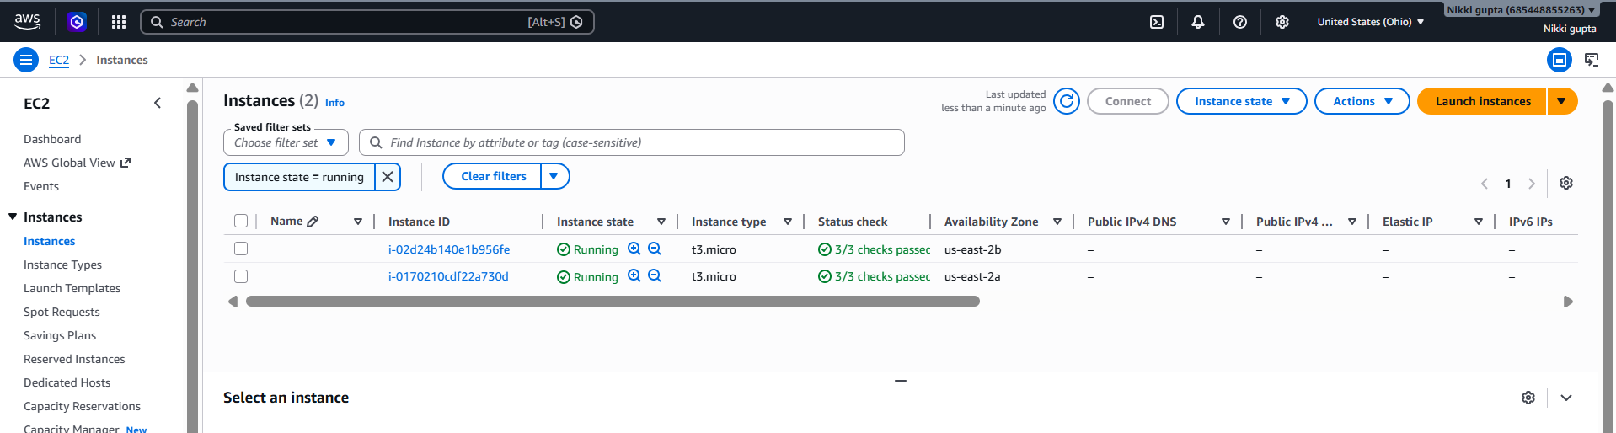
Ec2 instance running

Slide 14
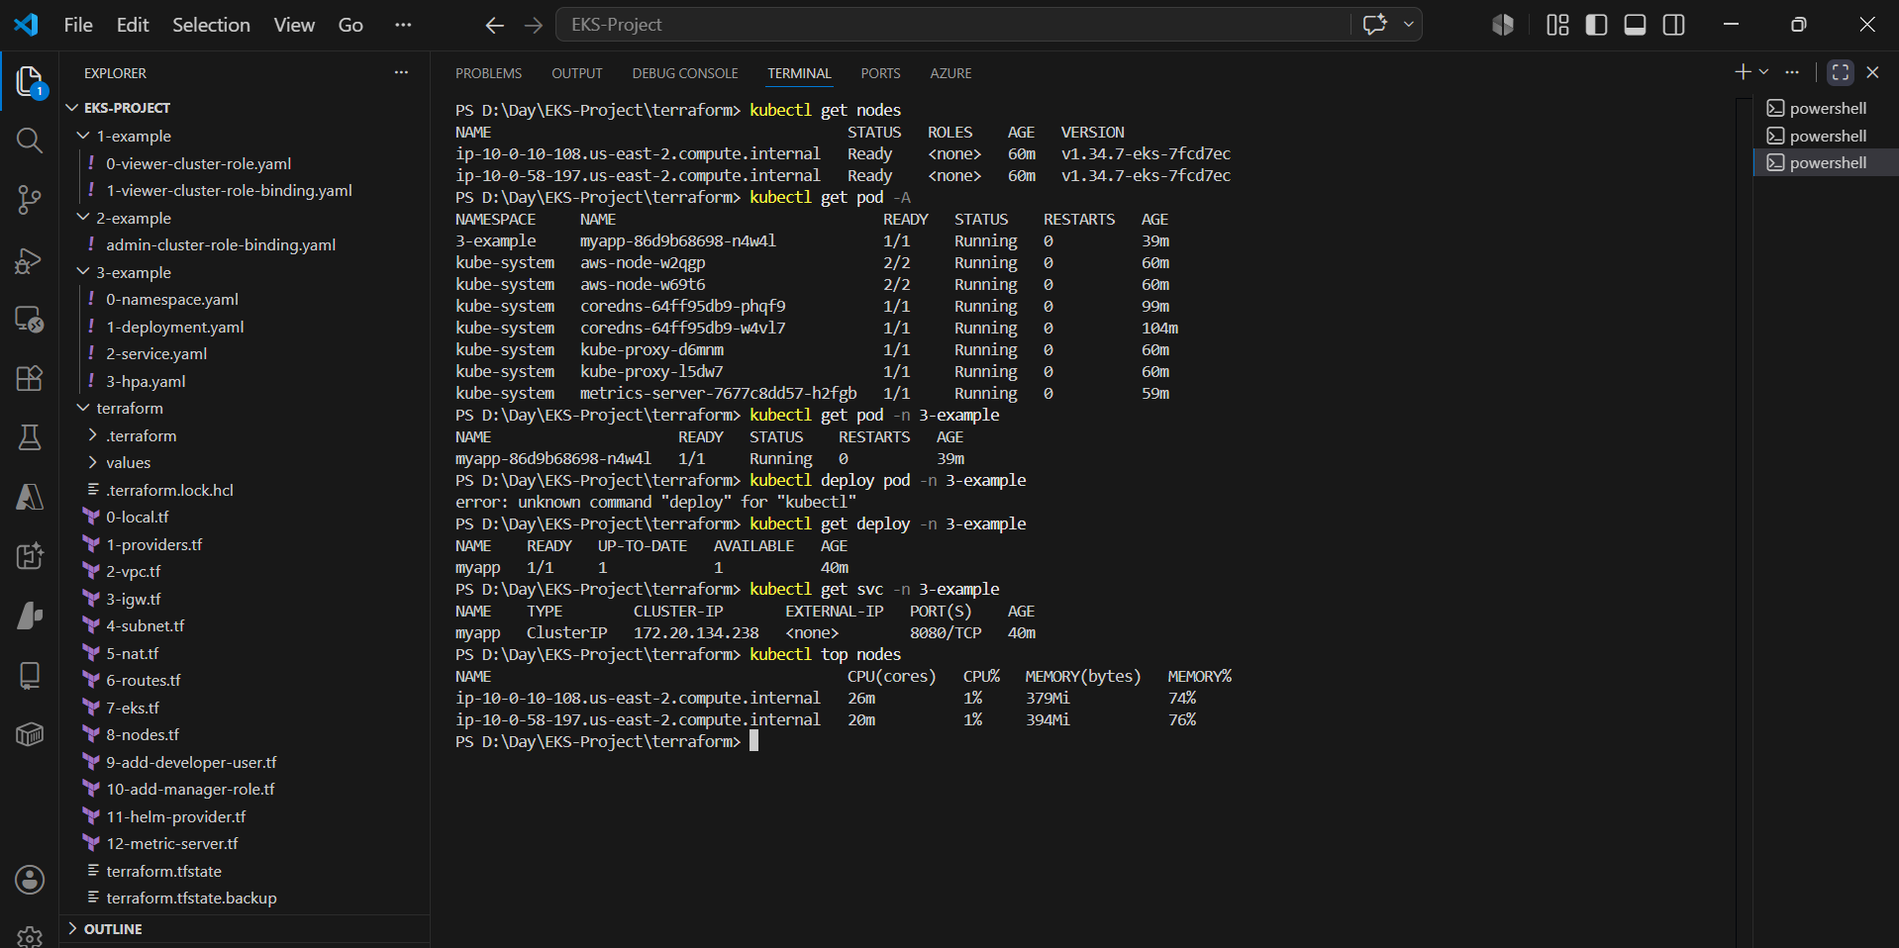
Kubernetes Artifacts

