Slide 1
EKS Terraform POC on AWS
Proof of Concept demonstrating AWS EKS infrastructure creation using Terraform and Kubernetes deployment validation.

Slide 2
Project Overview
This POC includes:
AWS VPC creation using Terraform
Public and Private Subnets
Internet Gateway and NAT Gateway
EKS Cluster and Node Group creation
IAM Users, Roles and Policies
Helm Provider integration
Metrics Server deployment
Kubernetes Deployment, Service and HPA
kubectl validation and monitoring

Slide 3
Terraform Folder Structure
Terraform files used in the project:
1-providers.tf
2-vpc.tf
3-igw.tf
4-subnet.tf
5-nat.tf
6-routes.tf
7-eks.tf
8-nodes.tf
9-add-developer-user.tf
10-add-manager-role.tf
11-helm-provider.tf
12-metric-server.tf

Slide 4
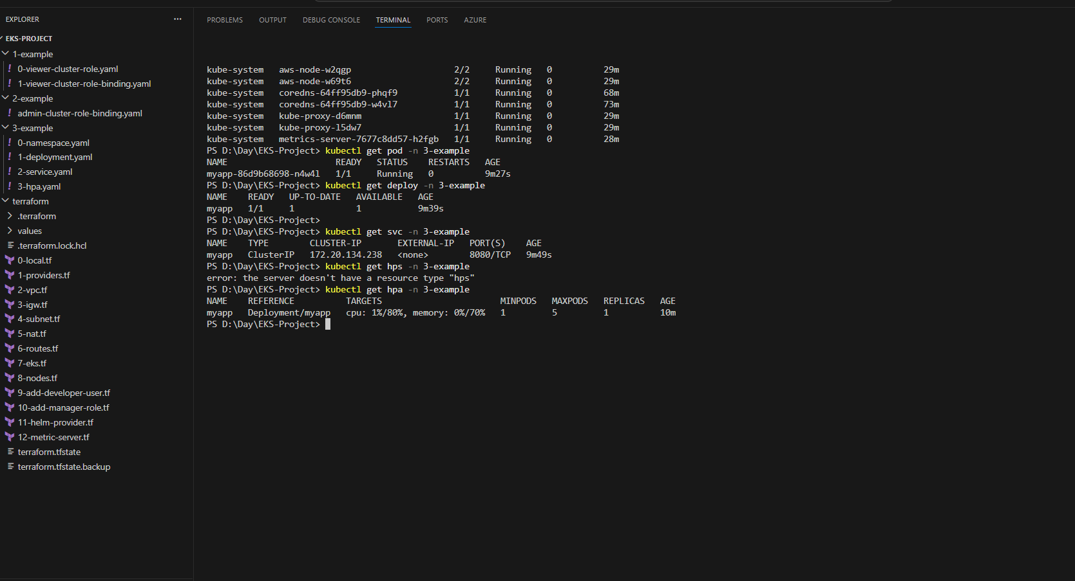
Terraform and Kubernetes Validation Output

Slide 5
Validation Commands Used
Kubernetes and Terraform verification commands:
terraform init
terraform validate
terraform plan
terraform apply
kubectl get nodes
kubectl get pods -A
kubectl get deployment -n 3-example
kubectl get svc -n 3-example
kubectl get hpa -n 3-example

Slide 6
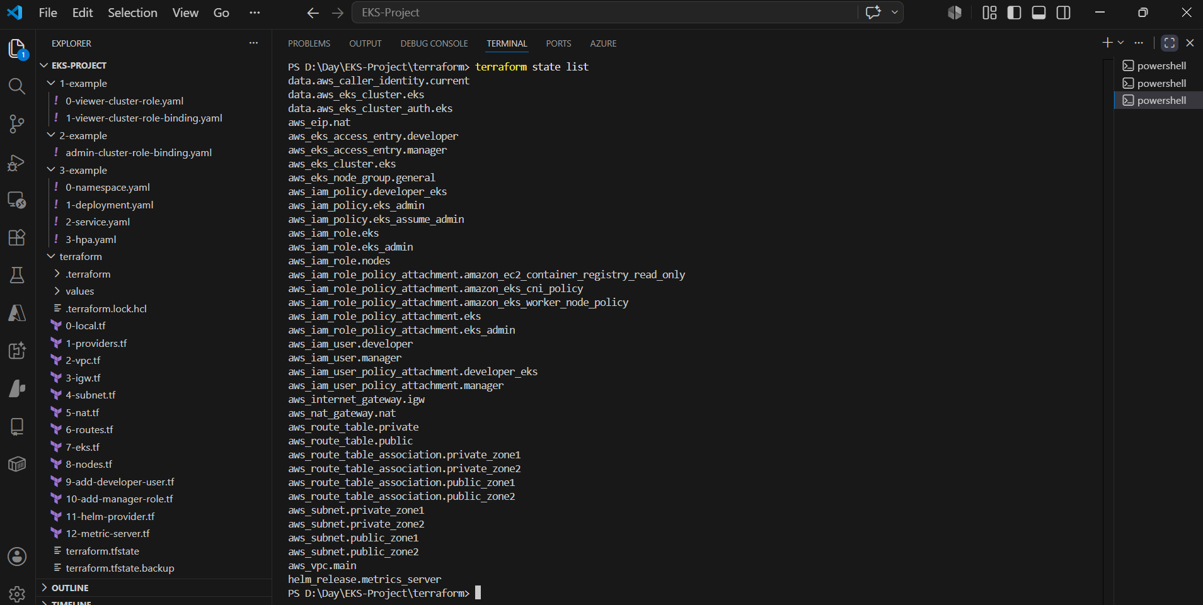
Infrastructure provisioned

Slide 7
POC Outcome
The Terraform-based EKS setup was successfully completed.
AWS infrastructure created using Infrastructure as Code
EKS cluster and worker nodes deployed successfully
Metrics Server installed using Helm
Application deployment and service validated
Horizontal Pod Autoscaler (HPA) configured and verified
Cluster monitored using kubectl commands

Slide 8
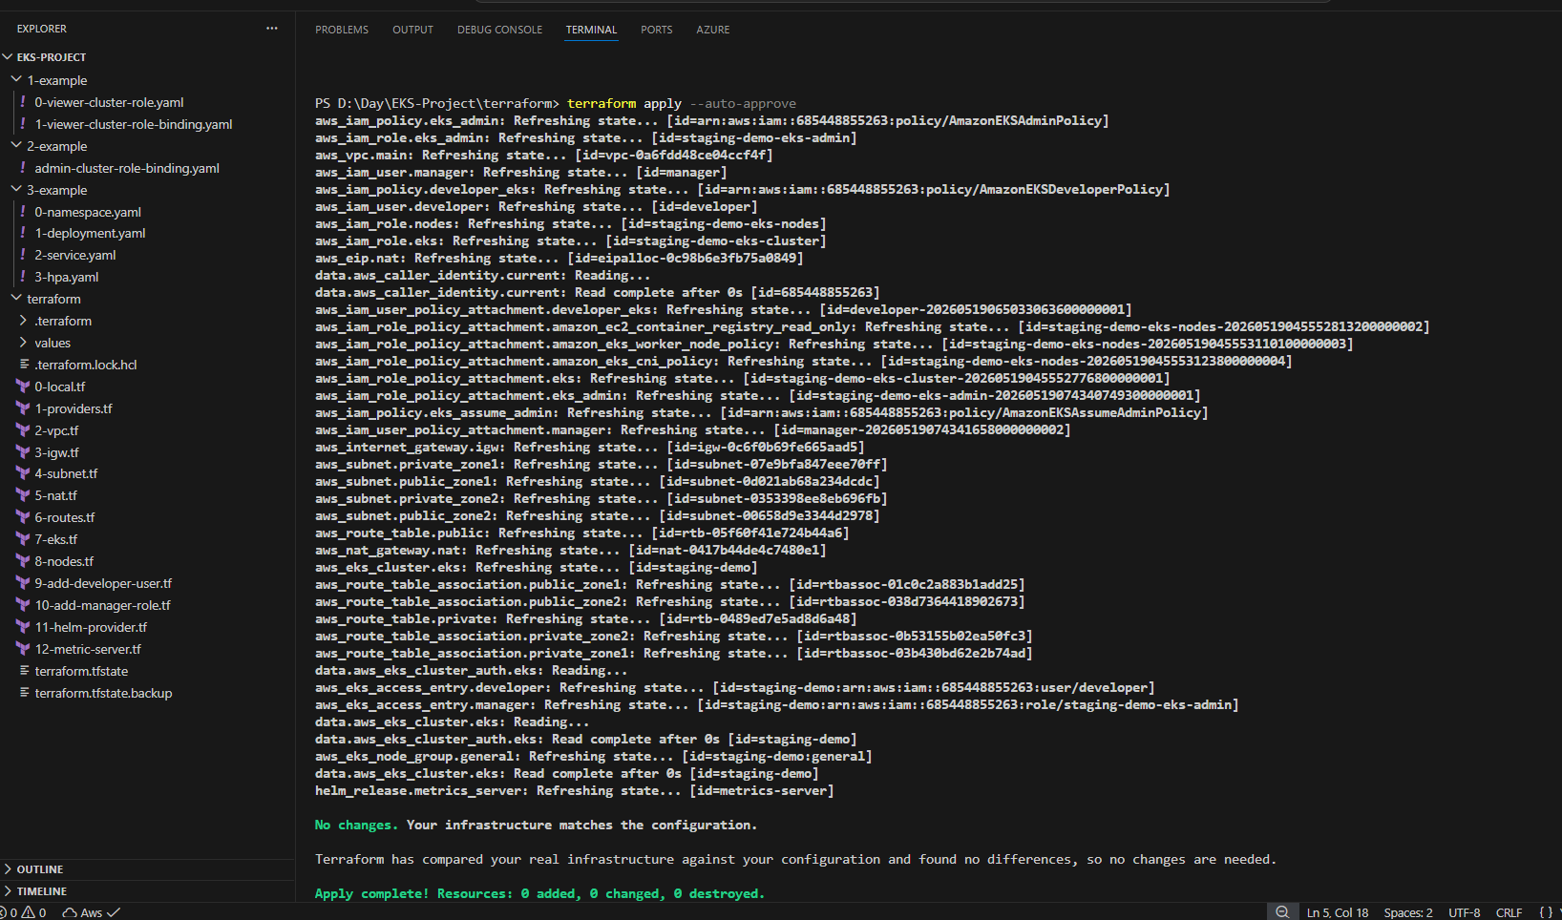
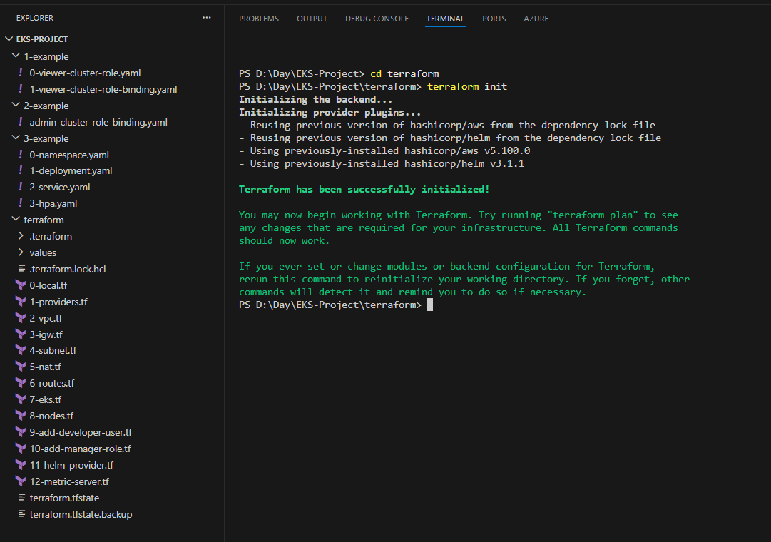
Infrastructure provisioning
Terraform init && Terraform apply

Slide 9
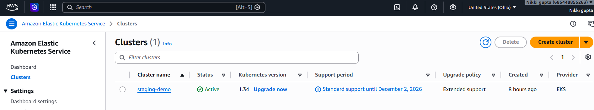
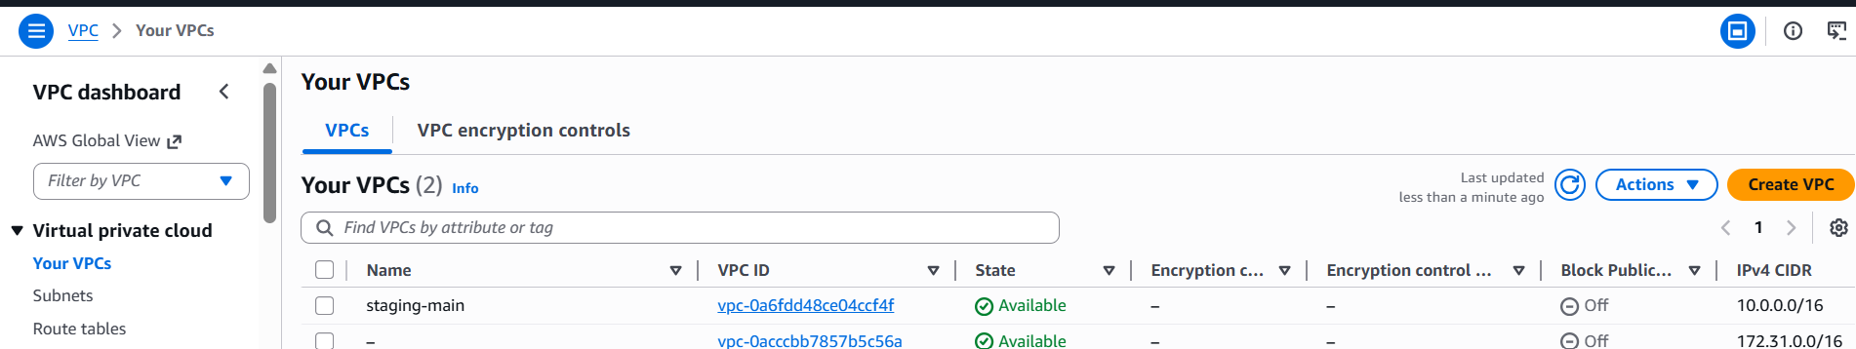
Aws provision
EKS : VPC

Slide 10
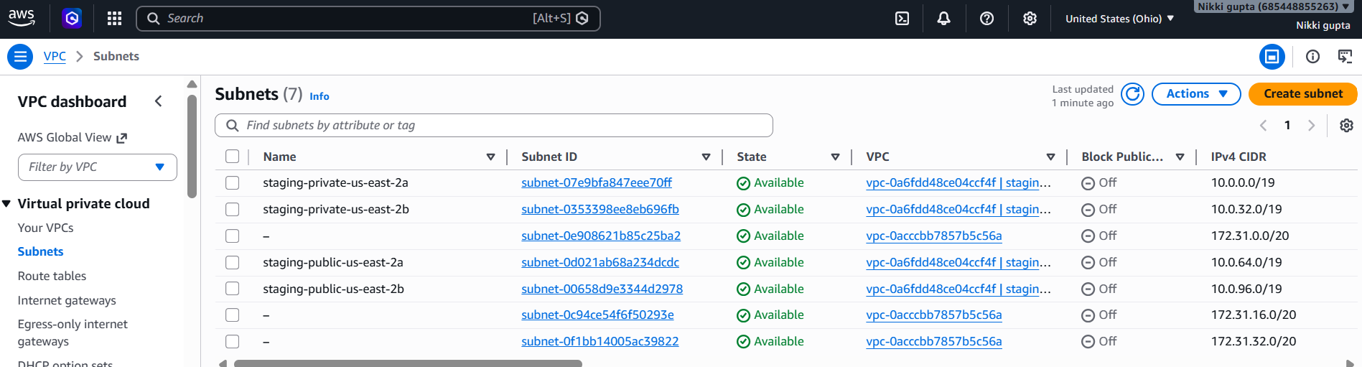
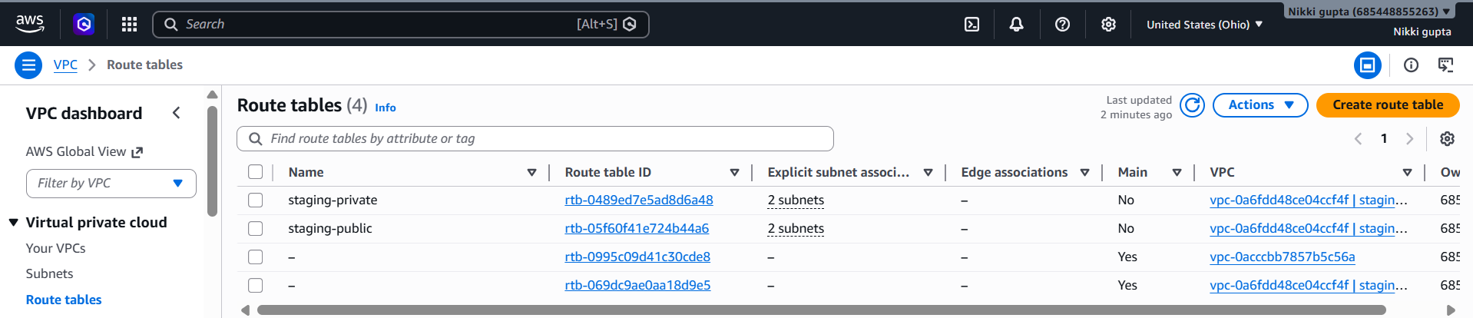
Subnet:Routetable

Slide 11
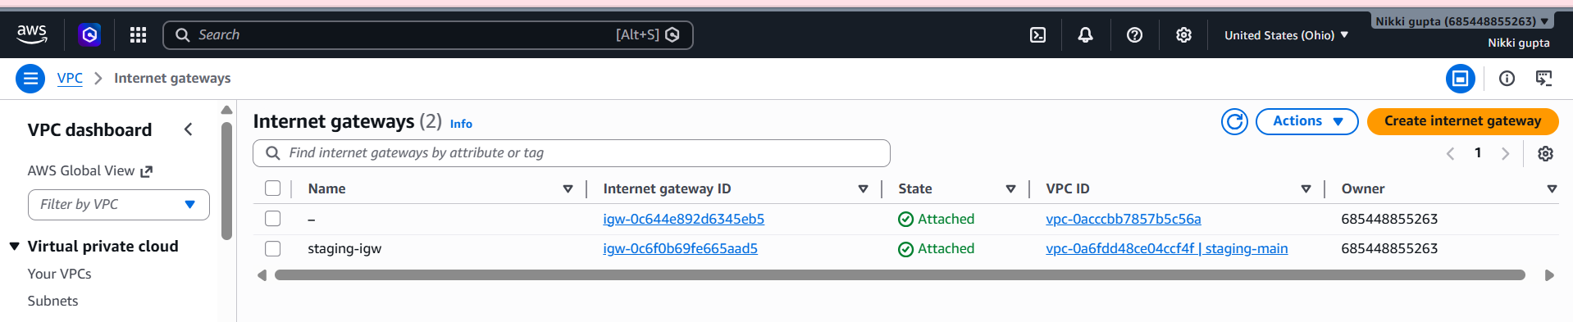
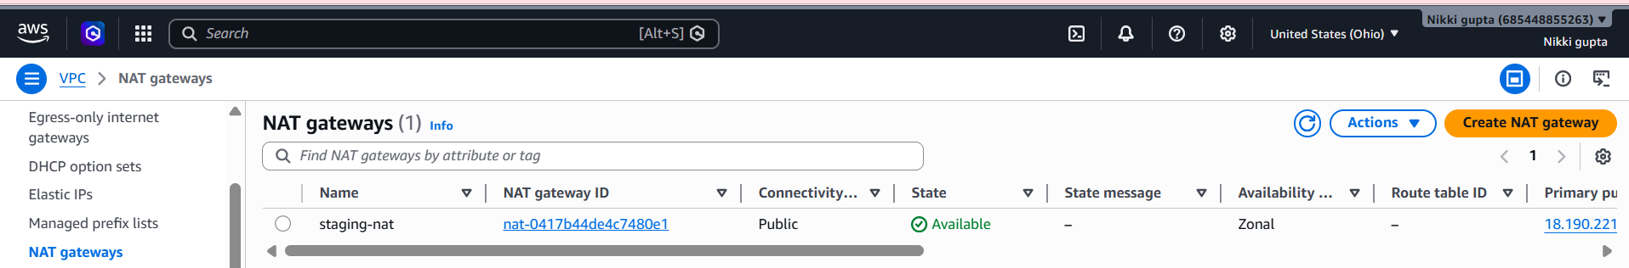
IG:NAT

Slide 12
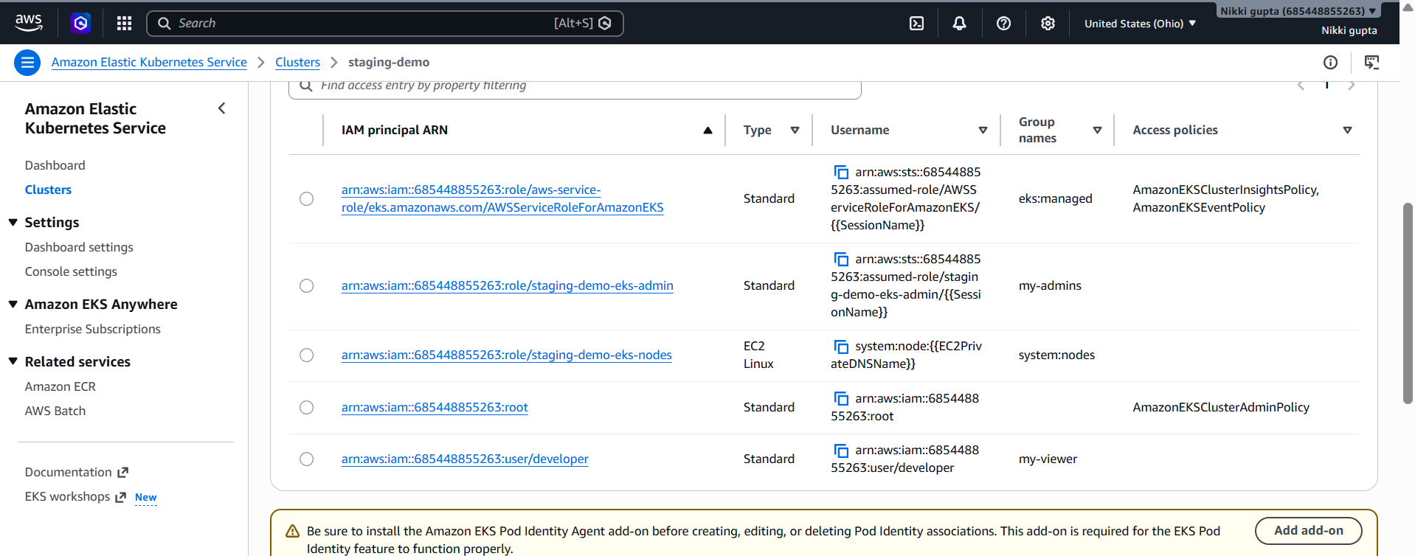
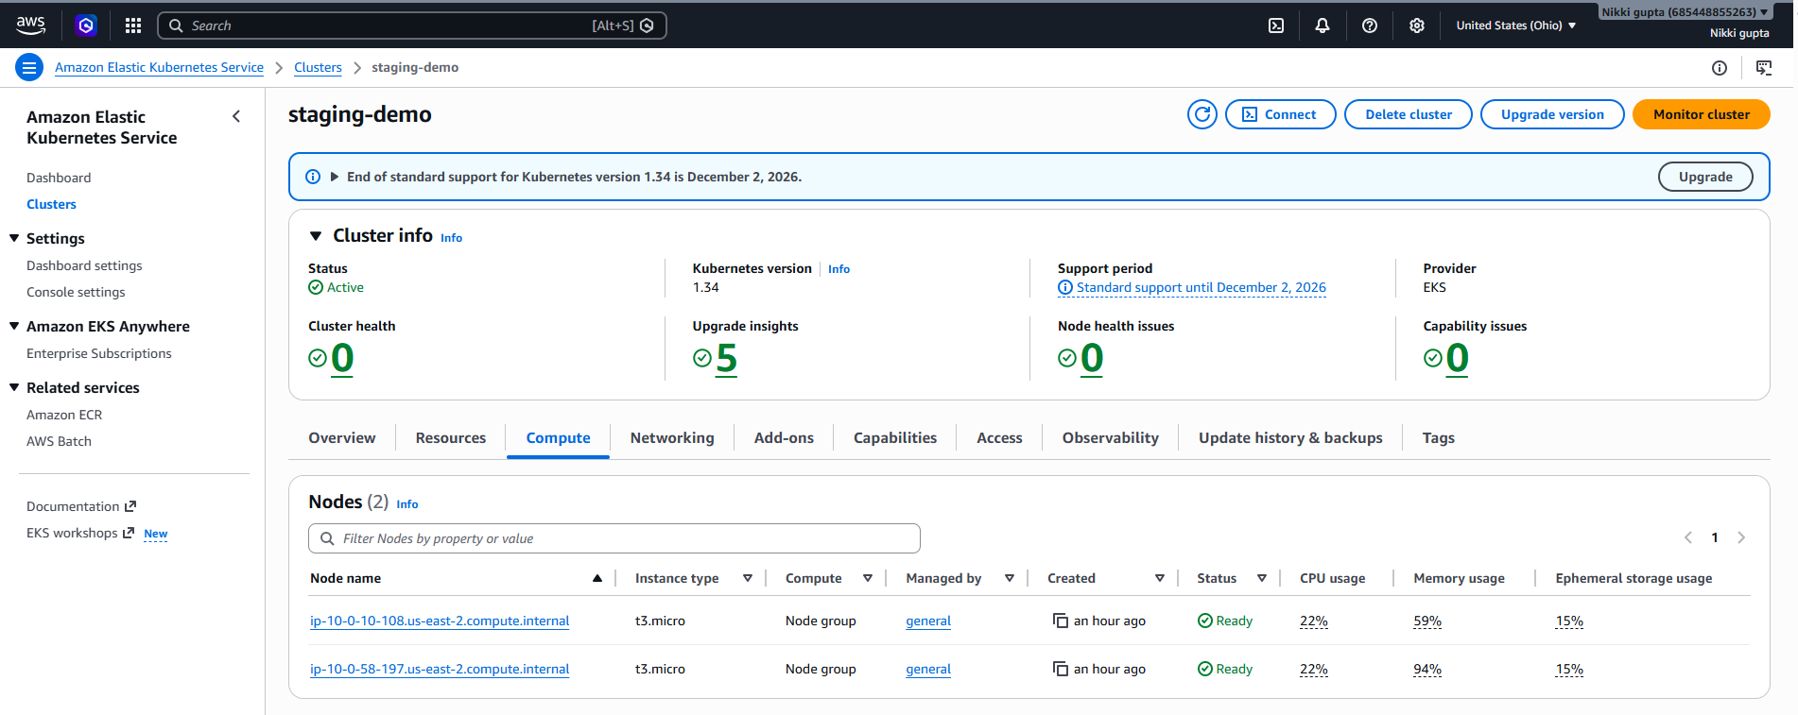
Iam Access Enteries: Worker Nodes

Slide 13
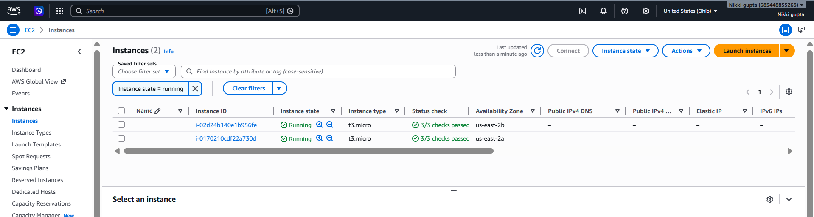
Ec2 instance running

Slide 14
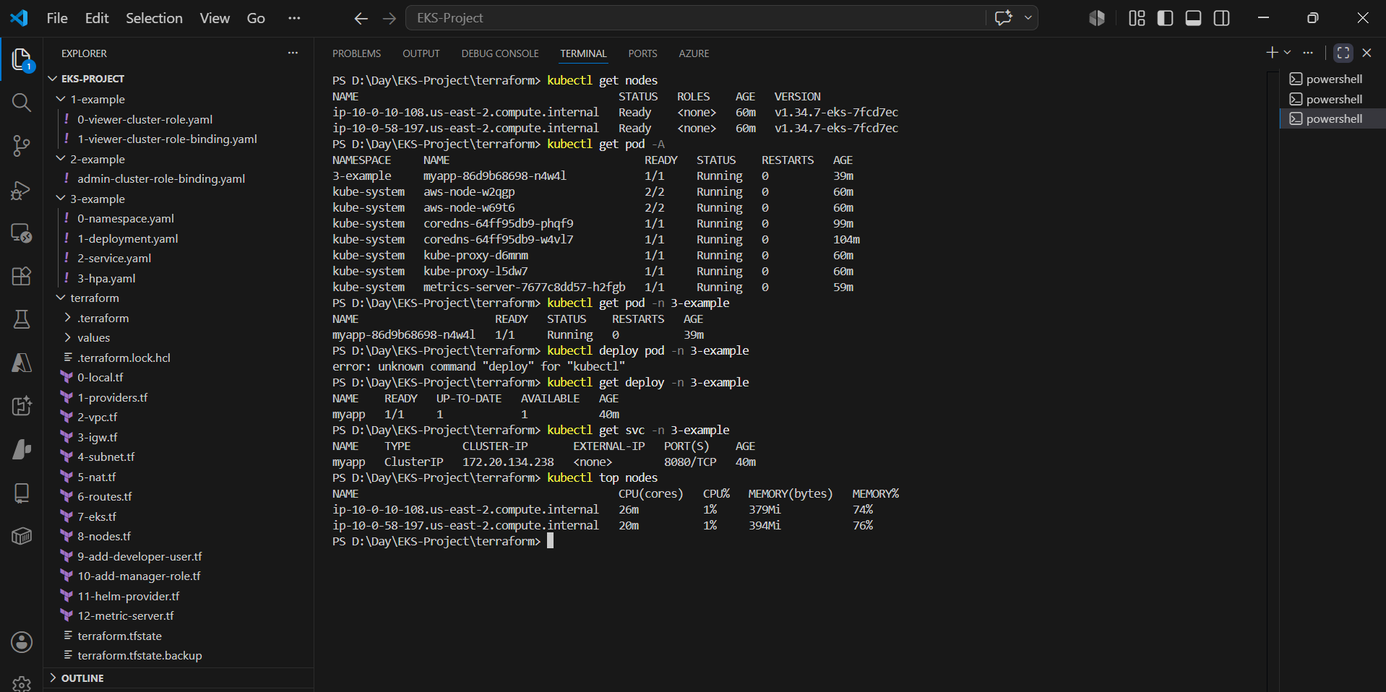
Kubernetes Artifacts

Slide 15
Karpenter
Karpenter is an open-source Kubernetes node autoscaler developed for Kubernetes clusters running on AWS.
It automatically:
Provisions new EC2 worker nodes
Removes unused nodes
Optimizes cluster cost
Improves pod scheduling
Unlike Cluster Autoscaler:
Faster scaling
Direct EC2 provisioning
Better bin-packing
Supports Spot/On-Demand instances

Slide 16
Architecture Used
Components Created
AWS Resources
EKS Cluster
VPC
Public & Private Subnets
NAT Gateway
IAM Roles
Security Groups
EC2 Worker Nodes
Kubernetes Components
Metrics Server
Karpenter Controller
NodePool
EC2NodeClass

Slide 17
Terraform file used
File Name | Purpose
7-eks.tf | EKS Cluster creation
8-nodes.tf | Managed node group
11-helm-provider.tf | Helm & Kubernetes provider
12-metric-server.tf | Metrics server installation
13-karpenter.tf | Karpenter Helm installation

Slide 18
Karpenter installation process
Step 1 — Metrics Server Installation
Metrics server is required for:
Resource metrics
CPU/Memory monitoring
Autoscaling
Installed using Helm.
Step 2 — IAM Configuration
IAM role and policies were configured for:
EC2 provisioning
Instance management
Node lifecycle operations
Step 3 — Install Karpenter Using Helm
Karpenter was installed using:
Helm provider in Terraform
Official Karpenter Helm chart
Note : namepsace used : karpenter

Slide 19
6. Karpenter YAML Resources Created
Folder Created
4-example.yaml
YAML Files Used
YAML File | Purpose
0-karpenter-nodeclass.yaml | Defines EC2 configuration
1-karpenter-nodepool.yaml | Defines scaling behavior

Slide 20
7. EC2NodeClass Purpose
EC2NodeClass defines:
AMI
IAM Role
Subnets
Security Groups
Example:
Amazon Linux 2 AMI
Private subnets
Discovery tags
8. NodePool Purpose
NodePool defines:
Allowed instance types
CPU limits
Node requirements
Autoscaling rules
Example used:
t3.small
t3.medium

Slide 21
Testing
Deployment Created :kubectl create deployment nginx --image=nginx
Scaled Application : kubectl scale deployment nginx --replicas=10
Check pod : kubectl get nodes –w
Checked karpenter pod : kubectl get pods -n karpenter

Slide 22
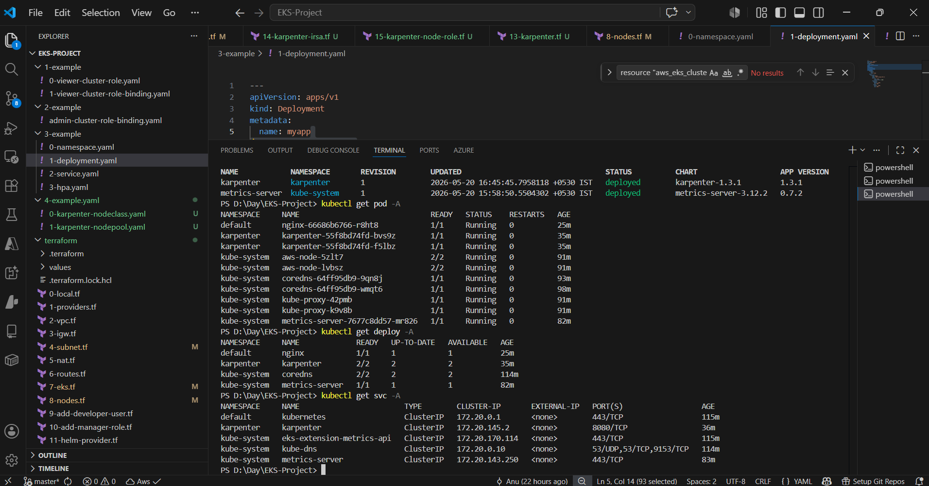
Karpenter helm release

Slide 23
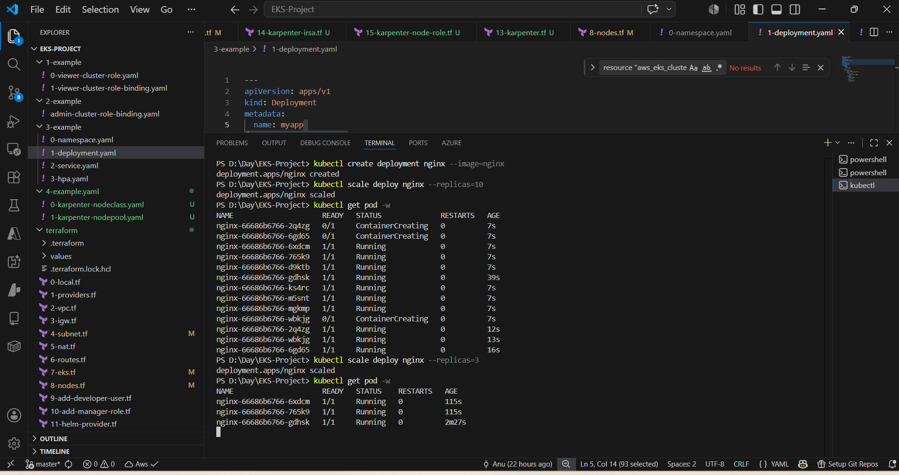
KarpenterTest

