Slide 1
IndicEdgeBench
How much Indian-language quality do small LLMs lose when compressed to run on a laptop CPU, and what do we gain?
Final-year capstone · Evaluation 1 · Pammy · 31 October 2026
Notes:
Introduce the one question the project answers. Everything that follows is about measuring both halves of the trade-off together.

Slide 2
The problem: offline AI in Indian languages has a hidden cost
Offline, private AI on the phones and laptops Indians actually own needs small (≤ 8B) models.
To fit, models are quantized (16-bit → 8, 4 or 2 bits) and run on CPU runtimes like llama.cpp.
Indian scripts are low-resource and split into many more tokens, so compression is expected to hurt them most.
Nobody has measured how much quality is lost against how much speed, memory and energy is gained in Indic languages.
5.5×
fewer words per second for Tamil than English, from the same model on the same CPU (our pilot)
Notes:
The 5.5x number comes from our own pilot: decode tokens per second divided by tokenizer fertility.

Slide 3
Literature: each half is studied, never both together
Work | Indic tasks | Quantization sweep | Measured CPU latency / RAM / energy
MILU, IndicParam, IndicGenBench, IndicRAGSuite | ✓ | ✗ | ✗
Marchisio et al. 2024: Quantization & multilingual LLMs | partial | ✓ | ✗
Marie & Fujita 2025: PTQ in machine translation | MT only | ✓ | ✗
Multilingual Quantization Tax 2026 (preprint) | partial | ✓ | ✗
PalmBench, Song et al. 2025, RooflineBench | ✗ | ✓ | ✓
IndicEdgeBench (this project) | ✓ | ✓ | ✓
Key evidence: a 1.7% automatic drop in Japanese hid a 16% drop in human ratings (Marchisio et al.); Indic MT can collapse entirely under PTQ (Marie & Fujita). All 20 references verified on arXiv; see docs/literature_survey.md.
Notes:
Indic benchmarks evaluate only full-precision models; on-device benchmarks evaluate only English. That empty cell is our contribution.

Slide 4
Objectives
1
Open harness
Score quantized GGUF models on Indic MCQs and measure CPU efficiency in one run
2
Quality loss
Per-language accuracy drop at F16 → Q8 → Q4 → Q2, with CIs and flip rates
3
Efficiency gain
Speed, time-to-first-token, peak RAM and energy per configuration
4
Tokenizer tax
Fertility (tokens/word) and the words/s a user actually experiences
5
Pareto frontier
Quality-vs-efficiency curves per language, released on GitHub and Hugging Face

Slide 5
System architecture: five layers, one command
1
2
3
4
5
Data
MILU (11 langs) or bundled 30-item parallel set → frozen, seeded sample
Models
GGUF from Hugging Face: F16 · Q8_0 · Q4_K_M · Q2_K
Runtime & meters
llama.cpp on CPU, one fresh process per config; RAM, energy, timing
Evaluation
Letter log-likelihood scoring; bootstrap CI, paired Δ, flip rate, words/s
Release
summary.csv, REPORT.md, plots; later HF dataset + leaderboard
python -m indicedgebench run configs/pilot.yaml
Resumable · config-driven · cross-platform (macOS dev, Windows 11 laptop runs) · 17 unit tests

Slide 6
Methodology
Quality
Statistics
Efficiency
Prompt ends in “Answer:”; pick the A–D letter with the highest next-token logit (lm-eval-harness style)
Deterministic, no answer parsing: robust for small models in Indic languages
Identical frozen items for every config
95% bootstrap CIs (1,000 resamples, fixed seed)
Paired bootstrap Δ vs. baseline on the same items
Flip rate: share of answers that change under quantization
Fresh process per config; warm-up before timing
Fixed 64-token greedy decode, 3 repeats, median ± std
Peak RSS sampled every 20 ms; energy = RAPL or labelled estimate

Slide 7
Implementation status (v0.1)
Done for Evaluation 1
Next
Config-driven sweep runner (resumable)
MILU loader + 30-item parallel en/hi/ta set
llama.cpp engine: MCQ scoring + generation timing
Memory, energy and fertility meters
Statistics: bootstrap CI, paired Δ, flip rate
Report: CSV, Markdown, 4 plots
Windows + macOS setup scripts, 17 tests
Pilot on Windows laptop: Qwen2.5-1.5B + Llama-3.2-1B
MILU with 200 items per language (HF token)
Native-speaker validation of the item set
More languages (Telugu, Bengali, Marathi)
ONNX INT8 runtime, Android phone measurements

Slide 8
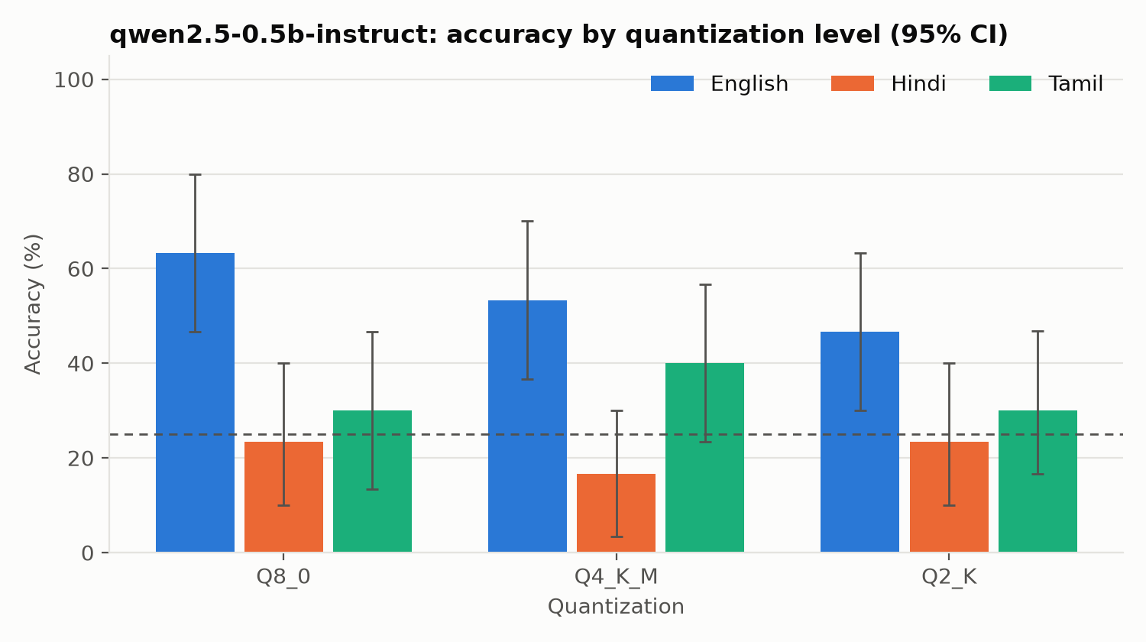
Pilot: Indic accuracy sits near chance; English degrades steadily
English: 63% → 47% from Q8 to Q2
Hindi 23% and Tamil 30% are already near chance (25%) at Q8: a 0.5B model barely understands them
Flip rate at Q4: 67% of Hindi and 73% of Tamil answers change vs. 20% in English
Flat accuracy can hide unstable answers; flip rate exposes it
Notes:
Qwen2.5-0.5B on Apple M3 CPU; Q8_0 is the baseline because the F16 download was paused. 30 items gives wide CIs (about ±17 points), which is why the laptop pilot uses 200 MILU items.

Slide 9
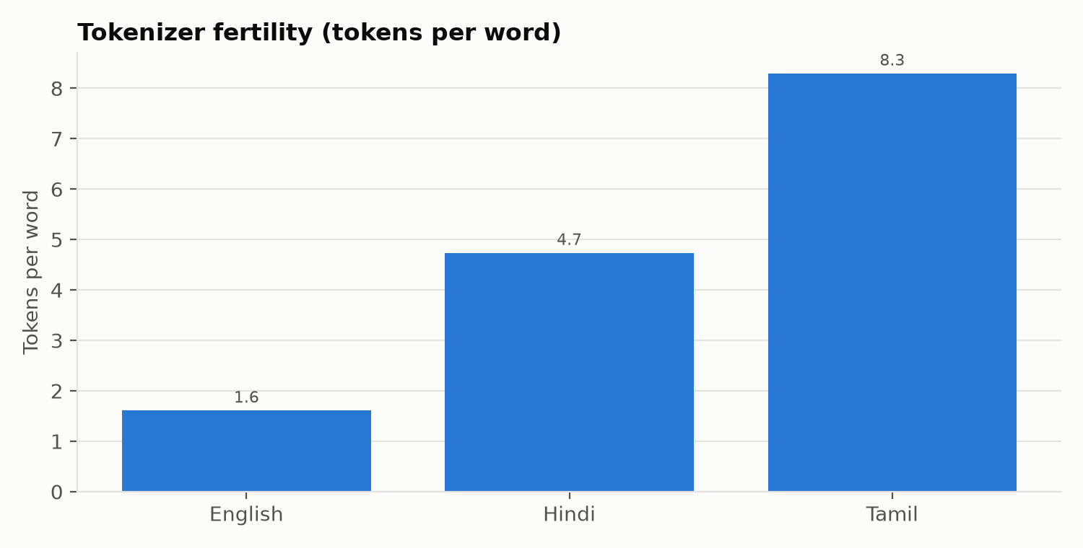
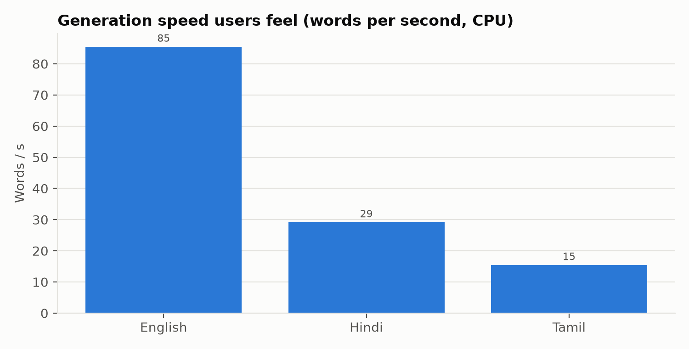
The tokenizer tax: same speed in tokens, 5× slower in words
128–138
2.1×
104 vs 52 ms
tokens/s decode in every language: the CPU is not the difference
energy per Tamil question vs. English (estimated)
time to first token, Tamil vs. English

Slide 10
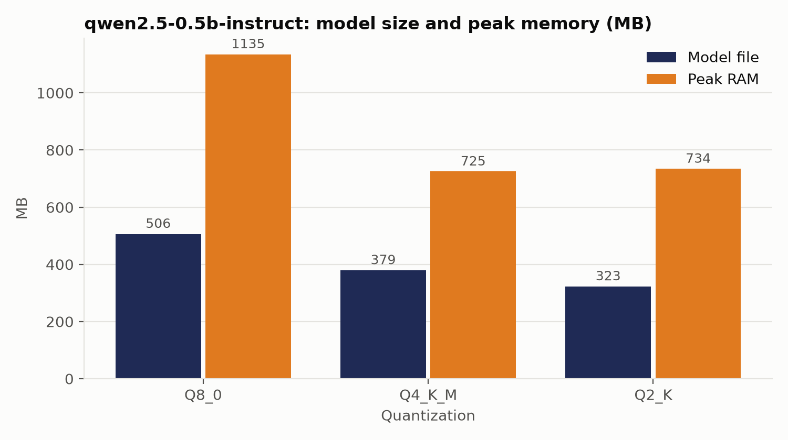
What compression buys at 0.5B: memory, not speed
Q4_K_M cuts peak RAM by 36% vs. Q8_0
Q2_K saves almost nothing more: runtime buffers dominate at this size
Decode speed barely moves (~130–140 tokens/s): a 0.5B model is not memory-bandwidth bound on the M3
Larger 1–1.5B models on the Intel laptop should show the speed gain; that is the next run

Slide 11
Honest limitations of the pilot
30 items
Wide confidence intervals (about ±17 points). Fix: MILU, 200+ items per language.
0.5B model
Too small for Indic: near-chance accuracy hides quantization effects. Fix: 1–1.5B models next.
Q8 baseline
F16 download paused on the dev Mac. Fix: F16 baseline in the laptop pilot.
Energy
Estimated from CPU time × TDP on macOS/Windows. Fix: RAPL on Linux, battery drain on phone.
Item validity
Hindi/Tamil items not yet native-speaker validated. Fix: annotation protocol, IAA ≥ 0.6.

Slide 12
Plan to the final evaluation
Weeks 1–4
Weeks 5–6
Weeks 7–10
Weeks 11–18
Weeks 19–24
Literature, design, harness v0.1, Mac pilot
Laptop pilot: 2 models × 3–4 quants, MILU
Native-speaker validation, fresh contamination-resistant slice
Full sweep: 6–8 models, 4–6 languages, ONNX INT8, phone
Pareto analysis, leaderboard, paper, HF release
Done = Evaluation 1 scope. Target venues: ACL/EMNLP/NeurIPS workshop (D&B, efficiency, ML4D) + arXiv preprint.

Slide 13
Thank you
Code, data and results: github.com/pammy01/IndicEdgeBench
Live demo: python -m indicedgebench run configs/smoke_mac.yaml (≈ 2 minutes)

