Slide 1
UseIt
The circular economy for everyday goods.
Ori Perelman · Netanel Pam · Michal Pravlov · Eden Ben Zion · Nitzan Zetun

Slide 2

THE PROBLEM
Stuff sits idle — and it costs more than closet space.
Production
→
Purchase
→
Brief Use
→
Shelf Time
→
Disposal
30
Target audience
Ages 25–45, urban, digitally native
On-demand mindset, mobile-first
Early adopters: eco-conscious, community-minded
Real pilot, not a survey
unused electrical items per household — up from 20 just four years ago (+50%).
We ran a month-long "dorm warehouse" — neighbors listing and renting real idle items from each other. Genuine, sustained supply and demand on both sides.
Material Focus, UK national electricals-recycling survey
UseIt
02

Slide 3



THE SOLUTION
"Airbnb for your things."
Passive Income
Rent with Confidence
List in 30 Seconds
Turn idle equipment into a steady monthly revenue stream.
Verified users, escrow payments, and a GPS-checked QR handoff.
Photograph the item — AI fills in the rest, instantly.
Closing the loop: instead of production → purchase → shelf time → disposal, UseIT keeps products in active use — cutting new production, easing storage pressure, and giving people affordable access to things they need only occasionally.
UseIt
03

Slide 4






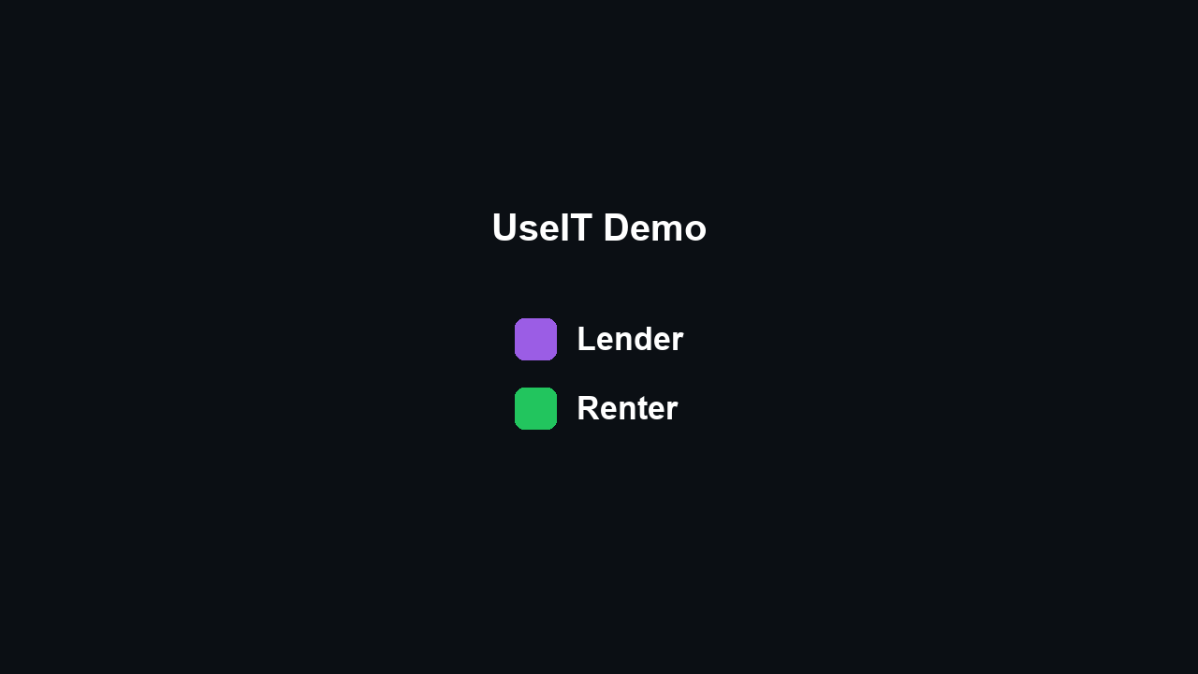
THE PRODUCT
Six steps, end to end.
→
→
→
→
→
Sign Up
Swipe to Find
Escrow Pay
QR Pickup
Use It
QR Return
UseIt
04

Slide 5
MARKET
Built for dense neighborhoods.
TAM
SAM
SOM
~9.5M
300K–800K
50K–150K
People living in urban areas in Israel (93% of ~10.2M).
People who could realistically rent or lend equipment.
Digitally native P2P rental audience, near-term addressable.
In a dense city, logistics disappear — no shipping, no long drives. The ideal rental is one block away. That is why Tel Aviv is the deliberate first market.
UseIt
05

Slide 6



COMPETITIVE LANDSCAPE
The alternatives were never built for this.
FB / WhatsApp
Rental Shops
Fat Llama
UseIt
Rental-native experience
Dispute resolution
Local trust layer (Israel)
CO₂ tracking & rewards
Native in-app payments
UseIT is purpose-built for rentals: dispute resolution, CO₂ tracking, and a fully native trust + payments layer, localized for Israel from day one.
UseIt
06

Slide 7


NEXT STEPS
Business and technology, in parallel.
Business
Technology
Get Lenders — Tel Aviv first, seed the catalog
Bring in Renters — community, referrals, reviews
Make It Stick — retention over raw acquisition
Year 2: scale city-by-city → 10,000 users
Raising a $150K pre-seed, ~12-month runway
Real KYC (Stripe Identity) for verified users
Premium "listing boost" for lenders (phase 2)
Automated first-pass dispute triage
Automated test suite — currently none
Android distribution beyond direct APK
UseIt
07

Slide 8

TECHNOLOGY · 1 OF 3
What it’s built with — and what fought back.
React Native + Expo
Supabase (Postgres)
Stripe Connect
Groq (Llama + Qwen)
A real bug, and how we found it
Our AI Auto-Fill feature (a Groq vision model reading a photo) started returning empty results. The model’s reasoning mode was silently burning its entire token budget on invisible chain-of-thought — leaving nothing for the actual answer. The first fix we tried (hiding the reasoning) didn’t work; it still spent the tokens, just off-screen. The real fix was disabling reasoning outright per-request.
UseIt
08

Slide 9
TECHNOLOGY · 2 OF 3
Security lives in the database, not just the app.
React Native
App
↔
Supabase
Postgres + RLS
↔
9 Edge
Functions
↕
Stripe Connect
+ Groq
Row-Level Security
Edge functions only for secrets
Physical-world verification
Most reads/writes go straight to Postgres — access rules are enforced by the database itself, not application code.
The 9 functions exist only where a trusted server or a secret key is required — payments, AI calls, admin actions.
Pickup/return require a GPS-checked QR scan — confirming both parties were actually present, not just a rating.
UseIt
09

Slide 10

TECHNOLOGY · 3 OF 3
AI, on both sides of the product.
In the product
Building the product
AI Auto-Fill — a Groq vision model reads one photo and fills title, category, description, and price
AI Trip Planner — a text model ranks listings against a free-text request and real date availability
Two different models on purpose — one needs vision, the other needs fast, cheap reasoning over text
AI coding tools helped write and review large parts of the codebase
The responsibility for what shipped is ours — not the tool’s
Example: the platform fee silently defaulted to a placeholder split — we caught it against our own decision and fixed it
Example: 7 database migrations existed live but were never committed to the repo — we found and backfilled the gap
UseIt
10

Slide 11
TEAM
Five people, one product.
OP
NP
MP
EBZ
NZ
Ori Perelman
Netanel Pam
Michal Pravlov
Eden Ben Zion
Nitzan Zetun
Full-Stack / Mobile
Full-Stack / Mobile
Market Strategy & Financial Modeling
Competitive Analysis
Pitch & Narrative
Product engineering, market research, financial modeling, and pitch strategy — the full path from a working product to a defensible business.
UseIt
11

Slide 12

UseIt
Use it. Don’t waste it.
github.com/pamnati592/UseIT

