Slide 1


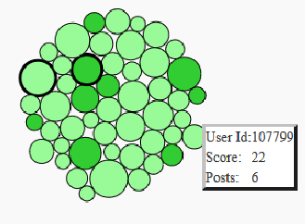
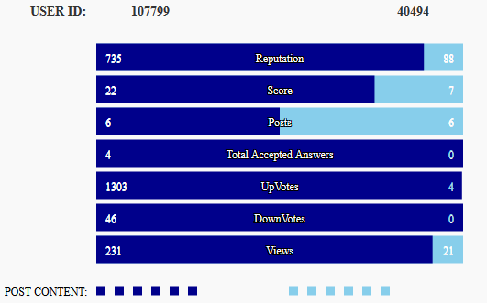
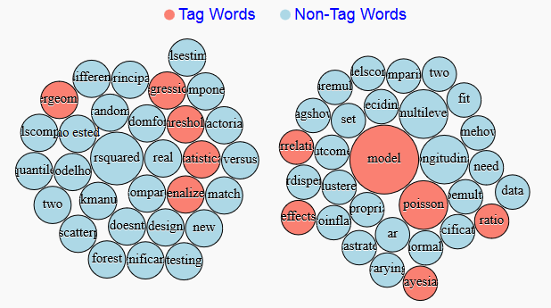
Analyzing and Comparing Different Users of CrossValidated R
Kavita Rathore, krathor1@asu.edu Nishi Shah, nkshah6@asu.edu
Kshama Jain, kjain10@asu.edu Prachi More, pamore@asu.edu
Motivation & Relevant Work:
On CrossValidated discussion forum, users provide answers to questions asked which receive reviews from other users in form of upvotes, downvotes or a comment.
Users build their skills in ‘R’ domain by receiving high upvotes for their posts; influencing their reputation as well.
On this Online Discussion Forum we can look into statistics of each and every users, such as posts, votes, views but we cannot compare different users.
Research Questions:
How to compare different users on CrossValidated based on their posts, scores, votes, views and number of answers accepted?
Is there a difference between words used in post by a high scoring user and a low scoring user?
Can we find correlation between different features of user profile ?
Whether the use of tag words in post affects the score of a user?
Methodology:
The forum is user centric, so user specific data and their posts are analysed.
Users are categorised based on their scores, number of posts and the number of accepted answers.
Two users can be compared with their attributes like score, posts, views, UpVotes, DownVotes.
D3- force is used to simulate a bubble chart for all users in R domain
Text analysis using Python script and R.
Used libraries: csv, sys, re (regular expression),nltk (natural language tool kit), tm(Text Mining)
Stemming, removing stopwords, lowercase conversion, removing non-alphabets
Bubble Chart implementation using results from text analysis
Categorizing users based on score
and
answers
accpted:
Comparing features of two users:
Data Collection and Cleaning:
Stack Exchange Data Explorer (http://data.stackexchange.com)
Parsing data and calculating frequency of relevant words after removing unwanted characters and words using R and Python script.
Text Analysis of posts of two users:
Findings:
There are significant amount of users with posts less than 5 in R domain. Number of skilled, high scoring users are only 3% of all the users in R.
Users with same number of posts differ in their score because of their number of accepted answers.
The quality of the post and the views it receives play an major role in developing the user’s score.
There is a positive correlation between the amount of answers accepted and the number of posts given by the user.
There is no relation found between the use of tag word in post and the score of the user.

