Slide 1
Introductionto Asp.Net Core
Jim Fawcett
CSE686 – Internet Programming
Spring 2018

Slide 2
Introduction
Asp.Net Core provides a framework for building and executing both Console and Web Applications
The 2.1 framework provides a host, responsible for startup and lifetime management.
Generic Host – host non-web apps
Windows services and executables
Web Host – suitable for hosting web applications
Create instance with IWebHostBuilder
Primary focus is web applications
It provides a pluggable hosting environment that supports:
Kestral, IIS, Apache, Nginx

Slide 3
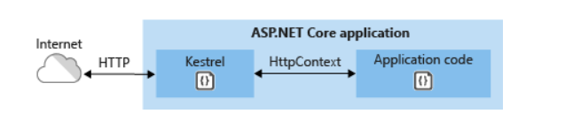
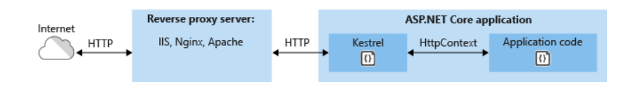
Web Application Hosting Options
Kestral
IIS, Apache, Nginx
Diagrams from https://docs.microsoft.com/en-us/aspnet/core/fundamentals/servers/?view=aspnetcore-2.2&tabs=windows

Slide 4
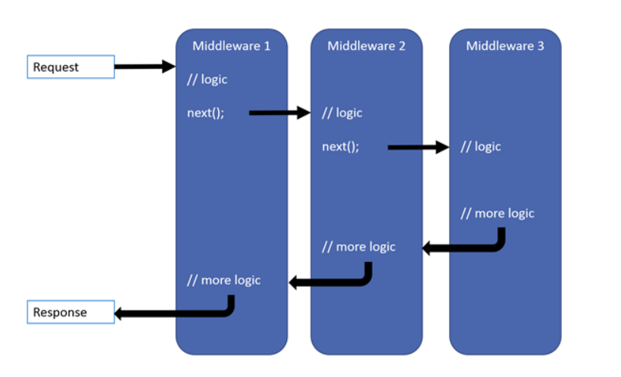
Asp.Net Core Pipeline
Provides an application pipeline that supports pluggable services
Pipeline services are delivered via a Dependency Injection Container
The pipeline is configured with one or more components.
Diagram from https://docs.microsoft.com/en-us/aspnet/core/fundamentals/middleware/?view=aspnetcore-2.2
Middleware components pass Requests to next component via Request Delegates.
Each component configures a lambda that binds to a Request Delegate, defining its processing and invoking a next() function.
When a Request arrives the middleware delegate sequence is invoked.

Slide 5
Middleware
Middleware is software that's assembled into an app pipeline to handle requests and responses. Each component:
Chooses whether to pass the request to the next component in the pipeline.
Can perform work before and after the next component in the pipeline.
Request delegates are used to build the request pipeline. The request delegates handle each HTTP request.
The points, above, are taken from:
https://docs.microsoft.com/en-us/aspnet/core/fundamentals/middleware/?view=aspnetcore-2.2

Slide 6
Configuring Middleware
You configure pipeline middleware using the Configure method, provided by the Startup class.
Services include:
Serving static files
MVC routing and operations
Custom services
Service lifetime:
AddSingletonService<IService, Service>() Singleton service used for the lifetime of the Application
AddScopedService<IService, Service>() Singleton service used for the duration of one HTTP request
AddTransientService<IService, Service>() Created with each request for service, possibly many times per HTTP request

Slide 7
Middleware provided by the framework - partial list
Authenication
Cookie Policy
CORS
Diagnostics
HTTPS Redirection
MVC
Routing
Session
Static Files
URL Rewriting
WebSockets

Slide 8
Startup
Startup Class
ConfigureServices method
Registers a service interface and implementing class for dependency injection using one of the AddService methods, described in the previous slide
Each AddService adds a service to the Dependency Injection Services container.
Configure method
Creates the application’s pipeline with app.UseXXX() invocations.
app.Run( some write method )
An app.UseXXX invocation need not pass a message down the pipeline.
App.Run executes only if all app.UseXXX() middleware pass along the request message.
Essentially, the pipeline is the sequence of app.UseXXX() methods in StartupConfigure()

Slide 9
Building Web Host
IWebHostBuilder CreateWebHostBuilder(string[] args)
Creates a host and defines the Startup Assembly
IWebHostBuilder methods:
Build()
…
Extension methods:
Start(IWebHostBuilder, String[])
UseConfiguration(IWebHostBuilder, IConfiguration)
UseServer(IWebHostBuilder, IServer)
UseStartup(IWebHostBuilder, String)
…

Slide 10
app.Run
app.Run(…) is similar to app.UseXXX(), but does not send on a request. It is the pipeline terminus.

Slide 11
That’s All Folks

