Slide 1
JavaSCRIPT

Slide 2
Async Await
Async and Await are extensions of promises.
More recent additions to the JavaScript language are async functions and the await keyword, part of the so-called ECMAScript 2017 JavaScript edition
async keyword, which you put in front of a function declaration to turn it into an async function.
Async functions enable us to write promise based code as if it were synchronous, but without blocking the execution thread. It operates asynchronously via the event-loop. Async functions will always return a value. Using async simply implies that a promise will be returned, and if a promise is not returned, JavaScript automatically wraps it in a resolved promise with its value.
Basically async functions will always return a promise and we can use await inside async.

Slide 3
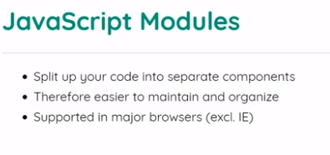

Slide 4
What is jquery
jQuery is a fast, small, and feature-rich JavaScript library. It makes things like HTML document traversal and manipulation, event handling, animation, and Ajax much simpler with an easy-to-use API that works across a multitude of browsers. With a combination of versatility and extensibility, jQuery has changed the way that millions of people write JavaScript.

Slide 5
jQuery selectors
$(this).hide() - hides the current element.
$("p").hide() - hides all <p> elements.
$(".test").hide() - hides all elements with class="test".
$("#test").hide() - hides the element with id="test".

Slide 6
More Selectors
Syntax | Description
$("*") | Selects all elements
$(this) | Selects the current HTML element
$("p.intro") | Selects all <p> elements with class="intro"
$("p:first") | Selects the first <p> element
$("ul li:first") | Selects the first <li> element of the first <ul>
$("ul li:first-child") | Selects the first <li> element of every <ul>
$("[href]") | Selects all elements with an href attribute
$("a[target='_blank']") | Selects all <a> elements with a target attribute value equal to "_blank"
$("a[target!='_blank']") | Selects all <a> elements with a target attribute value NOT equal to "_blank"
$(":button") | Selects all <button> elements and <input> elements of type="button"
$("tr:even") | Selects all even <tr> elements
$("tr:odd") | Selects all odd <tr> elements

Slide 7
The Document Ready Event
$(document).ready(function(){ // jQuery methods go here... });
This is to prevent any jQuery code from running before the document is finished loading (is ready).

Slide 8
Events
Mouse Events | Keyboard Events | Form Events | Document/Window Events
click | keypress | submit | load
dblclick | keydown | change | resize
mouseenter | keyup | focus | scroll
mouseleave |  | blur | unload

Slide 9
jQuery Animations
The jQuery animate() method is used to create custom animations.
$(selector).animate({params},speed,callback);
The required params parameter defines the CSS properties to be animated.
The optional speed parameter specifies the duration of the effect. It can take the following values: "slow", "fast", or milliseconds.
The optional callback parameter is a function to be executed after the animation completes.

Slide 10
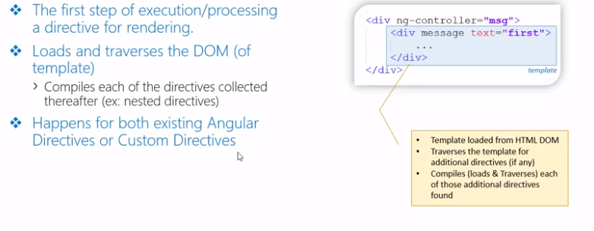
Compile

Slide 11
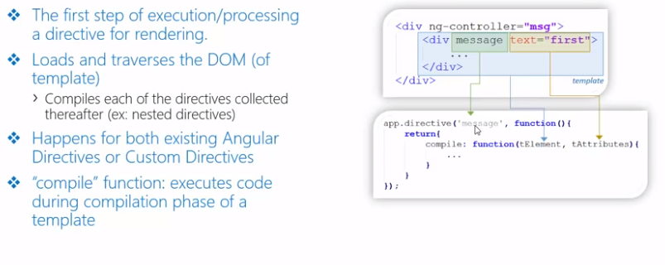
Compile

Slide 12
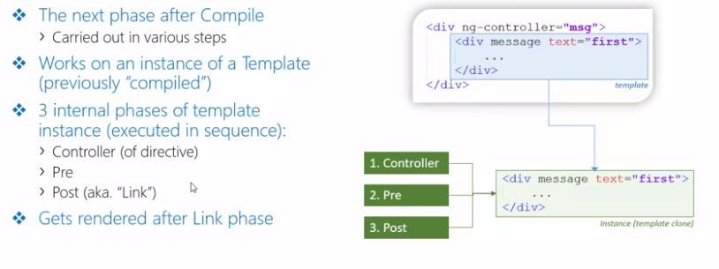
Link

Slide 13
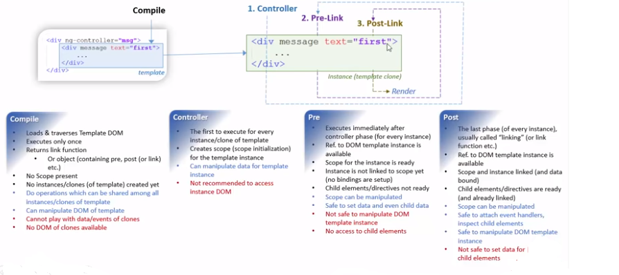
Compile & Link

Slide 14
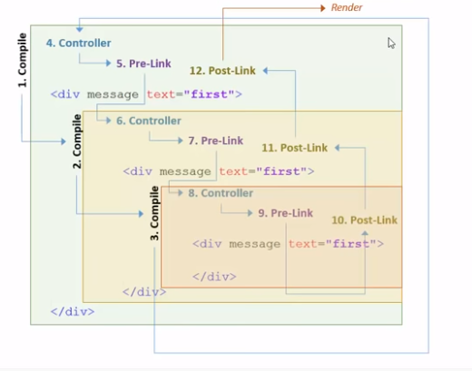
Order of execution

Slide 15
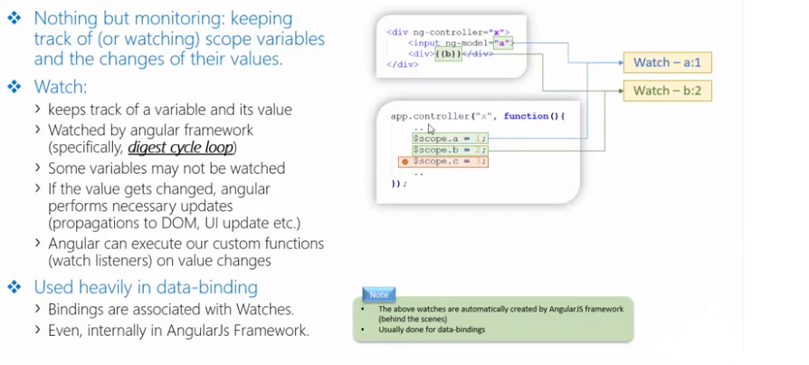
Watchers

Slide 16
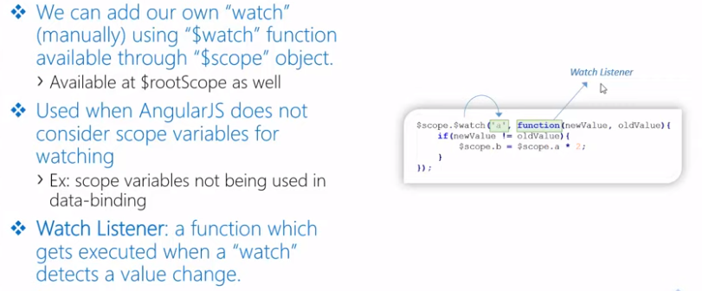
Watch Listener

Slide 17
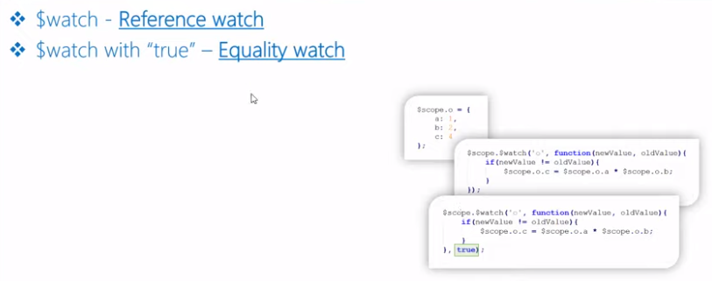
Reference Listener

Slide 18
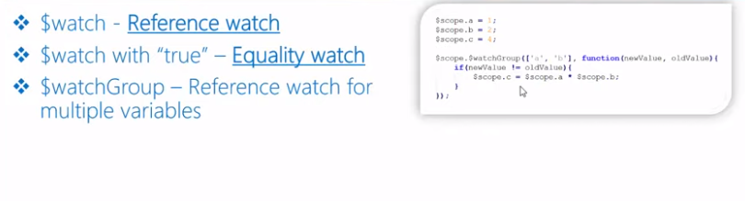
Equality Listener

Slide 19
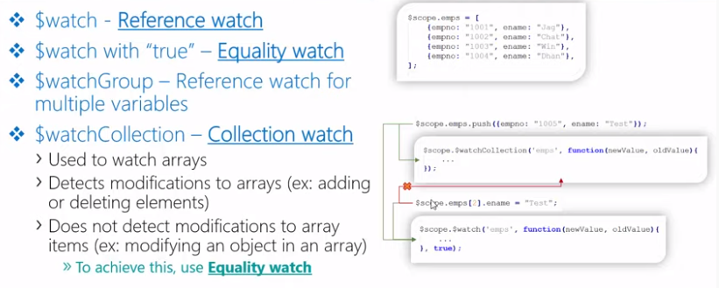
Collection Listener

Slide 20
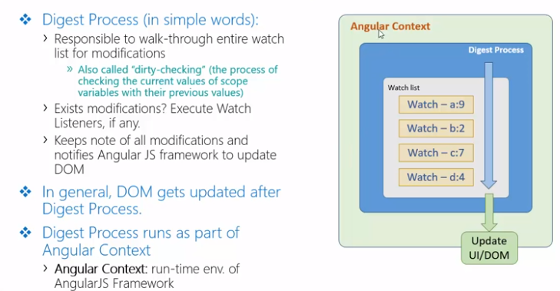
Digest Process

Slide 21
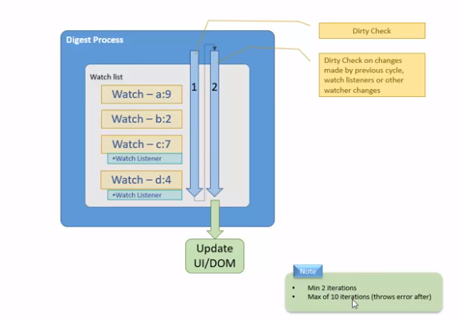
Digest Cycle

Slide 22
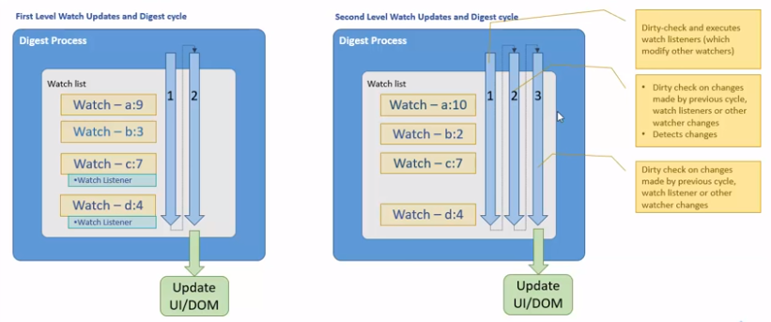

Slide 23
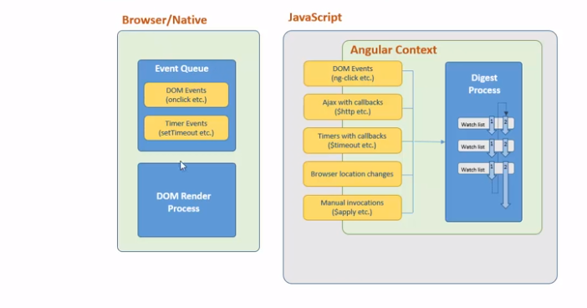
Angular Context

