Slide 1

Customer Churn Prediction
Pamudi Jayathilaka
Data Scientist

Slide 2
Contents
1
Objective
3
Exploratory Analysis
5
Methodology
2
Data PreProcessing
4
Feature Engineering
6
Results

Slide 3

Objective
Building a model which will predict whether a customer will move out of PickMe platform in an upcoming month or will go dormant

Slide 4
Data Set
Variable Name | Null Values
pickup_date | 5077799
distance | 5081668
driver_rating | 9004901
fare | 5081668
discount | 5081668
trip_fare | 5081668
payment_method | 7
promocode | 7063769
driver_rating | 9004901
Variable Name | Null Values
passengerid | 0
tripid | 0
pre_booked | 0
travel_status | 0
status_description | 0
profile_created | 0
taximodelid | 0
created_date | 0
Number of Records
9004901
Number of Variables
17
Number of Passengers
518744
Total Number of Trips
9004901

Slide 5
Data Preprocessing
Removed the “driverrating” and “promocode” variables due to a lot of null values
Filtered the data related to completed travels("travel_status" == 1)
Extracted year, month from the “trip_created_year”, “profile_created_year” variables and created new variables as follows.
“trip_created_month”, “trip_created_year”, “profile_created_year”, “active_period”

Slide 6
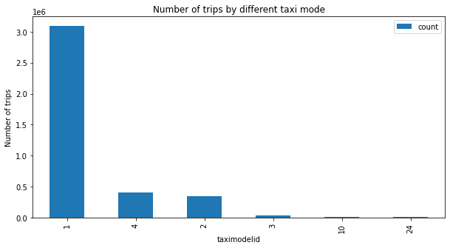
Exploratory Analysis
What is the most popular taxi mode?

Slide 7
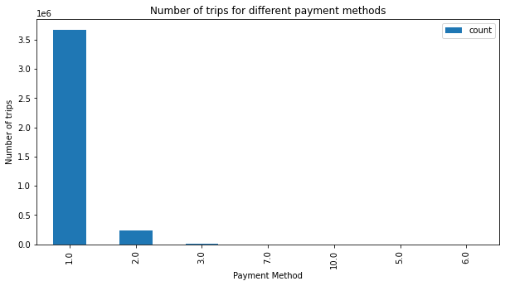
What is the most used payment method for trips?

Slide 8
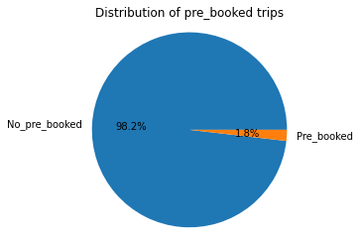
What is the most used booking type for trips?

Slide 9
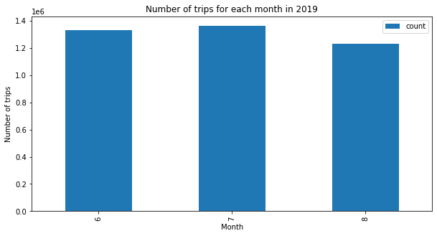
What is the month for a lot of trips?

Slide 10
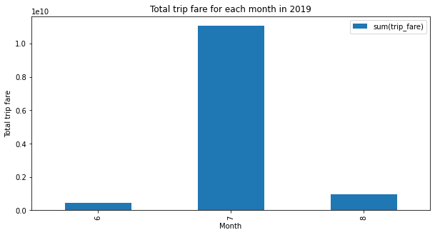
What is the month for the highest income of trips?

Slide 11
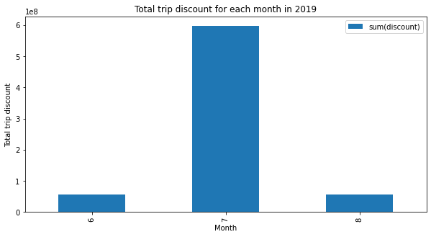
What is the month for a lot of discounts for customers?

Slide 12
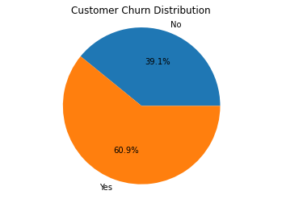
Problem statement
How to define a customer has ‘churned’
If there are no trips for each customer last month(August), there is a dormant/churn for next month.

Slide 13
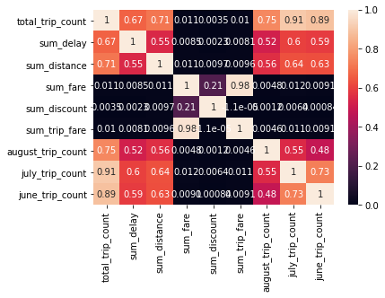
Feature Engineering
Removed the passengers who have created their profiles in August(last month)
Selected following generated features from the dataset to build the predictive model
sum_delay
sum_distance
sum_fare
sum_discount
sum_trip_fare
July_trip_count
june_trip_count

Slide 14
Methodology
Classification
Logistic Regression Algorithm - as a base model
Random Forest Algorithm
Gradient Boosting Algorithm
XGBoost(Extreme Gradient Boosting) Algorithm

Slide 15
Results
Model | Accuracy
Logistic Regression | 0.71
Random Forest | 0.82
Gradient Boosting | 0.81
XGBoost | 0.83

Slide 16
Further Work
Parameter tuning can be performed for the XGBClassifier to increase its performance.

Slide 17
Thank You

