Slide 1






Company Brain
Sensor
Learn
Policy
AI agents run your operations. Your people stay in control.
Gate
Tool
Finebase Labs · Pre-seed pitch · October 2026
Notes:
Hi, I'm Pamuditha from Finebase Labs. This is Company Brain: AI agents that run a company's daily operations, while its people stay in control.

Slide 2



SMEs run operations by hand, and know-how walks out the door
Work runs on people
Care chats, refunds, billing, scheduling and website updates are done by hand, one case at a time.
ONE REAL CASE
A customer asks for a full refund on an LKR 85,000 annual plan, 41 days after buying. Policy says 30 days.
Know-how lives in heads and inboxes
When a staff member leaves, the policy, the customer history and the fix leave with them.
Who decides? Someone guesses.
Nobody records why.
Next month, the same case starts from zero.
Today's AI tools are unsafe to let act
No approvals, no audit trail, customer data pasted into chat tools. A real risk under the PDPA.
SMEs are ~52% of Sri Lanka's GDP and ~45% of jobs.
Notes:
Small and mid-size companies in Sri Lanka run their operations by hand. Care chats, refunds, billing, scheduling: one case at a time. The know-how sits in people's heads and inboxes, so when someone leaves, it leaves too. Take one real case. A customer asks for a full refund on an 85,000 rupee annual plan, 41 days after buying. The policy says 30 days. Today someone guesses, nobody records why, and next month the same case starts from zero. And the AI tools people try today have no approvals and no audit trail. Under the new data law, that is a real risk.

Slide 3
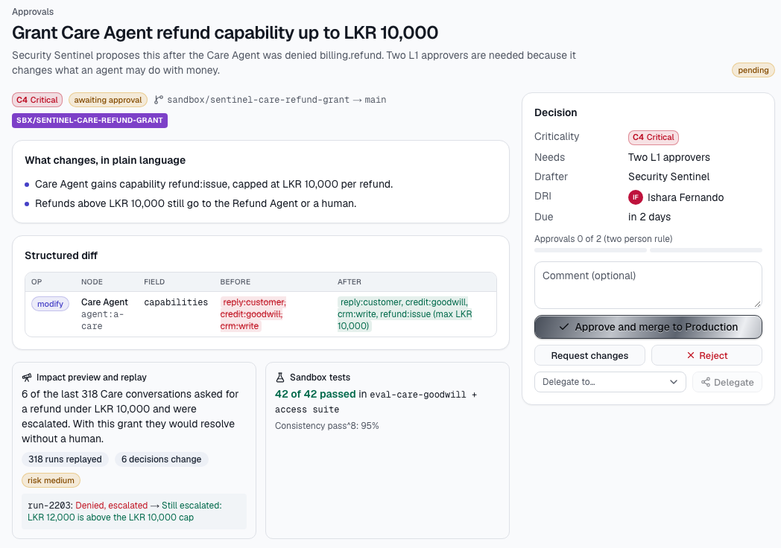
AI agents do the work. Your people keep control
Sensor
Notices what happened: an email, chat, payment or deadline
Policy
Decides what is allowed, before anything acts
Tool
The agent does the work through your existing systems
Quality gate
Checks the result. Risky actions wait for the right person
Learning
Each night, solved cases become reusable skills
A money-touching change waits for two leaders, with a replay of its impact on 318 past runs
Notes:
Company Brain fixes this. Every job runs as a loop. A sensor notices what happened, like that refund email. A policy decides what is allowed, before anything acts. The agent does the work through the company's own systems. A quality gate checks the result, and anything risky waits for the right person. On screen, a change that touches money waits for two leaders, with a replay of its effect on 318 past runs. And every night, the cases people solved become reusable skills. So the next refund like this one goes straight through.

Slide 4



A new data law and agents that can act make 2027 the moment
1 Jan 2027
46% a year
Cents a task
Sri Lanka's PDPA compliance rules start
AI agents moved from chatting to acting
Running an agent is now cheap
Data protection officers, breach notices and impact assessments become duties. SMEs need masking and audit trails.
The AI agents market grows from USD 7.8B in 2025 to USD 52.6B in 2030.
Small fast models take the volume and large models only the hard calls, so a governed task costs cents.
Gazette No. 2498/16, July 2026
MarketsandMarkets, 2025
Our model routing: Haiku, Sonnet, Opus
Notes:
Why now? Sri Lanka's data protection rules start on 1 January 2027, eleven weeks from today. AI agents have moved from chatting to acting, a market growing 46% a year. And running an agent now costs cents, not a salary.

Slide 5
A USD 0.72M SOM, built bottom-up from 120 customers
How we get to the SOM, month by month
TAM USD 52.6B
Global AI agents, 2030
Period | New customers a month | Customers at end
Year 1 | ~2 | 20
Year 2 | ~2.5 | 50
Year 3 | ~6 | 120
SAM USD 62M
Sri Lankan mid-size firms
120 customers × USD 6,000 a year = USD 0.72M ARR
SOM
USD 0.72M
That is ~1% of the 10,405 mid-size firms, so it is reachable with founder-led sales and partners.
Sources: MarketsandMarkets AI Agents report (2025); Dept. of Census and Statistics, Economic Census 2013/14 (10,405 medium establishments). SAM = 10,405 × USD 6,000.
Notes:
We sized the market bottom-up. We start with Sri Lanka's 10,405 mid-size firms. At 6,000 dollars a year each, that is a 62 million dollar serviceable market. Our three-year target is 120 customers: about 2 new customers a month in year one, 2 and a half in year two, and 6 in year three. That is 720 thousand dollars of annual revenue, about 1% of these firms.

Slide 6
USD 500 a month per customer, and 5x back on every customer won
Unit economics (targets)
Starter
Growth
Scale
USD 299
USD 699
USD 1,499
5 : 1
USD 1,800
per month
per month
per month
LTV to CAC
Cost to win a customer
3 agent loops, e.g. care, refunds, scheduling
2,000 governed tasks a month
Up to 8 loops, nightly learning and Skillify
PDPA readiness and evidence requests
Unlimited loops across clusters
Two-person approvals and a named steward
5 months
75%
Payback period
Gross margin
Billed monthly per company. Expected mix 60 / 35 / 5 gives a blended USD 500 a month (USD 6,000 a year).
LTV = USD 375 gross profit a month × 25-month life (4% monthly churn) = USD 9,375.
Why USD 299: one support hire in Colombo costs ~LKR 120,000 a month and covers one shift. Intercom's AI agent charges USD 0.99 per resolved case.
Notes:
We sell a monthly subscription per company, in three fixed tiers: 299, 699 and 1,499 dollars. We set 299 because one support hire in Colombo costs about 120,000 rupees a month and covers one shift, while our agents work all day. Our expected mix gives 500 dollars a month on average. Unit economics: winning a customer costs us about 1,800 dollars, mostly the free pilot and founder time. Gross margin is 75%, so we earn that back in 5 months. Over a 25-month customer life, each customer brings 9,375 dollars of gross profit. That is a 5 to 1 return on what we spend to win them.

Slide 7
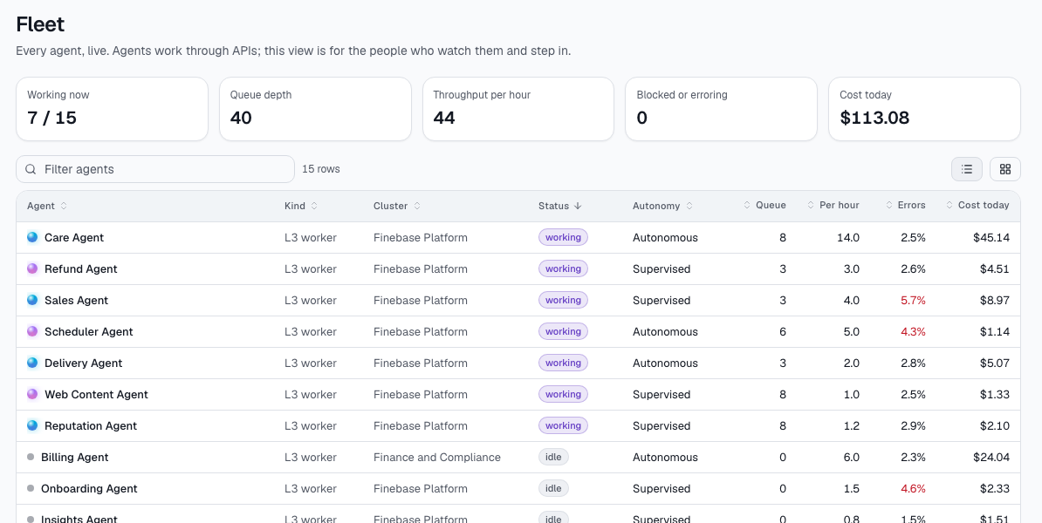
The product works today, and we run our own company on it
35
15
working screens across 3 tiers
governed pipeline stages, typed end to end
27
#1
guided use cases recorded on the real app
tenant: Finebase Labs runs on it
NEXT 90 DAYS
The live fleet: 15 agents doing care, refunds, billing, sales and scheduling, each with its queue, errors and cost
Target by 31 Jan 2027: 5 signed LOIs and 3 paid pilots
SME conversations so far: [ __ ] LOIs signed: [ __ ]
Notes:
This is not just an idea on slides. The product works today. We have 35 working screens across three tiers, for leaders, stewards and operators, and a 15-stage governed pipeline with typed contracts from the first email to the audit log. We recorded 27 real use cases on the live app. And we run our own company, Finebase Labs, on it as tenant number one. Next: by the end of January, 5 signed letters of intent and 3 paid pilots. So far we have spoken to [number] SMEs.

Slide 8

Founder-led pilots first, then partners: 0 to 120 customers
Ideal customer: Sri Lankan service SMEs with 20 to 200 staff, a busy support inbox and online payments. The buyer is the founder or COO.
0 → 20
20 → 50
50 → 120
Year 1 · Founder-led
Year 2 · Partners
Year 3 · First sales team
We call and visit 300 SMEs from our network and SLASSCOM members.
Free one-month pilot on one loop, then a monthly plan.
Accounting and audit firms resell us as their PDPA answer. Workshops with chambers of commerce.
Partner referral, 2-week pilot.
Two sales hires in Colombo. First pilots in the Maldives and Bangladesh.
Demo, pilot, annual deal.
Pilot costs us ~USD 900
Partner fee 20% of year one
Target CAC stays ≤ USD 1,800
Year 1 funnel: 300 contacted → 80 demos → 40 pilots → 20 paying (50% pilot conversion)
Notes:
Our first customers are Sri Lankan service SMEs with 20 to 200 staff, a busy support inbox and online payments. The buyer is the founder or COO. In year one, I do the selling myself. We contact 300 SMEs from our network and SLASSCOM members, run 80 demos and 40 free one-month pilots, and convert half, so 20 paying customers. Each pilot costs us about 900 dollars. In year two, accounting and audit firms resell us as their PDPA answer, for a 20% partner fee. In year three, we hire two salespeople and start pilots in the Maldives and Bangladesh.

Slide 9



Others either act or govern. We do both, at an SME price
What a buyer needs to be true
Company Brain
Agents really do the work
Agentforce, Sierra (enterprise price)
Not just answer questions: refund, bill, schedule, update the site.
Glean, Notion AI
Every action is governed
Governed and auditable →
Intercom Fin, Zendesk AI
Approvals by risk, a full audit trail, personal data masked by default.
Staff and spreadsheets
Built for a Sri Lankan SME
Zapier, Make
Priced below one hire, LKR and PDPA ready, Sri Lankan names and IDs masked.
Does the work across operations →
Notes:
We do have competition. Companies use staff and spreadsheets, Zapier rules, or support bots like Intercom Fin. Tools like Glean find answers but don't act. Agentforce and Sierra act and govern, but at enterprise prices. A buyer needs agents that really do the work, under real governance, priced for an SME, with Sri Lankan personal data masked. That is the corner we own.

Slide 10

We have built multi-tier operations software before
PS
?
?
Pamuditha Senanayake
[ Co-founder name ]
[ Team member name ]
Founder, CEO and lead engineer
[ Role, e.g. CTO or Head of Sales ]
[ Role ]
Built ChainSight: separate live dashboards for a District Secretariat, Divisional Secretariats and field officers. Designed and built Company Brain's console and 15-stage pipeline.
[ One line of relevant experience: a company, project or product like this ]
[ One line of relevant experience ]
Advisors we are adding, each with one job: [ Data protection / PDPA lawyer ] · [ SME sales leader in Sri Lanka ]
Notes:
I built ChainSight, live dashboards with separate views for a District Secretariat, Divisional Secretariats and field officers. Company Brain uses the same tier idea, only now the field workers are agents. I designed and built the console and the pipeline. [Co-founder: name, role and one relevant line.] We are adding two advisors, each with one job: a data protection lawyer, and an SME sales leader.

Slide 11
Break-even in year three with 120 customers
 | 2027 | 2028 | 2029
Customers at year end | 20 | 50 | 120
ARR at year end | 120K | 300K | 720K
Net result | −90K | −100K | +30K
Avg monthly net burn | 7.5K | 8.3K | 0
Headcount | 5 | 8 | 13
Monthly churn (target) | < 4% | < 4% | < 3%
All figures USD. Revenue = average customers in the year × USD 6,000. Pre-revenue estimates we can walk through line by line.
Notes:
Revenue grows from 60 thousand dollars in 2027 to 510 thousand in 2029. Costs grow slower, so we break even in year three, at 120 customers and 13 people. Net burn stays around 8 thousand dollars a month in the first two years, and we plan for churn under 4% a month.

Slide 12




USD 250K takes us to 50 customers and USD 300K ARR
We are raising
What the money proves by month 24
USD 250K
50 paying SMEs
Companies choose us and pay every month
Pre-seed · 24 months of runway
USD 300K ARR
Revenue that repeats, at 75% gross margin
Churn under 4% a month
Customers stay because agents keep improving
Ready for seed
The numbers a seed investor needs to see
Notes:
We are raising 250 thousand dollars, pre-seed, for 24 months of runway. 45% goes to product, 30% to sales and pilots, 15% to AI and cloud, and 10% to legal, PDPA and a buffer. By month 24, it buys 50 paying customers and 300 thousand dollars of annual recurring revenue. Those are the numbers we need for our seed round.

Slide 13
Every company deserves a brain it can trust
If we get this right, every Sri Lankan SME, then every SME in South Asia, runs its daily work through governed agents, and its know-how never walks out the door.
Pamuditha Senanayake
Founder, Finebase Labs
senanayakepamuditha@gmail.com · [ phone ]
Notes:
Every company deserves a brain it can trust. Thank you. My details are on the screen, and I'm happy to take questions.

