Slide 1


DESIGN AND SIMULATION OF A- DIGITAL DATA TRANSMISSION ERROR DETECTION SYSTEM USING XOR LOGIC

Slide 2
GROUP MEMBERS
01
2620040074- Abhiram Reddy
03
2620040089- Geethika Devasena
02
2620040087-Varshitha Chowdari
04
2620040091- Kaushik

Slide 3

INTRODUCTION
  Digital systems communicate using binary data (0s and 1s).
  During transmission, data may be altered due to noise or interference.
  A change in even one bit can make the received data incorrect.
  Therefore, digital systems need mechanisms to detect transmission errors.
  This project uses XOR logic to identify differences between transmitted and received data.

Slide 4
OBJECTIVES
The main objectives of this project are:
  To design a digital error detection system using XOR logic.
  To compare transmitted and received binary data.
  To detect changes in individual data bits.
  To simulate the designed circuit using digital simulation software.
  To verify the circuit's operation using different input combinations.
  To understand the application of XOR gate in digital cammunication.

Slide 5
XOR ERROR DETECTION
Design → Compare → Detect → Simulate → Verify → Understand

Slide 6

SYSTEM OVERVIEW
->TRANSMITTER:
Sends the original binary data.
Transmission
->Channel:
Represents the path through which data travels. An error may occur here.
->RECEIVER:
Receives the transmitted data.
->XOR COMPARATOR:
TAKES TWO INPUTS, COMPARES THEM AND SHOWS HOW THEY ARE RELATED.
ERROR INDICATOR:
INDICATES IF A ERROR OCCURS.
TRANSMITTER
│
│
Binary Data
↓
┌───────┐
│ Transmission│
│ Channel │
└───────┘
│
↓
RECEIVER
│
↓
┌────────┐
│ XOR Logic │
│ Comparator │
└────────┘
│
↓
Error Detection
↙ ↘
ERROR NO ERROR

Slide 7
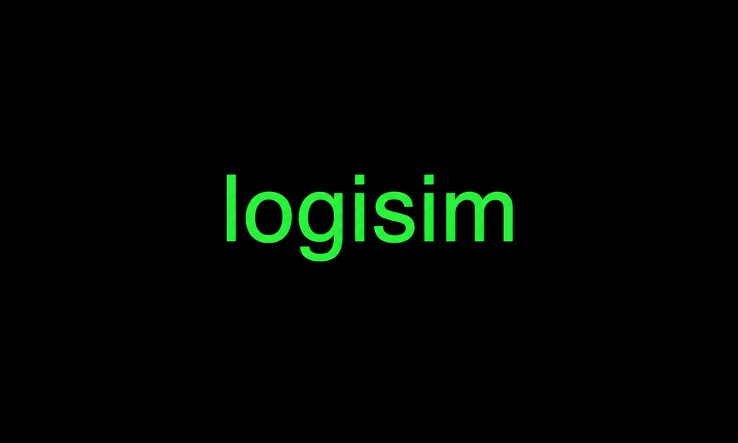
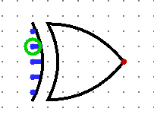
WORKING
Working Principle
The system works using the fundamental property of an XOR gate:
XOR output is 1 when the two inputs are different.
Step-by-step:
Step 1: Enter the original binary data.
Step 2: The data is transmitted through the channel.
Step 3: The receiver receives the data.
Step 4: Each transmitted bit is compared with its corresponding received bit using XOR.
Step 5:
  Same bits → XOR = 0
  Different bits → XOR = 1
Step 6: If any XOR output becomes 1, an error is detected.

Slide 8
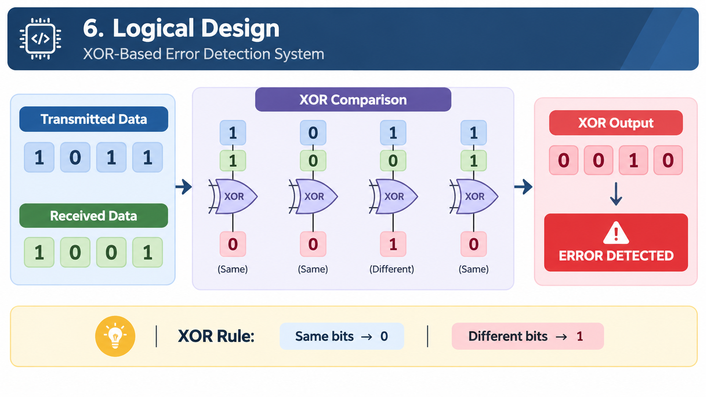
LOGICAL DESIGN

Slide 9
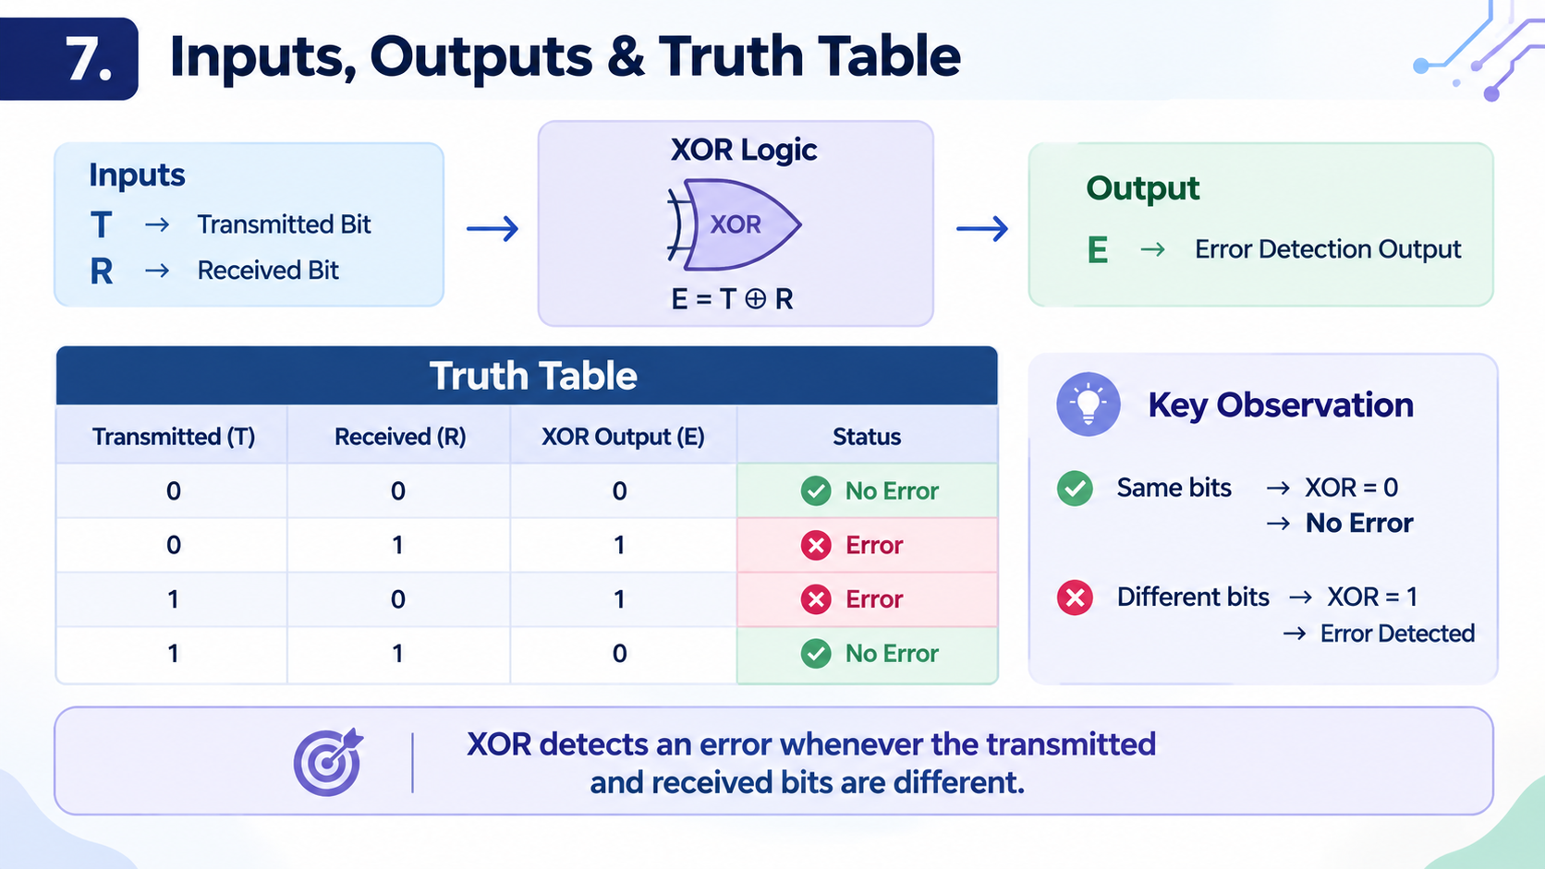
INPUTS, OUTPUTS AND TRUTH TABLE

Slide 10
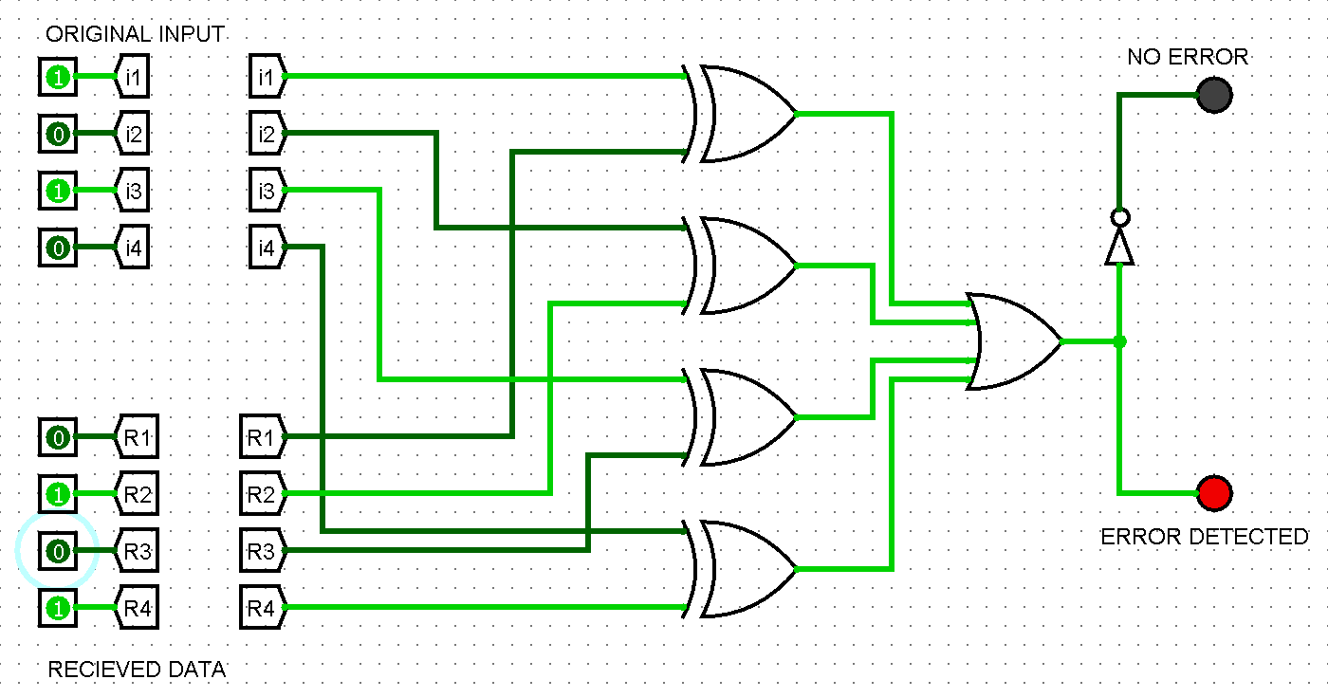
Logisim simulation (error condition)
Since there is a mismatch of
the recieved data bits and the
original data bits,
the system detected the mismatch and represented that there is an error

Slide 11
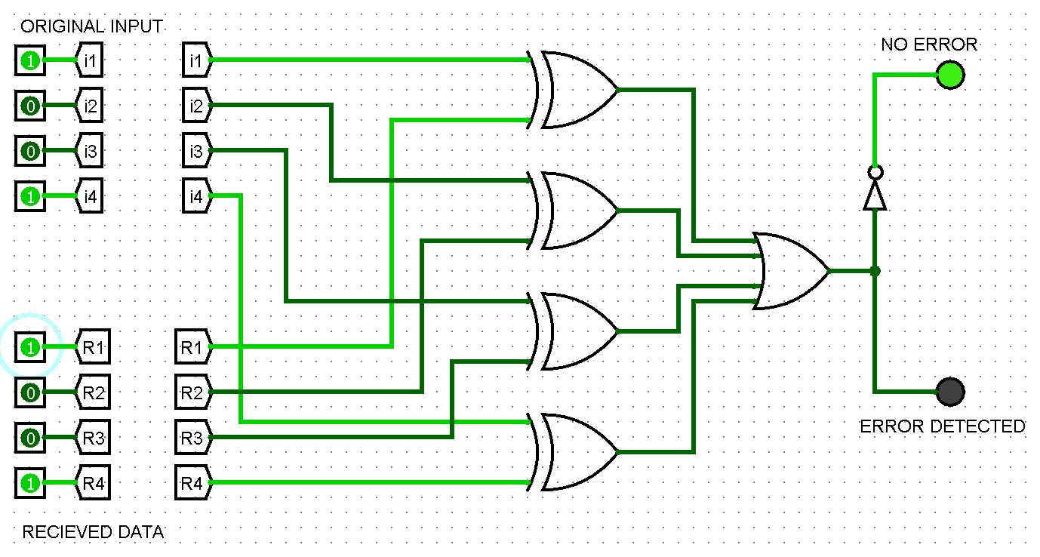
Logisim simulation
(no error condition)
Since the original and the recieved data bits match,the system shows no error, meaning that the actual data transmitted, and the data recieved match

Slide 12
APPLICATIONS
01
Computer Communication
04
Embedded Systems
Detecting changes in transmitted digital data.
Checking data exchanged between digital components.
02
Digital Communication Systems
05
Networking
Checking data integrity during communication.
Basic error detection techniques in data communication.
03
Memory & Storage Systems
06
Serial Communication
Detecting changes or inconsistencies in stored data.
Checking transmitted binary information between devices.

Slide 13
TOOLS USED
SOFTWARE
Logisim – Digital circuit design and simulation
CONCEPTS USED
DIGITAL COMPONENTS
  Boolean Algebra
  XOR Logic
  Digital Logic Gates
  Binary Data
  Error Detection
  XOR Gates
  OR Gates
  Input Switches
  LEDs / Logic Indicators

Slide 14
CONCLUSION
  An XOR-based circuit can be used to detect differences between transmitted and received data.
  The system identifies bit mismatches by producing an XOR output of 1.
  The proposed circuit is simple, low-cost, and easy to simulate.
  Simulation helps verify the correctness of the designed logic.
  The project demonstrates how digital logic gates can improve data reliability.
“Same bits → No Error | Different bits → Error Detected”

