Slide 1

RusProfiling: Analyzing Russian written texts to detect deception and identify the author’s personality and gender
Tatiana Litvinova
RusProfiling Lab, Voronezh, Russia
centr_rus_yaz@mail.ru
PAN @ CLEF
September 12, 2017
Dublin, Ireland

Slide 2
Plan of the talk
Introduction
Rationale
Lack of studies in AP in Slavic languages
Corpora
RusPersonality
RusNeuroPsych
Russian Deception Bank
Authorship profiling
Gender
Personality
Deception detection
RusProfiling Shared Task
Conclusion

Slide 3
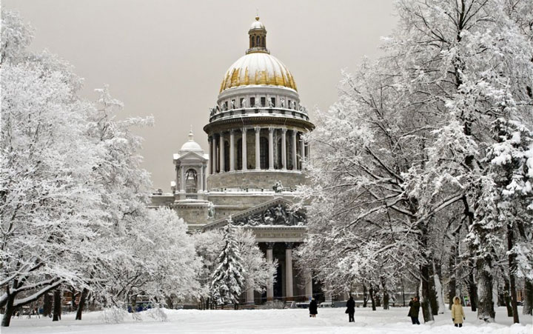
St. Petersburg, Russia, 19th century (very cold - brrrrr)
Notes:
Before I begin, let me take you all the way back to the 19th century Russia. Imagine a freezing cold winter night at the Russian capital (St. Petersburg at the time). How do you cope with Russian winters? Yes, you are probably going to want to use something to warm your body and for Russians it’s usually some alcohol (i.e. vodka).

Slide 4
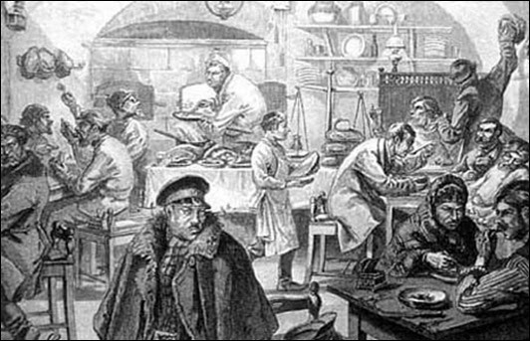
A night at a traktir (трактир) (keeping warm the Russian style)
Notes:
Slide 2 --- In order to enjoy some, you would find some intelligent residents of the city hanging out in what you call pubs here in Dublin (we used to call them traktirs in the old-time Russia).

Slide 5
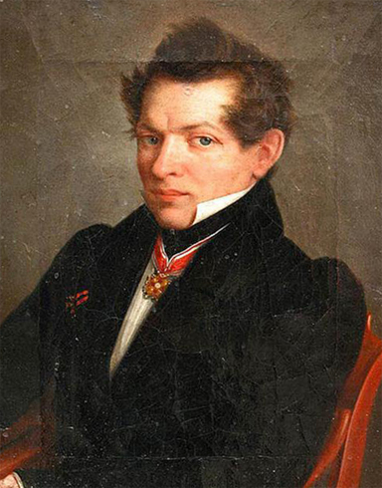
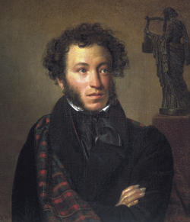

Some of the people at a table
Nikolaj Lobachevskiy
(1792-1856) – a famous Russian mathematician
Alexander Pushkin
(1799-1837) – a famous Russian poet and writer
Notes:
So you have these two guys with obviously very different perspectives on the world. Pushkin is all about words, putting them together, embellishing them to make unforgettable pieces of literature. Lobachevskiy cares for numbers, he is not so easily moved by the beauty the words create when put together. He would rather count them for that matter!

Slide 6
Some of the people at a table
The Physicists camp
The Lyricists camp
Notes:
When we speak about such situations where you have people from different backgrounds that would have trouble agreeing on anything at all, we say “Physicists and lyricists”.

Slide 7

За здоровье! Cheers!
“Verify Harmony by Means of Algebra” (A. Pushkin)
Notes:
As a result, these two realize they can actually compliment each other by bringing their different views together to do what intelligent people are here to do, i.e. to benefit society. Сделать, чтобы рукопожатие появилось в конце --- And they shake their hands on it.

Slide 8

RusProfiling Lab
The Lyricists camp
The Physicists Camp
Notes:
Of course, that’s not exactly how the idea for our Lab came about. But we originally had something we all have in common in mind – a beautiful gift, that is language. It offers anyone intelligent and brave enough to venture on studying it a variety of perspectives and things to investigate. We decided we would say no to all this “physicists vs. lyricists stuff” and join our forces as we have just imagined Lobachevskiy and Pushkin would do (it’s a shame really that even though they are said to have met, they never got to set up a lab together). But I assume they had a good time (we do here anyway). We don’t warm our bodies so much enjoying the bonding power of alcohol, but talking with each other to get to the bottom of things is what we find ourselves doing a lot as we conduct our research.

Slide 9
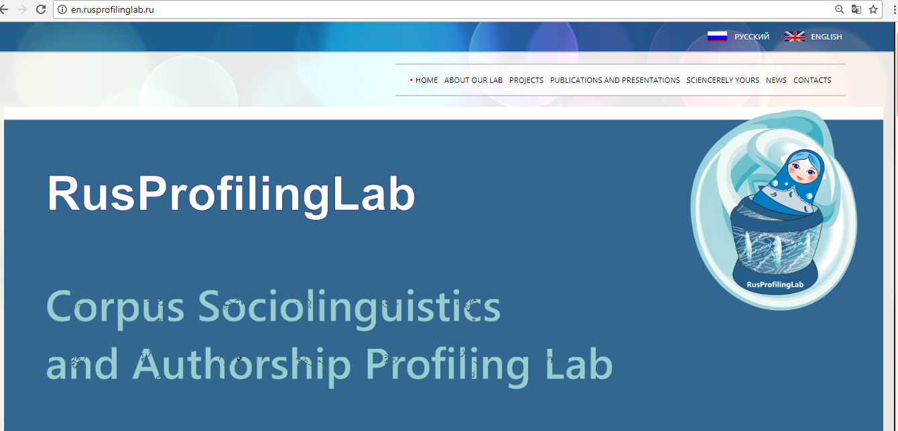
RusProfiling Lab

Slide 10
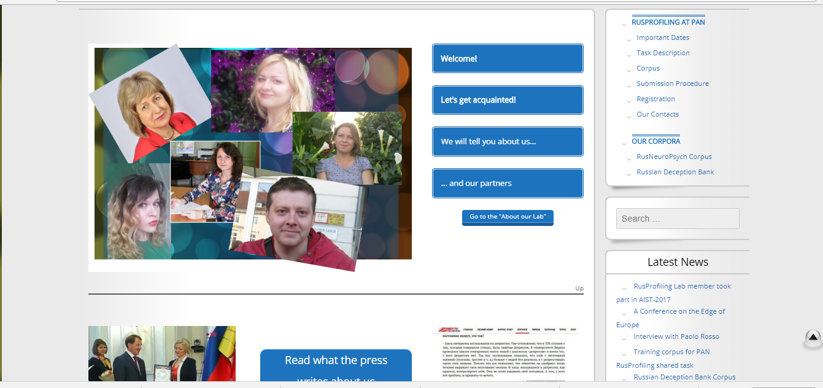
RusProfiling Lab

Slide 11
Authorship profiling
Profiling is a computational stylometry application with interesting research questions (W. Daelemans)
Given the text, determine author’s:
gender
age
personality
education and so on

Slide 12
Why is AP so important?
Author ship profiling is a problem of growing importance in applications in forensics, security, and marketing.
From a forensic linguistics perspective one would like being able to know the linguistic profile of the author of a harassing text message and identify certain characteristics.
From a marketing viewpoint, companies may be interested in knowing, on the basis of the analysis of blogs and online product reviews, the demographics of people that like or dislike their products.

Slide 13
LACK OF DATA
BUT!!! Large reference corpus needed of authors with various traits of interest
There are two types of such corpora:
automatically collected corpora of internet texts online communication (blogs, chats, tweets, social media messages, etc.) + details about authors are gathered as provided by them in their accounts (normally gender and age)
manually collected corpora of texts written purposely for research

Slide 14
First Group
Problems
“Noises”
borrowings (citations, links, etc.);
details about authors might be false
Advantage
a large number of corpora;
easy to collect

Slide 15
Name of the Corpus/Characteristics | Blog Authorship Corpus | myPersonality3 | TwiSty
Language | English | English | Italian, Dutch, German, Spanish, French, Portuguese
Metadata | Gender, age | Facebook profile, Big Five Personality Test | MBTI personality types and gender information
Number of respondents and texts | 19320/ 681.288 posts | 250/9900 statuses | 18,168 respondents
Length of texts | 7250 words (35 posts) From an author | No data | 140 characters
Genre | Blog | Facebook statuses | Tweets
Features | Texts are divided into three groups depending on the age of authors, balanced by gender | Data on the number of Facebook contacts as well as their density, connections are available. | Multilingual corpus
Expanded | No | Was last updated in February 2013 | No
Access features | Free, online | Free, online | Twitter ids of authors as well as the ids of their available tweets

Slide 16
Second Group
Very time-consuming process
Some examples:
English essays (J. Pennebaker) - 7 years (from 1997 to 2004) and contains 2469 texts (one from each participant) (1.9 million words with an average of 770 words in a text) and metadata with information about the gender of authors and results of the Big Five Personality Test – PAN
Stylometry Investigation (CSI) Corpus -749 texts (305 000 characters) (the average length of 1126 characters) and product reviews (an average of 128 characters) + gender, age, birthplace, Big Five Personality Test results (+) information about their sexual orientation (the Myers-Briggs Personality Test)

Slide 17

LACK OF DATA
A small body of related works for languages other than English (especially Slavic)
No such corpora available in Russian

Slide 18
TO BUILD NEW CORPORA!
Corpora of “experimental” texts :
RusPersonality
RusNeuroPsych
Russian Deception Bank
Gender Imitation Corpus
Russian Elderly Writing Corpus
Corpora of online texts
Social media corpus
Russian Suicide Writing Corpus

Slide 19
RusPersonality
Started at 2012;
Rich metadata (gender, age, personality…);
1 145 respondents;
1 867 texts (depending on the type of the tasks the respondents were instructed to write one or two texts);
around 300 000 word uses or around 1 800 000 characters;
in progress

Slide 20
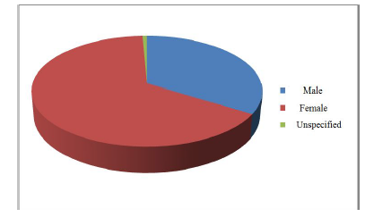
386 males, 751 females, 8 unspecified

Slide 21
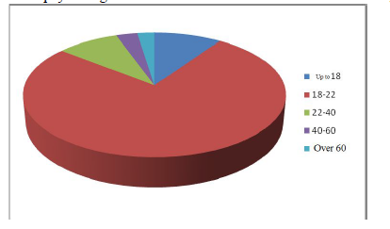
Age (from 12 to 79)

Slide 22
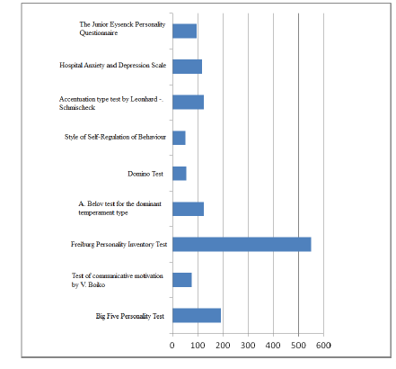
Personality

Slide 23
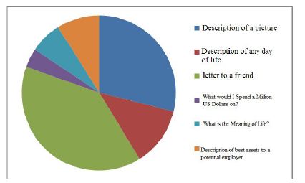
CHARACTERISTICS OF TEXTS (the average length of a text ranged from 56 (a subcorpus of texts by individuals with mental disorders) to 230 words (a subcorpus of texts “What is the Meaning of Life?”).

Slide 24
Authorship profiling

Slide 25
Gender

Slide 26
Rationale
Gender prediction is a very popular task in authorship profiling studies, but main focus is on English language and content features
No systematic study of the differences between male and female Russian written texts
No studies of interaction between gender and other variables

Slide 27
Methodology
Corpus
a specially designed corpus for authorship profiling studies RusPersonality (Litvinova at el., 2016), short texts (150-200 words), “A Letter to a Friend”, “Description of a Picture”, “How I Spent Yesterday” etc. + rich metadata. Each author (N = 556) wrote two texts, two scenarios -“joined” and “separate”
Texts parameters: high-frequent, topic independent, objectively countable, 78 in total - POS, POS ratios (pymorphy2) + lexical diversity measures (online service istio.com)
Pearson's correlation coefficient r, р < 0.05 (gender and text parameters)
Only the parameters that were shown to correlate with the gender of authors in the joined and separate scenario and for all topics were selected
Regression models for 5 parameters with the highest r were designed, the average arithmetic values from the solution of the five equations were found

Slide 28
Results
5 parameters with the highest r:
1. Type-token ratio (TTR) (0.39)
2. Percentage of the 100 most frequent Russian words in the text (-0.322)
3. The index of formality (0.315)
4. The index of the functional density (-0.295)
5. Percentage of prepositions and modifiers (r = 0.243 )
Male texts:
Have higher index of lexical diversity
Have more prepositions and modifiers
More formal
Female texts:
More repetitions and function words overall
More contextual
Accuracy of the model based on 5 parameters: 64 %

Slide 29
Discussion
Overall, results are in good agreement with previous findings:
High degree of lexical diversity of male texts was pointed out by Argamon et al. for English texts (2003), Oschepkova (2003) for Russian texts by different social groups (students and prisoners)
Rapport vs. report opposition was found in many studies (mostly for English): reporting is more important for men while rapport is more significant for women; therefore, texts by men seem more “formal” and those by women more “contextual” (Heylighen and Dewaele, 2002)

Slide 30
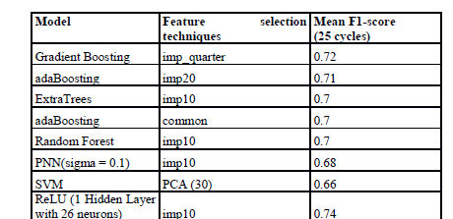
Gender (morphological features, syntactical parameters, derivative coefficients, punctuation)

Slide 31
Why is it still difficult to predict gender?
Gender prediction is a very popular task in authorship profiling studies, but it is still a complex issue particularly in cross-genre settings
Apart from gender, each individual is inherently characterised by different personality traits, emotional states, etc. which in combination affect one’s writing style and are thus to be investigated as one
Laterality which is primary integral characteristics of the work of the brain can be of such characteristics
To the best of our knowledge, it is the first time this issue has been addressed

Slide 32
Methodology
Corpus
a specially designed corpus RusNeuroPsych (freely available at http://en.rusprofilinglab.ru/korpus-tekstov/rusneuropsych-corpus/ ) , “Adult” subcorpus: short texts (150-200 words), N = 209, 392 texts, “A Letter to a Friend”, “Description of a Picture” (one or two texts from an author)
rich metadata (gender, year of birth, education, Big 5 scores, neuropsychological testing scores, scores on HADS test)
The index of handedness of the respondents was calculated as the difference between the number of “right”, “left” and “symmetrical” answers divided into the number of tests (7). As a result, all the respondents were divided into three subgroups according to their handedness: left (-1, -0.33), medium (-0.33, 0.33), right (0.33, 1)) levels. Respondents with the medium level of handedness were then removed. As a result, we had 128 texts by right-handed and 30 texts by left-handed females and 79 texts by right-handed and 21 by left-handed males.
The comparisons were performed for the following classes of texts:
1) written by right-handed females and left-handed females;
2) written by left-handed males and right-handed females;
3) written by right-handed males and left-handed females;
4) written by right-handed males and left-handed males;
5) written by right-handed males and right-handed females;
6) written by left-handed males and left-handed females.

Slide 33
Methodology
Texts parameters: high-frequent, topic independent, objectively countable- POS, POS ratios (pymorphy2) + lexical diversity measures (online service istio.com) + LIWC features, only those which occur in no less than 50 % of the texts, 156 in total
t-test and Mann-Whitney test, р < 0.05
At the final stage we calculated the distance measure for six classes of individuals depending on their gender and degree of handedness using Wave-Hedges distance formula

Slide 34
Results
Right-handed males and left-handed males: Proportion of function words + pronouns in the text; Proportion of function words in the text; percentage of 5 most frequent words excluding function words; Proportion of function words in 5 most frequent words; Proportion of quantitative words (numerals + pronominal adverbs) / total number of words; Proportion of perception words; Number of FW / number of commas;
Right-handed males and right-handed females: TTR(100); proportion of 5 most frequent words including FW; proportion of all punctuation marks;
Left-handed males and left-handed females: proportion of words describing perception.

Slide 35
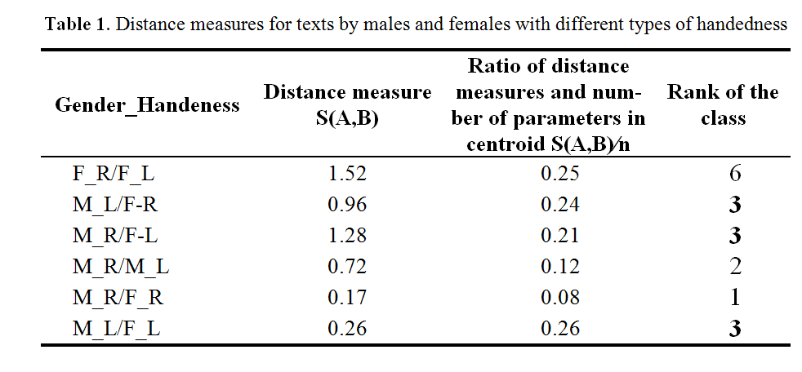
Results

Slide 36
Discussion
Texts by right-handed males and females respectively were found to be the most similar quantitatively
Texts by males and particularly females with different manual preferences vary the most
Handedness has a considerable effect on the quantitative text parameters.

Slide 37
Personality
Morphological (POS, POS bigrams, POS ratios) and syntactical features
regression models
60 to 65 % depending on a personality trait

Slide 38
Freiburg Personality Inventory
High:
“Spontaneous Aggressiveness”
“Depressiveness”
“Emotional Lability”
Low:
“Composedness” N = 33 (16 females, 17 males, average age is 20, SD = 2.3), and low risks of self-destructive behaviour (low (1-3) on 3 scales of FPI: “Spontaneous Aggressiveness”, “Depressiveness”, “Emotional Liability”, high (7-9) on “Composedness”, N = 27 (13 females, 14 males, average age is 19.5, SD = 2.2)
Two texts (about 176 words long, SD = 54 words)

Slide 39
Self-destructive tendencies
regression model (a system of linear equations)
80%
less lexical diversity,
fewer prepositions,
more pronouns overall (personal)
a higher coefficient of coherence
higher average sentence lengths

Slide 40
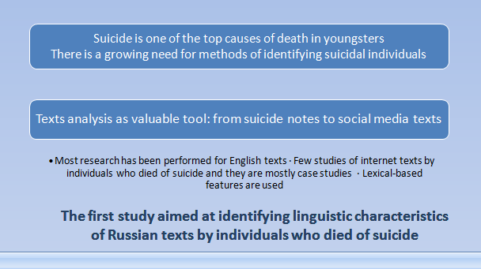
Russian Suicidal Writing Corpus

Slide 41
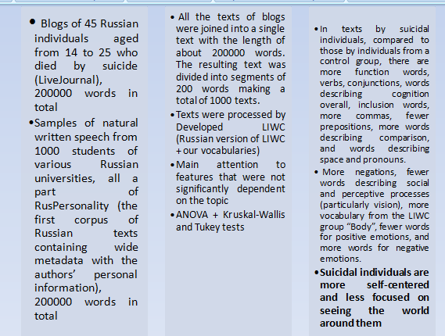
Russian Suicidal Writing Corpus

Slide 42
Deception detection

Slide 43
Two major classes of text corpora
in text-based deception detection studies
those which contain texts corpora which contain “real” texts
produced according to produced in situations where
a researcher’s instructions the stakes of deception
are middle or high
i.e. when there might be
severe consequences
in case deception is revealed
(loss of a job, imprisonment, etc.)

Slide 44
TYPES OF TEXT CORPORA
IN DECEPTION DETECTION STUDIES
Text corpora collected according to a researcher’s instructions
1.1 Corpora of written texts (a corpus of truths and lies collected by Rubin, V. L. et al.; Cross-Cultural Deception corpus;
CLiPS Stylometry Investigation (CSI) corpus;
Russian Deception Bank)
1.2 Spoken corpora (study by Newman et.; CSC Corpus; Multimodal Dataset for Deception Detection)
2. Corpora of real world texts produced in high-stake situations (corpora collected by Fitzpatrick; DECOUR; Real-life multimodal Deception dataset)

Slide 45
Russian Deception Bank
To the best of our knowledge, this is a first corpus of written texts for Slavic languages specially designed for text-based deception detection studies. It currently contains truthful and deceptive narratives written by the same individuals on the same topic (“How I spent yesterday”), 113 deceptive texts and 113 truthful texts written by 113 university students.
Contains rich metadata (gender, age, results of psychological testing and so on)
Freely available at RusProfiling Lab web site
http://rusprofilinglab.ru/korpusyi-tekstov/

Slide 46
Methodology
Each of text file was analyzed using LIWC 2007. We have employed a basic Russian language dictionary that comes with the software (74 parameters)
Only high-frequent parameters were selected
Parameters with coefficient of variation of over 50 % were excluded;
Then we calculated relative changes in each of the parameters from the deceptive texts in relation to truthful ones
T-test (p< 0,05)

Slide 47
On average deceptive texts contain:
fewer long words (of over six letters),
more pronouns (particularly personal ones),
more singular and plural first-person pronouns but fewer third-person plural pronouns,
fewer adverbs and prepositions but more conjunctions and negations, numerals, emotional words overall,
more words describing positive emotions but fewer words describing negative ones,
more words describing cognitive processes but the ratios in the subgroups are different : more words describing Insight, Causation, Tentativeness, Inclusion, Exclusive but fewer words from the subgroups Discrepancy, Certainty, Inhibition,
fewer words describing perception and particularly Seeing, Feeling but more from the subgroup Hearing,
fewer punctuation marks.

Slide 48
?!
The obtained results particularly those reporting a lot of words for positive emotions are in a way inconsistent with the psychological theory data arguing that deception is associated with negative emotions
[Fitzpatrick etc., 2015].
We must bear in mind that the analyzed texts were designed in a laboratory setting.
As in many other laboratory studies of deception, ours relied on the fact that subjects describing an event that they have not experienced and
thus a relation between deceptive and imaginative language is an important issue.

Slide 49
OUR suggestion of deception cue for compare “truthful” and “deceptive” texts –
is a ratio of the percentage of adverbs in a text to personal pronouns.
The reasons of this deception cue:
the average values of “the percentage of adverbs in a text” and “the percentage of personal pronouns in a text” are over one, i.e. both parameters are frequent;
changes in the parameters of a deceptive text are mutually opposite, i.e. on average deceptive texts have fewer adverbs and more personal pronouns compared to truthful ones;
a coefficient of variation for adverbs is twice as high as for personal pronouns and is over 33 %, which is indicative of this parameter being rather unstable [Litvinova etc., 2015].
A ratio of the two above parameters was also chosen so as to it was possible to compare texts of different length and rule out the effect of an author’s personality on the text parameters.

Slide 50
Deception Detection:
For truthful texts, the chosen parameter should be
over 0.21±0.02 and less than 0.19±0.02 for deceptive ones.
To test the efficiency of deception cue,
we used two subcorpora
(based on the text corpus “RusPersonality”)
First subcorpus – truthful texts
describing pictures
(312 texts)
Second text corpus – deceptive texts of individuals who had tried to convince potential employers that they were good enough to do the job on offer (intentionally deceptive personal information)
(64 texts)
Truthful texts
were identified with
an accuracy of ~71 %
Deceptive texts
were identified with
an accuracy of ~72 %

Slide 51
 There is a strong lack of correctly labeled corpora containing real-world texts
especially for non-English languages.

Slide 52
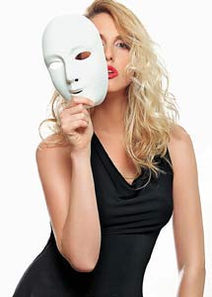
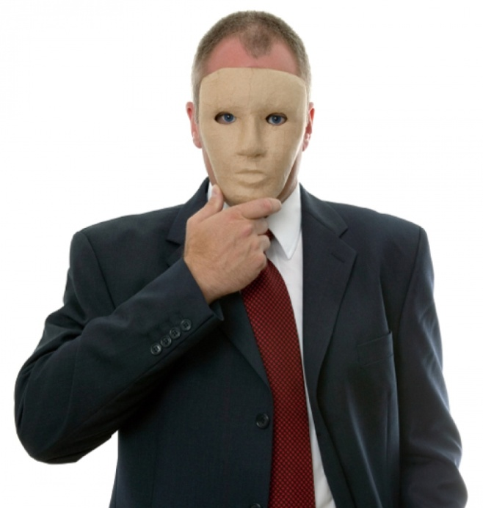
BUILDING A CORPUS OF REAL TEXTS
FOR DECEPTION DETECTION
The material is a collection of dialogues (interviews) in Russian with meta-labeling providing the interviewees’ data (gender, age, for some respondents – psychological testing scores).

Slide 53
BUILDING A CORPUS OF REAL TEXTS
FOR DECEPTION DETECTION
Two sources:
- video recordings of job interviews (private job interview data) as well as casual talks, robbery inspections, etc.;
- video recordings of crime suspects interrogations who were found to be guilty.
All samples are spontaneously produced.
The records used are 19 hours long.

Slide 54
Table 1. Main statistics of the collection
Respondent number | Time, min | Case type | Narrator
1 | 31 | Job interview | female, 32
2 | 46 | Inspection using a polygraph | female, 51
3 | 37 | Criminal case | male, 32
4 | 126 | Criminal case | male, 52
5 | 7 | Inspection using a polygraph | male, 33
6 | 151 | Inspection using a polygraph | female, 27
7 | 181 | Interior inspection using a polygraph | female, 25
8 | 40 | Inspection using a polygraph | female, 26
9 | 90 | Inspection using a polygraph | male, 25
10 | 221 | Inspection using a polygraph | male, 26
11 | 31 | Inspection using a polygraph | female, 44
12 | 64 | Inspection using a polygraph | female, 37
13 | 89 | Inspection using a polygraph | female, 42

Slide 55
BUILDING A CORPUS OF REAL TEXTS
FOR DECEPTION DETECTION
Information on the speaker:
all the respondents are native speakers of Russian;
metadata:
for all speakers - gender, age, occupation;
for those interviewing for a job or already working for the company - gender, age, occupation + scoring on the series of psychological tests (MMPI, Schmieschek Fragebogen Test, etc.).

Slide 56
BUILDING A CORPUS OF REAL TEXTS
FOR DECEPTION DETECTION
texts are being transcribed and annotated. Three postgraduate students with linguistics degrees currently annotate transcripts based on the information presented in the interviews (a speaker’s confession).
2) to label the segments of texts marked as truthful/deceptive we will use following software:
language-based features will be extracted using LIWC software [Newman, M., et al. 2003], POS taggers and so on;
audio based features will be extracted using openSMILE [Perez-Rosas, V., et al. 2013];
visual features will be retrieved using OpenFace [Baltrušaitis, T., Robinson, P., Morency, L.-P. 2016]. There will also be manual gesture labeling. The gesture annotations will be performed using the MUMIN coding scheme [Perez-Rosas, V., et al. 2015].

Slide 57
Advantages of this corpus
It is the first corpus known to contain real world texts in a Slavic language;
All the recordings contain high quality recorded speech to enable multimodal analysis of the speech and search for the correlations between the deception cues of different modalities.
A large amount of material collected from the same individual makes it possible to detect changes in their speech as deceptive information is being produced. Widely available data (court recordings, etc.) can barely be used to obtain this amount of data from the same individual.
It contains spontaneously produced speech.

Slide 58
Availability
The corpus will be made available on request following the signing of the license agreement.
For each case the following data will be available:
1) txt file with transcripts of the interview where statements are marked (interviewer/interviewee) as well as colored text fragments where there is coders agreement about their type (truthful/deceptive) and the data source;
2) txt files containing fragments of texts annotated as truthful/deceptive with an ID for each individual text;
3) joint .csv file with the authors’ metadata;
4) joint .csv file with linguistic data on the text fragments (LIWC scores, POS);
5) joint .csv file c Audio based features;
6) joint .csv file which contains the gesture annotation. This file will include binary features representing the existence of a certain gesture category as (1) and the absence of the gesture as (0).
All the joint files will contain IDs of fragments of interviews for identification.

Slide 59
Acknowledgment
The study of gender identification of the author of a written text is financially supported by the Russian Science Foundation, project N 16-18-10050 “Identifying the Gender and Age of Online Chatters Using Formal Parameters of their Texts”.
The study of the identification of intentionally deceptive information in written text is supported by a grant from the Russian Foundation for Humanities N 15-34-01221 “Lie Detection in a Written Text: A Corpus Study”.
The study of the connection between the human lateral organization profile and typological characteristics of their written texts is financially supported by the grant of RFBR “Linguistic Parameters of a Written Text and Neuropsychological Characteristics of its Author: A Corpus Study”, project number 16-36-00036.
The study of texts by suicidal individuals was performed as part of the project “Predicting the probability of suicide behavior based on speech analysis” from RF President's grants for young scientists (grant agreement N° МК-4633.2016.6).

Slide 60
PAN shared task on Cross-genre Gender Identification in Russian texts (RusProfiling Task)
PAN is a series of scientific events and shared tasks on digital text forensics http://pan.webis.de/
Russian has never been presented at PAN.
This year we introduce PAN shared task on Cross-genre Gender Identification in Russian texts where we will provide as training dataset tweets and as test dataset tweets, Facebook posts, as well as reviews, texts describing images, or letters to a friend.
Accepted papers describing results of the experiments will be published in CEUR proceedings (indexed by Scopus).

Slide 61
RusProfiling Task
We cordially invite all researchers and practitioners from all fields to participate in this year's PAN @ FIRE shared task with Scopus indexed publication.
For details, go to RusProfiling Lab page
http://en.rusprofilinglab.ru/rusprofiling-at-pan/
Stay up to date! Subscribe to our newsletter on our site! http://rusprofilinglab.ru

Slide 62
Conclusions and Future work
To replicate research using texts in Russian as second language (corpus is in progress)
Authorship attribution in multilingual settings
Cross-modal authorship attribution and profiling (given written text, could we attribute or profile the author if have oral speech samples?)

Slide 63
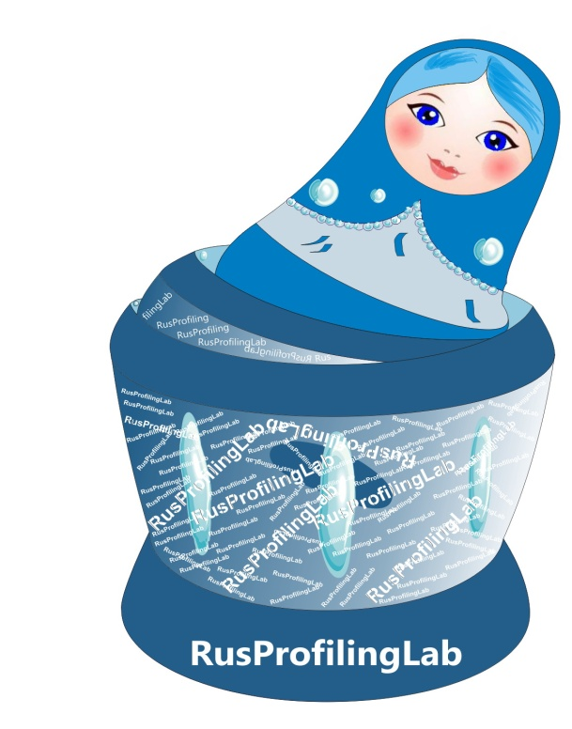
Thank you for attention!
RusProfiling Lab,
http://en.rusprofilinglab.ru/

