Slide 1
Style Change Detection using BERT
Aarish Iyer and Soroush Vosoughi
Department of Computer Science, Dartmouth College, Hanover, NH 03755
Aarish Iyer, and Soroush Vosoughi (2020). Style Change Detection Using BERT. In CLEF 2020 Labs and Workshops, Notebook Papers. CEUR-WS.org.

Slide 2
Task
This research was submitted as a solution to the Style Change Detection Challenge held by PAN@CLEF.
There were two sub-tasks for the challenge:
Given a document, is the document written by multiple authors?
Given a sequence of paragraphs of a (supposedly) multi-author document, is there a style change between any of the paragraphs?

Slide 3
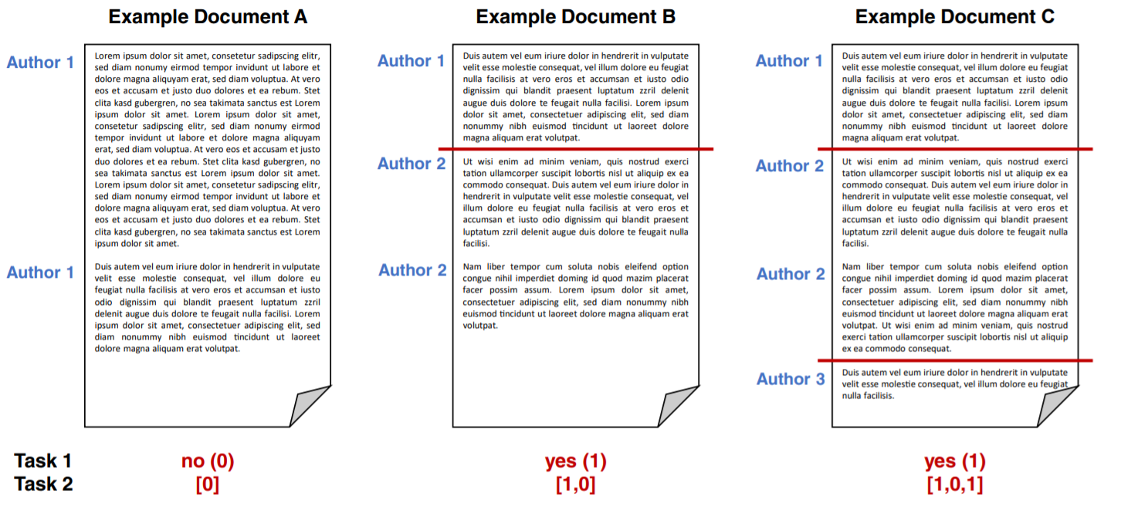
Eva Zangerle, Maximilian Mayerl, Günther Specht, Martin Potthast, Benno Stein (2020). Overview of the Style Change Detection Task at PAN 2020. In CLEF 2020 Labs and Workshops, Notebook Papers. CEUR-WS.org.

Slide 4
DataSet
All the data was extracted from the StackExchange family of websites

Slide 5
DataSet
All the data was extracted from the StackExchange family of websites
There were two datasets provided for the task:
Dataset-narrow : Questions and answers from a specific subset of StackExchange sites pertaining to topics of Computer Technology.
 | Narrow
Train | 3,442
Validation | 1,722
Table 1: Number of documents in
each dataset

Slide 6
DataSet
All the data was extracted from the StackExchange family of websites
There were two datasets provided for the task:
Dataset-narrow : Questions and answers from a specific subset of StackExchange sites pertaining to topics of Computer Technology.
Dataset-wide : Questions and answers from a subset of StackExchange sites that pertained to a wide variety of topics (Technology, Economics, Literature, Philosophy, and Mathematics).
 | Narrow | Wide
Train | 3,442 | 8,138
Validation | 1,722 | 4,078
Table 1: Number of documents in
each dataset

Slide 7
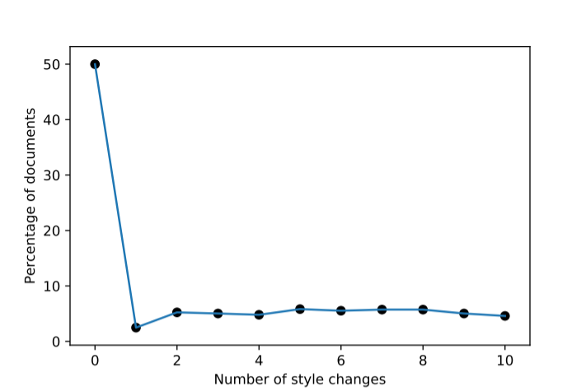
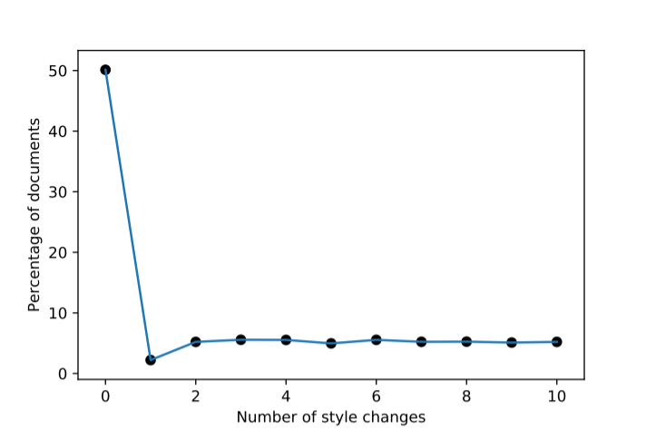
DataSet
Narrow
(b) Wide
Figure 1: Distribution of number of style changes in different datasets

Slide 8
Bidirectional Encoder Representations from Transformers (BERT)
BERT is a large-scale pre-trained deep model used for solving a variety of NLP tasks, obtaining state-of-the-art results on various benchmarks.
Of all the BERT models available, the BERT Base Cased model was used (layers= 12, hidden size= 768, self-attention heads= 12, total parameters= 110M).

Slide 9
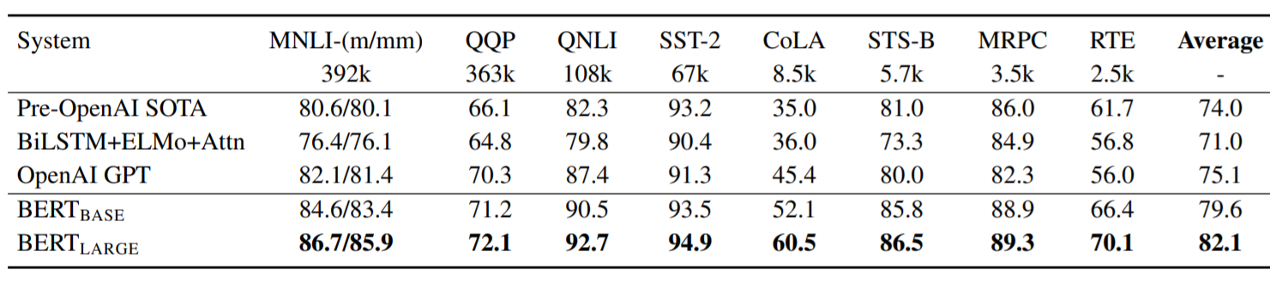
Bidirectional Encoder Representations from Transformers (BERT)
BERT is a large-scale pre-trained deep model used for solving a variety of NLP tasks, obtaining state-of-the-art results on various benchmarks.
Of all the BERT models available, the BERT Base Cased model was used (layers= 12, hidden size= 768, self-attention heads= 12, total parameters= 110M)
Jacob Devlin, Ming-Wei Chang, Kenton Lee, Kristina Toutanova, BERT: Pre-training of Deep Bidirectional Transformers for Language Understanding

Slide 10
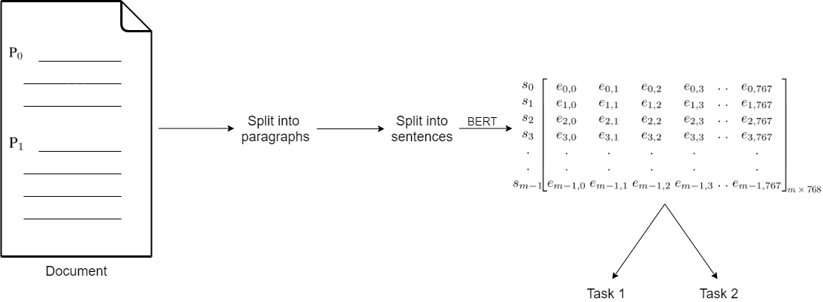
Approach
Figure 3: Our approach for generating feature vectors for the two tasks using pretrained BERT

Slide 11
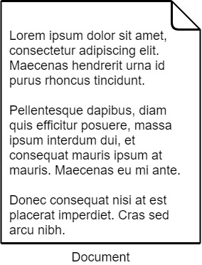
Approach

Slide 12
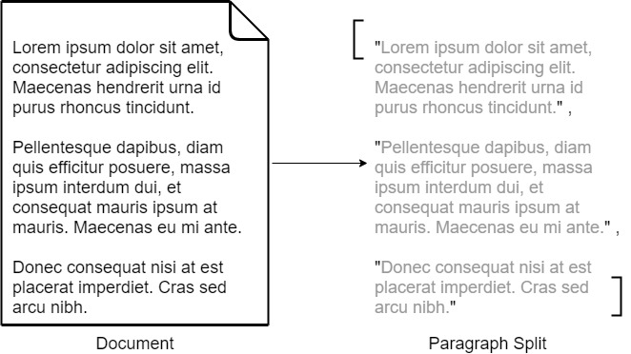
Approach

Slide 13
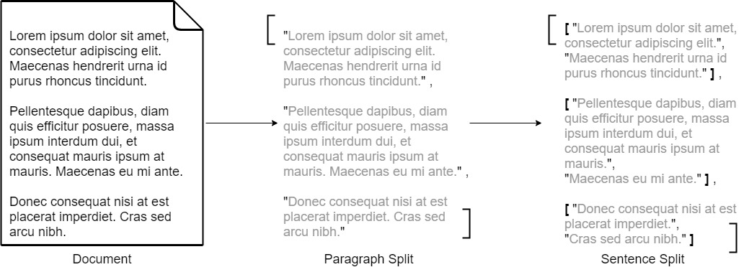
Approach

Slide 14
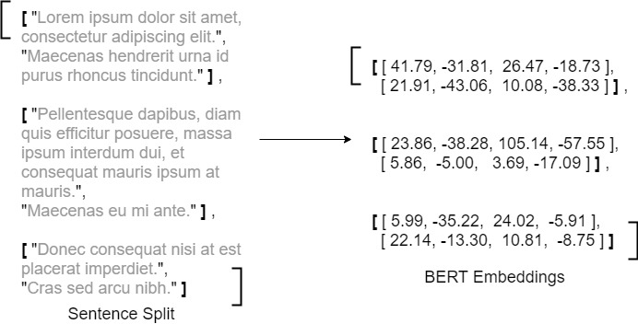
Approach

Slide 15
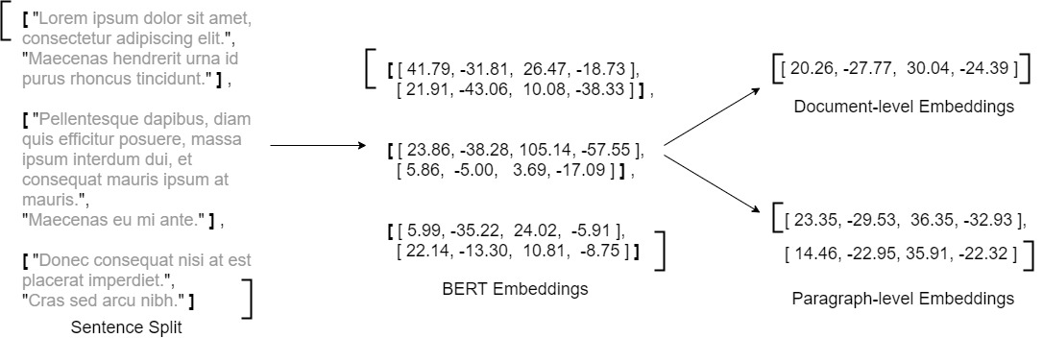
Approach

Slide 16
Classifier
We tried various binary classifiers for Task 1 on Dataset-wide. The results obtained on the validation set are:
Classifier | F-1 Score
SVM | 0.6504
Decision Tree | 0.6108
Logistic Regression | 0.6533
Gaussian Naive Baye’s | 0.566
Random Forest | 0.7367

Slide 17
Results
 | Narrow | Wide
Document-level | 0.7661 | 0.7575
Paragraph-level | 0.8805 | 0.8306
 | Average
Document-level | 0.6401
Paragraph-level | 0.8566
Table 2: F1 scores calculated on the validation
set for Document-level (task 1) and
Paragraph-level (task 2) predictions.
Table 3: Average F1 scores calculated on
the test set for Document-level
(task 1) and Paragraph-level
(task 2) predictions

Slide 18
Other Methods
Creating a Dataset of sentence pairs: Each data point was a pair of sentences from consecutive paragraphs.

Slide 19
Other Methods
Creating a Dataset of sentence pairs: Each data point was a pair of sentences from consecutive paragraphs.
The label of the data point would be assigned based on the following policy:
If the two sentences are from the same paragraph → 0
If the two sentences are from different paragraphs
If no style change occurred between the two paragraphs → 0
If a style change occurred between the two paragraphs → 1

Slide 20
Other Methods
Creating a Dataset of sentence pairs: Each data point was a pair of sentences from consecutive paragraphs.
The label of the data point would be assigned based on the following policy:
If the two sentences are from the same paragraph → 0
If the two sentences are from different paragraphs
If no style change occurred between the two paragraphs → 0
If a style change occurred between the two paragraphs → 1
The dataset was severely imbalanced at this stage, so it was balanced by removing data points from the majority class at random.

Slide 21
Other Methods
The following methods were tried on the newly constructed sentence-pair Dataset

Slide 22
Other Methods
The following methods were tried on the newly constructed sentence-pair Dataset
Fine-tuning BERT:
Fine-tune BERT using the sentence-pair dataset, and then perform the classification
Accuracy plateaued after a point

Slide 23


Other Methods
The following methods were tried on the newly constructed sentence-pair Dataset
Fine-tuning BERT:
Fine-tune BERT using the sentence-pair dataset, and then perform the classification
Accuracy plateaued after a point
Convolutional Neural Network:
The data points were converted to tensors of size
Then run through kernels of sizes
Experiments are ongoing with this technique

Slide 24
Pitfalls
Some of the disadvantages of our method are:
Runtime
All experiments were run in an environment that had access to a GPU
Running on the validation set for Dataset-wide took about 2-3 hours

Slide 25
Pitfalls
Some of the disadvantages of our method are:
Runtime
All experiments were run in an environment that had access to a GPU
Running on the validation set for Dataset-wide took about 2-3 hours
Only focuses on semantic features
We believe that the best approach for style change detection would be to combine both semantic and stylistic features, but our method only focuses on semantic features for now.

Slide 26
Future Work
Fine-tuning BERT
Since we only tried fine-tuning it with our custom dataset, it would be interesting to see the results by fine-tuning it with the original dataset

Slide 27
Future Work
Fine-tuning BERT
Since we only tried fine-tuning it with our custom dataset, it would be interesting to see the results by fine-tuning it with the original dataset
Combining Semantic and Syntactic features
A more sophisticated approach which takes into consideration both Semantic and Stylistic features would be the next step to improve the current model.

Slide 28
THANK YOU

