Slide 1
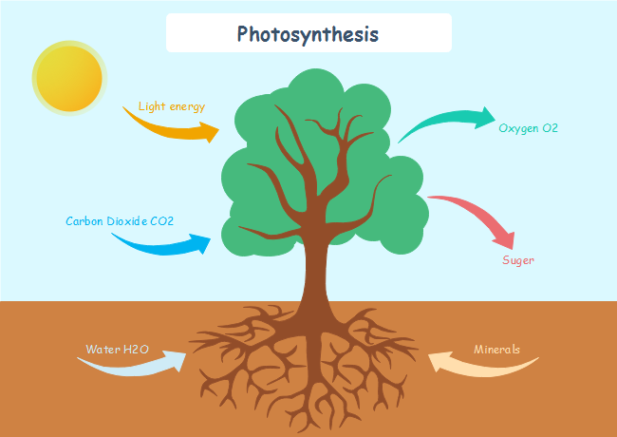
Introduction--What’s GPP?
Gross primary production (GPP) is the total amount of carbon fixed under the photosynthesis process by plants.
GPP could help the understanding of carbon flux on terrestrial ecosystems.
Fig.1 A graph of photosynthesis process

Slide 2
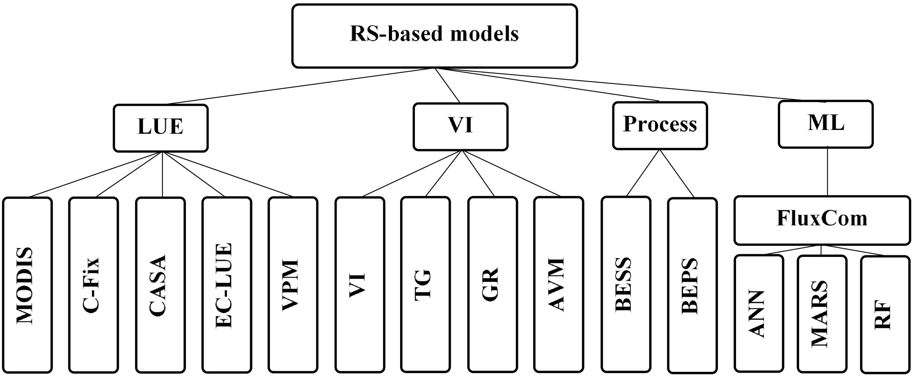
Introduction--models used to estimate GPP
Fig.2 The main remote sensing based-models used to estimate GPP
A variety of GPP data products are available based on different models, when GPP estimates are validated against eddy correlation variance data, however, the performance of different models varies widely.
Notes:
Accurate estimates of the terrestrial gross primary product (GPP) are critical for understanding the global carbon cycle and predicting future climate change.

Slide 3
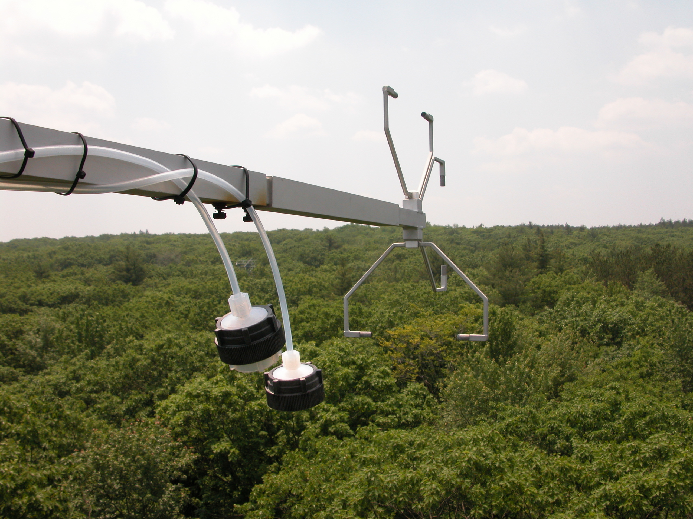
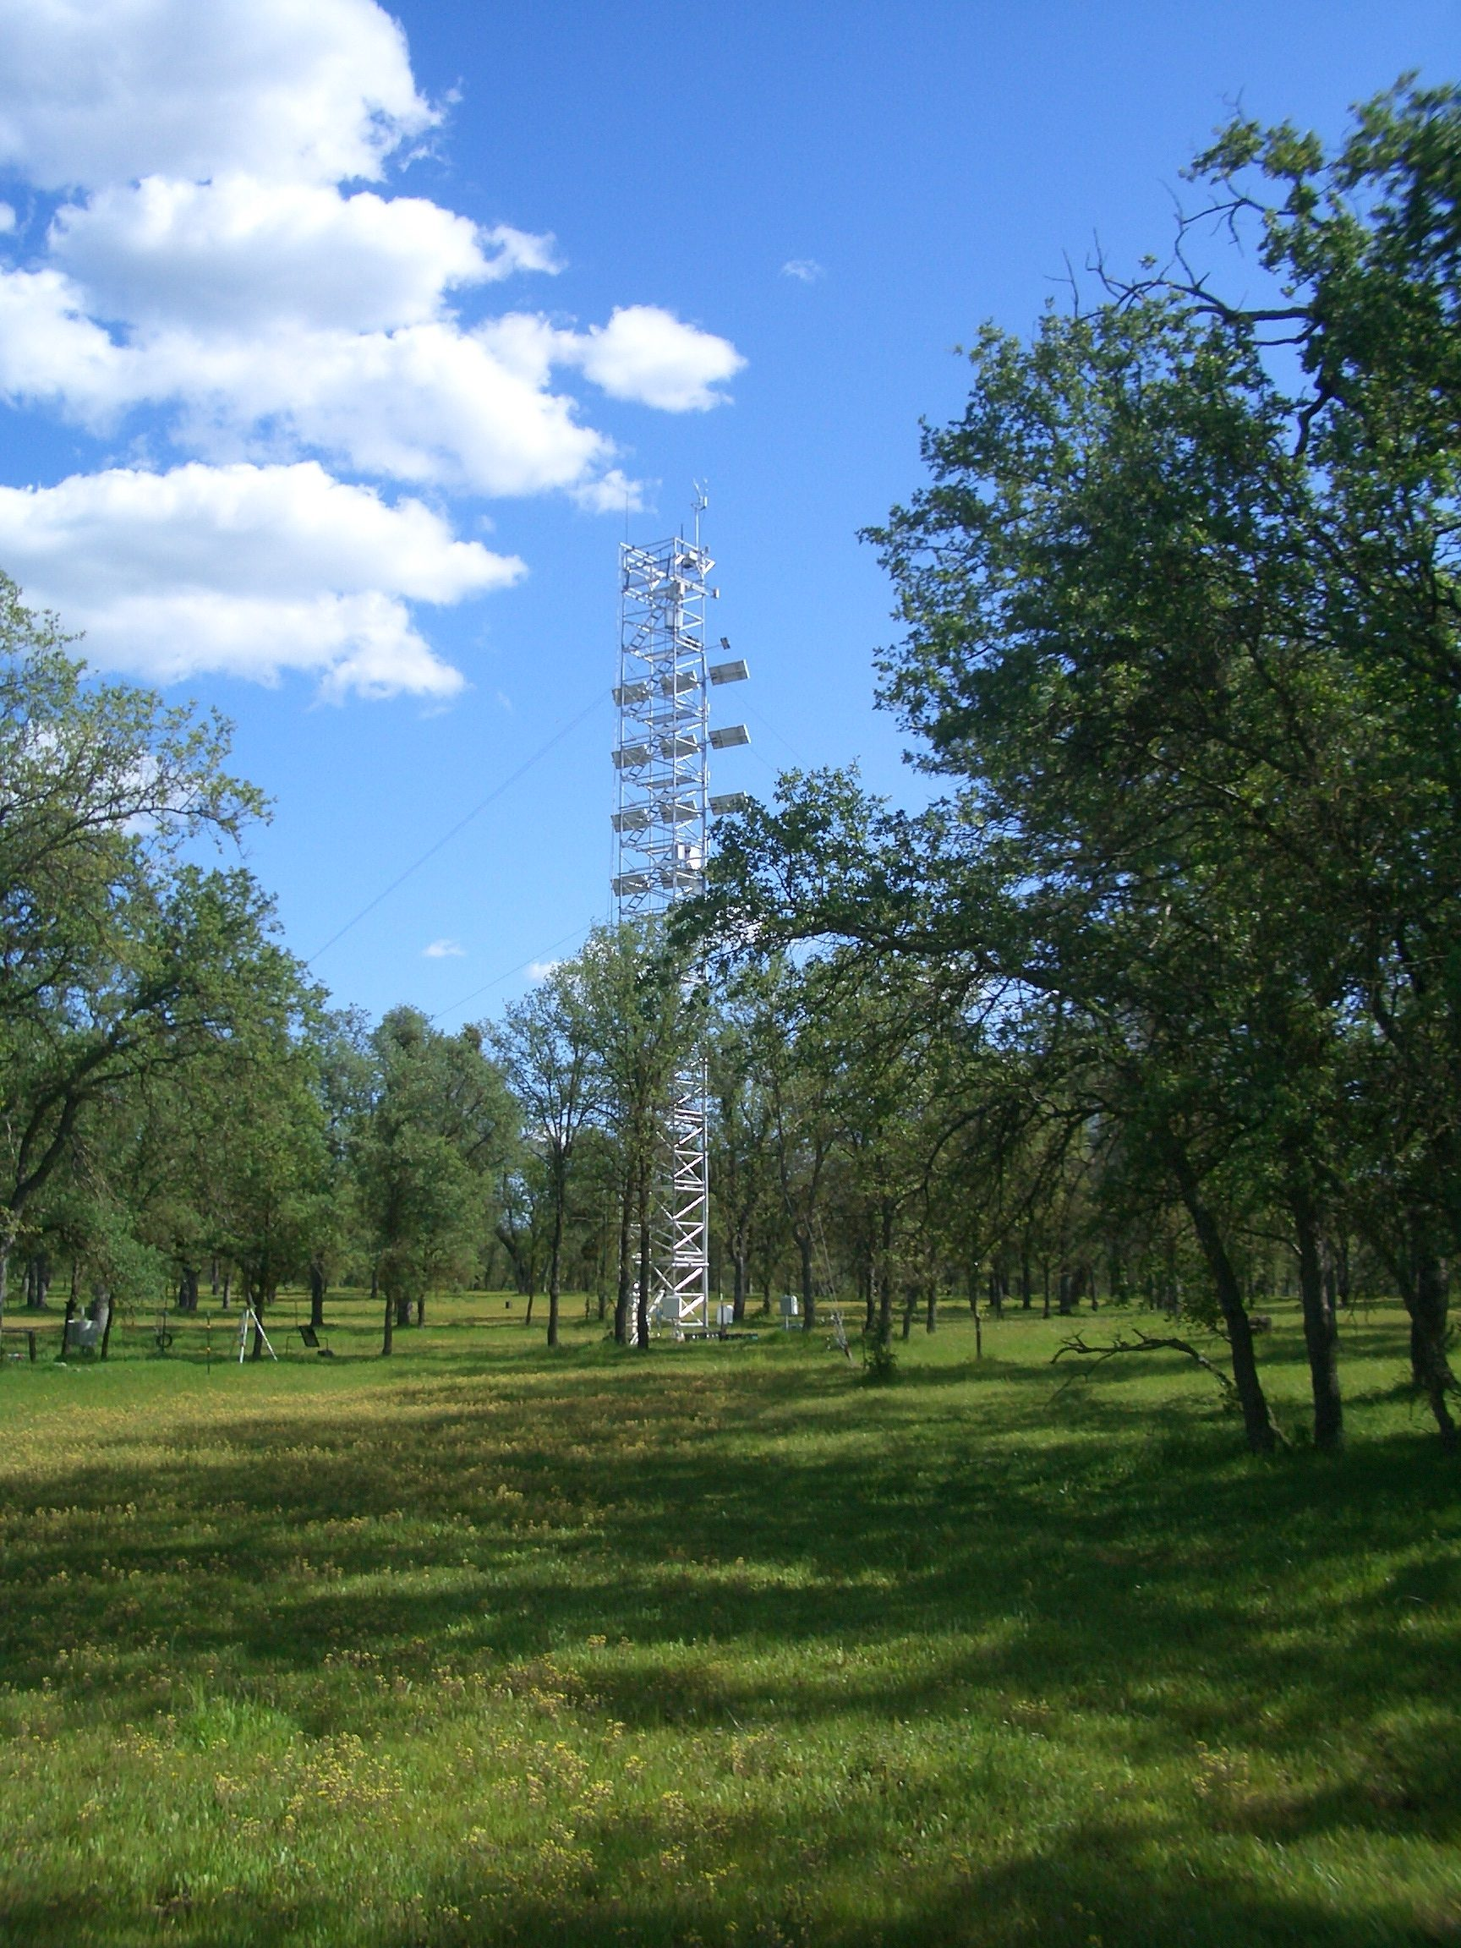
Methods-study area
Harvard Forest, US(45.5378°N, 72.1715°W)
Mean air temperature: 6.6°C
Mean precipitation: 1071 mm
Tonzi Savanna, US(38.4309˚N, 120.9960˚W)
Mean air temperature: 15.8 °C
Mean precipitation: 559 mm

Slide 4

Methods—Vegetation Photosynthesis Model
$$\text{GPP}=ε_{\text{g}} × {\text{APAR}}_{\text{chl}}$$
$${\text{APAR}}_{\text{chl}}=\text{PAR} × {\text{fPAR}}_{\text{chl}}$$
$${\text{fPAR}}_{\text{chl}}=\text{1.25} ×(\text{EVI}−\text{0.1})$$
$$ε_{\text{g}}= ε_{\text{0}}× {\text{T}}_{\text{scalar}} ×{\text{W}}_{\text{scalar}}$$
$${\text{T}}_{\text{scalar}}=\frac{\left(T−{\text{T}}_{\text{max}}\right)× (T−{\text{T}}_{\text{min}})}{\left(T−{\text{T}}_{\text{max}}\right)× \left(T−{\text{T}}_{\text{min}}\right)− {(T−{\text{T}}_{\text{opt}})}^{\text{2}}}$$
$${\text{W}}_{\text{scalar}}=\frac{\text{1} +\text{LSWI}}{\text{1} +{\text{LSWI}}_{\text{max}}}$$

Slide 5
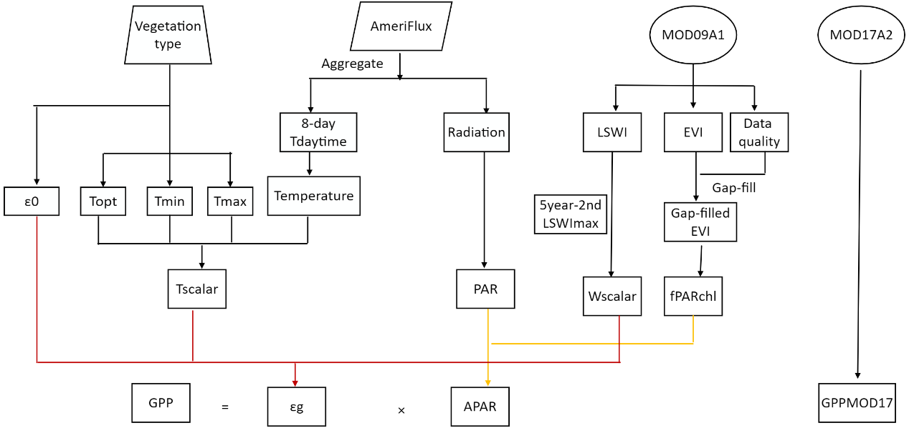
Methods-datasets and workflow
Fig.4 Datasets and workflow of VPM to calculate GPP

Slide 6
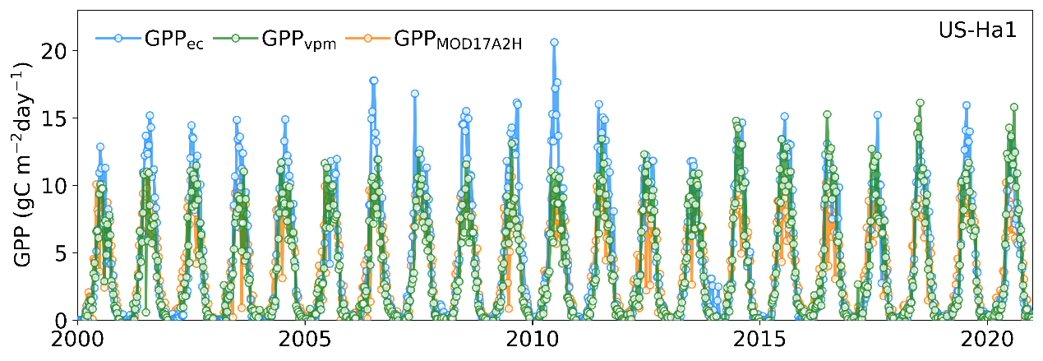
Results—Harvard Forest site
Fig.5 Seasonal dynamics and interannual variations of GPP at the Harvard Forest site during 2000-2021.

Slide 7
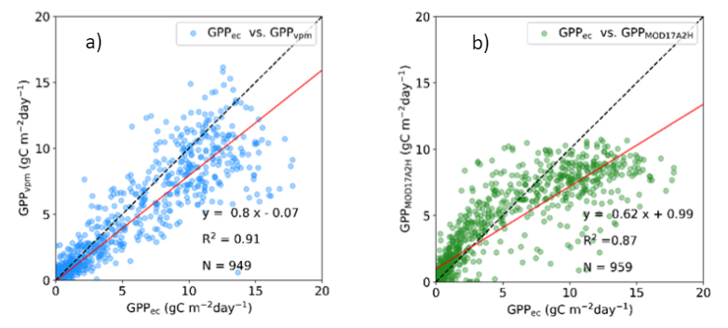
Results—Harvard Forest site
Fig.6 The comparison between predicted and estimated GPP at the Harvard Forest site.

Slide 8
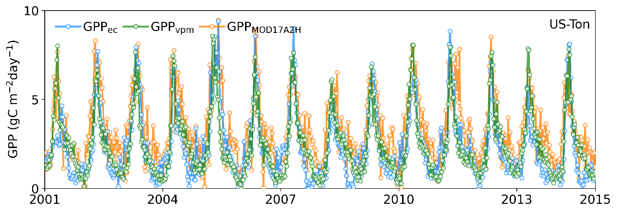
Results—Tonzi Savanna site
Fig.7 Seasonal dynamics and interannual variations of GPP at the Tonzi savanna site during 2001-2014.

Slide 9
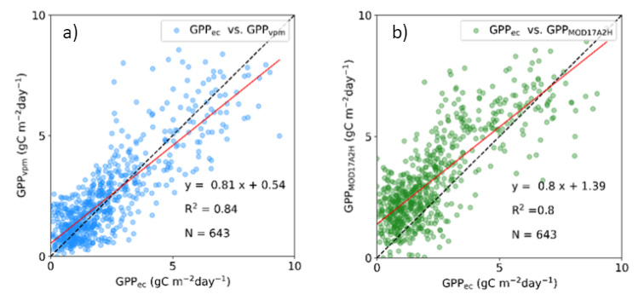
Results—Tonzi Savanna site
Fig.8 The comparison between predicted and estimated GPP at the Tonzi savanna site.

Slide 10
Conclusion
Seasonal dynamics of GPP_{vpm} successfully tracked the seasonal dynamics of GPP_{ec} (R²=0.91, 0.84)
The cross-site comparison also shows that GPP_{vpm} agreed reasonably well with the variations of GPP_{ec} across both years and sites.
Our Vegetation Photosynthesis Model has better performance to track GPP seasonal dynamics and interannual changes than widely used MODIS GPP product.

