Slide 1
Divide & Conquer

Slide 2
Divide and Conquer Algorithms
  Example
    Binary Search
    Merge Sort
    Quick Sort
    Counting
    Closest Pair of Points

Slide 3
Divide and Conquer
Divide the problem into a number of subproblems
  There must be base case (to stop recursion).
Conquer (solve) each subproblem recursively
Combine (merge) solutions to subproblems into a solution to the original problem

Slide 4
Divide-and-Conquer
Most common usage.
  Break up problem of size n into two equal parts of size ½n.
  Solve two parts recursively.
  Combine two solutions into overall solution in linear time.
Consequence.
  Brute force: n².
  Divide-and-conquer: n log n.

Slide 5
Quicksort

Slide 6
Quick Sort
It is a comparison sort where elements are sorted in place.
This sort uses the divide-and-conquer algorithm for sorting an array of n elements, S[1,2,…..n].

Slide 7
Quicksort Algorithm
Given an array of n elements (e.g., integers):
If array only contains one element, return
Else
  pick one element to use as pivot.
  Partition elements into two sub-arrays:
    Elements less than or equal to pivot
    Elements greater than pivot
  Quicksort two sub-arrays
  Return results

Slide 8
Pivot Selection
Use the first element as pivot. If the input is random, it is acceptable. But if
the input is presorted or in reverse order, pivot provides a poor partition.
Choose the pivot randomly. Although a random pivot is very unlikely provide poor partition but it is an expensive approach and does not reduce the average running time of rest of the algorithm.
Choose the median of three numbers as pivot. The best choice of pivot would be the median of array. Unfortunately, it is relatively hard to calculate and would slow down quicksort considerably.

Slide 9
Quicksort Algorithm
Quicksort(A , Left, Right)
If Left < Right
then q = Partition(A, Left, Right)
Quicksort(A, Left, q-1)
Quicksort(A, q+1, Right)
END
Partition(A, Left, Right)
x = A[Right]
i = Left – 1
For j = Left to Right – 1
do if A[j] <= x
then i = i + 1
Swap(A[i], A[j])
Swap(A[i + 1], A[Right])
Return (i + 1)

Slide 10
Quicksort Algorithm
Quicksort(A , Left, Right)
If Left < Right
then q = Partition(A, Left, Right)
Quicksort(A, Left, q-1)
Quicksort(A, q+1, Right)
END
Partition(A, Left, Right)
x = A[Right]
i = Left
For j = Left to Right – 1
do if A[j] <= x
then Swap(A[i], A[j])
i = i + 1
Swap(A[i], A[Right])
Return (i)

Slide 11
Example:
13 81 10 43 31 75 0 92
Select pivot
13 81 10 43 31 75 0 92
Partition
13 10 0
31
81 43 75 92
Quicksort
0 10 13
31
43 75 81 92
Sorted List
0 10 13 31 43 75 81 92

Slide 12
Example
We are given array of n integers to sort:
20
80
70
80
60
50
7
30
40

Slide 13
Pick Pivot Element
There are a number of ways to pick the pivot element. In this example, we will use the last element in the array:
20
80
70
10
60
50
7
30
40

Slide 14
Partitioning Array
Given a pivot, partition the elements of the array such that the resulting array consists of:
  One sub-array that contains elements >= pivot
  Another sub-array that contains elements < pivot
The sub-arrays are stored in the original data array.
Partitioning loops through, swapping elements below/above pivot.

Slide 15
pivot_index = 0
20
80
70
10
60
50
7
30
40
[0] [1] [2] [3] [4] [5] [6] [7] [8]
i
j

Slide 16
pivot_index = 0
20
80
70
10
60
50
7
30
40
[0] [1] [2] [3] [4] [5] [6] [7] [8]
i
j

Slide 17
pivot_index = 0
20
80
70
10
60
50
7
30
40
[0] [1] [2] [3] [4] [5] [6] [7] [8]
i
j

Slide 18
pivot_index = 0
20
80
70
10
60
50
7
30
40
[0] [1] [2] [3] [4] [5] [6] [7] [8]
i
j

Slide 19
pivot_index = 0
20
80
70
10
60
50
7
30
40
[0] [1] [2] [3] [4] [5] [6] [7] [8]
j
i

Slide 20
pivot_index = 0
20
10
70
80
60
50
7
30
40
[0] [1] [2] [3] [4] [5] [6] [7] [8]
i
j

Slide 21
pivot_index = 0
20
10
70
80
60
50
7
30
40
[0] [1] [2] [3] [4] [5] [6] [7] [8]
i
j

Slide 22
pivot_index = 0
20
10
70
80
60
50
7
30
40
[0] [1] [2] [3] [4] [5] [6] [7] [8]
i
j

Slide 23
pivot_index = 8
20
10
70
80
60
50
7
30
40
[0] [1] [2] [3] [4] [5] [6] [7] [8]
i
j

Slide 24
pivot_index = 0
20
10
7
80
60
50
70
30
40
[0] [1] [2] [3] [4] [5] [6] [7] [8]
i
j

Slide 25
pivot_index = 0
20
10
7
80
60
50
70
30
40
[0] [1] [2] [3] [4] [5] [6] [7] [8]
i
j

Slide 26
pivot_index = 0
20
10
7
30
60
50
70
80
40
[0] [1] [2] [3] [4] [5] [6] [7] [8]
i
j

Slide 27
pivot_index = 0
20
10
7
30
40
50
70
80
60
[0] [1] [2] [3] [4] [5] [6] [7] [8]
i

Slide 28
Partition Result
20
10
7
30
40
50
70
80
60
[0] [1] [2] [3] [4] [5] [6] [7] [8]
<= data[pivot]
> data[pivot]

Slide 29
Recursion: Quicksort Sub-arrays
20
10
7
30
40
50
70
80
60
[0] [1] [2] [3] [4] [5] [6] [7] [8]
<= data[pivot]
> data[pivot]

Slide 30
Complexity of Quick Sort
1. Worst Case:
The worst case occurs if the input is presorted or in reverse order and if the 1st or the last element is chosen as pivot. In this case pivot provides a poor partition because all elements go into one partition and the other partition is empty. The worst case running time is 0(N²).
2. Average Case:
The average running time of Quick sort is obtained by averaging the runtime of all possible subproblems’ sizes. That means it occurs from the fact that on average each reduction step of the algorithm produces two subsets. So, the average running time is 0(NlogN).
3. Best Case:
The best case occurs when the partition always splits into two subsets with equal number of elements. So, the running time is 0(NlogN).

Slide 31
Mergesort

Slide 32
Merge Sort
Merge sort is a comparison sorting technique.
This technique follows the divide-and-conquer approach.
It maintains the following 3 steps:
1. Divide: Divide N-element sequence to be sorted into two subsequences of
about N/2 elements each and sort the two subsequences recursively .
2. Conquer: Merge the two sorted subsequences to produce the sorted result.
Merge sort uses the “merge” step to combine two sorted sublists to create one single
sorted list.
Suppose A is a sorted list with R elements and B is another sorted list with S elements.
After merging there is only a single sorted list C with N=R+S elements.

Slide 33
Mergesort Algorithm
Merge-Sort(A, Left, Right)
(1) If Left < Right do steps 2 to 5
Set Center = (Left+Right)/2
Merge-Sort (A, Left, Center)
Merge-Sort (A,Center+1, Right)
Merge(A, Left, Center, Right)
End
Merge(A, Left, Center, Right)
n₁ = Center – Left + 1; n₂ = Right – Center
Create arrays L[1…(n₁+1)] and R[1…(n₂+1)]
For i = 1 to n₁
do L[i] = A[Left + i -1]
For j = 1 to n₂
do R[j] = A[Center + j]
L[n₁ +1]=inf; R[n₂+1]=inf;
i = 1 ; j = 1
For k = Left to Right
do if L[i] <= R[j]
then A[k] = L[i]
i = i + 1
else A[k] = R[j]
j = j + 1
(16) End

Slide 34
Example:
Suppose Array A = 5, 2, 4, 7, 1, 3, 2, 6. Sort the array using Mergesort.
5 | 2 | 4 | 1 | 7 | 3 | 2 | 6
5 | 2 | 4 | 1
7 | 3 | 2 | 6
5 | 2
4 | 1
7 | 3
2 | 6
5
2
4
1
7
3
2
6
2 | 5
1 | 4
3 | 7
2 | 6
1 | 2 | 4 | 5
2 | 3 | 6 | 7
1 | 2 | 2 | 3 | 4 | 5 | 6 | 7

Slide 35
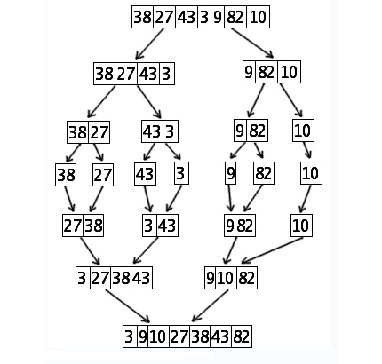
Example:
Suppose Array A = 38, 27, 43, 3, 9, 82 and 10. Sort the array using Mergesort.

Slide 36
Merging
Merging. Combine two pre-sorted lists into a sorted whole.
How to merge efficiently?
  Linear number of comparisons.
  Use temporary array.
A
G
L
O
R
H
I
M
S
T
A
G
H
I

Slide 37
Merging
Merge.
  Keep track of smallest element in each sorted half.
  Insert smallest of two elements into auxiliary array.
  Repeat until done.
smallest
smallest
A
G
L
O
R
H
I
M
S
T
A
auxiliary array

Slide 38
Merging
Merge.
  Keep track of smallest element in each sorted half.
  Insert smallest of two elements into auxiliary array.
  Repeat until done.
smallest
smallest
A
G
L
O
R
H
I
M
S
T
A
G
auxiliary array

Slide 39
Merging
Merge.
  Keep track of smallest element in each sorted half.
  Insert smallest of two elements into auxiliary array.
  Repeat until done.
smallest
smallest
A
G
L
O
R
H
I
M
S
T
A
G
H
auxiliary array

Slide 40
Merging
Merge.
  Keep track of smallest element in each sorted half.
  Insert smallest of two elements into auxiliary array.
  Repeat until done.
smallest
smallest
A
G
L
O
R
H
I
M
S
T
A
G
H
I
auxiliary array

Slide 41
Merging
Merge.
  Keep track of smallest element in each sorted half.
  Insert smallest of two elements into auxiliary array.
  Repeat until done.
smallest
smallest
A
G
L
O
R
H
I
M
S
T
A
G
H
I
L
auxiliary array

Slide 42
Merging
Merge.
  Keep track of smallest element in each sorted half.
  Insert smallest of two elements into auxiliary array.
  Repeat until done.
smallest
smallest
A
G
L
O
R
H
I
M
S
T
A
G
H
I
L
M
auxiliary array

Slide 43
Merging
Merge.
  Keep track of smallest element in each sorted half.
  Insert smallest of two elements into auxiliary array.
  Repeat until done.
smallest
smallest
A
G
L
O
R
H
I
M
S
T
A
G
H
I
L
M
O
auxiliary array

Slide 44
Merging
Merge.
  Keep track of smallest element in each sorted half.
  Insert smallest of two elements into auxiliary array.
  Repeat until done.
smallest
smallest
A
G
L
O
R
H
I
M
S
T
A
G
H
I
L
M
O
R
auxiliary array

Slide 45
Merging
Merge.
  Keep track of smallest element in each sorted half.
  Insert smallest of two elements into auxiliary array.
  Repeat until done.
first half
exhausted
smallest
A
G
L
O
R
H
I
M
S
T
A
G
H
I
L
M
O
R
S
auxiliary array

Slide 46
Merging
Merge.
  Keep track of smallest element in each sorted half.
  Insert smallest of two elements into auxiliary array.
  Repeat until done.
first half
exhausted
smallest
A
G
L
O
R
H
I
M
S
T
A
G
H
I
L
M
O
R
S
T
auxiliary array

Slide 47
Merging
Merge.
  Keep track of smallest element in each sorted half.
  Insert smallest of two elements into auxiliary array.
  Repeat until done.
first half
exhausted
second half
exhausted
A
G
L
O
R
H
I
M
S
T
A
G
H
I
L
M
O
R
S
T
auxiliary array

Slide 48
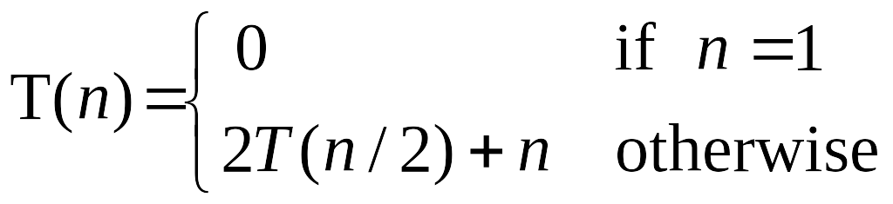
A Useful Recurrence Relation
Def. T(n) = number of comparisons to mergesort an input of size n.
Mergesort recurrence.
Solution. T(n) = O(n log₂ n).
Assorted proofs. We describe several ways to prove this recurrence. Initially we assume n is a power of 2 and replace ≤ with =.

Slide 49
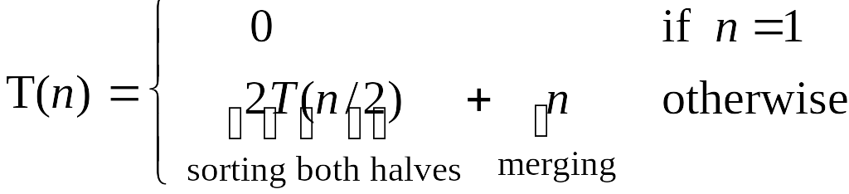
Proof by Recursion Tree
T(n)
n
T(n/2)
T(n/2)
2(n/2)
T(n/4)
T(n/4)
T(n/4)
T(n/4)
4(n/4)
log₂n
. . .
T(n / 2^{k})
2^{k} (n / 2^{k})
. . .
T(2)
T(2)
T(2)
T(2)
T(2)
T(2)
T(2)
T(2)
n/2 (2)
n log₂n

Slide 50
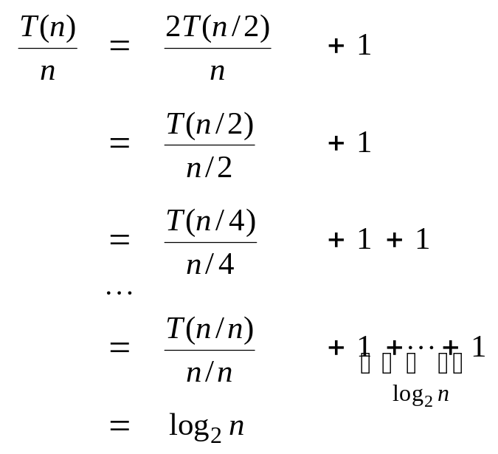
Proof by Telescoping
Claim. If T(n) satisfies this recurrence, then T(n) = n log₂ n.
Pf. For n > 1:
assumes n is a power of 2

Slide 51
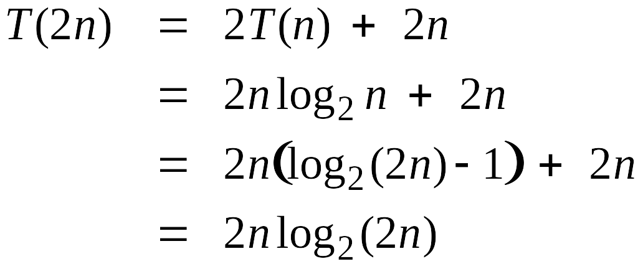
Proof by Induction
Claim. If T(n) satisfies this recurrence, then T(n) = n log₂ n.
Pf. (by induction on n)
  Base case: n = 1.
  Inductive hypothesis: T(n) = n log₂ n.
  Goal: show that T(2n) = 2n log₂ (2n).
assumes n is a power of 2

