Slide 1
NETWORK FLOW
CSE 2203: Design and Analysis of Algorithms

Slide 2
The Problem
Use a graph to model material that flows through conduits.
Each edge represents one conduit, and has a capacity, which is an upper bound on the flow rate = units/time.
Can think of edges as pipes of different sizes.
Want to compute max rate that we can ship material from a designated source to a designated sink.

Slide 3
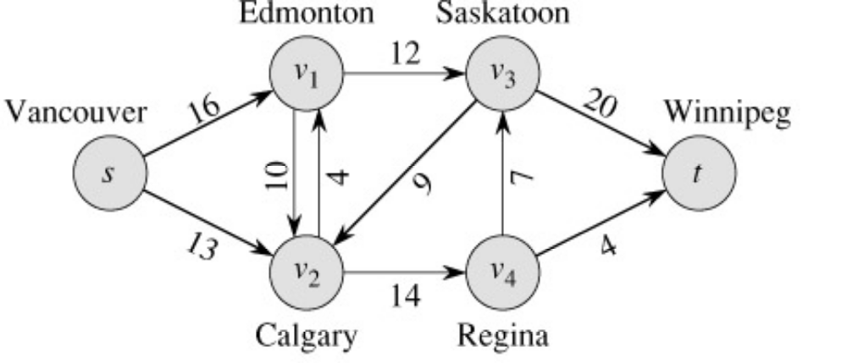
What is Network Flow?
Each edge (u,v) has a nonnegative capacity c(u,v).
If (u,v) is not in E, assume c(u,v)=0.
We have a source s, and a sink t.
Assume that every vertex v in V is on some path from s to t.
c(s,v₁)=16; c(v₁,s)=0; c(v₂,v₃)=0

Slide 4
Some assumptions…
We will simplify our discussion by assuming the following:
No edge enters s, the source
No edge leaves t, the sink
At least one edge is incident to each node
All capacities are integers

Slide 5
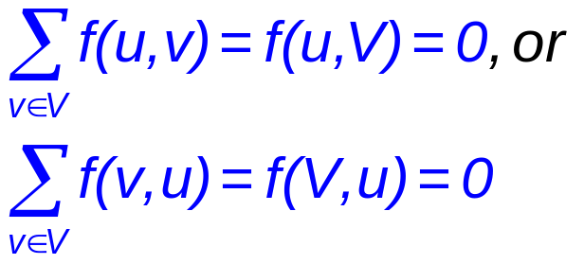
Formalization
Flow network – G=(V,E)
  Directed, each edge has capacity c(u,v) ≥ 0
  Two special vertices: source s, and sink t
  For any other vertex v, there is a path s→…→v→…→t
Flow – f : V × V → R
  Capacity constraint: ∀u,v ∈ V: f(u,v) ≤ c(u,v)
  Skew symmetry: ∀u,v ∈ V: f(u,v) = –f(v,u)
  Flow conservation: ∀u ∈ V – {s, t}:

Slide 6
Flow in a Flow Network
  A flow in the network is an integer-valued function f defined on the edges of G satisfying 0 ≤ f(i,j) ≤ c(i,j) for every edge (i,j) in E.

Slide 7
What is a Flow in a Network?
For each edge (u,v), the flow f(u,v) is a real-valued function that must satisfy 3 conditions:
Note that skew symmetry condition implies that f(u,u)=0.

Slide 8
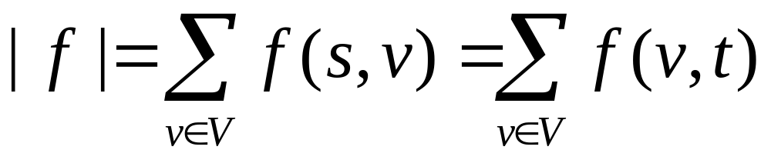
The Value of a flow
The value of a flow is given by
This is the total flow leaving s = the total flow arriving in t.

Slide 9
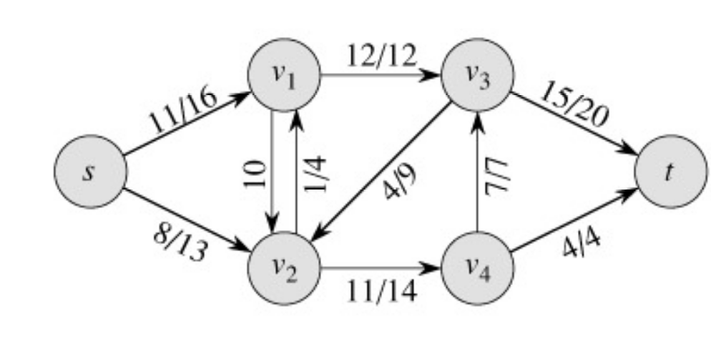
Example:
|f| = f(s, v₁) + f(s, v₂) + f(s, v₃) + f(s, v₄) + f(s, t) =
11 + 8 + 0 + 0 + 0 = 19
|f|= f(s, t) + f(v₁, t) + f(v₂, t) + f(v₃, t) + f(v₄, t) =
0 + 0 + 0 + 15 + 4 = 19

Slide 10
Example of a Flow
flow
capacity
0
0
f(v₂, v₁) = 1, c(v₂, v₁) = 4.
f(v₁, v₂) = -1, c(v₁, v₂) = 10.
f(v3, s) + f(v3, v1) + f(v3, v2) + f(v3, v4) + f(v3, t) =
0 + (-12) + 4 + (-7) + 15 = 0

Slide 11
A flow in a network
We assume that there is only flow in one direction at a time.
Sending 7 trucks from Edmonton to Calgary and 3 trucks from Calgary to Edmonton has the same net effect as sending 4 trucks from Edmonton to Calgary.

Slide 12
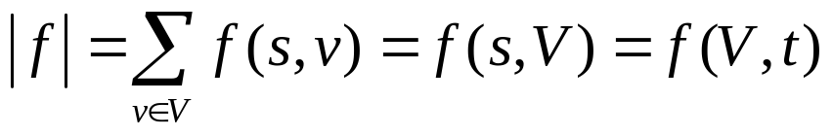
Maximum flow
What do we want to maximize?
  Value of the flow f:
a
13
b
15
8
19
10
10
13
t
s
4
2
9
5
6
5
3
14
c
11
d
3
8

Slide 13
Some Lemmas:
Prove that, f(s,V)=f(V,t) [pg-649]
[Lemma26.2] Prove that, |f+f′|=|f|+|f′|
Lemma: 26.3
Lemma 26.4 |f′| = |f| + |f_{p}| ≥|f|
Lemma: 26.5 |f| = f(S,T)
Lemma: 26.6 |f| ≤ c(S,T)

Slide 14
Cuts
A cut is a partition of V into S and T = V – S, such that s ∈ S and t ∈ T
The net flow (f(S,T)) through the cut is the sum of flows f(u,v), where s ∈ S and t ∈ T
  Includes negative flows back from T to S
The capacity (c(S,T)) of the cut is the sum of capacities c(u,v), where s ∈ S and t ∈ T
  The sum of positive capacities
Minimum cut – a cut with the smallest capacity of all cuts.
  |f|= f(S,T) i.e. the value of a max flow is equal to the capacity of a min cut.
a
8/13
b
10/15
13/19
s
10
9
5/5
t
2/4
6/14
c
8/11
d
3/3
Cut capacity = 24
Min Cut capacity = 21

Slide 15

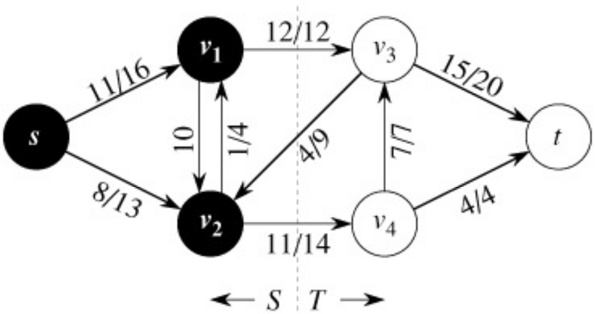
The Net Flow Through a Cut(S,T)
The value of any flow f in a flow network G is bounded from above by the capacity of any cut of G.
S
T
f(S,T) = 12 – 4 + 11 = 19

Slide 16
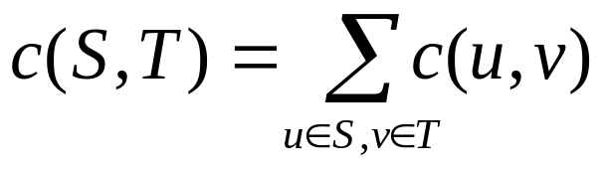
The Capacity of Cut(S,T)
c(S,T)= 12+ 14 = 26

Slide 17
Maxflow-Mincut Theorem
Max-flow min-cut theorem:
  If f is the flow in G, the following conditions are equivalent:
    1. f is a maximum flow in G
    2. The residual network G_{f} contains no augmenting paths
    3. |f| = c(S,T) for some cut (S,T) of G

Slide 18
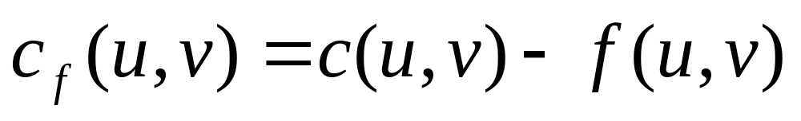
The Ford-Fulkerson Method
Try to improve the flow, until we reach the maximum.
The residual capacity of the network with a flow f is given by:
Always nonnegative (why?)

Slide 19
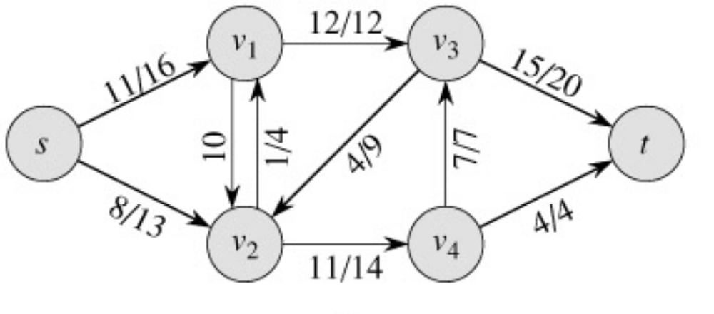
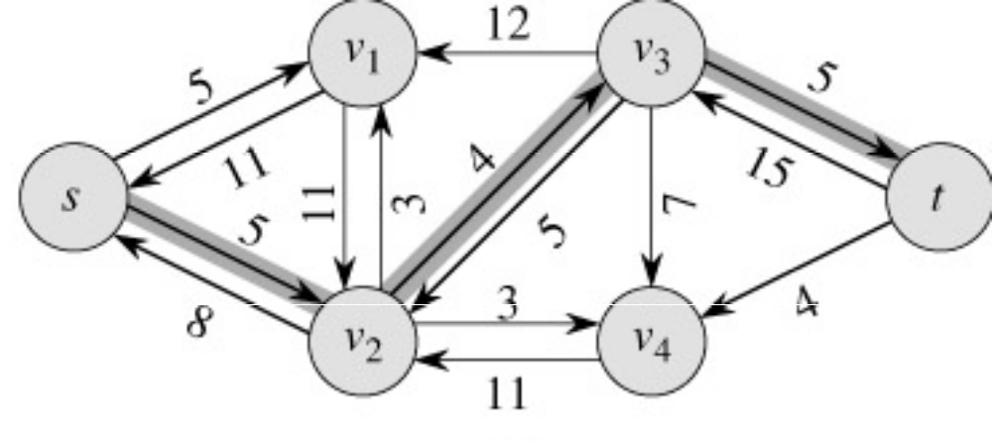
Example of residual capacities
Network:
Residual Network:
Augmenting path

Slide 20
The residual network
The edges of the residual network are the edges on which the residual capacity is positive.

Slide 21
Why do we need residual networks?
Residual networks allow us to reverse flows if necessary.
If we have taken a bad path then residual networks allow one to detect the condition and reverse the flow.
A bad path is one which overlaps with too many other paths.

Slide 22
Example
a
Source
1
1
Destination
1
1
1
b
Paths source, a, destinations and source, b destination gives a flow of 2 units.
Path source, a, b, destination overlaps with both the optimal paths.
If we initially choose source, a, b, destination as our path, then no greedy strategy will be able to augment the network flow any further (unless we use residual edges which allows recovery)
Verify how we recover in spite of the initial bad choice, if we use the residual network to augment flows.

Slide 23
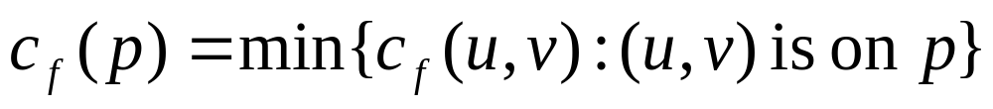
Augmenting Paths
An augmenting path p is a simple path from s to t on the residual network.
We can put more flow from s to t through p.
We call the maximum capacity by which we can increase the flow on p the residual capacity of p.

Slide 24
Augmenting Paths - example
The residual capacity of p = 4.
Can improve the flow along p by 4.

Slide 25
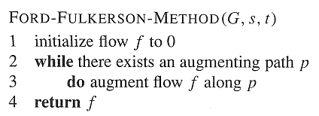
Ford-Fulkerson Method

Slide 26
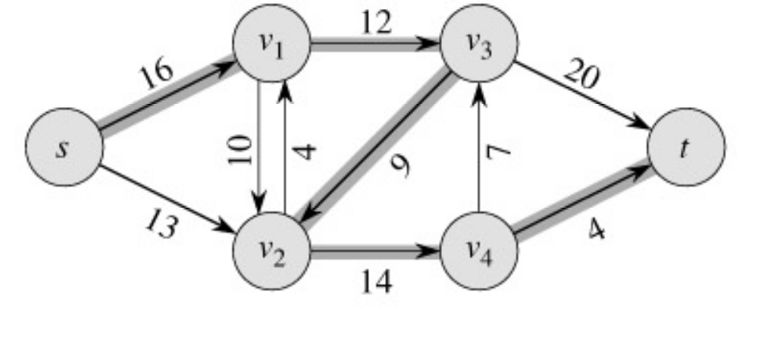
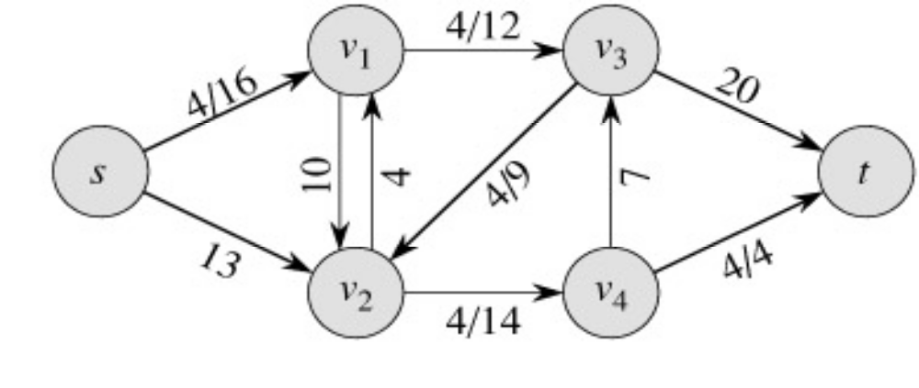
Example
augmenting path
Original Network
Resulting Flow =4

Slide 27
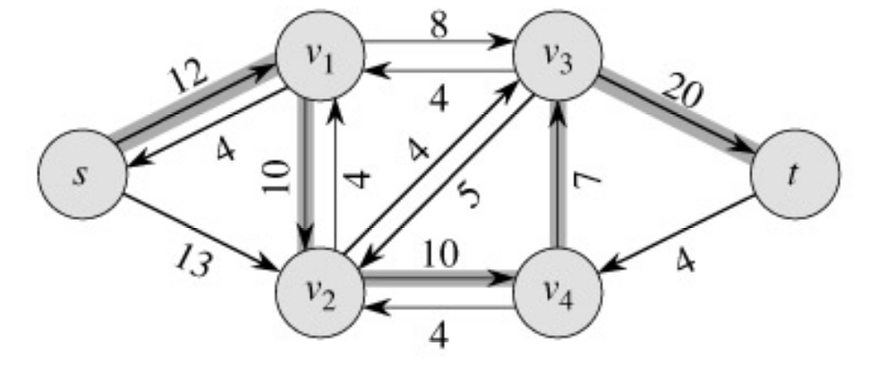
Example
Resulting
Flow = 4
augmenting path
Residual Network

Slide 28
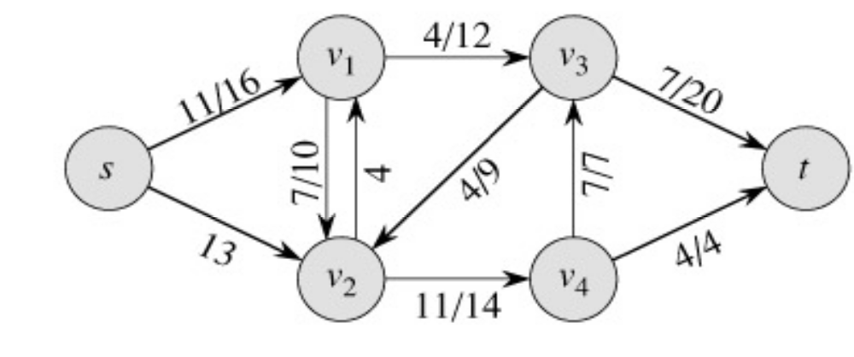
Example
Residual Network
Resulting Flow =11

Slide 29
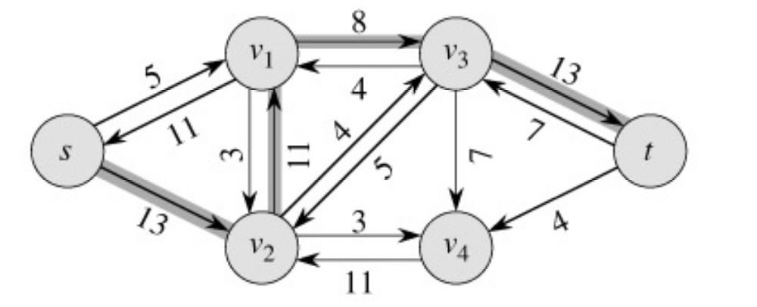
Example
Resulting
Flow =11
augmenting path
Residual Network

Slide 30
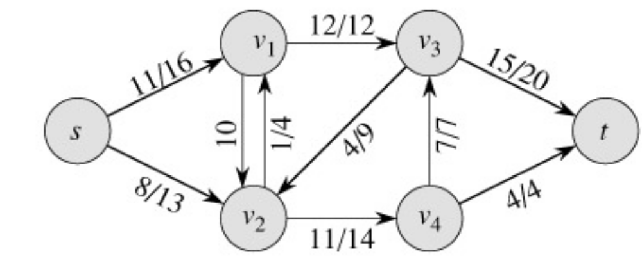
Example
Residual Network
Resulting
Flow =19

Slide 31
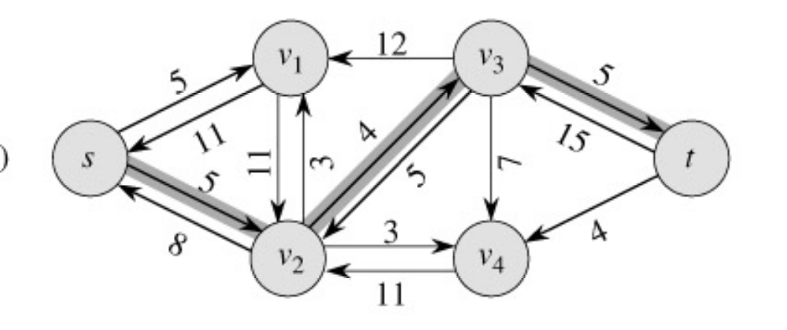
Example
Resulting
Flow = 19
augmenting path
Residual Network

Slide 32
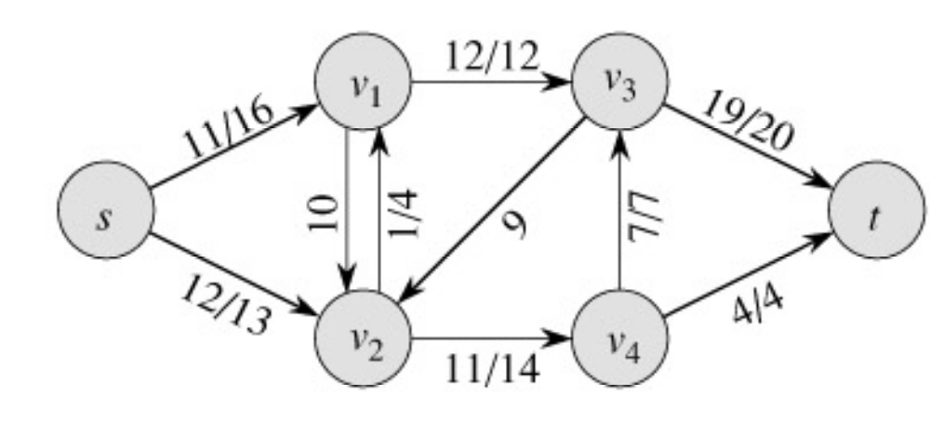
Example
Residual Network
Resulting
Flow = 23

Slide 33
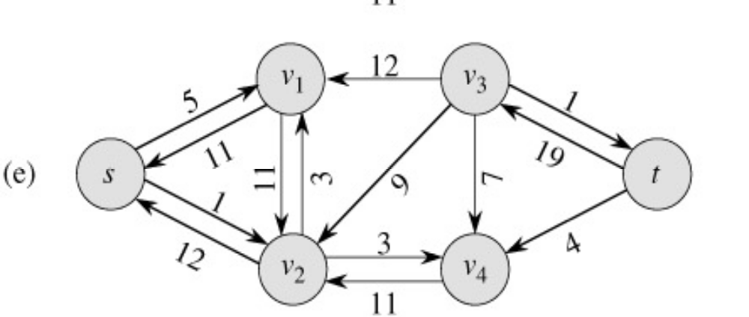
Example
Resulting
Flow = 23
No augmenting path:
Maxflow=23
Residual Network
  The residual network Gf contains no
  augmented paths. So f is a maximum
  flow in G.

Slide 34
Ford-Fulkerson method, with details
Ford-Fulkerson(G,s,t)
1 for each edge (u,v)∈G.E do
2 f(u,v) = f(v,u) = 0
3 while ∃ path p from s to t in residual network G_{f} do
4 c_{f} = min{c_{f}(u,v): (u,v)∈p}
5 for each edge (u,v) in p do
6 f(u,v) = f(u,v) + c_{f}
7 f(v,u) = -f(u,v)
8 return f
The algorithms based on this method differ in how they choose p in step 3.

Slide 35
Time Analysis I
A complete analysis establishing which specific method is best is a complex task, however, because their running times depend on
  The number of augmenting paths needed to find a maxflow
  The time needed to find each augmenting path

Slide 36
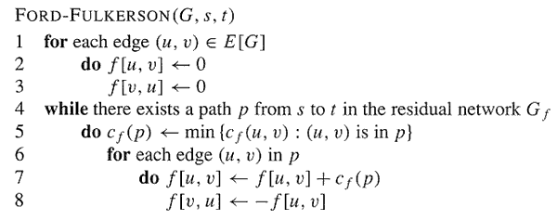
Analysis
O(E)
O(E)

Slide 37
Analysis
If capacities are all integer, then each augmenting path raises |f| by ≥ 1.
If max flow is f*, then need ≤ |f*| iterations
  So time is O(E|f*|).
Note that this running time is not polynomial in input size. It depends on |f*|, which is not a function of |V| or |E|.
If capacities are rational, can scale them to integers.
If irrational, FORD-FULKERSON might never terminate!

Slide 38
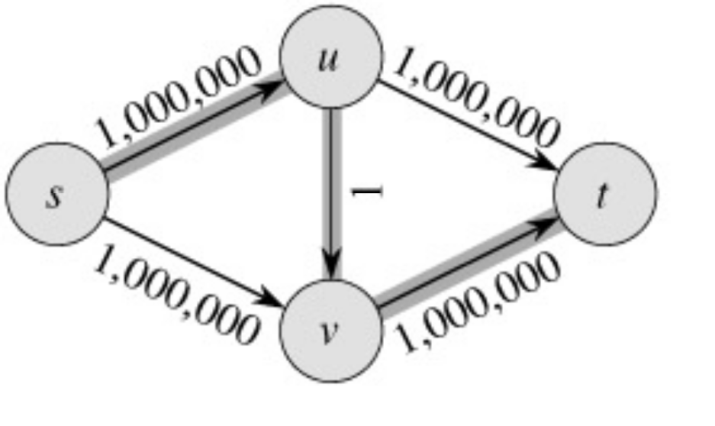
The basic Ford-Fulkerson Algorithm
With time O ( E |f*|), the algorithm is not polynomial.
This problem is real: Ford-Fulkerson may perform very badly if we are unlucky:
|f*|=2,000,000

Slide 39
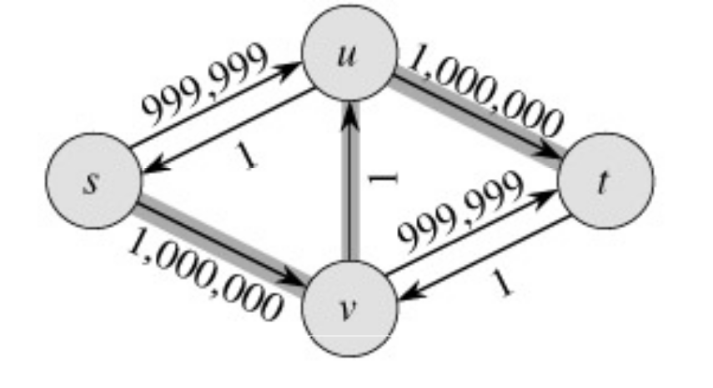
Run Ford-Fulkerson on this example
Augmenting Path
Residual Network

Slide 40
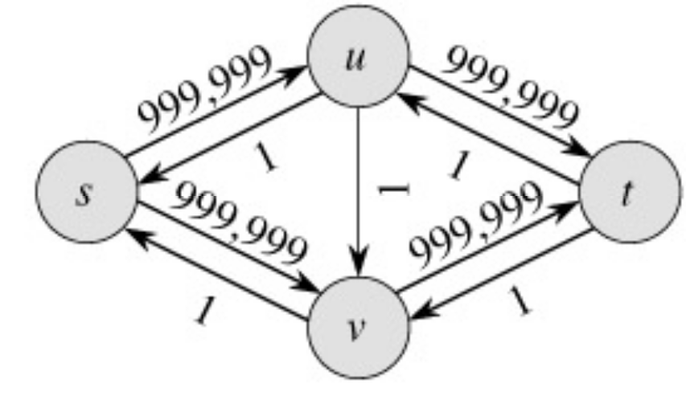
Run Ford-Fulkerson on this example
Augmenting Path
Residual Network

Slide 41

Run Ford-Fulkerson on this example
Repeat 999,999 more times…

Slide 42
The Edmonds-Karp Algorithm
A small fix to the Ford-Fulkerson algorithm makes it work in polynomial time.
Specify how to compute the path in line 4.

Slide 43
The Edmonds-Karp Algorithm
Compute the path in line 4 using breadth-first search on residual network.
The augmenting path p is the shortest path from s to t in the residual network (treating all edge weights as 1).
Runs in time O(V E²).

Slide 44
The Edmonds-Karp Algorithm - example
Edmonds-Karp’s algorithm runs only 2 iterations on this graph.

Slide 45
Time Complexity
Let, total number of flow augmentations performed by Edmonds-Karp algorithm is O(VE)
BFS to find the augmented path – O(E)
So, Total running time is O(VE²)

Slide 46
Thm: Total number of flow augmentations is O(VE)
Proof:

Slide 47
Conditions
If f is a flow in a flow network G=(V,E), with source s and sink t, then the following conditions are equivalent:
  f is a maximum flow in G.
  The residual network G_{f} contains no augmented paths.
  |f| = c(S,T) for some cut (S,T) (a min-cut).
It is a flow since there is no augmented paths It is maximum since the sink is not reachable from the source

Slide 48
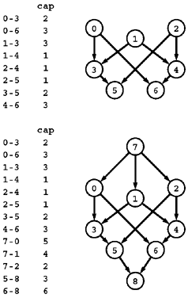
Multiple sources and sinks
Problem:
  What if you have a problem with more than one source and more than one sink?
  The network at the top has three sources (0, 1, and 2) and two sinks (5 and 6).
Reduction: Create a network which
  is a copy of the original network
  with the addition of a new source 7 and
  a new sink 8.
  There is an edge from 7 to each original-network source with capacity equal to the sum of the capacities of that source's outgoing edges,
  an edge from each original-network sink to 8 with capacity equal to the sum of the capacities of that sink's incoming edges.

Slide 49
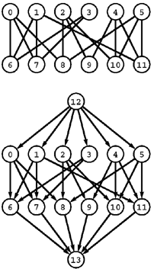
Bipartite matching
Problem:
  Given a bipartite graph, find a set of edges of maximum cardinality such that each vertex is connected to at most one other vertex.
Reduction: Construct an st-network
  by directing all the edges from the top row to the bottom row,
  adding a new source with edges to each vertex on the top row,
  adding a new sink with edges to each vertex on the bottom row, and
  assigning capacity 1 to all edges.
  In any flow, at most one outgoing edge from each vertex on the top row can be filled and at most one incoming edge to each vertex on the bottom row can be filled, so a solution to the maxflow problem on this network gives a maximum matching for the bipartite graph.

Slide 50
Model for Matching Problem
Group1 on leftmost set, Group2 on rightmost set, edges if they are compatible
A
A
X
A
X
X
B
B
B
Y
Y
Y
C
C
C
Z
Z
D
Z
D
D
G1
G2
A matching
Optimal matching

Slide 51
Solution Using Max Flow
Add a supersouce, supersink, make each undirected edge directed with a flow of 1
A
A
X
X
B
B
t
Y
s
Y
C
C
Z
Z
D
D
Since the input is 1, flow conservation prevents multiple matchings

