Slide 1
CSE-304
Design & Analysis of Algorithm
Recurrence Relation

Slide 2
GENERAL RULES FOR ANALYSIS(1/5)
1. Consecutive statements
  Maximum statement is the one counted
    e.g. a fragment with single for-loop followed by double for- loop is O(n²).
Block #1
t₁
t₁+t₂ = max(t₁,t₂)
Block #2
t₂

Slide 3
GENERAL RULES FOR ANALYSIS(2/5)
2. If/Else
if cond then S1
else
S2
Block #1
t₁
Block #2
t₂
Max(t₁,t₂)

Slide 4
GENERAL RULES FOR ANALYSIS(3/5)
3. For Loops
Running time of a for-loop is at most the running time of the statements inside the for-loop times number of iterations
for (i = sum = 0; i < n; i++)
sum += a[i];
for loop iterates n times, executes 2 assignment statements each iteration ==> asymptotic complexity of O(n)

Slide 5
GENERAL RULES FOR ANALYSIS(4/5)
4. Nested For-Loops
Analyze inside-out. Total running time is running time of the statement multiplied by product of the sizes of all the for-loops
e.g. for (i =0; i < n; i++)
for (j = 0, sum = a[0]; j <= i ; j++)
sum += a[j];
  printf("sum for subarray - through %d is %d\n", i, sum);

Slide 6
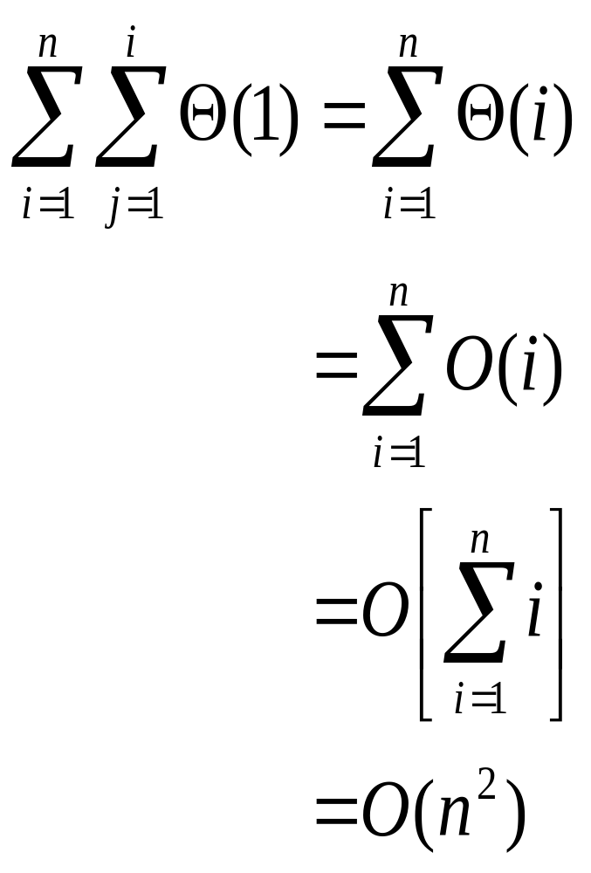
GENERAL RULES FOR ANALYSIS(5/5)

Slide 7
Recurrence Relations (1/2)
A recurrence relation is an equation which is defined in terms of itself.
Why are recurrences good things?
  Many natural functions are easily expressed as recurrences:
    a_{n} = a _{n-1} + 1, a₁ = 1−−> a_{n} = n (polynomial)
    a_{n} = 2a _{n-1} ,a₁ = 1−−> a_{n} = 2^{n} (exponential)
    a_{n} = na _{n-1} ,a₁ = 1−−> a_{n} = n! (weird function)
It is often easy to find a recurrence as the solution of a counting problem

Slide 8
Recurrence Relations (2/2)
In both, we have general and boundary conditions, with the general condition breaking the problem into smaller and smaller pieces.
The initial or boundary condition terminate the recursion.

Slide 9
Recurrence Equations
A recurrence equation defines a function, say T(n). The function is defined recursively, that is, the function T(.) appear in its definition. (recall recursive function call). The recurrence equation should has a base case.
For example:
T(n) = T(n-1)+T(n-2), if n>1
    1, if n=1 or n=0.
base case
for convenient, we sometime write the recurrence equation as:
T(n) = T(n-1)+T(n-2)
T(0) = T(1) = 1.

Slide 10
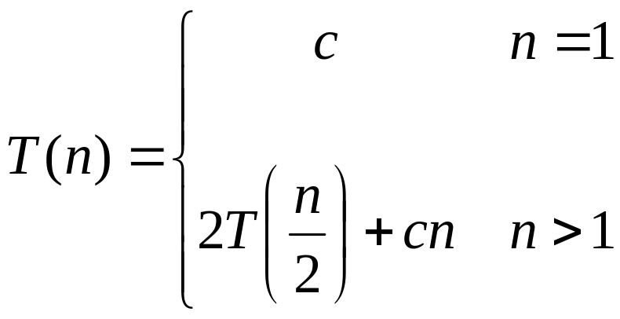
Recurrences
The expression:
is a recurrence.
  Recurrence: an equation that describes a function in terms of its value on smaller functions

Slide 11



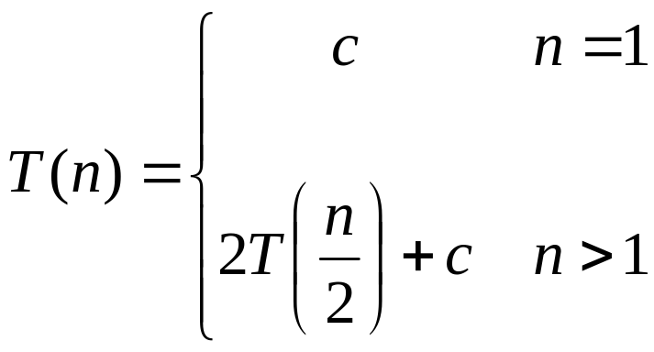
Recurrence Examples

Slide 12
More Recurrence equations:
T(n) = 2 * T(n/2) + 1,
T(1) = 1.
Base case;
initial condition.
T(n) = T(n-1) + n,
T(1) = 1.
Selection Sort
T(n) = 2* T(n/2) + n,
T(1) = 1.
Merge Sort
Quick Sort
T(n) = 2*T(n/2) + log n,
T(1) = 1.
Heap Construction
T(n) = T(n/2) + 1,
T(1) = 0.
Binary search

Slide 13
Methods for Solving Recurrences
Iteration method
Substitution method
Recursion tree method
Master method

Slide 14
Simplications:
There are two simplications we apply that won't affect asymptotic analysis
  ignore floors and ceilings (justification in text)
  assume base cases are constant, i.e., T(n) = Θ(1) for n small enough

Slide 15
Solving Recurrences: Iteration (convert to summation)
Expand the recurrence
Work some algebra to express as a summation
Evaluate the summation

Slide 16
The Iteration Method
T(n) = c + T(n/2)
T(n) = c + T(n/2)
= c + c + T(n/4)
= c + c + c + T(n/8)
Assume n = 2^{k}
T(n) = c + c + … + c + T(1)
= clgn + T(1)
= Θ(lgn)
T(n/2) = c + T(n/4)
T(n/4) = c + T(n/8)
k times

Slide 17

s(n) =
c + s(n-1)
c + c + s(n-2)
2c + s(n-2)
2c + c + s(n-3)
3c + s(n-3)
…
kc + s(n-k) = ck + s(n-k)

Slide 18
So far for n >= k we have
  s(n) = ck + s(n-k)
What if k = n?
  s(n) = cn + s(0) = cn

Slide 19
So far for n >= k we have
  s(n) = ck + s(n-k)
What if k = n?
  s(n) = cn + s(0) = cn
So
Thus in general
  s(n) = cn

Slide 20
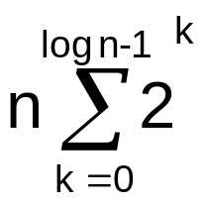
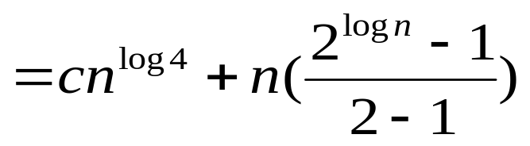
Solving Recurrences: Iteration (convert to summation)
Example: T(n) = 4T(n/2) + n
T(n) = 4T(n/2) + n /**expand**/
= 4(n/2 + 4T(n/4)) + n /**simplify**/
= 16T(n/4) + 2n + n /**expand**/
= 16(n/4 + 4T(n/8)) + 2n + n /**simplify**/
= 4^{log n} T(1)+ … + 4n + 2n + n /** #levels = log n **/
= c4^{log n} + /** convert to summation**/
/** a^{log b} = b^{log a} **/

Slide 21
Solving Recurrences: Iteration (convert to summation) (cont.)
= cn²+n(n^{log 2} -1) /** 2^{log n} = n^{log 2} **/
= cn² +n(n - 1)
= cn² +n² - n
= Θ(n²)

Slide 22
The substitution method
Guess a solution
Use induction to prove that the solution works

Slide 23
Substitution method
Guess a solution
  T(n) = O(g(n))
  Induction goal: apply the definition of the asymptotic notation
    T(n) ≤ d g(n), for some d > 0 and n ≥ n₀
  Induction hypothesis: T(k) ≤ d g(k) for all k < n
Prove the induction goal
  Use the induction hypothesis to find some values of the constants d and n₀ for which the induction goal holds

Slide 24
Example: Binary Search
T(n) = c + T(n/2)
Guess: T(n) = O(lgn)
  Induction goal: T(n) ≤ d lgn, for some d and n ≥ n₀
  Induction hypothesis: T(n/2) ≤ d lg(n/2)
Proof of induction goal:
T(n) = T(n/2) + c ≤ d lg(n/2) + c
= d lgn – d + c ≤ d lgn
if: – d + c ≤ 0, d ≥ c

Slide 25
Example 2
T(n) = T(n-1) + n
Guess: T(n) = O(n²)
  Induction goal: T(n) ≤ c n², for some c and n ≥ n₀
  Induction hypothesis: T(k-1) ≤ c(k-1)² for all k < n
Proof of induction goal:
T(n) = T(n-1) + n ≤ c (n-1)² + n
= cn² – (2cn – c - n) ≤ cn²
if: 2cn – c – n ≥ 0 ⇔ c ≥ n/(2n-1) ⇔ c ≥ 1/(2 – 1/n)
  For n ≥ 1 ⇒ 2 – 1/n ≥ 1 ⇒ any c ≥ 1 will work

Slide 26
Example 3
T(n) = 2T(n/2) + n
Guess: T(n) = O(nlgn)
  Induction goal: T(n) ≤ cn lgn, for some c and n ≥ n₀
  Induction hypothesis: T(n/2) ≤ cn/2 lg(n/2)
Proof of induction goal:
T(n) = 2T(n/2) + n ≤ 2c (n/2)lg(n/2) + n
= cn lgn – cn + n ≤ cn lgn
if: - cn + n ≤ 0 ⇒ c ≥ 1

Slide 27

Changing variables
T(n) = 2T( ) + lgn
  Rename: m = lgn ⇒ n = 2^{m}
  T (2^{m}) = 2T(2^{m/2}) + m
  Rename: S(m) = T(2^{m})
  S(m) = 2S(m/2) + m ⇒ S(m) = O(mlgm) (demonstrated before)
  T(n) = T(2^{m}) = S(m) = O(mlgm)=O(lgnlglgn)
  Idea: transform the recurrence to one that you have seen before

Slide 28
Evaluate recursive equation using Recursion Tree
Evaluate: T(n) = T(n/2) + T(n/2) + n
  Work copy: T(k) = T(k/2) + T(k/2) + k
  For k=n/2, T(n/2) = T(n/4) + T(n/4) + (n/2)
[size|cost]

Slide 29
Recursion-tree method
A recursion tree models the costs (time) of a recursive execution of an algorithm.
The recursion tree method is good for generating guesses for the substitution method.
The recursion-tree method can be unreliable.
The recursion-tree method promotes intuition, however.

Slide 30
Recursion Tree e.g.
To evaluate the total cost of the recursion tree
  sum all the non-recursive costs of all nodes
  = Sum (rowSum(cost of all nodes at the same depth))
Determine the maximum depth of the recursion tree:
  For our example, at tree depth d
  the size parameter is n/(2^{d})
  the size parameter converging to base case, i.e. case 1
  such that, n/(2^{d}) = 1,
  d = lg(n)
  The rowSum for each row is n
Therefore, the total cost, T(n) = n lg(n)

Slide 31
Example of recursion tree
Solve T(n) = T(n/4) + T(n/2) + n²:

Slide 32
Example of recursion tree
Solve T(n) = T(n/4) + T(n/2) + n²:
T(n)

Slide 33
Example of recursion tree
Solve T(n) = T(n/4) + T(n/2) + n²:
n²
T(n/4)
T(n/2)

Slide 34
Example of recursion tree
Solve T(n) = T(n/4) + T(n/2) + n²:
n²
(n/4)²
(n/2)²
T(n/16)
T(n/8)
T(n/8)
T(n/4)

Slide 35
Example of recursion tree
Solve T(n) = T(n/4) + T(n/2) + n²:
n²
(n/4)²
(n/2)²
(n/16)²
(n/8)²
(n/8)²
(n/4)²
…
Θ(1)

Slide 36

Example of recursion tree
Solve T(n) = T(n/4) + T(n/2) + n²:
n²
(n/4)²
(n/2)²
(n/16)²
(n/8)²
(n/8)²
(n/4)²
…
Θ(1)

Slide 37
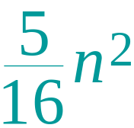
Example of recursion tree
Solve T(n) = T(n/4) + T(n/2) + n²:
n²
(n/4)²
(n/2)²
(n/16)²
(n/8)²
(n/8)²
(n/4)²
…
Θ(1)

Slide 38
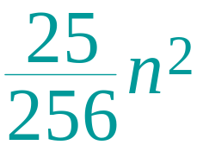
Example of recursion tree
Solve T(n) = T(n/4) + T(n/2) + n²:
n²
(n/4)²
(n/2)²
(n/16)²
(n/8)²
(n/8)²
(n/4)²
…
…
Θ(1)

Slide 39
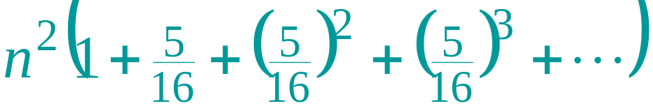
Example of recursion tree
Solve T(n) = T(n/4) + T(n/2) + n²:
n²
(n/4)²
(n/2)²
(n/16)²
(n/8)²
(n/8)²
(n/4)²
…
…
Θ(1)
Total =
= Θ(n²)
geometric series

Slide 40
The Master Method
Based on the Master theorem.
“Cookbook” approach for solving recurrences of the form
  T(n) = aT(n/b) + f(n)
    a ≥ 1, b > 1 are constants.
    f(n) is asymptotically positive.
    n/b may not be an integer, but we ignore floors and ceilings.
Requires memorization of three cases.

Slide 41
The Master Theorem
Theorem 4.1
Let a ≥ 1 and b > 1 be constants, let f(n) be a function, and
Let T(n) be defined on nonnegative integers by the recurrence
T(n) = aT(n/b) + f(n), where we can replace n/b by ⎣n/b⎦ or ⎡n/b⎤.
T(n) can be bounded asymptotically in three cases:
If f(n) = O(n^{logba–ε}) for some constant ε > 0, then T(n) = Θ(n^{logba}).
If f(n) = Θ(n^{logba}), then T(n) = Θ(n^{logba}lg n).
If f(n) = Ω(n^{logba+ε}) for some constant ε > 0,
and if, for some constant c < 1 and all sufficiently large n,
we have a·f(n/b) ≤ c f(n), then T(n) = Θ(f(n)).

Slide 42
Master Method – Examples
T(n) = 16T(n/4)+n
  a = 16, b = 4, n^{logba} = n^{log416} = n².
  f(n) = n = O(n^{logba-ε}) = O(n^{2-ε} ), where ε = 1 ⇒ Case 1.
  Hence, T(n) = Θ(n^{logba} ) = Θ(n²).
T(n) = T(3n/7) + 1
  a = 1, b=7/3, and n^{logba} = n^{log 7/3 1} = n⁰ = 1
  f(n) = 1 = Θ(n^{logba}) ⇒ Case 2.
  Therefore, T(n) = Θ(n^{logba} lg n) = Θ(lg n)

Slide 43
Master Method – Examples
T(n) = 3T(n/4) + n lg n
  a = 3, b=4, thus n^{logba} = n^{log43} = O(n^{0.793})
  f(n) = n lg n = Ω(n^{log43 + ε} ) where ε ≈ 0.2 ⇒ Case 3.
  Therefore, T(n) = Θ(f(n)) = Θ(n lg n).
T(n) = 2T(n/2) + n lg n
  a = 2, b=2, f(n) = n lg n, and n^{logba} = n^{log22} = n
  f(n) is asymptotically larger than n^{logba}, but not polynomially larger. The ratio lg n is asymptotically less than n^{ε} for any positive ε. Thus, the Master Theorem doesn’t apply here.

