Slide 1
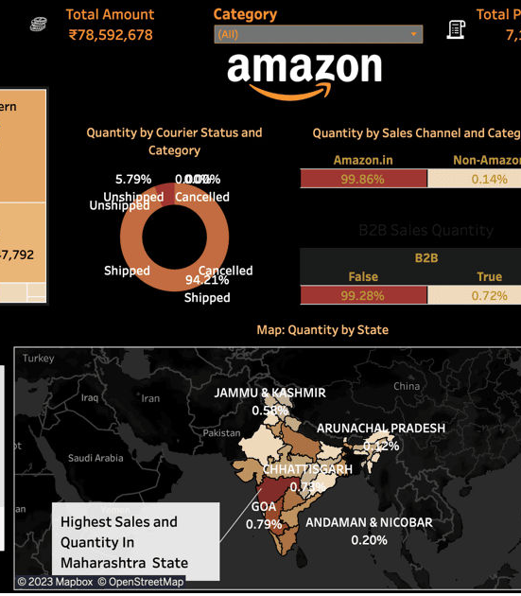
ANALYZING AMAZON SALES DATA
company name - Unified Mentor
Start date - 15/01/2024 End date - 15/02/2024
presented by- Israd (211401022)

Slide 2

Training objectives
Understanding Sales Data
Fundamentals
Data Collection and Management
Sales Performance Analysis

Slide 3
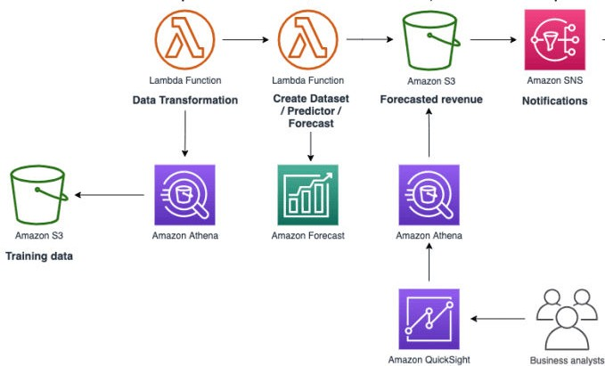
Architecture diagram

Slide 4
Training Modules List
Data Analysis Techniques Customer Behavior Analysis
Predictive Analytics and Forecasting Optimization and Decision-Making Practical Applications and Case Studies Reporting and Communication

Slide 5
Modules Description

Slide 6

Data Analysis Techniques
Descriptive Statistics: Use descriptive statistics to summarize sales data and identify trends.
Data Visualization: Create visualizations (charts, graphs, dashboards) to represent sales data clearly and effectively using tools like Excel, Tableau, or Power BI.
Segmentation: Perform customer and product segmentation to identify patterns and target specific groups.

Slide 7
Customer Behavior Analysis
Purchase Patterns: Study customer purchase patterns and behaviors. Customer Feedback: Analyze customer reviews and ratings to gain insights into product quality and customer satisfaction.
Churn Analysis: Identify factors contributing to customer churn and develop strategies to retain customers.

Slide 8
Predictive Analytics and Forecasting
Sales Forecasting: Use statistical models and machine learning techniques to forecast future sales.
Demand Prediction: Predict demand for products to optimize inventory management.
Scenario Analysis: Conduct what-if analyses to understand the impact of different variables on sales outcomes.

Slide 9
Optimization and Decision-Making
Inventory Management: Optimize inventory levels to balance supply and demand.
Pricing Strategies: Develop and test pricing strategies to maximize revenue. Marketing Effectiveness: Assess the effectiveness of marketing campaigns and promotions on sales performance.

Slide 10
Practical Applications and Case Studies
Real-world Case Studies: Analyze case studies of successful Amazon sellers to understand best practices.
Hands-on Projects: Engage in hands-on projects and simulations to apply theoretical knowledge to real-world scenarios.
Tools and Software: Gain proficiency in tools and software commonly used in sales data analysis (e.g., SQL, Python, R, Excel).

Slide 11
Reporting and Communication
Reporting: Learn to create comprehensive sales reports for stakeholders.
Data-Driven Decision Making: Develop skills to present data-driven insights and recommendations to support strategic decisions.
Stakeholder Communication: Enhance communication skills to effectively share analysis results with various stakeholders (e.g., management, marketing teams).

Slide 12
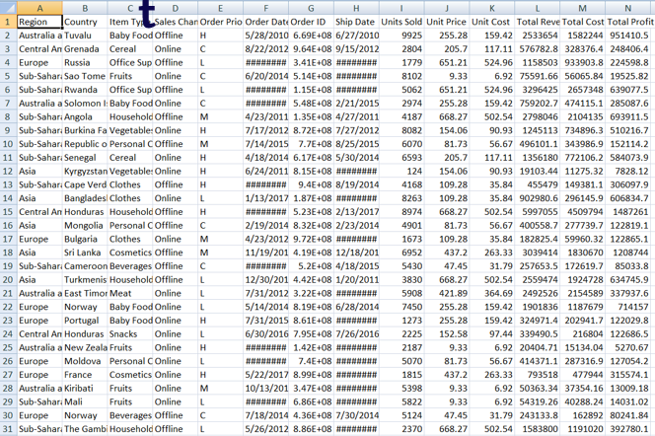
INPUT

Slide 13
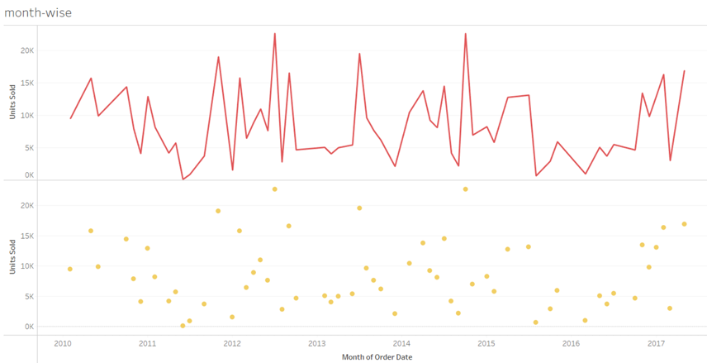
Month-wise line and point graph

Slide 14
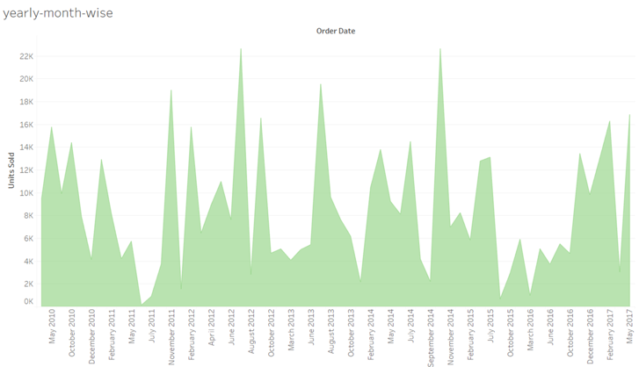
MONTH WISE MOUNT GRAPH

Slide 15
Outcomes of training
Enhanced Analytical Skills Improved Decision-Making
Better Sales and Marketing Strategies Competitive Advantage
Forecasting and Predictive Analysis

Slide 16
THANK YOU

