Slide 1


Slide 2
VR QuickStart with Unity3D
Panayot Cankov | Principal Software Engineer

Slide 3

What is Virtual Reality?
Fully enclosed, synthetic experience with no sense of the real world
Notes:
What is VR – a completely digital environment

Slide 4
Safety
Security in Public Spaces
Play Space Guardian
Cyber Sickness
Health

Slide 5
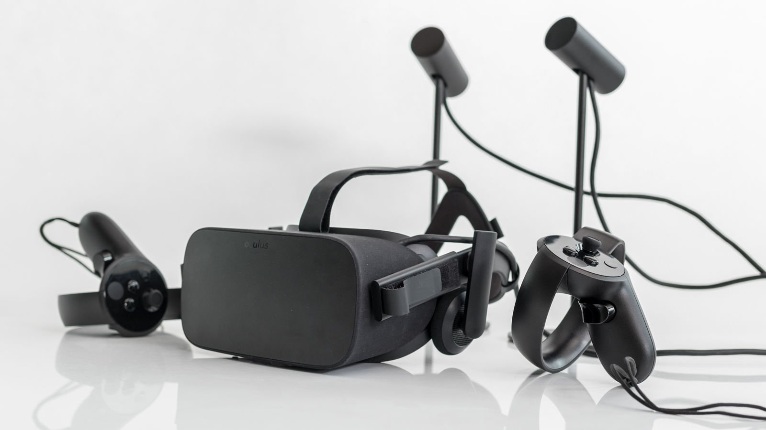
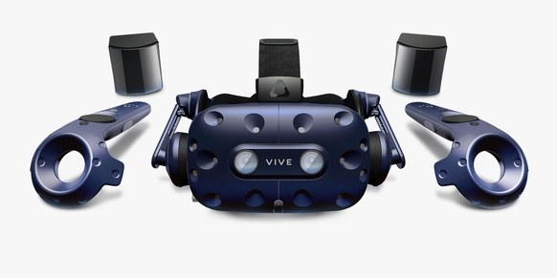
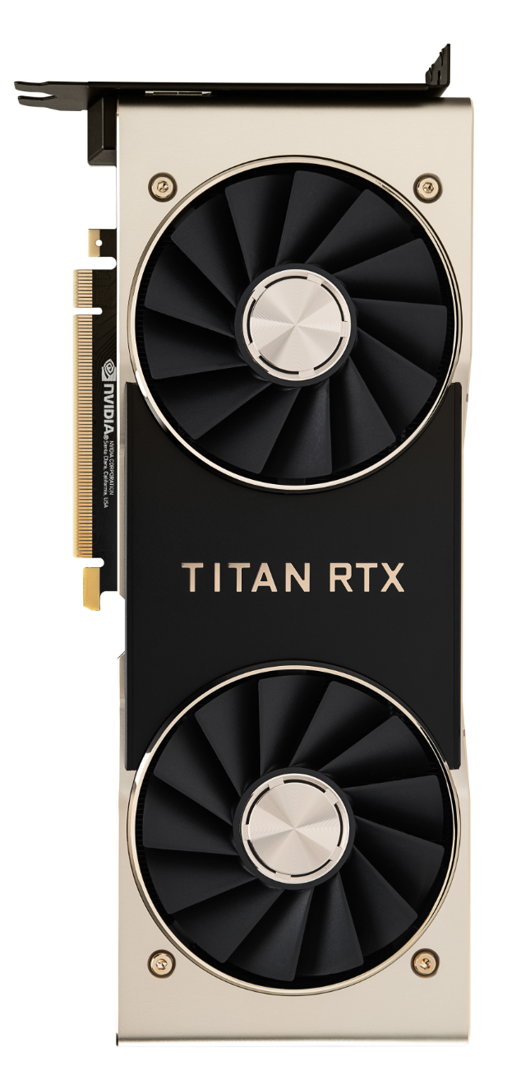
Tethered VR Hardware
Oculus Rift
HTC Vive Pro
PC GPU
+

Slide 6
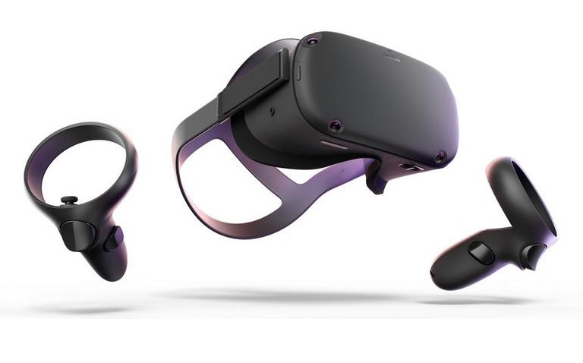
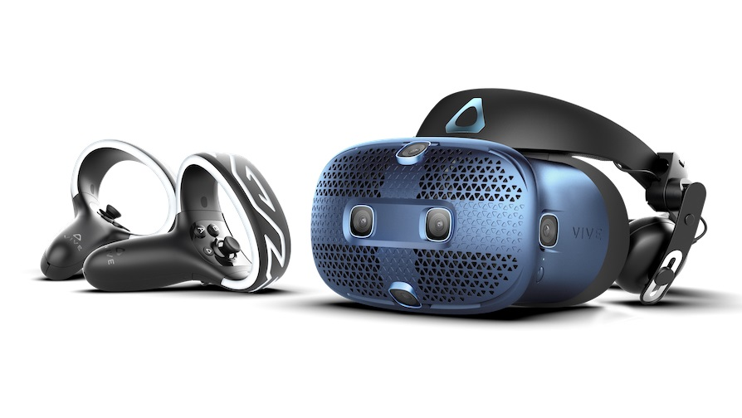
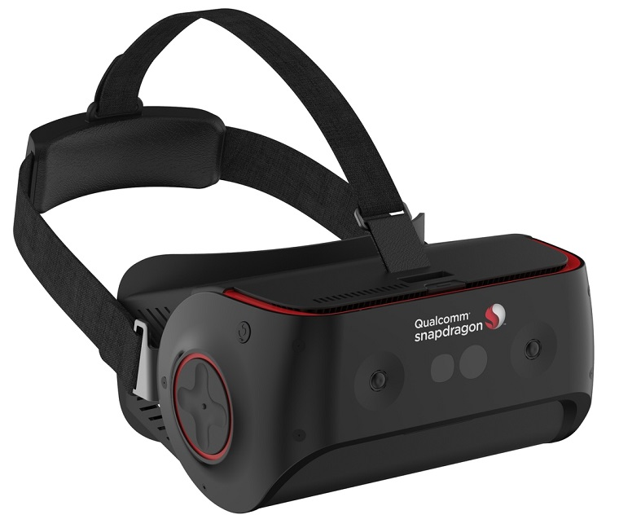
Mobile VR Hardware
Oculus Quest
HTC Cosmos
Snapdragon
Snapdragon 845 VR Development Kit

Slide 7
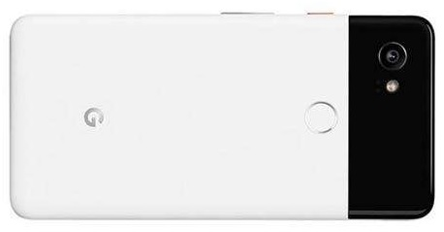
Mobile VR vs Mobile Phone Hardware
Oculus Quest
Qualcomm Snapdragon 835
OLED, 1440 x 1600 x 2, 72Hz
Adreno 540
4GB Ram
Li-ion battery (2-3 hours playtime)
571g
4 Monochromic Cameras
Android
Google Pixel 2 XL
Qualcomm Snapdragon 835
pOLED, 1440 x 2880, 60Hz
Adreno 540
4GB Ram
Li-Ion battery
175g
2 Cameras
Android

Slide 8

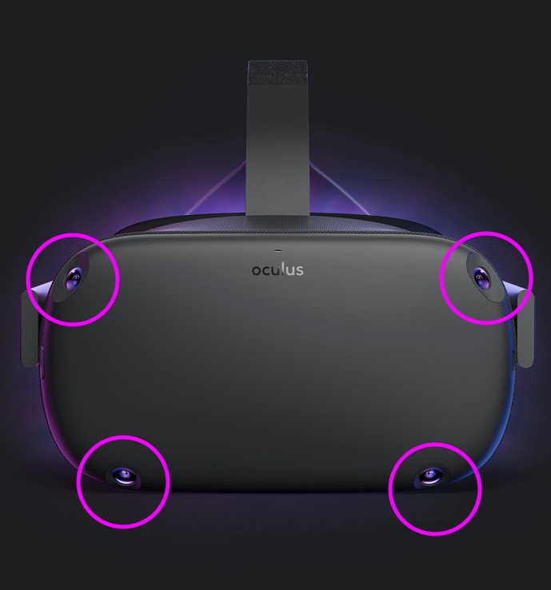
Quest Tracking
4 monochromic cameras
6DoF Inside-out tracking
6DoF Controllers tracking
Play Area Guardian
Hand tracking coming soon

Slide 9
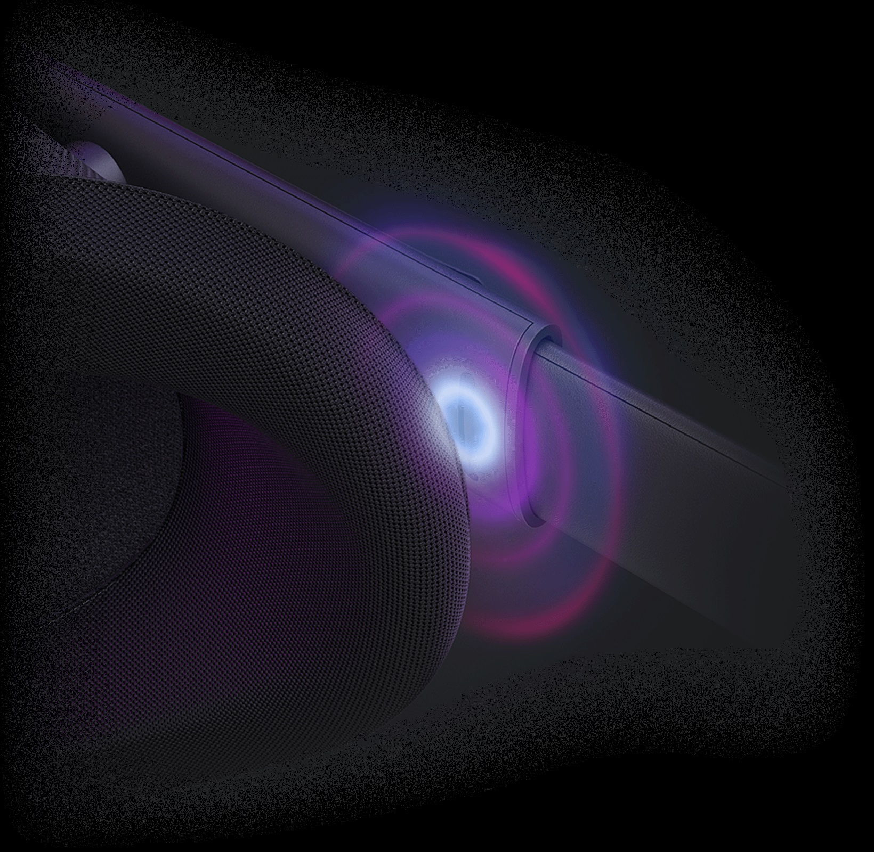
Quest Audio
Built-in Headset speakers
Over-the-ear waveguide
Positional Audio

Slide 10
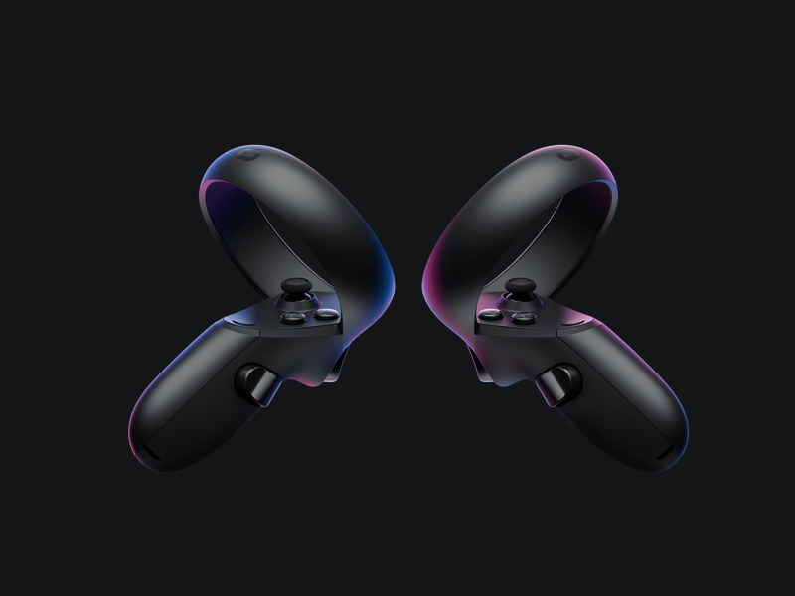
Quest Controllers
6DoF
2 Top Buttons
Joystick
Trigger Button
Grip Button

Slide 11
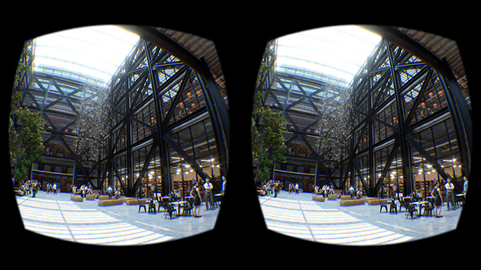
VR Stereoscopic Rendering

Slide 12
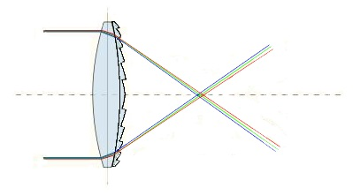
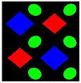
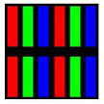
VR Displays
Stereoscopic
Fresnel Lens Optics
God Rays
Chromatic Aberrations
Diamond PenTile vs RGB Stripe
Ghosting Effect
Screen Door Effect
Fresnel Lens
DiamondPenTile
RGB Stripe

Slide 13

2D Rendering
Crisp texts
What you see is what you get
Good anti-aliasing
High angular resolution

Slide 14
3D VR Rendering
Timewrap reprojects the rendered image
Low angular resolution
Expensive antialiasing

Slide 15
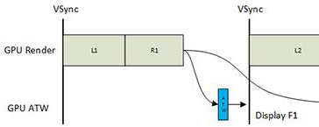
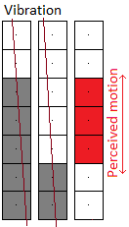

3D VR Rendering
Asynchronous Timewarp
x1.33+ supersampling
Timewarp transforms the rendered image,
to significantly reduce the motion-to-photon delay
Jitter
x4 multisampling

