Slide 1

Lecture 4 Divide and Conquer II: Counting inversions, counting intersections, max subarray, maxima set
CS 161 Design and Analysis of Algorithms
Ioannis Panageas

Slide 2
Divide and conquer method (recap)
Steps of method:
Divide input into parts (smaller problems)
Conquer (solve) each part recursively
Combine results to obtain solution of original
Notes:
Exercise: guess merge sort

Slide 3
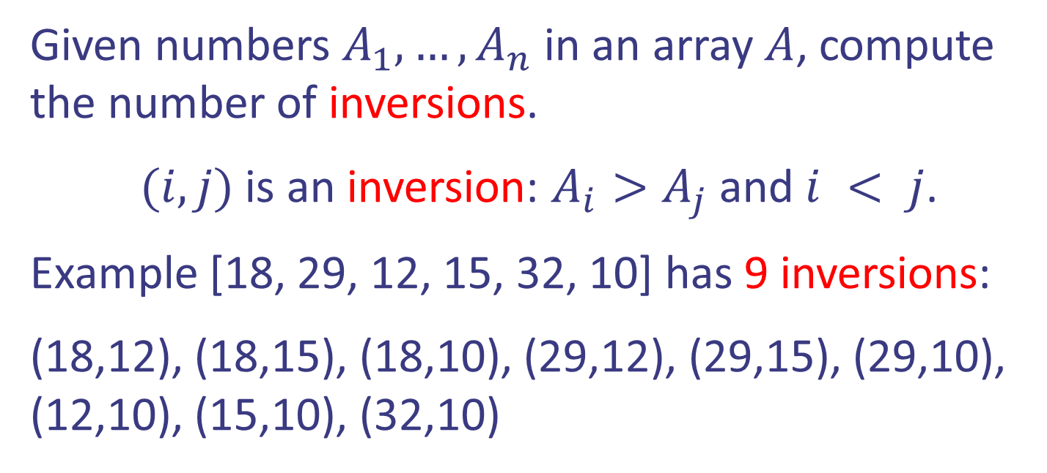
Case study I: Counting inversions
Given numbers $A_{1},…,A_{n}$ in an array $A$, compute the number of inversions.
$(i,j)$ is an inversion: $A_{i}>A_{j}$ and $i < j$.
Example [18, 29, 12, 15, 32, 10] has 9 inversions:
(18,12), (18,15), (18,10), (29,12), (29,15), (29,10), (12,10), (15,10), (32,10)
Design and Analysis of Algorithms

Slide 4
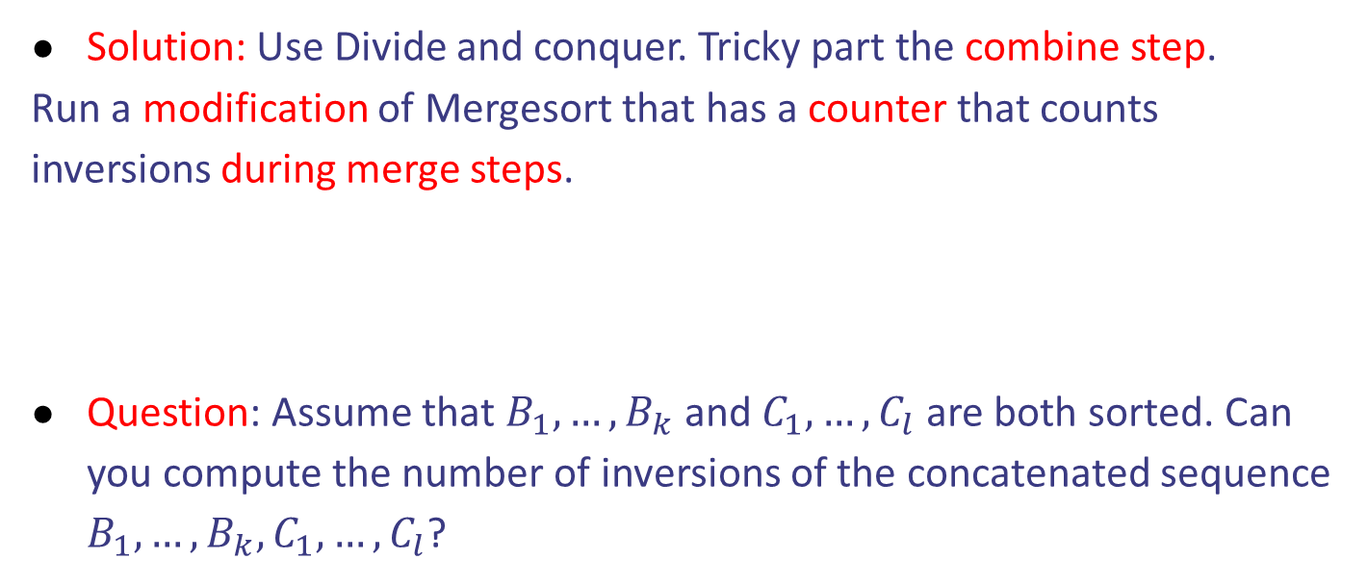
Case study I: Counting inversions
Solution: Use Divide and conquer. Tricky part the combine step.
Run a modification of Mergesort that has a counter that counts inversions during merge steps.
Question: Assume that $B_{1},…,B_{k}$ and $C_{1},…,C_{l}$ are both sorted. Can you compute the number of inversions of the concatenated sequence $B_{1},…,B_{k}, C_{1},…, C_{l}$?
Design and Analysis of Algorithms

Slide 5




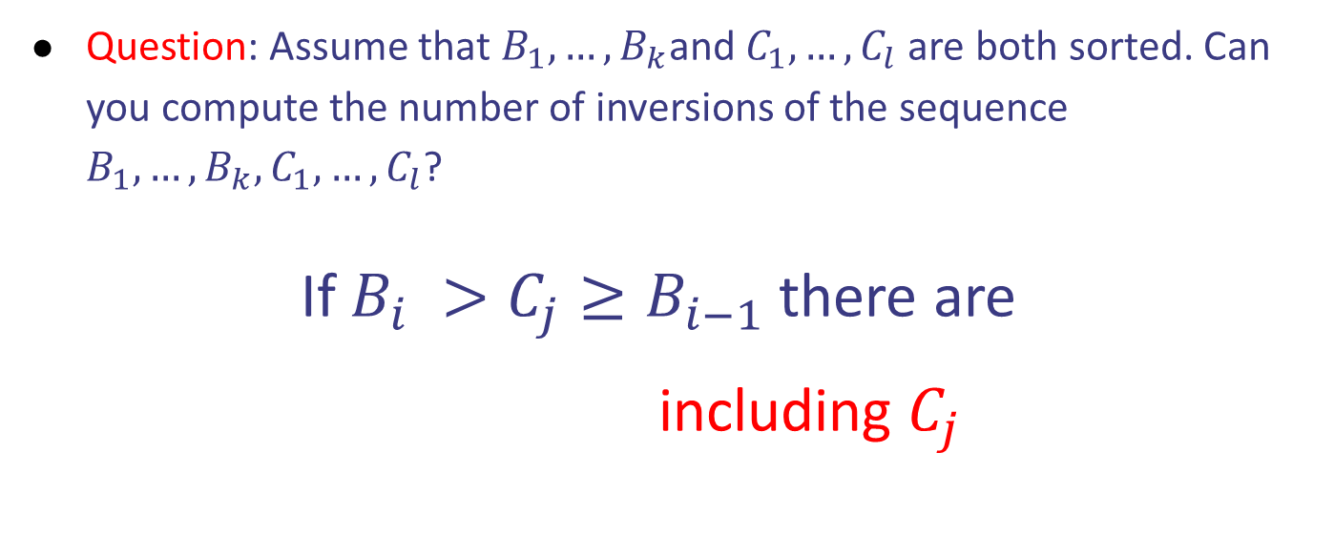
Case study I: Counting inversions
Question: Assume that $B_{1},…,B_{k}$and $C_{1},…,C_{l}$ are both sorted. Can you compute the number of inversions of the sequence $B_{1},…,B_{k}, C_{1},…, C_{l}$?
If $B_{i} >C_{j}≥B_{i−1}$ there are
$k−i+1$ including $C_{j}$
$$B_{1},…,B_{i},…,B_{k}$$
$$C_{1},…,C_{j},…,C_{l}$$
Design and Analysis of Algorithms

Slide 6
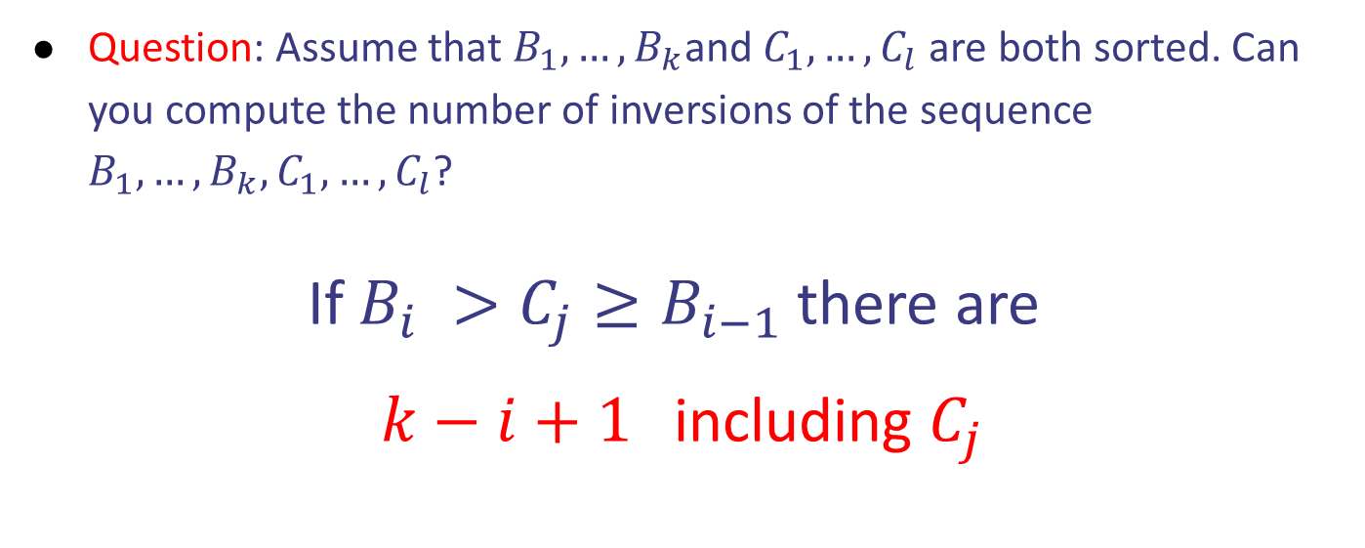
Case study I: Counting inversions
Question: Assume that $B_{1},…,B_{k}$and $C_{1},…,C_{l}$ are both sorted. Can you compute the number of inversions of the sequence $B_{1},…,B_{k}, C_{1},…, C_{l}$?
If $B_{i} >C_{j}≥B_{i−1}$ there are
$k−i+1$ including $C_{j}$
$$B_{1},…,B_{i},…,B_{k}$$
$$C_{1},…,C_{j},…,C_{l}$$
Design and Analysis of Algorithms

Slide 7
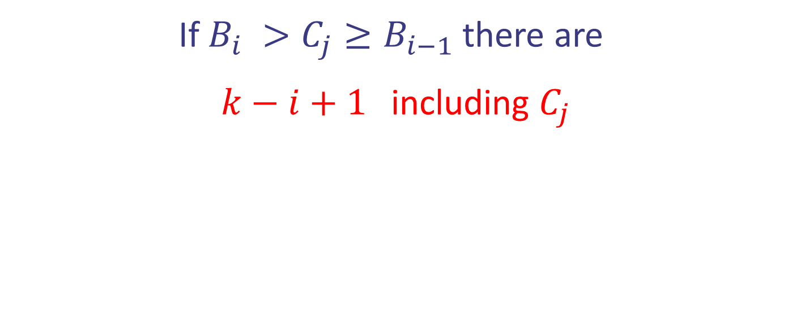





Case study I: Counting inversions
If $B_{i} >C_{j}≥B_{i−1}$ there are
$k−i+1$ including $C_{j}$
$$B_{1},…,B_{i},…,B_{k}$$
$$C_{1},…,C_{j},…,C_{l}$$
Concatenated:
8 participates in 2 inversions. $k=5, i = 4$
Design and Analysis of Algorithms

Slide 8

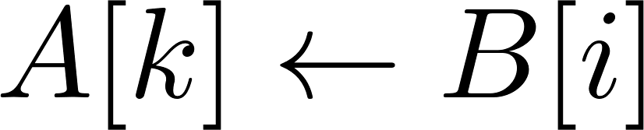
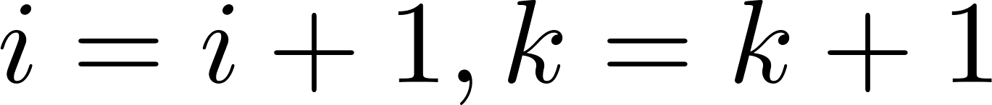




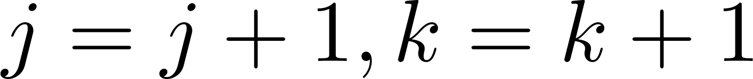
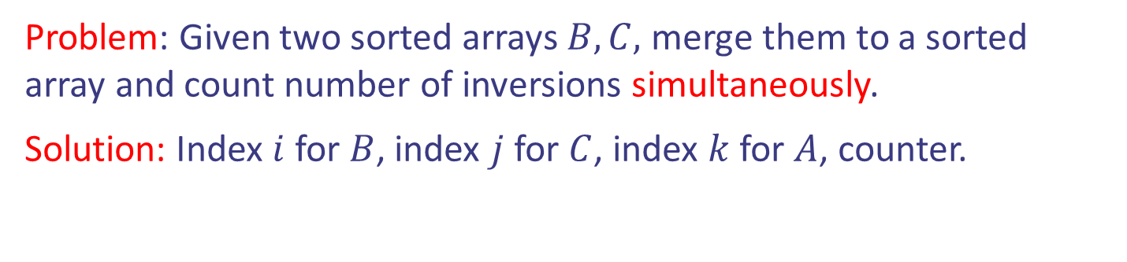
Case study I: Counting inversions
Problem: Given two sorted arrays $B,C,$ merge them to a sorted array and count number of inversions simultaneously.
Solution: Index $i$ for $B$, index $j$ for $C$, index $k$ for $A$, counter.

Slide 9

Case study I: Counting inversions
Problem: Given two sorted arrays $B,C,$ merge them to a sorted array and count number of inversions simultaneously.
Solution: Index $i$ for $B$, index $j$ for $C$, index $k$ for $A$, counter.

Slide 10


Case study I: Counting inversions
Problem: Given two sorted arrays $B,C,$ merge them to a sorted array and count number of inversions simultaneously.
Solution: Index $i$ for $B$, index $j$ for $C$, index $k$ for $A$, counter.

Slide 11

Case study I: Counting inversions
Problem: Given two sorted arrays $B,C,$ merge them to a sorted array and count number of inversions simultaneously.
Solution: Index $i$ for $B$, index $j$ for $C$, index $k$ for $A$, counter.

Slide 12


Case study I: Counting inversions
Problem: Given two sorted arrays $B,C,$ merge them to a sorted array and count number of inversions simultaneously.
Solution: Index $i$ for $B$, index $j$ for $C$, index $k$ for $A$, counter.

Slide 13

Case study I: Counting inversions
Problem: Given two sorted arrays $B,C,$ merge them to a sorted array and count number of inversions simultaneously.
Solution: Index $i$ for $B$, index $j$ for $C$, index $k$ for $A$, counter.

Slide 14


Case study I: Counting inversions
Problem: Given two sorted arrays $B,C,$ merge them to a sorted array and count number of inversions simultaneously.
Solution: Index $i$ for $B$, index $j$ for $C$, index $k$ for $A$, counter.

Slide 15


Case study I: Counting inversions
Problem: Given two sorted arrays $B,C,$ merge them to a sorted array and count number of inversions simultaneously.
Solution: Index $i$ for $B$, index $j$ for $C$, index $k$ for $A$, counter.

Slide 16

Case study I: Counting inversions
Problem: Given two sorted arrays $B,C,$ merge them to a sorted array and count number of inversions simultaneously.
Solution: Index $i$ for $B$, index $j$ for $C$, index $k$ for $A$, counter.

Slide 17
Case study I: Counting inversions
Problem: Given two sorted arrays $B,C,$ merge them to a sorted array and count number of inversions simultaneously.
Solution: Index $i$ for $B$, index $j$ for $C$, index $k$ for $A$, counter.

Slide 18

Case study I: Counting inversions
Problem: Given two sorted arrays $B,C,$ merge them to a sorted array and count number of inversions simultaneously.
Solution: Index $i$ for $B$, index $j$ for $C$, index $k$ for $A$, counter.

Slide 19
Case study I: Counting inversions
Problem: Given two sorted arrays $B,C,$ merge them to a sorted array and count number of inversions simultaneously.
Solution: Index $i$ for $B$, index $j$ for $C$, index $k$ for $A$, counter.

Slide 20


Case study I: Counting inversions
Pseudocode:

Slide 21
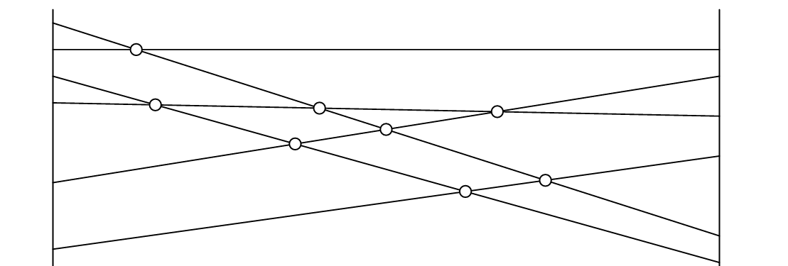
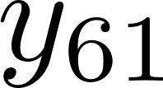
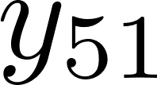
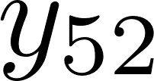
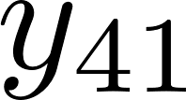
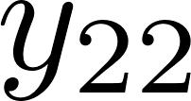
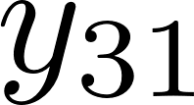
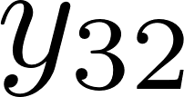
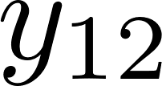
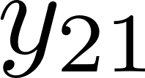
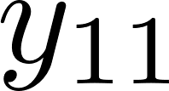

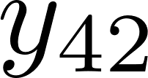


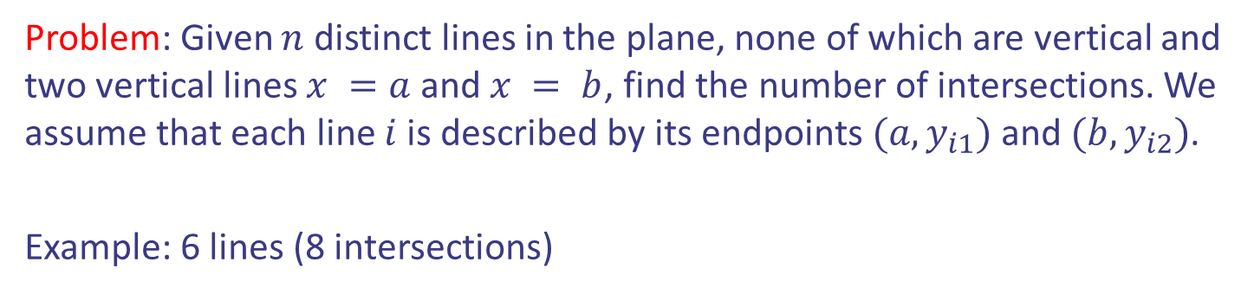
Case study II: Counting intersections
Problem: Given $n$ distinct lines in the plane, none of which are vertical and two vertical lines $x =a$ and $x = b$, find the number of intersections. We assume that each line $i$ is described by its endpoints $(a,y_{i1})$ and $(b,y_{i2})$.
Example: 6 lines (8 intersections)

Slide 22
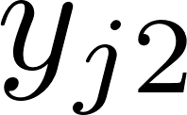
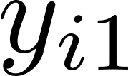
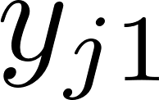
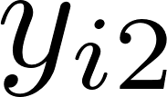
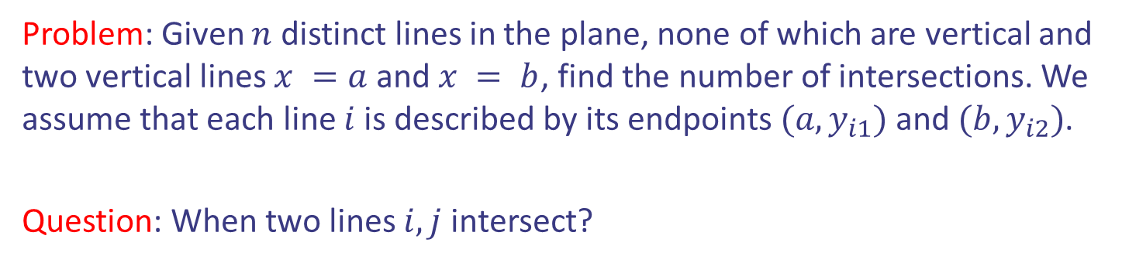
Case study II: Counting intersections
Problem: Given $n$ distinct lines in the plane, none of which are vertical and two vertical lines $x =a$ and $x = b$, find the number of intersections. We assume that each line $i$ is described by its endpoints $(a,y_{i1})$ and $(b,y_{i2})$.
Question: When two lines $i,j$ intersect?

Slide 23
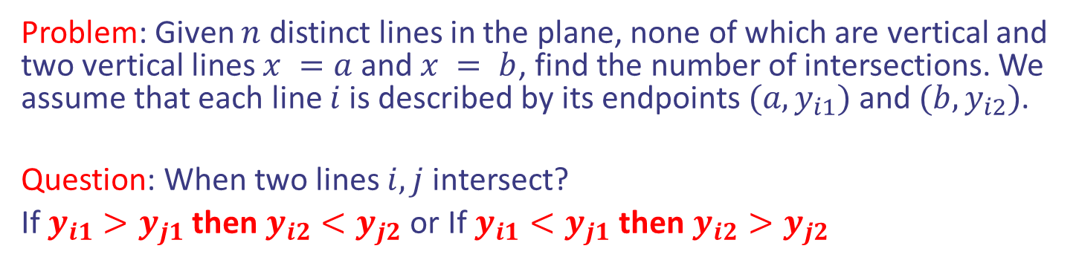
Case study II: Counting intersections
Problem: Given $n$ distinct lines in the plane, none of which are vertical and two vertical lines $x =a$ and $x = b$, find the number of intersections. We assume that each line $i$ is described by its endpoints $(a,y_{i1})$ and $(b,y_{i2})$.
Question: When two lines $i,j$ intersect?
If $y_{i1}>y_{j1}$ then $y_{i2}<y_{j2}$ or If $y_{i1}<y_{j1}$ then $y_{i2}>y_{j2}$

Slide 24

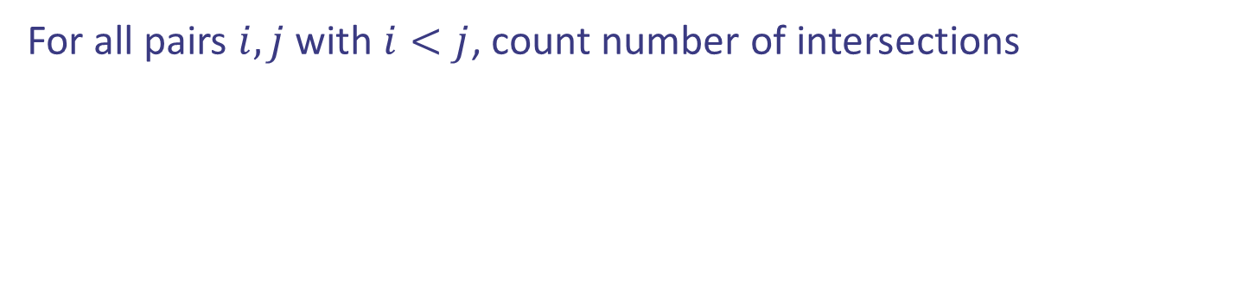
Case study II: Counting intersections
For all pairs $i,j$ with $i<j$, count number of intersections
Pseudocode:

Slide 25

Case study II: Counting intersections
For all pairs $i,j$ with $i<j$, count number of intersections
Pseudocode:
Running time $Θ(n^{2})$
Can we do better?

Slide 26






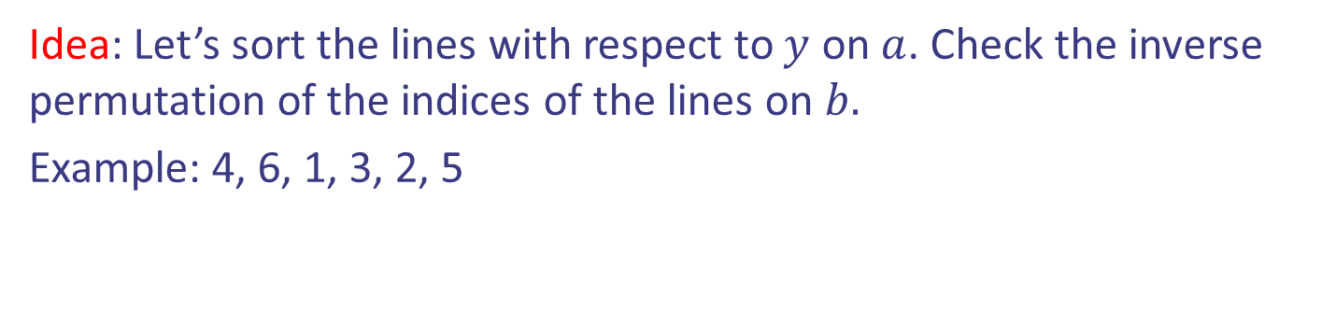
Case study II: Counting intersections
Idea: Let’s sort the lines with respect to $y$ on $a$. Check the inverse permutation of the indices of the lines on $b.$
Example: 4, 6, 1, 3, 2, 5

Slide 27
Case study II: Counting intersections
Idea: Let’s sort the lines with respect to $y$ on $a$. Check the inverse permutation of the indices of the lines on $b.$
Example: 4, 6, 1, 3, 2, 5
Key observation: Number of inversions is equal to number of intersections. In example (4, 1), (4,3), (4,2), (6,1), (6,3), (6,2), (6,5), (3,2)

Slide 28
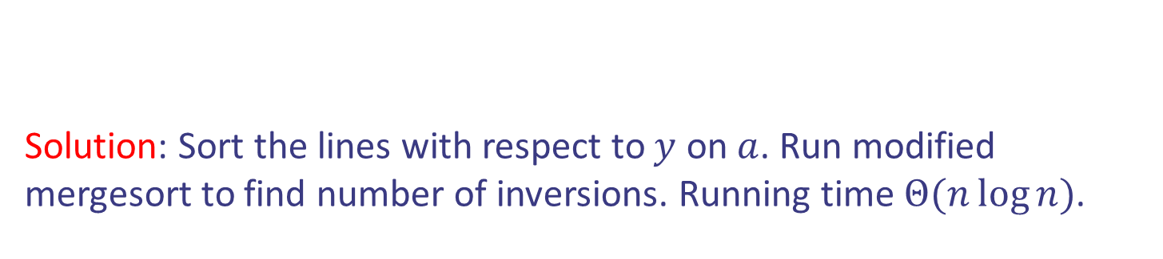
Case study II: Counting intersections
Idea: Let’s sort the lines with respect to $y$ on $a$. Check the inverse permutation of the indices of the lines on $b.$
Example: 4, 6, 1, 3, 2, 5
Solution: Sort the lines with respect to $y$ on $a$. Run modified mergesort to find number of inversions. Running time $Θ(n\log{n})$.

Slide 29
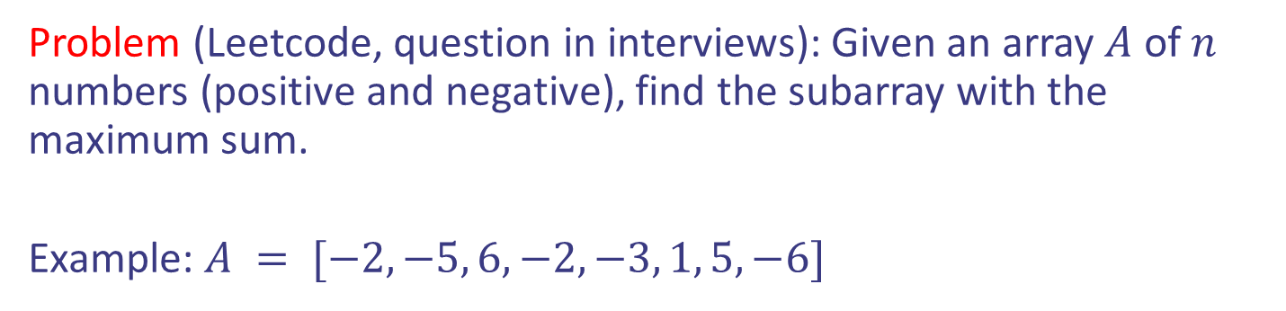
Case study III: Maximum subarray
Problem (Leetcode, question in interviews): Given an array $A$ of $n$ numbers (positive and negative), find the subarray with the maximum sum.
Example: $A = [−2, −5, 6, −2, −3, 1, 5, −6]$

Slide 30
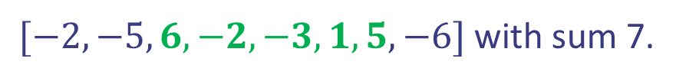
Case study III: Maximum subarray
Problem (Leetcode, question in interviews): Given an array $A$ of $n$ numbers (positive and negative), find the subarray with the maximum sum.
Example: $A = [−2, −5, 6, −2, −3, 1, 5, −6]$
Solution of example:
$[−2, −5, 6, −2, −3, 1, 5, −6]$ with sum 7.

Slide 31

Case study III: Maximum subarray
For all $i,j$ with $i≤j$, compute $A_{i}+A_{i+1}+…+A_{j}$. Keep the maximum from all sums. Total number of computations is…

Slide 32







Case study III: Maximum subarray
For all $i,j$ with $i≤j$, compute $A_{i}+A_{i+1}+…+A_{j}$. Keep the maximum from all sums. Total number of computations is…
Pseudocode:

Slide 33

Case study III: Maximum subarray
For all $i,j$ with $i<j$, compute $A_{i}+A_{i+1}+…+A_{j}$. Keep the maximum from all sums. Total number of computations is
Pseudocode:
Can we do better?

Slide 34
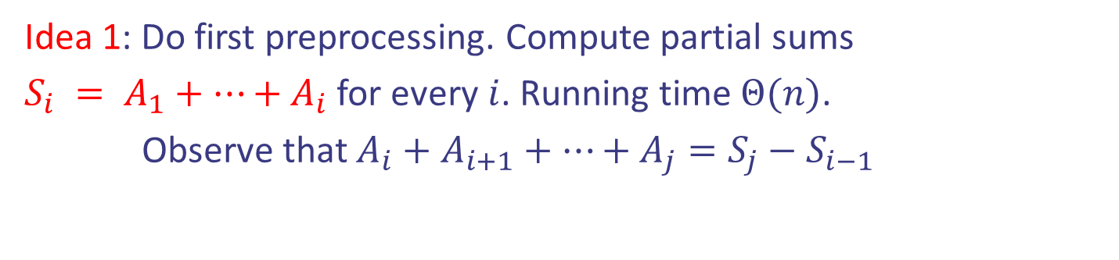
Case study III: Maximum subarray
Idea 1: Do first preprocessing. Compute partial sums
$S_{i} = A_{1}+…+A_{i}$ for every $i$. Running time $Θ(n)$.
Observe that $A_{i}+A_{i+1}+…+A_{j}=S_{j}−S_{i−1}$

Slide 35
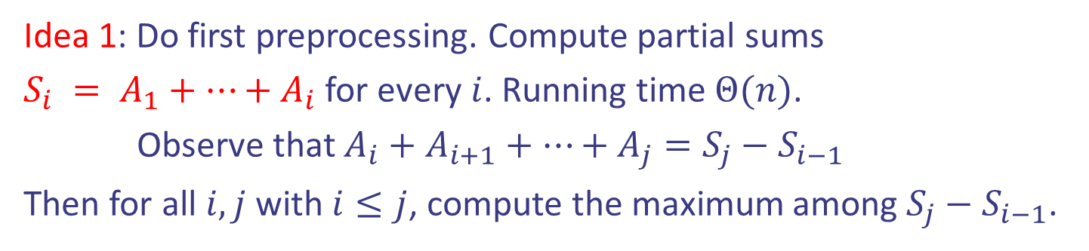
Case study III: Maximum subarray
Idea 1: Do first preprocessing. Compute partial sums
$S_{i} = A_{1}+…+A_{i}$ for every $i$. Running time $Θ(n)$.
Observe that $A_{i}+A_{i+1}+…+A_{j}=S_{j}−S_{i−1}$
Then for all $i,j$ with $i≤j$, compute the maximum among $S_{j}−S_{i−1}$.

Slide 36
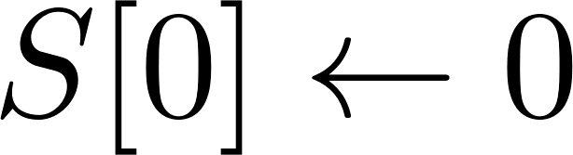
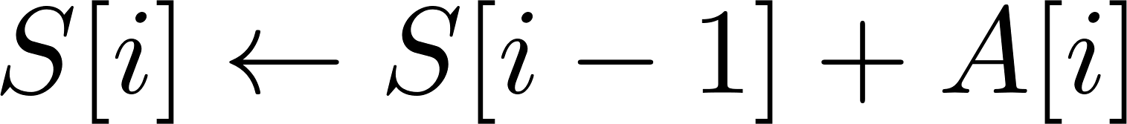
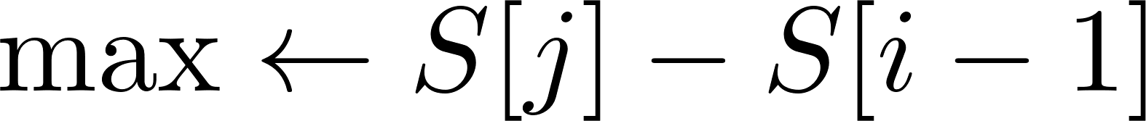

Case study III: Maximum subarray
Idea 1: Do first preprocessing. Compute partial sums
$S_{i} = A_{1}+…+A_{i}$ for every $i$. Running time $Θ(n)$.
Observe that $A_{i}+A_{i+1}+…+A_{j}=S_{j}−S_{i−1}$
Then for all $i,j$ with $i≤j$, compute the maximum among $S_{j}−S_{i−1}$.
$$\left[−2, −5, 6, −2, −3, 1, 5, −6\right]$$
S = [0, -2, -7, -1, -3, -6, -5, 0, -6]
-5+6-2-3+1 = S[6] – S[1] = -3

Slide 37

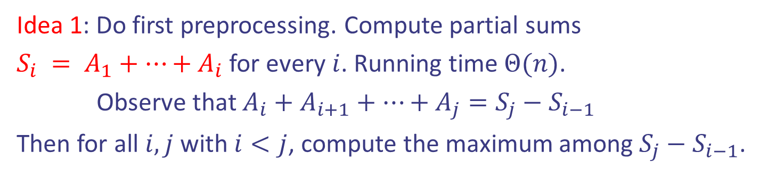
Case study III: Maximum subarray
Idea 1: Do first preprocessing. Compute partial sums
$S_{i} = A_{1}+…+A_{i}$ for every $i$. Running time $Θ(n)$.
Observe that $A_{i}+A_{i+1}+…+A_{j}=S_{j}−S_{i−1}$
Then for all $i,j$ with $i<j$, compute the maximum among $S_{j}−S_{i−1}$.
Running time $Θ(n^{2})$
Can we do better?

Slide 38
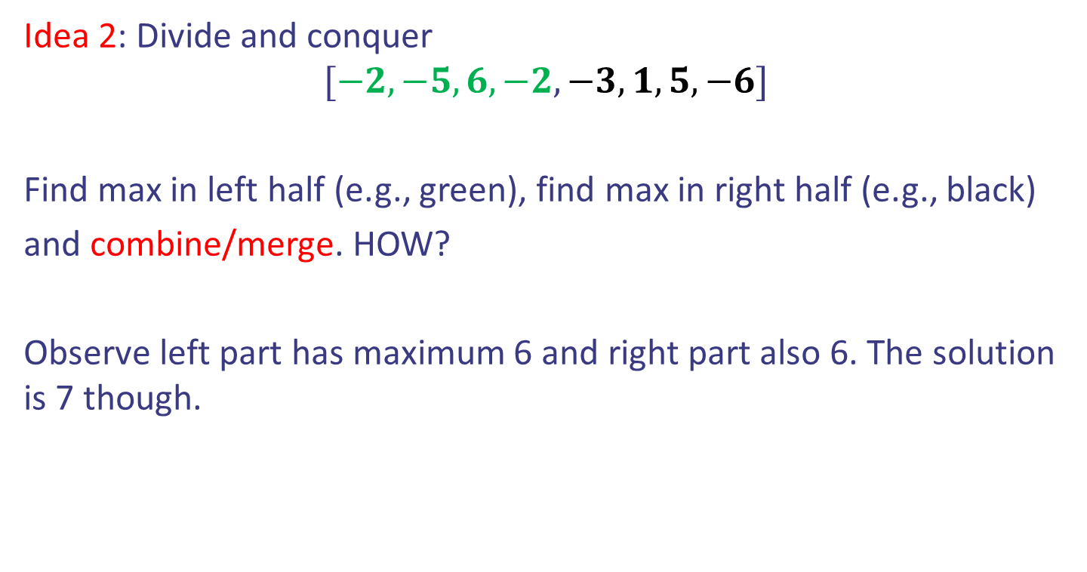
Case study III: Maximum subarray
Idea 2: Divide and conquer
$$[−2, −5, 6, −2, −3, 1, 5, −6]$$
Find max in left half (e.g., green), find max in right half (e.g., black)
and combine/merge. HOW?
Observe left part has maximum 6 and right part also 6. The solution is 7 though.

Slide 39
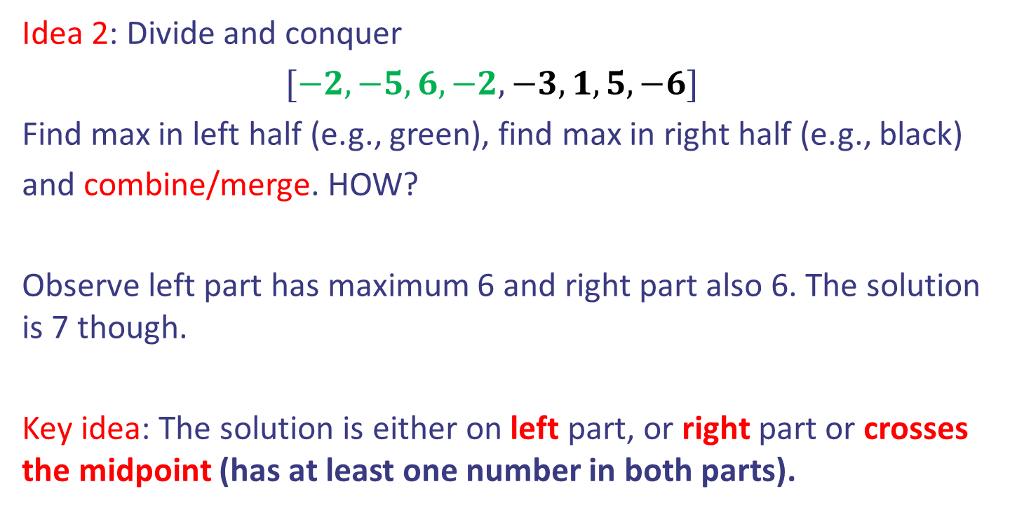
Case study III: Maximum subarray
Idea 2: Divide and conquer
$[−2, −5, 6, −2, −3, 1, 5, −6]$
Find max in left half (e.g., green), find max in right half (e.g., black)
and combine/merge. HOW?
Observe left part has maximum 6 and right part also 6. The solution is 7 though.
Key idea: The solution is either on left part, or right part or crosses the midpoint (has at least one number in both parts).

Slide 40

Case study III: Maximum subarray
Idea 2: Divide and conquer
$$[−2, −5, 6, −2, −3, 1, 5, −6]$$
Question: How to get the maximum subarray that crosses the midpoint?

Slide 41
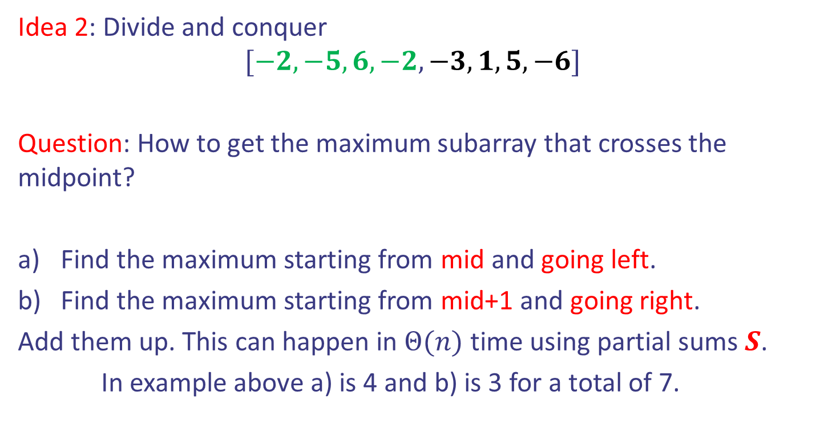
Case study III: Maximum subarray
Idea 2: Divide and conquer
$$[−2, −5, 6, −2, −3, 1, 5, −6]$$
Question: How to get the maximum subarray that crosses the midpoint?
Find the maximum starting from mid and going left.
Find the maximum starting from mid+1 and going right.
Add them up. This can happen in $Θ(n)$ time using partial sums $S$.
In example above a) is 4 and b) is 3 for a total of 7.

Slide 42
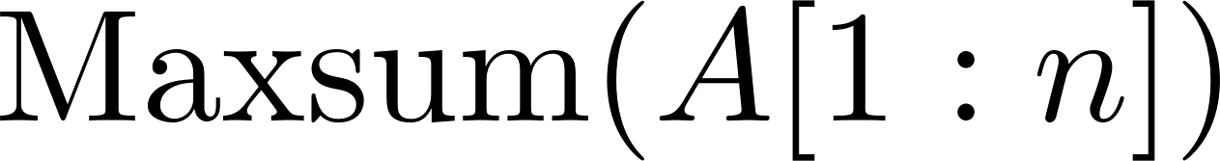


Case study III: Maximum subarray
Pseudocode:

Slide 43

Case study III: Maximum subarray
Pseudocode:
$$[−2, −5, 6, −2, −3, 1, 5, −6]$$
maxL = 6, maxR = 6, max1+max2 = 4+3 = 7

Slide 44
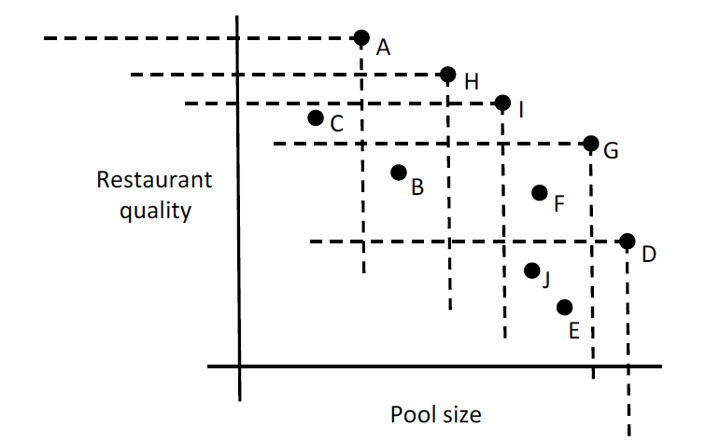
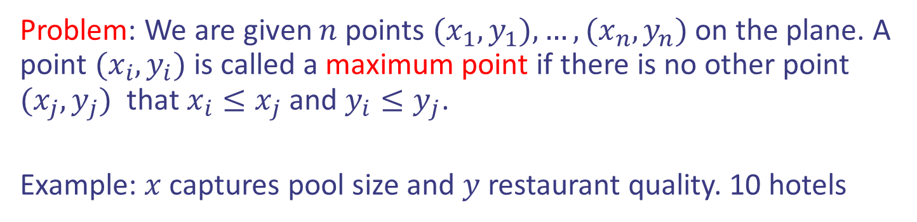
Case study IV: Maxima Set
Problem: We are given $n$ points $(x_{1},y_{1}),…,(x_{n},y_{n})$ on the plane. A point $(x_{i},y_{i})$ is called a maximum point if there is no other point $(x_{j}, y_{j})$ that $x_{i}≤x_{j}$ and $y_{i}≤y_{j}$.
Example: $x$ captures pool size and $y$ restaurant quality. 10 hotels

Slide 45
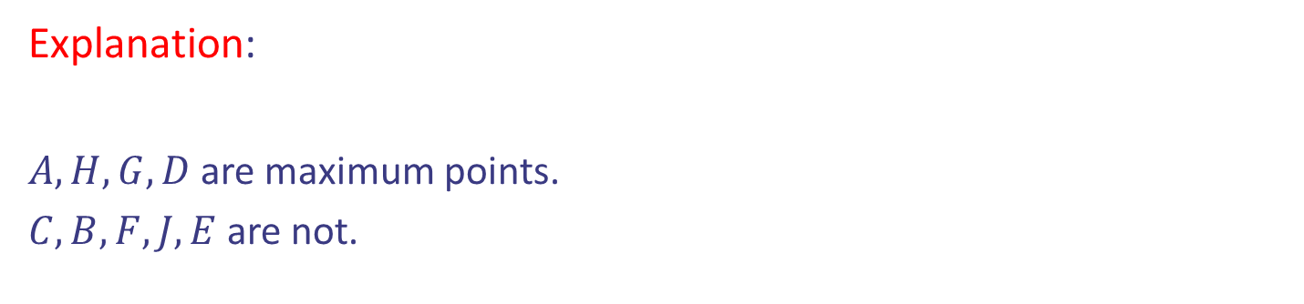
Case study IV: Maxima Set
Problem: We are given $n$ points $(x_{1},y_{1}),…,(x_{n},y_{n})$ on the plane. A point $(x_{i},y_{i})$ is called a maximum point if there is no other point $(x_{j}, y_{j})$ that $x_{i}≤x_{j}$ and $y_{i}≤y_{j}$.
Example: $x$ captures pool size and $y$ restaurant quality. 10 hotels
Explanation:
$A, H, G, D$are maximum points.
$C, B, F, J, E$are not.

Slide 46
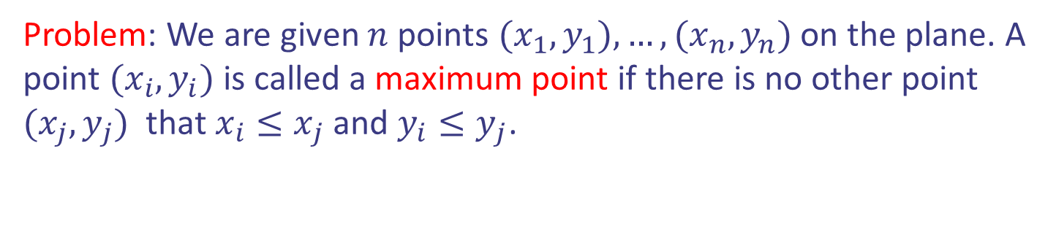
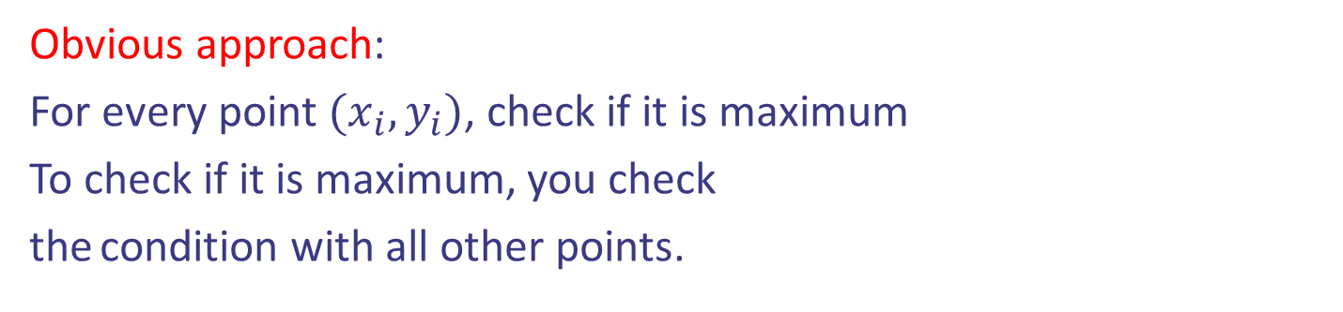
Case study IV: Maxima Set
Problem: We are given $n$ points $(x_{1},y_{1}),…,(x_{n},y_{n})$ on the plane. A point $(x_{i},y_{i})$ is called a maximum point if there is no other point $(x_{j}, y_{j})$ that $x_{i}≤x_{j}$ and $y_{i}≤y_{j}$.
Obvious approach:
For every point $(x_{i},y_{i})$, check if it is maximum
To check if it is maximum, you check
the condition with all other points.

Slide 47
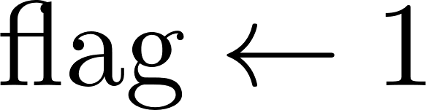

Case study IV: Maxima Set
Problem: We are given $n$ points $(x_{1},y_{1}),…,(x_{n},y_{n})$ on the plane. A point $(x_{i},y_{i})$ is called a maximum point if there is no other point $(x_{j}, y_{j})$ that $x_{i}≤x_{j}$ and $y_{i}≤y_{j}$.
Pseudocode:
Running time $Θ(n^{2})$
Can we do better?

Slide 48
Case study IV: Maxima Set
Problem: We are given $n$ points $(x_{1},y_{1}),…,(x_{n},y_{n})$ on the plane. A point $(x_{i},y_{i})$ is called a maximum point if there is no other point $(x_{j}, y_{j})$ that $x_{i}≤x_{j}$ and $y_{i}≤y_{j}$.
Idea: Divide and conquer. Divide step and Combine step is challenging.

Slide 49
Case study IV: Maxima Set
Divide step: It should split the points in two parts of equal size.
How?

Slide 50







Case study IV: Maxima Set
Divide step: It should split the points in two parts of equal size.
How? Choose the middle (median) point with respect to $x$ coordinates.

Slide 51

Case study IV: Maxima Set
Divide step: It should split the points in two parts of equal size.
How? Choose the middle (median) point with respect to $x$ coordinates.
Combine step: Return $M_{1}∪M_{2}$?

Slide 52




Case study IV: Maxima Set
Combine step: Return $M_{1}∪M_{2}$? Wrong: blue points below of $M_{1}$ are not part of the solution

Slide 53




Case study IV: Maxima Set
Combine step idea: $M_{2}$ points should part of the solution. From
$M_{1}$, the points that are maximum should not be dominated by smallest with respect to x coordinates in $M_{2}$

Slide 54

Case study IV: Maxima Set
Pseudocode:

Slide 55
Case study IV: Maxima Set
Pseudocode:

Slide 56

Case study IV: Maxima Set
Pseudocode:
Next week we will see how to find the median in $Θ(n)$ time!
This fact will yield $Θ$(nlog n) for Maxima Set.

