Slide 1

Lecture 14 Greedy Method: Fractional Knapsack, Interval scheduling
CS 161 Design and Analysis of Algorithms
Ioannis Panageas

Slide 2
Greedy method
The greedy method is a general algorithm design technique, in which given:
configurations: different choices we need to make
objective function: a score assigned to all configurations, which we want to either maximize or minimize
We should make choices greedily: We can find a globally-optimal solution by a series of local improvements from a starting configuration.
Notes:
Exercise: guess merge sort

Slide 3
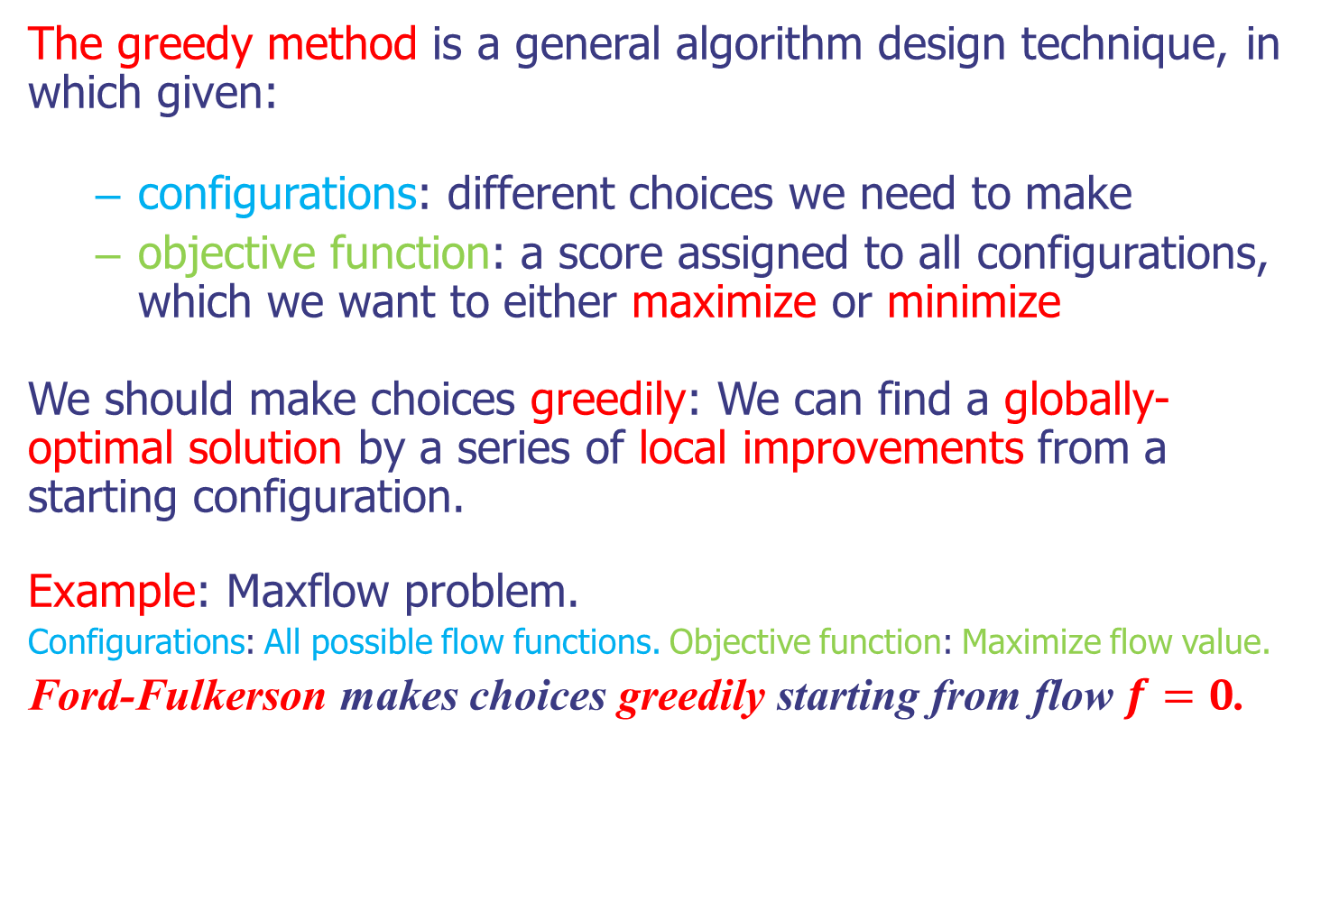
Greedy method
The greedy method is a general algorithm design technique, in which given:
configurations: different choices we need to make
objective function: a score assigned to all configurations, which we want to either maximize or minimize
We should make choices greedily: We can find a globally-optimal solution by a series of local improvements from a starting configuration.
Example: Maxflow problem.
Configurations: All possible flow functions. Objective function: Maximize flow value.
Ford-Fulkerson makes choices greedily starting from flow $f=0$.
Notes:
Exercise: guess merge sort

Slide 4
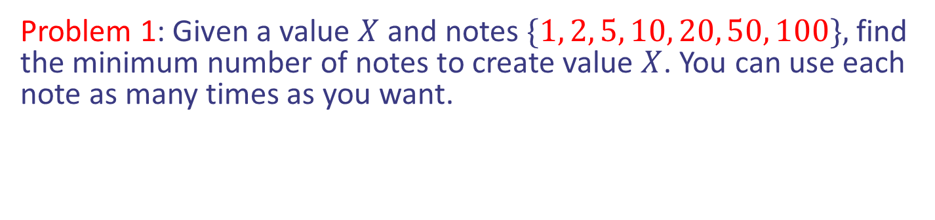
Greedy does not always work
Problem 1: Given a value $X$ and notes $\{1, 2, 5, 10, 20, 50, 100\},$ find the minimum number of notes to create value $X$. You can use each note as many times as you want.
Notes:
Exercise: guess merge sort

Slide 5
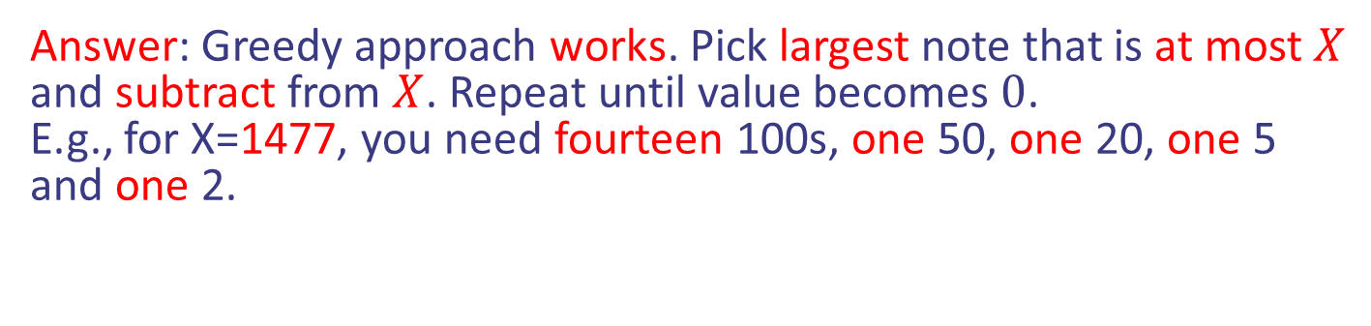
Greedy does not always work
Problem 1: Given a value $X$ and notes $\{1, 2, 5, 10, 20, 50, 100\},$ find the minimum number of notes to create value $X$. You can use each note as many times as you want.
Answer: Greedy approach works. Pick largest note that is at most $X$ and subtract from $X$. Repeat until value becomes $0$.
E.g., for X=1477, you need fourteen 100s, one 50, one 20, one 5 and one 2.
Notes:
Exercise: guess merge sort

Slide 6
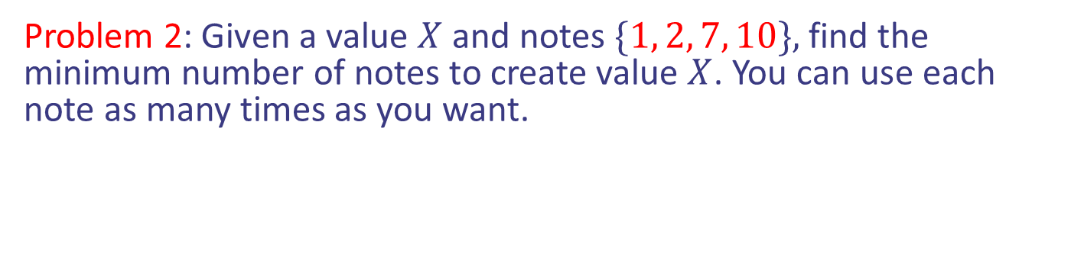
Greedy does not always work
Problem 1: Given a value $X$ and notes $\{1, 2, 5, 10, 20, 50, 100\},$ find the minimum number of notes to create value $X$. You can use each note as many times as you want.
Answer: Greedy approach works. Pick largest note that is at most $X$ and subtract from $X$. Repeat until value becomes $0$.
E.g., for X=1477, you need fourteen 100s, one 50, one 20, one 5 and one 2.
Problem 2: Given a value $X$ and notes $\{1, 2, 7, 10\},$ find the minimum number of notes to create value $X$. You can use each note as many times as you want.
Notes:
Exercise: guess merge sort

Slide 7
Greedy does not always work
Problem 1: Given a value $X$ and notes $\{1, 2, 5, 10, 20, 50, 100\},$ find the minimum number of notes to create value $X$. You can use each note as many times as you want.
Answer: Greedy approach works. Pick largest note that is at most $X$ and subtract from $X$. Repeat until value becomes $0$.
E.g., for X=1477, you need fourteen 100s, one 50, one 20, one 5 and one 2.
Problem 2: Given a value $X$ and notes $\{1, 2, 7, 10\},$ find the minimum number of notes to create value $X$. You can use each note as many times as you want.
Answer: Greedy approach does not work as before.
E.g., for X=14, you need two 7s, but greedy will give one 10, two 2s.
Notes:
Exercise: guess merge sort

Slide 8
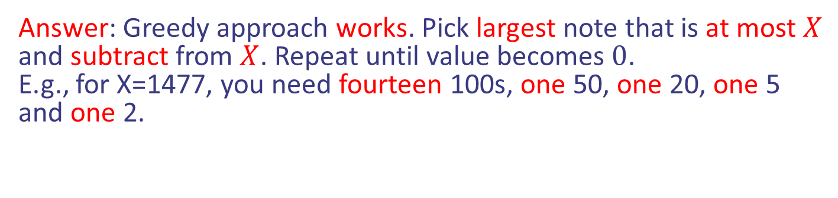
Greedy does not always work
Problem 1: Given a value $X$ and notes $\{1, 2, 5, 10, 20, 50, 100\},$ find the minimum number of notes to create value $X$. You can use each note as many times as you want.
Answer: Greedy approach works. Pick largest note that is at most $X$ and subtract from $X$. Repeat until value becomes $0$.
E.g., for X=1477, you need fourteen 100s, one 50, one 20, one 5 and one 2.
Problem 2: Given a value $X$ and notes $\{1, 2, 7, 10\},$ find the minimum number of notes to create value $X$. You can use each note as many times as you want.
Answer: Greedy approach does not work as before.
E.g., for X=14, you need two 7s, but greedy will give one 10, two 2s.
Greedy does not work always
Notes:
Exercise: guess merge sort

Slide 9

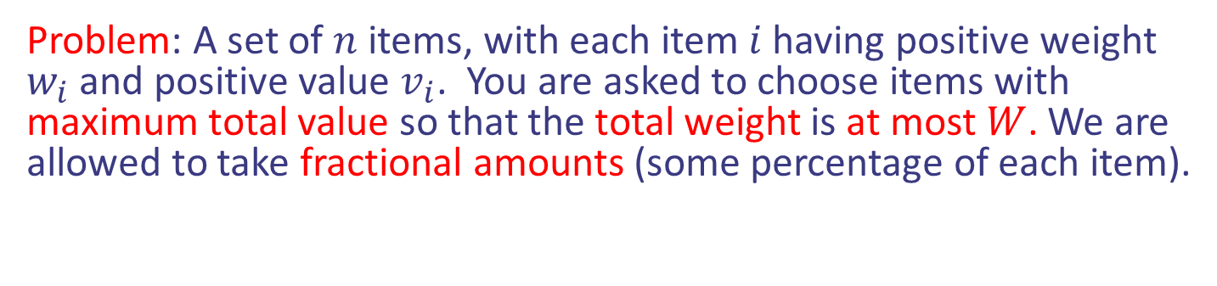
Fractional Knapsack
Problem: A set of $n$ items, with each item $i$ having positive weight $w_{i}$ and positive value $v_{i}$. You are asked to choose items with maximum total value so that the total weight is at most $W$. We are allowed to take fractional amounts (some percentage of each item).
Items:
1
2
3
4
5
Weight:
4 ml
8 ml
2 ml
6 ml
1 ml
Value:
$12
$32
$40
$30
$50
“knapsack”
with 10ml
Value:
$3
$4
$20
$5
$50
($ per ml)
Notes:
Exercise: guess merge sort

Slide 10
Fractional Knapsack
Problem: A set of $n$ items, with each item $i$ having positive weight $w_{i}$ and positive value $v_{i}$. You are asked to choose items with maximum total value so that the total weight is at most $W$. We are allowed to take fractional amounts (some percentage of each item).
Solution:
1 ml of 5
2 ml of 3
6 ml of 4
1 ml of 2
Total Value: $124
Items:
1
2
3
4
5
Weight:
4 ml
8 ml
2 ml
6 ml
1 ml
Value:
$12
$32
$40
$30
$50
“knapsack”
with 10ml
Value:
$3
$4
$20
$5
$50
($ per ml)
Notes:
Exercise: guess merge sort

Slide 11

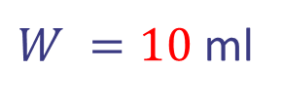
Fractional Knapsack
Idea: Greedy approach. Keep taking item with highest value to weight ratio until knapsack is full or run out of items.
Items:
1
2
3
4
5
Weight:
4 ml
8 ml
2 ml
6 ml
1 ml
Value:
$12
$32
$40
$30
$50
$W =10$ ml
Value:
$3
$4
$20
$5
$50
$value =$ $0
Notes:
Exercise: guess merge sort

Slide 12
Fractional Knapsack
Idea: Greedy approach. Keep taking item with highest value to weight ratio until knapsack is full or run out of items.
Items:
1
2
3
4
5
Weight:
4 ml
8 ml
2 ml
6 ml
1 ml
Value:
$12
$32
$40
$30
$50
$W =10$ ml
Value:
$3
$4
$20
$5
$50
$value =$ $0
Notes:
Exercise: guess merge sort

Slide 13

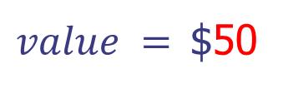
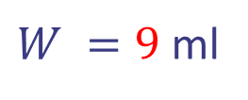
Fractional Knapsack
Idea: Greedy approach. Keep taking item with highest value to weight ratio until knapsack is full or run out of items.
Items:
1
2
3
4
Weight:
4 ml
8 ml
2 ml
6 ml
Value:
$12
$32
$40
$30
$W =9$ ml
Value:
$3
$4
$20
$5
$value =$ $50
Notes:
Exercise: guess merge sort

Slide 14
Fractional Knapsack
Idea: Greedy approach. Keep taking item with highest value to weight ratio until knapsack is full or run out of items.
Items:
1
2
3
4
Weight:
4 ml
8 ml
2 ml
6 ml
Value:
$12
$32
$40
$30
$W =9$ ml
Value:
$3
$4
$20
$5
$value =$ $50
Notes:
Exercise: guess merge sort

Slide 15

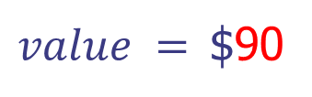
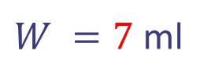
Fractional Knapsack
Idea: Greedy approach. Keep taking item with highest value to weight ratio until knapsack is full or run out of items.
Items:
1
2
4
Weight:
4 ml
8 ml
6 ml
Value:
$12
$32
$30
$W =7$ ml
Value:
$3
$4
$5
$value =$ $90
Notes:
Exercise: guess merge sort

Slide 16
Fractional Knapsack
Idea: Greedy approach. Keep taking item with highest value to weight ratio until knapsack is full or run out of items.
Items:
1
2
4
Weight:
4 ml
8 ml
6 ml
Value:
$12
$32
$30
$W =7$ ml
Value:
$3
$4
$5
$value =$ $90
Notes:
Exercise: guess merge sort

Slide 17

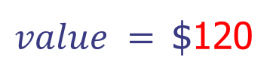
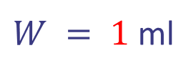
Fractional Knapsack
Idea: Greedy approach. Keep taking item with highest value to weight ratio until knapsack is full or run out of items.
Items:
1
2
Weight:
4 ml
8 ml
Value:
$12
$32
$W = 1$ ml
Value:
$3
$4
$value =$ $120
Notes:
Exercise: guess merge sort

Slide 18
Fractional Knapsack
Idea: Greedy approach. Keep taking item with highest value to weight ratio until knapsack is full or run out of items.
Items:
1
2
Weight:
4 ml
8 ml
Value:
$12
$32
$W = 1$ ml
Value:
$3
$4
$value =$ $120
Notes:
Exercise: guess merge sort

Slide 19

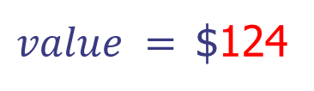
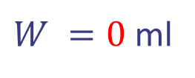
Fractional Knapsack
Idea: Greedy approach. Keep taking item with highest value to weight ratio until knapsack is full or run out of items.
Items:
1
2
Weight:
4 ml
7 ml
Value:
$12
$32
$W =0$ ml
Value:
$3
$4
$value =$ $124
Running time: ?
Notes:
Exercise: guess merge sort

Slide 20
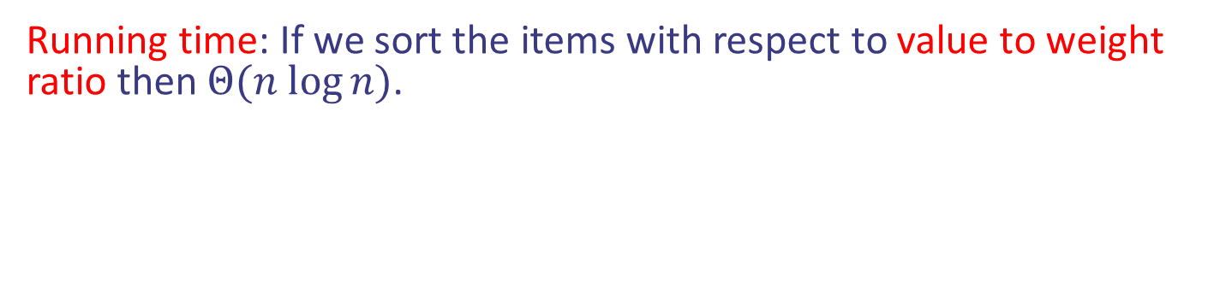
Fractional Knapsack
Idea: Greedy approach. Keep taking item with highest value to weight ratio until knapsack is full or run out of items.
Items:
1
2
Weight:
4 ml
7 ml
Value:
$12
$32
$W =0$ ml
Value:
$3
$4
$value =$ $124
Running time: If we sort the items with respect to value to weight ratio then $Θ(n log⁡n)$.
Notes:
Exercise: guess merge sort

Slide 21


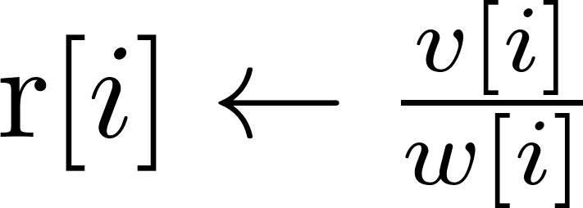
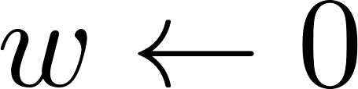
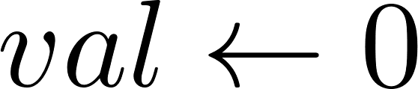
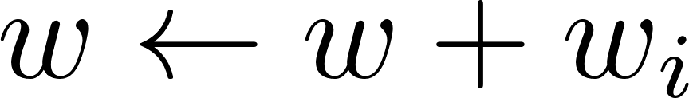
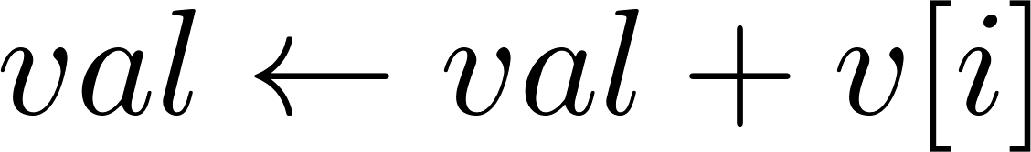

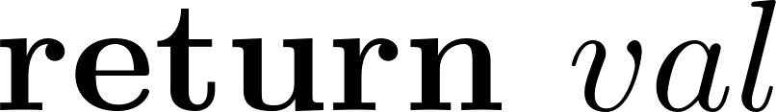
Fractional Knapsack
Pseudocode:
Notes:
Exercise: guess merge sort

Slide 22
Fractional Knapsack
Pseudocode:
Compute the ratios
Initialization
While knapsack not full
If whole item fits
Notes:
Exercise: guess merge sort

Slide 23





Fractional Knapsack
Pseudocode:
Percentage of item i
that fits
Compute the ratios
Initialization
While knapsack not full
If whole item fits
Notes:
Exercise: guess merge sort

Slide 24
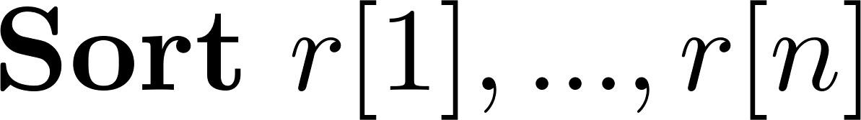

Fractional Knapsack
Pseudocode:
This is fast, in $O(1)$ time.
Notes:
Exercise: guess merge sort

Slide 25
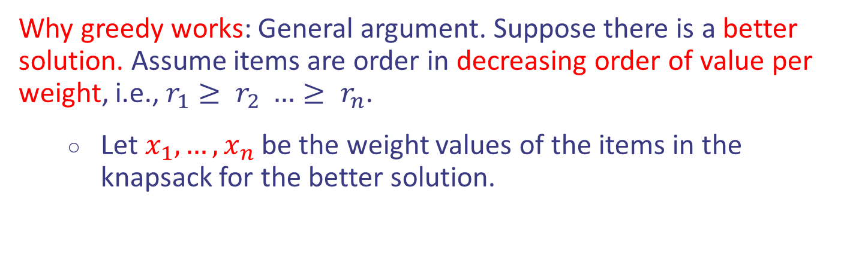
Fractional Knapsack
Why greedy works: General argument. Suppose there is a better solution. Assume items are order in decreasing order of value per weight, i.e., $r_{1}≥ r_{2} …≥ r_{n}$.
Let $x_{1},…,x_{n}$ be the weight values of the items in the knapsack for the better solution.
Notes:
Exercise: guess merge sort

Slide 26
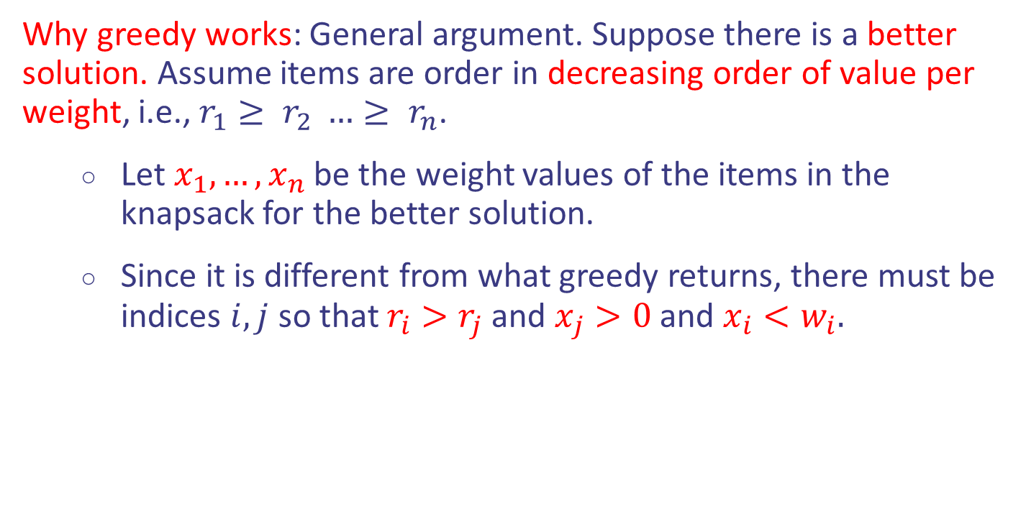
Fractional Knapsack
Why greedy works: General argument. Suppose there is a better solution. Assume items are order in decreasing order of value per weight, i.e., $r_{1}≥ r_{2} …≥ r_{n}$.
Let $x_{1},…,x_{n}$ be the weight values of the items in the knapsack for the better solution.
Since it is different from what greedy returns, there must be indices $i,j$ so that $r_{i}>r_{j}$ and $x_{j}>0$ and $x_{i}<w_{i}.$
Notes:
Exercise: guess merge sort

Slide 27
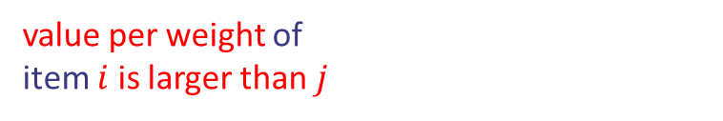
Fractional Knapsack
Why greedy works: General argument. Suppose there is a better solution. Assume items are order in decreasing order of value per weight, i.e., $r_{1}≥ r_{2} …≥ r_{n}$.
Let $x_{1},…,x_{n}$ be the weight values of the items in the knapsack for the better solution.
Since it is different from what greedy returns, there must be indices $i,j$ so that $r_{i}>r_{j}$ and $x_{j}>0$ and $x_{i}<w_{i}.$
value per weight of
item $i$ is larger than $j$
Notes:
Exercise: guess merge sort

Slide 28
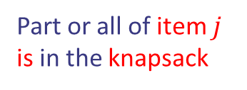
Fractional Knapsack
Why greedy works: General argument. Suppose there is a better solution. Assume items are order in decreasing order of value per weight, i.e., $r_{1}≥ r_{2} …≥ r_{n}$.
Let $x_{1},…,x_{n}$ be the weight values of the items in the knapsack for the better solution.
Since it is different from what greedy returns, there must be indices $i,j$ so that $r_{i}>r_{j}$ and $x_{j}>0$ and $x_{i}<w_{i}.$
value per weight of
item $i$ is larger than $j$
Part or all of item $j$
is in the knapsack
Notes:
Exercise: guess merge sort

Slide 29
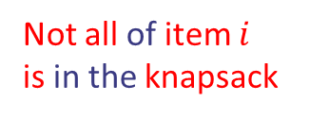
Fractional Knapsack
Why greedy works: General argument. Suppose there is a better solution. Assume items are order in decreasing order of value per weight, i.e., $r_{1}≥ r_{2} …≥ r_{n}$.
Let $x_{1},…,x_{n}$ be the weight values of the items in the knapsack for the better solution.
Since it is different from what greedy returns, there must be indices $i,j$ so that $r_{i}>r_{j}$ and $x_{j}>0$ and $x_{i}<w_{i}.$
value per weight of
item $i$ is larger than $j$
Part or all of item $j$
is in the knapsack
Not all of item $i$
is in the knapsack
Notes:
Exercise: guess merge sort

Slide 30
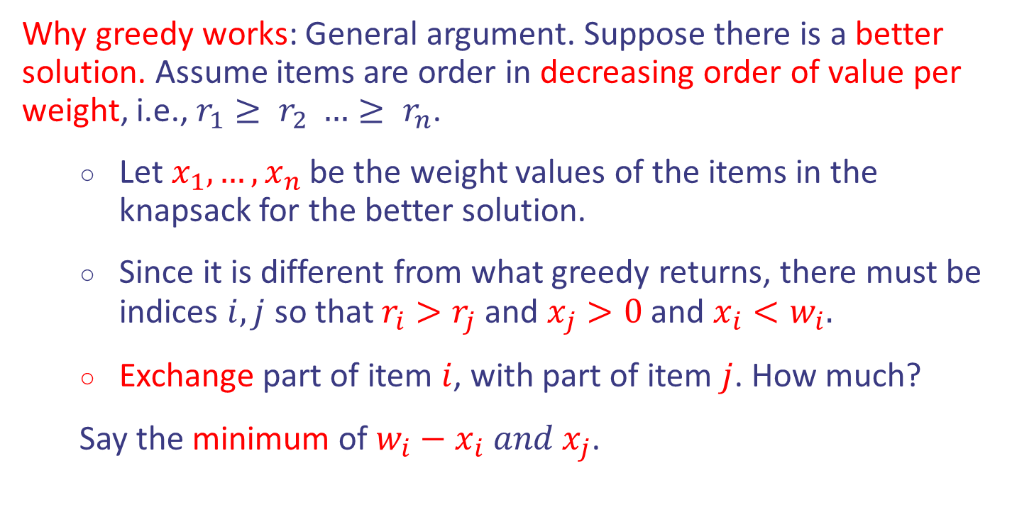
Fractional Knapsack
Why greedy works: General argument. Suppose there is a better solution. Assume items are order in decreasing order of value per weight, i.e., $r_{1}≥ r_{2} …≥ r_{n}$.
Let $x_{1},…,x_{n}$ be the weight values of the items in the knapsack for the better solution.
Since it is different from what greedy returns, there must be indices $i,j$ so that $r_{i}>r_{j}$ and $x_{j}>0$ and $x_{i}<w_{i}.$
Exchange part of item $i$, with part of item $j$. How much?
Say the minimum of $w_{i}−x_{i} and x_{j}$.
Notes:
Exercise: guess merge sort

Slide 31
Fractional Knapsack
Why greedy works: General argument. Suppose there is a better solution. Assume items are order in decreasing order of value per weight, i.e., $r_{1}≥ r_{2} …≥ r_{n}$.
Let $x_{1},…,x_{n}$ be the weight values of the items in the knapsack for the better solution.
Since it is different from what greedy returns, there must be indices $i,j$ so that $r_{i}>r_{j}$ and $x_{j}>0$ and $x_{i}<w_{i}.$
Exchange part of item $i$, with part of item $j$. How much?
Say the minimum of $w_{i}−x_{i} and x_{j}$.
Total value will increase by $\left(r_{i}−r_{j}\right)⋅ min⁡(w_{i}−x_{i},x_{j})$
Notes:
Exercise: guess merge sort

Slide 32
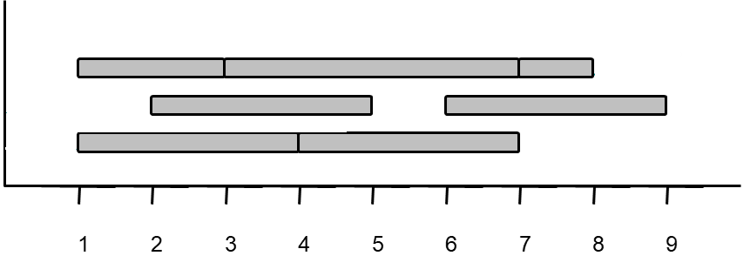
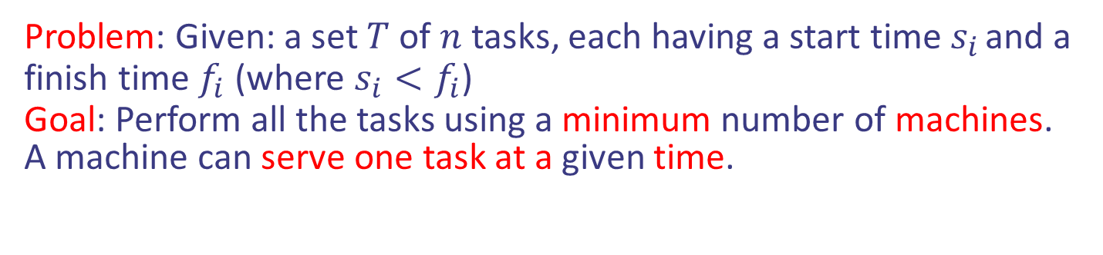
Task scheduling
Problem: Given: a set $T$ of $n$ tasks, each having a start time $s_{i}$ and a finish time $f_{i}$ (where $s_{i}<f_{i}$)
Goal: Perform all the tasks using a minimum number of machines.
A machine can serve one task at a given time.
Design and Analysis of Algorithms

Slide 33
Task scheduling
Problem: Given: a set $T$ of $n$ tasks, each having a start time $s_{i}$ and a finish time $f_{i}$ (where $s_{i}<f_{i}$)
Goal: Perform all the tasks using a minimum number of machines.
A machine can serve one task at a given time.
Machine 3
Machine 2
Machine 1
1
2
3
4
5
6
7
8
9
Design and Analysis of Algorithms

Slide 34
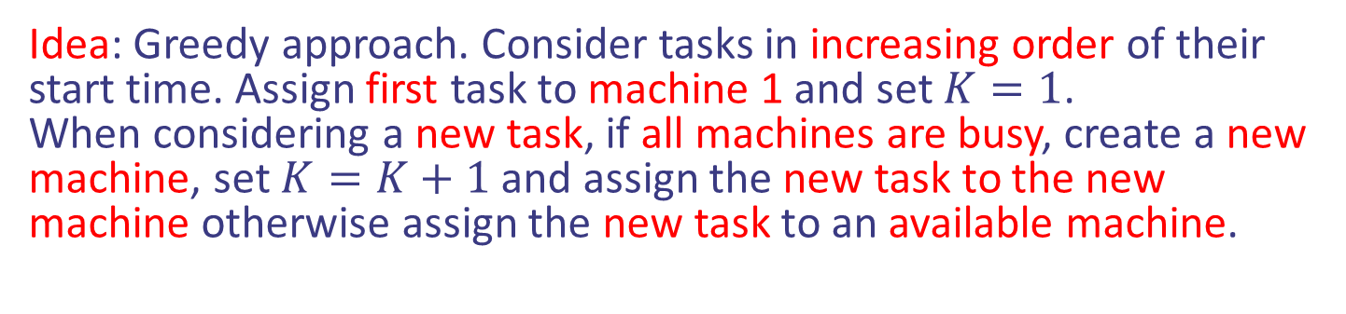
Task scheduling
Idea: Greedy approach. Consider tasks in increasing order of their start time. Assign first task to machine 1 and set $K=1$.
When considering a new task, if all machines are busy, create a new machine, set $K=K+1$ and assign the new task to the new machine otherwise assign the new task to an available machine.
Design and Analysis of Algorithms

Slide 35


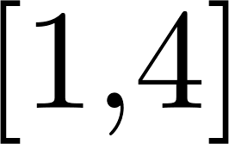
Task scheduling
Idea: Greedy approach. Consider tasks in increasing order of their start time. Assign first task to machine 1 and set $K=1$.
When considering a new task, if all machines are busy, create a new machine, set $K=K+1$ and assign the new task to the new machine otherwise assign the new task to an available machine.
Design and Analysis of Algorithms

Slide 36


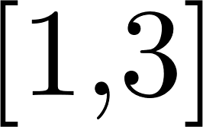
Task scheduling
Idea: Greedy approach. Consider tasks in increasing order of their start time. Assign first task to machine 1 and set $K=1$.
When considering a new task, if all machines are busy, create a new machine, set $K=K+1$ and assign the new task to the new machine otherwise assign the new task to an available machine.
Design and Analysis of Algorithms

Slide 37

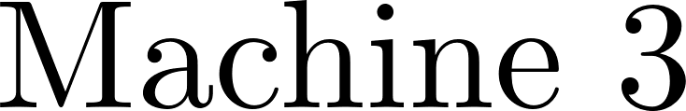
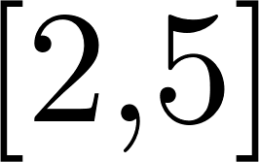
Task scheduling
Idea: Greedy approach. Consider tasks in increasing order of their start time. Assign first task to machine 1 and set $K=1$.
When considering a new task, if all machines are busy, create a new machine, set $K=K+1$ and assign the new task to the new machine otherwise assign the new task to an available machine.
Design and Analysis of Algorithms

Slide 38
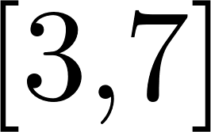
Task scheduling
Idea: Greedy approach. Consider tasks in increasing order of their start time. Assign first task to machine 1 and set $K=1$.
When considering a new task, if all machines are busy, create a new machine, set $K=K+1$ and assign the new task to the new machine otherwise assign the new task to an available machine.
Design and Analysis of Algorithms

Slide 39
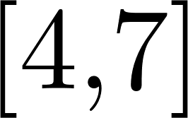
Task scheduling
Idea: Greedy approach. Consider tasks in increasing order of their start time. Assign first task to machine 1 and set $K=1$.
When considering a new task, if all machines are busy, create a new machine, set $K=K+1$ and assign the new task to the new machine otherwise assign the new task to an available machine.
Design and Analysis of Algorithms

Slide 40
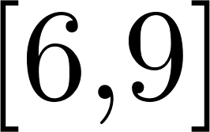
Task scheduling
Idea: Greedy approach. Consider tasks in increasing order of their start time. Assign first task to machine 1 and set $K=1$.
When considering a new task, if all machines are busy, create a new machine, set $K=K+1$ and assign the new task to the new machine otherwise assign the new task to an available machine.
Design and Analysis of Algorithms

Slide 41
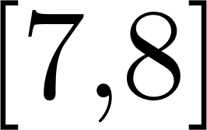
Task scheduling
Idea: Greedy approach. Consider tasks in increasing order of their start time. Assign first task to machine 1 and set $K=1$.
When considering a new task, if all machines are busy, create a new machine, set $K=K+1$ and assign the new task to the new machine otherwise assign the new task to an available machine.
Design and Analysis of Algorithms

Slide 42
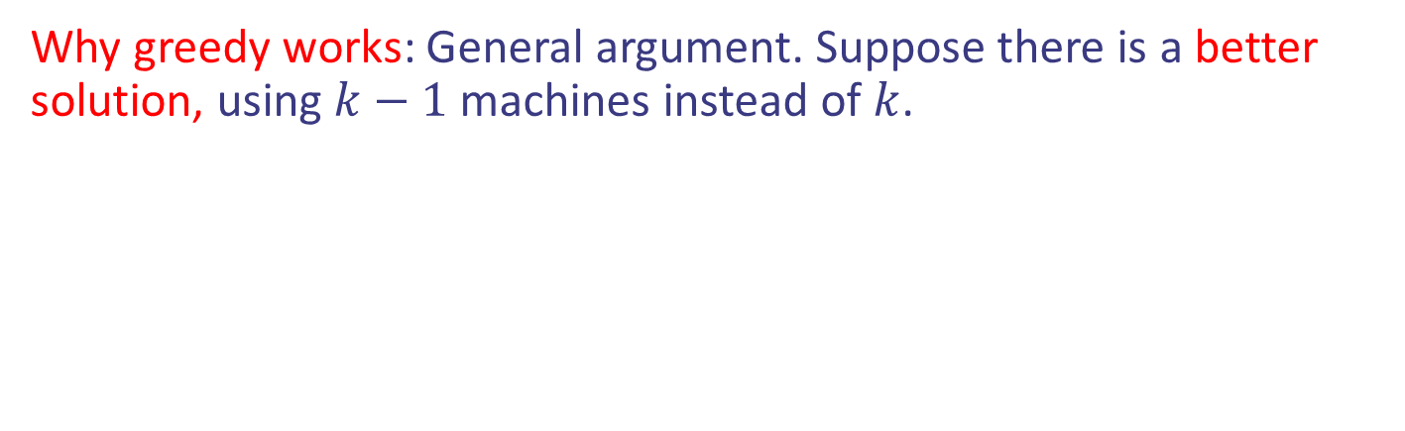
Task scheduling
Idea: Greedy approach. Consider tasks in increasing order of their start time. Assign first task to machine 1 and set $K=1$.
When considering a new task, if all machines are busy, create a new machine, set $K=K+1$ and assign the new task to the new machine otherwise assign the new task to an available machine.
Why greedy works: General argument. Suppose there is a better solution, using $k−1$ machines instead of $k$.
Design and Analysis of Algorithms

Slide 43
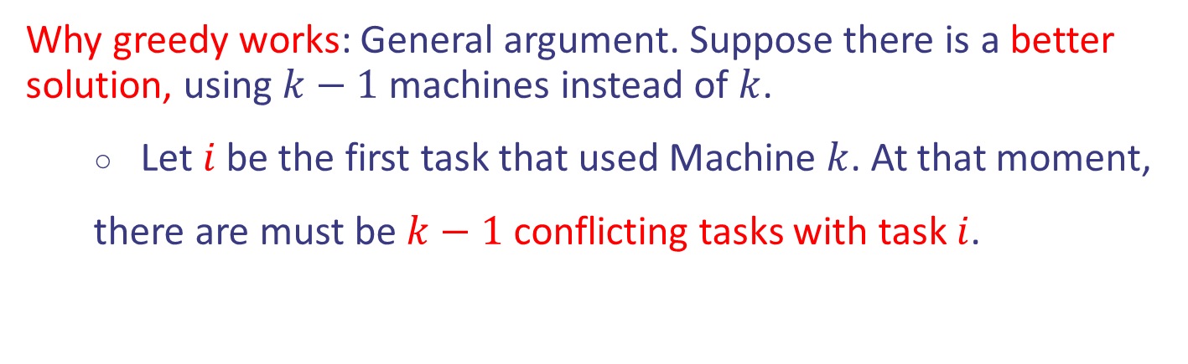
Task scheduling
Idea: Greedy approach. Consider tasks in increasing order of their start time. Assign first task to machine 1 and set $K=1$.
When considering a new task, if all machines are busy, create a new machine, set $K=K+1$ and assign the new task to the new machine otherwise assign the new task to an available machine.
Why greedy works: General argument. Suppose there is a better solution, using $k−1$ machines instead of $k$.
Let $i$ be the first task that used Machine $k$. At that moment,
there are must be $k−1$ conflicting tasks with task $i$.
Design and Analysis of Algorithms

Slide 44
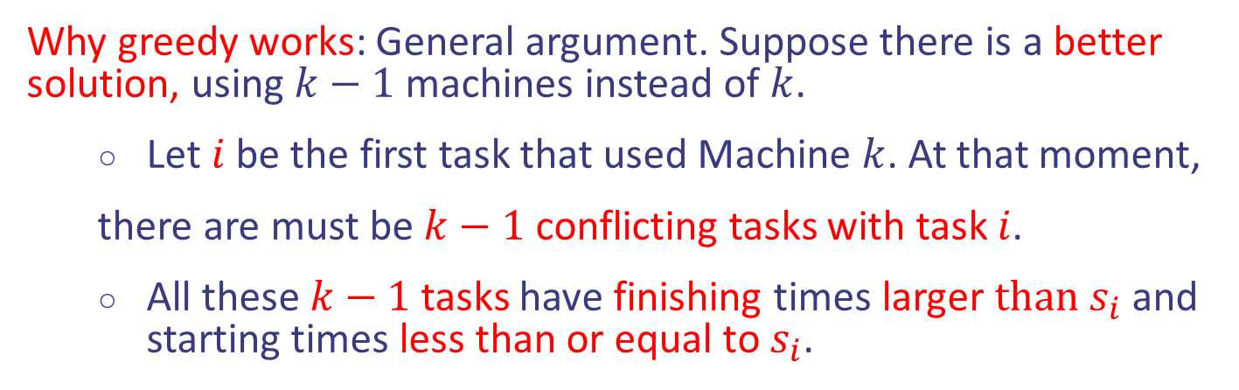
Task scheduling
Idea: Greedy approach. Consider tasks in increasing order of their start time. Assign first task to machine 1 and set $K=1$.
When considering a new task, if all machines are busy, create a new machine, set $K=K+1$ and assign the new task to the new machine otherwise assign the new task to an available machine.
Why greedy works: General argument. Suppose there is a better solution, using $k−1$ machines instead of $k$.
Let $i$ be the first task that used Machine $k$. At that moment,
there are must be $k−1$ conflicting tasks with task $i$.
All these $k−1$ tasks have finishing times larger $than s_{i}$ and starting times less than or equal to $s_{i}$.
Design and Analysis of Algorithms

Slide 45
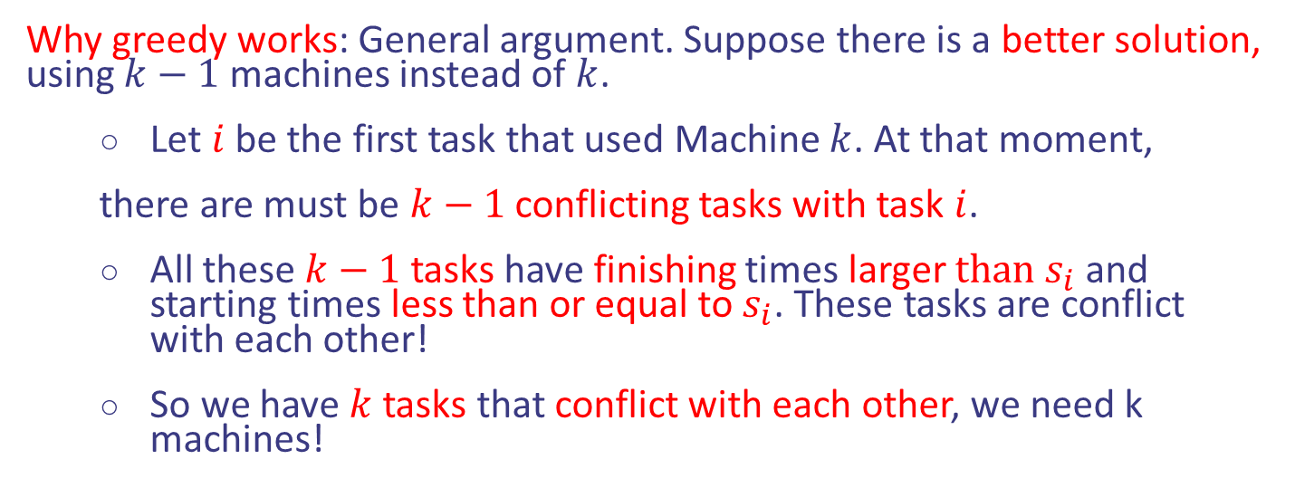
Task scheduling
Idea: Greedy approach. Consider tasks in increasing order of their start time. Assign first task to machine 1 and set $K=1$.
When considering a new task, if all machines are busy, create a new machine, set $K=K+1$ and assign the new task to the new machine otherwise assign the new task to an available machine.
Why greedy works: General argument. Suppose there is a better solution, using $k−1$ machines instead of $k$.
Let $i$ be the first task that used Machine $k$. At that moment,
there are must be $k−1$ conflicting tasks with task $i$.
All these $k−1$ tasks have finishing times larger $than s_{i}$ and starting times less than or equal to $s_{i}$. These tasks are conflict with each other!
So we have $k$ tasks that conflict with each other, we need k machines!
Design and Analysis of Algorithms

Slide 46
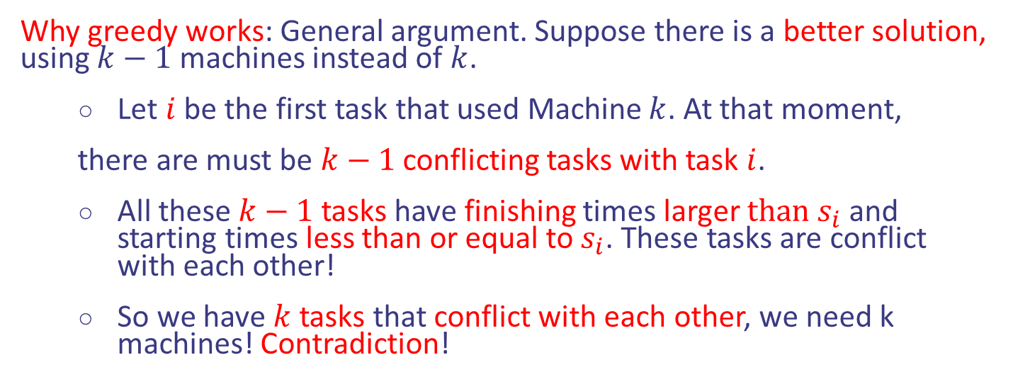
Task scheduling
Idea: Greedy approach. Consider tasks in increasing order of their start time. Assign first task to machine 1 and set $K=1$.
When considering a new task, if all machines are busy, create a new machine, set $K=K+1$ and assign the new task to the new machine otherwise assign the new task to an available machine.
Why greedy works: General argument. Suppose there is a better solution, using $k−1$ machines instead of $k$.
Let $i$ be the first task that used Machine $k$. At that moment,
there are must be $k−1$ conflicting tasks with task $i$.
All these $k−1$ tasks have finishing times larger $than s_{i}$ and starting times less than or equal to $s_{i}$. These tasks are conflict with each other!
So we have $k$ tasks that conflict with each other, we need k machines! Contradiction!
Design and Analysis of Algorithms

