Slide 1

Lecture 8 Dynamic Programming I: Introduction, Memoization, Rod Cutting, Knapsack
CS 161 Design and Analysis of Algorithms
Ioannis Panageas

Slide 2
Dynamic Programming
Technique for solving optimization problems.
Solve problem by solving sub-problems and combine:
This is called Optimal substructure property.

Slide 3
Dynamic Programming
Technique for solving optimization problems.
Solve problem by solving sub-problems and combine:
This is called Optimal substructure property.
Similar to divide-and-conquer: recursion (for solving sub-problems)
Sub-problems overlap: solve them only once!
DP = recursion + re-use (Memoization)

Slide 4


Dynamic Programming
Example: Given a positive integer numbers $n$, compute Fibonacci $F_{n}$. Definition: $F_{1}=F_{2}=1$ and $F_{n} = F_{n−1} + F_{n−2}$.
Recursion (slow):
Notes:
Exercise: guess merge sort

Slide 5
Dynamic Programming
Example: Given a positive integer numbers $n$, compute Fibonacci $F_{n}$. Definition: $F_{1}=F_{2}=1$ and $F_{n} = F_{n−1} + F_{n−2}$.
Recursion (slow):
Why is it slow?
Notes:
Exercise: guess merge sort

Slide 6
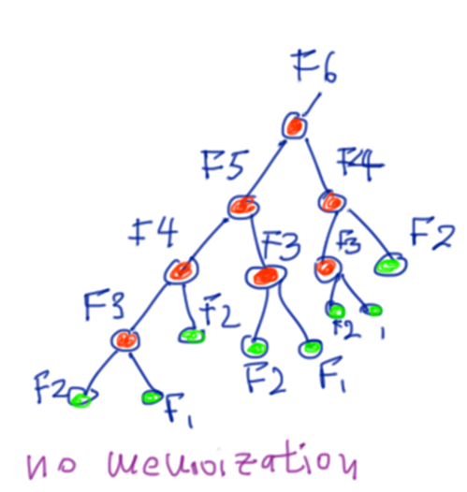
Dynamic Programming
Example: Given a positive integer numbers $n$, compute Fibonacci $F_{n}$. Definition: $F_{1}=F_{2}=1$ and $F_{n} = F_{n−1} + F_{n−2}$.
Recursion (slow):
Why is it slow? F(6)
Red nodes: Recursive calls.
Green nodes: Bases cases.
F(5) is computed once, F(4) twice,
F(3) three times, F(2) five times, F(1) three times
Notes:
Exercise: guess merge sort

Slide 7

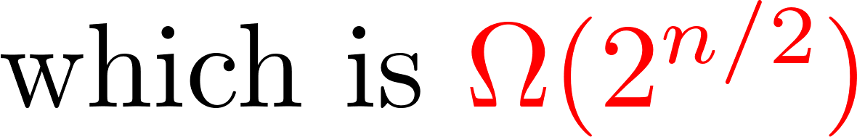
Dynamic Programming
Example: Given a positive integer numbers $n$, compute Fibonacci $F_{n}$. Definition: $F_{1}=F_{2}=1$ and $F_{n} = F_{n−1} + F_{n−2}$.
Recursion (slow):
Exponential time
Red nodes: Recursive calls.
Green nodes: Bases cases.
F(5) is computed once, F(4) twice,
F(3) three times, F(2) five times, F(1) three times
Notes:
Exercise: guess merge sort

Slide 8


Dynamic Programming
Example: Given a positive integer numbers $n$, compute Fibonacci $F_{n}$. Definition: $F_{1}=F_{2}=1$ and $F_{n} = F_{n−1} + F_{n−2}$.
Memoization (fast):
Notes:
Exercise: guess merge sort

Slide 9
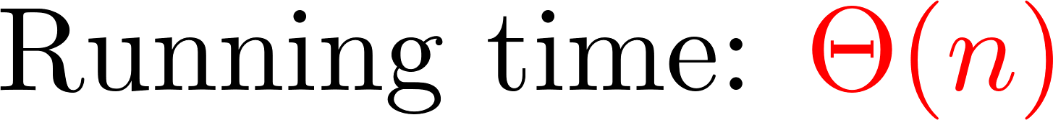
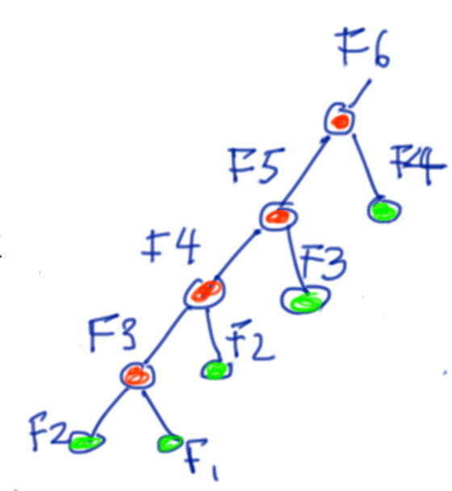
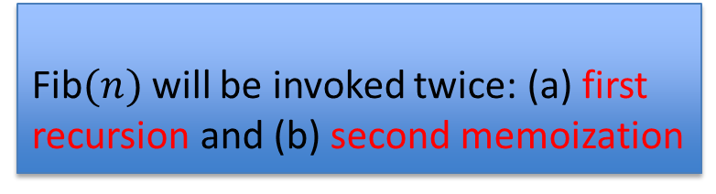
Dynamic Programming
Example: Given a positive integer numbers $n$, compute Fibonacci $F_{n}$. Definition: $F_{1}=F_{2}=1$ and $F_{n} = F_{n−1} + F_{n−2}$.
Linear time: Let’s see F(6)
Memoization (fast):
Fib$(n)$ will be invoked twice: (a) first recursion and (b) second memoization
Notes:
Exercise: guess merge sort

Slide 10
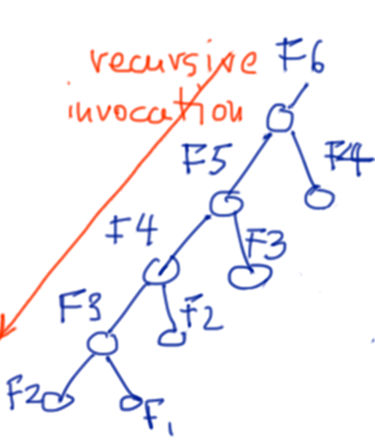
Dynamic Programming
DP = recursion + re-use (Memoization)
Two approaches in Dynamic Programming
Top-down approach:
If solution is stored in the array,
return it (memoization).
Otherwise solves
subproblems recursively
Design and Analysis of Algorithms

Slide 11
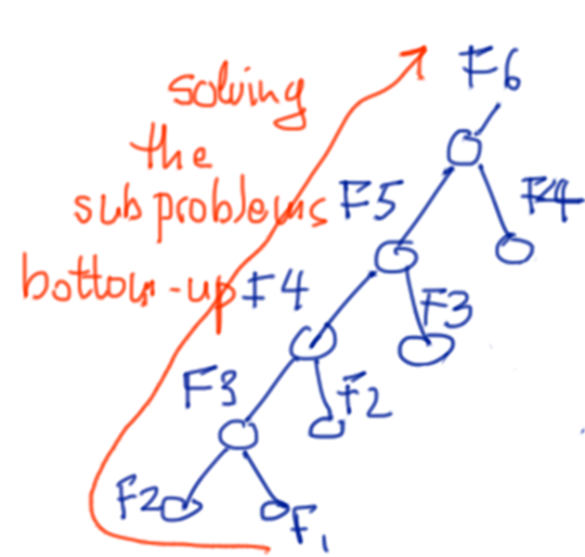

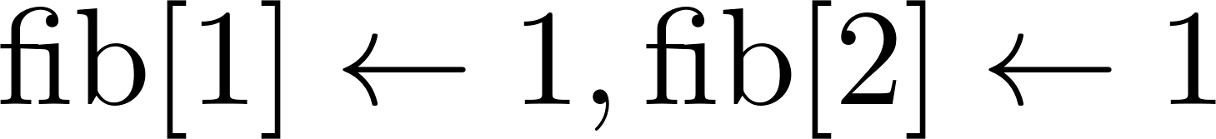

Dynamic Programming
DP = recursion + re-use (Memoization)
Two approaches in Dynamic Programming
Bottom-up approach:
Solves subproblems iteratively
in the order of smallest
to largest subproblems.
Design and Analysis of Algorithms

Slide 12
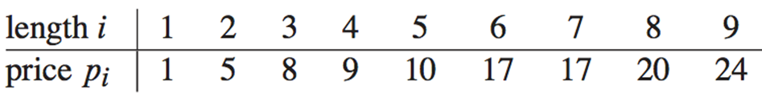
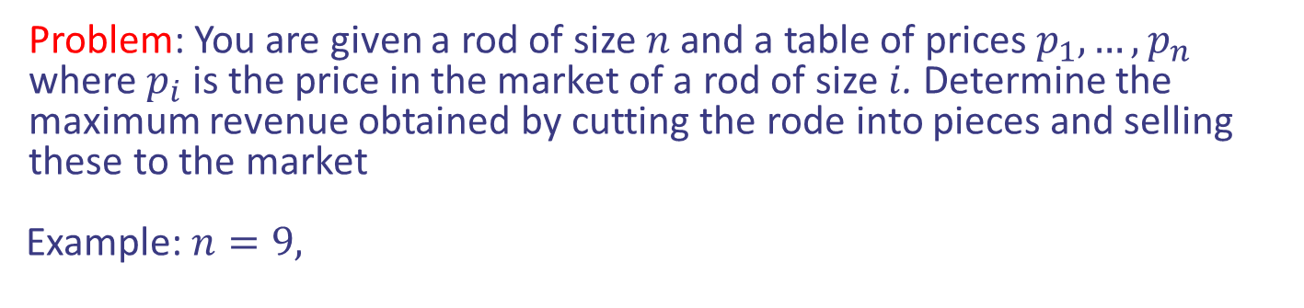
Case study I: Rod cutting problem
Problem: You are given a rod of size $n$ and a table of prices $p_{1},…,p_{n}$ where $p_{i}$ is the price in the market of a rod of size $i$. Determine the maximum revenue obtained by cutting the rode into pieces and selling these to the market
Example: $n=9,$
Design and Analysis of Algorithms

Slide 13
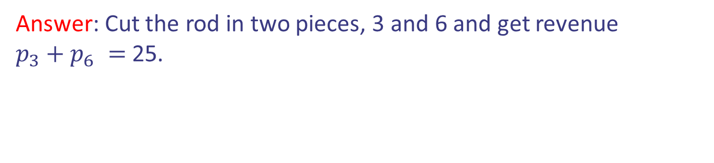
Case study I: Rod cutting problem
Problem: You are given a rod of size $n$ and a table of prices $p_{1},…,p_{n}$ where $p_{i}$ is the price in the market of a rod of size $i$. Determine the maximum revenue obtained by cutting the rode into pieces and selling these to the market
Example: $n=9,$
Answer: Cut the rod in two pieces, 3 and 6 and get revenue
$p_{3}+p_{6} =$ 25.
Design and Analysis of Algorithms

Slide 14
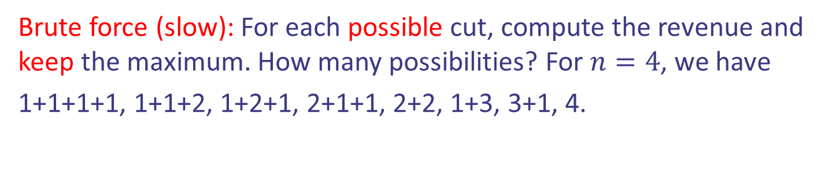
Case study I: Rod cutting problem
Problem: You are given a rod of size $n$ and a table of prices $p_{1},…,p_{n}$ where $p_{i}$ is the price in the market of a rod of size $i$. Determine the maximum revenue obtained by cutting the rode into pieces and selling these to the market
Example: $n=9,$
Answer: Cut the rod in two pieces, 3 and 6 and get revenue
$p_{3}+p_{6} =$ 25.
Brute force (slow): For each possible cut, compute the revenue and keep the maximum. How many possibilities? For $n=4$, we have
1+1+1+1, 1+1+2, 1+2+1, 2+1+1, 2+2, 1+3, 3+1, 4.
Design and Analysis of Algorithms

Slide 15

Case study I: Rod cutting problem
Problem: You are given a rod of size $n$ and a table of prices $p_{1},…,p_{n}$ where $p_{i}$ is the price in the market of a rod of size $i$. Determine the maximum revenue obtained by cutting the rode into pieces and selling these to the market
Example: $n=9,$
Answer: Cut the rod in two pieces, 3 and 6 and get revenue
$p_{3}+p_{6} =$ 25.
Brute force (slow): For each possible cut, compute the revenue and keep the maximum. How many possibilities? For $n=4$, we have
1+1+1+1, 1+1+2, 1+2+1, 2+1+1, 2+2, 1+3, 3+1, 4.
Exponential many $2^{n−1}$
Hence exponential time
Design and Analysis of Algorithms

Slide 16

Case study I: Rod cutting problem
General Approach
Step 1: Define the problem and subproblems.
Answer: Let $DP[k]$ be the maximum value I can get from rod with size $k$.
Design and Analysis of Algorithms

Slide 17

Case study I: Rod cutting problem
General Approach
Step 1: Define the problem and subproblems.
Answer: Let $DP[k]$ be the maximum value I can get from rod with size $k$.
Step 2: Define the goal/output given Step 1.
Design and Analysis of Algorithms

Slide 18

Case study I: Rod cutting problem
General Approach
Step 1: Define the problem and subproblems.
Answer: Let $DP[k]$ be the maximum value I can get from rod with size $k$.
Step 2: Define the goal/output given Step 1.
It is $DP[n]$.
Design and Analysis of Algorithms

Slide 19

Case study I: Rod cutting problem
General Approach
Step 1: Define the problem and subproblems.
Answer: Let $DP[k]$ be the maximum value I can get from rod with size $k$.
Step 2: Define the goal/output given Step 1.
It is $DP[n]$.
Step 3: Define the base cases
Design and Analysis of Algorithms

Slide 20

Case study I: Rod cutting problem
General Approach
Step 1: Define the problem and subproblems.
Answer: Let $DP[k]$ be the maximum value I can get from rod with size $k$.
Step 2: Define the goal/output given Step 1.
It is $DP[n]$.
Step 3: Define the base cases
It is $DP[0]=0$.
Step 4: Define the recurrence
Design and Analysis of Algorithms

Slide 21


Case study I: Rod cutting problem
General Approach
Step 4: Define the recurrence.
Create a recursive relationship between the subproblems (the tricky part).
Question: Given a rod of size $k$, where should I cut it first?
Design and Analysis of Algorithms

Slide 22


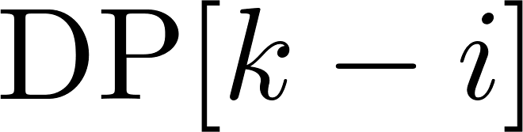

Case study I: Rod cutting problem
General Approach
Step 4: Define the recurrence.
Create a recursive relationship between the subproblems (the tricky part).
Question: Given a rod of size $k$, where should I cut it first? Cut at index $i$ gives price of $i$ and $DP[k−i]$
Length $i$
Length $k−i$
Design and Analysis of Algorithms

Slide 23
Case study I: Rod cutting problem
General Approach
Step 4: Define the recurrence.
Create a recursive relationship between the subproblems (the tricky part).
Question: Given a rod of size $k$, where should I cut it first? Cut at index $i$ gives price of $i$ and $DP[k−i]$
Design and Analysis of Algorithms

Slide 24

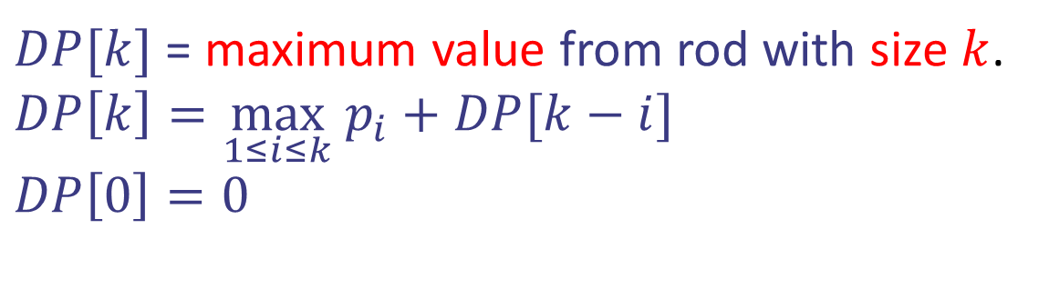
Case study I: Rod cutting problem
size of piece | 1 | 2 | 3 | 4
market price | 2 | 5 | 7 | 8
Rod of size $n=4$
$DP[k]$ = maximum value from rod with size $k$.
$DP\left[k\right]=\max_{1≤i≤k} p_{i}+DP[k−i]$
$$DP\left[0\right]=0$$
0
Design and Analysis of Algorithms

Slide 25
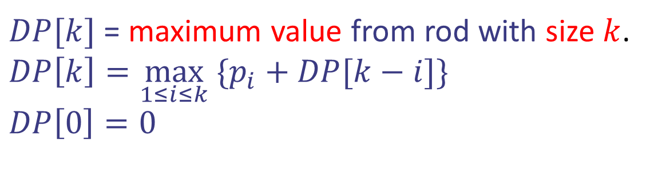
Case study I: Rod cutting problem
size of piece | 1 | 2 | 3 | 4
market price | 2 | 5 | 7 | 8
Rod of size $n=4$
$DP[k]$ = maximum value from rod with size $k$.
$DP\left[k\right]=\max_{1≤i≤k} \{p_{i}+DP[k−i]\}$
$$DP\left[0\right]=0$$
+2
0
2
Design and Analysis of Algorithms

Slide 26
Case study I: Rod cutting problem
size of piece | 1 | 2 | 3 | 4
market price | 2 | 5 | 7 | 8
Rod of size $n=4$
$DP[k]$ = maximum value from rod with size $k$.
$DP\left[k\right]=\max_{1≤i≤k} \{p_{i}+DP[k−i]\}$
$$DP\left[0\right]=0$$
+5
+2
0
2
5
Design and Analysis of Algorithms

Slide 27
Case study I: Rod cutting problem
size of piece | 1 | 2 | 3 | 4
market price | 2 | 5 | 7 | 8
Rod of size $n=4$
$DP[k]$ = maximum value from rod with size $k$.
$DP\left[k\right]=\max_{1≤i≤k} \{p_{i}+DP[k−i]\}$
$$DP\left[0\right]=0$$
+7
+5
+2
0
2
5
7
Design and Analysis of Algorithms

Slide 28
Case study I: Rod cutting problem
size of piece | 1 | 2 | 3 | 4
market price | 2 | 5 | 7 | 8
Rod of size $n=4$
$DP[k]$ = maximum value from rod with size $k$.
$DP\left[k\right]=\max_{1≤i≤k} \{p_{i}+DP[k−i]\}$
$$DP\left[0\right]=0$$
+8
+2
+7
+5
0
2
5
7
10
Design and Analysis of Algorithms

Slide 29

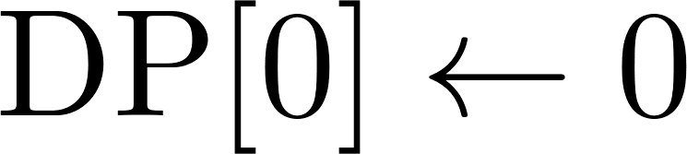

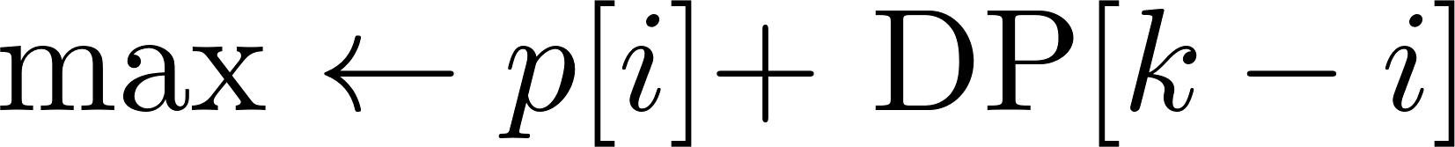


Case study I: Rod cutting problem
Pseudocode:
Design and Analysis of Algorithms

Slide 30
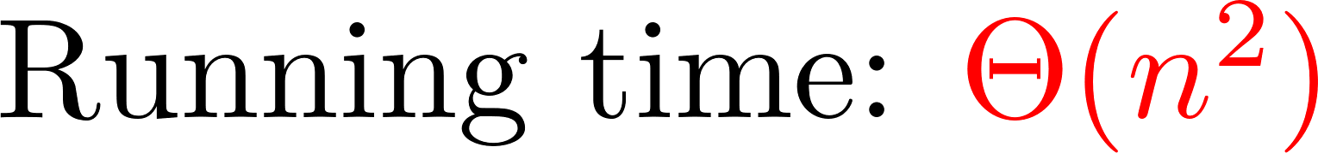
Case study I: Rod cutting problem
Pseudocode:
Base case
Implement recursive
formula with double
for-loop
GOAL
Design and Analysis of Algorithms

Slide 31
Case study I: Rod cutting problem
Pseudocode:
Base case
Implement recursive
formula with double
for-loop
GOAL
Design and Analysis of Algorithms

Slide 32
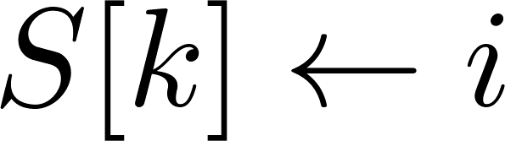
Case study I: Rod cutting problem
Pseudocode:
Base case
Implement recursive
formula with double
for-loop
GOAL
Design and Analysis of Algorithms

Slide 33


Case study I: Rod cutting problem
Example: $n=9$
len | 0 | 1 | 2 | 3 | 4 | 5 | 6 | 7 | 8 | 9
DP[] | 0 | 1 | 5 | 8 | 10 | 13 | 17 | 18 | 22 | 25
S[] | 0 | 0 | 0 | 0 | 2 | 2 | 0 | 1 | 2 | 3
Solution for $n=9$:
Need to cut at $S[9] =3$. Then remaining length is 9-3=6.
Need to cut at $S[6]=0$. The solution is 3+6 which give 8+17=25
Design and Analysis of Algorithms

Slide 34
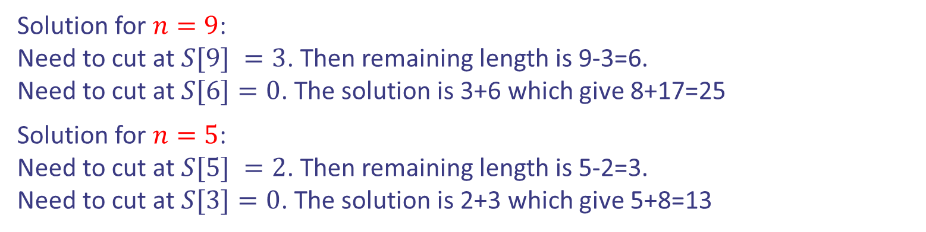
Case study I: Rod cutting problem
Example: $n=9$
len | 0 | 1 | 2 | 3 | 4 | 5 | 6 | 7 | 8 | 9
DP[] | 0 | 1 | 5 | 8 | 10 | 13 | 17 | 18 | 22 | 25
S[] | 0 | 0 | 0 | 0 | 2 | 2 | 0 | 1 | 2 | 3
Solution for $n=9$:
Need to cut at $S[9] =3$. Then remaining length is 9-3=6.
Need to cut at $S[6]=0$. The solution is 3+6 which give 8+17=25
Solution for $n=5$:
Need to cut at $S[5] =2$. Then remaining length is 5-2=3.
Need to cut at $S[3]=0$. The solution is 2+3 which give 5+8=13
Design and Analysis of Algorithms

Slide 35

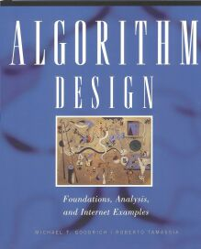
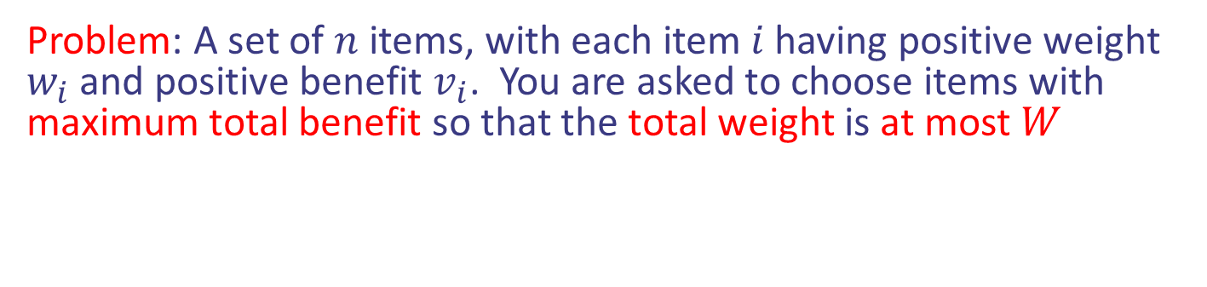
Case study II: 0/1 Knapsack
Problem: A set of $n$ items, with each item $i$ having positive weight $w_{i}$ and positive benefit $v_{i}$. You are asked to choose items with maximum total benefit so that the total weight is at most $W$
“knapsack” with 9 lbs capacity
Items:
Weight:
4 lbs
2 lbs
2 lbs
6 lbs
2 lbs
Solution:
item 5 ($80, 2 lbs)
item 3 ($6, 2lbs)
item 1 ($20, 4lbs)
Benefit:
$20
$3
$6
$25
$80
Design and Analysis of Algorithms

Slide 36
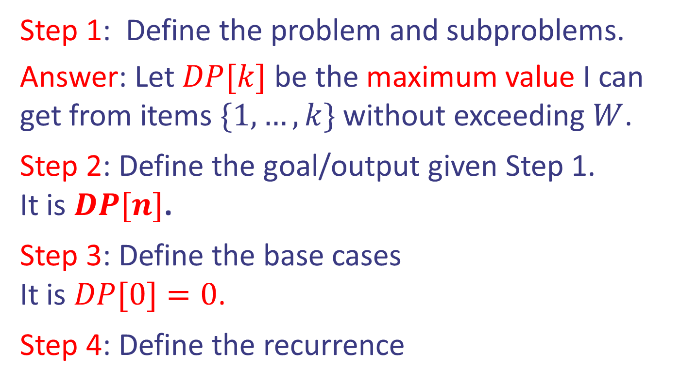
Case study II: 0/1 Knapsack
Idea: Dynamic Programming (first attempt).
Step 1: Define the problem and subproblems.
Answer: Let $DP[k]$ be the maximum value I can get from items $\{1,…,k\}$ without exceeding $W$.
Step 2: Define the goal/output given Step 1.
It is $DP[n]$.
Step 3: Define the base cases
It is $DP[0]=0$.
Step 4: Define the recurrence
Design and Analysis of Algorithms

Slide 37
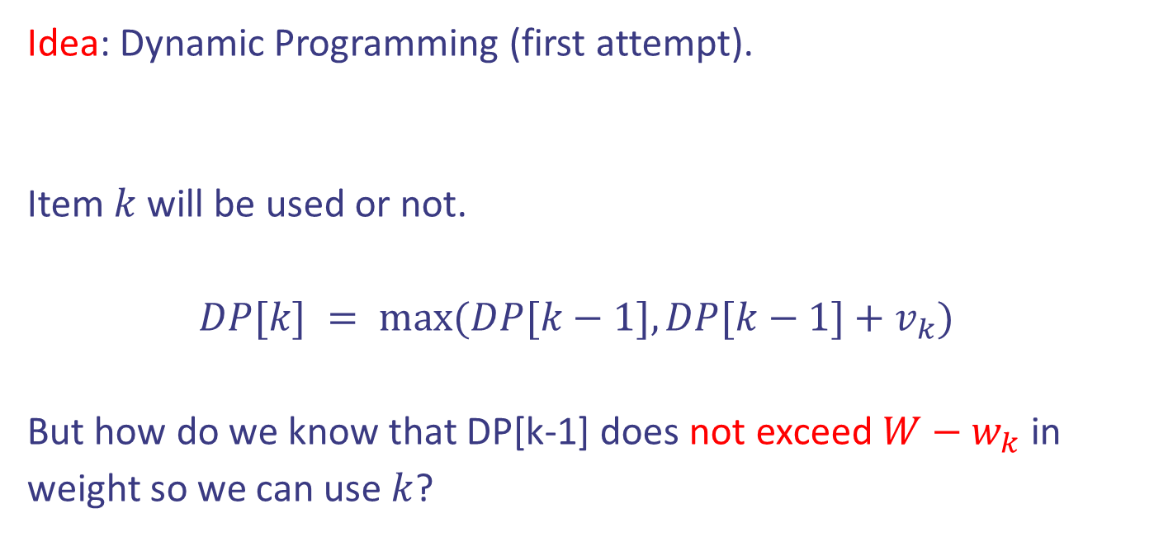
Case study II: 0/1 Knapsack
Idea: Dynamic Programming (first attempt).
Item $k$ will be used or not.
$DP[k] = max⁡(DP[k−1], DP[k−1]+v_{k})$
But how do we know that DP[k-1] does not exceed $W−w_{k}$ in weight so we can use $k$?
Step 4: Define the recurrence
Design and Analysis of Algorithms

Slide 38

Case study II: 0/1 Knapsack
Idea: Dynamic Programming (correct attempt).
Step 1: Define the problem and subproblems.
Answer: Let $DP[k,j]$ be the maximum value I can get from items $\{1,…,k\}$ without exceeding $j$.
Design and Analysis of Algorithms

Slide 39

Case study II: 0/1 Knapsack
Idea: Dynamic Programming (correct attempt).
Step 1: Define the problem and subproblems.
Answer: Let $DP[k,j]$ be the maximum value I can get from items $\{1,…,k\}$ without exceeding $j$.
Step 2: Define the goal/output given Step 1.
It is $DP[n,W]$.
Design and Analysis of Algorithms

Slide 40
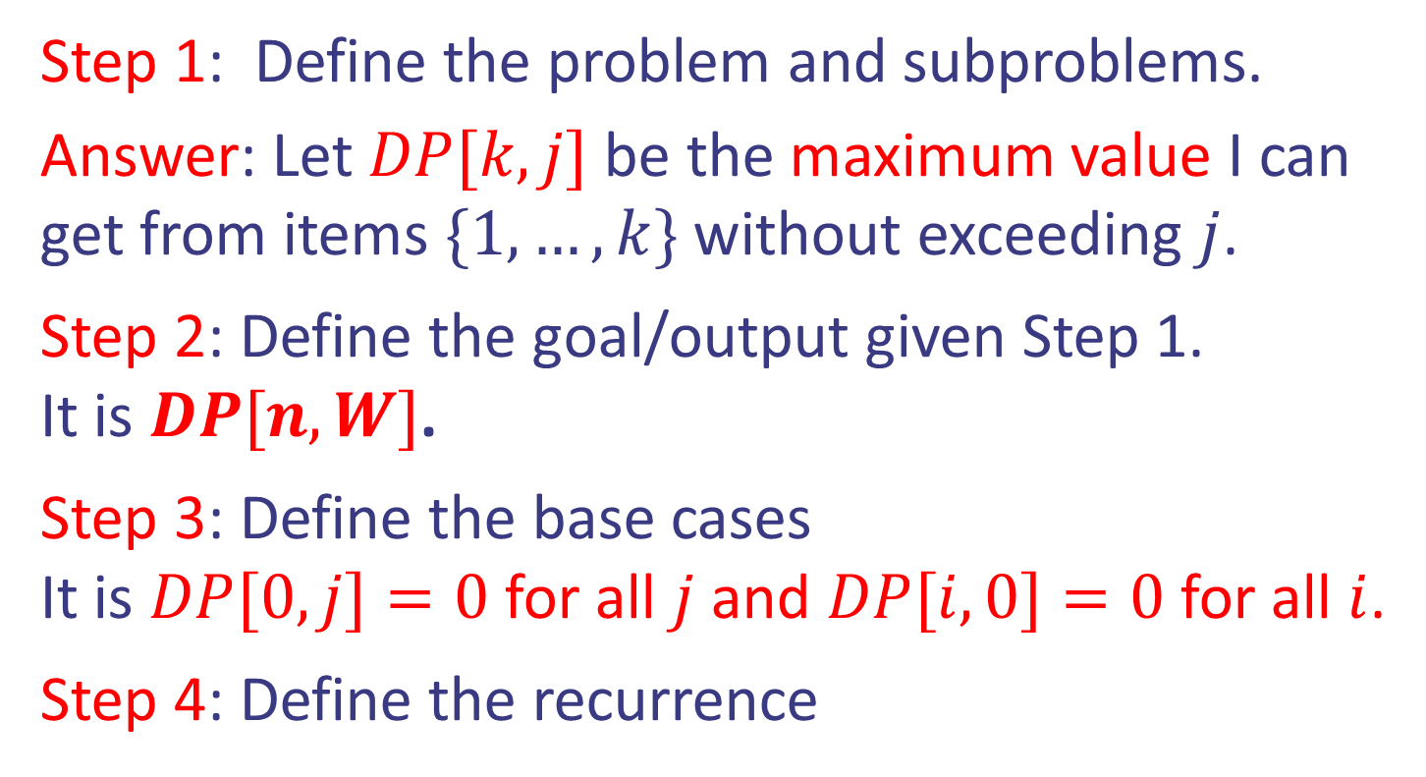
Case study II: 0/1 Knapsack
Idea: Dynamic Programming (correct attempt).
Step 1: Define the problem and subproblems.
Answer: Let $DP[k,j]$ be the maximum value I can get from items $\{1,…,k\}$ without exceeding $j$.
Step 2: Define the goal/output given Step 1.
It is $DP[n,W]$.
Step 3: Define the base cases
It is $DP[0,j]=0$ for all $j$ and $DP[i,0]=0$ for all $i$.
Step 4: Define the recurrence
Design and Analysis of Algorithms

Slide 41

Case study II: 0/1 Knapsack
Idea: Dynamic Programming (correct attempt).
Item $k$ will be used or not.
$DP\left[k\right][j] = max⁡(DP[k−1][j−w_{k}]+v_{k},DP[k−1][j])$
Step 4: Define the recurrence
Design and Analysis of Algorithms

Slide 42
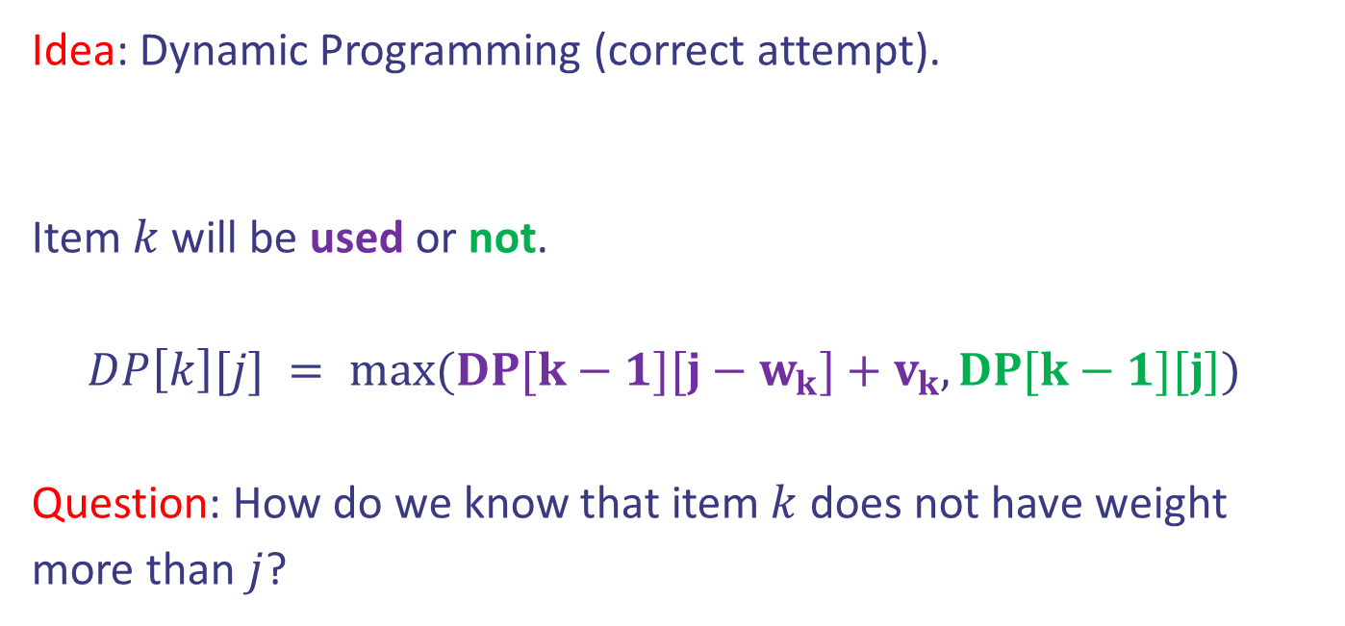
Case study II: 0/1 Knapsack
Idea: Dynamic Programming (correct attempt).
Item $k$ will be used or not.
$DP\left[k\right][j] = max⁡(DP[k−1][j−w_{k}]+v_{k},DP[k−1][j])$
Question: How do we know that item $k$ does not have weight more than $j$?
Step 4: Define the recurrence
Design and Analysis of Algorithms

Slide 43
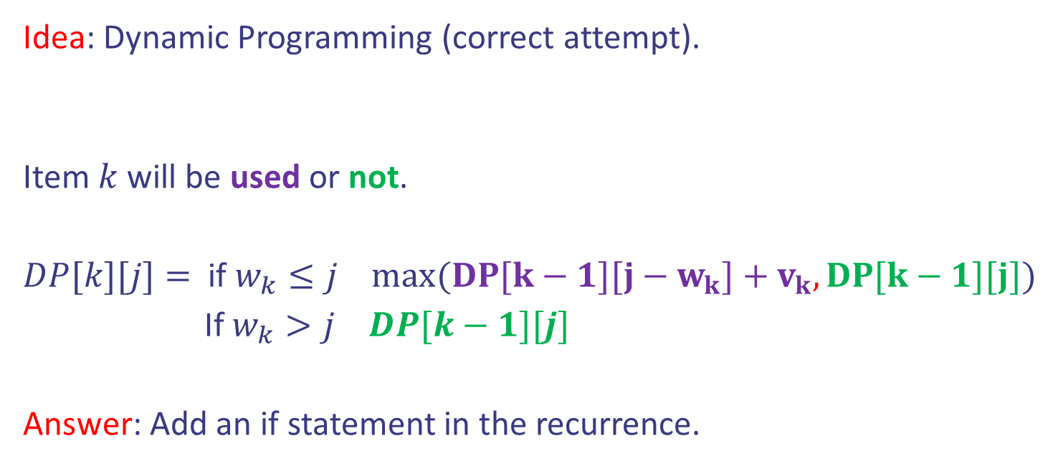
Case study II: 0/1 Knapsack
Idea: Dynamic Programming (correct attempt).
Item $k$ will be used or not.
$DP[k][j]=$ if $w_{k}≤j$ $max⁡(DP[k−1][j−w_{k}]+v_{k},DP[k−1][j])$
If $w_{k}>j$ $DP[k−1][j]$
Answer: Add an if statement in the recurrence.
Step 4: Define the recurrence
Design and Analysis of Algorithms

Slide 44
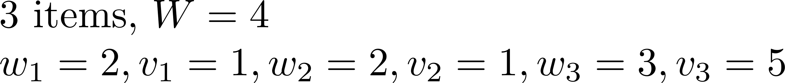

Case study II: 0/1 Knapsack
 | j=0 | 1 | 2 | 3 | 4
i=0 | 0 | 0 | 0 | 0 | 0
1 | 0
2 | 0
3 | 0

Slide 45
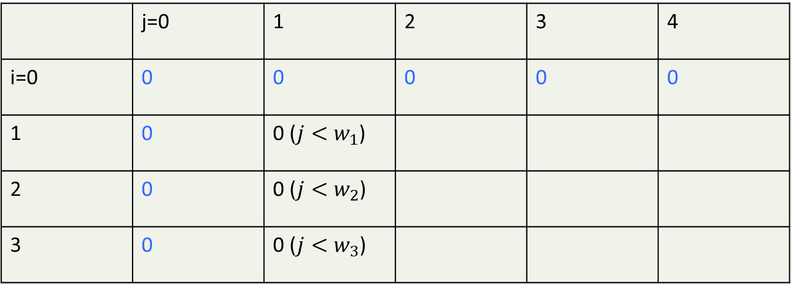
Case study II: 0/1 Knapsack
 | j=0 | 1 | 2 | 3 | 4
i=0 | 0 | 0 | 0 | 0 | 0
1 | 0 | 0 ($j<w_{1}$)
2 | 0 | 0 ($j<w_{2}$)
3 | 0 | 0 ($j<w_{3}$)

Slide 46


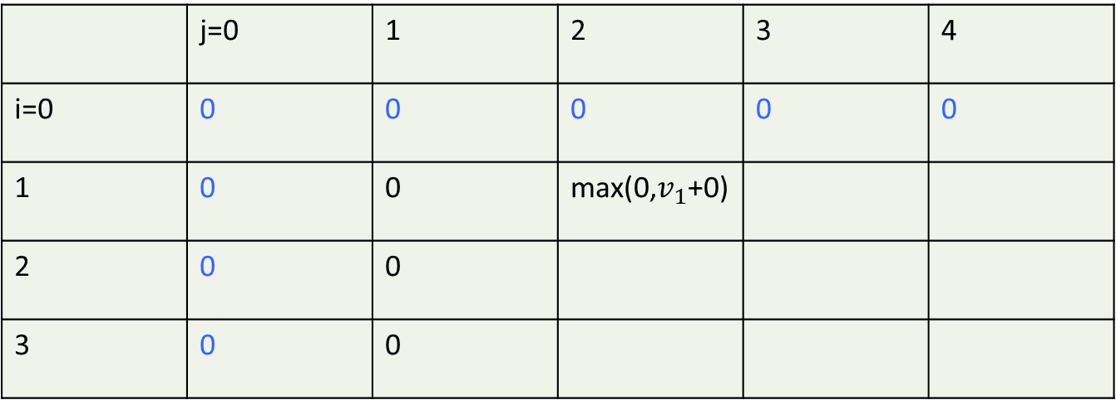
Case study II: 0/1 Knapsack
 | j=0 | 1 | 2 | 3 | 4
i=0 | 0 | 0 | 0 | 0 | 0
1 | 0 | 0 | max(0,$v_{1}$+0)
2 | 0 | 0
3 | 0 | 0

Slide 47


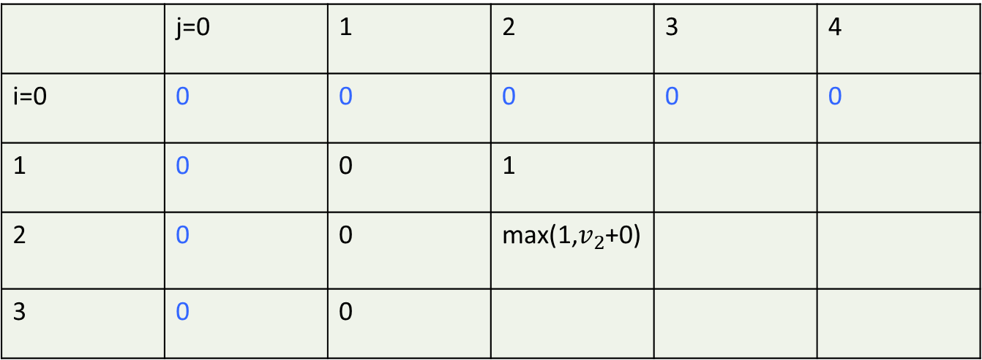
Case study II: 0/1 Knapsack
 | j=0 | 1 | 2 | 3 | 4
i=0 | 0 | 0 | 0 | 0 | 0
1 | 0 | 0 | 1
2 | 0 | 0 | max(1,$v_{2}$+0)
3 | 0 | 0

Slide 48
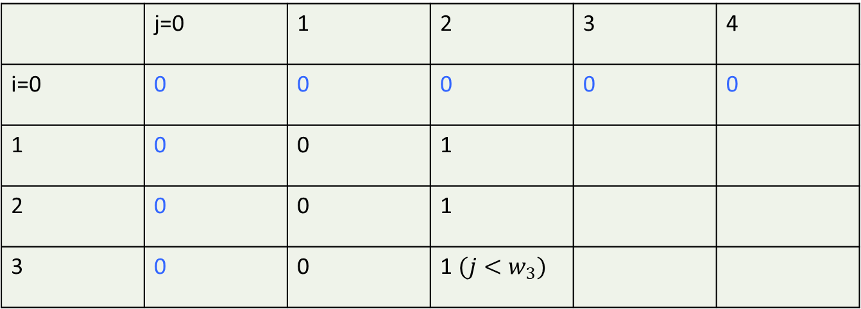
Case study II: 0/1 Knapsack
 | j=0 | 1 | 2 | 3 | 4
i=0 | 0 | 0 | 0 | 0 | 0
1 | 0 | 0 | 1
2 | 0 | 0 | 1
3 | 0 | 0 | 1 $(j<w_{3})$

Slide 49


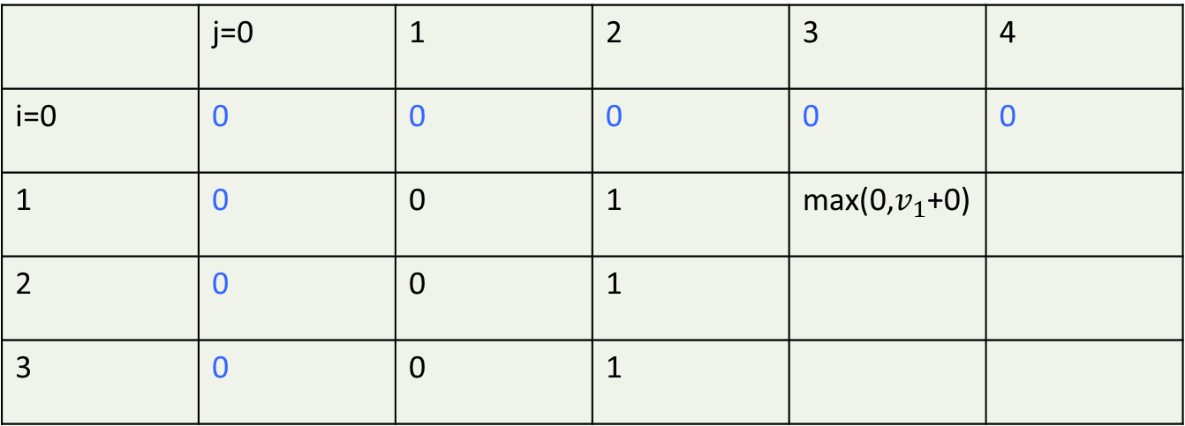
Case study II: 0/1 Knapsack
 | j=0 | 1 | 2 | 3 | 4
i=0 | 0 | 0 | 0 | 0 | 0
1 | 0 | 0 | 1 | max(0,$v_{1}$+0)
2 | 0 | 0 | 1
3 | 0 | 0 | 1

Slide 50
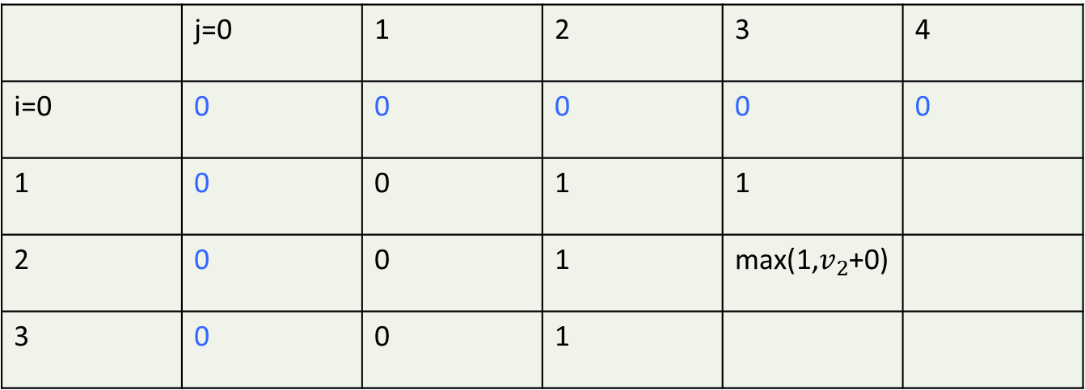
Case study II: 0/1 Knapsack
 | j=0 | 1 | 2 | 3 | 4
i=0 | 0 | 0 | 0 | 0 | 0
1 | 0 | 0 | 1 | 1
2 | 0 | 0 | 1 | max(1,$v_{2}$+0)
3 | 0 | 0 | 1

Slide 51
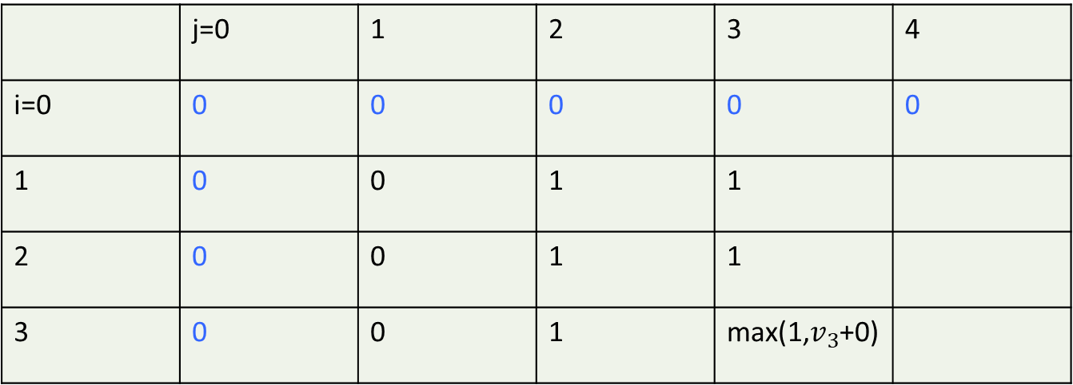
Case study II: 0/1 Knapsack
 | j=0 | 1 | 2 | 3 | 4
i=0 | 0 | 0 | 0 | 0 | 0
1 | 0 | 0 | 1 | 1
2 | 0 | 0 | 1 | 1
3 | 0 | 0 | 1 | max(1,$v_{3}$+0)

Slide 52
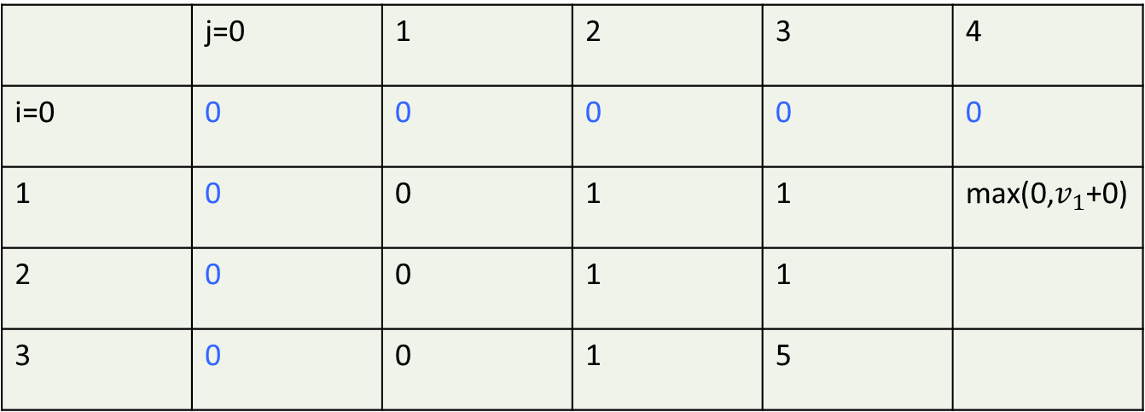
Case study II: 0/1 Knapsack
 | j=0 | 1 | 2 | 3 | 4
i=0 | 0 | 0 | 0 | 0 | 0
1 | 0 | 0 | 1 | 1 | max(0,$v_{1}$+0)
2 | 0 | 0 | 1 | 1
3 | 0 | 0 | 1 | 5

Slide 53
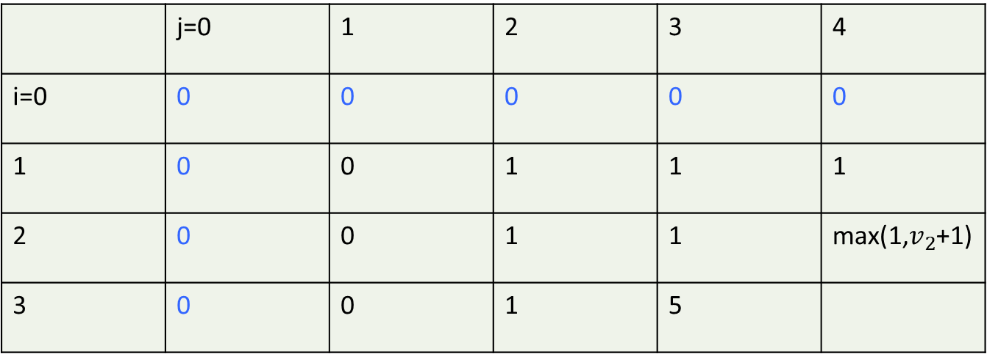
Case study II: 0/1 Knapsack
 | j=0 | 1 | 2 | 3 | 4
i=0 | 0 | 0 | 0 | 0 | 0
1 | 0 | 0 | 1 | 1 | 1
2 | 0 | 0 | 1 | 1 | max(1,$v_{2}$+1)
3 | 0 | 0 | 1 | 5

Slide 54
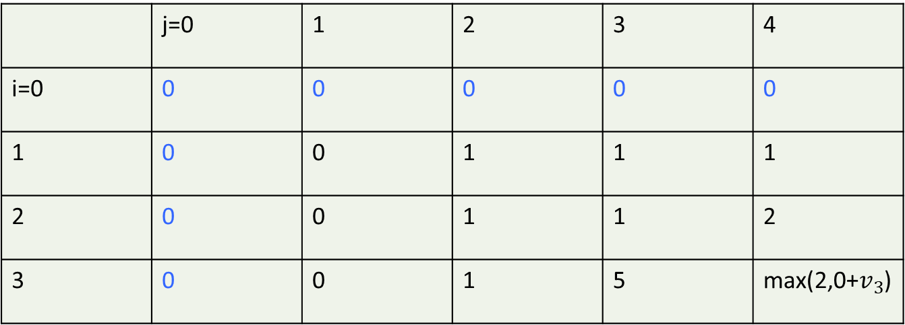
Case study II: 0/1 Knapsack
 | j=0 | 1 | 2 | 3 | 4
i=0 | 0 | 0 | 0 | 0 | 0
1 | 0 | 0 | 1 | 1 | 1
2 | 0 | 0 | 1 | 1 | 2
3 | 0 | 0 | 1 | 5 | max(2,0+$v_{3}$)

Slide 55
Case study II: 0/1 Knapsack
 | j=0 | 1 | 2 | 3 | 4
i=0 | 0 | 0 | 0 | 0 | 0
1 | 0 | 0 | 1 | 1 | 1
2 | 0 | 0 | 1 | 1 | 2
3 | 0 | 0 | 1 | 5 | 5

Slide 56







Case study II: 0/1 Knapsack
Pseudocode:
Initialization
Bottom up filliing DP
Goal
Design and Analysis of Algorithms

Slide 57

Case study II: 0/1 Knapsack
Pseudocode:
Initialization
Bottom up filliing DP
Goal
Design and Analysis of Algorithms

