Slide 1

Lecture 18 P, NP and reductions
CS 161 Design and Analysis of Algorithms
Ioannis Panageas

Slide 2


Different time complexities
Different algorithms can have different time complexities.
We say an algorithm runs in polynomial time if its time complexity is $O(n^{c})$ for some constant $c$.
Some common complexity classes | Notation (input size $=n$)
Constant | $$O(1)$$
Logarithmic | $$O(\log{n})$$
Linear | $$O(n)$$
Log-linear | $$O(n\log{n})$$
Quadratic | $$O(n^{2})$$
Cubic | $$O(n^{3})$$
Exponential | $$O(e^{n})$$
Factorial | $$O(n!)$$
Doubly-exponential | $$O(e^{e^{n}})$$
Polynomial time

Slide 3

P and NP
Given a decision problem $A$ (output yes/no), there could be many possible solutions, with possibly different time complexities.
The class P: We say can be solved in polynomial time or belongs in $P$ if there exist at least one algorithm that solves the problem and runs in polynomial time.

Slide 4
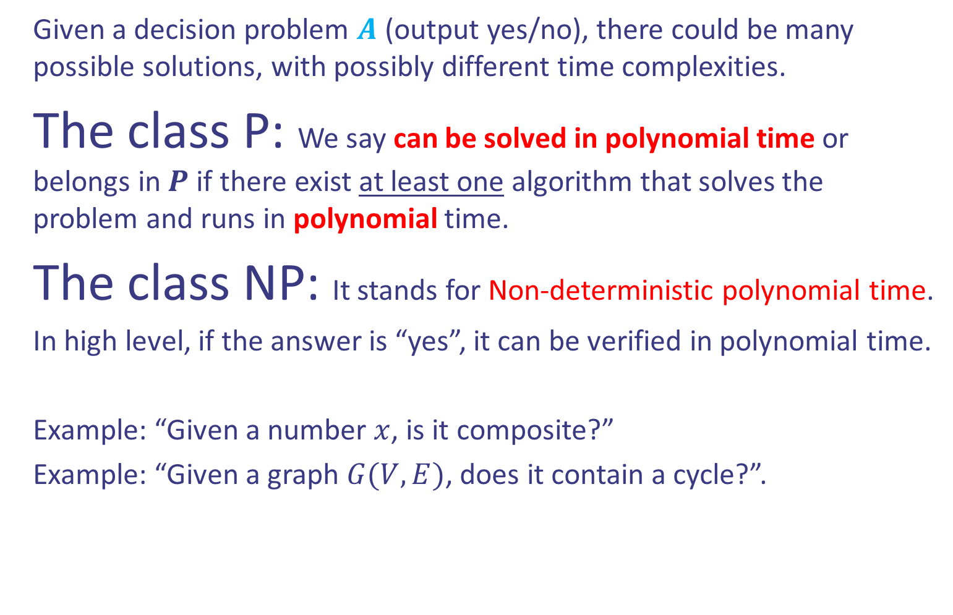
P and NP
Given a decision problem $A$ (output yes/no), there could be many possible solutions, with possibly different time complexities.
The class P: We say can be solved in polynomial time or belongs in $P$ if there exist at least one algorithm that solves the problem and runs in polynomial time.
The class NP: It stands for Non-deterministic polynomial time.
In high level, if the answer is “yes”, it can be verified in polynomial time.
Example: “Given a number $x$, is it composite?”
Example: “Given a graph $G(V,E)$, does it contain a cycle?”.

Slide 5
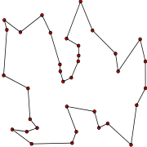
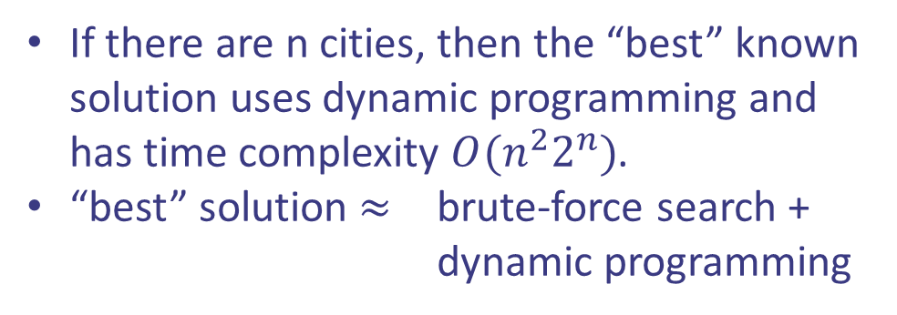
Optimization Problems
Problem: The traveling salesman problem
Given a list of cities and the distances between each pair of cities, what is a shortest possible route that visits each city exactly once and returns to the origin city?
This problem is suspected to be not solvable in polynomial time.
We still do not know…
Other example: 0/1 Knapsack problem.
If there are n cities, then the “best” known solution uses dynamic programming and has time complexity $O(n^{2}2^{n})$.
“best” solution $≈$ brute-force search + dynamic programming

Slide 6
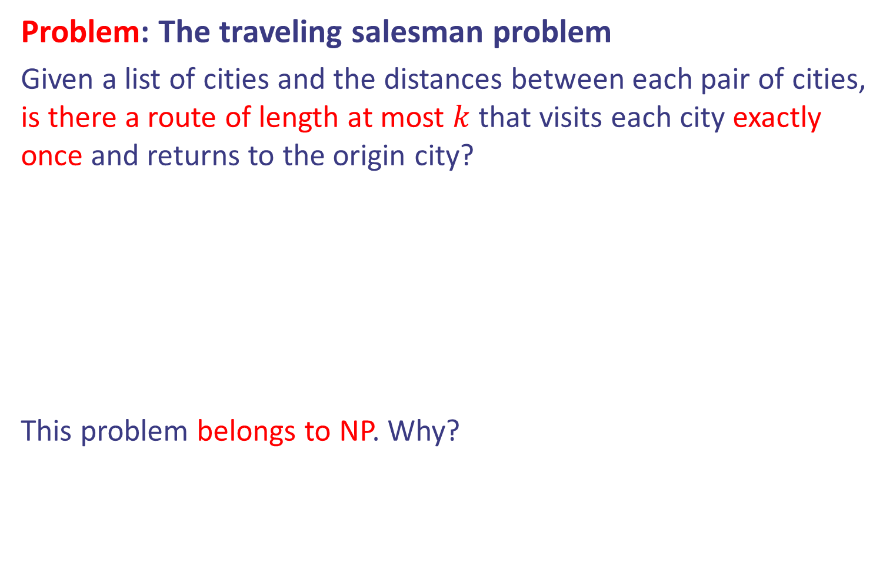
Convert optimization to decision problems
Problem: The traveling salesman problem
Given a list of cities and the distances between each pair of cities, is there a route of length at most $k$ that visits each city exactly once and returns to the origin city?
This problem belongs to NP. Why?
If there are n cities, then the “best” known solution uses dynamic programming and has time complexity $O(n^{2}2^{n})$.
“best” solution $≈$ brute-force search + dynamic programming

Slide 7
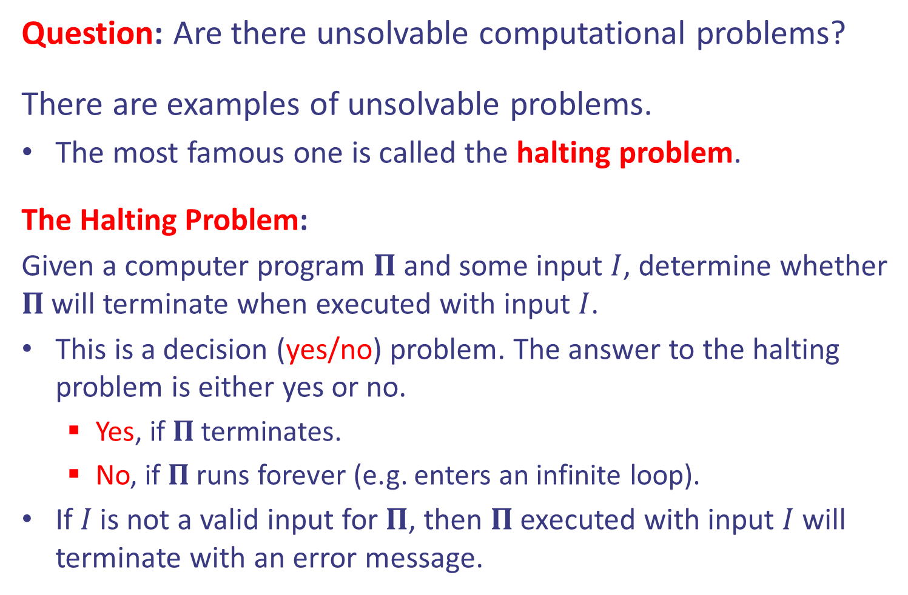
Unsolvable problems?
Question: Are there unsolvable computational problems?
There are examples of unsolvable problems.
The most famous one is called the halting problem.
The Halting Problem:
Given a computer program $Π$ and some input $I$, determine whether $Π$will terminate when executed with input $I$.
This is a decision (yes/no) problem. The answer to the halting problem is either yes or no.
Yes, if $Π$ terminates.
No, if $Π$runs forever (e.g. enters an infinite loop).
If $I$ is not a valid input for $Π$, then $Π$executed with input $I$ will terminate with an error message.

Slide 8
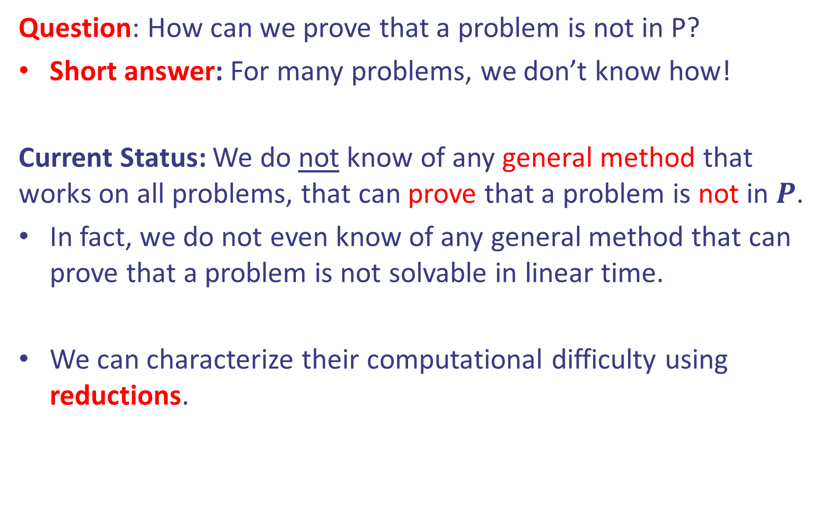
How do we show a problem is not in P?
Question: How can we prove that a problem is not in P?
Short answer: For many problems, we don’t know how!
Current Status: We do not know of any general method that works on all problems, that can prove that a problem is not in $P$.
In fact, we do not even know of any general method that can prove that a problem is not solvable in linear time.
We can characterize their computational difficulty using reductions.

Slide 9
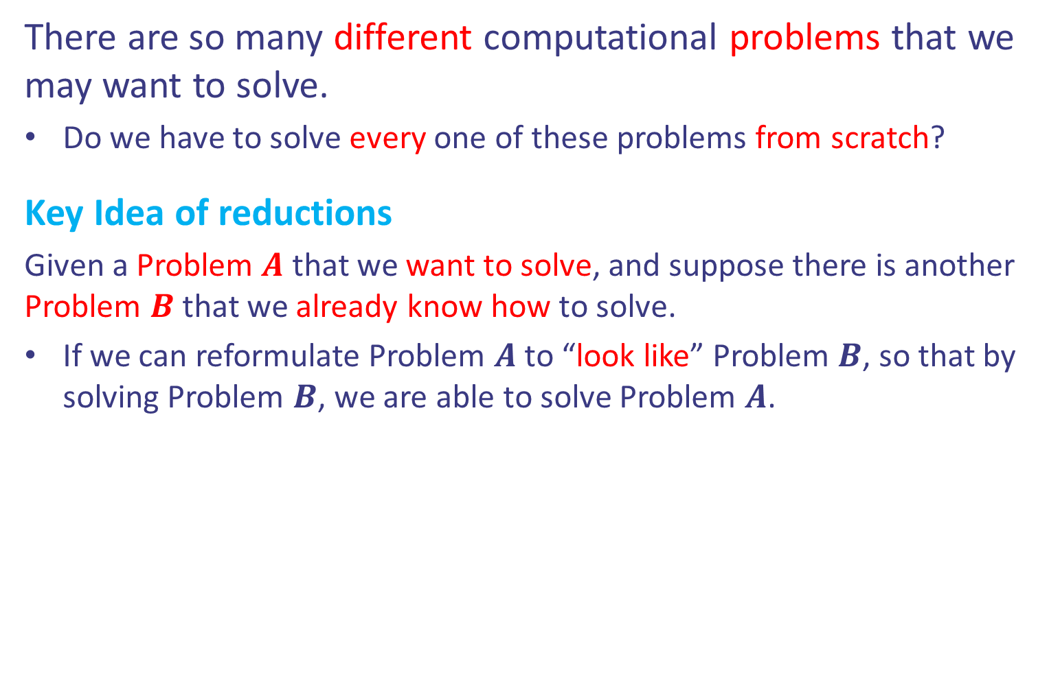
The idea of reductions
There are so many different computational problems that we may want to solve.
Do we have to solve every one of these problems from scratch?
Key Idea of reductions
Given a Problem $A$ that we want to solve, and suppose there is another Problem $B$ that we already know how to solve.
If we can reformulate Problem $A$ to “look like” Problem $B$, so that by solving Problem $B$, we are able to solve Problem $A$.

Slide 10
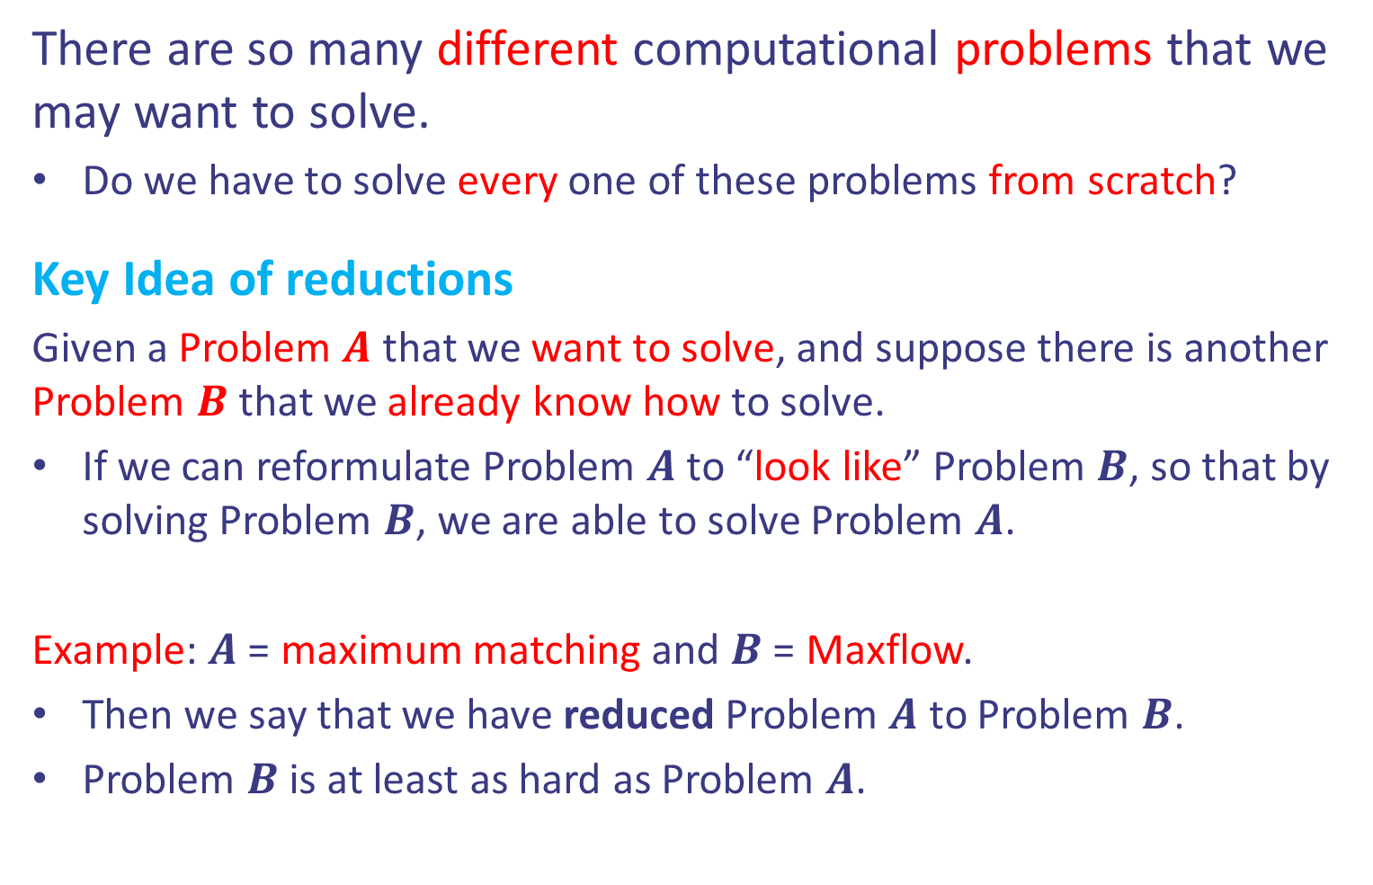
The idea of reductions
There are so many different computational problems that we may want to solve.
Do we have to solve every one of these problems from scratch?
Key Idea of reductions
Given a Problem $A$ that we want to solve, and suppose there is another Problem $B$ that we already know how to solve.
If we can reformulate Problem $A$ to “look like” Problem $B$, so that by solving Problem $B$, we are able to solve Problem $A$.
Example: $A$ = maximum matching and $B$ = Maxflow.
Then we say that we have reduced Problem $A$ to Problem $B$.
Problem $B$ is at least as hard as Problem $A$.

Slide 11
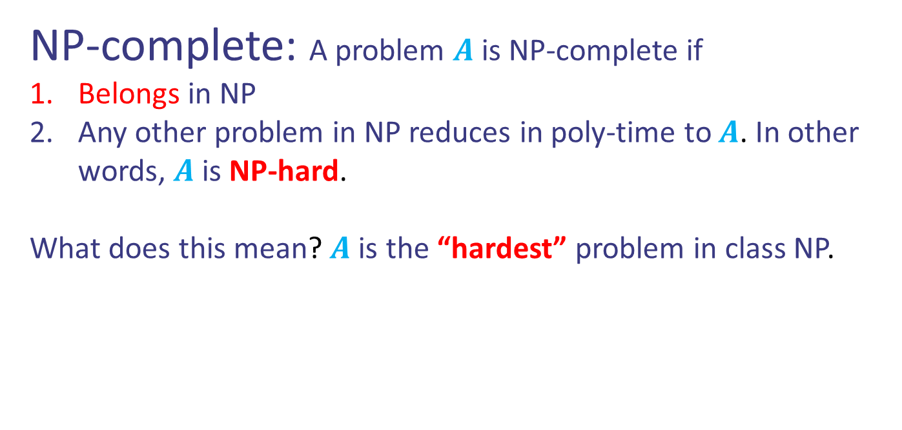
NP-complete problems
NP-complete: A problem $A$ is NP-complete if
Belongs in NP
Any other problem in NP reduces in poly-time to $A$. In other words, $A$ is NP-hard.
What does this mean? $A$ is the “hardest” problem in class NP.

Slide 12
NP-complete problems
NP-complete: A problem $A$ is NP-complete if
Belongs in NP
Any other problem in NP reduces in poly-time to $A$. In other words, $A$ is NP-hard.
What does this mean? $A$ is the “hardest” problem in class NP.
In 1971, the first NP-complete problem appears.
Theorem: The 3-SAT problem is NP-complete. (Cook–Levin’s Thm, 1971)

Slide 13

3-SAT is NP-complete
Problem: 3-SAT
Given a Boolean expression $E$, such that $E$ is a conjunction of clauses, where each clause is a disjunction of exactly $3$ literals, is $E$ satisfiable?

Slide 14
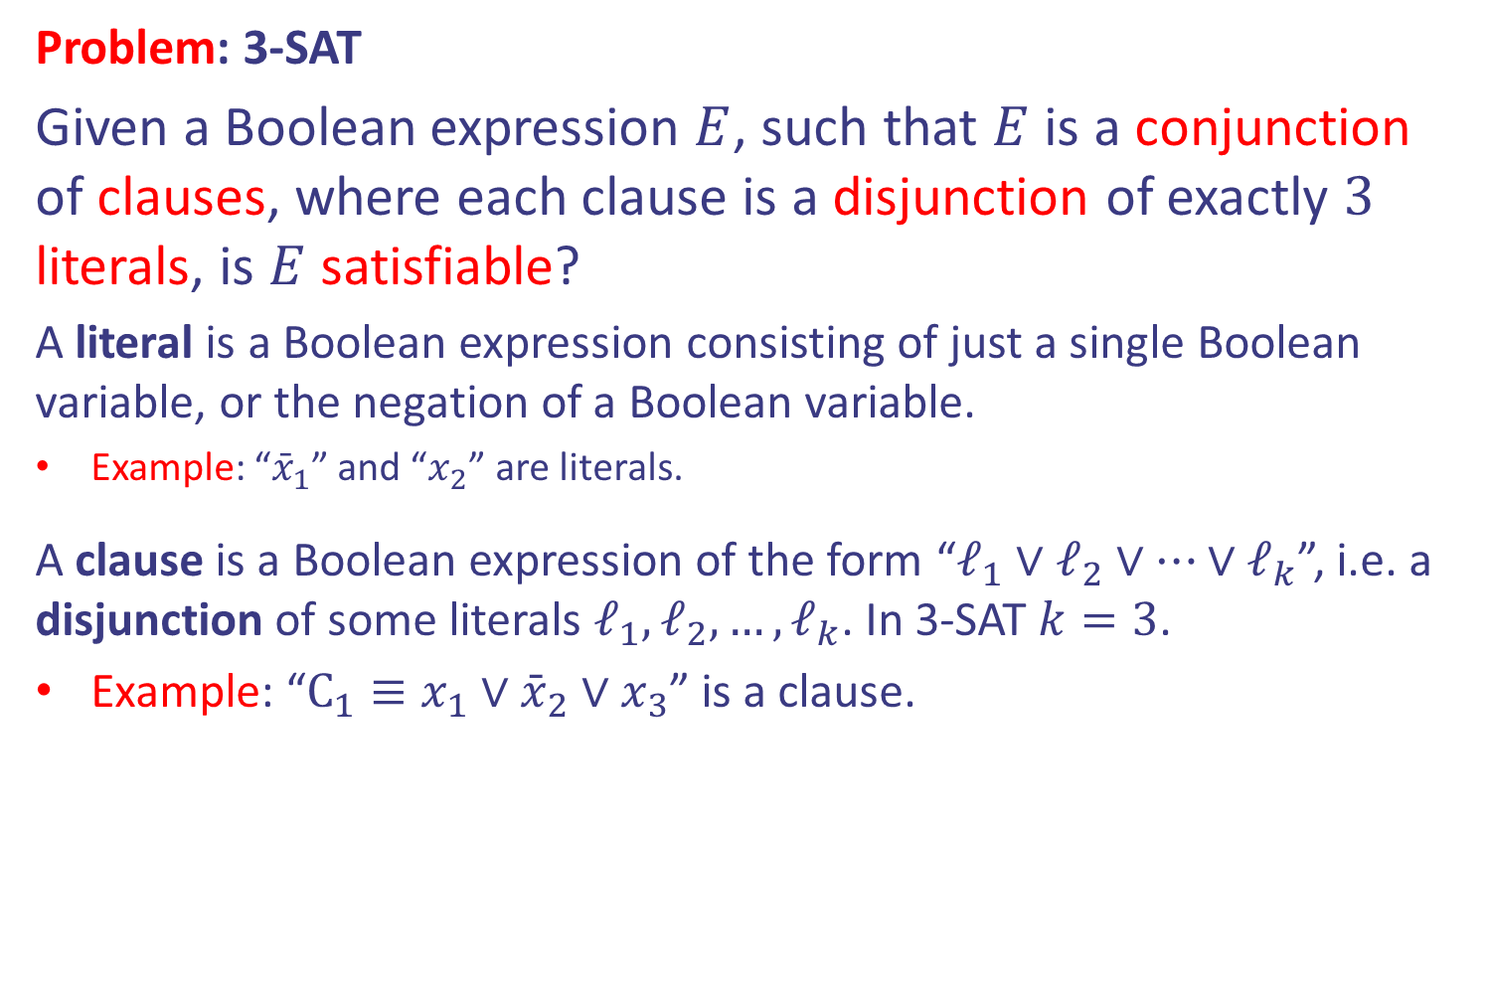
3-SAT is NP-complete
Problem: 3-SAT
Given a Boolean expression $E$, such that $E$ is a conjunction of clauses, where each clause is a disjunction of exactly $3$ literals, is $E$ satisfiable?
A literal is a Boolean expression consisting of just a single Boolean variable, or the negation of a Boolean variable.
Example: “${\bar{x}}_{1}$” and “$x_{2}$” are literals.
A clause is a Boolean expression of the form “$ℓ_{1}∨ℓ_{2}∨…∨ℓ_{k}$”, i.e. a disjunction of some literals $ℓ_{1},ℓ_{2},…, ℓ_{k}$. In 3-SAT $k=3$.
Example: “$C_{1}≡x_{1}∨{\bar{x}}_{2}∨x_{3}$” is a clause.

Slide 15
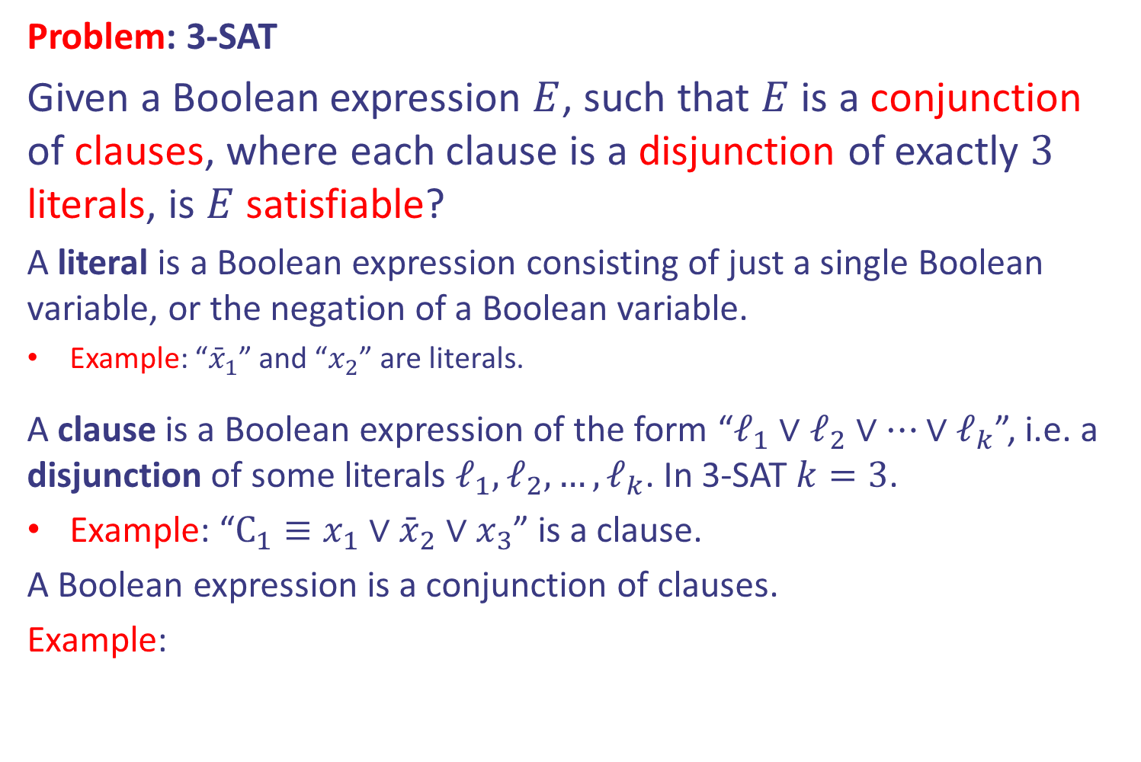
3-SAT is NP-complete
Problem: 3-SAT
Given a Boolean expression $E$, such that $E$ is a conjunction of clauses, where each clause is a disjunction of exactly $3$ literals, is $E$ satisfiable?
A literal is a Boolean expression consisting of just a single Boolean variable, or the negation of a Boolean variable.
Example: “${\bar{x}}_{1}$” and “$x_{2}$” are literals.
A clause is a Boolean expression of the form “$ℓ_{1}∨ℓ_{2}∨…∨ℓ_{k}$”, i.e. a disjunction of some literals $ℓ_{1},ℓ_{2},…, ℓ_{k}$. In 3-SAT $k=3$.
Example: “$C_{1}≡x_{1}∨{\bar{x}}_{2}∨x_{3}$” is a clause.
A Boolean expression is a conjunction of clauses.
Example:
$$(x_{1}∨{\bar{x}}_{2}∨{\bar{x}}_{3})∧({\bar{x}}_{1}∨x_{2}∨x_{3})∧({\bar{x}}_{1}∨x_{2}∨{\bar{x}}_{3})∧(x_{1}∨{\bar{x}}_{2}∨x_{3})$$

Slide 16

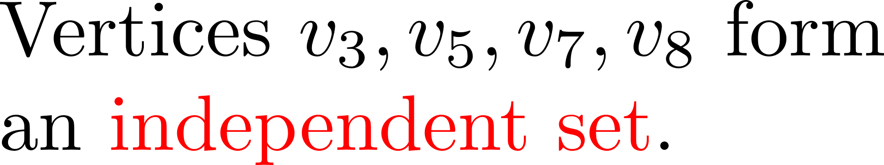




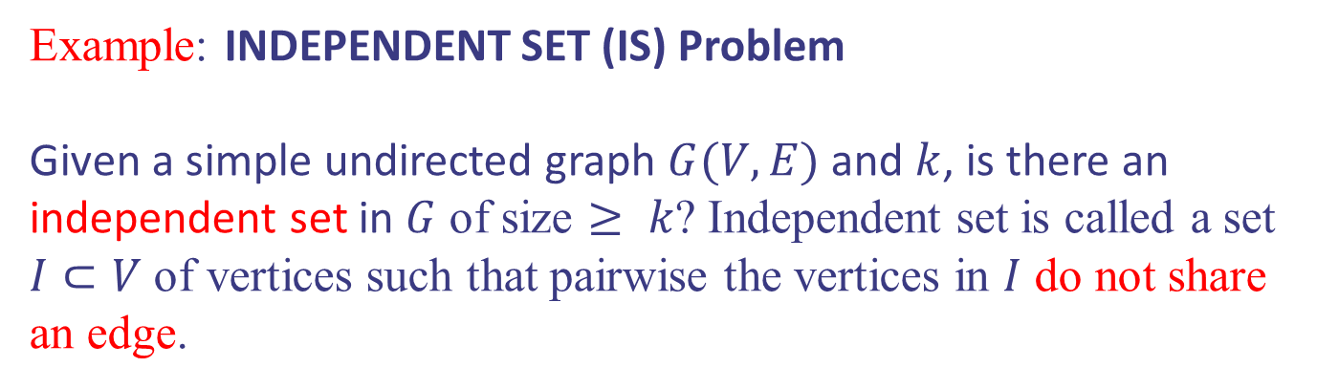




Reductions in NP
Example: INDEPENDENT SET (IS) Problem
Given a simple undirected graph $G(V,E)$ and $k$, is there an independent set in $G$ of size $≥ k$? Independent set is called a set $I⊂V$ of vertices such that pairwise the vertices in $I$ do not share an edge.
$$v_{1}$$
$$v_{2}$$
$$v_{3}$$
$$v_{4}$$
$$v_{7}$$
$$v_{8}$$
$$v_{6}$$
$$v_{5}$$

Slide 17
Reductions in NP
Example: INDEPENDENT SET (IS) Problem
Given a simple undirected graph $G(V,E)$ and $k$, is there an independent set in $G$ of size $≥ k$? Independent set is called a set $I⊂V$ of vertices such that pairwise the vertices in $I$ do not share an edge.
$$v_{1}$$
$$v_{2}$$
$$v_{3}$$
$$v_{4}$$
$$v_{7}$$
$$v_{8}$$
$$v_{6}$$
$$v_{5}$$
Claim: INDEPENDENT SET is NP-complete.
Proof: (1) INDEPENDENT SET belongs to NP (why?).
(2) Reduce 3-SAT to INDEPENDENT SET. Since 3-SAT is NP-hard, INDEPENDENT SET is NP-hard.

Slide 18

Reductions in NP
Example: INDEPENDENT SET (IS) Problem
Given a simple undirected graph $G(V,E)$ and $k$, is there an independent set in $G$ of size $≥ k$? Independent set is called a set $I⊂V$ of vertices such that pairwise the vertices in $I$ do not share an edge.
$$v_{1}$$
$$v_{2}$$
$$v_{3}$$
$$v_{4}$$
$$v_{7}$$
$$v_{8}$$
$$v_{6}$$
$$v_{5}$$
Claim: INDEPENDENT SET is NP-complete.
Proof: (1) INDEPENDENT SET belongs to NP (why?).
(2) Reduce 3-SAT to INDEPENDENT SET. Since 3-SAT is NP-hard, INDEPENDENT SET is NP-hard.

Slide 19
3-SAT reduction to IS
3-SAT instance: Can you assign True, False to the variables of the formula below so that the expression is True?
Let’s reduce the above to an IS instance. We need a graph!
$$E=(x_{1}∨{\bar{x}}_{2}∨{\bar{x}}_{3})∧({\bar{x}}_{1}∨x_{2}∨x_{3})∧({\bar{x}}_{1}∨x_{2}∨{\bar{x}}_{3})∧(x_{1}∨{\bar{x}}_{2}∨x_{3})$$

Slide 20



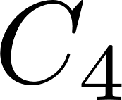
3-SAT reduction to IS
3-SAT instance: Can you assign True, False to the variables of the formula below so that the expression is True?
$$E=(x_{1}∨{\bar{x}}_{2}∨{\bar{x}}_{3})∧({\bar{x}}_{1}∨x_{2}∨x_{3})∧({\bar{x}}_{1}∨x_{2}∨{\bar{x}}_{3})∧(x_{1}∨{\bar{x}}_{2}∨x_{3})$$

Slide 21
3-SAT reduction to IS
3-SAT instance: Can you assign True, False to the variables of the formula below so that the expression is True?
$$E=(x_{1}∨{\bar{x}}_{2}∨{\bar{x}}_{3})∧({\bar{x}}_{1}∨x_{2}∨x_{3})∧({\bar{x}}_{1}∨x_{2}∨{\bar{x}}_{3})∧(x_{1}∨{\bar{x}}_{2}∨x_{3})$$

Slide 22
3-SAT reduction to IS
3-SAT instance: Can you assign True, False to the variables of the formula below so that the expression is True?
$$E=(x_{1}∨{\bar{x}}_{2}∨{\bar{x}}_{3})∧({\bar{x}}_{1}∨x_{2}∨x_{3})∧({\bar{x}}_{1}∨x_{2}∨{\bar{x}}_{3})∧(x_{1}∨{\bar{x}}_{2}∨x_{3})$$
IS of size 4

Slide 23
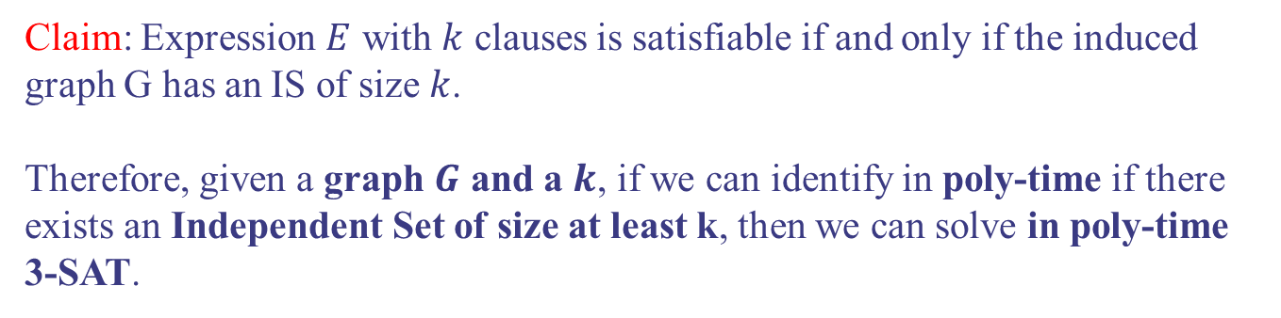
3-SAT reduction to IS
Claim: Expression $E$ with $k$ clauses is satisfiable if and only if the induced graph G has an IS of size $k$.
Therefore, given a graph $G$ and a $k$, if we can identify in poly-time if there exists an Independent Set of size at least k, then we can solve in poly-time 3-SAT.

Slide 24

3-SAT reduction to IS
Claim: Expression $E$ with $k$ clauses is satisfiable if and only if the induced graph G has an IS of size $k$.
Therefore, given a graph $G$ and a $k$, if we can identify in poly-time if there exists an Independent Set of size at least k, then we can solve in poly-time 3-SAT.

Slide 25
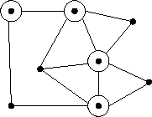

Vertex Cover (VC)
Problem: Vertex Cover (VC):
Given a simple undirected graph $G(V,E)$ and $k$, is there an vertex cover in $G$ of size $≥ k$? Vertex cover is called a set $I⊂V$ of vertices such that all edges are “covered”?
e.g., in this graph, 4 of the 8
vertices are enough to cover
all edges.

Slide 26
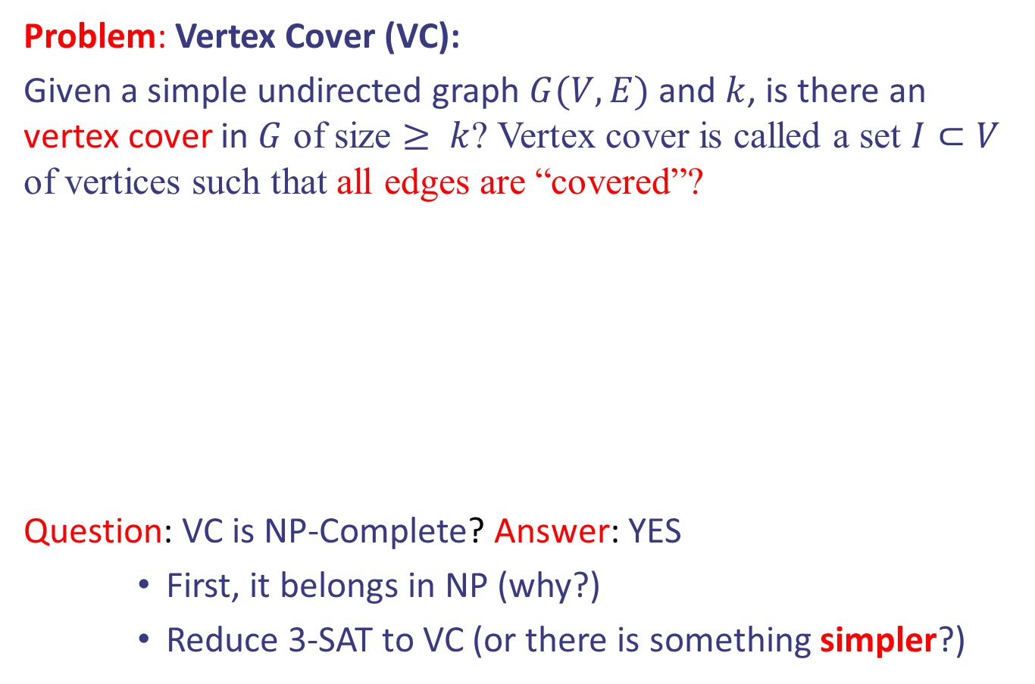
Vertex Cover (VC)
Problem: Vertex Cover (VC):
Given a simple undirected graph $G(V,E)$ and $k$, is there an vertex cover in $G$ of size $≥ k$? Vertex cover is called a set $I⊂V$ of vertices such that all edges are “covered”?
Question: VC is NP-Complete? Answer: YES
First, it belongs in NP (why?)
Reduce 3-SAT to VC (or there is something simpler?)
e.g., in this graph, 4 of the 8
vertices are enough to cover
all edges.

Slide 27

Reduction of IS to Vertex Cover (VC)
Given a graph $G(V,E)$, with $\left|V\right|=n$, we want to know if there exists an Independent Set of size $k$.

Slide 28
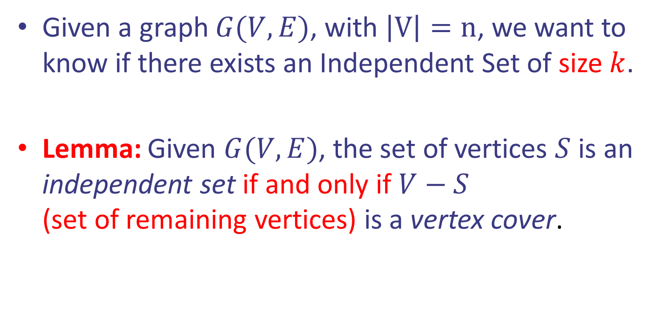
Reduction of IS to Vertex Cover (VC)
Given a graph $G(V,E)$, with $\left|V\right|=n$, we want to know if there exists an Independent Set of size $k$.
Lemma: Given $G(V,E)$, the set of vertices $S$ is an independent set if and only if $V−S$ (set of remaining vertices) is a vertex cover.

Slide 29
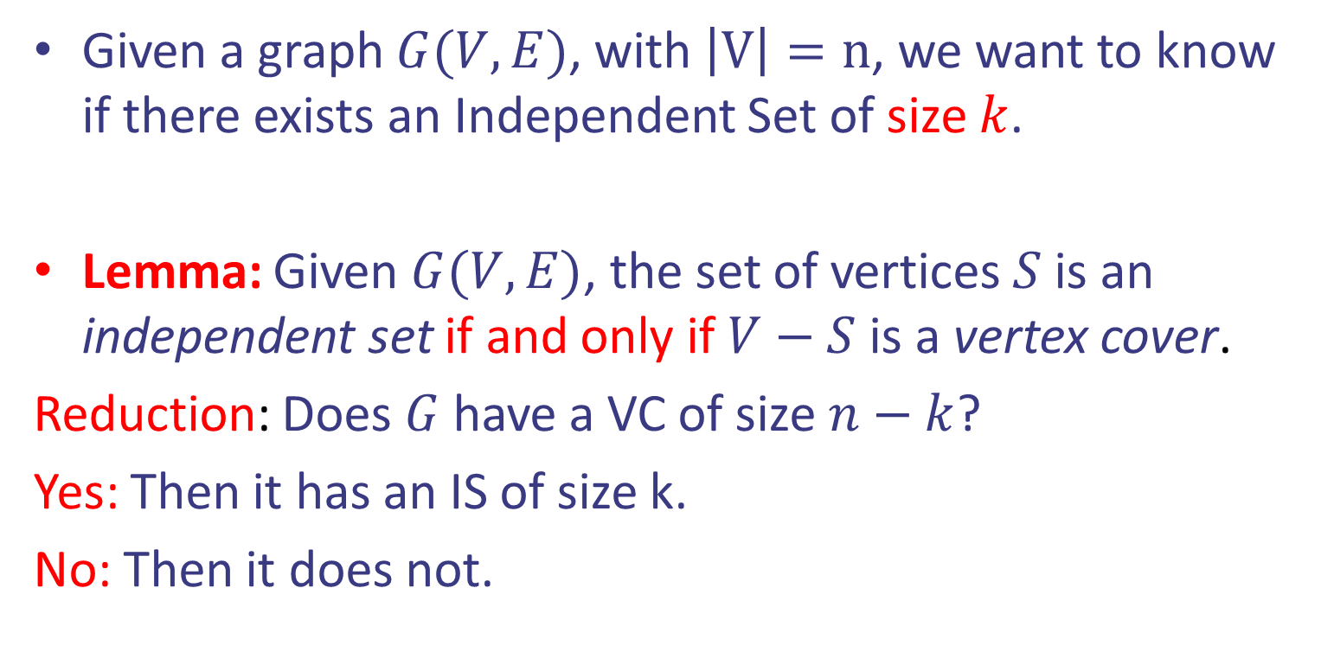
Reduction of IS to Vertex Cover (VC)
Given a graph $G(V,E)$, with $\left|V\right|=n$, we want to know if there exists an Independent Set of size $k$.
Lemma: Given $G(V,E)$, the set of vertices $S$ is an independent set if and only if $V−S$ is a vertex cover.
Reduction: Does $G$ have a VC of size $n−k$?
Yes: Then it has an IS of size k.
No: Then it does not.

Slide 30
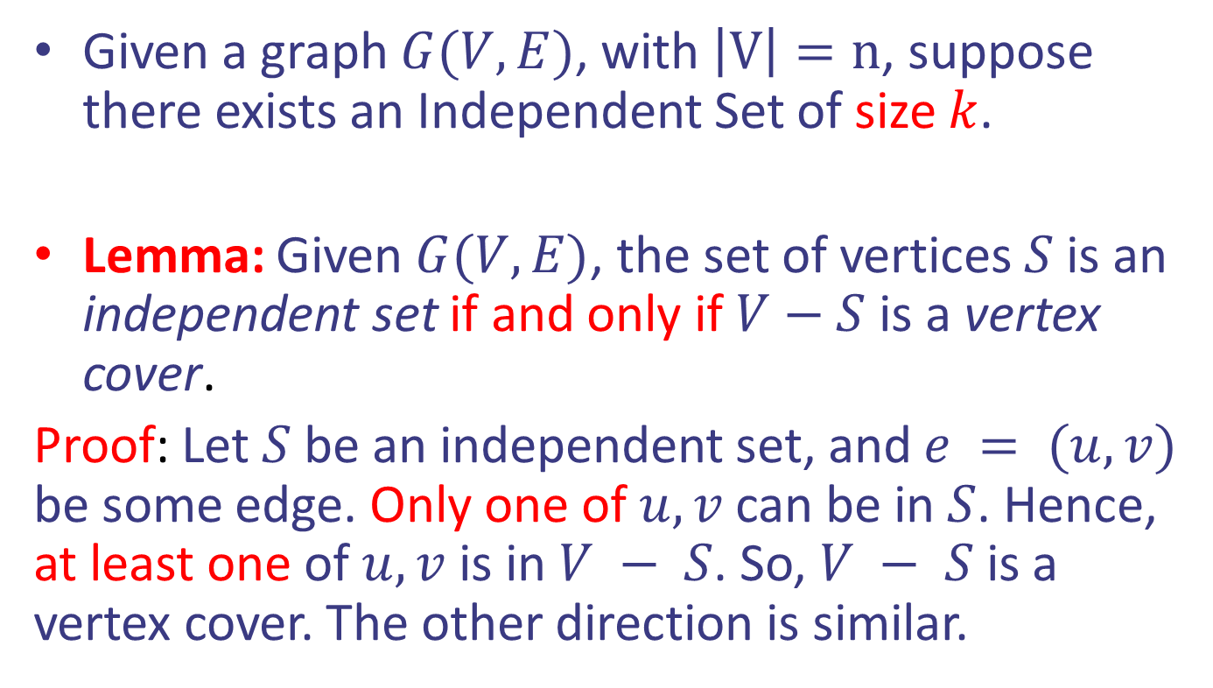
Reduction of IS to Vertex Cover (VC)
Given a graph $G(V,E)$, with $\left|V\right|=n$, suppose there exists an Independent Set of size $k$.
Lemma: Given $G(V,E)$, the set of vertices $S$ is an independent set if and only if $V−S$ is a vertex cover.
Proof: Let $S$ be an independent set, and $e = (u, v)$ be some edge. Only one of $u, v$can be in $S$. Hence, at least one of $u, v$ is in $V − S$. So, $V − S$is a vertex cover. The other direction is similar.

