Slide 1

Lecture 12 Network flows, Max flow, Min-cut
CS 161 Design and Analysis of Algorithms
Ioannis Panageas

Slide 2
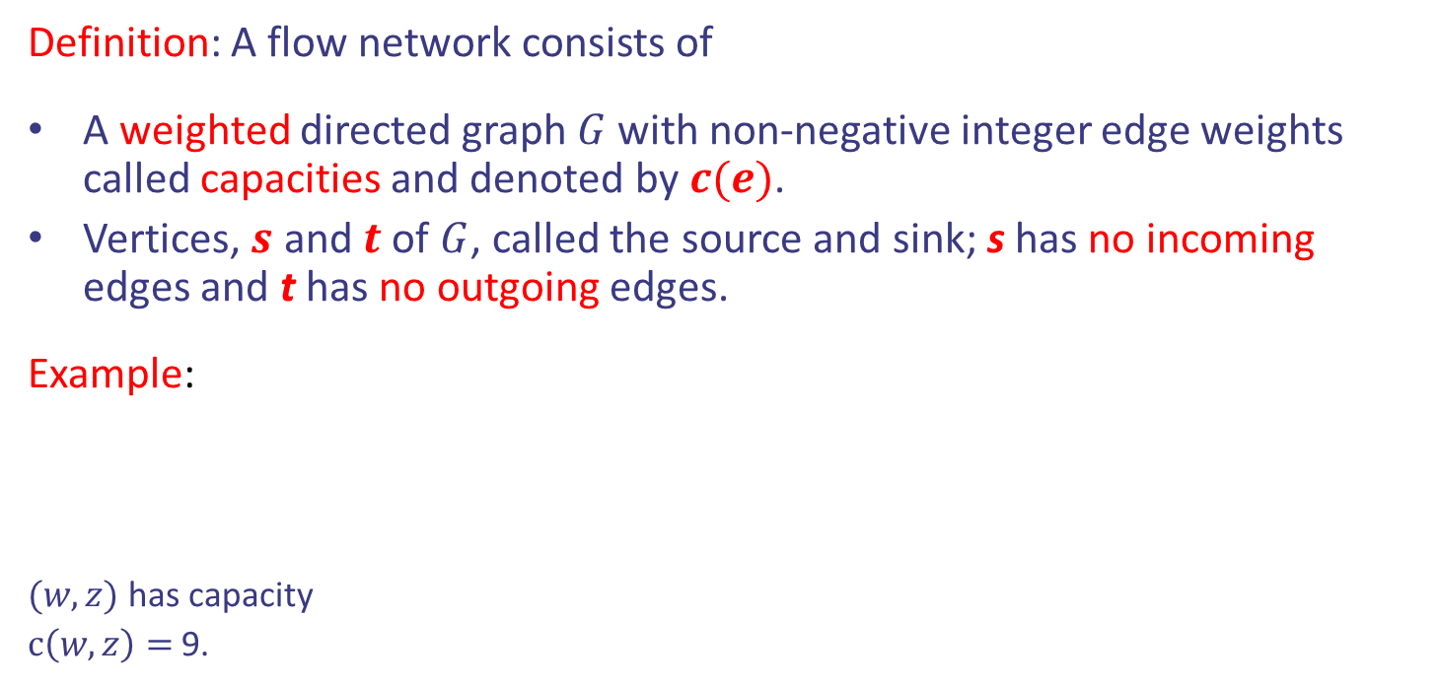
Flow Networks
Definition: A flow network consists of
A weighted directed graph $G$ with non-negative integer edge weights called capacities and denoted by $c(e)$.
Vertices, $s$ and $t$ of $G$, called the source and sink; s has no incoming edges and t has no outgoing edges.
Example:
$(w,z)$ has capacity
$c\left(w,z\right)=$9.
v
3
6
1
7
t
s
3
w
1
9
5
5
u
2
z

Slide 3
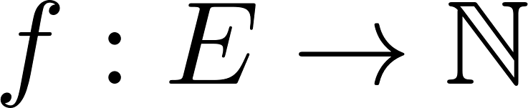
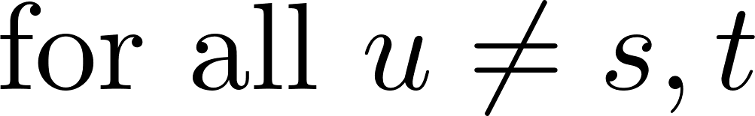
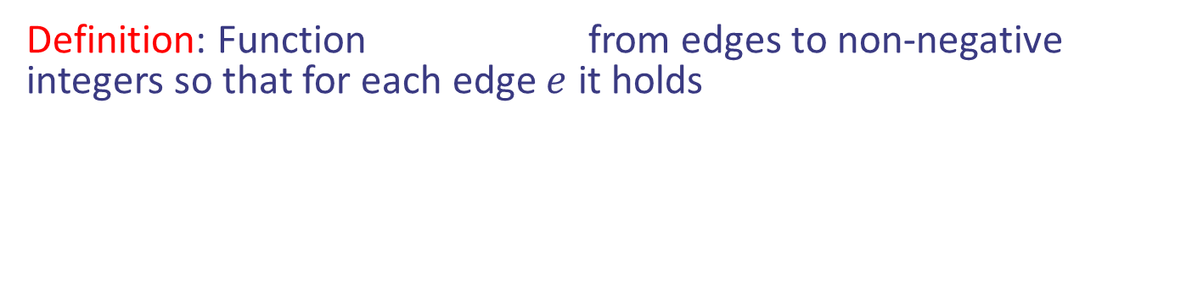
Flow of a Network
Definition: Function from edges to non-negative integers so that for each edge $e$ it holds
Design and Analysis of Algorithms

Slide 4

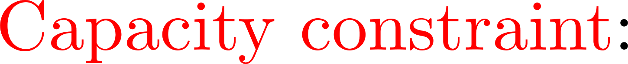
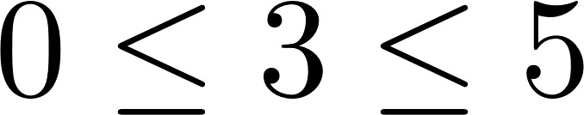
Flow of a Network
Definition: Function from edges to non-negative integers so that for each edge $e$ it holds
v
1/3
3/5
2/6
s
u
1/1
3/7
t
s
3/3
w
1/1
2/9
4/5
3/5
u
2/2
z
Design and Analysis of Algorithms

Slide 5
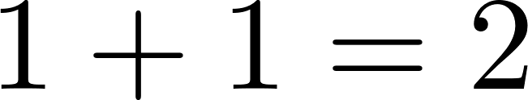
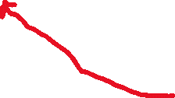


Flow of a Network
Definition: Function from edges to non-negative integers so that for each edge $e$ it holds
v
1/3
2/6
v
1/3
2/6
1/1
3/7
t
s
3/3
1/1
w
1/1
2/9
4/5
3/5
u
2/2
z
Design and Analysis of Algorithms

Slide 6

Flow of a Network
Definition: Function from edges to non-negative integers so that for each edge $e$ it holds
Question: if $f\left(e\right)=0$ for all $e$,
is it a flow? Yes.
v
1/3
2/6
v
1/3
2/6
1/1
3/7
t
s
3/3
1/1
w
1/1
2/9
4/5
3/5
u
2/2
z
Design and Analysis of Algorithms

Slide 7
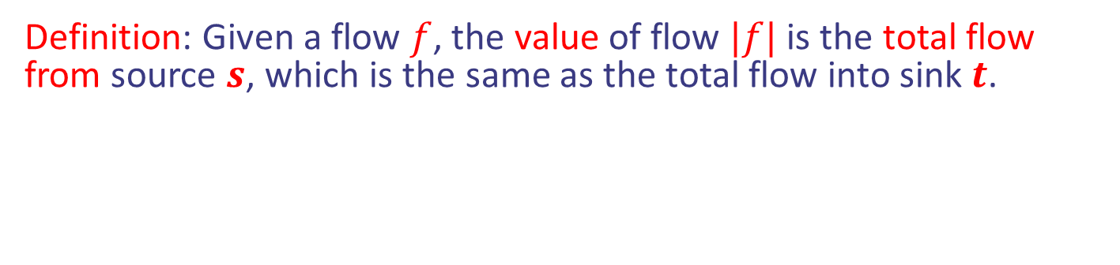
Value of a flow
Definition: Given a flow $f$, the value of flow $|f|$ is the total flow from source $s$, which is the same as the total flow into sink $t$.
v
1/3
2/6
2/6
s
v
1/1
3/7
t
s
3/3
3/3
w
3/5
1/1
2/9
4/5
3/5
w
u
z
u
2/2
Design and Analysis of Algorithms

Slide 8
Value of a flow
Definition: Given a flow $f$, the value of flow $|f|$ is the total flow from source $s$, which is the same as the total flow into sink $t$.
v
1/3
1/3
2/6
t
v
1/1
3/7
t
s
3/3
3/7
w
4/5
1/1
2/9
4/5
3/5
w
u
z
z
2/2
Design and Analysis of Algorithms

Slide 9

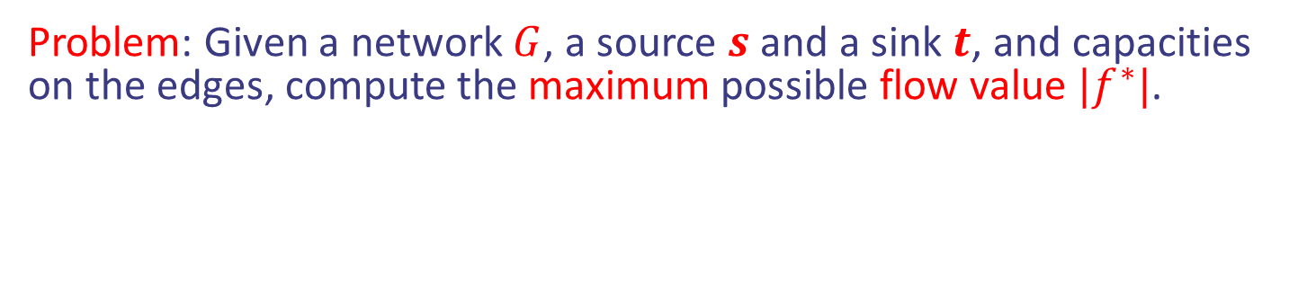
Maxflow Problem
Problem: Given a network $G$, a source $s$ and a sink $t$, and capacities on the edges, compute the maximum possible flow value $|f^{∗}|$.
v
$/3
$/6
$/1
$/7
t
s
$/3
w
$/1
$/9
$/5
$/5
u
$/2
z
Find the $ to get maxflow $|f^{∗}|$
Design and Analysis of Algorithms

Slide 10
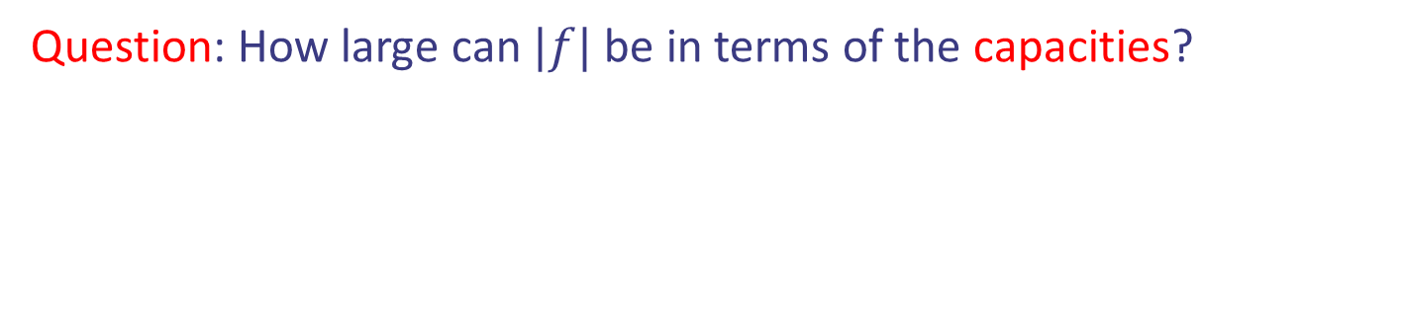
Maxflow Problem
Question: How large can $|f|$ be in terms of the capacities?
v
$/3
$/6
$/1
$/7
t
s
$/3
w
$/1
$/9
$/5
$/5
u
$/2
z
Design and Analysis of Algorithms

Slide 11

Maxflow Problem
Question: How large can $|f|$ be in terms of the capacities?
v
$/3
$/6
s
6
$/1
v
$/7
t
s
$/3
3
w
5
$/1
$/9
$/5
$/5
w
u
z
u
$/2
Answer
Focusing on Cut 1, it should be at most 6+3+5=14.
Design and Analysis of Algorithms

Slide 12

Maxflow Problem
Question: How large can $|f|$ be in terms of the capacities?
v
$/3
$/6
t
3
$/1
v
$/7
t
s
$/3
7
w
5
$/1
$/9
$/5
$/5
w
u
z
z
$/2
Answer
Focusing on Cut 1, it should be at most 6+3+5=14.
Focusing on Cut 2, it should be at most 3+7+5=15.
Design and Analysis of Algorithms

Slide 13
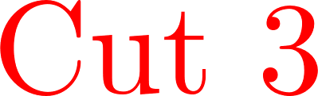
Maxflow Problem
v
3
6
1
7
t
s
3
w
1
9
5
5
u
2
z
Answer
Focusing on Cut 3, it should be at most 6+3+1+2=12.
Design and Analysis of Algorithms

Slide 14

Maxflow Problem
v
3
6
1
7
t
s
3
w
1
9
5
5
u
2
z
Answer
Focusing on Cut 3, it should be at most 6+3+1+2=12.
Focusing on Cut 4, it should be at most 3+1+3+1+2=10.
Design and Analysis of Algorithms

Slide 15
Maxflow Problem
v
3/3
4/6
1/1
5/7
t
s
3/3
w
1/1
0/9
2/5
3/5
u
2/2
z
Answer
The above is a flow function (satisfies all conditions)
The value of the flow is 4+3+3 = 10.
Design and Analysis of Algorithms

Slide 16

Maxflow Problem
v
3/3
4/6
1/1
5/7
t
s
3/3
w
1/1
0/9
2/5
3/5
u
2/2
z
Answer
The above is a flow function (satisfies all conditions)
The value of the flow is 4+3+3 = 10.
Maxflow should be $≤10$ and
found a flow with $|f|=10$
Design and Analysis of Algorithms

Slide 17
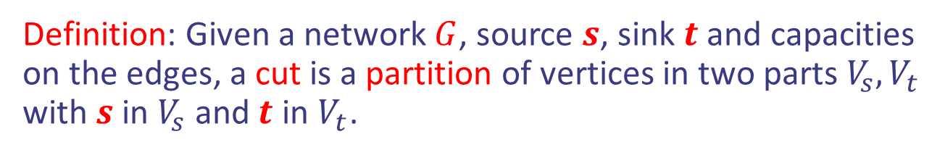
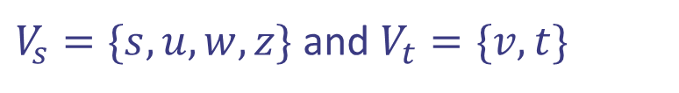
Cut
Definition: Given a network $G$, source $s$, sink $t$ and capacities on the edges, a cut is a partition of vertices in two parts $V_{s}, V_{t}$ with $s$ in $V_{s}$ and $t$ in $V_{t}$.
v
3
6
1
7
t
s
3
w
1
9
5
5
u
2
z
$V_{s}=\{s,u,w,z\}$and $V_{t}=\{v,t\}$
Design and Analysis of Algorithms

Slide 18
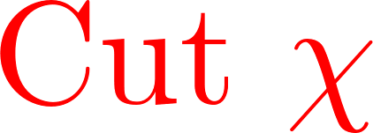
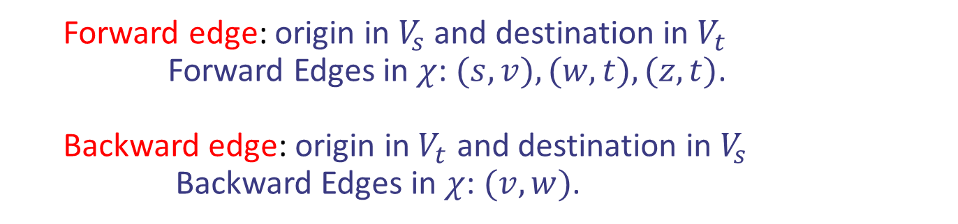

Cut
v
3
6
1
7
t
s
3
w
1
9
5
5
u
2
z
$V_{s}=\{s,u,w,z\}$and $V_{t}=\{v,t\}$
Forward edge: origin in $V_{s}$ and destination in $V_{t}$
Forward Edges in $χ$: $(s,v), (w,t), (z,t)$.
Backward edge: origin in $V_{t}$ and destination in $V_{s}$
Backward Edges in $χ$: $(v,w)$.
Design and Analysis of Algorithms

Slide 19
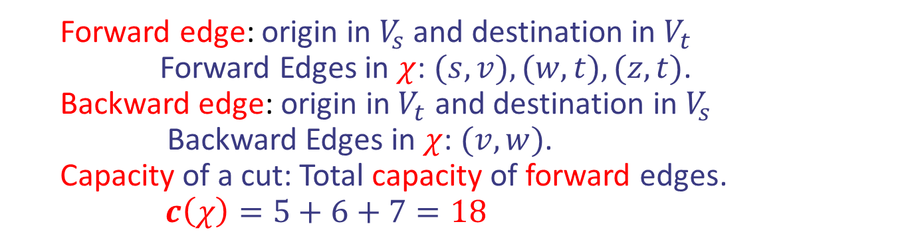

Cut
v
3
6
1
7
t
s
3
w
1
9
5
5
u
2
z
$V_{s}=\{s,u,w,z\}$and $V_{t}=\{v,t\}$
Forward edge: origin in $V_{s}$ and destination in $V_{t}$
Forward Edges in $χ$: $(s,v), (w,t), (z,t)$.
Backward edge: origin in $V_{t}$ and destination in $V_{s}$
Backward Edges in $χ$: $(v,w)$.
Capacity of a cut: Total capacity of forward edges.
$c\left(χ\right)=5+6+7=18$
Design and Analysis of Algorithms

Slide 20
Maxflow = Min Cut
v
3
6
1
7
t
s
3
w
1
9
5
5
u
2
z
There are 16 cuts (why)?
Design and Analysis of Algorithms

Slide 21
Maxflow = Min Cut
v
3
6
1
7
t
s
3
w
1
9
5
5
u
2
z
There are 16 cuts (why)?
Theorem: The minimum capacity cut equals the maxflow value.
Design and Analysis of Algorithms

Slide 22
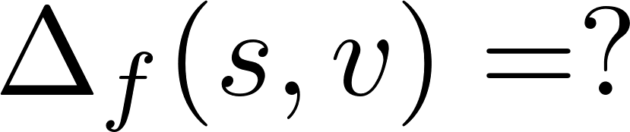
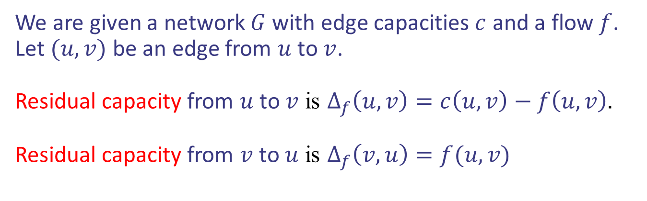
Augmenting paths
We are given a network $G$ with edge capacities $c$ and a flow $f$. Let $(u,v)$ be an edge from $u$ to $v$.
Residual capacity from $u$ to $v$ is $Δ_{f}\left(u,v\right)=c\left(u,v\right)−f\left(u,v\right).$
Residual capacity from $v$ to $u$ is $Δ_{f}\left(v,u\right)=f(u,v)$
v
1/3
2/6
1/1
3/7
t
s
3/3
w
1/1
2/9
4/5
3/5
u
2/2
z
Design and Analysis of Algorithms

Slide 23
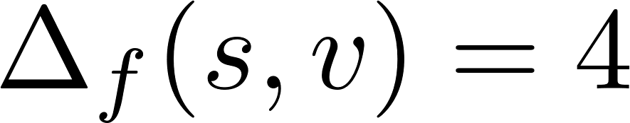
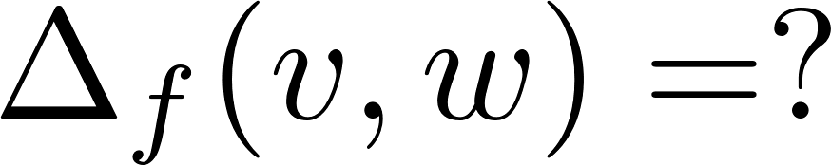
Augmenting paths
We are given a network $G$ with edge capacities $c$ and a flow $f$. Let $(u,v)$ be an edge from $u$ to $v$.
Residual capacity from $u$ to $v$ is $Δ_{f}\left(u,v\right)=c\left(u,v\right)−f\left(u,v\right).$
Residual capacity from $v$ to $u$ is $Δ_{f}\left(v,u\right)=f(u,v)$
v
1/3
2/6
1/1
3/7
t
s
3/3
w
1/1
2/9
4/5
3/5
u
2/2
z
Design and Analysis of Algorithms

Slide 24
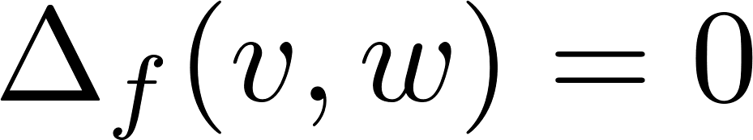
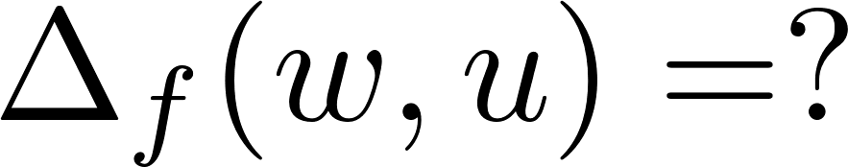
Augmenting paths
We are given a network $G$ with edge capacities $c$ and a flow $f$. Let $(u,v)$ be an edge from $u$ to $v$.
Residual capacity from $u$ to $v$ is $Δ_{f}\left(u,v\right)=c\left(u,v\right)−f\left(u,v\right).$
Residual capacity from $v$ to $u$ is $Δ_{f}\left(v,u\right)=f(u,v)$
v
1/3
2/6
1/1
3/7
t
s
3/3
w
1/1
2/9
4/5
3/5
u
2/2
z
Design and Analysis of Algorithms

Slide 25
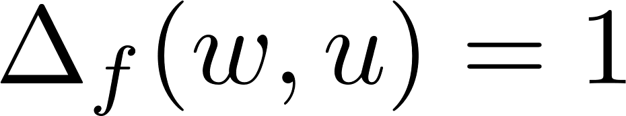
Augmenting paths
We are given a network $G$ with edge capacities $c$ and a flow $f$. Let $(u,v)$ be an edge from $u$ to $v$.
Residual capacity from $u$ to $v$ is $Δ_{f}\left(u,v\right)=c\left(u,v\right)−f\left(u,v\right).$
Residual capacity from $v$ to $u$ is $Δ_{f}\left(v,u\right)=f(u,v)$
v
1/3
2/6
1/1
3/7
t
s
3/3
w
1/1
2/9
4/5
3/5
u
2/2
z
Design and Analysis of Algorithms

Slide 26
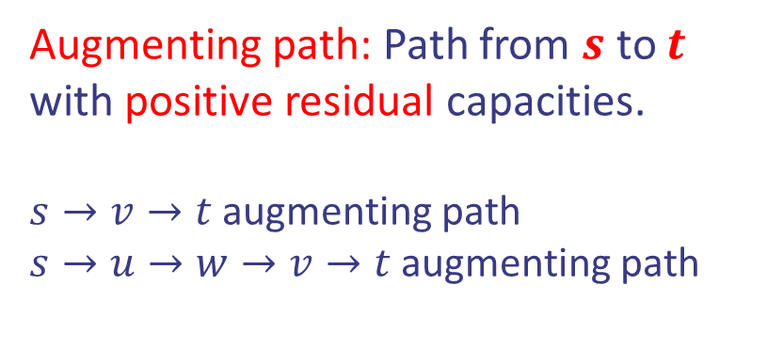
Augmenting paths
We are given a network $G$ with edge capacities $c$ and a flow $f$. Let $(u,v)$ be an edge from $u$ to $v$.
Residual capacity from $u$ to $v$ is $Δ_{f}\left(u,v\right)=c\left(u,v\right)−f\left(u,v\right).$
Residual capacity from $v$ to $u$ is $Δ_{f}\left(v,u\right)=f(u,v)$
Augmenting path: Path from $s$ to $t$ with positive residual capacities.
$s→v→t$ augmenting path
$s→u→w→v→t$ augmenting path
v
1/3
2/6
1/1
3/7
t
s
3/3
w
0/1
2/9
4/5
2/5
u
2/2
z
Design and Analysis of Algorithms

Slide 27
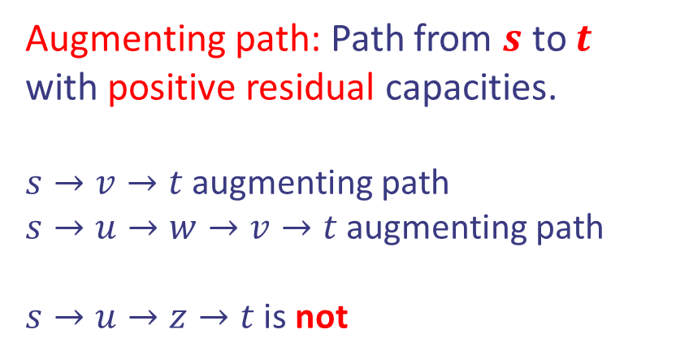
Augmenting paths
We are given a network $G$ with edge capacities $c$ and a flow $f$. Let $(u,v)$ be an edge from $u$ to $v$.
Residual capacity from $u$ to $v$ is $Δ_{f}\left(u,v\right)=c\left(u,v\right)−f\left(u,v\right).$
Residual capacity from $v$ to $u$ is $Δ_{f}\left(v,u\right)=f(u,v)$
Augmenting path: Path from $s$ to $t$ with positive residual capacities.
$s→v→t$ augmenting path
$s→u→w→v→t$ augmenting path
$s→u→z→t$ is not
v
1/3
2/6
1/1
3/7
t
s
3/3
w
0/1
2/9
4/5
2/5
u
2/2
z
Design and Analysis of Algorithms

Slide 28
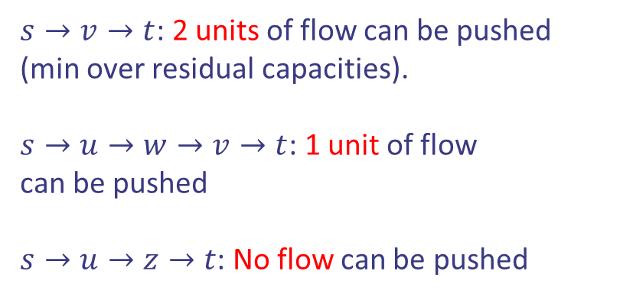
Augmenting paths
We are given a network $G$ with edge capacities $c$ and a flow $f$. Let $(u,v)$ be an edge from $u$ to $v$.
Residual capacity from $u$ to $v$ is $Δ_{f}\left(u,v\right)=c\left(u,v\right)−f\left(u,v\right).$
Residual capacity from $v$ to $u$ is $Δ_{f}\left(v,u\right)=f(u,v)$
$s→v→t$: 2 units of flow can be pushed
(min over residual capacities).
$s→u→w→v→t$: 1 unit of flow
can be pushed
$s→u→z→t$: No flow can be pushed
v
1/3
2/6
1/1
3/7
t
s
3/3
w
0/1
2/9
4/5
2/5
u
2/2
z
Design and Analysis of Algorithms

Slide 29
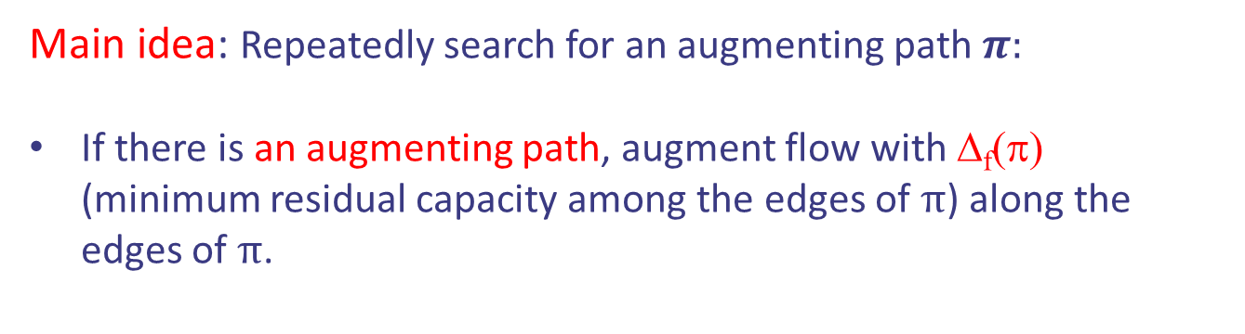
The Ford-Fulkerson Algorithm
Main idea: Repeatedly search for an augmenting path $π:$
If there is an augmenting path, augment flow with Δ_{f}(π) (minimum residual capacity among the edges of $π$) along the edges of $π$.
Design and Analysis of Algorithms

Slide 30
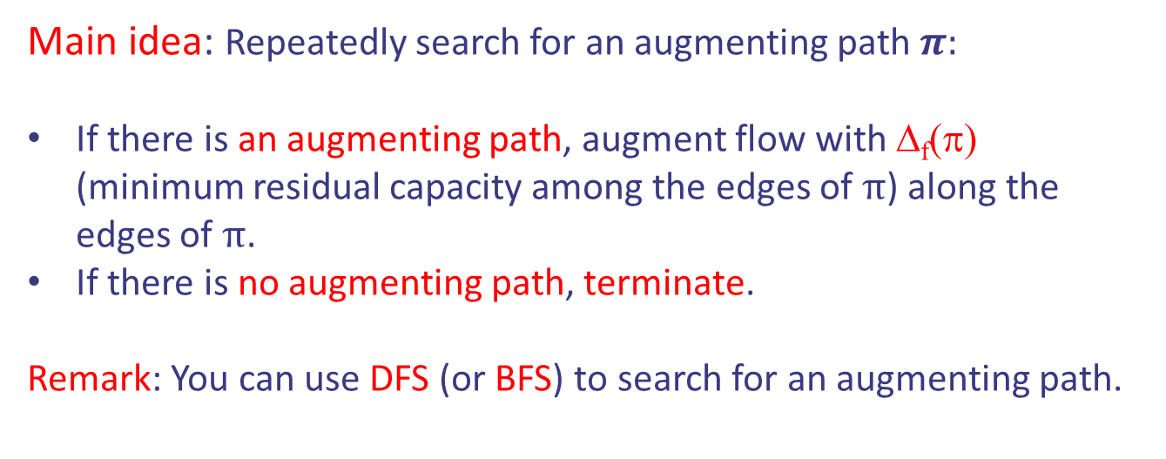
The Ford-Fulkerson Algorithm
Main idea: Repeatedly search for an augmenting path $π:$
If there is an augmenting path, augment flow with Δ_{f}(π) (minimum residual capacity among the edges of $π$) along the edges of $π$.
If there is no augmenting path, terminate.
Remark: You can use DFS (or BFS) to search for an augmenting path.
Running time: ?
Design and Analysis of Algorithms

Slide 31

The Ford-Fulkerson Algorithm
Main idea: Repeatedly search for an augmenting path $π:$
If there is an augmenting path, augment flow with Δ_{f}(π) (minimum residual capacity among the edges of $π$) along the edges of $π$.
If there is no augmenting path, terminate.
Remark: You can use DFS (or BFS) to search for an augmenting path.
Running time:
Time to search for an augmenting path $×$ number of updates.
Design and Analysis of Algorithms

Slide 32

The Ford-Fulkerson Algorithm
Main idea: Repeatedly search for an augmenting path $π:$
If there is an augmenting path, augment flow with Δ_{f}(π) (minimum residual capacity among the edges of $π$) along the edges of $π$.
If there is no augmenting path, terminate.
Remark: You can use DFS (or BFS) to search for an augmenting path.
Running time:
Time to search for an augmenting path $×$ number of updates.
$$Θ\left(|V|+|E|\right)⋅|f^{∗}|$$
Running time of DFS or BFS
Updates increase flow by 1 unit only
Design and Analysis of Algorithms

Slide 33
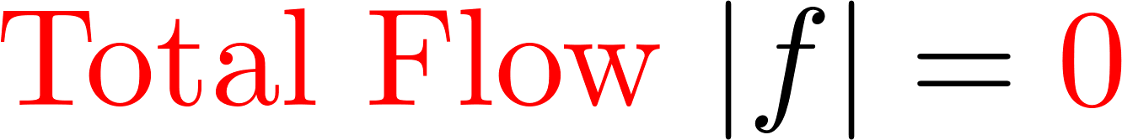
The Ford-Fulkerson Algorithm
v
0/3
0/6
0/1
0/7
t
s
0/3
w
0/1
0/9
0/5
0/5
u
z
0/2
Design and Analysis of Algorithms

Slide 34
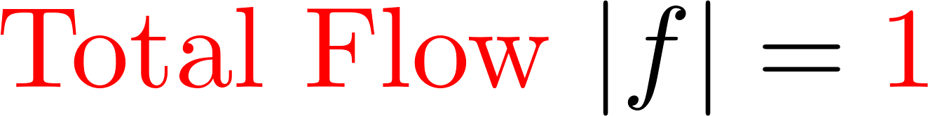
The Ford-Fulkerson Algorithm
v
0/3
0/6
0/1
1/7
t
s
0/3
w
1/1
0/9
0/5
1/5
u
z
0/2
Design and Analysis of Algorithms

Slide 35
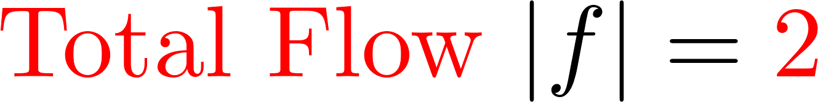
The Ford-Fulkerson Algorithm
v
0/3
0/6
0/1
1/7
t
s
1/3
w
0/1
0/9
1/5
1/5
u
z
1/2
Design and Analysis of Algorithms

Slide 36
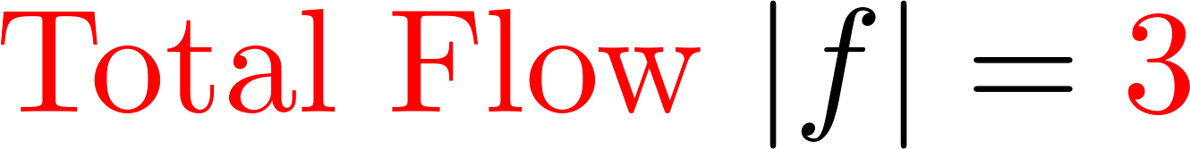
The Ford-Fulkerson Algorithm
v
0/3
1/6
1/1
2/7
t
s
1/3
w
0/1
0/9
1/5
1/5
u
z
1/2
Design and Analysis of Algorithms

Slide 37
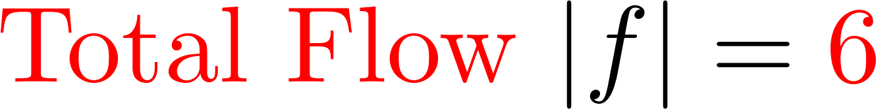
The Ford-Fulkerson Algorithm
v
3/3
4/6
1/1
2/7
t
s
1/3
w
0/1
0/9
1/5
1/5
u
z
1/2
Design and Analysis of Algorithms

Slide 38
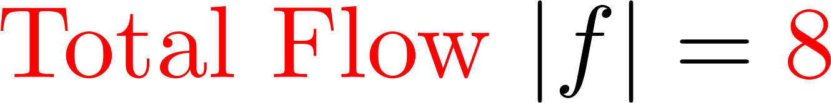
The Ford-Fulkerson Algorithm
v
3/3
4/6
1/1
4/7
t
s
3/3
w
0/1
0/9
1/5
1/5
u
z
1/2
Design and Analysis of Algorithms

Slide 39
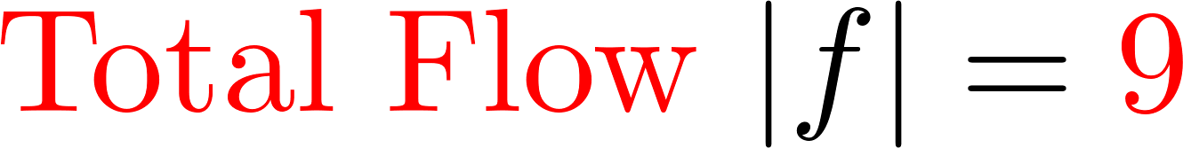
The Ford-Fulkerson Algorithm
v
3/3
4/6
1/1
4/7
t
s
3/3
w
1/1
1/9
2/5
2/5
u
z
1/2
Design and Analysis of Algorithms

Slide 40

The Ford-Fulkerson Algorithm
v
3/3
4/6
1/1
4/7
t
s
3/3
w
1/1
1/9
3/5
3/5
u
z
2/2
Design and Analysis of Algorithms

Slide 41
The Ford-Fulkerson Algorithm
v
3/3
4/6
1/1
4/7
t
s
3/3
w
1/1
1/9
3/5
3/5
u
z
2/2
No more augmenting paths!
Design and Analysis of Algorithms

Slide 42
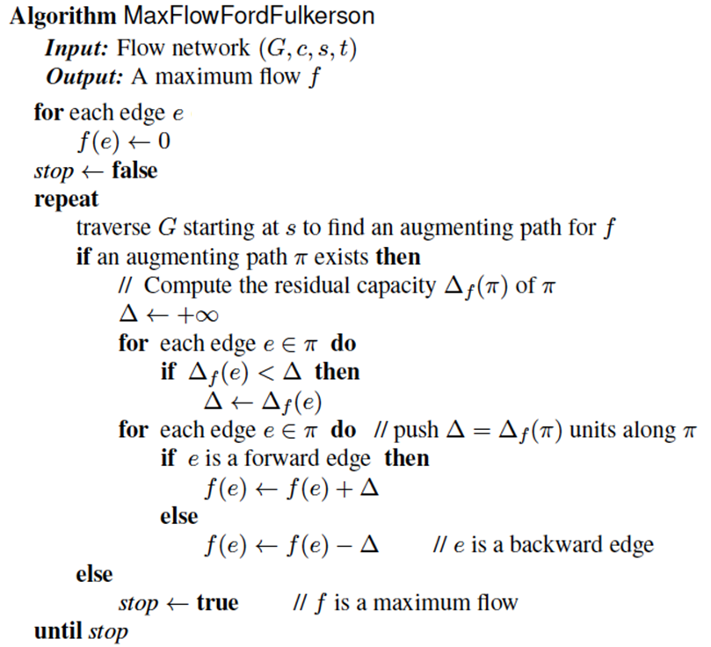




The Ford-Fulkerson Algorithm
Pseudocode:
Initialization $f=0$
$$Δ:min residual capacity on aug. path$$
$$Update flow on aug. path$$
$$No more aug. paths$$
Design and Analysis of Algorithms

Slide 43


Application: Maximum Matching
Definition: Given a bipartite graph, a matching is just a collection of edges that do not share a vertex.
Design and Analysis of Algorithms

Slide 44

Application: Maximum Matching
Definition: Given a bipartite graph, a matching is just a collection of edges that do not share a vertex.
Design and Analysis of Algorithms

Slide 45


Application: Maximum Matching
Definition: Given a bipartite graph, a matching is just a collection of edges that do not share a vertex.
Design and Analysis of Algorithms

Slide 46
Application: Maximum Matching
Problem: Given a bipartite graph, compute/find a
maximum matching.
Design and Analysis of Algorithms

Slide 47
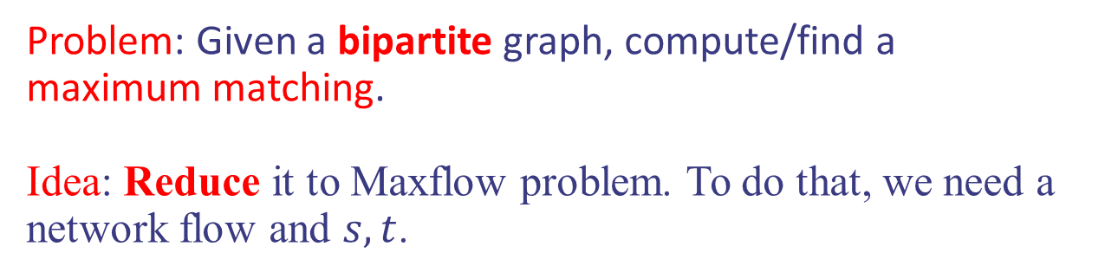
Application: Maximum Matching
Problem: Given a bipartite graph, compute/find a
maximum matching.
Idea: Reduce it to Maxflow problem. To do that, we need a network flow and $s,t$.
Design and Analysis of Algorithms

Slide 48
Application: Maximum Matching
Problem: Given a bipartite graph, compute/find a
maximum matching.
Idea: Reduce it to Maxflow problem. To do that, we need a network flow and $s,t$.
s
t
Design and Analysis of Algorithms

Slide 49
Application: Maximum Matching
Problem: Given a bipartite graph, compute/find a
maximum matching.
Idea: Reduce it to Maxflow problem. To do that, we need a network flow and $s,t$.
s
t
Design and Analysis of Algorithms

Slide 50

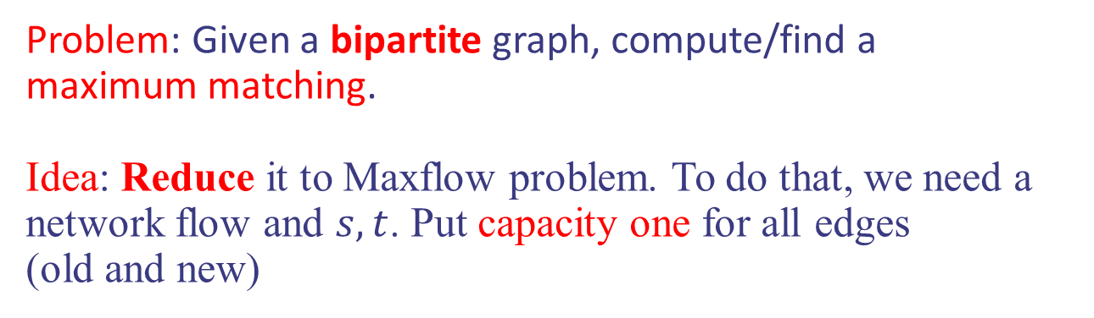
Application: Maximum Matching
Problem: Given a bipartite graph, compute/find a
maximum matching.
Idea: Reduce it to Maxflow problem. To do that, we need a network flow and $s,t$. Put capacity one for all edges
(old and new)
s
t
Design and Analysis of Algorithms

Slide 51


Application: Maximum Matching
Problem: Given a bipartite graph, compute/find a
maximum matching.
Idea: Reduce it to Maxflow problem. To do that, we need a network flow and $s,t$. Put capacity one for all edges
(old and new)
$Maxflow$ in new graph
Maximum Matching in old graph
s
t
Design and Analysis of Algorithms

Slide 52

Application: Maximum Matching
Problem: Given a bipartite graph, compute/find a
maximum matching.
Idea: Reduce it to Maxflow problem. To do that, we need a network flow and $s,t$. Put capacity one for all edges
(old and new)
Running time $O(\left(V+E\right)⋅V)$
$Maxflow$ in new graph
Maximum Matching in old graph
s
t
Design and Analysis of Algorithms

