Slide 1

Lecture 13 More problems on Maxflow, Maximum Matching, Baseball elimination, Vertex cover
CS 161 Design and Analysis of Algorithms
Ioannis Panageas

Slide 2
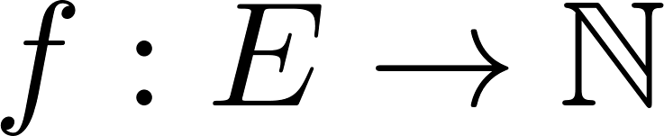
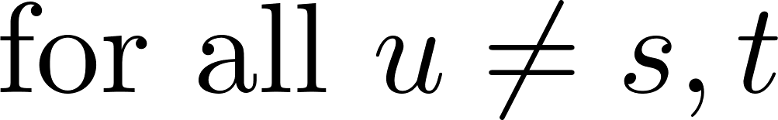


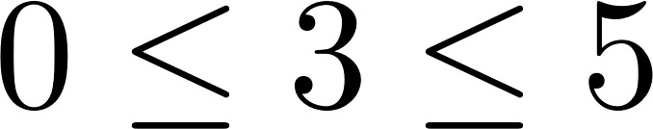
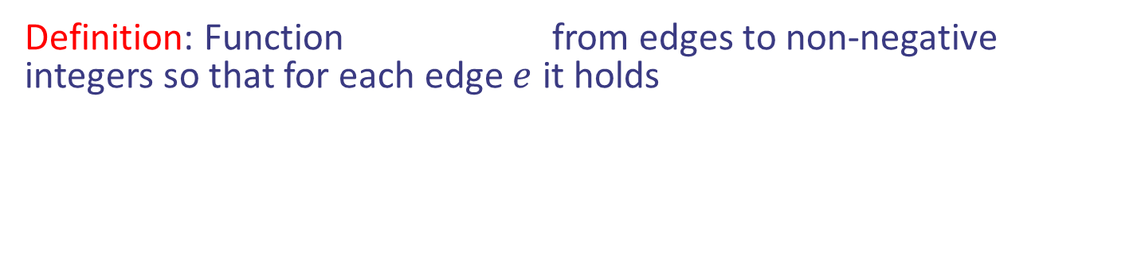
Flow of a Network (Recap)
Definition: Function from edges to non-negative integers so that for each edge $e$ it holds
v
1/3
3/5
2/6
s
u
1/1
3/7
t
s
3/3
w
1/1
2/9
4/5
3/5
u
2/2
z
Design and Analysis of Algorithms

Slide 3
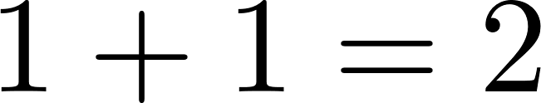



Flow of a Network (Recap)
Definition: Function from edges to non-negative integers so that for each edge $e$ it holds
v
1/3
2/6
v
1/3
2/6
1/1
3/7
t
s
3/3
1/1
w
1/1
2/9
4/5
3/5
u
2/2
z
Design and Analysis of Algorithms

Slide 4

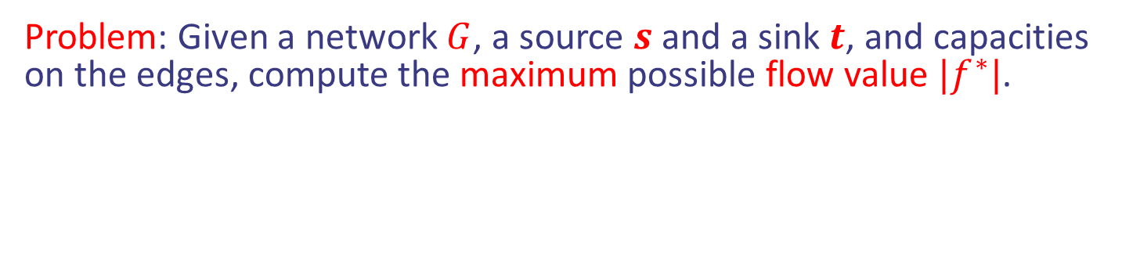
Maxflow Problem (Recap)
Problem: Given a network $G$, a source $s$ and a sink $t$, and capacities on the edges, compute the maximum possible flow value $|f^{∗}|$.
v
$/3
$/6
$/1
$/7
t
s
$/3
w
$/1
$/9
$/5
$/5
u
$/2
z
Find the $ to get maxflow $|f^{∗}|$
Design and Analysis of Algorithms

Slide 5
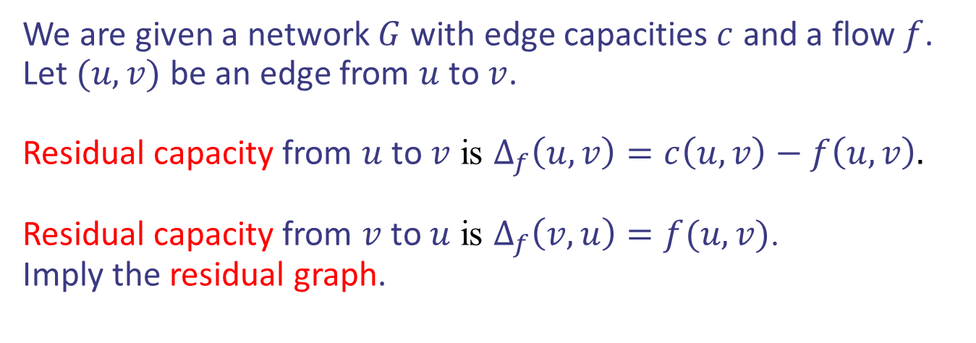
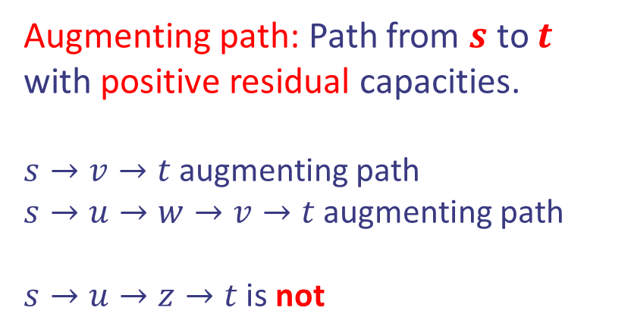
Augmenting paths (Recap)
We are given a network $G$ with edge capacities $c$ and a flow $f$. Let $(u,v)$ be an edge from $u$ to $v$.
Residual capacity from $u$ to $v$ is $Δ_{f}\left(u,v\right)=c\left(u,v\right)−f\left(u,v\right).$
Residual capacity from $v$ to $u$ is $Δ_{f}\left(v,u\right)=f(u,v)$.
Imply the residual graph.
Augmenting path: Path from $s$ to $t$ with positive residual capacities.
$s→v→t$ augmenting path
$s→u→w→v→t$ augmenting path
$s→u→z→t$ is not
v
1/3
2/6
1/1
3/7
t
s
3/3
w
0/1
2/9
4/5
2/5
u
2/2
z
Design and Analysis of Algorithms

Slide 6

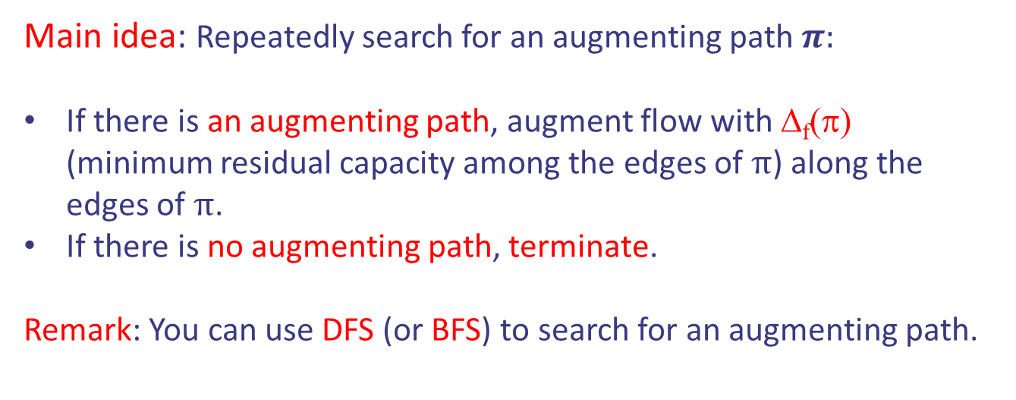
The Ford-Fulkerson Algorithm
Main idea: Repeatedly search for an augmenting path $π:$
If there is an augmenting path, augment flow with Δ_{f}(π) (minimum residual capacity among the edges of $π$) along the edges of $π$.
If there is no augmenting path, terminate.
Remark: You can use DFS (or BFS) to search for an augmenting path.
Running time:
Time to search for an augmenting path $×$ number of updates.
$$Θ\left(|V|+|E|\right)⋅|f^{∗}|$$
Running time of DFS or BFS
Updates increase flow by 1 unit only
Design and Analysis of Algorithms

Slide 7
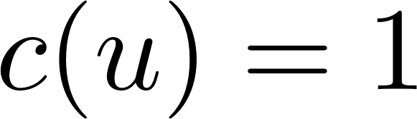
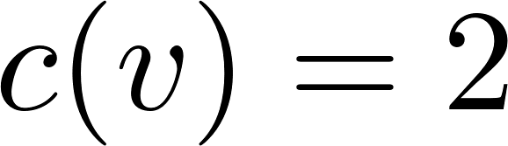
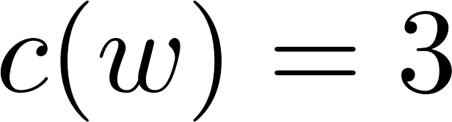
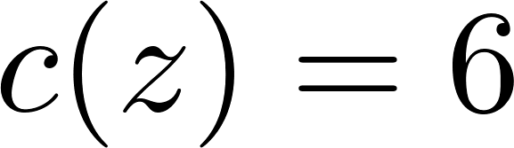
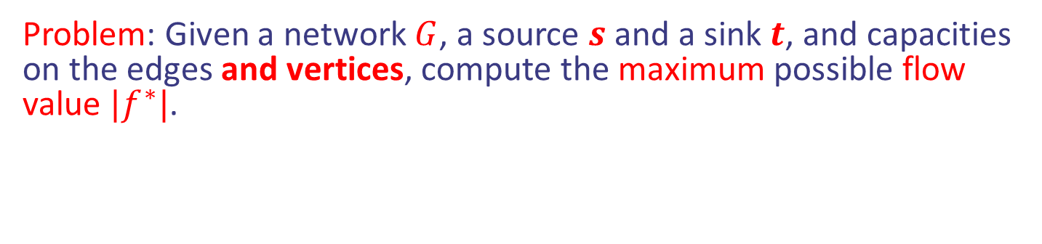
Case study I: Capacities on the vertices
Problem: Given a network $G$, a source $s$ and a sink $t$, and capacities on the edges and vertices, compute the maximum possible flow value $|f^{∗}|$.
2
v
3
6
1
3
7
t
s
3
w
1
9
5
5
1
6
u
2
z
Design and Analysis of Algorithms

Slide 8
Case study I: Capacities on the vertices
Main idea: Reduce it to classic Maxflow problem. To do that, we need to remove the capacity constraints on vertices. How?
3
1
3
w
7
1
9
Design and Analysis of Algorithms

Slide 9
Case study I: Capacities on the vertices
Main idea: Reduce it to classic Maxflow problem. To do that, we need to remove the capacity constraints on vertices. How?
0
1
3
w
7
1
w
7
0
1
9
9
Slow approach: Consider all possible capacities on incoming edges. Run Maxflow in all possible flow networks.
Exponentially many.
Design and Analysis of Algorithms

Slide 10
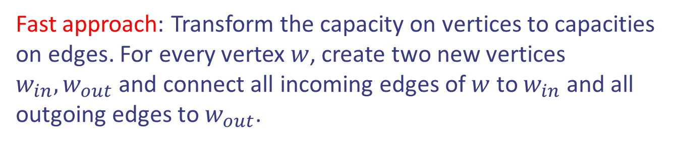
Case study I: Capacities on the vertices
Main idea: Reduce it to classic Maxflow problem. To do that, we need to remove the capacity constraints on vertices. How?
3
1
1
3
w
7
3
3
win
wout
7
1
9
1
9
Fast approach: Transform the capacity on vertices to capacities on edges. For every vertex $w$, create two new vertices $w_{in}, w_{out}$ and connect all incoming edges of $w$ to $w_{in}$ and all outgoing edges to $w_{out}$.
Design and Analysis of Algorithms

Slide 11
Case study I: Capacities on the vertices
2
v
3
6
1
3
7
t
s
3
w
1
9
5
5
1
6
u
2
z
2
3
vin
vo
6
1
wo
3
7
t
s
win
3
9
1
5
5
1
6
uin
uo
zin
zo
2
Design and Analysis of Algorithms

Slide 12
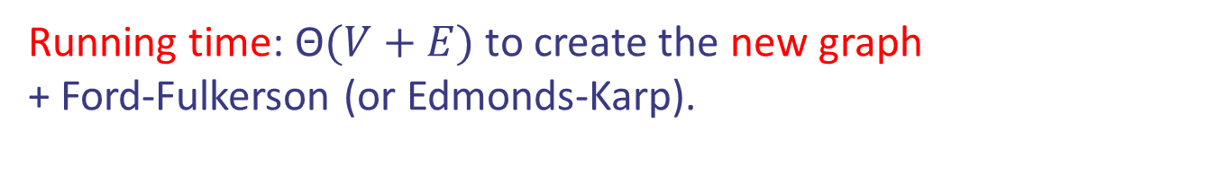
Case study I: Capacities on the vertices
Running time: Θ$(V+E)$ to create the new graph
+ Ford-Fulkerson (or Edmonds-Karp).
2
3
vin
vo
6
1
wo
3
7
t
s
win
3
9
1
5
5
1
6
uin
uo
zin
zo
2
Another Question: What if you have multiple sources and/or sinks?
Design and Analysis of Algorithms

Slide 13
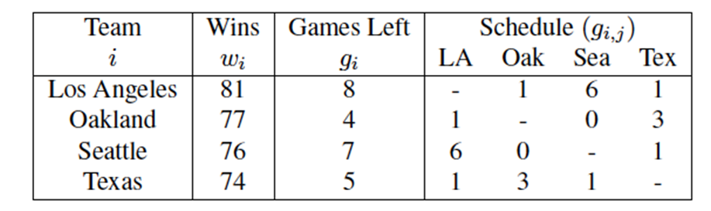
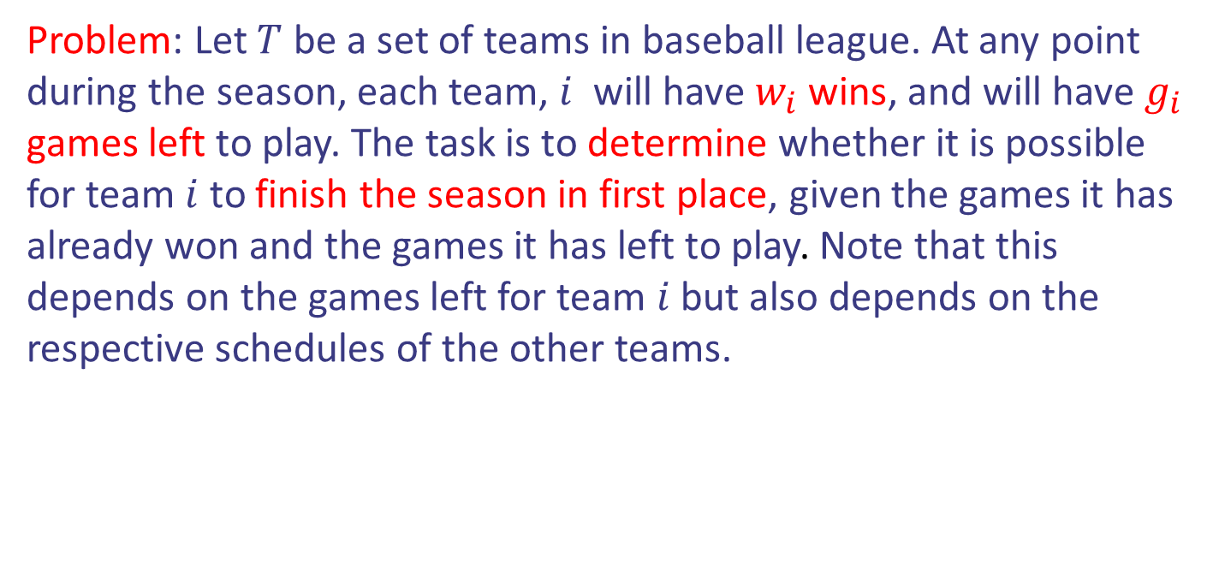
Case study II: Baseball Elimination
Problem: Let $T$ be a set of teams in baseball league. At any point during the season, each team, $i$ will have $w_{i}$ wins, and will have $g_{i}$ games left to play. The task is to determine whether it is possible for team $i$ to finish the season in first place, given the games it has already won and the games it has left to play. Note that this depends on the games left for team $i$ but also depends on the respective schedules of the other teams.
Design and Analysis of Algorithms

Slide 14
Case study II: Baseball Elimination
Problem: Let $T$ be a set of teams in baseball league. At any point during the season, each team, $i$ will have $w_{i}$ wins, and will have $g_{i}$ games left to play. The task is to determine whether it is possible for team $i$ to finish the season in first place, given the games it has already won and the games it has left to play. Note that this depends on the games left for team $i$ but also depends on the respective schedules of the other teams.
Question: Can Texas finish first? What about Oakland?
Design and Analysis of Algorithms

Slide 15
Case study II: Baseball Elimination
Question: Can Texas finish first? What about Oakland?
Answer: For Texas the answer is NO. It can win at most 79 wins.
For Oakland is also NO. Either LA or Seattle will definitely reach 82 wins.
Design and Analysis of Algorithms

Slide 16
Case study II: Baseball Elimination
Design and Analysis of Algorithms

Slide 17
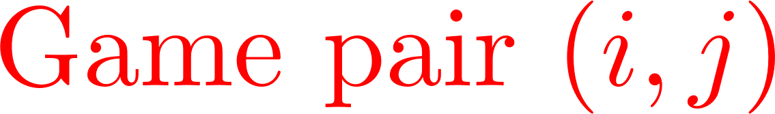

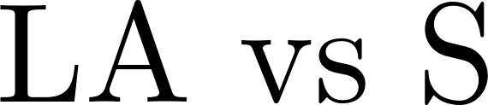





Case study II: Baseball Elimination
s
t
Design and Analysis of Algorithms

Slide 18
Case study II: Baseball Elimination
s
t
Design and Analysis of Algorithms

Slide 19




Case study II: Baseball Elimination
s
t
Design and Analysis of Algorithms

Slide 20




Case study II: Baseball Elimination
s
t
Design and Analysis of Algorithms

Slide 21

Case study II: Baseball Elimination
For team $i$, capacity is $W−w_{i}$
s
t
Design and Analysis of Algorithms

Slide 22

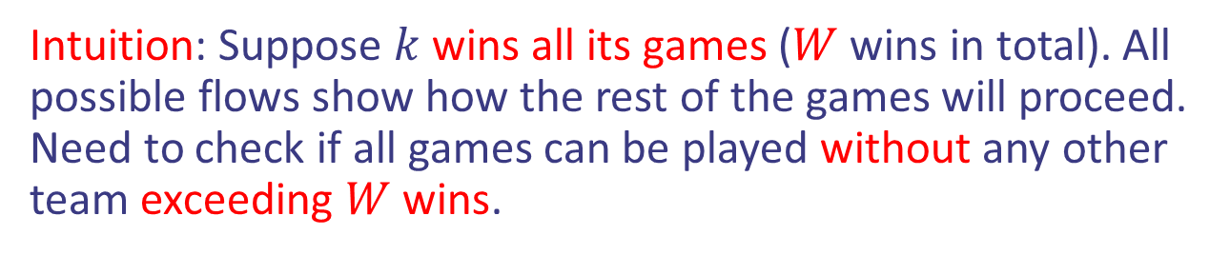
Case study II: Baseball Elimination
Intuition: Suppose $k$ wins all its games ($W$ wins in total). All possible flows show how the rest of the games will proceed. Need to check if all games can be played without any other team exceeding $W$ wins.
$Maxflow$ in new graph
Maximum Matching in old graph
Design and Analysis of Algorithms

Slide 23

Case study II: Baseball Elimination
Intuition: Suppose $k$ wins all its games ($W$ wins in total). All possible flows show how the rest of the games will proceed. Need to check if all games can be played without any other team exceeding $W$ wins.
$Maxflow$ in graph
= # of remaining games (without $k$)
$k$ can finish first.
Design and Analysis of Algorithms

Slide 24

Case study III: Vertex Cover on Bipartite Graphs
Problem (Practice): We use the term line of a matrix to mean either a row or a column. Given an $n×n$ matrix of 0’s and 1's, your task is to find a smallest number of lines such that every 1 entry of the matrix is contained in one of the selected lines.
1 | 0 | 1 | 1
0 | 1 | 0 | 0
0 | 1 | 1 | 0
0 | 1 | 0 | 0
Design and Analysis of Algorithms

Slide 25
Case study III: Vertex Cover on Bipartite Graphs
Problem (Practice): We use the term line of a matrix to mean either a row or a column. Given an $n×n$ matrix of 0’s and 1's, your task is to find a smallest number of lines such that every 1 entry of the matrix is contained in one of the selected lines.
1 | 0 | 1 | 1
0 | 1 | 0 | 0
0 | 1 | 1 | 0
0 | 1 | 0 | 0
Three lines. Can you do it with two?
Design and Analysis of Algorithms

Slide 26








Case study III: Vertex Cover on Bipartite Graphs
Idea: Create a bipartite graph.
1 | 0 | 1 | 1
0 | 1 | 0 | 0
0 | 1 | 1 | 0
0 | 1 | 0 | 0
Design and Analysis of Algorithms

Slide 27
Case study III: Vertex Cover on Bipartite Graphs
Idea: Create a bipartite graph.
1 | 0 | 1 | 1
0 | 1 | 0 | 0
0 | 1 | 1 | 0
0 | 1 | 0 | 0
Design and Analysis of Algorithms

Slide 28
Case study III: Vertex Cover on Bipartite Graphs
Idea: Create a bipartite graph.
1 | 0 | 1 | 1
0 | 1 | 0 | 0
0 | 1 | 1 | 0
0 | 1 | 0 | 0
Design and Analysis of Algorithms

Slide 29
Case study III: Vertex Cover on Bipartite Graphs
Idea: Create a bipartite graph.
1 | 0 | 1 | 1
0 | 1 | 0 | 0
0 | 1 | 1 | 0
0 | 1 | 0 | 0
Design and Analysis of Algorithms

Slide 30
Case study III: Vertex Cover on Bipartite Graphs
Idea 2: Choose min number of vertices to cover all the edges (minimum vertex cover)
1 | 0 | 1 | 1
0 | 1 | 0 | 0
0 | 1 | 1 | 0
0 | 1 | 0 | 0
Design and Analysis of Algorithms

Slide 31


Case study III: Vertex Cover on Bipartite Graphs
Idea 2: Choose min number of vertices to cover all the edges (minimum vertex cover)
1 | 0 | 1 | 1
0 | 1 | 0 | 0
0 | 1 | 1 | 0
0 | 1 | 0 | 0
Not Vertex Cover
Design and Analysis of Algorithms

Slide 32

Case study III: Vertex Cover on Bipartite Graphs
Idea 2: Choose min number of vertices to cover all the edges (minimum vertex cover)
1 | 0 | 1 | 1
0 | 1 | 0 | 0
0 | 1 | 1 | 0
0 | 1 | 0 | 0
Design and Analysis of Algorithms

Slide 33
Case study III: Vertex Cover on Bipartite Graphs
Idea 3: Find a maximum Matching. Theorem (Konig): This is equal to min VC in bipartite graphs.
1 | 0 | 1 | 1
0 | 1 | 0 | 0
0 | 1 | 1 | 0
0 | 1 | 0 | 0
Design and Analysis of Algorithms

