Slide 1

Lecture 5 Divide and Conquer III: quicksort, quickselect, median, integer multiplication
CS 161 Design and Analysis of Algorithms
Ioannis Panageas

Slide 2
Divide and Conquer (recap)
Steps of method:
Divide input into parts (smaller problems)
Conquer (solve) each part recursively
Combine results to obtain solution of original
Notes:
Exercise: guess merge sort

Slide 3
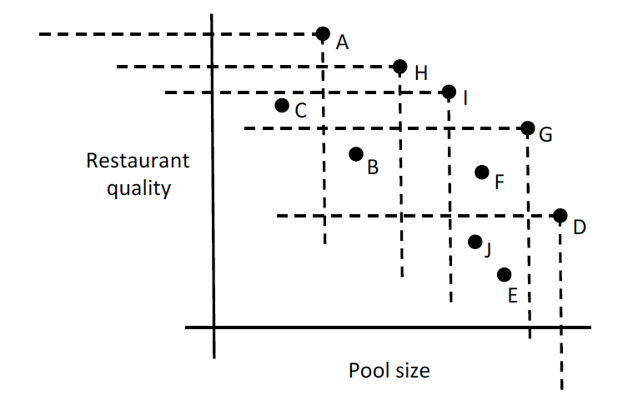
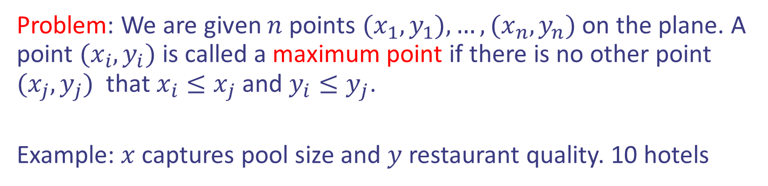
Case study IV: Maxima Set
Problem: We are given $n$ points $(x_{1},y_{1}),…,(x_{n},y_{n})$ on the plane. A point $(x_{i},y_{i})$ is called a maximum point if there is no other point $(x_{j}, y_{j})$ that $x_{i}≤x_{j}$ and $y_{i}≤y_{j}$.
Example: $x$ captures pool size and $y$ restaurant quality. 10 hotels

Slide 4
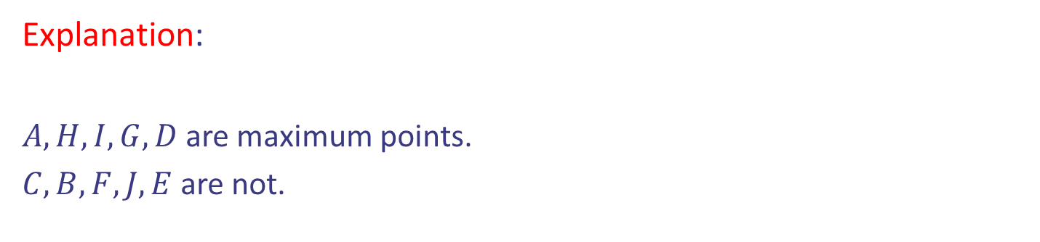
Case study IV: Maxima Set
Problem: We are given $n$ points $(x_{1},y_{1}),…,(x_{n},y_{n})$ on the plane. A point $(x_{i},y_{i})$ is called a maximum point if there is no other point $(x_{j}, y_{j})$ that $x_{i}≤x_{j}$ and $y_{i}≤y_{j}$.
Example: $x$ captures pool size and $y$ restaurant quality. 10 hotels
Explanation:
$A, H, I, G, D$are maximum points.
$C, B, F, J, E$are not.

Slide 5
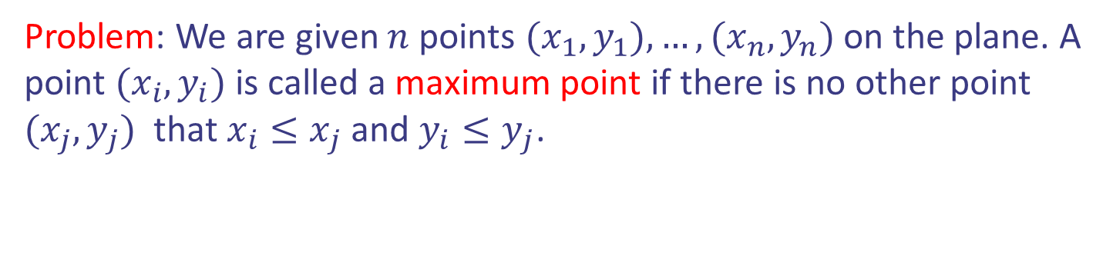
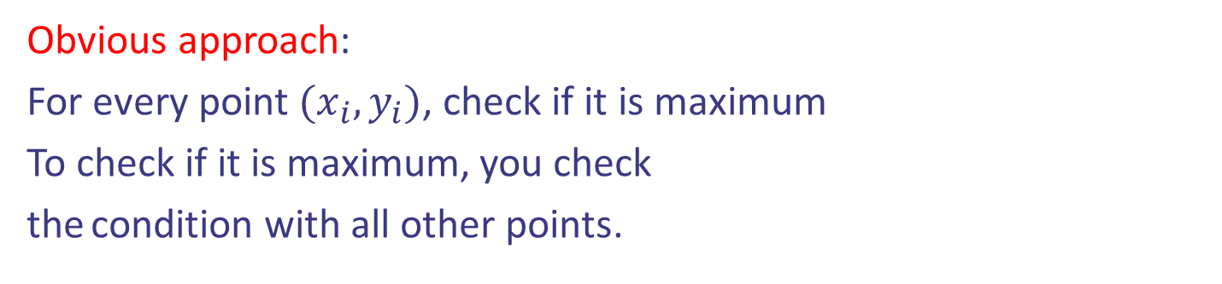
Case study IV: Maxima Set
Problem: We are given $n$ points $(x_{1},y_{1}),…,(x_{n},y_{n})$ on the plane. A point $(x_{i},y_{i})$ is called a maximum point if there is no other point $(x_{j}, y_{j})$ that $x_{i}≤x_{j}$ and $y_{i}≤y_{j}$.
Obvious approach:
For every point $(x_{i},y_{i})$, check if it is maximum
To check if it is maximum, you check
the condition with all other points.

Slide 6

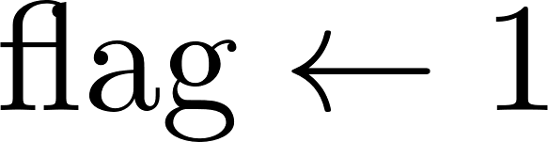

Case study IV: Maxima Set
Problem: We are given $n$ points $(x_{1},y_{1}),…,(x_{n},y_{n})$ on the plane. A point $(x_{i},y_{i})$ is called a maximum point if there is no other point $(x_{j}, y_{j})$ that $x_{i}≤x_{j}$ and $y_{i}≤y_{j}$.
Pseudocode:
Running time $Θ(n^{2})$
Can we do better?

Slide 7
Case study IV: Maxima Set
Problem: We are given $n$ points $(x_{1},y_{1}),…,(x_{n},y_{n})$ on the plane. A point $(x_{i},y_{i})$ is called a maximum point if there is no other point $(x_{j}, y_{j})$ that $x_{i}≤x_{j}$ and $y_{i}≤y_{j}$.
Idea: Divide and conquer. Divide step and Combine step is challenging.

Slide 8
Case study IV: Maxima Set
Divide step: It should split the points in two parts of equal size.
How?

Slide 9




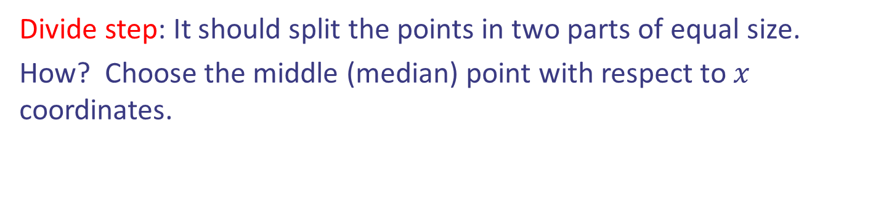


Case study IV: Maxima Set
Divide step: It should split the points in two parts of equal size.
How? Choose the middle (median) point with respect to $x$ coordinates.

Slide 10
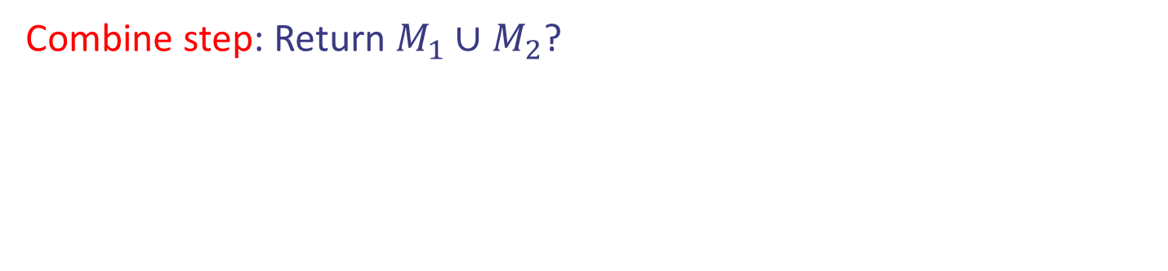
Case study IV: Maxima Set
Divide step: It should split the points in two parts of equal size.
How? Choose the middle (median) point with respect to $x$ coordinates.
Combine step: Return $M_{1}∪M_{2}$?

Slide 11
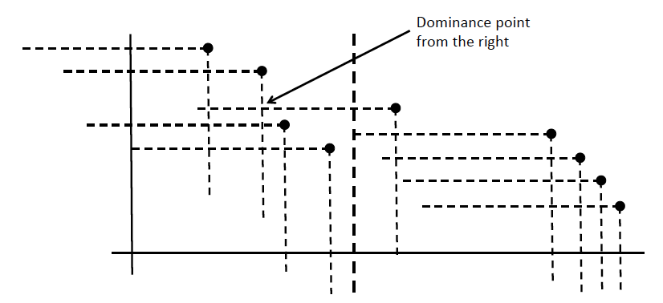



Case study IV: Maxima Set
Combine step: Return $M_{1}∪M_{2}$? Wrong: blue points below of $M_{1}$ are not part of the solution

Slide 12
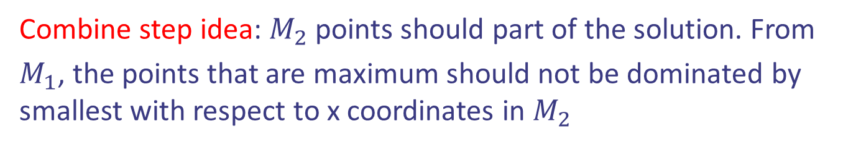



Case study IV: Maxima Set
Combine step idea: $M_{2}$ points should part of the solution. From
$M_{1}$, the points that are maximum should not be dominated by smallest with respect to x coordinates in $M_{2}$

Slide 13
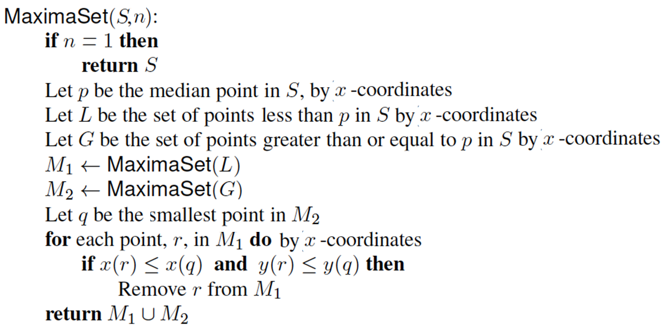
Case study IV: Maxima Set
Pseudocode:

Slide 14
Case study IV: Maxima Set
Pseudocode:
Running time??

Slide 15
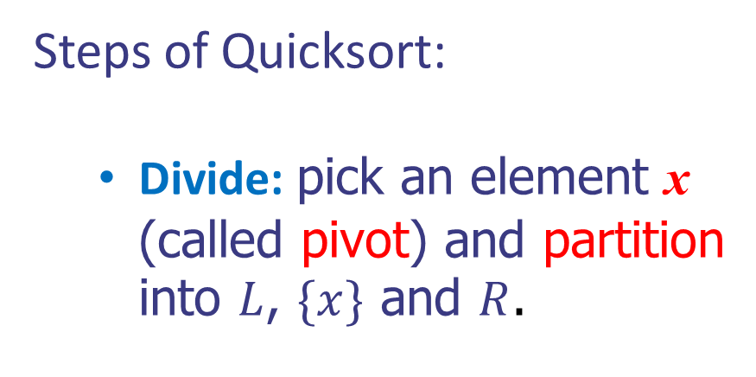


Quicksort (recap)
Steps of Quicksort:
Divide: pick an element x (called pivot) and partition into $L$, $\{x\}$ and $R$.
x
x
$$L$$
$$R$$
Notes:
Exercise: guess merge sort

Slide 16
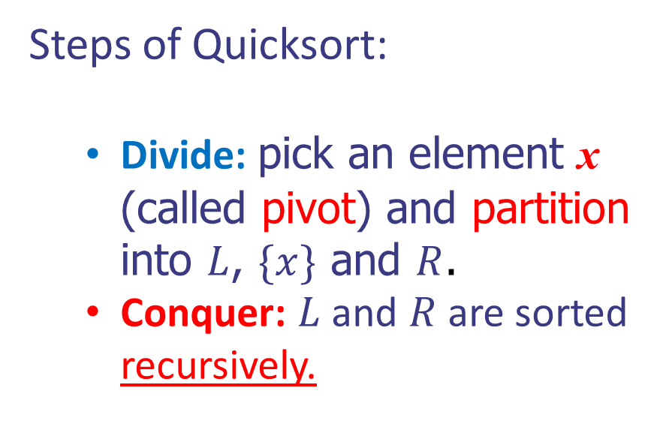
Quicksort (recap)
Steps of Quicksort:
Divide: pick an element x (called pivot) and partition into $L$, $\{x\}$ and $R$.
Conquer: $L$ and $R$ are sorted recursively.
x
x
$$L$$
$$R$$
Notes:
Exercise: guess merge sort

Slide 17
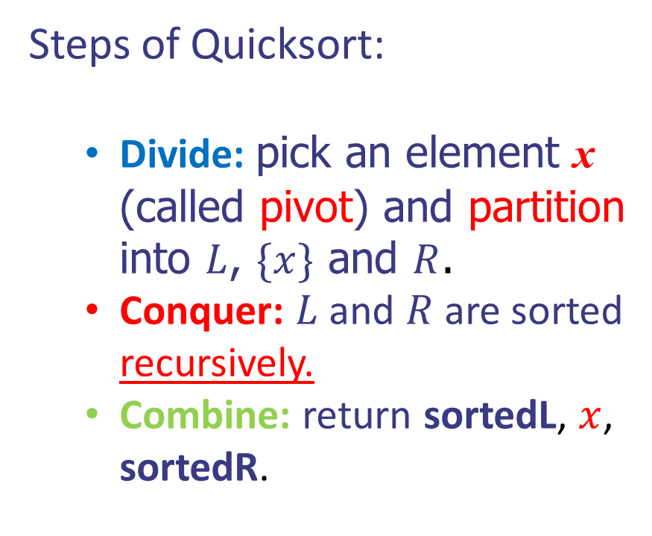


Quicksort (recap)
Steps of Quicksort:
Divide: pick an element x (called pivot) and partition into $L$, $\{x\}$ and $R$.
Conquer: $L$ and $R$ are sorted recursively.
Combine: return sortedL, $x$, sortedR.
x
x
sorted$L$
sorted$R$
Notes:
Exercise: guess merge sort

Slide 18
Quicksort (Example)
Pivot selection
7 2 9 4 3 7 6 1 → 1 2 3 4 6 7 8 9
7 2 9 4 → 2 4 7 9
3 8 6 1 → 1 3 8 6
2 → 2
9 4 → 4 9
3 → 3
8 → 8
9 → 9
4 → 4

Slide 19
Quicksort (Example)
Partition, recursive call and pivot selection
7 2 9 4 3 7 6 1 → 1 2 3 4 6 7 8 9
2 4 3 1 → 2 4 7 9
3 8 6 1 → 1 3 8 6
2 → 2
9 4 → 4 9
3 → 3
8 → 8
9 → 9
4 → 4

Slide 20
Quicksort (Example)
Partition, recursive call, base case
7 2 9 4 3 7 6 1 → → 1 2 3 4 6 7 8 9
2 4 3 1 →→ 2 4 7
3 8 6 1 → 1 3 8 6
1 → 1
9 4 → 4 9
3 → 3
8 → 8
9 → 9
4 → 4

Slide 21
Quicksort (Example)
Recursive call, …, base case, join
7 2 9 4 3 7 6 1 → 1 2 3 4 6 7 8 9
2 4 3 1 → 1 2 3 4
3 8 6 1 → 1 3 8 6
1 → 1
4 3 → 3 4
3 → 3
8 → 8
4 → 4

Slide 22
Quicksort (Example)
Recursive call, pivot selection
7 2 9 4 3 7 6 1 → 1 2 3 4 6 7 8 9
2 4 3 1 → 1 2 3 4
7 9 7 1 → 1 3 8 6
1 → 1
4 3 → 3 4
8 → 8
9 → 9
4 → 4

Slide 23
Quicksort (Example)
Partition, …, recursive call, base case
7 2 9 4 3 7 6 1 → 1 2 3 4 6 7 8 9
2 4 3 1 → 1 2 3 4
7 9 7 1 → 1 3 8 6
1 → 1
4 3 → 3 4
7 → 7
9 → 9
9 → 9
4 → 4

Slide 24
Quicksort (Example)
Join, join
7 2 9 4 3 7 6 1 → 1 2 3 4 6 7 7 9
2 4 3 1 → 1 2 3 4
7 9 7 → 17 7 9
1 → 1
4 3 → 3 4
7 → 7
9 → 9
9 → 9
4 → 4

Slide 25




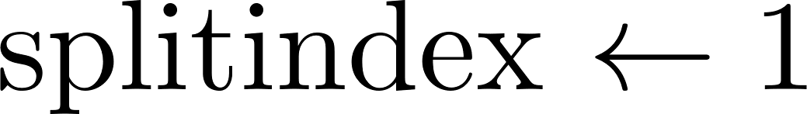

Quicksort
Pseudocode:

Slide 26
Quicksort
Pseudocode:
Base case
Pivot
Partition
Recursion

Slide 27
Quicksort
Running time: Depends on the choice of the pivot.

Slide 28
Quicksort
Running time: Depends on the choice of the pivot.
Worst case: Pivot is the unique minimum or maximum element. Either L and R has size n - 1 and the other has size 0.
Choose pivots as follows: 1, then 2, then 3, then 4, then 7, then 9.
Example: 9 7 4 3 2 1

Slide 29
Quicksort
Running time: Depends on the choice of the pivot.
Worst case: Pivot is the unique minimum or maximum element. Either L and R has size n - 1 and the other has size 0.
Example: 9 7 4 3 2 1
9 7 4 3 2 1
9 7 4 3 2
…
9 7

Slide 30


Quicksort
Running time: Depends on the choice of the pivot.
Worst case: Pivot is the unique minimum or maximum element. Either L and R has size n - 1 and the other has size 0.
Example: 9 7 4 3 2 1
9 7 4 3 2 1
9 7 4 3 2
Number of computations of order
$$n+\left(n−1\right)+…+2+1∈Θ(n^{2})$$
…
9 7

Slide 31

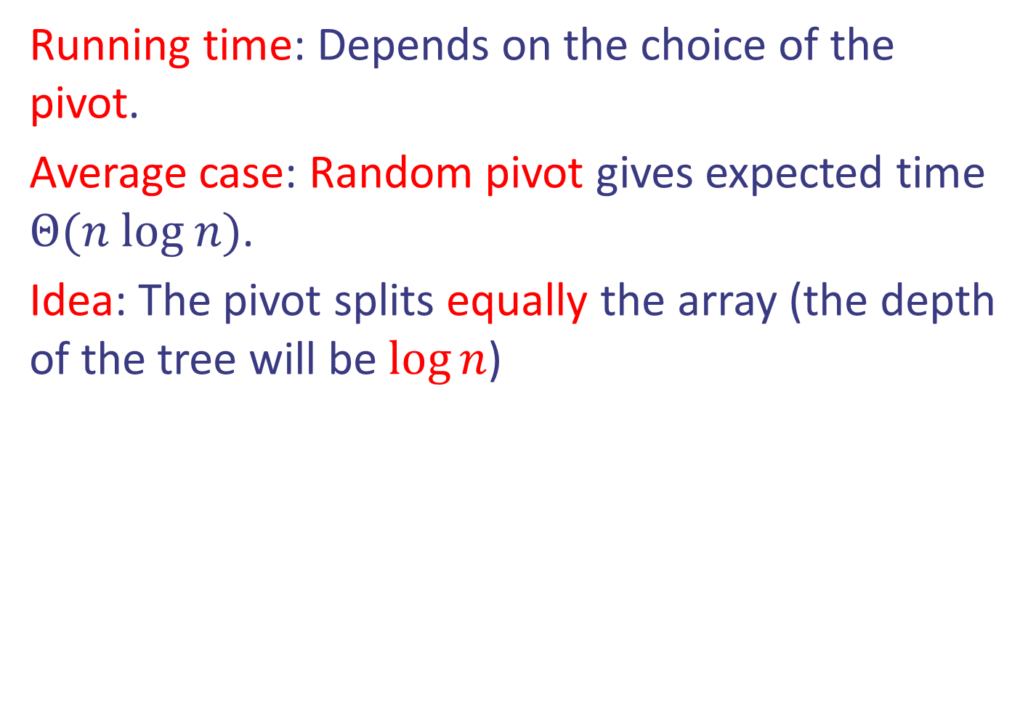


Quicksort
Running time: Depends on the choice of the pivot.
Average case: Random pivot gives expected time $Θ(n log n)$.
Idea: The pivot splits equally the array (the depth of the tree will be $\log{n}$)
7 9 3 2 1
2 1
7 9
$$2→2$$
$$7→7$$

Slide 32

Quicksort
Running time: Depends on the choice of the pivot.
Average case: Random pivot gives expected time $Θ(n log n)$.
Idea: The pivot splits equally the array (the depth of the tree will be $\log{n}$)
7 9 3 2 1
Can we achieve $Θ\left(nlog n\right) in worst case?$
2 1
7 9
$$2→2$$
$$7→7$$

Slide 33
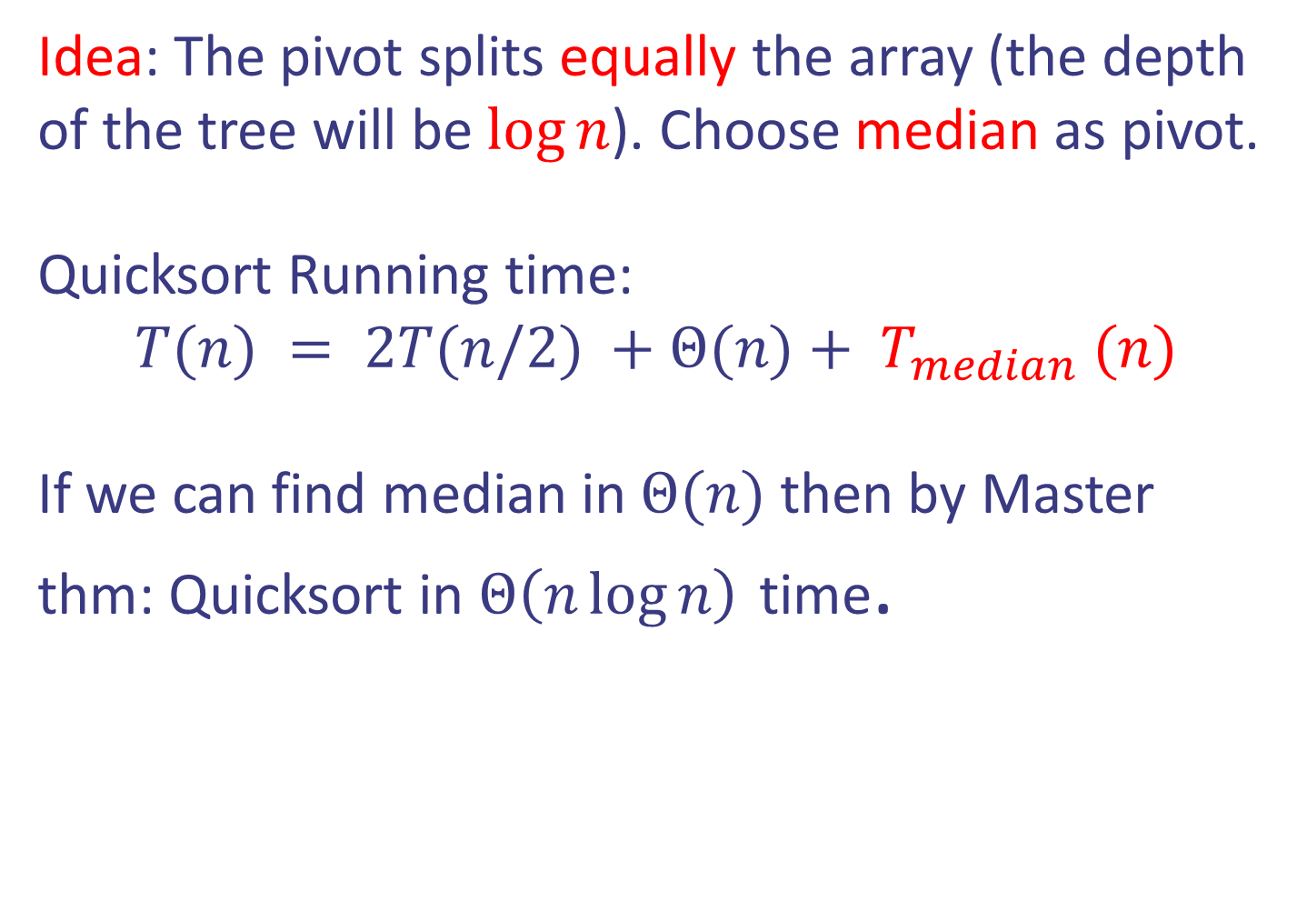
Case study V: Median-selection
Idea: The pivot splits equally the array (the depth of the tree will be $\log{n}$). Choose median as pivot.
Quicksort Running time:
$$T(n) = 2T(n/2) +Θ(n)+ T_{median} (n)$$
If we can find median in $Θ(n)$ then by Master thm: Quicksort in $Θ\left(n\log{n}\right)$ time.
Design and Analysis of Algorithms

Slide 34
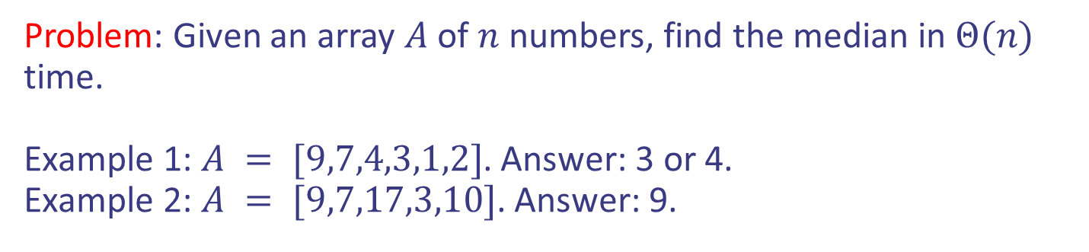
Case study V: Median-selection
Problem: Given an array $A$ of $n$ numbers, find the median in $Θ(n)$ time.
Example 1: $A = [9,7,4,3,1,2]$. Answer: 3 or 4.
Example 2: $A = [9,7,17,3,10]$. Answer: 9.
Design and Analysis of Algorithms

Slide 35

Case study V: Median-selection
Problem: Given an array $A$ of $n$ numbers, find the median in $Θ(n)$ time.
Example 1: $A = [9,7,4,3,1,2]$. Answer: 3 or 4.
Example 2: $A = [9,7,17,3,10]$. Answer: 9.
Idea: Unfortunately sorting and picking the middle position needs $Θ\left(n\log{n}\right)$ time. Use divide and conquer.
Design and Analysis of Algorithms

Slide 36

Case study V: Median-selection
Problem: Given an array $A$ of $n$ numbers, find the median in $Θ(n)$ time.
Idea: Use divide and conquer. Let’s try to solve the more general problem of selection.
Problem: Given an array $A$ of $n$ numbers and positive integer $k$, find the $k$-th smallest in $Θ(n)$ time. Median when?
Design and Analysis of Algorithms

Slide 37



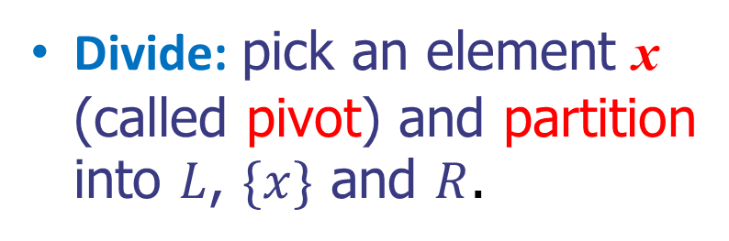
Case study V: Median-selection
Problem: Given an array $A$ of $n$ numbers, find the $k$-th smallest in $Θ(n)$ time.
Divide: pick an element x (called pivot) and partition into $L$, $\{x\}$ and $R$.
x
x
$$L$$
$$R$$
Design and Analysis of Algorithms

Slide 38

Case study V: Median-selection
Problem: Given an array $A$ of $n$ numbers, find the $k$-th smallest in $Θ(n)$ time.
Divide: pick an element x (called pivot) and partition into $L$, $\{x\}$ and $R$.
x
Where is the $k$-th element?
x
$$L$$
$$R$$
Design and Analysis of Algorithms

Slide 39

Case study V: Median-selection
Problem: Given an array $A$ of $n$ numbers, find the $k$-th smallest in $Θ(n)$ time.
Divide: pick an element x (called pivot) and partition into $L$, $\{x\}$ and $R$.
x
Where is the $k$-th element?
Depends on the size of $L$!
x
$$L$$
$$R$$
Design and Analysis of Algorithms

Slide 40


Case study V: Median-selection
Problem: Given an array $A$ of $n$ numbers, find the $k$-th smallest in $Θ(n)$ time.
Divide: pick an element x (called pivot) and partition into $L$, $\{x\}$ and $R$.
Conquer and Combine:
If $\left|L\right|≥k$ then recursively find $k$-th in $L$.
x
x
$$L$$
$$R$$
Design and Analysis of Algorithms

Slide 41

Case study V: Median-selection
Problem: Given an array $A$ of $n$ numbers, find the $k$-th smallest in $Θ(n)$ time.
Divide: pick an element x (called pivot) and partition into $L$, $\{x\}$ and $R$.
Conquer and Combine:
If $\left|L\right|≥k$ then recursively find $k$-th in $L$.
If $\left|L\right|=k−1$ then $x$ is $k$-th element.
x
x
$$L$$
$$R$$
Design and Analysis of Algorithms

Slide 42

Case study V: Median-selection
Problem: Given an array $A$ of $n$ numbers, find the $k$-th smallest in $Θ(n)$ time.
Divide: pick an element x (called pivot) and partition into $L$, $\{x\}$ and $R$.
Conquer and Combine:
If $\left|L\right|≥k$ then recursively find $k$-th in $L$.
If $\left|L\right|=k−1$ then $x$ is $k$-th element.
If $\left|L\right|<k−1$ then recursively
find $k−L−1$-th element in $R$.
x
x
$$L$$
$$R$$
Design and Analysis of Algorithms

Slide 43




Case study V: Median-selection
Problem: Given an array $A$ of $n$ numbers, find the $k$-th smallest in $Θ(n)$ time.
Pseudocode:
Design and Analysis of Algorithms

Slide 44
Case study V: Median-selection
Example: Each node represents a recursive call of quick-select
k=5, A = (7 4 9 3 2 6 5 1 8), L = (2 1)
k=2, A = (7 4 9 6 5 8), L = (4 5 6 7)
k=2, A = (7 4 6 5), L = empty
k=1, S=(7 6 5), L = empty
5
Design and Analysis of Algorithms

Slide 45

Case study V: Median-selection
Problem: Given an array $A$ of $n$ numbers, find the $k$-th smallest in $Θ(n)$ time.
Pseudocode:
Running time?
Depends on the choice of pivot
Good pivots:
$L$ and $R$ have both at least
$c⋅n$ elements
Design and Analysis of Algorithms

Slide 46
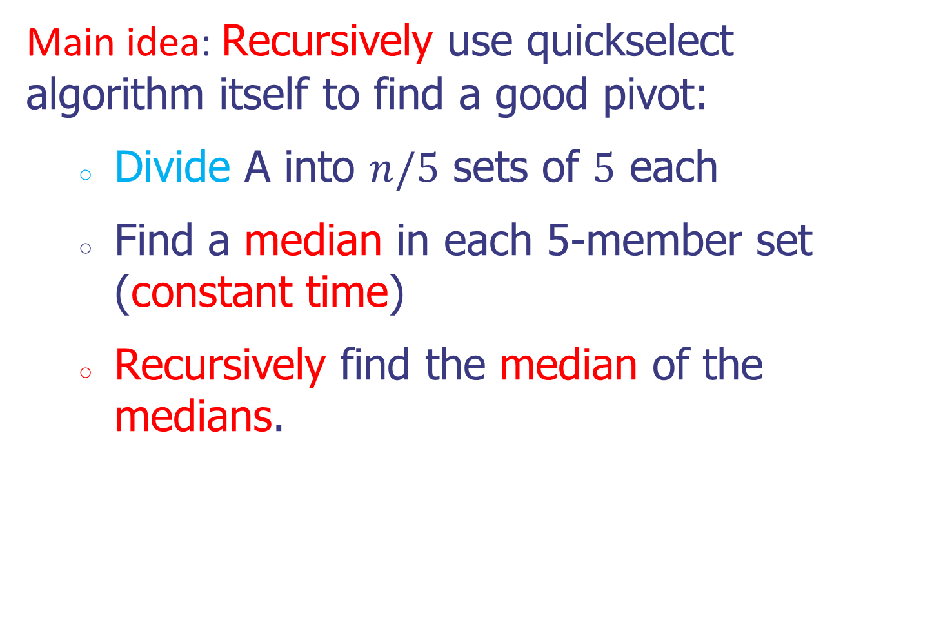
Case study V: Median-selection
Problem: Given an array $A$ of $n$ numbers, find the $k$-th smallest in $Θ(n)$ time.
Main idea: Recursively use quickselect algorithm itself to find a good pivot:
Divide A into $n/5$ sets of $5$ each
Find a median in each 5-member set (constant time)
Recursively find the median of the medians.
Design and Analysis of Algorithms

Slide 47
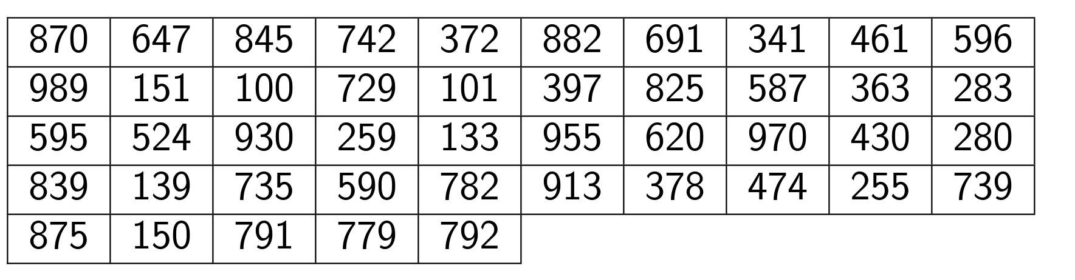












Case study V: Median-selection
Problem: Given an array $A$ of $n$ numbers, find the $k$-th smallest in $Θ(n)$ time.
Median of 742, 596, 151, 397, 524, 620, 735, 474, 791 is 596
which is our pivot.
Design and Analysis of Algorithms

Slide 48
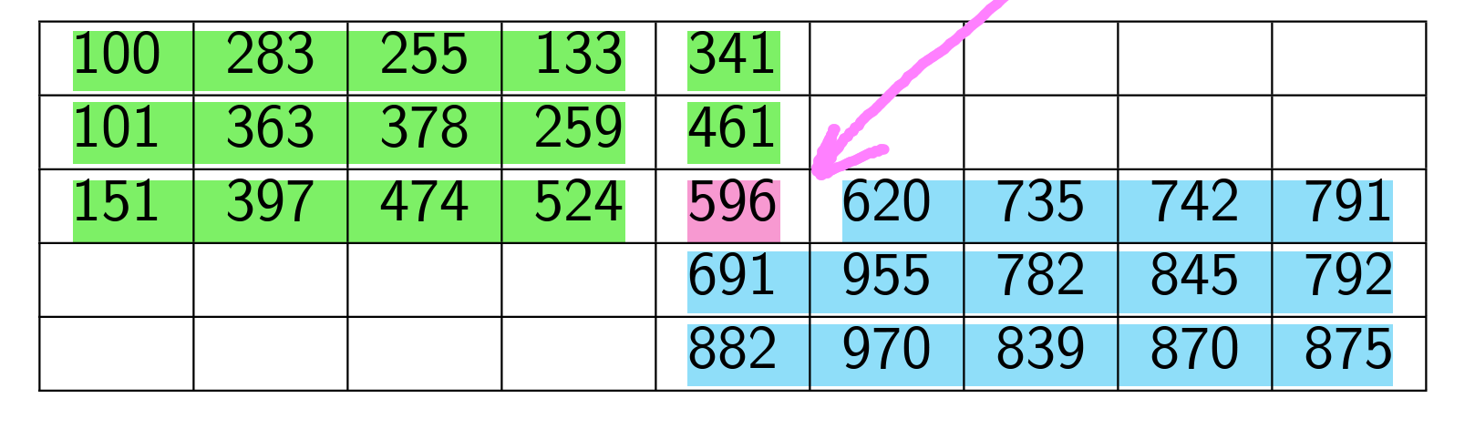



Case study V: Median-selection
Problem: Given an array $A$ of $n$ numbers, find the $k$-th smallest in $Θ(n)$ time.
$$x$$
Design and Analysis of Algorithms

Slide 49

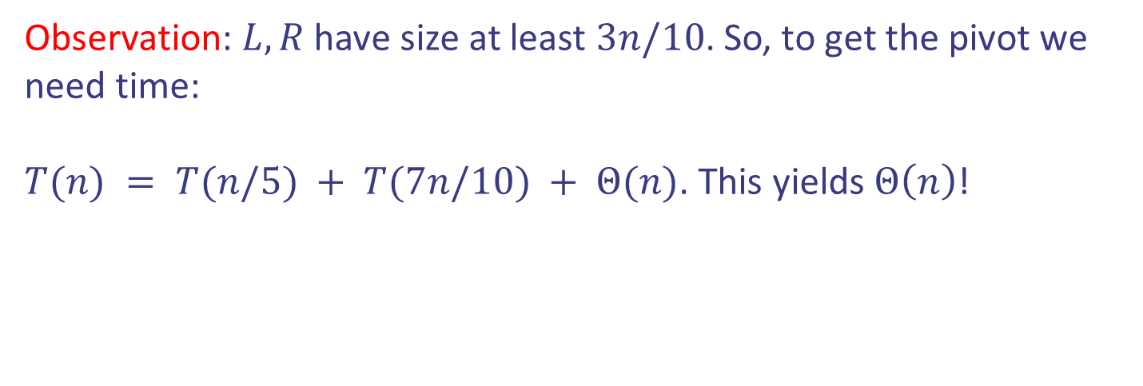
Case study V: Median-selection
Problem: Given an array $A$ of $n$ numbers, find the $k$-th smallest in $Θ(n)$ time.
$$x$$
Observation: $L,R$ have size at least $3n/10$. So, to get the pivot we need time:
$T(n) = T(n/5) + T(7n/10) + Θ(n)$. This yields $Θ\left(n\right)$!
Design and Analysis of Algorithms

Slide 50
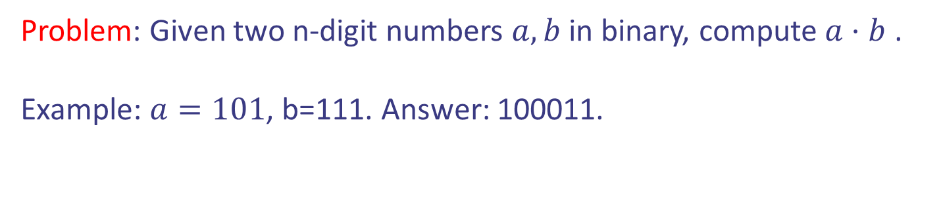
Case study VI: Integer Multiplication
Problem: Given two n-digit numbers $a,b$ in binary, compute $a⋅b$ .
Example: $a=101$, b=111. Answer: 100011.
Design and Analysis of Algorithms

Slide 51



Case study VI: Integer Multiplication
Problem: Given two n-digit numbers $a,b$ in binary, compute $a⋅b$ .
Example: $a=101$, b=111. Answer: 100011.
Standard Algorithm: $Θ\left(n^{2}\right)$ time. Summing two
$n$-bit numbers takes $Θ\left(n\right)$ time.
1
1
0
1
0
1
0
1
*
0
1
1
1
1
1
0
1
1
1
0
1
0
1
0
1
0
0
0
0
0
0
0
0
0
0
1
1
0
1
0
1
0
1
0
1
1
0
1
0
1
0
1
0
1
1
1
1
1
1
0
1
1
1
0
1
0
1
0
1
0
1
1
0
1
0
1
0
1
1
1
0
1
0
1
0
1
0
+
0
1
1
1
1
1
0
1
1
1
0
1
0
1
0
1
0
0
0
0
0
0
0
0
0
0
1
0
1
0
1
0
0
1
0
0
1
1
0
1
0
0
0
0
0
0
0
0
0
0
1
0
Design and Analysis of Algorithms

Slide 52
Case study VI: Integer Multiplication
Problem: Given two n-digit numbers $a,b$ in binary, compute $a⋅b$ .
Example: $a=101$, b=111. Answer: 100011.
Standard Algorithm: $Θ\left(n^{2}\right)$ time. Summing two
$n$-bit numbers takes $Θ\left(n\right)$ time.
1
1
0
1
0
1
0
1
*
0
1
1
1
1
1
0
1
1
1
0
1
0
1
0
1
0
0
0
0
0
0
0
0
0
0
Can we do better?
1
1
0
1
0
1
0
1
0
1
1
0
1
0
1
0
1
0
1
1
1
1
1
1
0
1
1
1
0
1
0
1
0
1
0
1
1
0
1
0
1
0
1
1
1
0
1
0
1
0
1
0
+
0
1
1
1
1
1
0
1
1
1
0
1
0
1
0
1
0
0
0
0
0
0
0
0
0
0
1
0
1
0
1
0
0
1
0
0
1
1
0
1
0
0
0
0
0
0
0
0
0
0
1
0
Design and Analysis of Algorithms

Slide 53







Case study VI: Integer Multiplication
Idea: Divide and conquer.
$a=a_{1}a_{2}…a_{n/2}{ a}_{n/2+1}…a_{n}$
$$a_{L}$$
$$a_{R}$$
$b=b_{1}b_{2}…b_{n/2}{ b}_{n/2+1}…b_{n}$
$$b_{R}$$
$$b_{L}$$
Design and Analysis of Algorithms

Slide 54
Case study VI: Integer Multiplication
Idea: Divide and conquer.
$a=a_{1}a_{2}…a_{n/2}{ a}_{n/2+1}…a_{n}$
$$a_{L}$$
$$a_{R}$$
$b=b_{1}b_{2}…b_{n/2}{ b}_{n/2+1}…b_{n}$
Recursively
$$b_{R}$$
$$b_{L}$$
$$a⋅b=a_{R}⋅b_{R}+2^{\frac{n}{2}} a_{L}⋅b_{R}+a_{R}⋅2^{\frac{n}{2}} b_{L}+2^{\frac{n}{2}} a_{L}⋅2^{\frac{n}{2}} b_{L}$$
Design and Analysis of Algorithms

Slide 55
Case study VI: Integer Multiplication
Idea: Divide and conquer.
$a=a_{1}a_{2}…a_{n/2}{ a}_{n/2+1}…a_{n}$
$$a_{L}$$
$$a_{R}$$
$b=b_{1}b_{2}…b_{n/2}{ b}_{n/2+1}…b_{n}$
Recursively
$$b_{R}$$
$$b_{L}$$
$$a⋅b=a_{R}⋅b_{R}+2^{\frac{n}{2}} a_{L}⋅b_{R}+a_{R}⋅2^{\frac{n}{2}} b_{L}+2^{\frac{n}{2}} a_{L}⋅2^{\frac{n}{2}} b_{L}$$
Running time: $T\left(n\right)=4T\left(\frac{n}{2}\right)+Θ\left(n\right)→Θ\left(n^{2}\right)$ by Master thm
Design and Analysis of Algorithms

Slide 56
Case study VI: Integer Multiplication
Idea (modified): Divide and conquer.
$a=a_{1}a_{2}…a_{n/2}{ a}_{n/2+1}…a_{n}$
$$a_{L}$$
$$a_{R}$$
$b=b_{1}b_{2}…b_{n/2}{ b}_{n/2+1}…b_{n}$
$$b_{R}$$
$$b_{L}$$
$$a⋅b=2^{\frac{n}{2}} a_{L}⋅2^{\frac{n}{2}} b_{L}+a_{R}⋅b_{R}+$$
$$2^{\frac{n}{2}}( \left(a_{L}−a_{R}\right)⋅(b_{R}−b_{L})+a_{L}⋅b_{L}+a_{R}⋅b_{R})$$
Design and Analysis of Algorithms

Slide 57







Case study VI: Integer Multiplication
Idea (modified): Divide and conquer.
$a=a_{1}a_{2}…a_{n/2}{ a}_{n/2+1}…a_{n}$
Recursively compute
$(a_{L}−a_{R})(b_{R}−b_{L})$
$a_{L}⋅b_{L}$
$a_{R }⋅b_{R}$
$$a_{L}$$
$$a_{R}$$
$b=b_{1}b_{2}…b_{n/2}{ b}_{n/2+1}…b_{n}$
$$b_{R}$$
$$b_{L}$$
$$a⋅b=2^{\frac{n}{2}} a_{L}⋅2^{\frac{n}{2}} b_{L}+a_{R}⋅b_{R}+$$
$$2^{\frac{n}{2}}( \left(a_{L}−a_{R}\right)⋅(b_{R}−b_{L})+a_{L}⋅b_{L}+a_{R}⋅b_{R})$$
Design and Analysis of Algorithms

Slide 58

Case study VI: Integer Multiplication
Idea (modified): Divide and conquer.
$a=a_{1}a_{2}…a_{n/2}{ a}_{n/2+1}…a_{n}$
Recursively compute
$(a_{L}−a_{R})(b_{R}−b_{L})$
$a_{L}⋅b_{L}$
$a_{R }⋅b_{R}$
$$a_{L}$$
$$a_{R}$$
$b=b_{1}b_{2}…b_{n/2}{ b}_{n/2+1}…b_{n}$
$$Θ\left(n^{1.585}\right)$$
$$b_{R}$$
$$b_{L}$$
Running time: $T\left(n\right)=3T\left(\frac{n}{2}\right)+Θ\left(n\right)→Θ\left(n^{\log_{2}{3}}\right)$ by Master thm
Design and Analysis of Algorithms

