Slide 1

Lecture 6 Divide and Conquer IV: integer multiplication, further examples
CS 161 Design and Analysis of Algorithms
Ioannis Panageas

Slide 2
Divide and Conquer (recap)
Steps of method:
Divide input into parts (smaller problems)
Conquer (solve) each part recursively
Combine results to obtain solution of original
Notes:
Exercise: guess merge sort

Slide 3
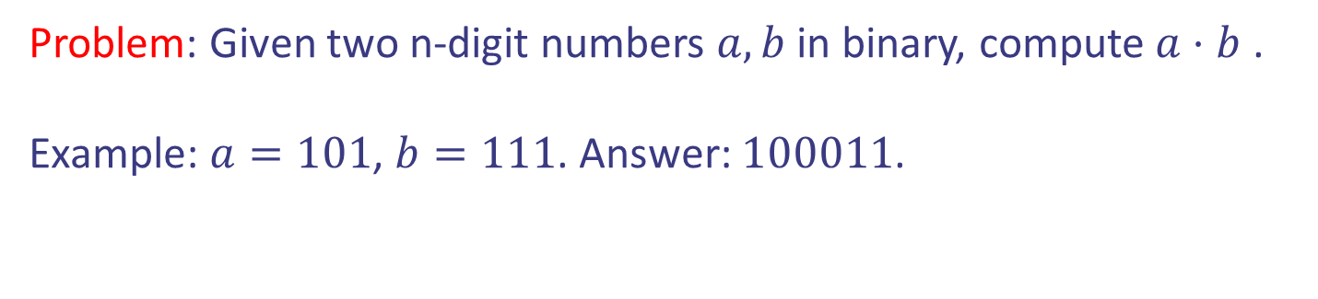
Case study VI: Integer Multiplication
Problem: Given two n-digit numbers $a,b$ in binary, compute $a⋅b$ .
Example: $a=101$, $b=111$. Answer: $100011$.
Design and Analysis of Algorithms

Slide 4



Case study VI: Integer Multiplication
Problem: Given two n-digit numbers $a,b$ in binary, compute $a⋅b$ .
Example: $a=101$, $b=111$. Answer: $100011$.
Standard Algorithm: $Θ\left(n^{2}\right)$ time. Summing two
$n$-bit numbers takes $Θ\left(n\right)$ time.
1
1
0
1
0
1
0
1
*
0
1
1
1
1
1
0
1
1
1
0
1
0
1
0
1
0
0
0
0
0
0
0
0
0
0
1
1
0
1
0
1
0
1
0
1
1
0
1
0
1
0
1
0
1
1
1
1
1
1
0
1
1
1
0
1
0
1
0
1
0
1
1
0
1
0
1
0
1
1
1
0
1
0
1
0
1
0
+
0
1
1
1
1
1
0
1
1
1
0
1
0
1
0
1
0
0
0
0
0
0
0
0
0
0
1
0
1
0
1
0
0
1
0
0
1
1
0
1
0
0
0
0
0
0
0
0
0
0
1
0
Design and Analysis of Algorithms

Slide 5
Case study VI: Integer Multiplication
Problem: Given two n-digit numbers $a,b$ in binary, compute $a⋅b$ .
Example: $a=101$, $b=111$. Answer: $100011$.
Standard Algorithm: $Θ\left(n^{2}\right)$ time. Summing two
$n$-bit numbers takes $Θ\left(n\right)$ time.
1
1
0
1
0
1
0
1
*
0
1
1
1
1
1
0
1
1
1
0
1
0
1
0
1
0
0
0
0
0
0
0
0
0
0
Can we do better?
1
1
0
1
0
1
0
1
0
1
1
0
1
0
1
0
1
0
1
1
1
1
1
1
0
1
1
1
0
1
0
1
0
1
0
1
1
0
1
0
1
0
1
1
1
0
1
0
1
0
1
0
+
0
1
1
1
1
1
0
1
1
1
0
1
0
1
0
1
0
0
0
0
0
0
0
0
0
0
1
0
1
0
1
0
0
1
0
0
1
1
0
1
0
0
0
0
0
0
0
0
0
0
1
0
Design and Analysis of Algorithms

Slide 6







Case study VI: Integer Multiplication
Idea: Divide and conquer.
$a=a_{1}a_{2}…a_{n/2}{ a}_{n/2+1}…a_{n}$
$$a_{L}$$
$$a_{R}$$
$b=b_{1}b_{2}…b_{n/2}{ b}_{n/2+1}…b_{n}$
$$b_{R}$$
$$b_{L}$$
Design and Analysis of Algorithms

Slide 7
Case study VI: Integer Multiplication
Idea: Divide and conquer.
$a=a_{1}a_{2}…a_{n/2}{ a}_{n/2+1}…a_{n}$
$$a_{L}$$
$$a_{R}$$
$b=b_{1}b_{2}…b_{n/2}{ b}_{n/2+1}…b_{n}$
Recursively
$$b_{R}$$
$$b_{L}$$
$$a⋅b=a_{R}⋅b_{R}+2^{\frac{n}{2}} a_{L}⋅b_{R}+a_{R}⋅2^{\frac{n}{2}} b_{L}+2^{\frac{n}{2}} a_{L}⋅2^{\frac{n}{2}} b_{L}$$
Design and Analysis of Algorithms

Slide 8
Case study VI: Integer Multiplication
Idea: Divide and conquer.
$a=a_{1}a_{2}…a_{n/2}{ a}_{n/2+1}…a_{n}$
$$a_{L}$$
$$a_{R}$$
$b=b_{1}b_{2}…b_{n/2}{ b}_{n/2+1}…b_{n}$
Recursively
$$b_{R}$$
$$b_{L}$$
$$a⋅b=a_{R}⋅b_{R}+2^{\frac{n}{2}} a_{L}⋅b_{R}+a_{R}⋅2^{\frac{n}{2}} b_{L}+2^{\frac{n}{2}} a_{L}⋅2^{\frac{n}{2}} b_{L}$$
Running time: $T\left(n\right)=4T\left(\frac{n}{2}\right)+Θ\left(n\right)→Θ\left(n^{2}\right)$ by Master thm
Design and Analysis of Algorithms

Slide 9
Case study VI: Integer Multiplication
Idea (modified): Divide and conquer.
$a=a_{1}a_{2}…a_{n/2}{ a}_{n/2+1}…a_{n}$
$$a_{L}$$
$$a_{R}$$
$b=b_{1}b_{2}…b_{n/2}{ b}_{n/2+1}…b_{n}$
$$b_{R}$$
$$b_{L}$$
$$a⋅b=2^{\frac{n}{2}} a_{L}⋅2^{\frac{n}{2}} b_{L}+a_{R}⋅b_{R}+$$
$$2^{\frac{n}{2}}( \left(a_{L}−a_{R}\right)⋅(b_{R}−b_{L})+a_{L}⋅b_{L}+a_{R}⋅b_{R})$$
Design and Analysis of Algorithms

Slide 10







Case study VI: Integer Multiplication
Idea (modified): Divide and conquer.
$a=a_{1}a_{2}…a_{n/2}{ a}_{n/2+1}…a_{n}$
Recursively compute
$(a_{L}−a_{R})(b_{R}−b_{L})$
$a_{L}⋅b_{L}$
$a_{R }⋅b_{R}$
$$a_{L}$$
$$a_{R}$$
$b=b_{1}b_{2}…b_{n/2}{ b}_{n/2+1}…b_{n}$
$$b_{R}$$
$$b_{L}$$
$$a⋅b=2^{\frac{n}{2}} a_{L}⋅2^{\frac{n}{2}} b_{L}+a_{R}⋅b_{R}+$$
$$2^{\frac{n}{2}}( \left(a_{L}−a_{R}\right)⋅(b_{R}−b_{L})+a_{L}⋅b_{L}+a_{R}⋅b_{R})$$
Design and Analysis of Algorithms

Slide 11

Case study VI: Integer Multiplication
Idea (modified): Divide and conquer.
$a=a_{1}a_{2}…a_{n/2}{ a}_{n/2+1}…a_{n}$
Recursively compute
$(a_{L}−a_{R})(b_{R}−b_{L})$
$a_{L}⋅b_{L}$
$a_{R }⋅b_{R}$
$$a_{L}$$
$$a_{R}$$
$b=b_{1}b_{2}…b_{n/2}{ b}_{n/2+1}…b_{n}$
$$Θ\left(n^{1.585}\right)$$
$$b_{R}$$
$$b_{L}$$
Running time: $T\left(n\right)=3T\left(\frac{n}{2}\right)+Θ\left(n\right)→Θ\left(n^{\log_{2}{3}}\right)$ by Master thm
Design and Analysis of Algorithms

Slide 12
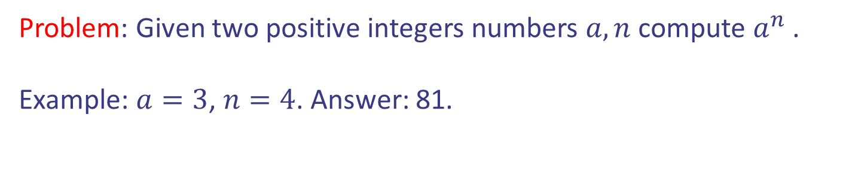
Case study VII: Computing powers
Problem: Given two positive integers numbers $a,n$ compute $a^{n}$ .
Example: $a=3$, $n=4$. Answer: 81.
Design and Analysis of Algorithms

Slide 13



Case study VII: Computing powers
Problem: Given two positive integers numbers $a,n$ compute $a^{n}$ .
Example: $a=3$, $n=4$. Answer: 81.
Obvious approach:
$Θ\left(n\right)$ operations
Can we do better?
Design and Analysis of Algorithms

Slide 14
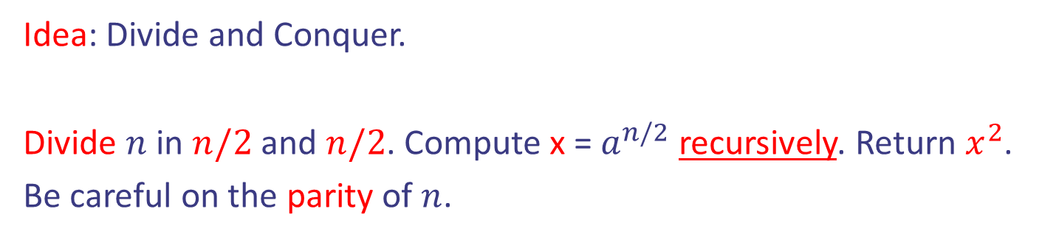
Case study VII: Computing powers
Problem: Given two positive integers numbers $a,n$ compute $a^{n}$ .
Example: $a=3$, $n=4$. Answer: 81.
Idea: Divide and Conquer.
Divide $n$ in $n/2$ and $n/2$. Compute x = $a^{n/2}$ recursively. Return $x^{2}$.
Be careful on the parity of $n$.
Design and Analysis of Algorithms

Slide 15

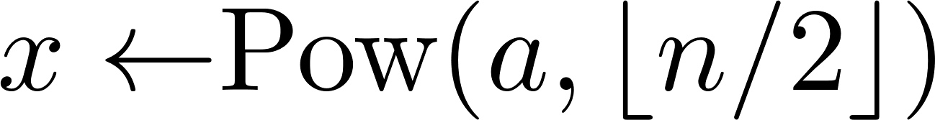

Case study VII: Computing powers
Problem: Given two positive integers numbers $a,n$ compute $a^{n}$ .
Example: $a=3$, $n=4$. Answer: 81.
Idea: Divide and Conquer.
Design and Analysis of Algorithms

Slide 16
Case study VII: Computing powers
Problem: Given two positive integers numbers $a,n$ compute $a^{n}$ .
Example: $a=3$, $n=4$. Answer: 81.
Idea: Divide and Conquer.
Base case
Divide + Conquer
Combine
Design and Analysis of Algorithms

Slide 17
Case study VII: Computing powers
Problem: Given two positive integers numbers $a,n$ compute $a^{n}$ .
Example: $a=3$, $n=4$. Answer: 81.
Idea: Divide and Conquer.
Base case
Divide + Conquer
Combine
Running time: $T\left(n\right)=T\left(\frac{n}{2}\right)+Θ\left(1\right)→Θ\left(\log{n}\right)$ by Master thm
Design and Analysis of Algorithms

Slide 18
Case study VII: Computing powers
Problem: Given two positive integers numbers $a,n$ compute $a^{n}$ .
Example: $a=3$, $n=4$. Answer: 81.
Remark: Same works for powers of
Matrices.
Idea: Divide and Conquer.
Base case
Divide + Conquer
Combine
Running time: $T\left(n\right)=T\left(\frac{n}{2}\right)+Θ\left(1\right)→Θ\left(\log{n}\right)$ by Master thm
Design and Analysis of Algorithms

Slide 19
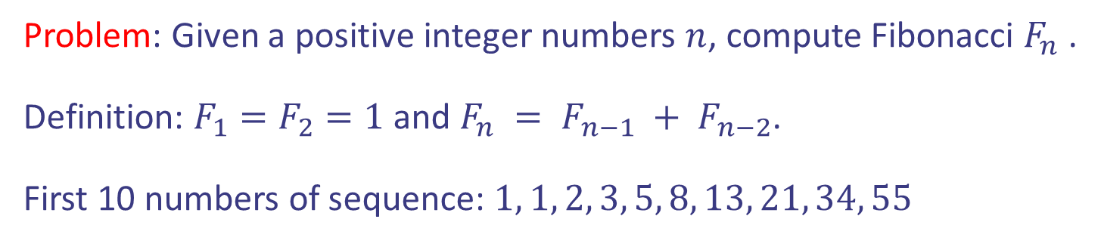
Case study VIII: Fibonacci sequence
Problem: Given a positive integer numbers $n$, compute Fibonacci $F_{n}$ .
Definition: $F_{1}=F_{2}=1$ and $F_{n} = F_{n−1} + F_{n−2}$.
First 10 numbers of sequence: $1, 1, 2, 3, 5, 8, 13, 21, 34, 55$
Design and Analysis of Algorithms

Slide 20




Case study VIII: Fibonacci sequence
Problem: Given a positive integer numbers $n$, compute Fibonacci $F_{n}$ .
Definition: $F_{1}=F_{2}=1$ and $F_{n} = F_{n−1} + F_{n−2}$.
First 10 numbers of sequence: $1, 1, 2, 3, 5, 8, 13, 21, 34, 55$
Obvious approach:
Design and Analysis of Algorithms

Slide 21
Case study VIII: Fibonacci sequence
Problem: Given a positive integer numbers $n$, compute Fibonacci $F_{n}$ .
Definition: $F_{1}=F_{2}=1$ and $F_{n} = F_{n−1} + F_{n−2}$.
First 10 numbers of sequence: $1, 1, 2, 3, 5, 8, 13, 21, 34, 55$
Obvious approach:
$Θ\left(n\right)$ operations
Can we do better?
Design and Analysis of Algorithms

Slide 22


Case study VIII: Fibonacci sequence
Problem: Given a positive integer numbers $n$, compute Fibonacci $F_{n}$ .
Definition: $F_{1}=F_{2}=1$ and $F_{n} = F_{n−1} + F_{n−2}$.
First 10 numbers of sequence: $1, 1, 2, 3, 5, 8, 13, 21, 34, 55$
Idea: Express $F_{n}$ as a power of a Matrix.
$$\left(\begin{matrix}F_{n} \\ F_{n−1}\end{matrix}\right)=\left(\begin{matrix}1 & 1 \\ 1 & 0\end{matrix}\right)⋅\left(\begin{matrix}F_{n−1} \\ F_{n−2}\end{matrix}\right)$$
Design and Analysis of Algorithms

Slide 23
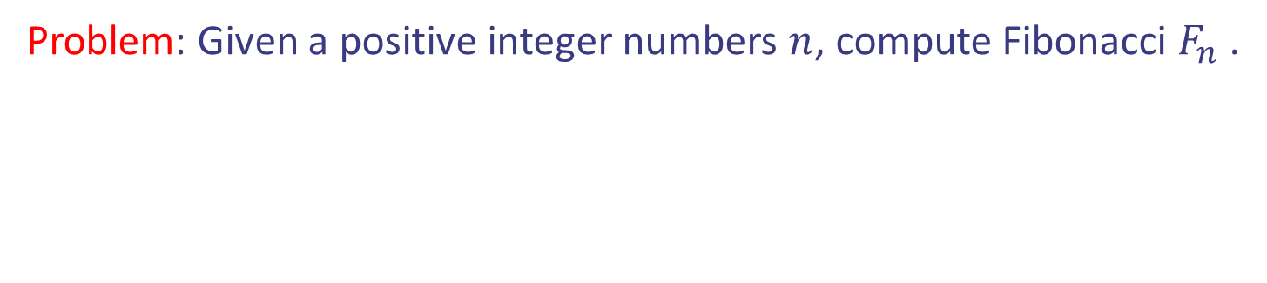




Case study VIII: Fibonacci sequence
Problem: Given a positive integer numbers $n$, compute Fibonacci $F_{n}$ .
Idea: Express $F_{n}$ as a power of a Matrix.
$$\left(\begin{matrix}F_{n} \\ F_{n−1}\end{matrix}\right)=\left(\begin{matrix}1 & 1 \\ 1 & 0\end{matrix}\right)⋅\left(\begin{matrix}F_{n−1} \\ F_{n−2}\end{matrix}\right)$$
$$\left(\begin{matrix}F_{n−1} \\ F_{n−2}\end{matrix}\right)=\left(\begin{matrix}1 & 1 \\ 1 & 0\end{matrix}\right)⋅\left(\begin{matrix}F_{n−2} \\ F_{n−3}\end{matrix}\right)$$
$$…$$
$$\left(\begin{matrix}F_{3} \\ F_{2}\end{matrix}\right)=\left(\begin{matrix}1 & 1 \\ 1 & 0\end{matrix}\right)⋅\left(\begin{matrix}F_{2} \\ F_{1}\end{matrix}\right)$$
Design and Analysis of Algorithms

Slide 24


Case study VIII: Fibonacci sequence
Problem: Given a positive integer numbers $n$, compute Fibonacci $F_{n}$ .
Idea: Express $F_{n}$ as a power of a Matrix.
$$\left(\begin{matrix}F_{n} \\ F_{n−1}\end{matrix}\right)={\left(\begin{matrix}1 & 1 \\ 1 & 0\end{matrix}\right)}^{n−2}\left(\begin{matrix}F_{2} \\ F_{1}\end{matrix}\right)$$
$={\left(\begin{matrix}1 & 1 \\ 1 & 0\end{matrix}\right)}^{n−2}\left(\begin{matrix}1 \\ 1\end{matrix}\right)$
Design and Analysis of Algorithms

Slide 25


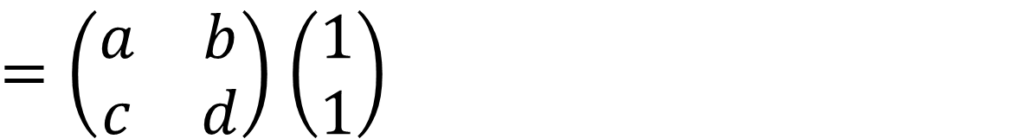
Case study VIII: Fibonacci sequence
Problem: Given a positive integer numbers $n$, compute Fibonacci $F_{n}$ .
Idea: Express $F_{n}$ as a power of a Matrix.
$$\left(\begin{matrix}F_{n} \\ F_{n−1}\end{matrix}\right)={\left(\begin{matrix}1 & 1 \\ 1 & 0\end{matrix}\right)}^{n−2}\left(\begin{matrix}F_{2} \\ F_{1}\end{matrix}\right)$$
$={\left(\begin{matrix}1 & 1 \\ 1 & 0\end{matrix}\right)}^{n−2}\left(\begin{matrix}1 \\ 1\end{matrix}\right)$
$=\left(\begin{matrix}a & b \\ c & d\end{matrix}\right)$ $\left(\begin{matrix}1 \\ 1\end{matrix}\right)$
$F_{n}$ is $a+b$ and $F_{n−1}$ is $c+d$!
Design and Analysis of Algorithms

Slide 26
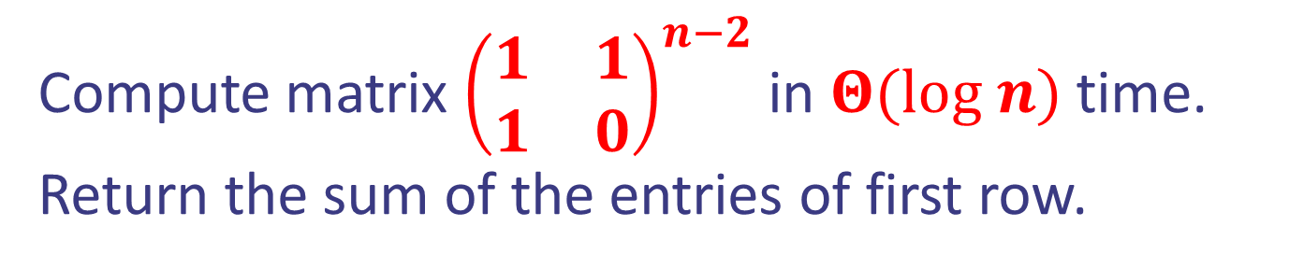
Case study VIII: Fibonacci sequence
Problem: Given a positive integer numbers $n$, compute Fibonacci $F_{n}$ .
Solution:
Compute matrix ${\left(\begin{matrix}1 & 1 \\ 1 & 0\end{matrix}\right)}^{n−2}$ in $Θ(log n)$ time. Return the sum of the entries of first row.
Design and Analysis of Algorithms

Slide 27
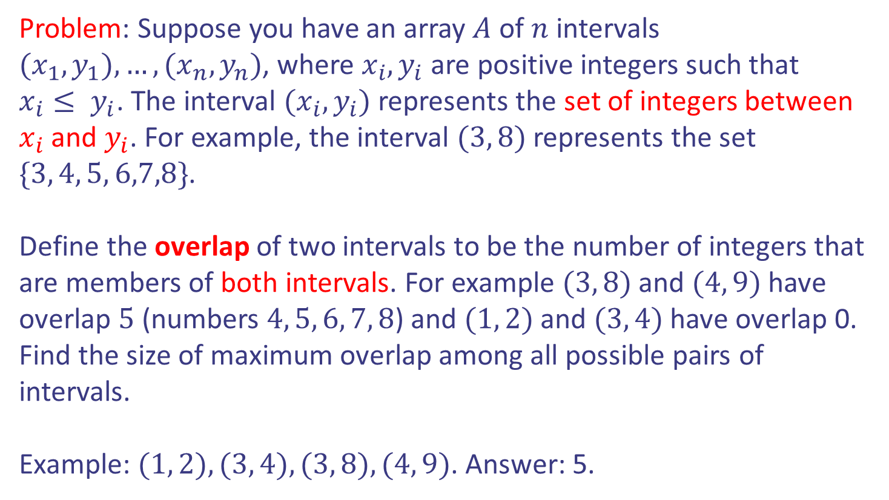
Case study IX: From practice problems
Problem: Suppose you have an array $A$ of $n$ intervals $(x_{1},y_{1}),…,(x_{n},y_{n})$, where $x_{i}, y_{i}$ are positive integers such that
$x_{i}≤ y_{i}$. The interval $(x_{i},y_{i})$ represents the set of integers between $x_{i}$ and $y_{i}$. For example, the interval $(3, 8)$ represents the set $\{3, 4, 5, 6,7,8\}$.
Define the overlap of two intervals to be the number of integers that are members of both intervals. For example $(3, 8)$ and $(4, 9)$ have overlap $5$ (numbers $4, 5, 6, 7, 8$) and $(1, 2)$ and $(3, 4)$ have overlap 0. Find the size of maximum overlap among all possible pairs of intervals.
Example: $(1, 2), (3, 4), (3, 8), (4, 9)$. Answer: 5.
Design and Analysis of Algorithms

Slide 28





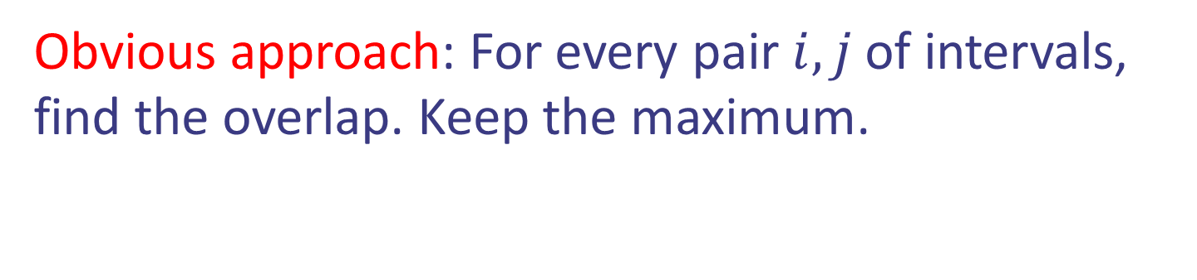

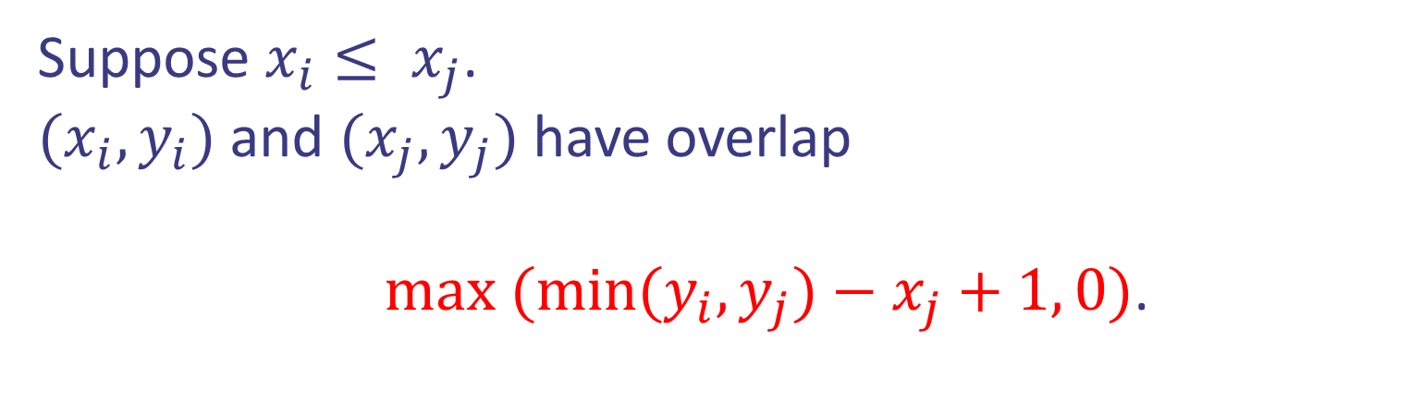
Case study IX: From practice problems
Obvious approach: For every pair $i,j$ of intervals, find the overlap. Keep the maximum.
Suppose $x_{i}≤ x_{j}$.
$(x_{i},y_{i})$ and $(x_{j},y_{j})$ have overlap
$max (min(y_{i},y_{j})−x_{j}+1, 0)$.
Design and Analysis of Algorithms

Slide 29
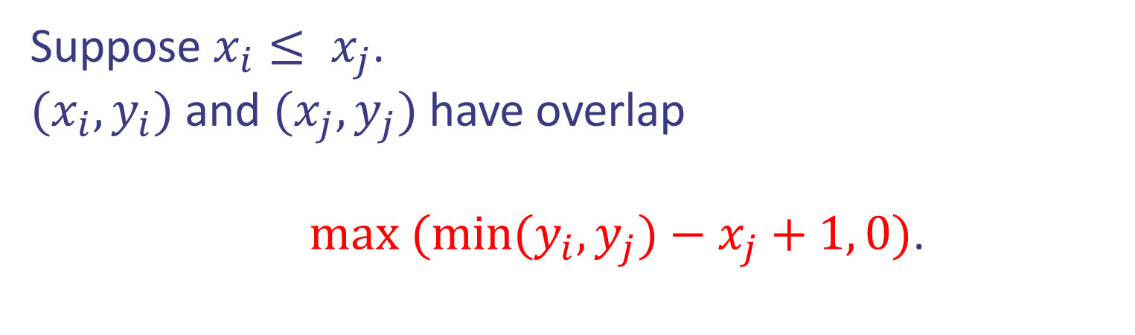

Case study IX: From practice problems
Obvious approach: For every pair $i,j$ of intervals, find the overlap. Keep the maximum.
Suppose $x_{i}≤ x_{j}$.
$(x_{i},y_{i})$ and $(x_{j},y_{j})$ have overlap
$max (min(y_{i},y_{j})−x_{j}+1, 0)$.
$Θ\left(n^{2}\right)$ running time
Can we do better?
Design and Analysis of Algorithms

Slide 30
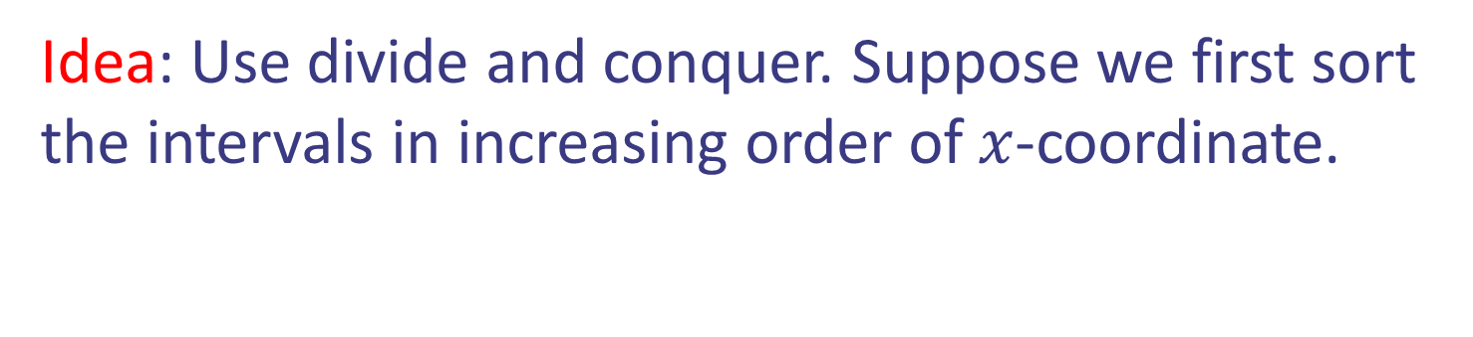
Case study IX: From practice problems
Idea: Use divide and conquer. Suppose we first sort the intervals in increasing order of $x$-coordinate.
Design and Analysis of Algorithms

Slide 31
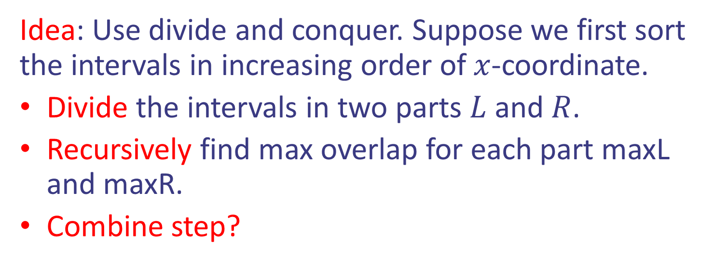
Case study IX: From practice problems
Idea: Use divide and conquer. Suppose we first sort the intervals in increasing order of $x$-coordinate.
Divide the intervals in two parts $L$ and $R$.
Recursively find max overlap for each part maxL and maxR.
Combine step?
Design and Analysis of Algorithms

Slide 32
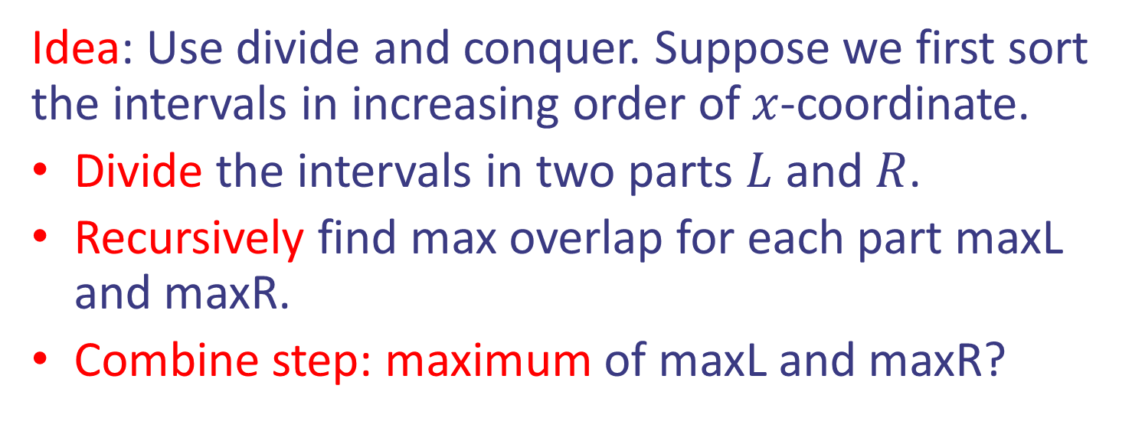
Case study IX: From practice problems
Idea: Use divide and conquer. Suppose we first sort the intervals in increasing order of $x$-coordinate.
Divide the intervals in two parts $L$ and $R$.
Recursively find max overlap for each part maxL and maxR.
Combine step: maximum of maxL and maxR?
Design and Analysis of Algorithms

Slide 33
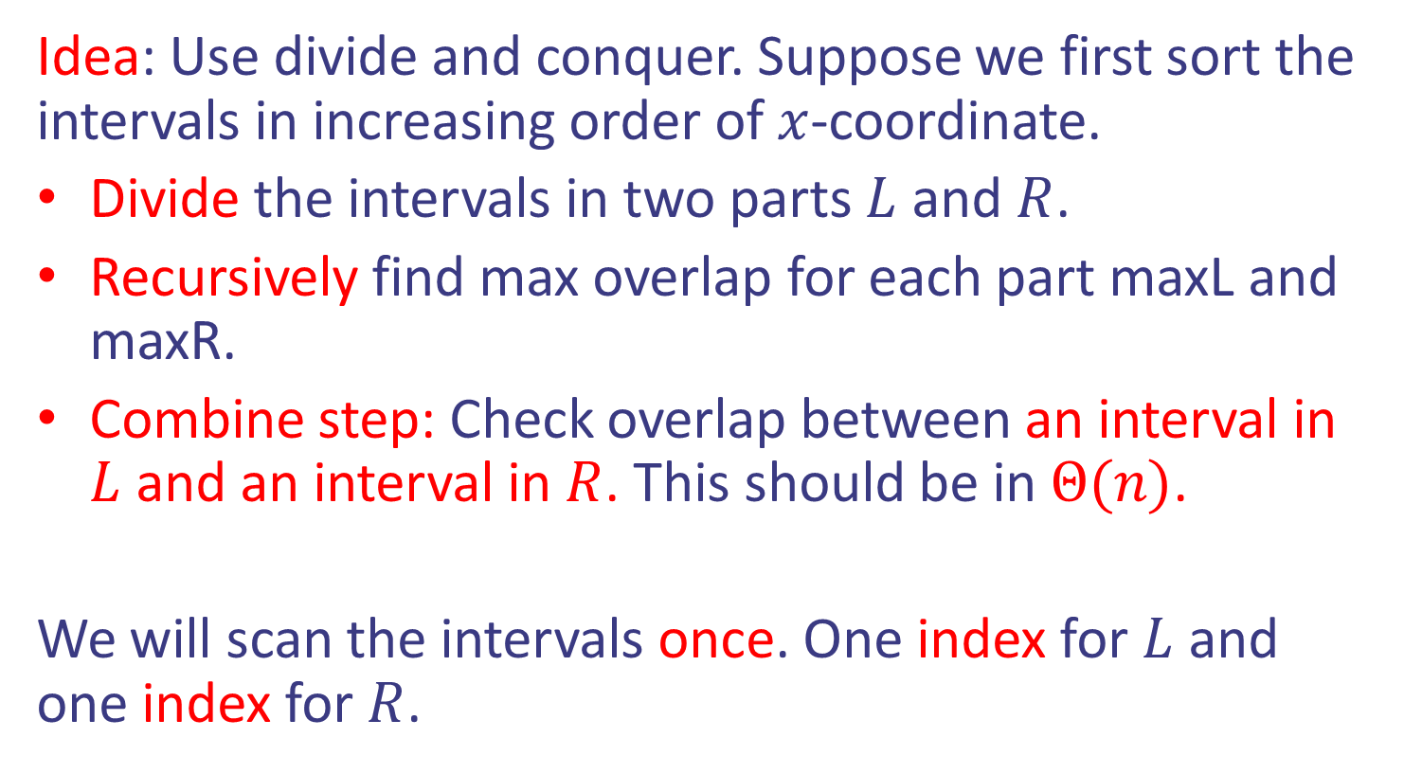
Case study IX: From practice problems
Idea: Use divide and conquer. Suppose we first sort the intervals in increasing order of $x$-coordinate.
Divide the intervals in two parts $L$ and $R$.
Recursively find max overlap for each part maxL and maxR.
Combine step: Check overlap between an interval in $L$ and an interval in $R$. This should be in $Θ(n)$.
We will scan the intervals once. One index for $L$ and one index for $R$.
Design and Analysis of Algorithms

Slide 34

Case study IX: From practice problems
Combine step: Black is in $L$, red in $R$.
Design and Analysis of Algorithms

Slide 35
Case study IX: From practice problems
Combine step: Black is in $L$, red in $R$.
Design and Analysis of Algorithms

Slide 36

Case study IX: From practice problems
Combine step: Black is in $L$, red in $R$.
All intervals after $j$ in $R$ will not give larger overlap with interval $i$.
Design and Analysis of Algorithms

Slide 37


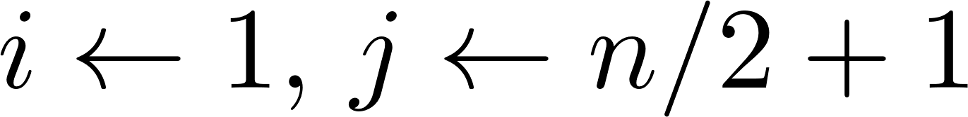
Case study IX: From practice problems
Pseudocode:
Design and Analysis of Algorithms

Slide 38


Case study IX: From practice problems
Pseudocode:
$T(n/2)$ Running time
$T(n/2)$ Running time
Θ$(n)$ Running time
Design and Analysis of Algorithms

Slide 39


Case study IX: From practice problems
$Θ(n\log{n})$ Running time
Pseudocode:
$T(n/2)$ Running time
$T(n/2)$ Running time
Θ$(n)$ Running time
Design and Analysis of Algorithms

