Slide 1

Lecture 2 Overview of concepts
CS 161 Design and Analysis of Algorithms
Ioannis Panageas

Slide 2
Design and Analysis of Algorithms
This is a theoretical/of mathematical nature class. Ideas the primarily focus, not implementation.
An algorithm is a step-by-step procedure for performing some task in a finite amount of time. Transforms input object to output object.
Input Algorithm Output

Slide 3
Design and Analysis of Algorithms
https://piazza.com/uci/spring2023/cs161
Design: Come up with a procedure.
Analysis: Running time.

Slide 4
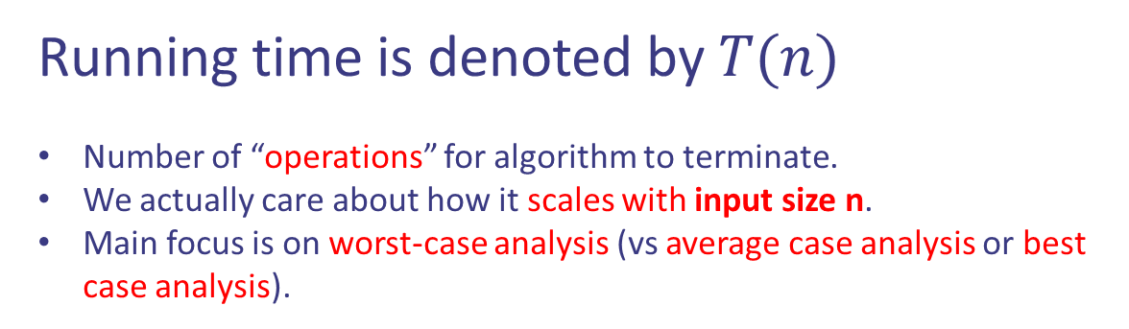
Design and Analysis of Algorithms
https://piazza.com/uci/spring2023/cs161
Design: Come up with a procedure.
Analysis: Running time.
Running time is denoted by $T(n)$
Number of “operations” for algorithm to terminate.
We actually care about how it scales with input size n.
Main focus is on worst-case analysis (vs average case analysis or best case analysis).

Slide 5
Example on worst-case vs average/best case
https://piazza.com/uci/spring2023/cs161
Given different numbers $x_{1}, x_{2}, …, x_{n}$, find the position of $x$ (assume exists).

Slide 6




Example on worst-case vs average/best case
https://piazza.com/uci/spring2023/cs161
Given different numbers $x_{1}, x_{2}, …, x_{n}$, find the position of $x$ (assume exists).

Slide 7
Example on worst-case vs average/best case
https://piazza.com/uci/spring2023/cs161
Given different numbers $x_{1}, x_{2}, …, x_{n}$, find the position of $x$ (assume exists).
Best case: 1 iterate

Slide 8
Example on worst-case vs average/best case
https://piazza.com/uci/spring2023/cs161
Given different numbers $x_{1}, x_{2}, …, x_{n}$, find the position of $x$ (assume exists).
Best case: 1 iterate
Worst case: n iterates

Slide 9
Example on worst-case vs average/best case
https://piazza.com/uci/spring2023/cs161
Given different numbers $x_{1}, x_{2}, …, x_{n}$, find the position of $x$ (assume exists).
Best case: 1 iterate
Worst case: n iterates
Average case: Challenging

Slide 10

Example on worst-case vs average/best case
https://piazza.com/uci/spring2023/cs161
Given different numbers $x_{1}, x_{2}, …, x_{n}$, find the position of $x$ (assume exists).
Best case: 1 iterate
Worst case: n iterates
Average case: $\frac{n+1}{2}$ iterates

Slide 11

Example on worst-case vs average/best case
https://piazza.com/uci/spring2023/cs161
Given different numbers $x_{1}, x_{2}, …, x_{n}$, find the position of $x$ (assume exists).

Slide 12
Example on worst-case vs average/best case
https://piazza.com/uci/spring2023/cs161
Given different numbers $x_{1}, x_{2}, …, x_{n}$, find the position of $x$ (assume exists).

Slide 13
Example on worst-case vs average/best case
https://piazza.com/uci/spring2023/cs161
Given different numbers $x_{1}, x_{2}, …, x_{n}$, find the position of $x$ (assume exists).

Slide 14
Example on worst-case vs average/best case
https://piazza.com/uci/spring2023/cs161
Given different numbers $x_{1}, x_{2}, …, x_{n}$, find the position of $x$ (assume exists).

Slide 15
Recap on proofs

Slide 16
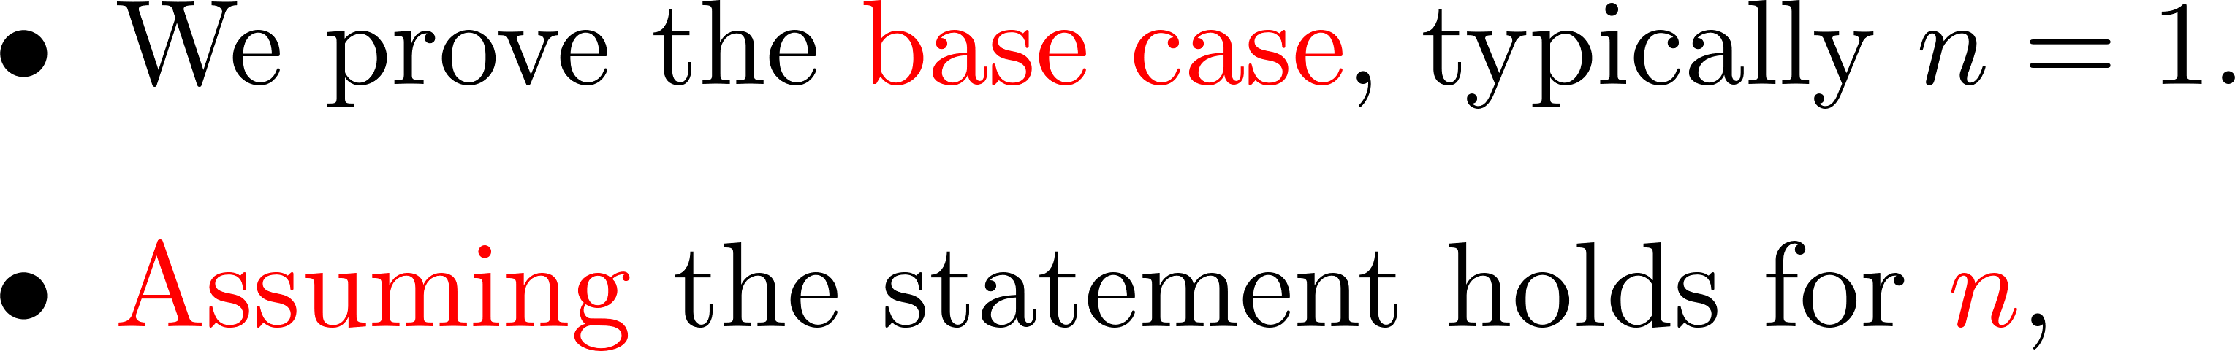
Recap on proofs

Slide 17


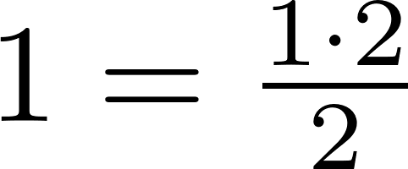
Recap on proofs

Slide 18
Recap on proofs

Slide 19
Recap on proofs

Slide 20
Recap on proofs

Slide 21
Recap on proofs

Slide 22
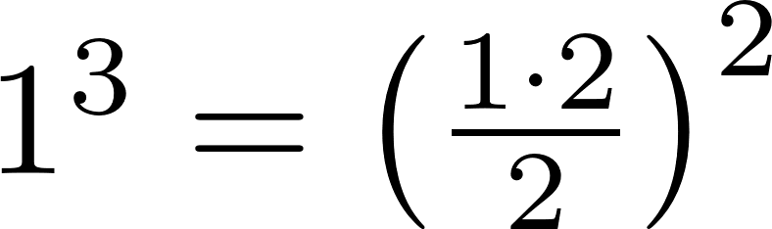
Recap on proofs

Slide 23
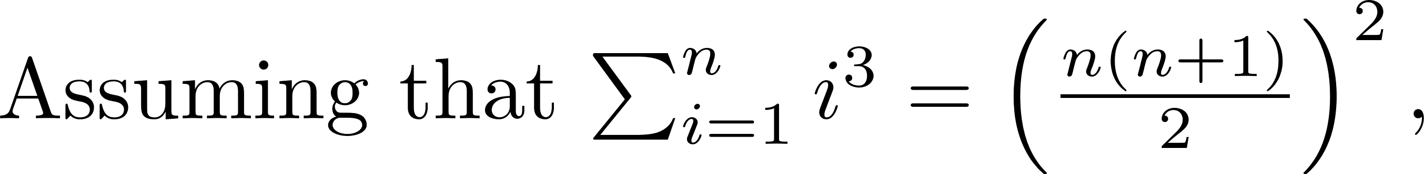
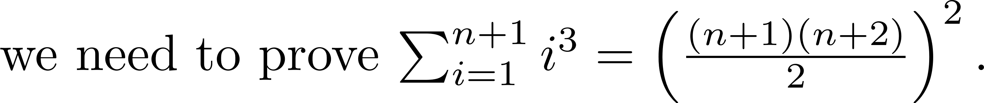
Recap on proofs

Slide 24
Recap on proofs

Slide 25
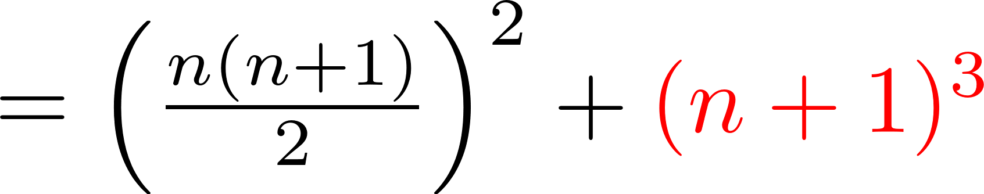
Recap on proofs

Slide 26
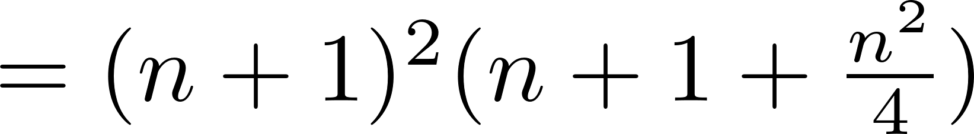
Recap on proofs

Slide 27
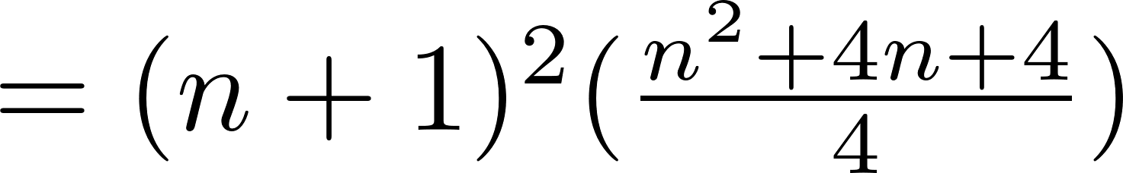
Recap on proofs

Slide 28
Recap on proofs

Slide 29
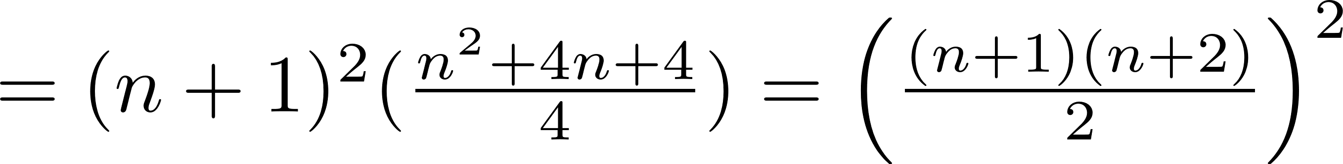
Recap on proofs

Slide 30
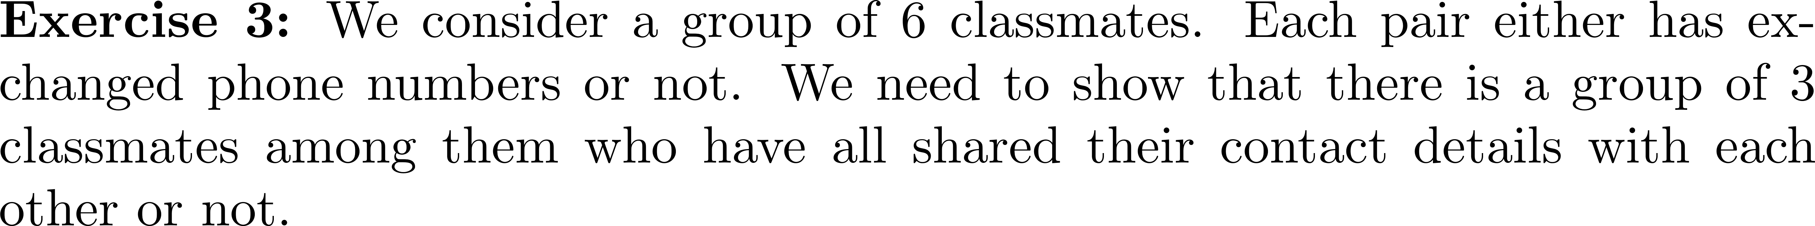












Recap on proofs
3 and 6 have exchanged phone
numbers.
2 and 5 have not exchanged
Phone numbers.

Slide 31

Recap on proofs

Slide 32
Recap on proofs

Slide 33
Recap on proofs

Slide 34


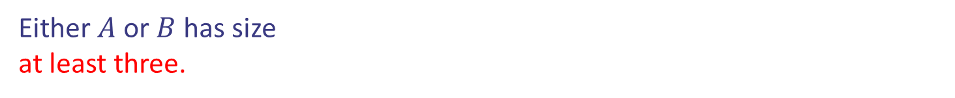
Recap on proofs
Consider the classmate with name 1 (green).
Either $A$ or $B$ has size
at least three.

Slide 35
Recap on proofs
Case 1: $A$ is at least of size three

Slide 36
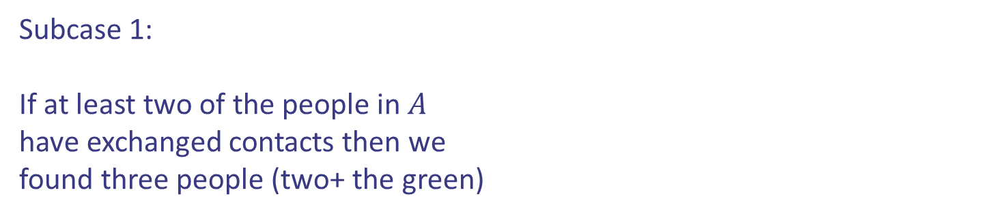
Recap on proofs
Case 1: $A$ is at least of size three
Subcase 1:
If at least two of the people in $A$
have exchanged contacts then we
found three people (two+ the green)

Slide 37
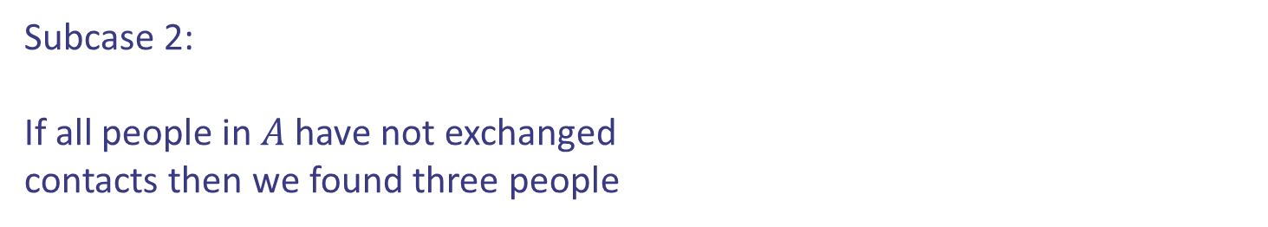
Recap on proofs
Case 1: $A$ is at least of size three
Subcase 2:
If all people in $A$ have not exchanged
contacts then we found three people

Slide 38

Recap on proofs
Case 2: $B$ is at least of size 3 (similar)
Case 1: $A$ is at least of size three
Subcase 2:
If all people in $A$ have not exchanged
contacts then we found three people

Slide 39
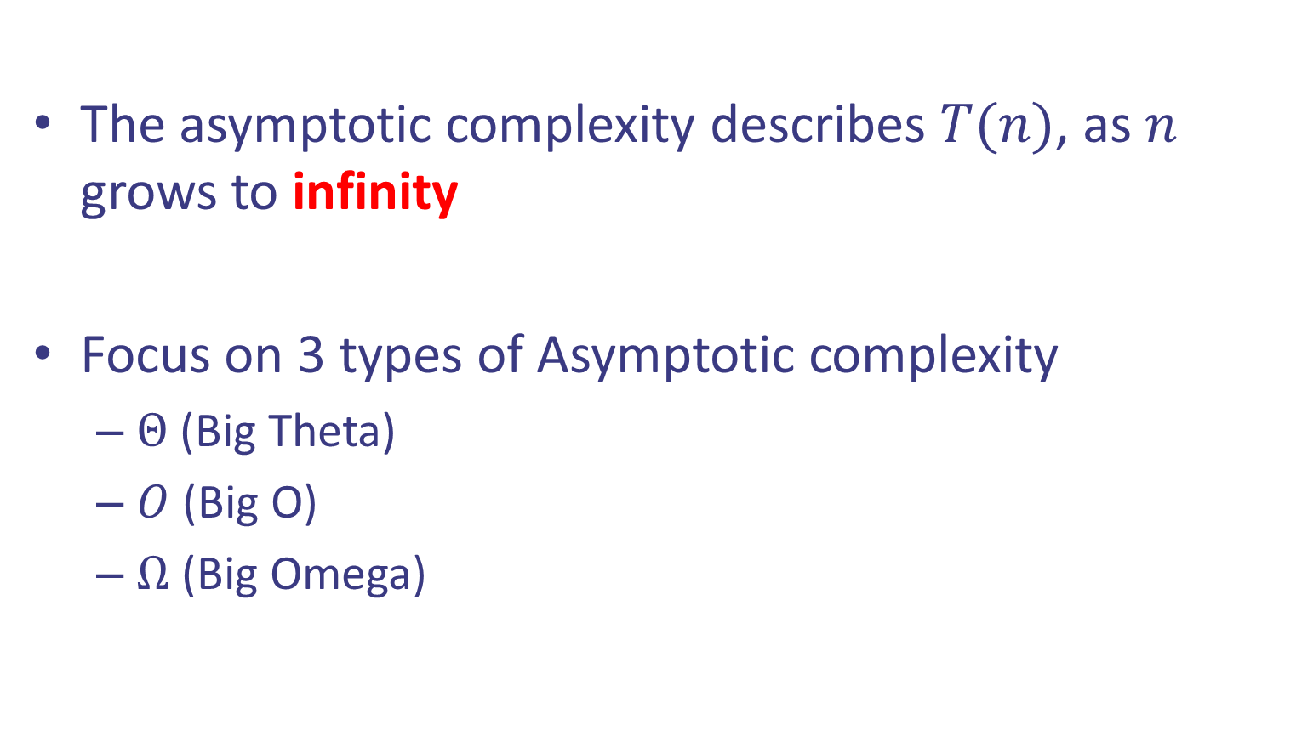
Recap on Asymptotics
The asymptotic complexity describes $T(n)$, as $n$ grows to infinity
Focus on 3 types of Asymptotic complexity
$Θ$ (Big Theta)
$O$ (Big O)
$Ω$ (Big Omega)

Slide 40



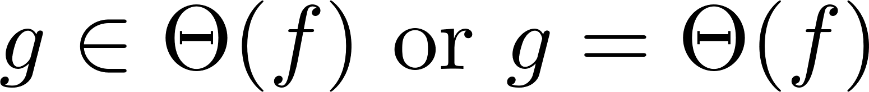
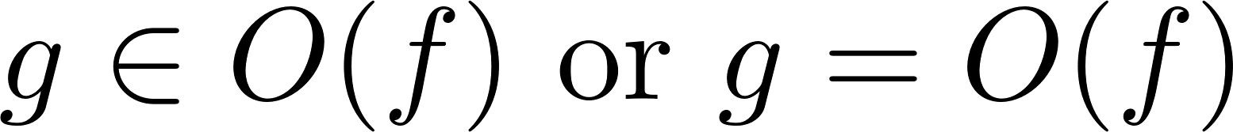
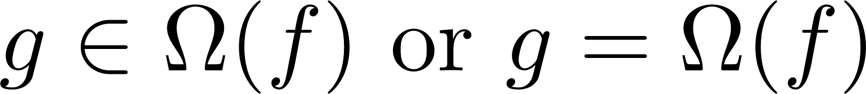
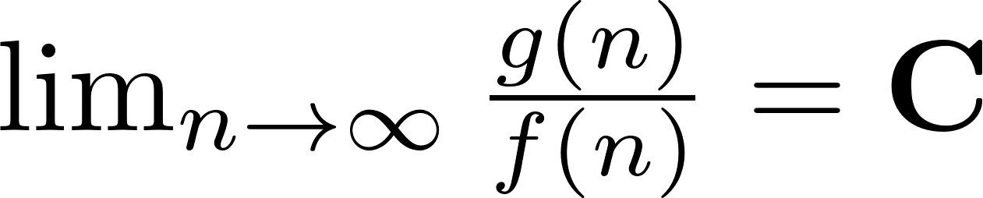


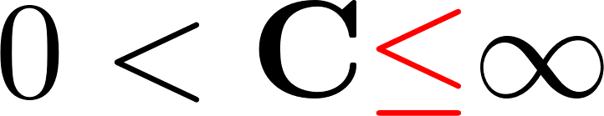

Recap on Asymptotics
$Θ$ (Big Theta) means “grows asymptotically $=$ ”
$O$ (Big O) means “grows asymptotically $≤$ ”
$Ω$ (Big Omega) means “grows asymptotically $≥$ ”

Slide 41
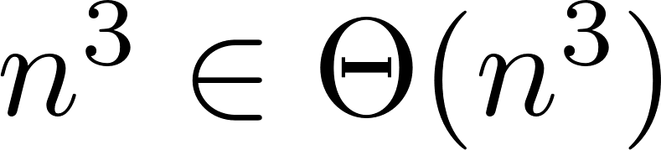
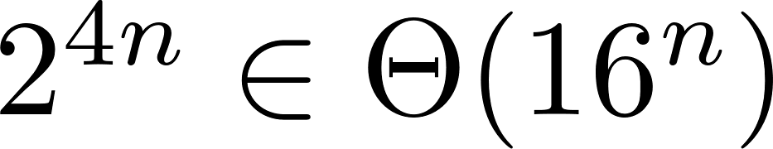
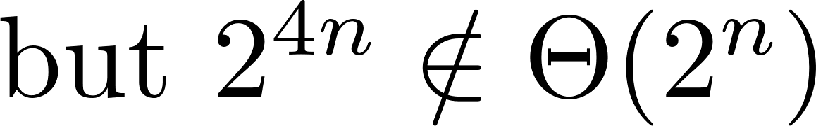
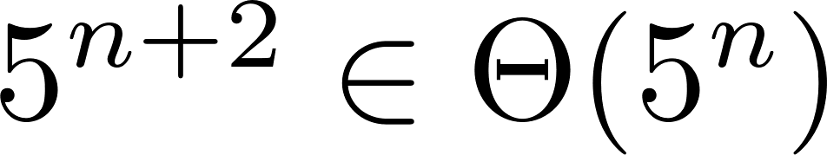


Recap on Asymptotics
Big $Θ$ examples:
$g\left(n\right)∈Θ(f(n))$ means “$g$ grows as $f$, when $n$ goes to infinity”.

Slide 42
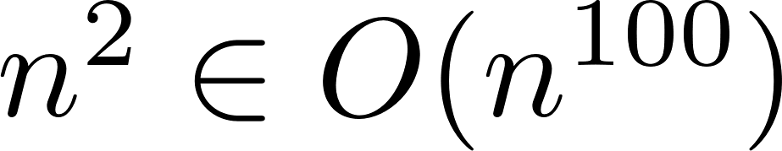
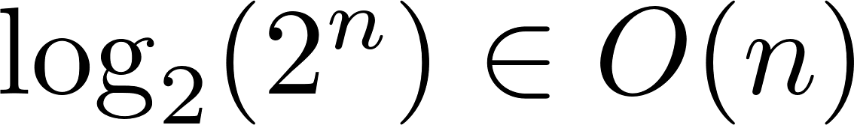
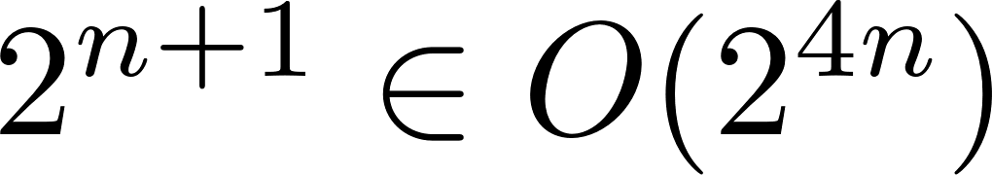


Recap on Asymptotics
Big $O$ examples:
$g\left(n\right)∈ O(f(n))$ means “$g$ grows at most as fast as $f$, when $n$ goes to infinity”.

Slide 43
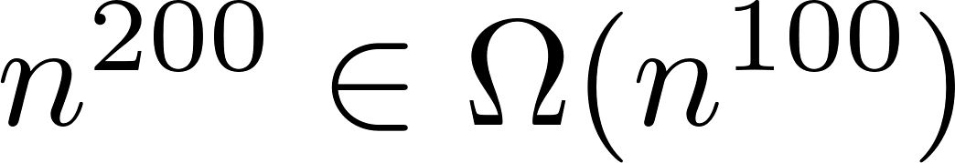
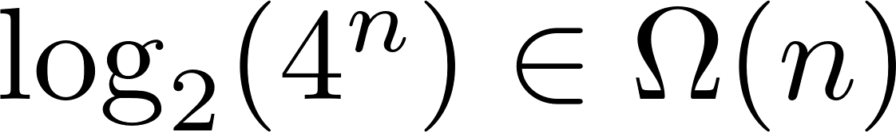


Recap on Asymptotics
Big $Ω$ examples:
$g\left(n\right)∈ O(f(n))$ means “$g$ grows at least as fast as $f$, when $n$ goes to infinity”.

Slide 44
Recap on Asymptotics

Slide 45
Recap on Asymptotics

Slide 46
Recap on Asymptotics

Slide 47
Recap on Asymptotics

Slide 48
Recap on Graphs
Undirected
V={a,b,c,d}
E={{a,b}, {a,c}, {b,c}, {b,d}, {c,d}}
Directed
V = {a,b,c}
E = {(a,c), (a,b) (b,c), (c,b)}
a
b
a
b
c
c
d
Representation
Adjacency matrix/list, incidence list.

Slide 49
Recap on Graphs

Slide 50
Recap on Graphs

Slide 51
Recap on Graphs
Induction?

Slide 52
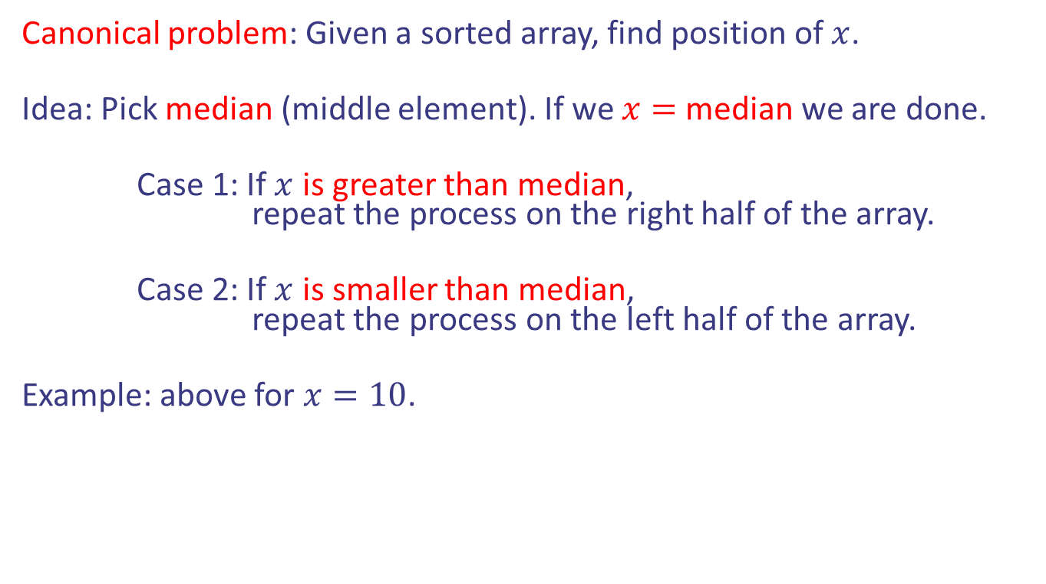
Recap on binary search
1
2
3
5
8
10
13
Canonical problem: Given a sorted array, find position of $x$.
Idea: Pick median (middle element). If we $x=$median we are done.
Case 1: If $x$ is greater than median, repeat the process on the right half of the array.
Case 2: If $x$ is smaller than median, repeat the process on the left half of the array.
Example: above for $x=10$.
Notes:
Note peak condition at the edges!

Slide 53
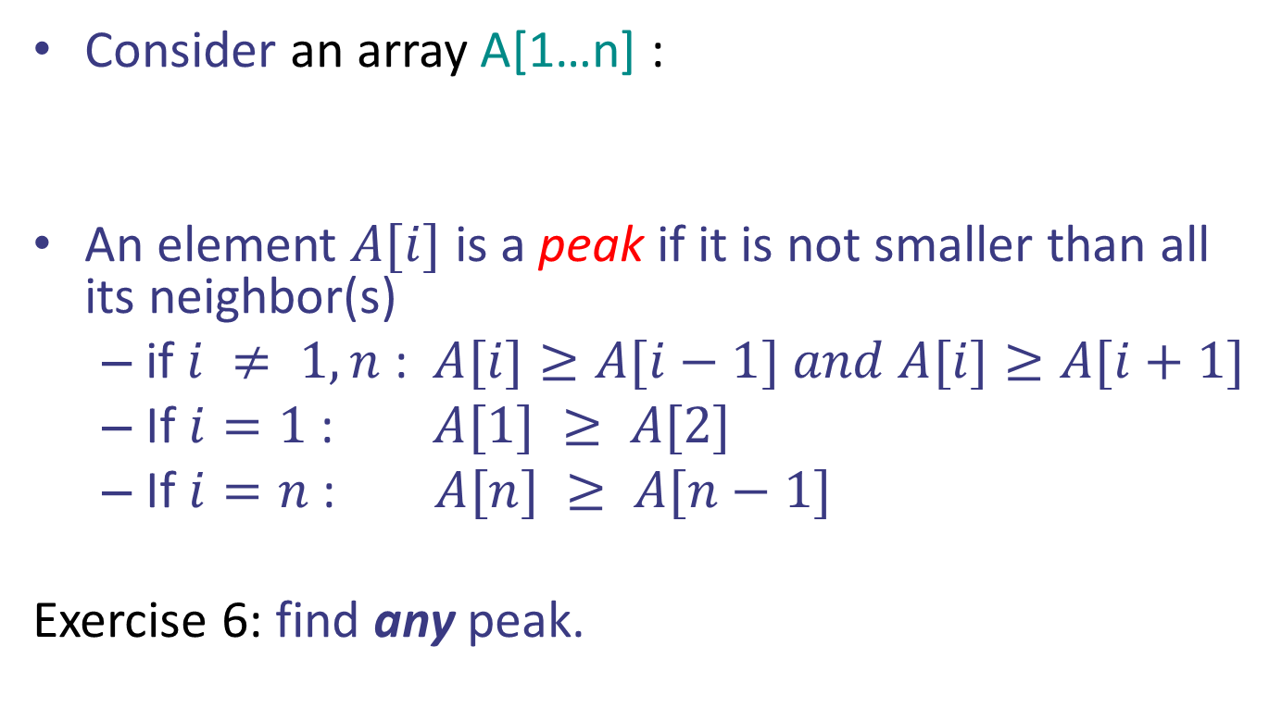
Recap on binary search
10
13
5
8
3
2
1
Consider an array A[1…n] :
An element $A[i]$ is a peak if it is not smaller than all its neighbor(s)
if $i ≠ 1, n$ : $A[i]≥A[i−1] and A[i]≥A[i+1]$
If $i=1$ : $A[1] ≥ A[2]$
If $i=n$ : $A[n] ≥ A[n−1]$
Exercise 6: find any peak.
Notes:
Note peak condition at the edges!

Slide 54
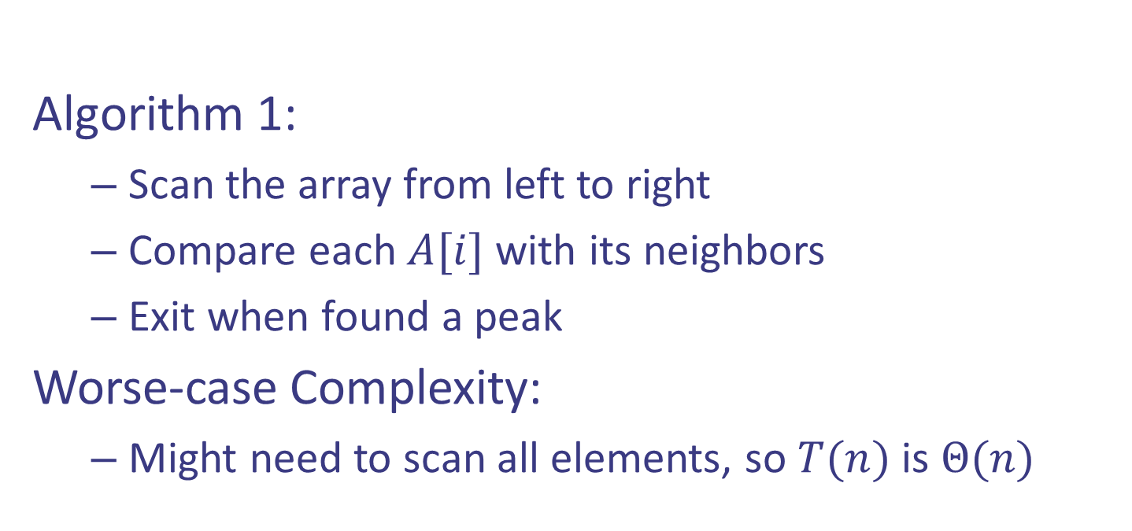
Recap on binary search
Algorithm 1:
Scan the array from left to right
Compare each $A[i]$ with its neighbors
Exit when found a peak
Worse-case Complexity:
Might need to scan all elements, so $T(n)$ is $Θ(n)$
1
2
4
8
9
12
21

Slide 55
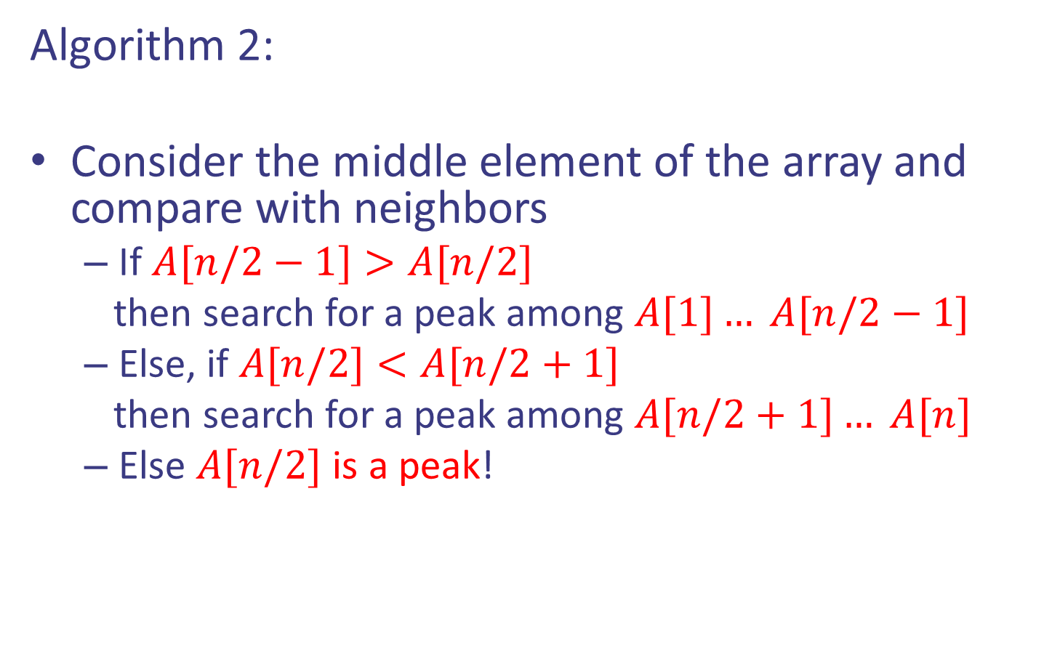
Recap on binary search
A[n/2-1]
A[n/2]
A[n/2+1]
Algorithm 2:
Consider the middle element of the array and compare with neighbors
If $A[n/2−1]>A[n/2]$
then search for a peak among $A[1]… A[n/2−1]$
Else, if $A[n/2]<A[n/2+1]$
then search for a peak among $A[n/2+1]… A[n]$
Else $A[n/2]$ is a peak!

Slide 56
Recap on binary search
A[n/2-1]
A[n/2]
A[n/2+1]
Algorithm 2:
Consider the middle element of the array and compare with neighbors
If $A[n/2−1]>A[n/2]$
then search for a peak among $A[1]… A[n/2−1]$
Else, if $A[n/2]<A[n/2+1]$
then search for a peak among $A[n/2+1]… A[n]$
Else $A[n/2]$ is a peak!

Slide 57
Pseudocode
High-level description of an algorithm
Less detailed than a program
Preferred notation for describing algorithms
Hides program design issues

Slide 58





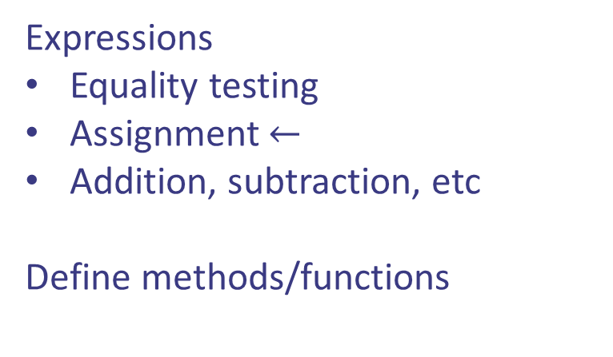
Pseudocode
Control flow:
Expressions
Equality testing
Assignment $←$
Addition, subtraction, etc
Define methods/functions

Slide 59
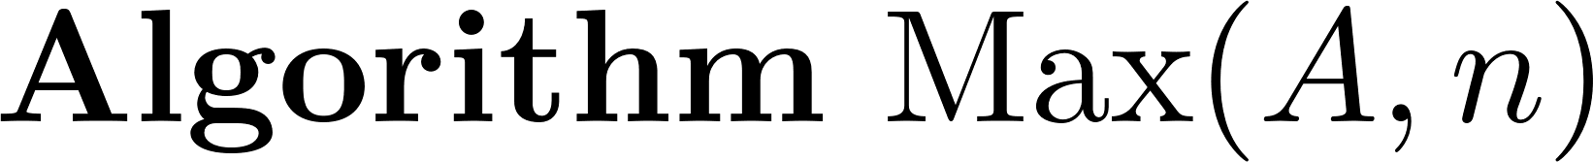
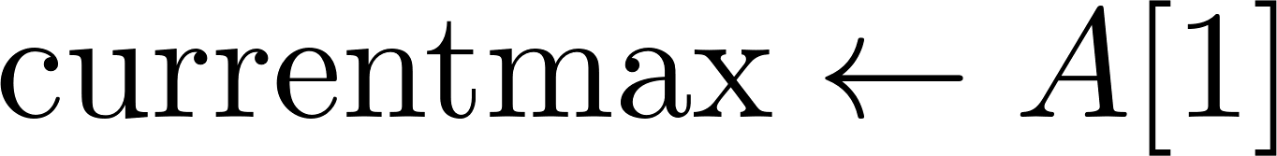
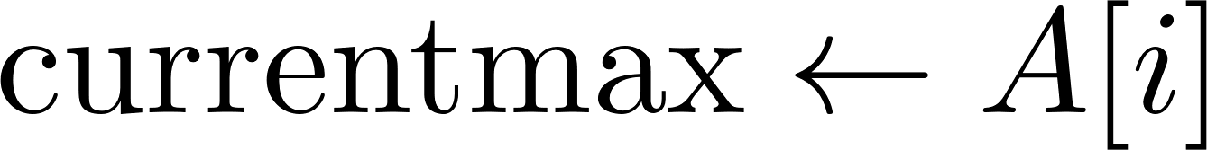
Pseudocode
Example (running time $T(n)$ is $Θ(n)$, linear time)

Slide 60
Need to Review (Reading)
Sums, summations, Logarithms
Asymptotics
Data structures: Queues, stacks, lists, binary search trees
Binary search
Insertion and Selection sort
Graph representation and DFS, BFS
We are here to help, please ask questions!
Next week Divide and Conquer Method

